Slide 1
Population Subdivision 2
University of Miami
Fall 2024

Slide 2

Population Subdivision for Two Populations
2N_{e}μ
Genetic variation; Allele or genotype frequencies
Mutation
Genetic Drift
Migration
2N_{e}μ
Genetic variation; Allele or genotype frequencies
Mutation
Genetic Drift
Mutation and genetic drift (and selection) act independently in each population.
Gene flow homogenizes allele frequencies, offsets drift by increasing Ne.

Slide 3
How to test for population structure using probabilistic assignment tests
& other methods

Slide 4


Population Applications

Slide 5
Maximum Likelihood & Bayesian Parameter Estimation
Data = true (not estimated) measure of a population
Parameter estimate = a quantity of interest that defines a group; this is the item of biological interest.
Maximum Likelihood (-lnL) = Method for estimating unknown parameter from data using a statistical model.
Bayesian - specifies some prior probability, which is then updated to a posterior probability with the addition of new, relevant data.
Prior - a prior probability distribution.
Posterior - conditional probability assigned after data are collected (e.g., such as the results of an experiment or set of genealogies).

Slide 6
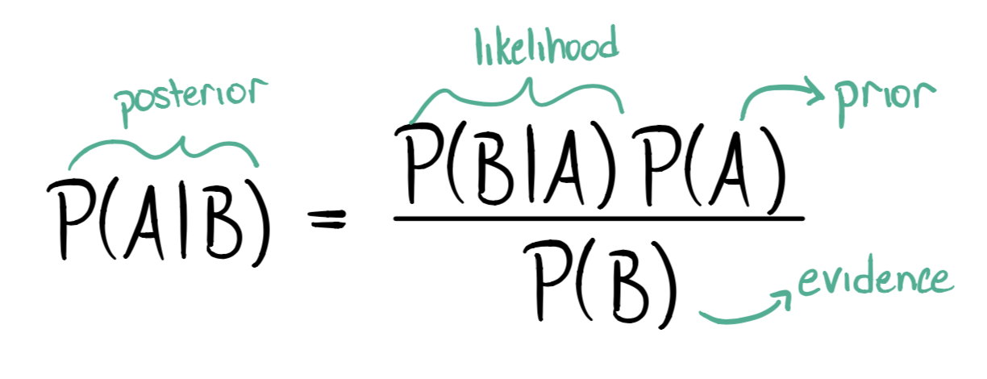
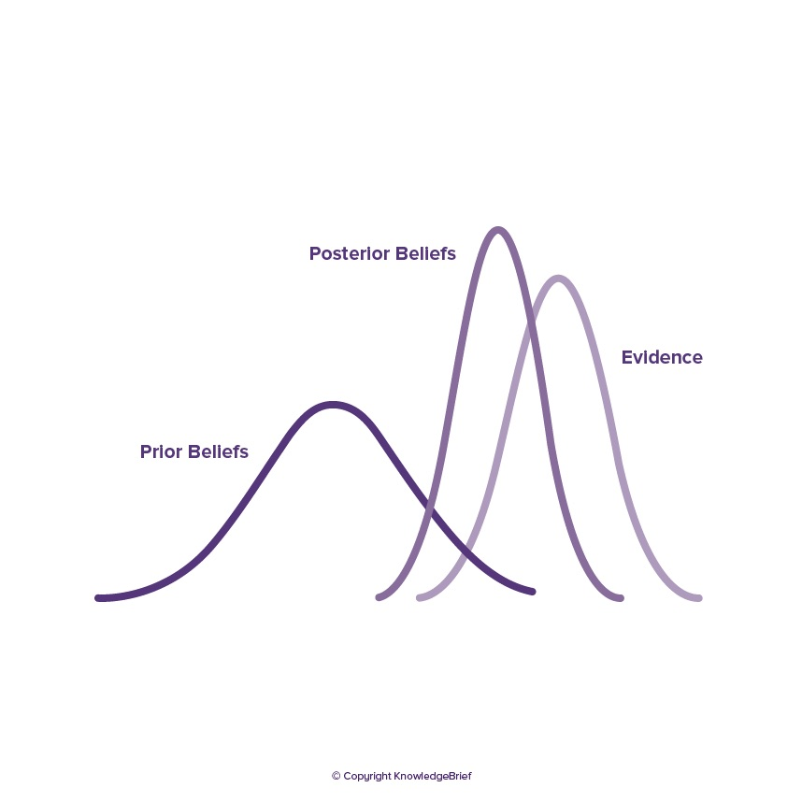

Slide 7
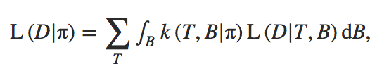
Maximum Likelihood Steps
(1) Specify mathematical relationship between parameter being estimated (e.g., tree length) and data observed (e.g., genealogies built using nucleotide substitution models).
(2) Calculate probability of observing data assuming a particular parameter value.
(3) Repeat step 2 for each possible parameter value.
Best parameter estimate maximizes the probability of observing the data given a model:
where k(T, B|π) is the Kingman coalescent probability density and L(D|T, B) is the likelihood of the data given the genealogy.

Slide 8
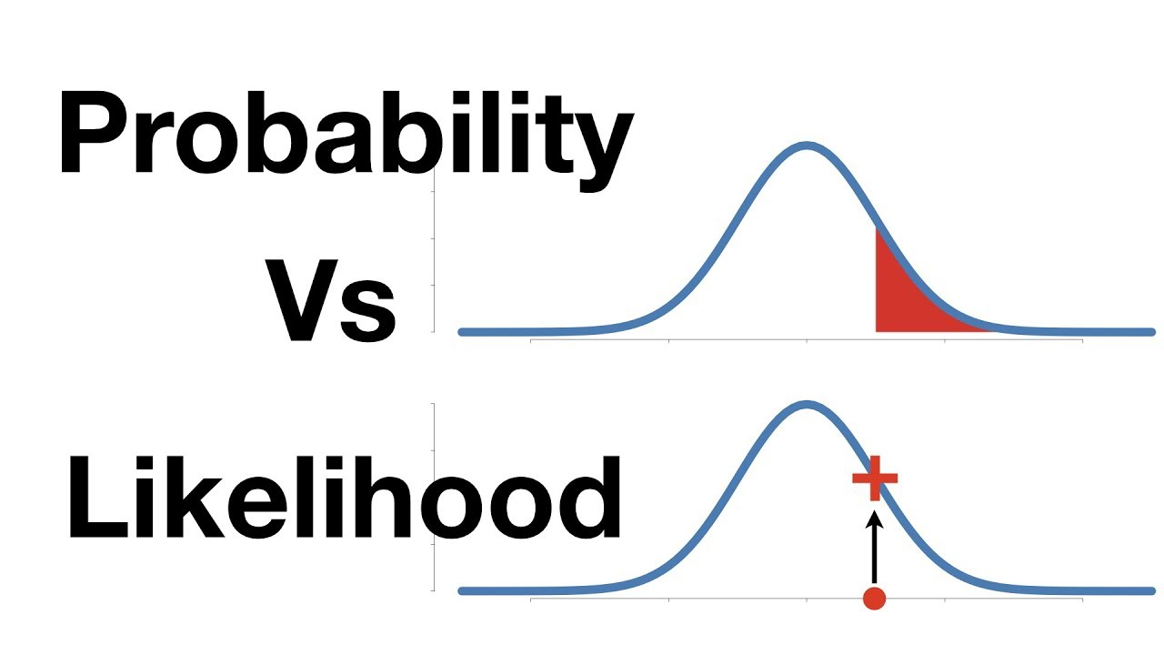
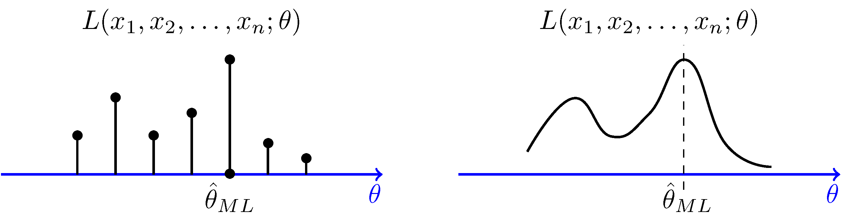
https://www.probabilitycourse.com/chapter8/8_2_3_max_likelihood_estimation.php

Slide 9
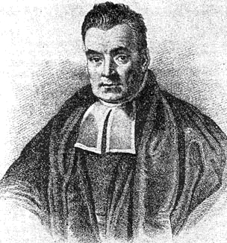

Bayesian Estimation
Named after Rev. Thomas Bayes (1701-1761).
Incorporates Maximum Likelihood but proceeds differently.
Allows direct probabilistic test of a parameter given the data (with confidence intervals).
Posterior distribution is approximated over many samples, in genetics there are often genealogies.
<-- a posterior probability

Slide 10
The difference in sum:
In ML, the best parameter estimate maximizes the probability of observing the data given a model.
L(Data|Model)
Bayesian allows direct probabilistic test of a parameter given the data (with confidence intervals).
f(Model|Data x Prior)
Posterior probability

Slide 11
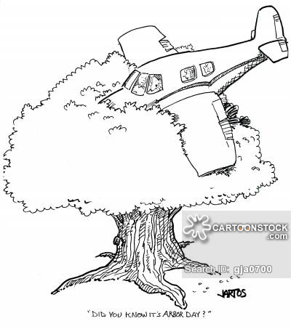
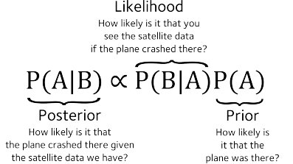
In Bayesian Estimation each prior piece of information is multiplied by the likelihood to obtain what is called a posterior.
This provides the relative importance location in the search space.

Slide 12
Genetic Assignment Tests
Maximize Hardy-Weinberg (HW) equilibrium & minimize linkage disequilibrium (LD) to assign individuals to populations based on genotypes at many loci.
Randomly reassign individuals to pre-specified groups and compute the likelihood based of the model based on this criterion.
Utilizes a Markov Chain Monte Carlo (MCMC) to move through parameter space.

Slide 13
Genetic Assignment Test (oversimplified):
Assume a model of K populations.
Step 1:
  Cluster individuals into K populations either randomly or based on genetic similarity.
  Calculate allele frequencies
  Determine the likelihood of the model given the data
Step 2:
  Move one individual from population i into population j.
  Calculate allele frequencies
  Determine the likelihood of the model given the data
  Compare likelihood with that from Step 1.
  If worse fit, move individual back to population i and repeat process.
  If better fit, choose another individual to move.
Steps 3+:
  Repeat step 2 over millions of iterations.
  Determine optimal K by comparing models (e.g., K = 1–10 populations)
    Calculate the likelihood of the data given K
Credit: J. L. Peters

Slide 14
Assignment Probabilities
The amount of time individuals spend in each population becomes the assignment probability.
  Individual 1—99.9% Population 1
  Individual 2—50% Pop 1, 50% Pop 2
    Admixed Individual (hybrid)
    Insufficient data???
  Individual 3—99.9% Population 2
Assumptions
  Diploid organisms
  Random mating
  Hardy-Weinberg equilibrium within populations
  Multiple, independent loci (they are not closely linked on the same chromosome)
  i.e., maximize HW & minimize LD
Credit: J. L. Peters

Slide 15
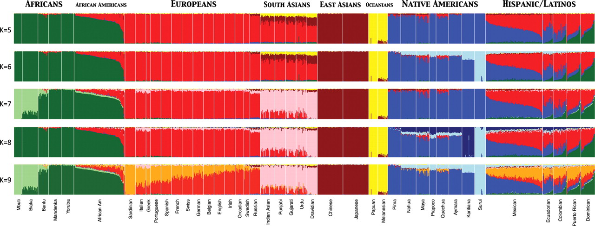
Assignment Tests to Study Structure of Worldwide Human Populations
Used ADMIXTURE clustering algorithm to infer genomic assignments/ individual
K = number of assumed populations
73,901 autosomal SNP markers & 1,112 individuals from 42 global pops
Assignment Tests – Maximize Hardy-Weinberg equilibrium & minimize LD to assign individuals to populations based on genotypes at many loci.
Henn B M et al. Hum. Mol. Genet. 2010;19:R221-R226
© The Author 2010. Published by Oxford University Press. All rights reserved. For Permissions, please email: journals.permissions@oxfordjournals.org

Slide 16
Principal Components Analysis (PCA)
An exploratory technique first developed by Karl Pearson used to reduce a large number of variables in a data set to fewer variables that still contain the information.
  Variables in a data set are often highly correlated.
  PCA identifies correlations among variables in a data set and creates new variables that capture that information.
  The new variables, called principal components (PCs) or eigenvalues, are uncorrelated.
Can be used to:
  Find patterns in high-dimensional data
  Visualize data of high dimensionality
Population genetics applications:
  Detect population structure using genomic data (large number of loci sequenced from the genome)
  Identify admixed individuals

Slide 17
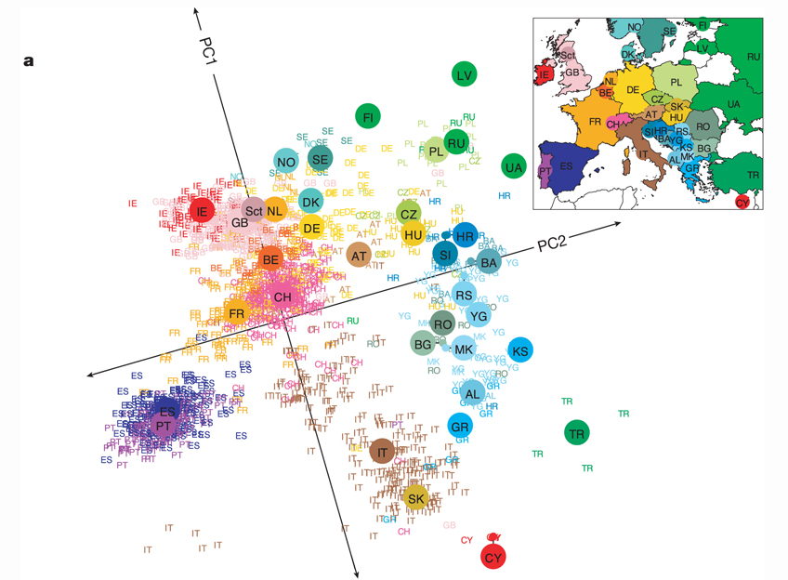
Principal Components Analysis (PCA)
Transforms genotypic data into components that account for correlations in genotypes among multiple loci. Results in clustering of individuals with similar genotypes.
Human Population structure within Europe.
Novembre et al. (2008) Nature 456, 98-101

Slide 18
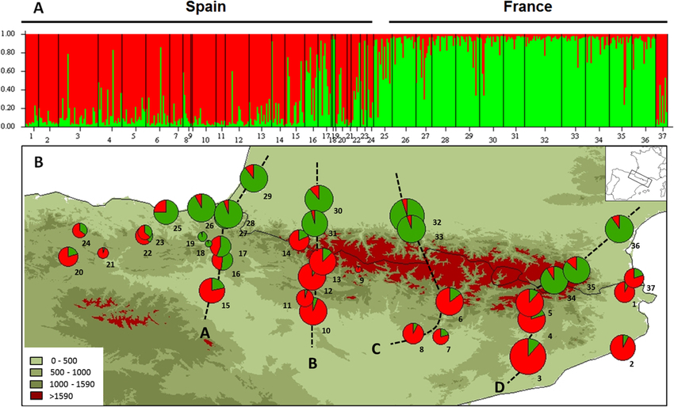
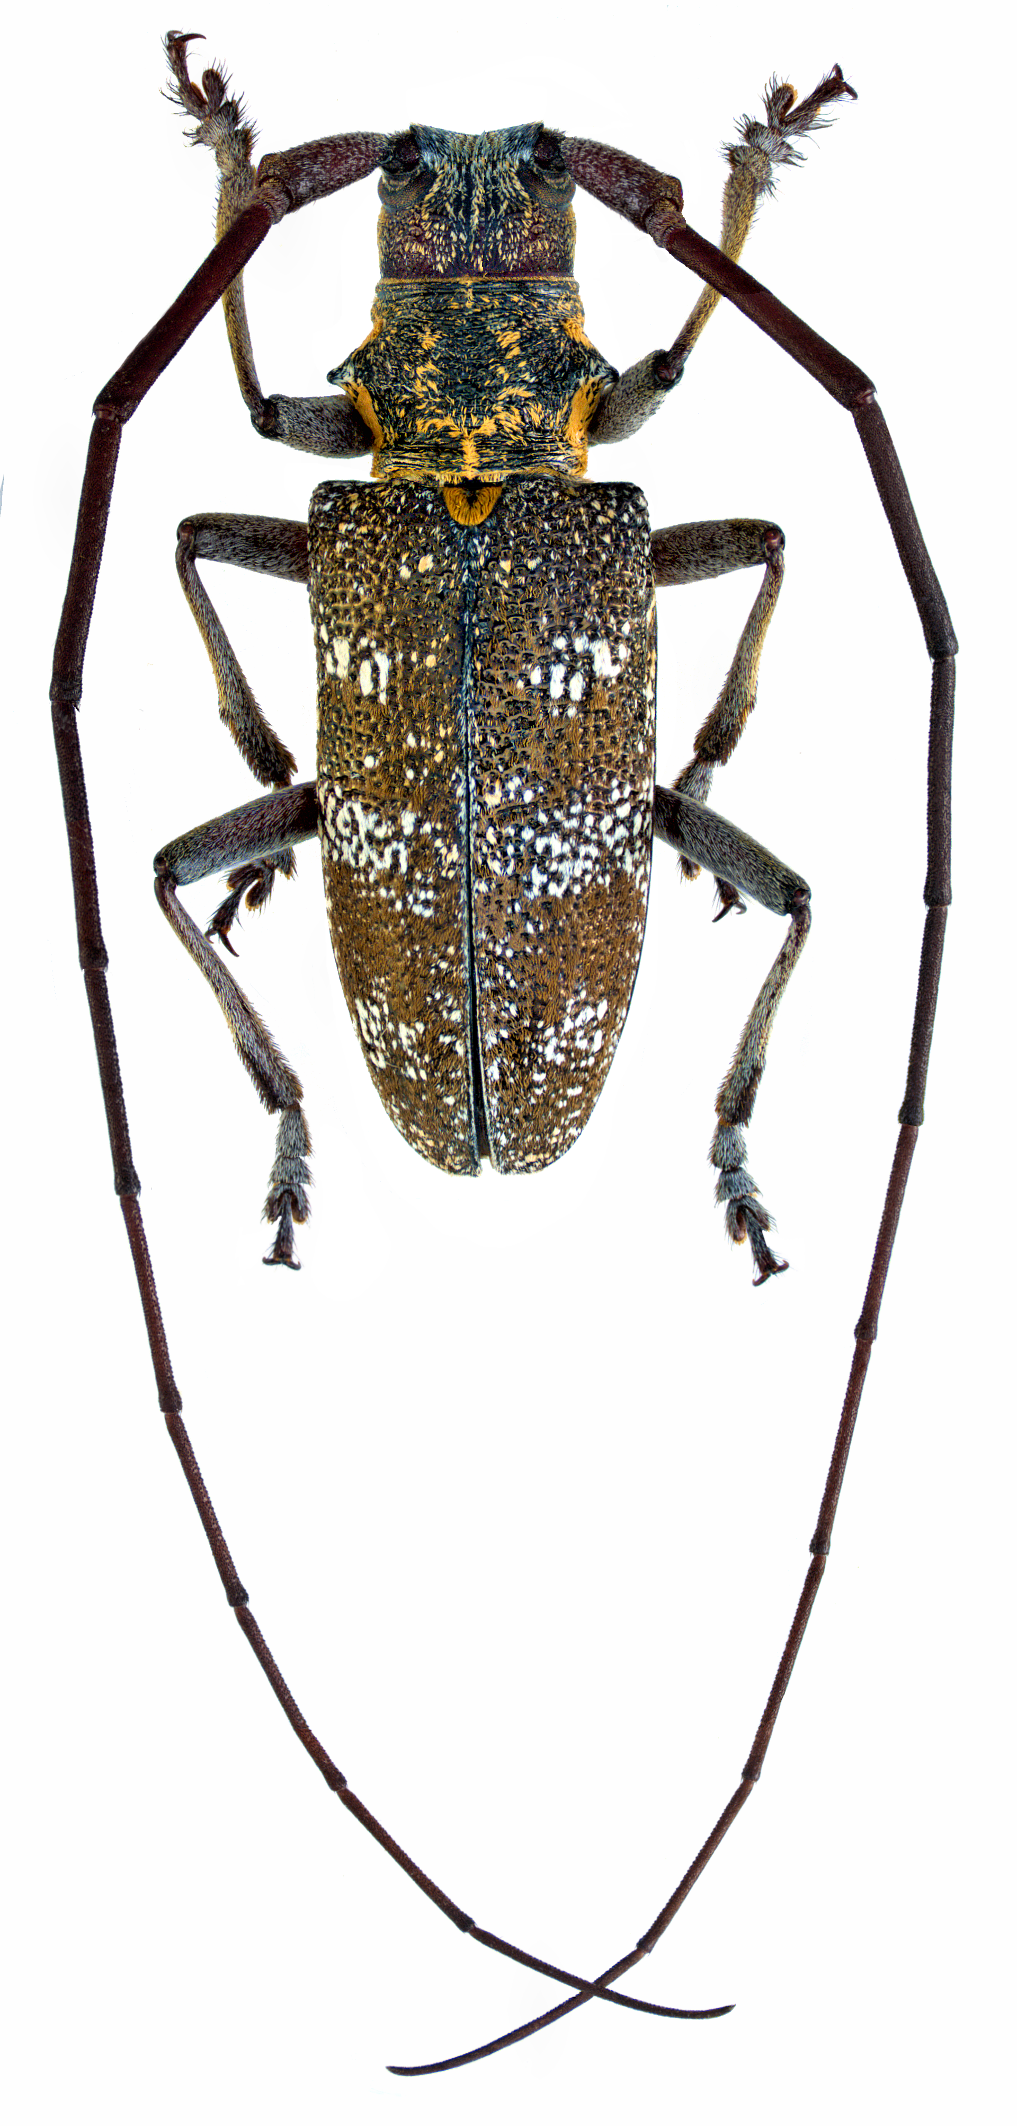
Altitudinal Barrier to the Spread of an Invasive Species: Could the Pyrenean Chain Slow the Natural Spread of the Pinewood Nematode?
July 2015
PLoS ONE DOI: 10.1371/journal.pone.0134126
Population genetic structure of the native vector, Monochamus galloprovincialis, a type of long-horned beetle.

Slide 19
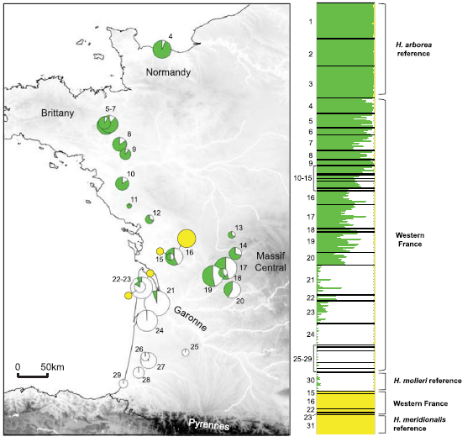
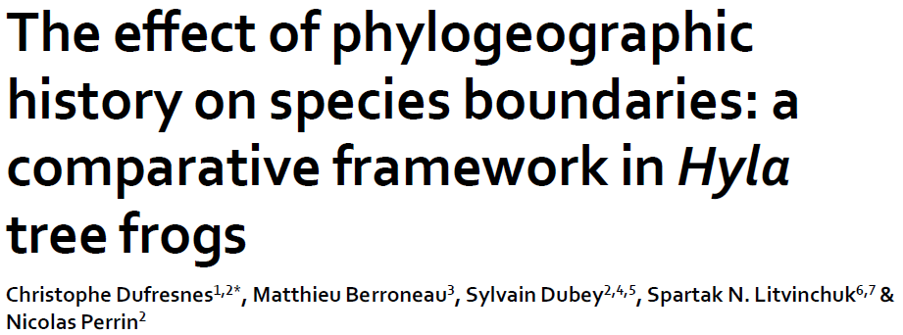
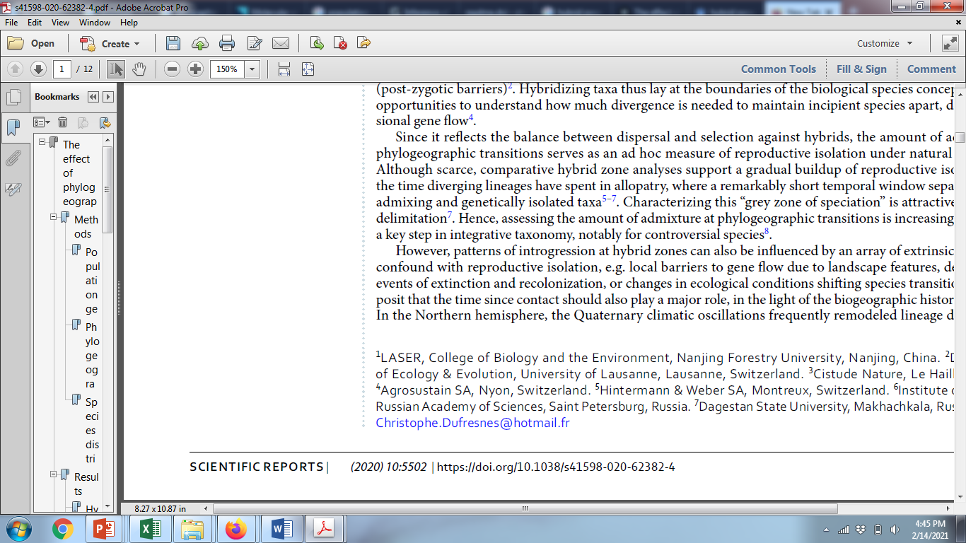
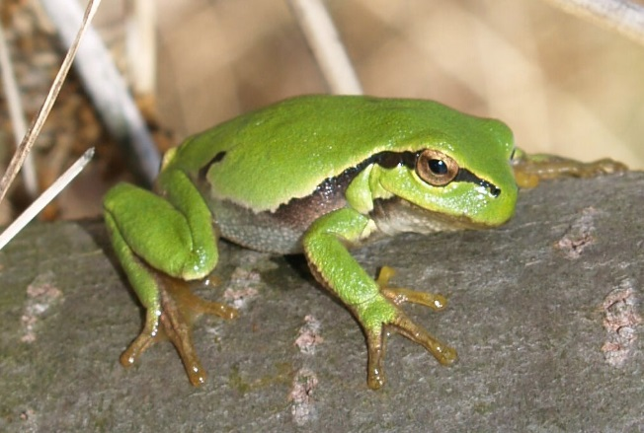
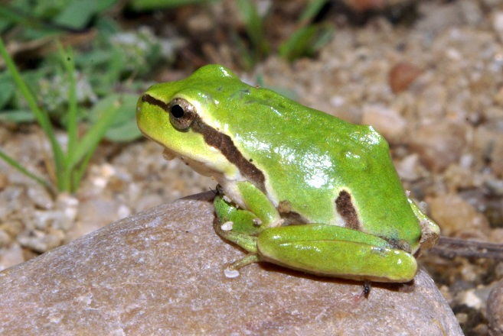
Studying hybrid zones
Hybrid zone
Hyla arborea
Hyla molleri
Assignment based on 26 microsatellite loci

Slide 20
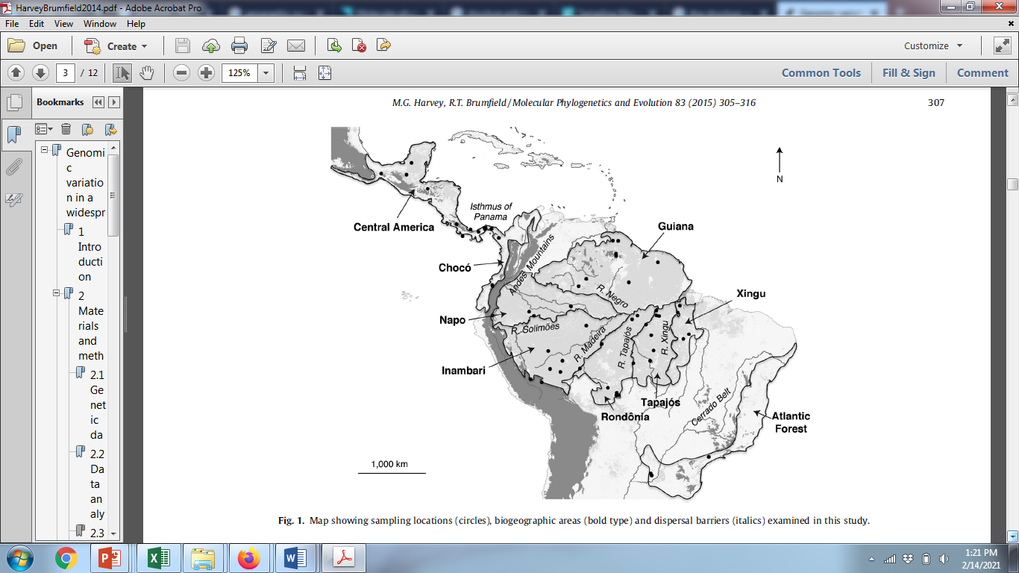
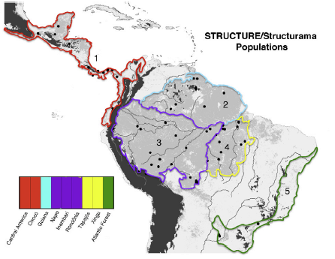

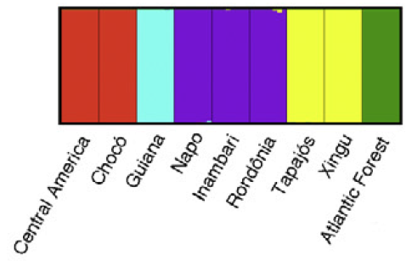
Genomic variation in a widespread Neotropical bird (Xenops minutus) reveals divergence, population expansion, and gene flow
Identifying population boundaries & assigning individuals to populations

Slide 21
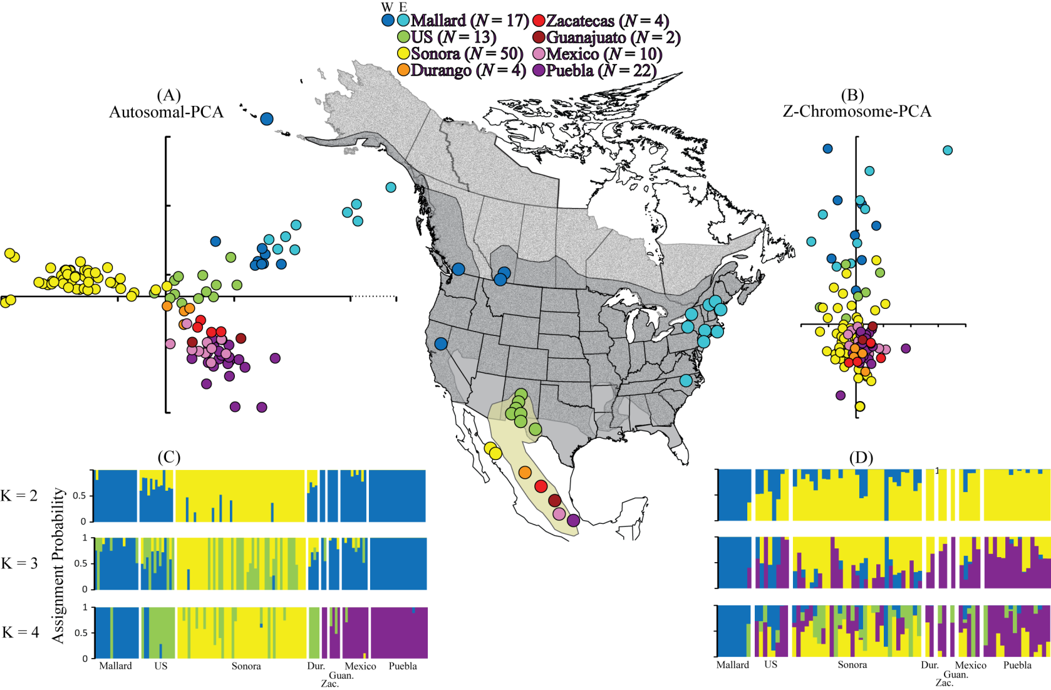
Mexican Duck Data – Lavretsky et al. (2015) Speciation genomics and a role for the Z chromosome in the early stages of divergence between Mexican ducks and mallards. Molecular Ecology 24:5364–5378.

Slide 22
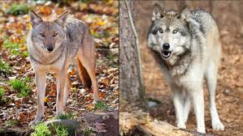
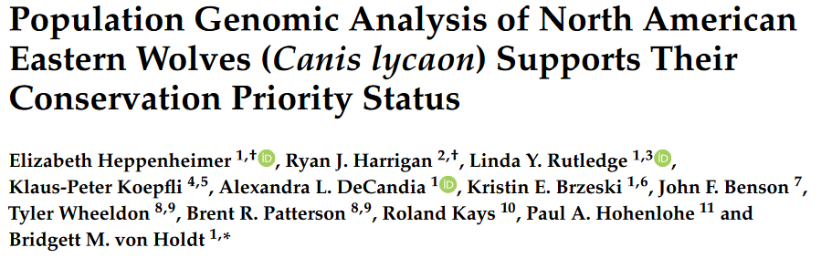
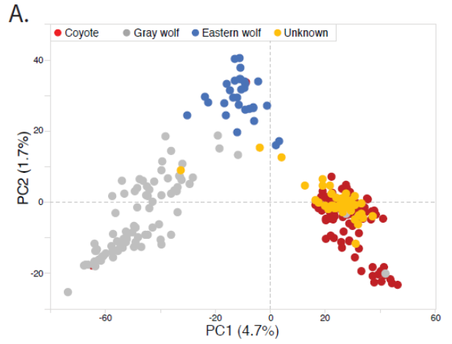
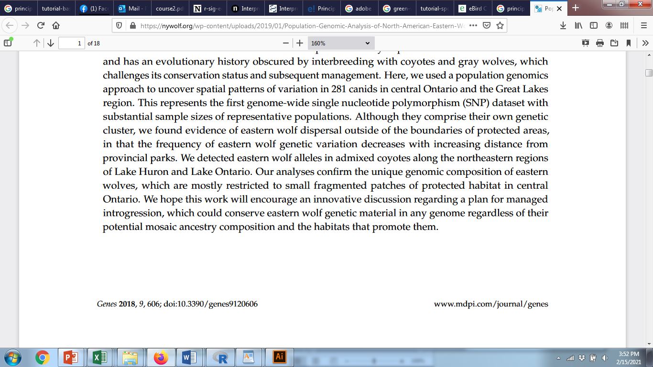
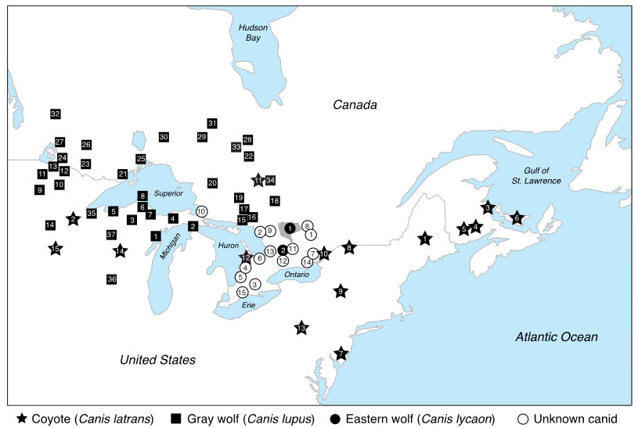
Identifying Unknown Individuals
Two clusters of wolves
Possible hybrids
Most “unknowns” clustered with coyotes
Examined 16,587 SNPs for 304 canid samples
Credit: J. L. Peters

Slide 23
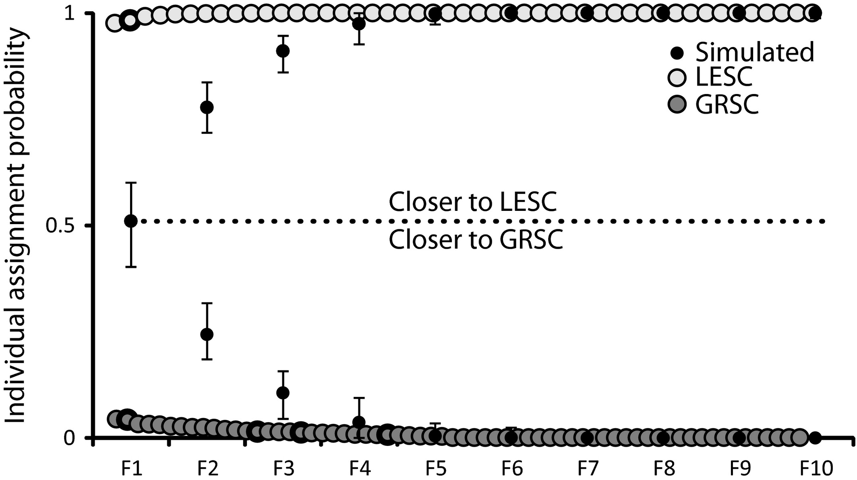
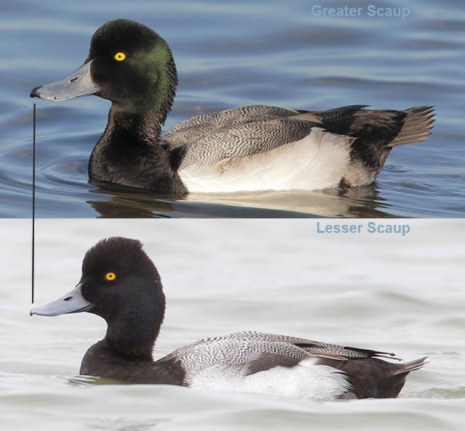
Empirical and simulated data indicate that backcrossing will cause “hybrids” to blend back into one or the other genetic background by about 5 generations
Molecular Ecology, Volume: 25, Issue: 3, Pages: 661-674, First published: 24 November 2015, DOI: (10.1111/mec.13487)
Becoming pure: identifying generational classes of admixed individuals within lesser and greater scaup populations
Notes:
The average and range of assignment probabilities from admixture results across 25 simulated replications of hybridization (F1) and nine generations of backcrossing (F2–F10). Empirical data for lesser (LESC) and greater (GRSC) scaup are ordered by assignment probability. Individuals with interspecific mtDNA haplotypes (N = 5; Fig. A) are shown with a bold circle outline.
IF THIS IMAGE HAS BEEN PROVIDED BY OR IS OWNED BY A THIRD PARTY, AS INDICATED IN THE CAPTION LINE, THEN FURTHER PERMISSION MAY BE NEEDED BEFORE ANY FURTHER USE. PLEASE CONTACT WILEY'S PERMISSIONS DEPARTMENT ON PERMISSIONS@WILEY.COM OR USE THE RIGHTSLINK SERVICE BY CLICKING ON THE 'REQUEST PERMISSIONS' LINK ACCOMPANYING THIS ARTICLE. WILEY OR AUTHOR OWNED IMAGES MAY BE USED FOR NON-COMMERCIAL PURPOSES, SUBJECT TO PROPER CITATION OF THE ARTICLE, AUTHOR, AND PUBLISHER.

Slide 24

Solving Crimes with DNA Matches
https://youtu.be/wkZ8RERRJy4?si=VP-KdGAZugNJbdFT

Slide 25
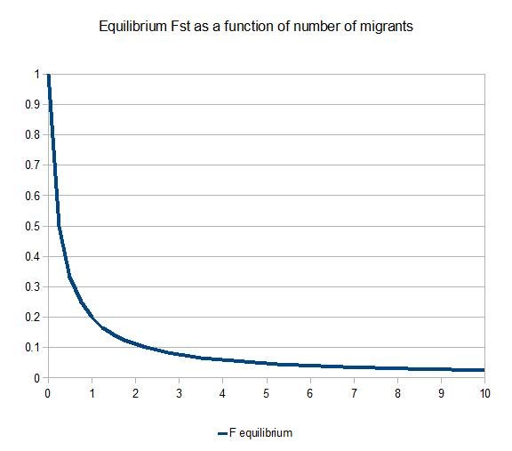
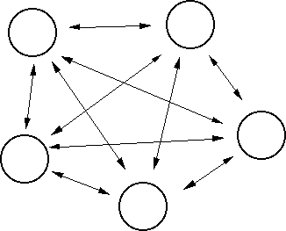
For the Island Model, with equal sample sizes per population:
1 _
1 + 4Nm_{T}
F_{ST} =
F_{ST}
Nm
Island Model
1 migrant per generation prevents fixation

Slide 26
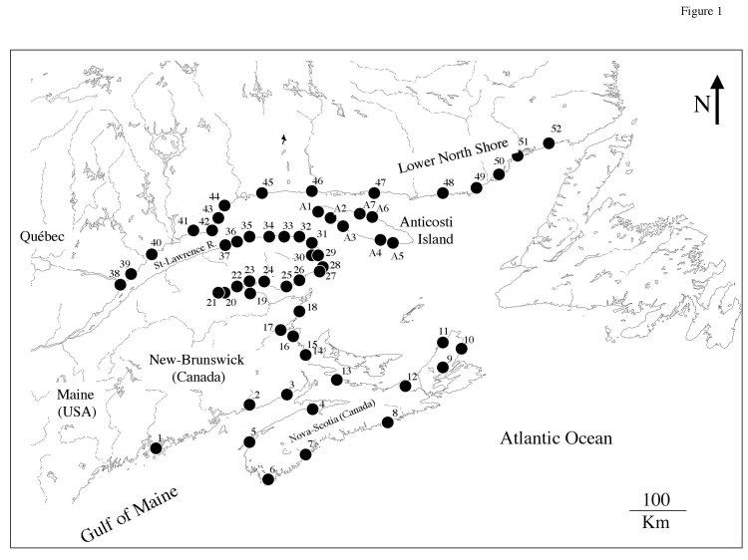
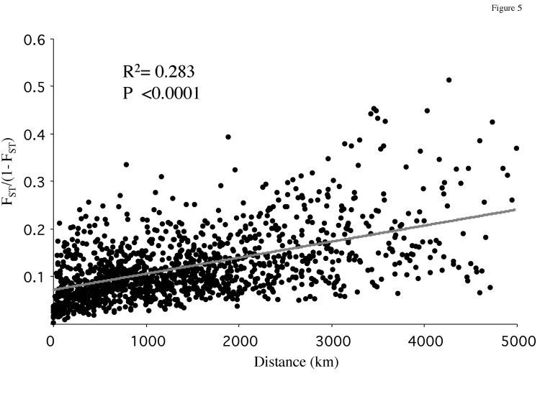
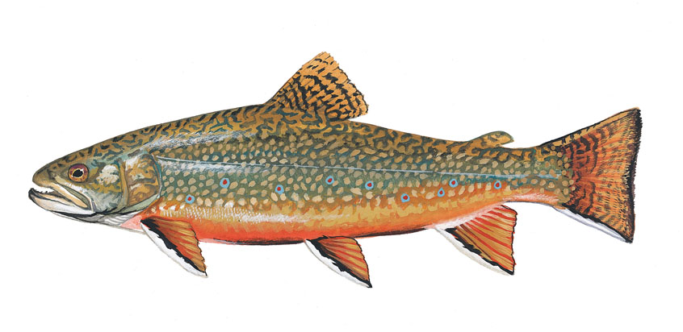
Isolation by Distance - the other IBD
Typically plotted against geographic distance as F_{ST}/(1 - F_{ST}) to obtain a linear relationship.
The rise and fall of isolation by distance in the anadromous brook charr Salvelinus fontinalis Mitchill
http://theses.ulaval.ca/archimede/fichiers/20348/ch04.html

Slide 27
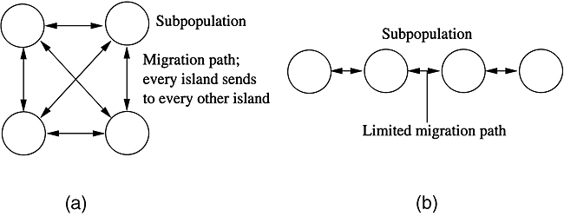
Island Model
Stepping Stone Model

Slide 28
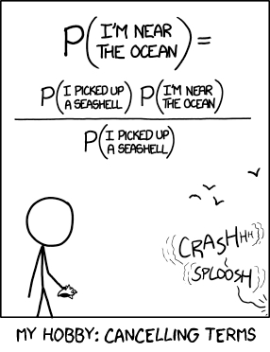
https://xianblog.wordpress.com/2013/07/13/the-original-xkcd-entry-on-bayes-with-its-mistake/

