Slide 1
Phylogeny & Systematics 1
University of Miami
Fall 2024

Slide 2
Outline of topics
Phylogeny
A. Definitions of Phylogenetics and Systematics
B. Basic terms to describe phylogenetic trees
C. A Phylogeny is an hypothesis
D. Determination of characters
1. Types (Morphological & Genetic)
2. Attractive properties of good characters (independent & homologous)
E. Philosophy
1. phenetics
2. cladistics
F. Defining homoplasy and homology based on trees
G. Outgroup analysis
H. Constructing trees and maximum parsimony

Slide 3
Phylogenetics
Determining the relationships within and among groups
Systematics
Classification of organisms into a hierarchical series of groups emphasizing their historical relationships

Slide 4
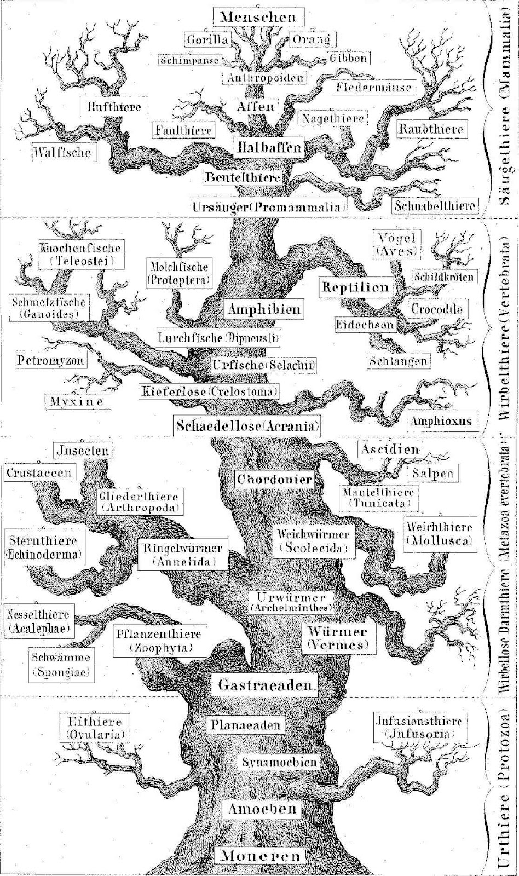
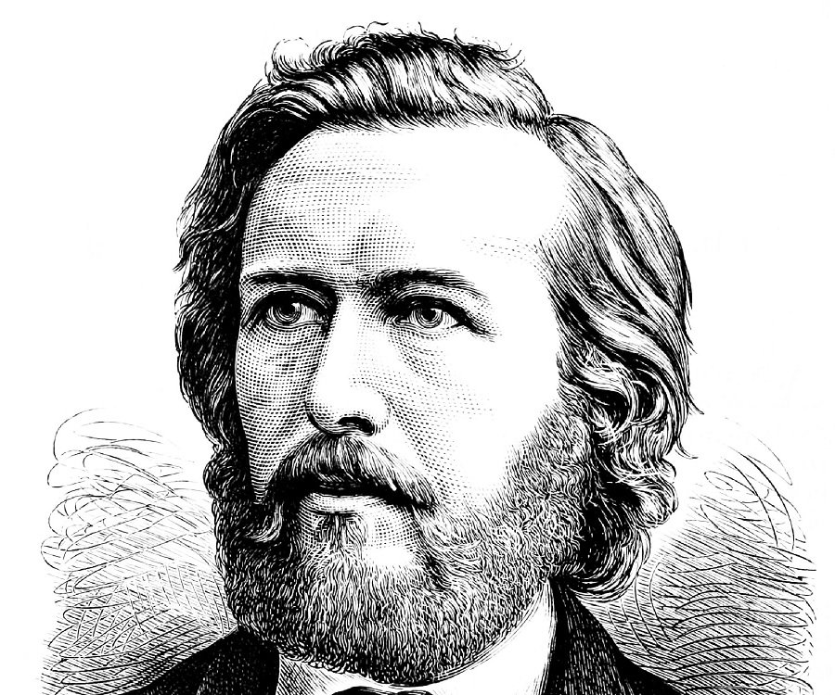
Concept of phylogenetic tree goes back to Ernst Haeckel 1866

Slide 5
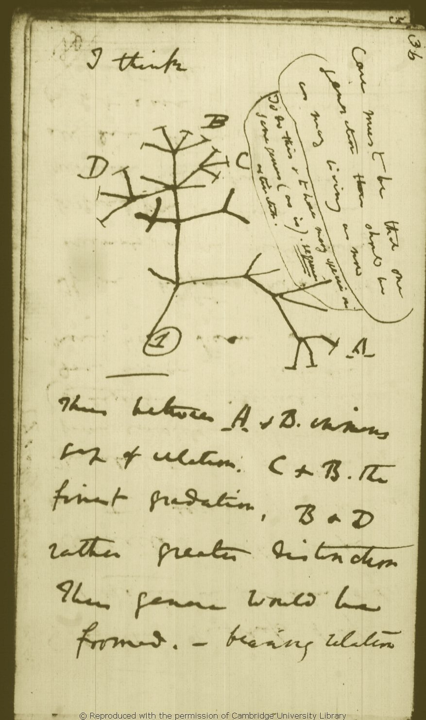
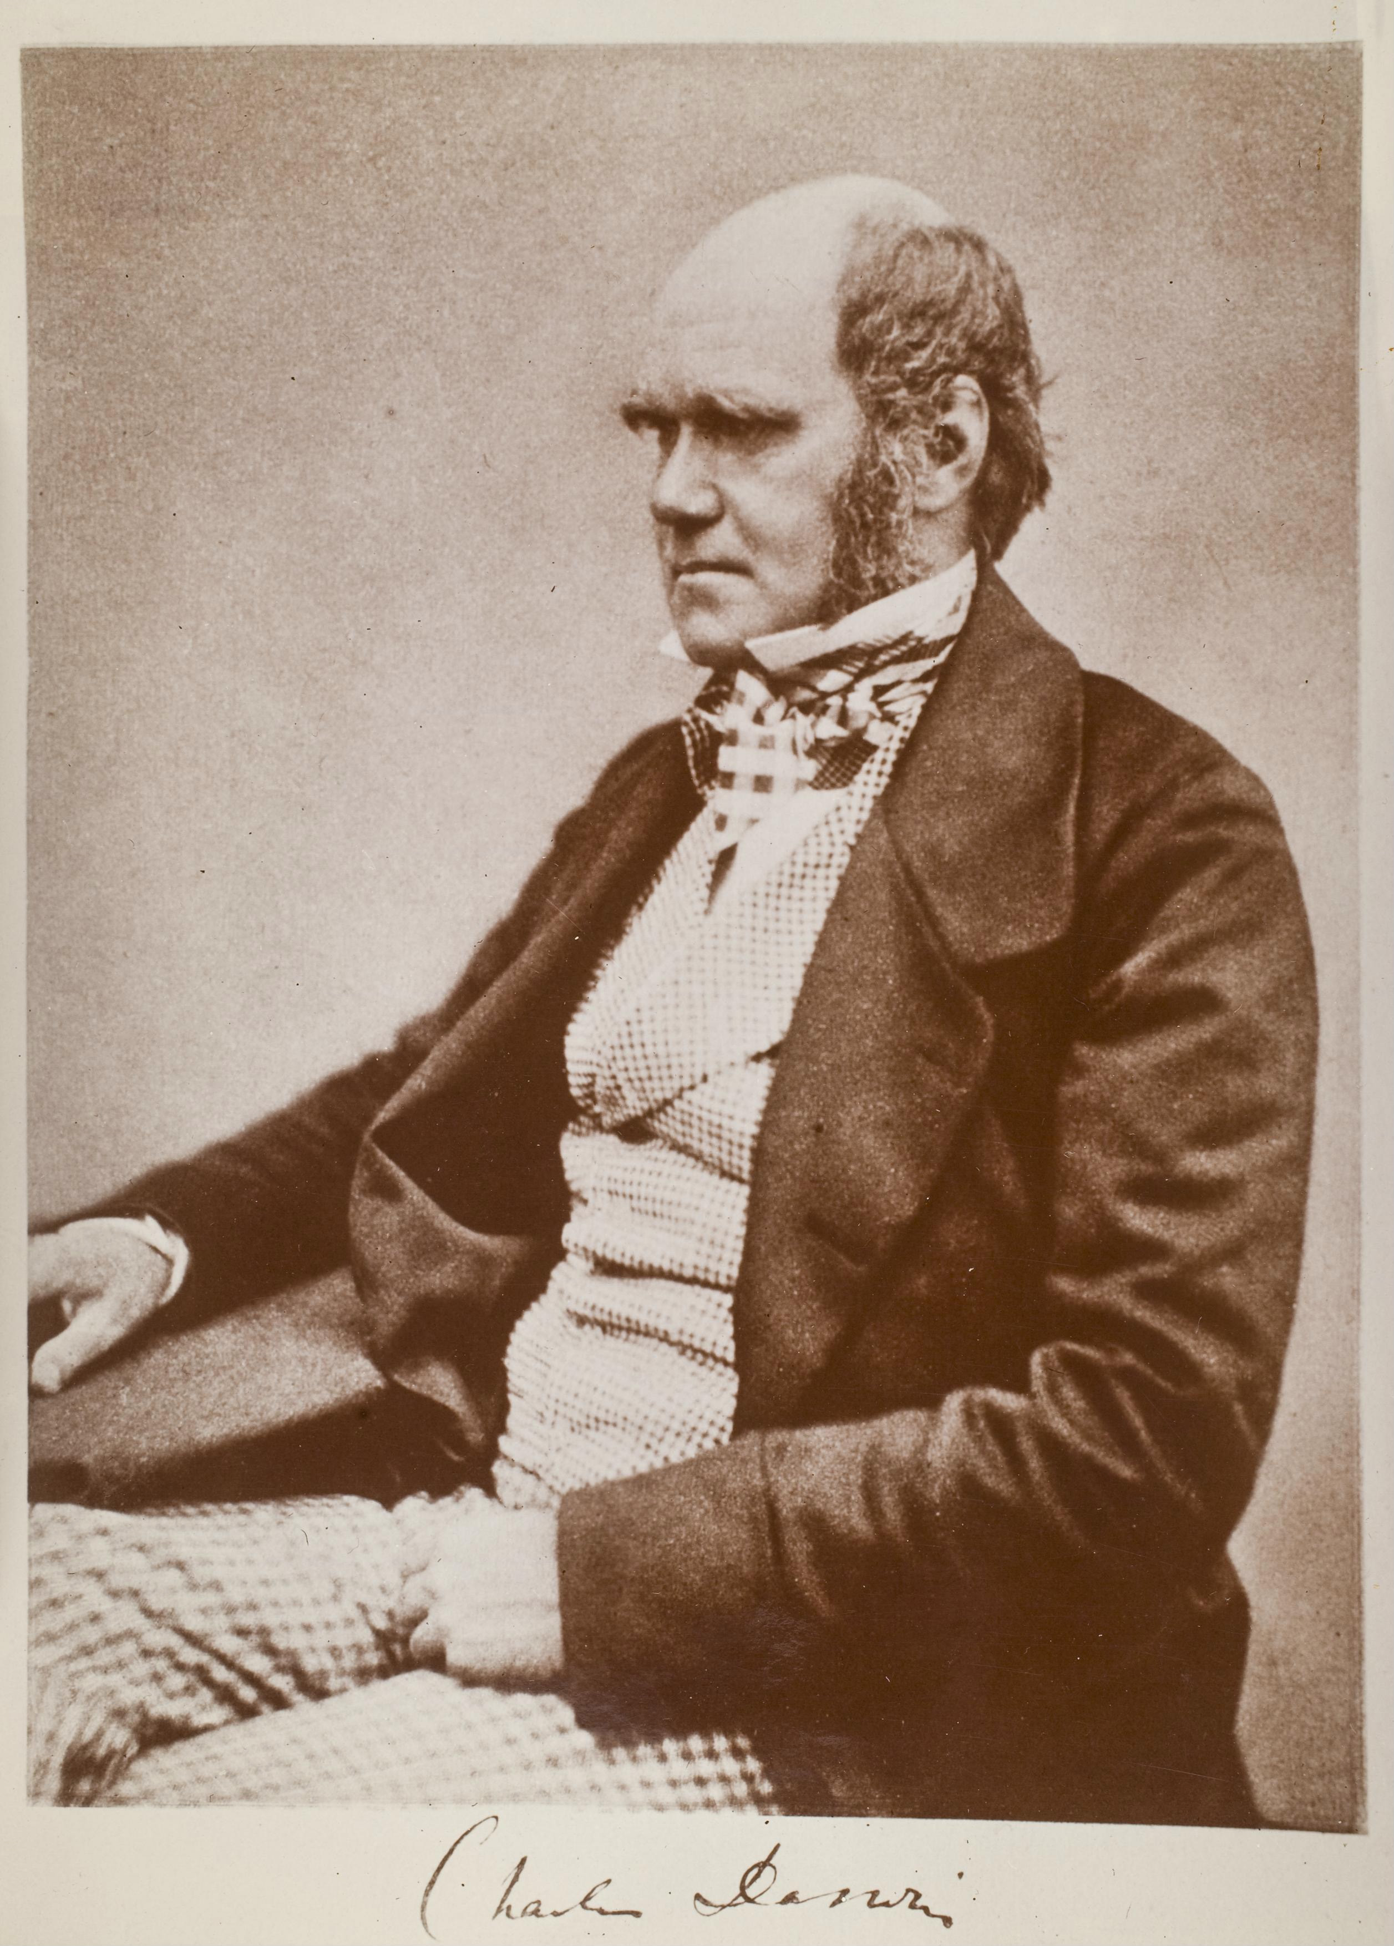
Charles Darwin probably illustrated the first phylogenetic tree in 1837

Slide 6
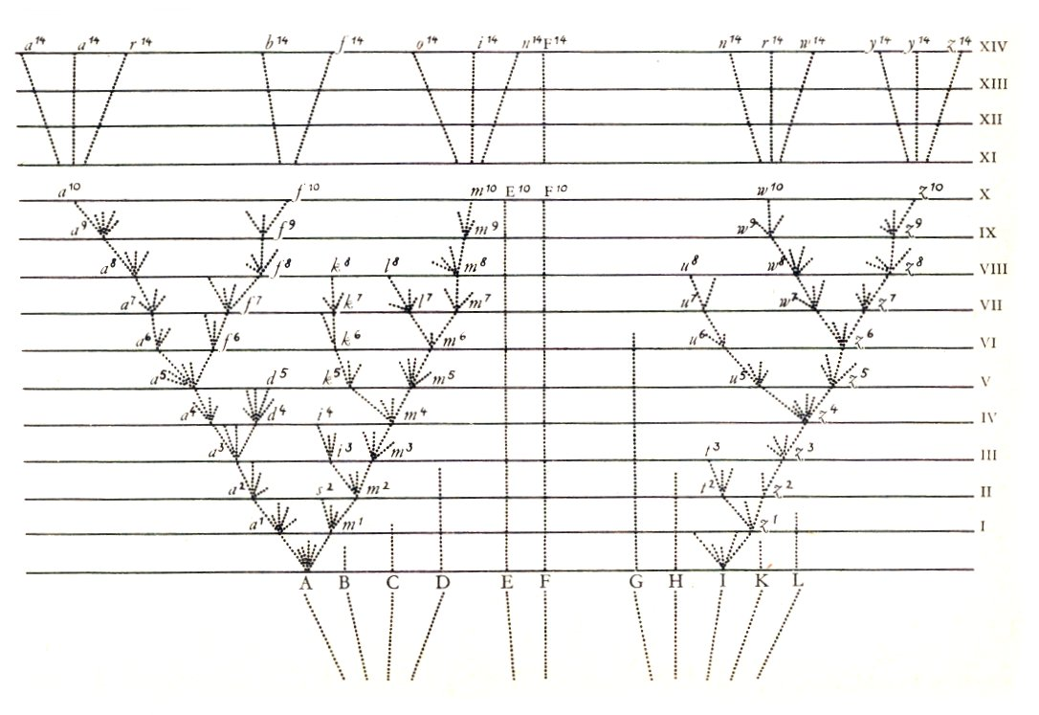
Only figure in On the Origin of Species
1859

Slide 7
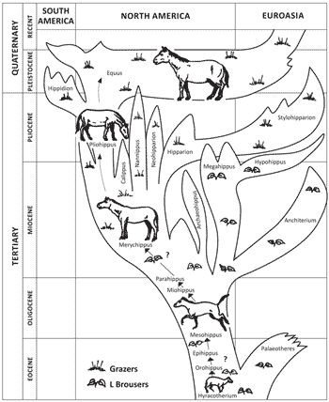
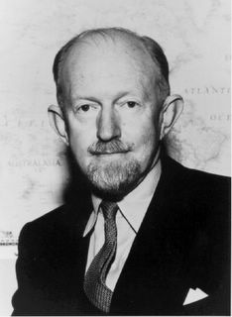
George Gaylord Simpson - Illustrated this tree depicting evolution of the horse in 1951

Slide 8
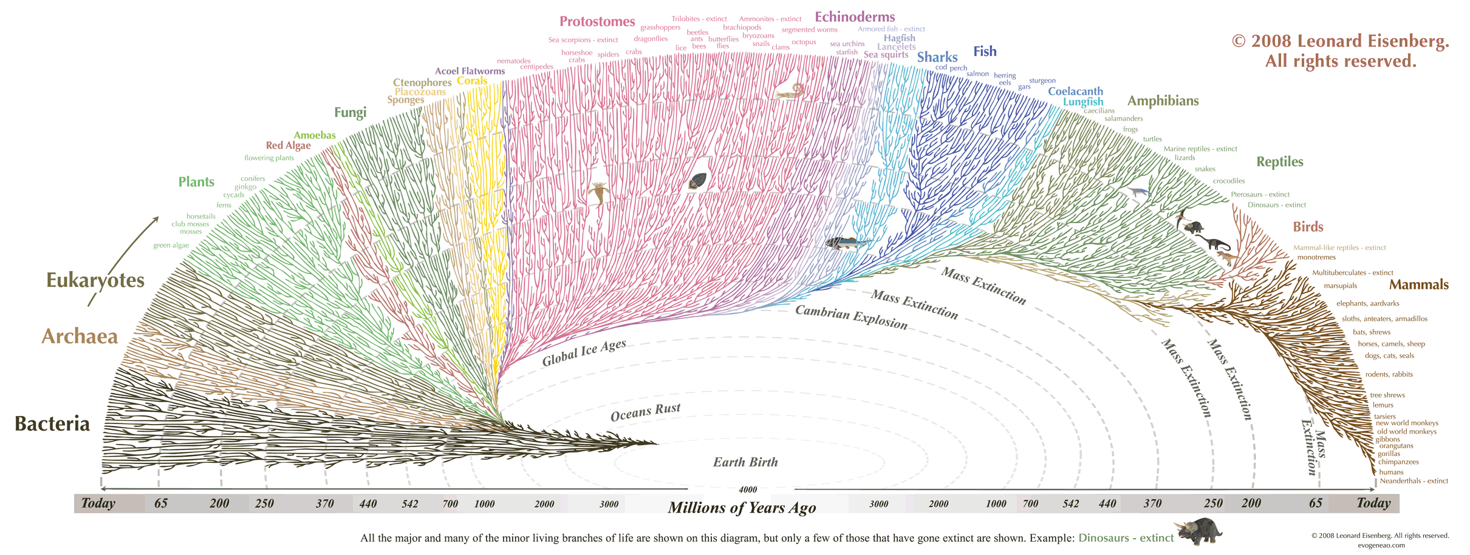

Slide 9
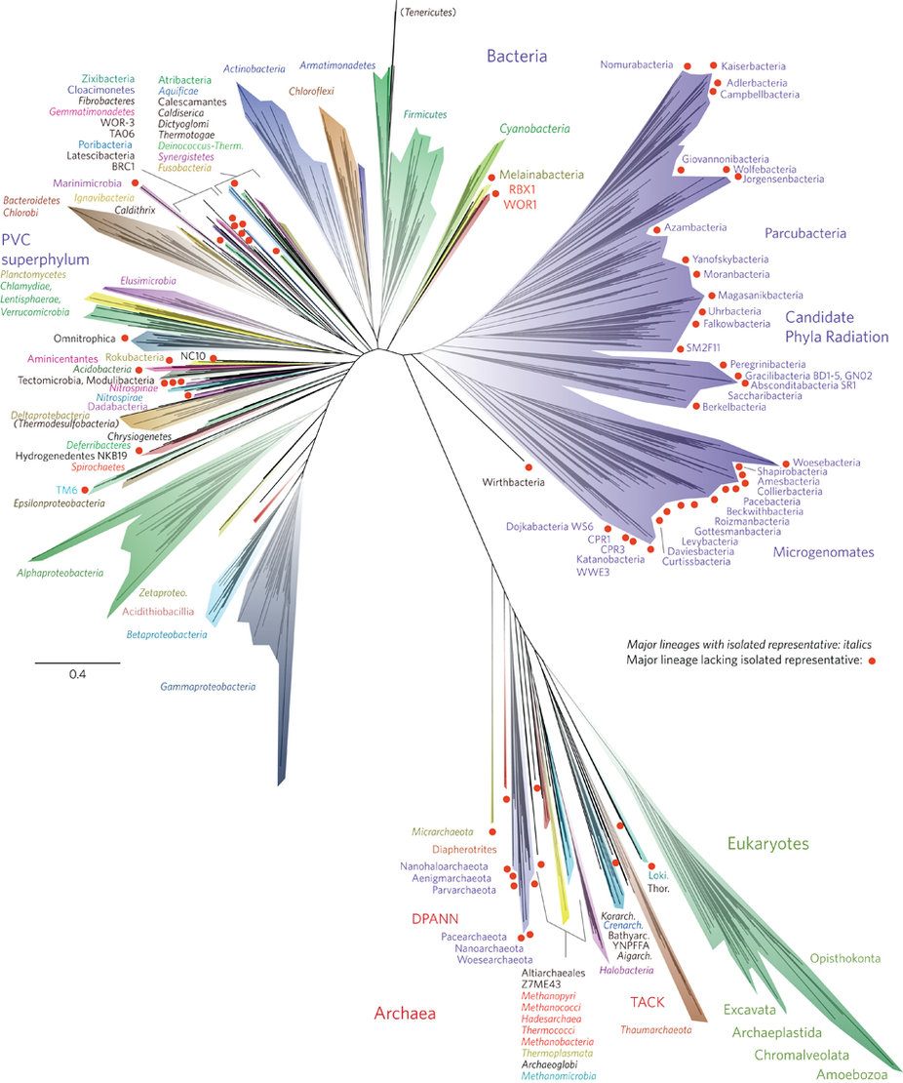
Hug et al. Nature Microbiology 1:16048(2016)

Slide 10
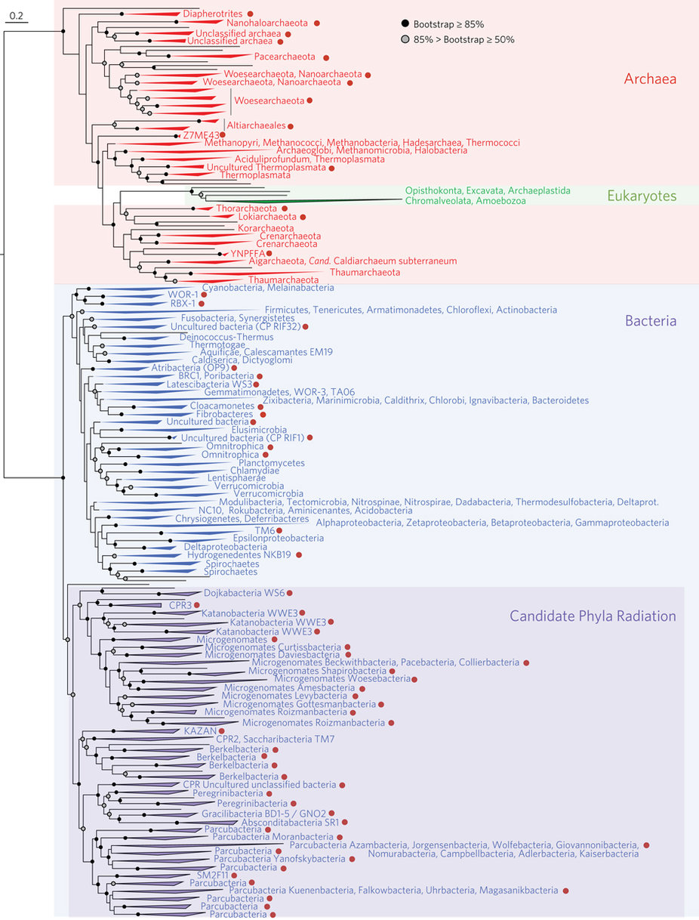
Hug et al. Nature Microbiology 1:16048(2016)

Slide 11
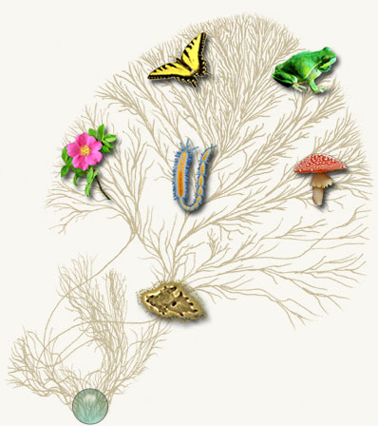
Tree of Life Web Project
http://tolweb.org/tree/phylogeny.html

Slide 12
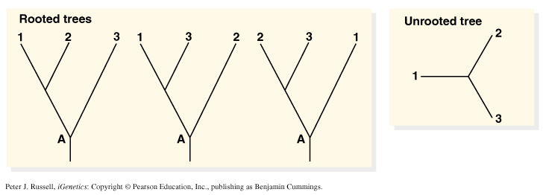
Simplest phylogenetic trees:
Branching patterns (trees) depict genealogical relationships
  Useful for molecular/non-molecular data
The 3-taxon example:

Slide 13
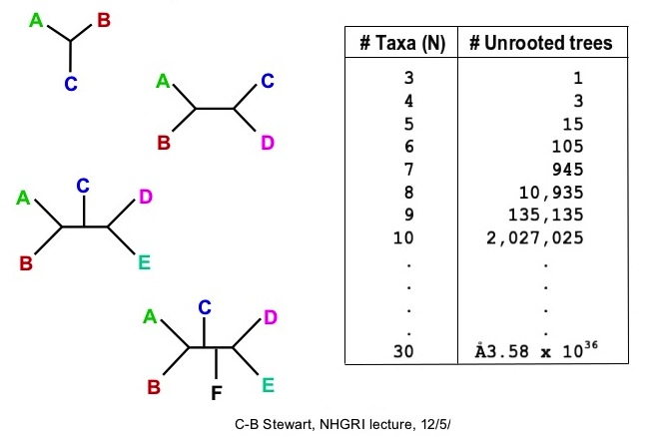
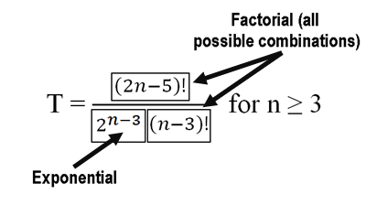
The # of possible unrooted trees grow by factorial:

Slide 14
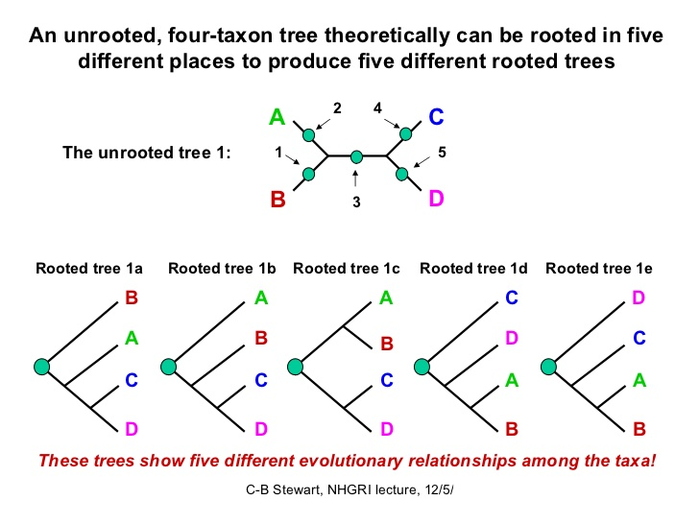

Slide 15
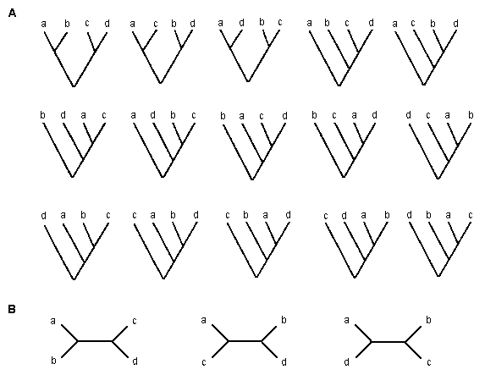
3 unrooted trees, each rooted to produce 5 trees = 15 trees total
https://www.ctu.edu.vn/~dvxe/Bioinformatic/Software/BIT%20Software/Phylogen.htm

Slide 16
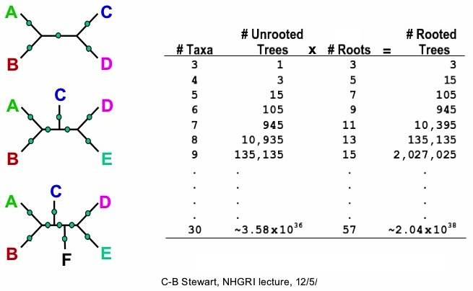

Slide 17
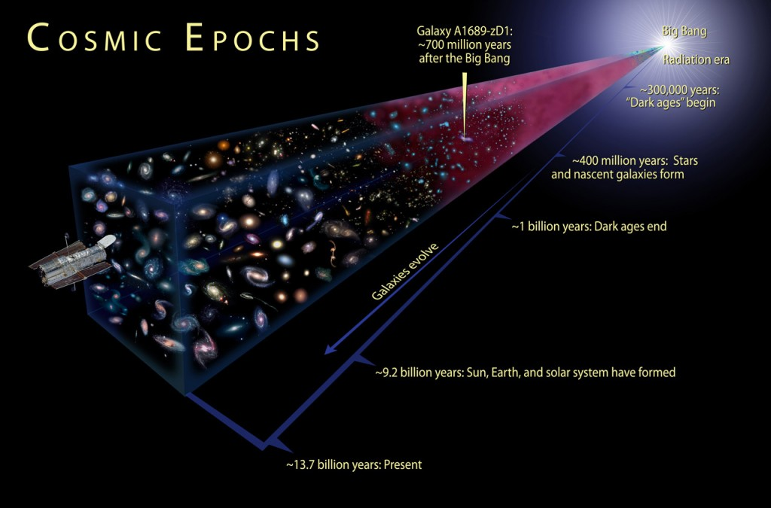
10⁷⁸ to 10⁸² atoms in the known, observable universe = between ten quadrillion vigintillion & one-hundred thousand quadrillion vigintillion atoms.
http://www.universetoday.com/36302/atoms-in-the-universe/
For 100 taxa there are 10¹⁸² possible unrooted trees!

Slide 18
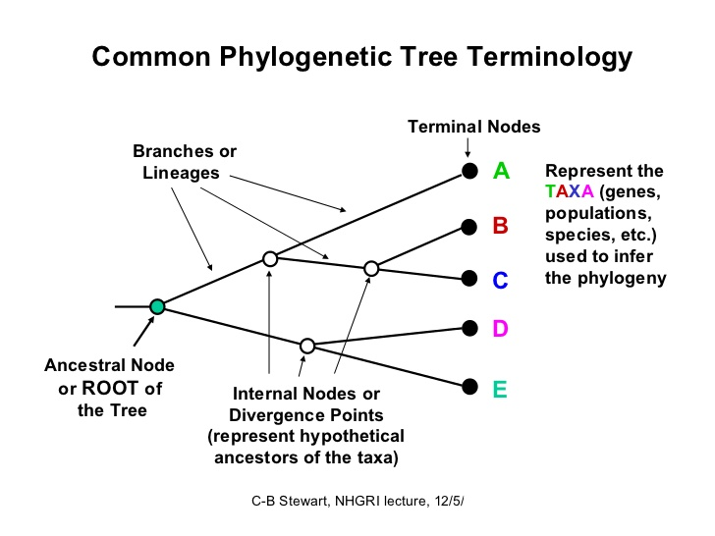

Slide 19
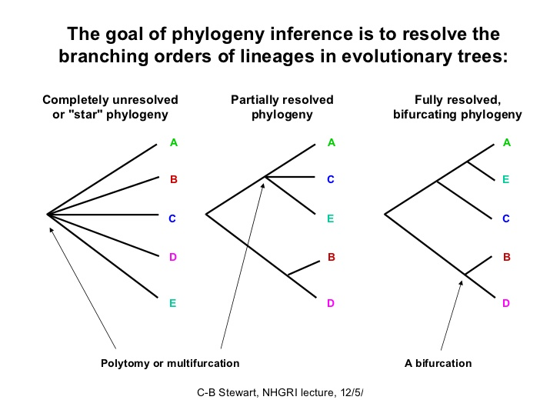

Slide 20
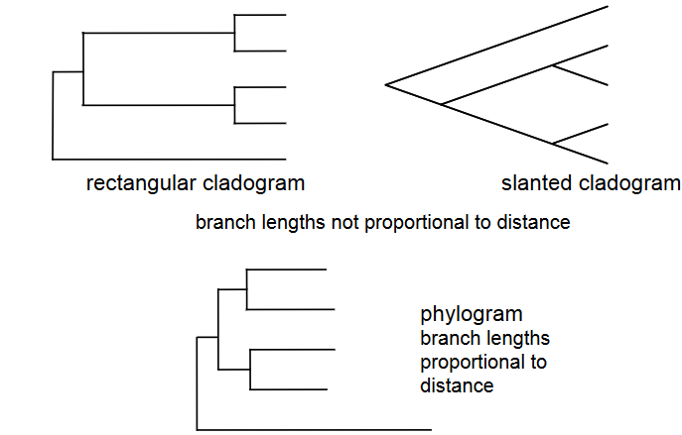
Types of Tree Representations

Slide 21
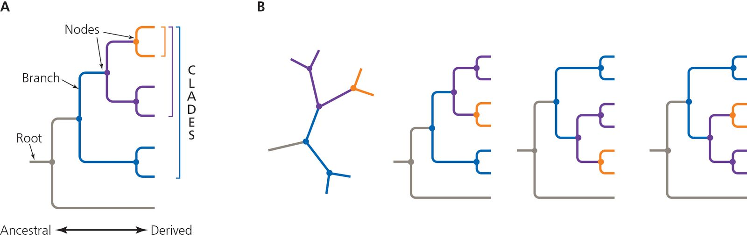
Reading a phylogenetic tree
Terminal node
Taxa can be rotated around nodes and still depict the same relationships

Slide 22
These are the same
C
A
B
C
A
A
B
A
B
B
C
C
Rotation
A
B
C
D
E
C
A
B
D
E
Congruent trees

Slide 23
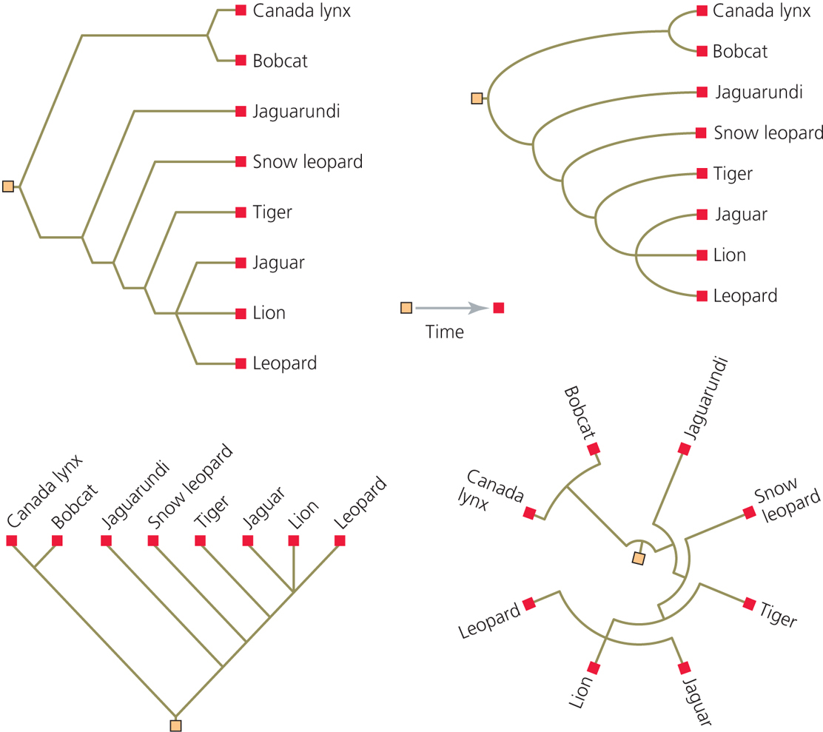
Figure 4-5
All the same topology

Slide 24
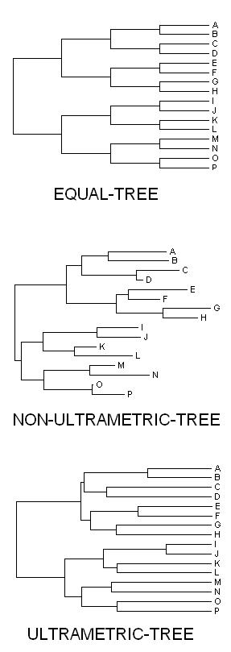
equal branch lengths
proportional branches
ultrametric branches
(UPGMA)

Slide 25
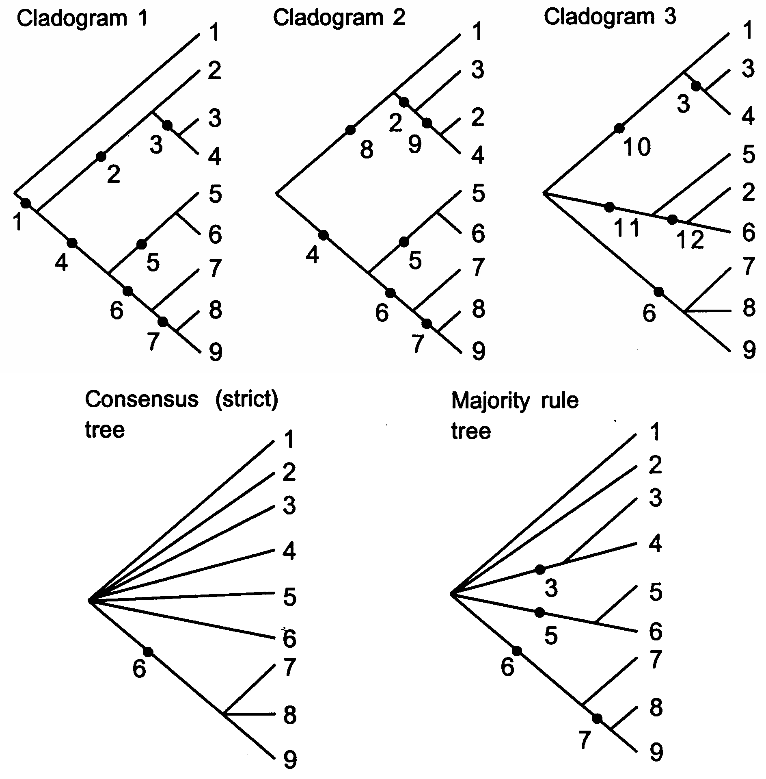
Consensus Trees
http://bio.slu.edu/mayden/systematics/bsc420520lect12.html

Slide 26
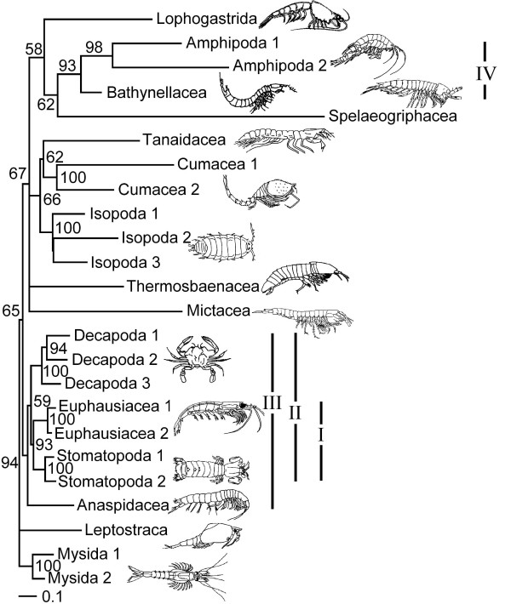
Branch Support – Clade Credibility Values
Values on branches
indicate proportion (%) of trees in posterior sample (i.e., n = 1000 from MrBayes analysis) supporting the particular clade.
A Bayesian approach
Clade support value is a posterior probability
Drawn from a set of trees
Pr (Clade | Set of Trees)
=> set of trees can obtained using search criterion such as maximum likelihood
Jenner, R. A., Dhubhghaill, C. N., Ferla, M. P., & Wills, M. A. (2009) Eumalacostracan phylogeny and total evidence: limitations of the usual suspects. BMC Evolutionary Biology, 9:21.

Slide 27
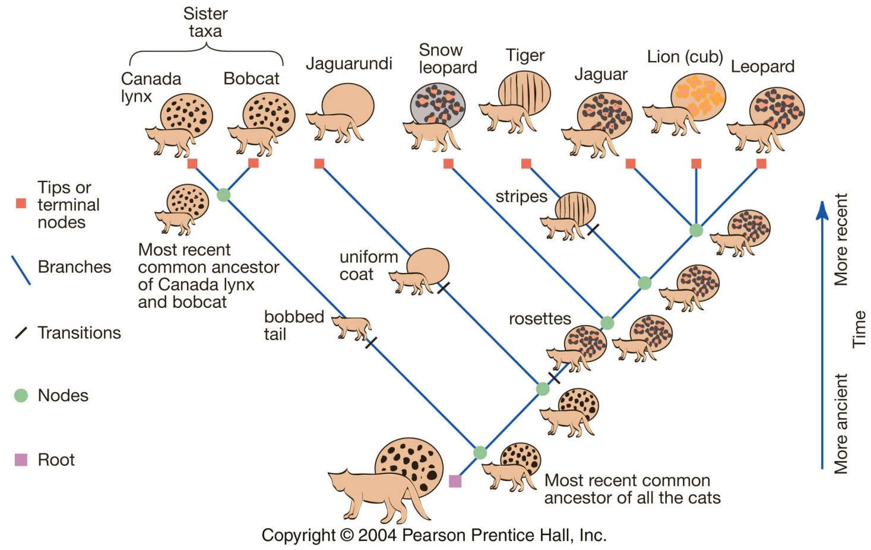
Consider a phylogeny as an hypothesis that can be tested using additional data - either molecular or morphological.

Slide 28
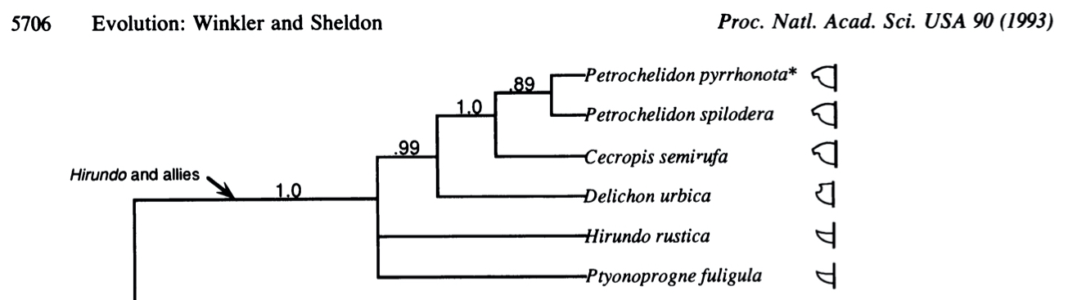
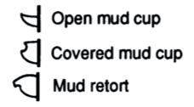
Winkler, D.W. and Sheldon, F.H., 1993. Evolution of nest construction in swallows (Hirundinidae): a molecular phylogenetic perspective. Proceedings of the National Academy of Sciences, 90(12), pp.5705-5707.

Slide 29
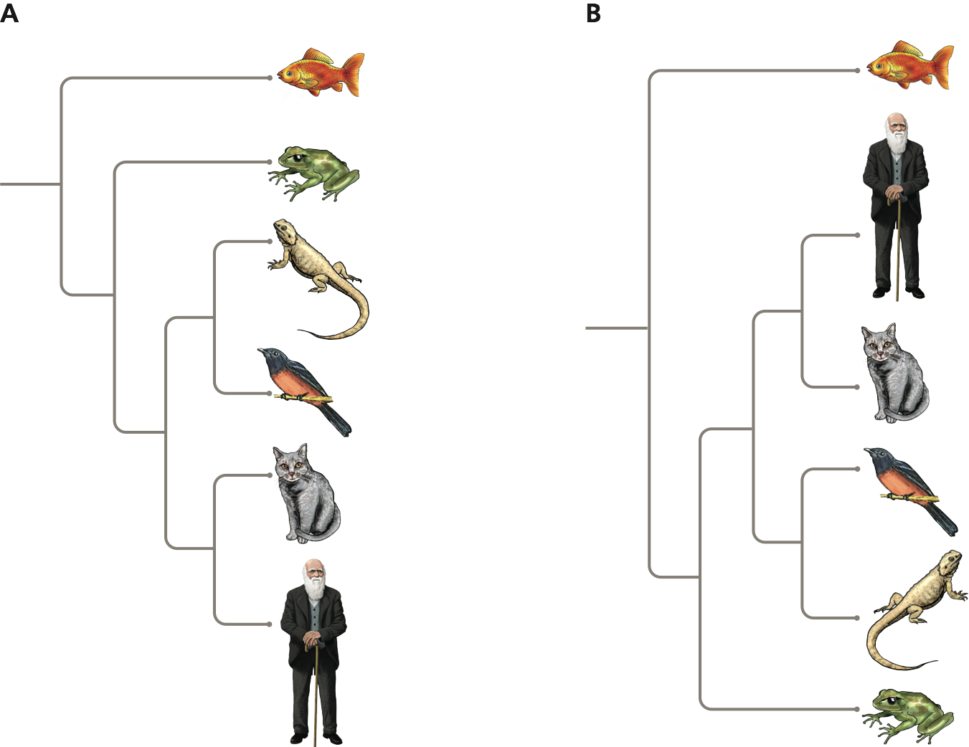
No currently existing species is ancestral to any other
All individuals represented at the tips of the tree are sampled at the same point in time.
Notes:
Important not to interpret the sequence of species as a linear ancestor-descendant relationship

Slide 30
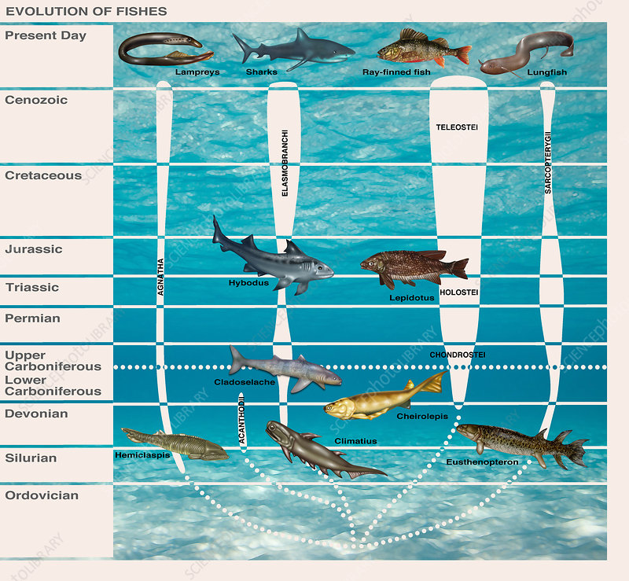
Modern sharks may appear similar morphologically to their distant ancestors, but they are no less present day extant organisms than modern ray-finned fish.
https://www.sciencephoto.com/media/700972/view/evolution-of-fishes-illustration

Slide 31
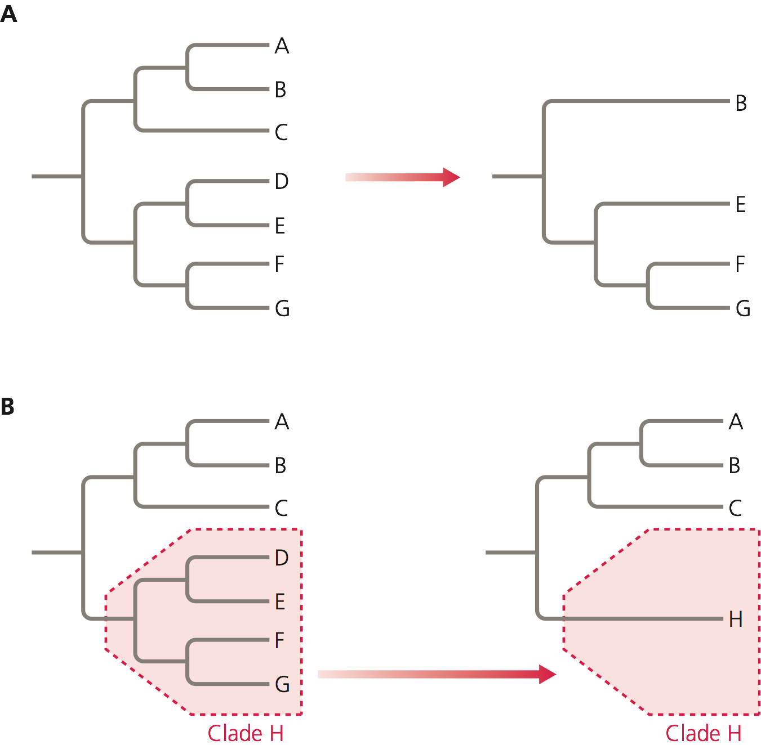
Trees can be drawn with fewer species to simplify a complex diagram

Slide 32
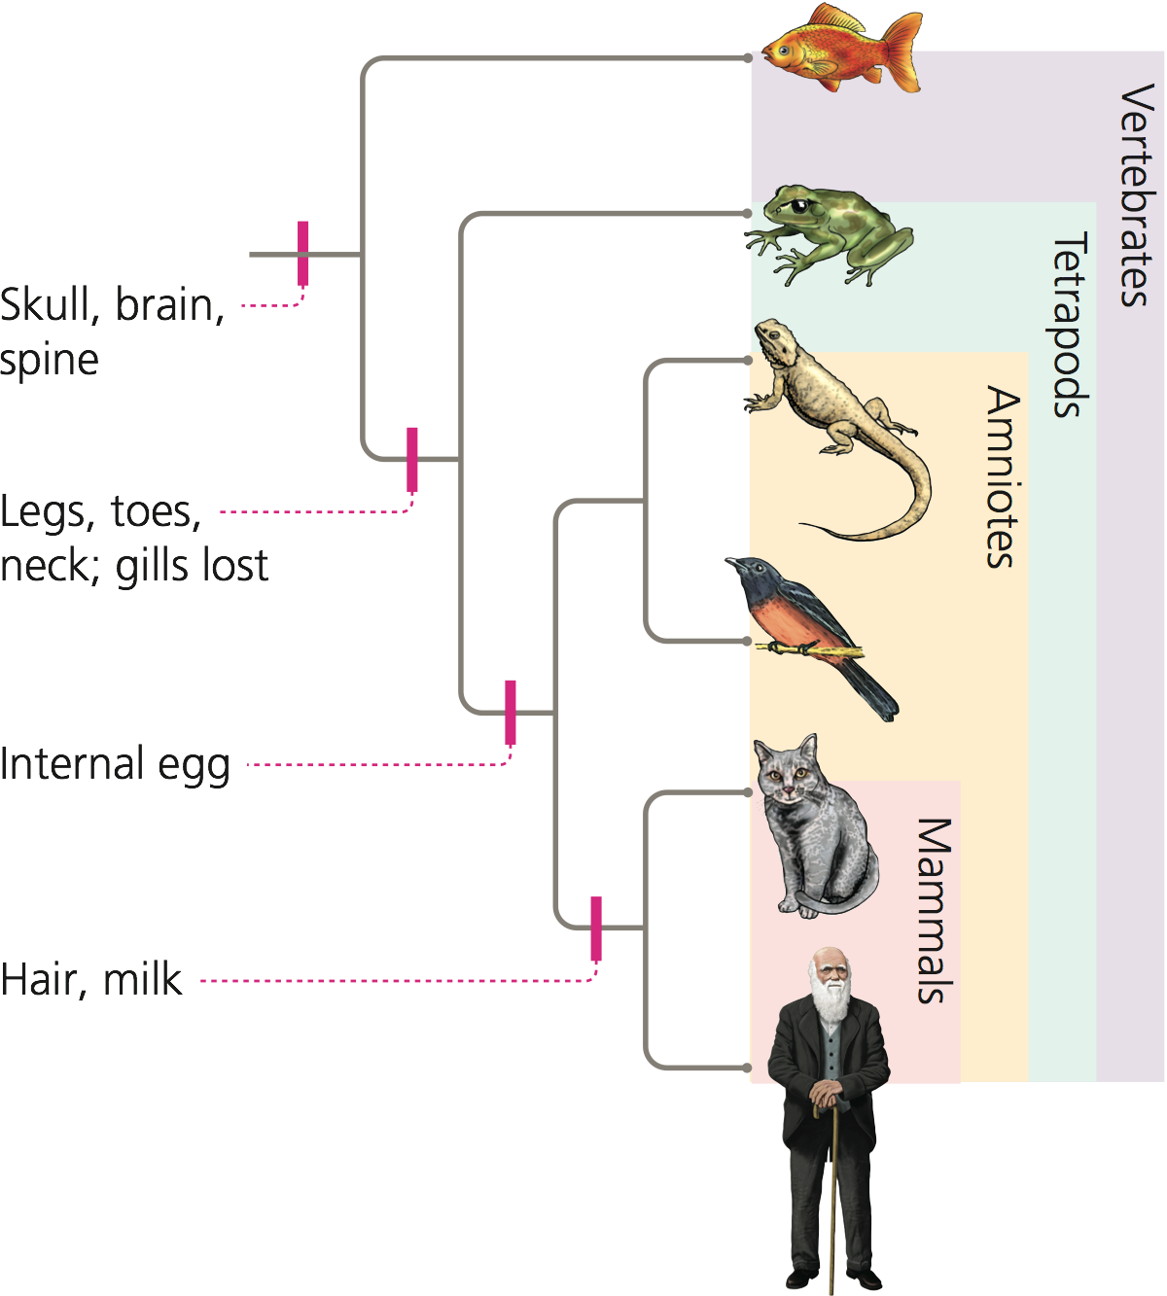
Trait evolution is organized in a nested hierarchy

Slide 33
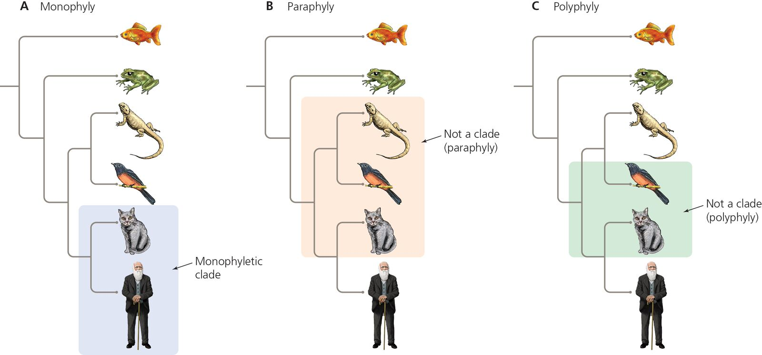
Taxonomic units are “legitimate” only if they represent a clade
Clades are monophyletic groups

Slide 34
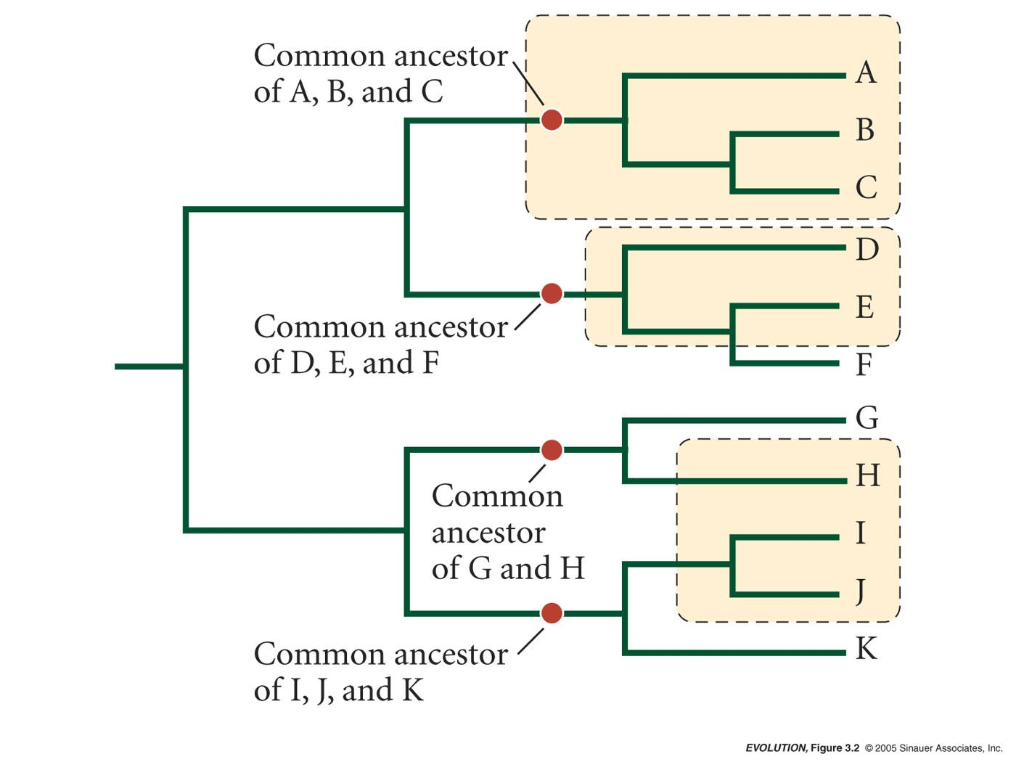
Monophyletic – a group consisting of all species descended from a single common ancestor
Paraphyletic – a group all descended from a common ancestor, but that does not contain all of the descendants from that ancestor
Polyphyletic – a group composed of members that do not share a common ancestor

Slide 35
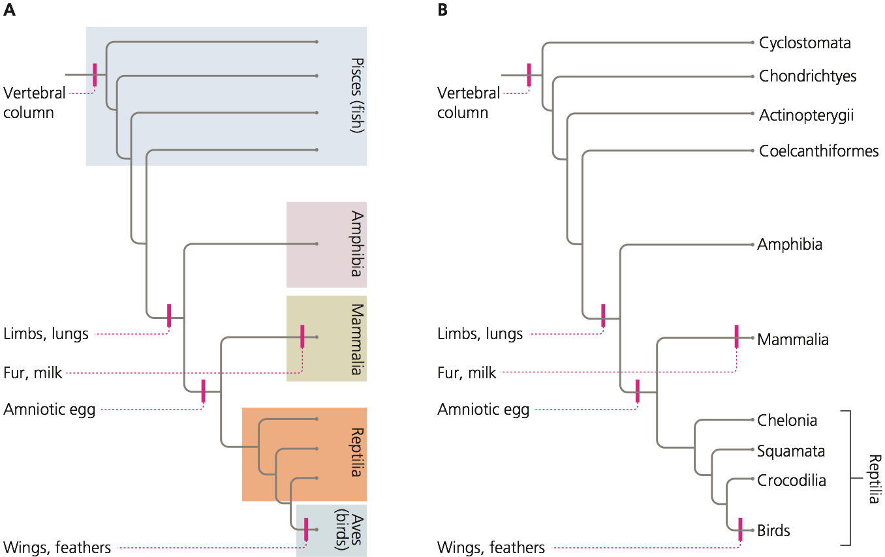
Some Linnaean classifications are not monophyletic

Slide 36
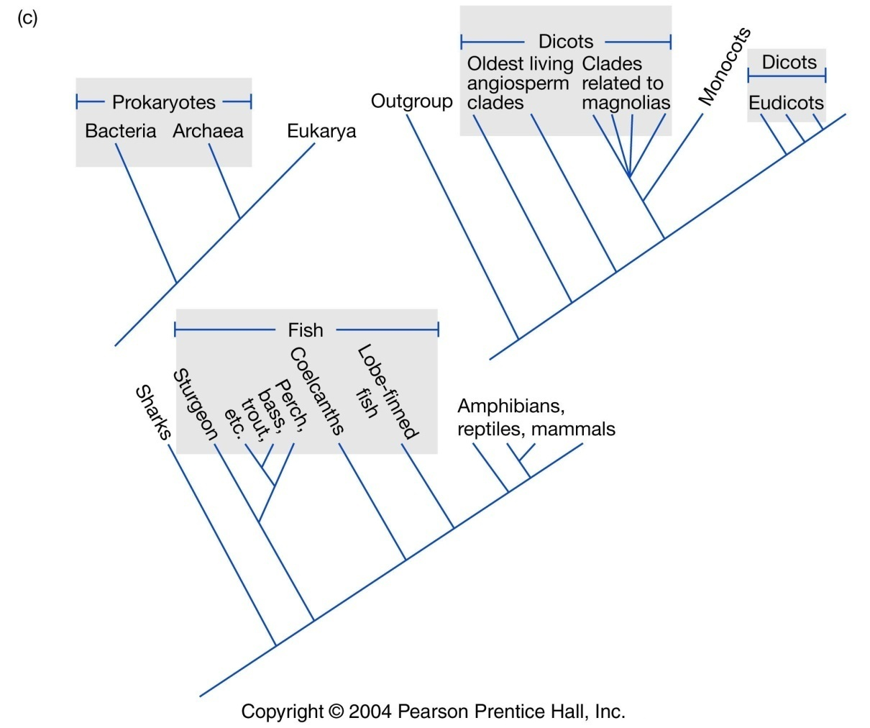
Additional paraphyletic groups
Notes:
All are paraphyletic groups

Slide 37

Four billion years of evolution in six minutes
Prosanta Chakrabarty
Ichthyologist
https://www.ted.com/talks/prosanta_chakrabarty_four_billion_years_of_evolution_in_six_minutes

Slide 38

Next lecture topics
How do we code trees and character data into data files?
How do we search tree space to find the best trees(s)?
=> This is a Computational Problem!

