Slide 1
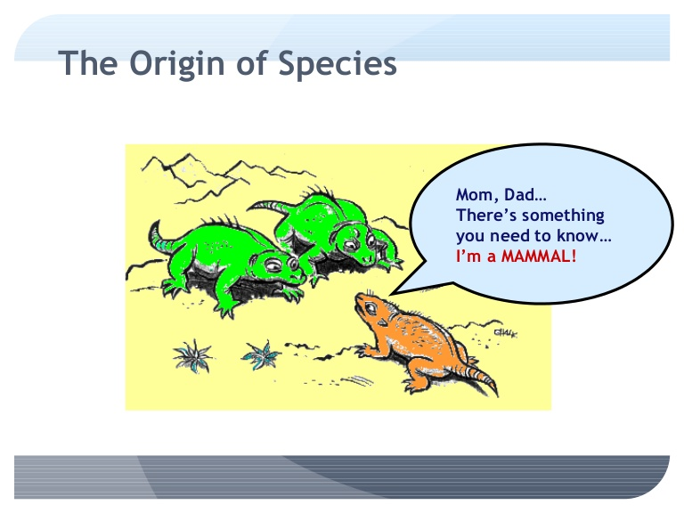
Speciation
What is a species and how do they originate?

Slide 2
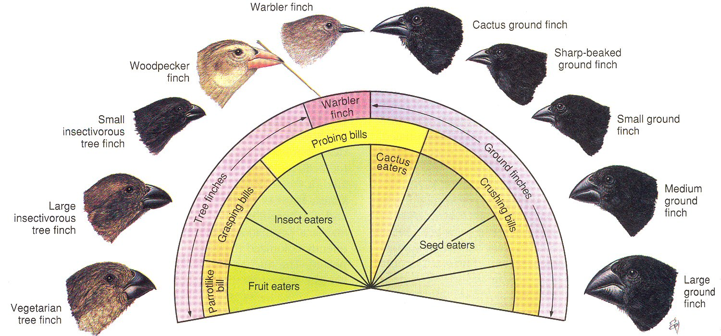
How does speciation occur?
Darwin’s Finches.

Slide 3
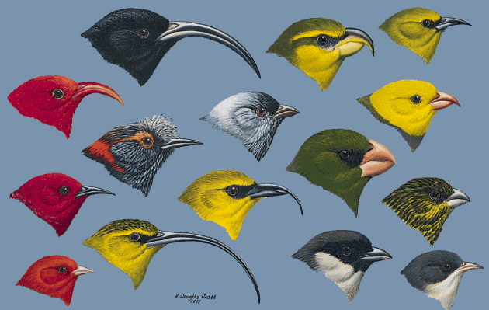
How does speciation occur?
Hawaiian Honeycreepers display even more impressive range of variation than Darwin’s Finches.

Slide 4
A. Species definitions
  1. Is a Species a cultural construct?
  2. Species definitions
    Morphospecies Concept
    Biological Species Concept
    Phylogenetic Species Concept
    Others
B. Isolating barriers
  Prezygotic
    a. Premating
    b. Postmating
  2. Postzygotic
  a. Extrinsic & intrinsic
  b. Dobzhansky-Muller incompatibilities
C. Models of speciation
  Allopatric
    Evidence
    Mechanisms for evolution of isolating barriers
      Dobzhasky-Muller incompatibilities
      Ecological isolation
      Sexual selection
      Reinforcement selection
  Peripatric
  Sympatric
Part I
Part II

Slide 5
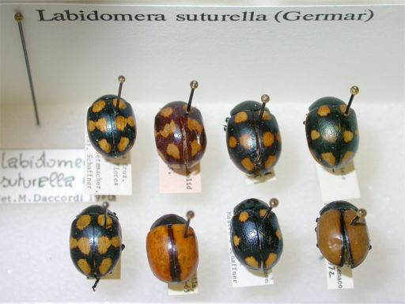
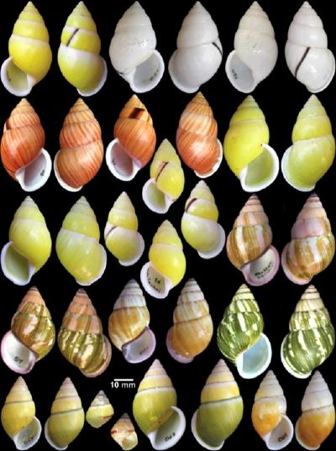
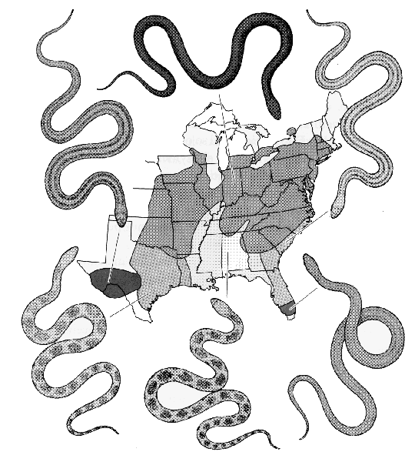
Where are species boundaries?

Slide 6
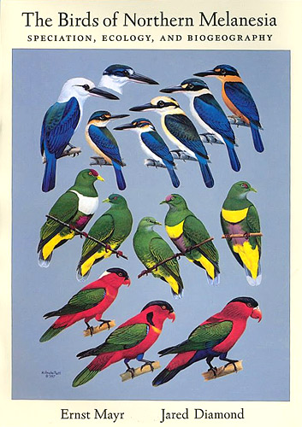
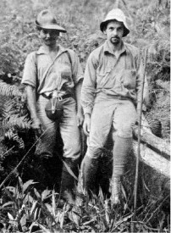
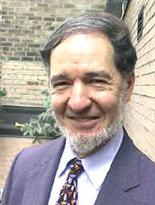
Does the unit called a “Species” actually exist in nature or is it a cultural construct?
Do people from different cultures recognize the same species divisions as biologists?

Slide 7
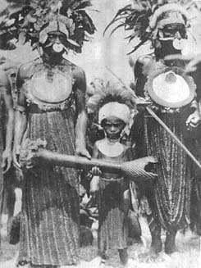
New Guinea tribesmen of Mt. Arfak had 136 names for 137 Linnean species (Mayr 1963)
Kalam of New Guinea: 123 of 176 species recognized by western zoologists had 1:1 correspondence with a folk designation
  80% concordance in frogs
  95% concordance in reptiles
Tzeltal of southern Mexico have 471 folk names for plants , 66% of which have a 1:1 correspondence with Linnaean species

Slide 8
What is a species? (depends on your definition)
1) Morphospecies Concept
2) Biological Species Concept
3) Phylogenetic Species Concept
4) Others

Slide 9
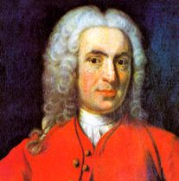
Morphospecies Concept
- Linnaeus
Species are morphologically similar organisms
Advantage:
1) Widely applicable
Disadvantage
1) Criteria for species classification varies among taxonomists. How much divergence reveals a species? (lumpers vs. splitters)
2) Not genetic

Slide 10
Biological Species Concept (BSC)
- Ernst Mayr
Species are groups of actually or potentially
interbreeding natural populations that are
reproductively isolated from other such groups.
  Legal definition used by Endangered Species Act
  1973 – Law Signed by Richard Nixon
Reproductive isolation – reduction or prevention of gene flow between populations because of genetically determined differences between them.

Slide 11
Biological Species Concept (BSC) - Ernst Mayr
Advantages:
1) Clear testable definition.
2) Leads to testable hypotheses regarding how and why species arise. Emphasizes the process of speciation and the evolution of reproductive isolation.
3) Makes predictions about how genes evolve.

Slide 12
Biological Species Concept (BSC) - Ernst Mayr
Disadvantages:
1) Not useful when applied to asexual organisms.
2) Does not allow for assessment of speciation through time. --> How do we know whether a present-day species is reproductively isolated from its ancestor?
3) The extent to which species must be reproductively isolated is unclear. Many species can hybridize.
4) Difficult to implement if it is necessary to cross species to determine reproductive isolation?

Slide 13
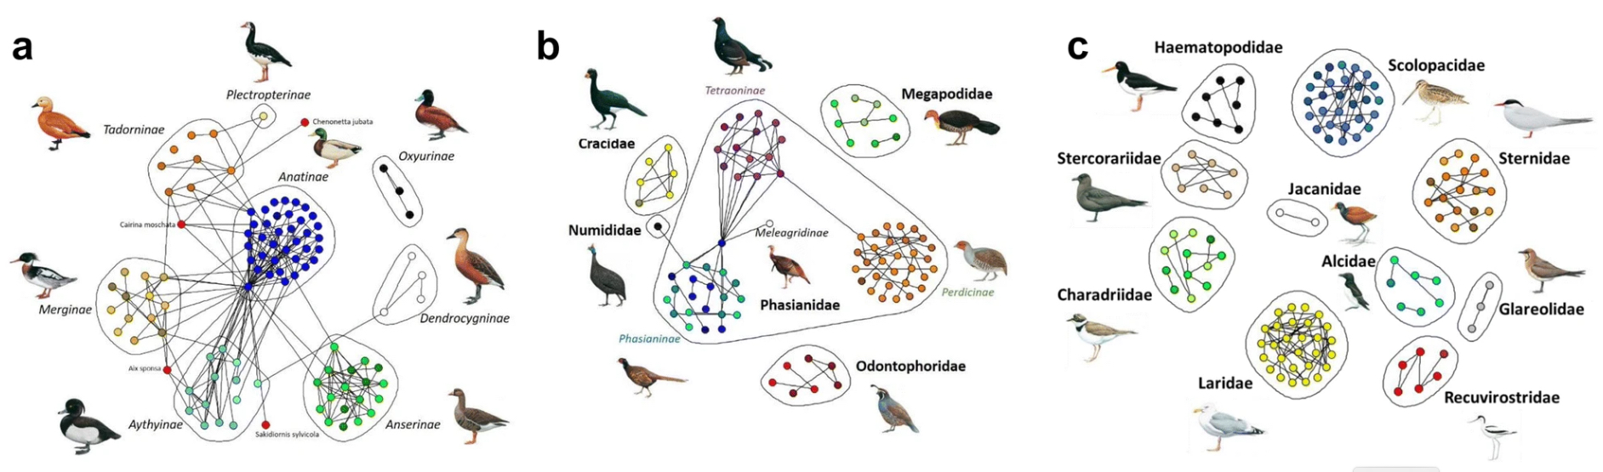
Tendency to hybridize varies greatly among taxonomic groups.
Anseriformes
Galliformes
Charadriiformes
Ottenburghs, J., 2019. Multispecies hybridization in birds. Avian Research, 10(1), pp.1-11.

Slide 14
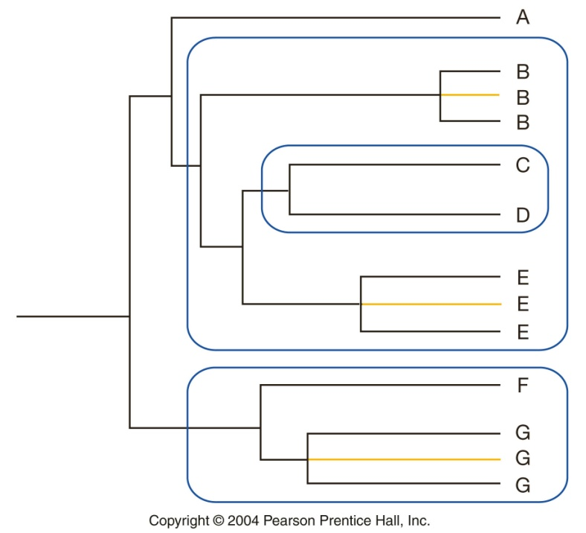
Phylogenetic Species Concept (PSC)
Cracraft, Donahue, deQueiroz => based on a tree
A species is the smallest monophyletic group of common ancestry
Monophyletic group – populations or groups of populations that contain all known descendants of single common ancestors

Slide 15
Phylogenetic Species Concept (PSC)
Rationale – to be called a species, a population must have been evolutionarily independent for a sufficient time for diagnostic traits to emerge.
Emphasizes species as the outcome of evolution
Advantages:
1) Relatively easy to implement – just sequence DNA from individuals.
2) Applies to all life forms (asexuals included.)
3) Lots of species with this concept (birders like it).

Slide 16

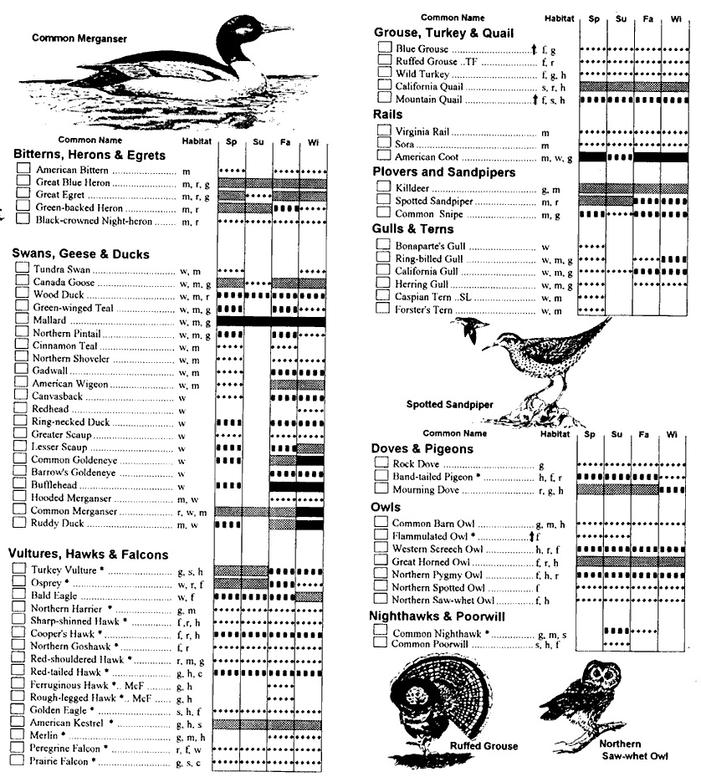

Lumpers => fewer
Splitters => more
Species Checklist

Slide 17
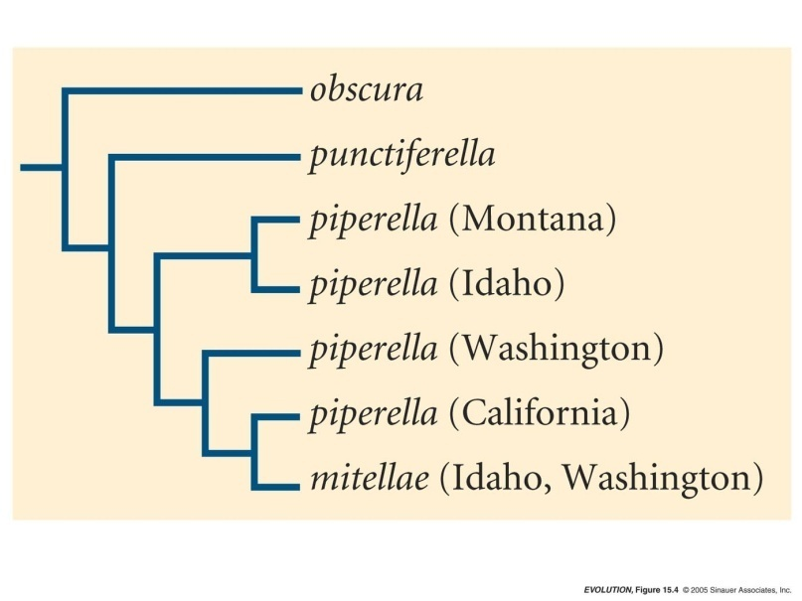
Phylogenetic Species Concept (PSC)
Disadvantages:
Speciation occurs whenever a population undergoes a genetic fixation that distinguishes it from other populations – even if the difference is in only a single base pair.
2) Newly arisen species are often not sufficiently diverged to be correctly classified.
3) How many genes sequenced?
Greya moth phylogeny

Slide 18
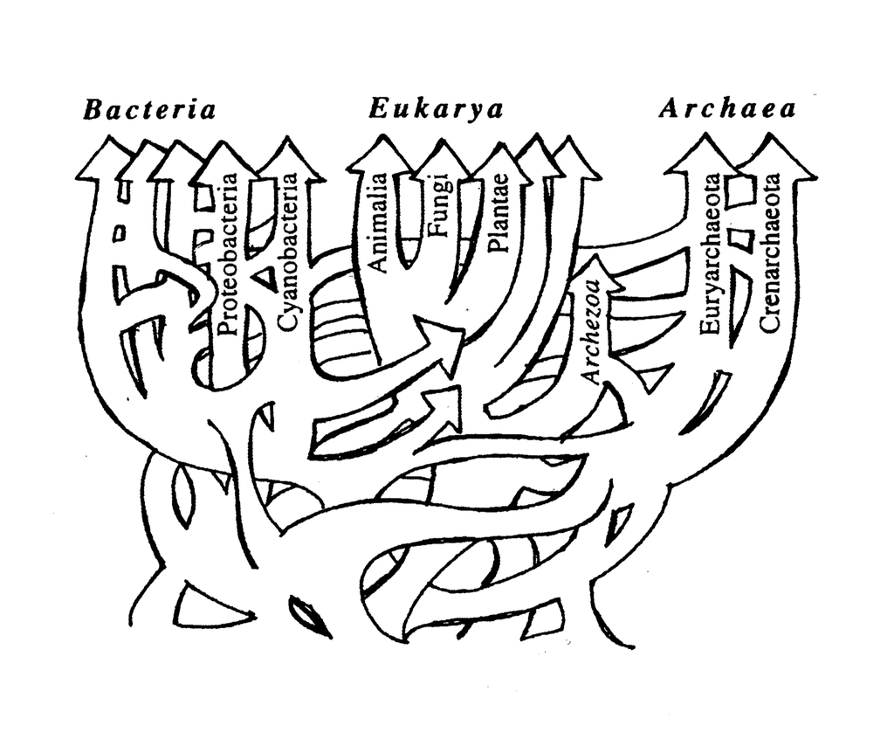
Phylogenetic Species Concept (PSC)
Disadvantages:
4) Horizontal transfer (i.e., hybridization, which has been shown to occur quite often in plants) will result in misclassification.
The Tangled Tree: A Radical New History of Life
by David Quammen

Slide 19
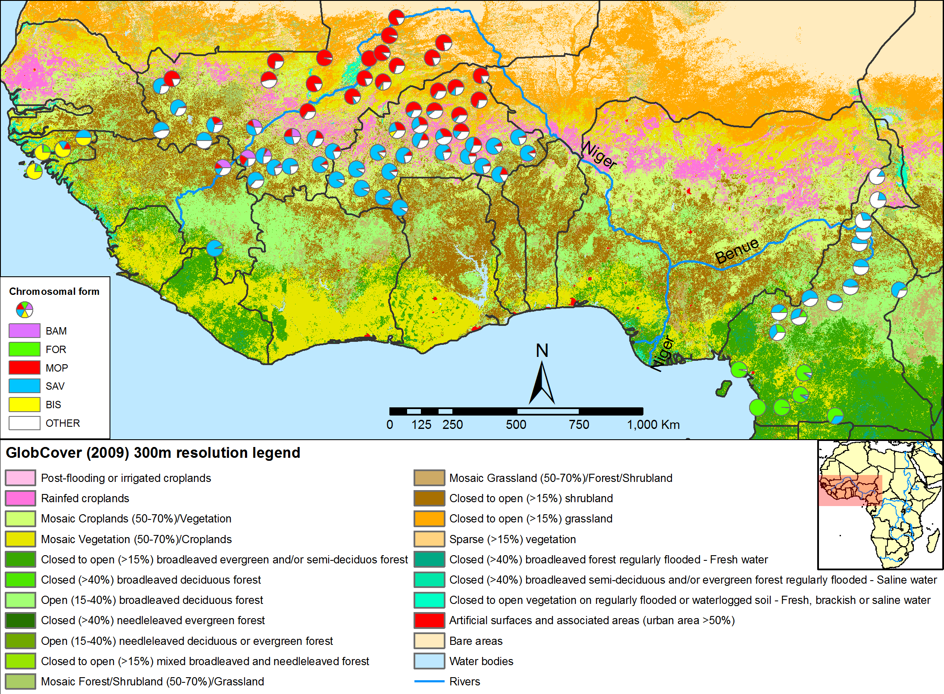
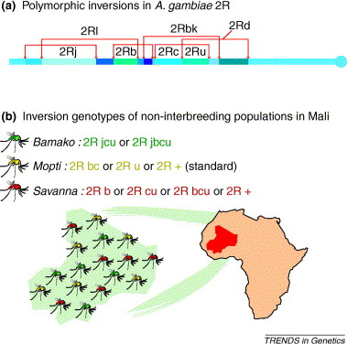
Newly arisen species can be cryptic
Anopheles gambiae mosquito vectors of malaria differ in their habitat and feeding preferences, and they also differ genetically (e.g., chromosome inversions), but are morphologically very similar.
A classic example of incipient speciation leads to cryptic speciation.

Slide 20
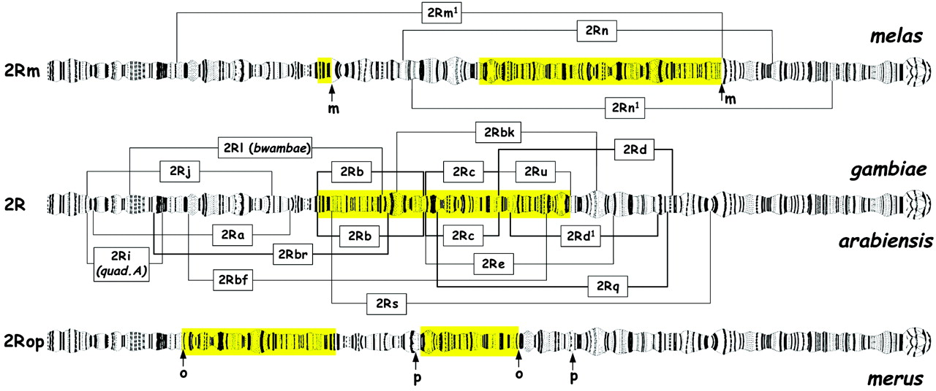

Figure 1 The main fixed and polymorphic 2R paracentric inversions in the sibling species of the A. gambiae complex.
*Jumping ahead to post-zygotic barriers → Chromosomal inversions create reproductive incompatibilities for individuals heterozygous for the inversion (e.g., 50% reduction in gamete viability).
Mario Coluzzi et al. Science 2002;298:1415-1418
©2002 by American Association for the Advancement of Science
Notes:
The main fixed and polymorphic 2R paracentric inversions in the sibling species of the A. gambiae complex. Fixed rearrangements characterize 2R of A. melas (2Rm, with ↑m indicating the boundaries of the inversion) and A. merus (2Rop, with ↑o and ↑p indicating the boundaries of the overlapping o and p inversions). Brackets indicate polymorphic inversions. In A. gambiae, A. arabiensis, A. bwambae, and A. quadriannulatus(species A from southern Africa) all polymorphic inversions are based on the standard 2R arrangement except for inversions 2Rf and 2Rr in A. arabiensis and 2Rk in A. gambiae. The latter three inversions are based on a preexisting 2Rb inversion and thus are designated 2Rbf, 2Rbr, and 2Rbk. Inversion 2Rc was recorded almost exclusively in combination with 2Rb and 2Ru as 2Rbc or 2Rcu, and 2Re was always found in combination with 2Rb as 2Rbe. Most of the 2R inversions occurred as groups of nonoverlapping, contiguous inversions that resulted in sets of nearly parallel inversion polymorphism (43) in these two species. The A. gambiaeinversion arrangements 2Rbc, 2Rcu, 2Rbcu, 2Rbcd, 2Rjd, 2Rjbcu, and 2Rjcu covered roughly the same regions of 2R as the A. arabiensis arrangements 2Rbc, 2Rbe, 2Rbcd¹, 2Rad¹, and 2Rabe (the superscript 1 in 2Rd¹ identifies an inversion that is morphologically similar but distinct from 2Rd). The 2Rb and 2Rc inversions appear cytologically identical in A. gambiae and A. arabiensis (i.e., with the same telomeric and centromeric breakpoints), so were probably transferred by introgression. Parallel 2R inversion polymorphisms are also found in allopatric populations ofA. melas, where 2Rmm¹ (2Rm¹ in combination with the fixed 2Rm) is observed in Congo and Angola, 2Rmn¹ (2Rn¹ in combination with the fixed 2Rm) is present in Benin and Togo, and 2Rmn (2Rn in combination with the fixed 2Rm) is present in The Gambia, Senegal, the Casamance region of Senegal, and Guinea Bissau. Geographical barriers between theseA. melas populations probably consist of sandy or rocky coastal areas without mangroves. The region spanned by 2Rbcu (yellow) is involved in virtually all nonstandard chromosome 2R rearrangements differentiating the members of the A. gambiaecomplex.

Slide 21
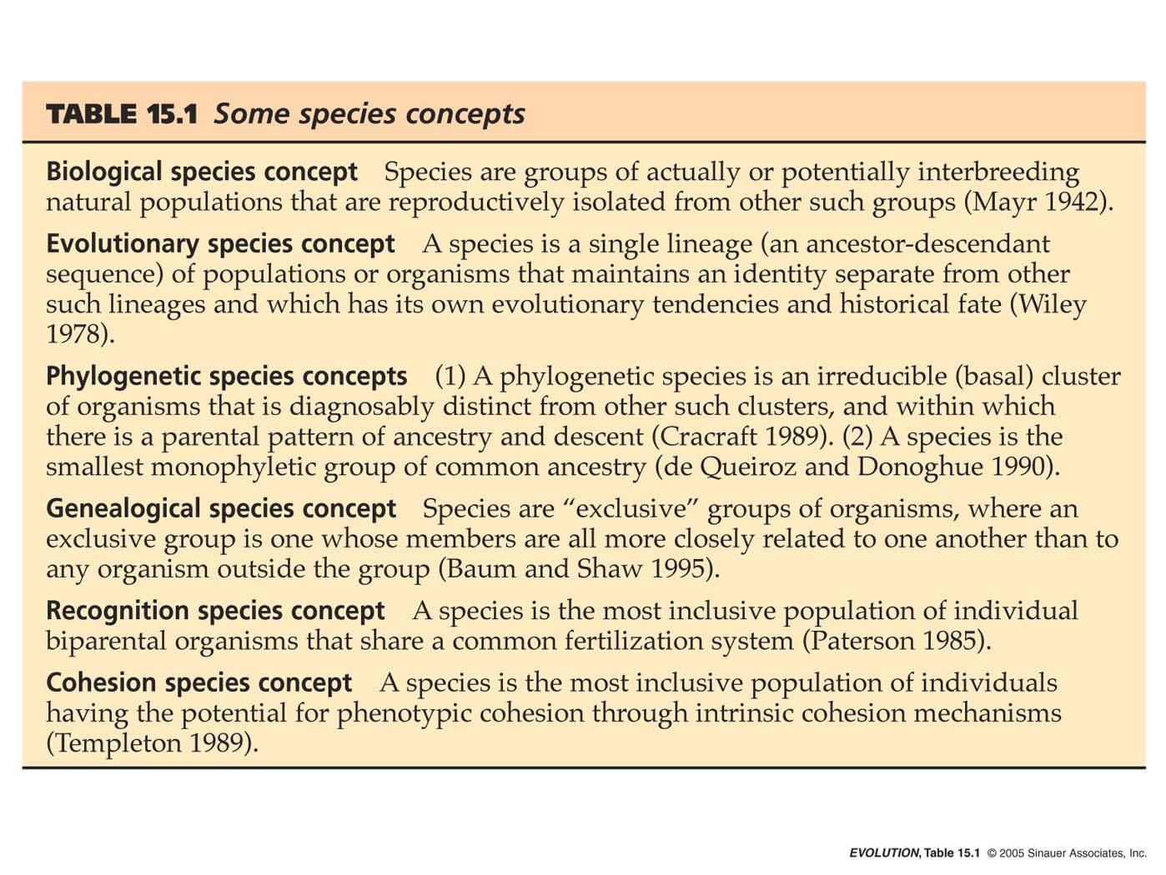

Slide 22
Under the Phylogenetic Species Concept (PSC), species are classified based on pattern.
But under the Biological Species Concept (BSC), speciation is defined by process, the evolution of barriers to gene flow.
What are such isolating barriers and how do we classify them?
Prezygotic
Pre-mating
Post-mating
Postzygotic

Slide 23
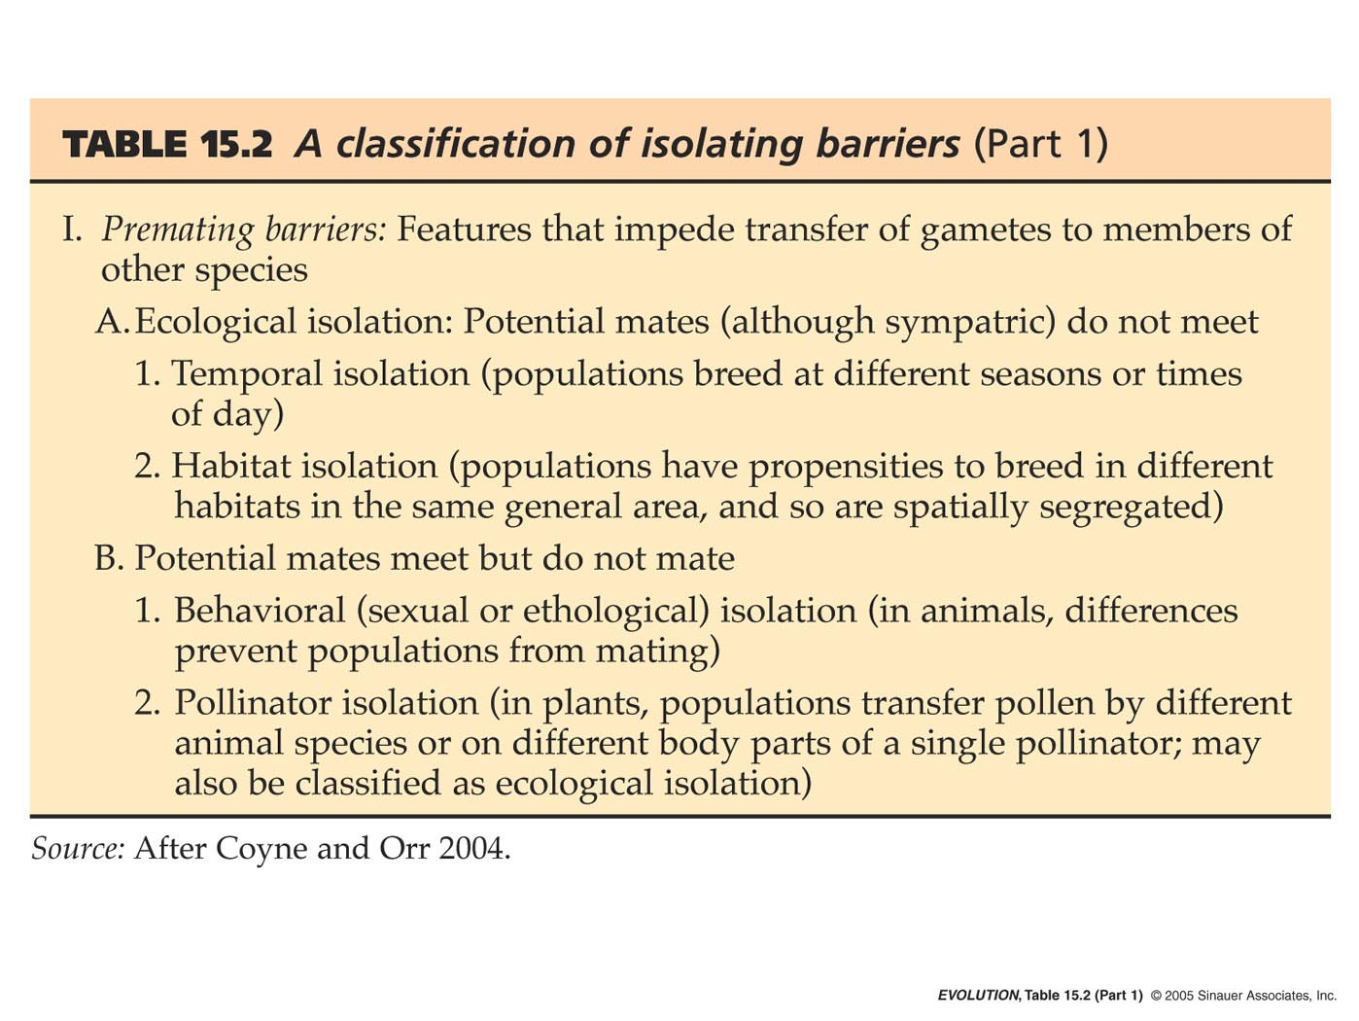
Prezygotic - Pre-mating

Slide 24
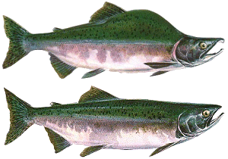
Temporal Isolation in Pink Salmon (Oncorhynchus gorbuscha)
Two year life cycle, spawn in rivers (2 yrs).
Many streams have an even- and odd-year brood that are reproductively isolated.
Alternate year brood lines within a single stream have more genetic divergence than do fish within a region that breed in the same year but in different streams.
A low rate of gene flow results from rare 3 year breeders.

Slide 25
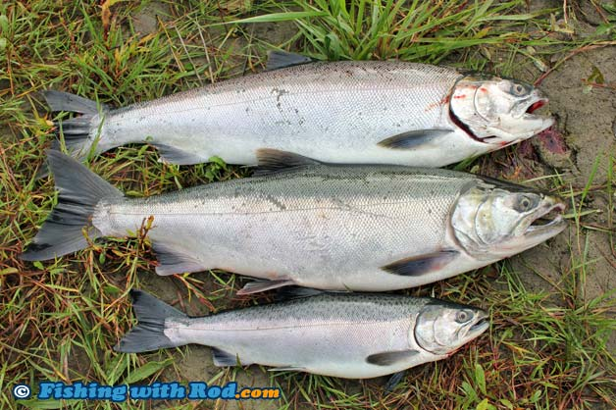
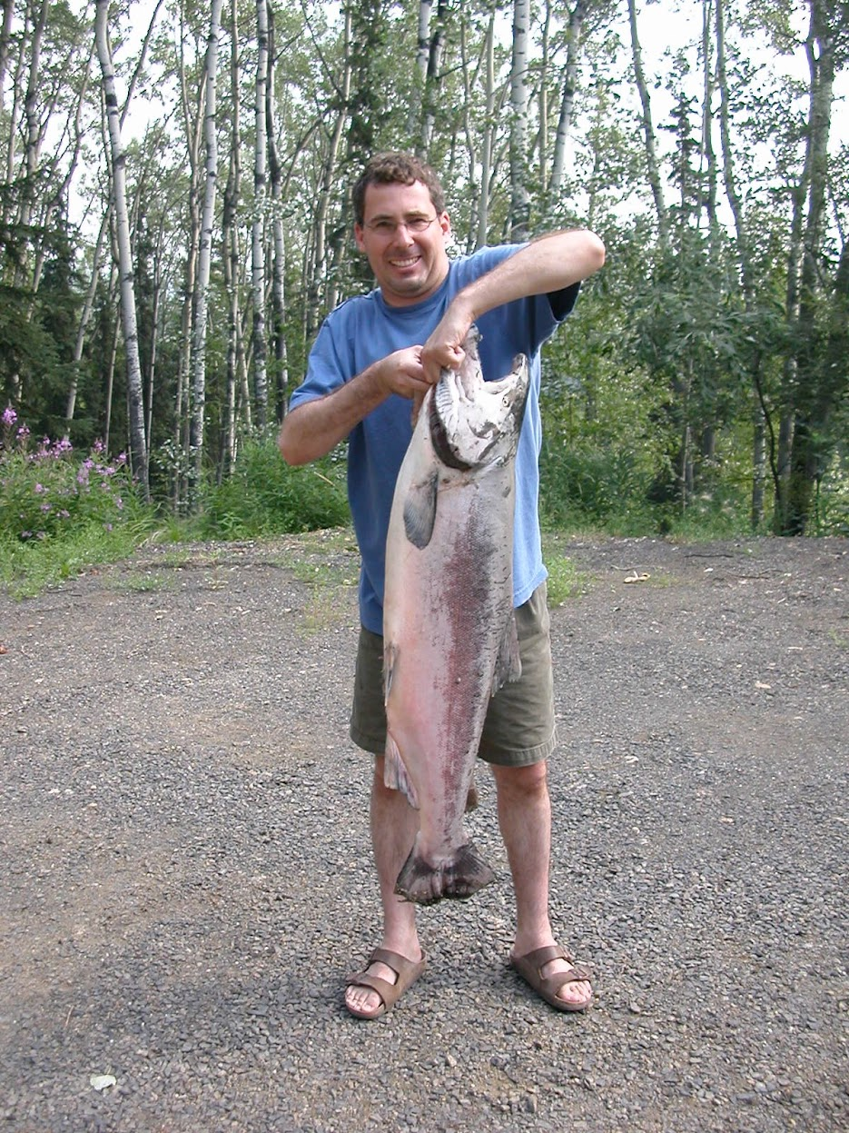
“Jacks” or “Jack salmon” are a term used to describe a male King salmon that returns to spawning grounds one or a few years earlier than the typical age of maturity. Jacks are usually small, typically weighing between one and five pounds, and are distinguished by their relatively small size and early arrival.
https://www.boardwalklodge.com/alaska-king-salmon-fact-sheet/
56 lb full size King

Slide 26
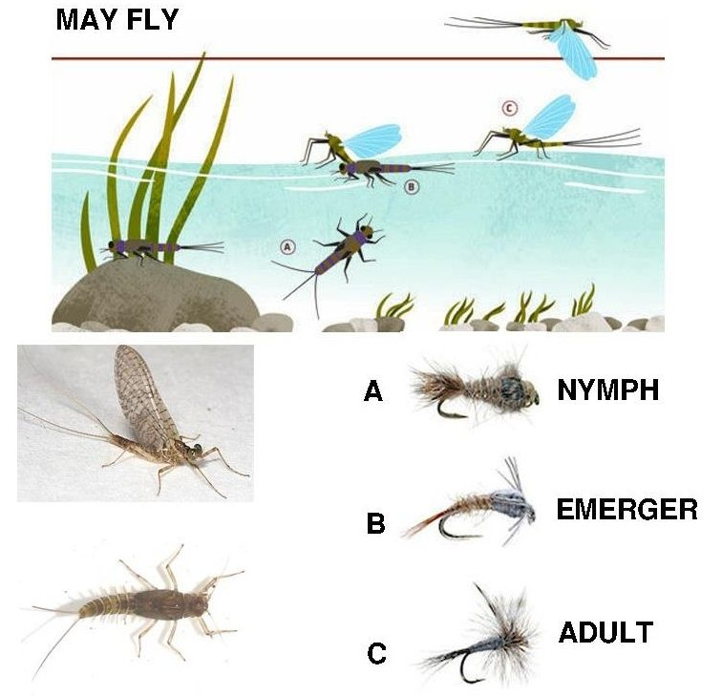
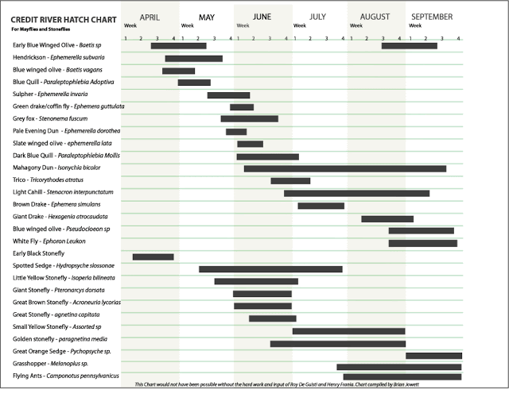
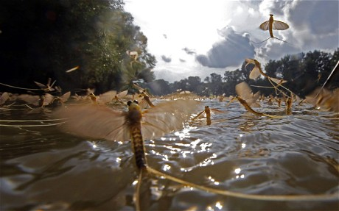
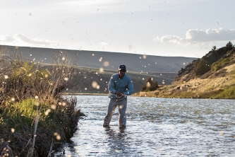
Different species of Mayflies (Ephemeroptera; ~3,000 spp.) hatch at different times on the same river.

Slide 27
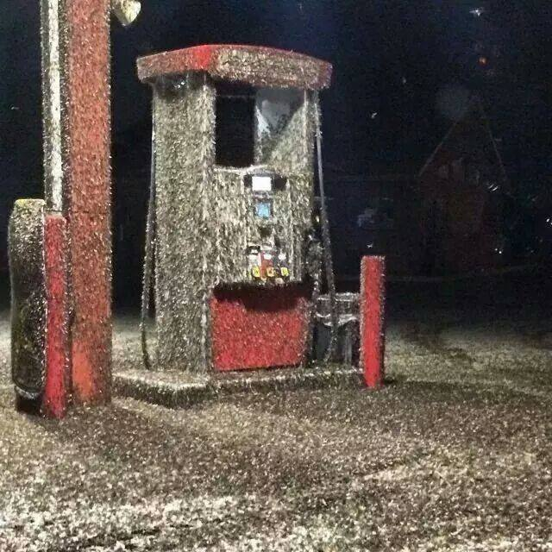
Mayfly Hatch in Wisconsin 2014
https://www.kare11.com/article/news/local/mayfly-hatch-blankets-mississippi-river-communities/89-107058850

Slide 28
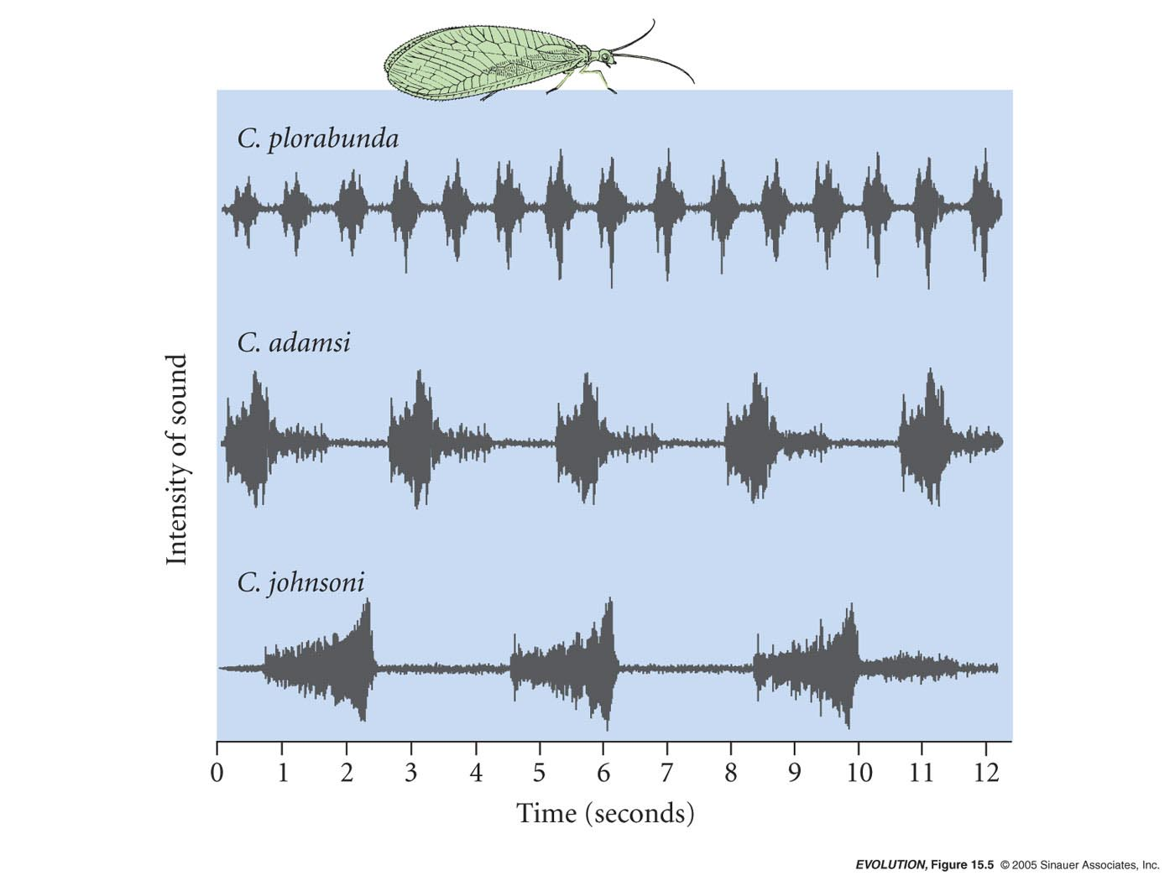
Behavioral premating barrier – different species have different songs
Lacewings mate only after singing a “duet.”
Song recognition is important!

Slide 29
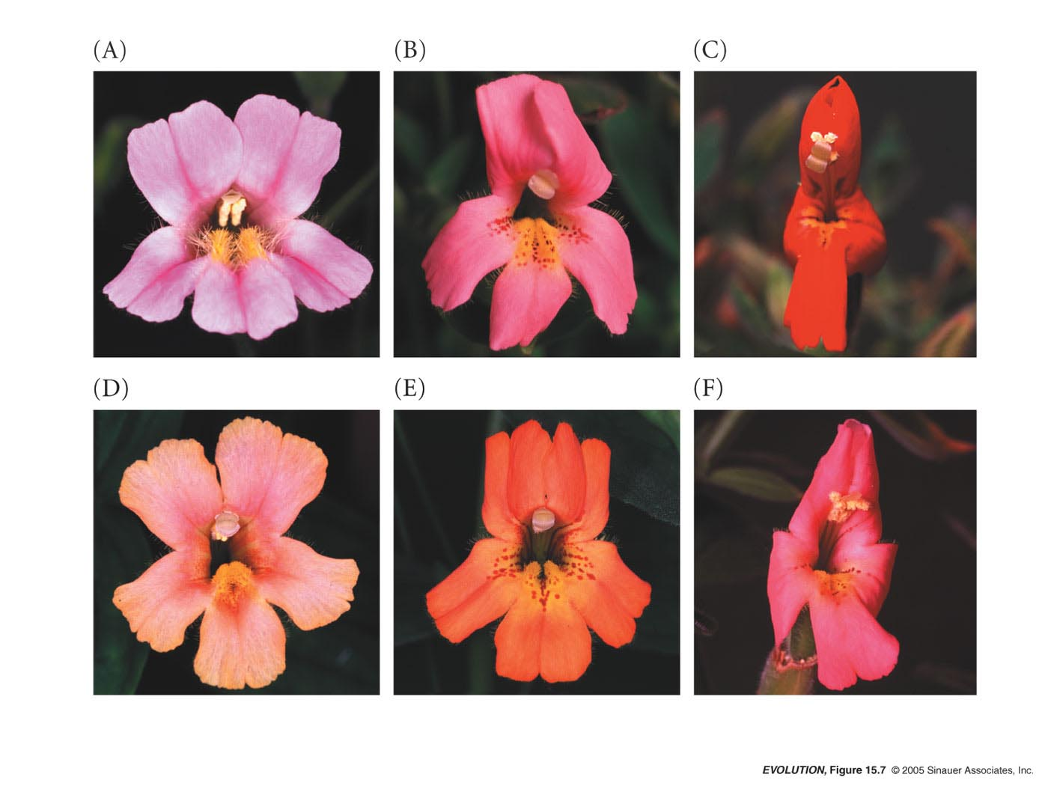
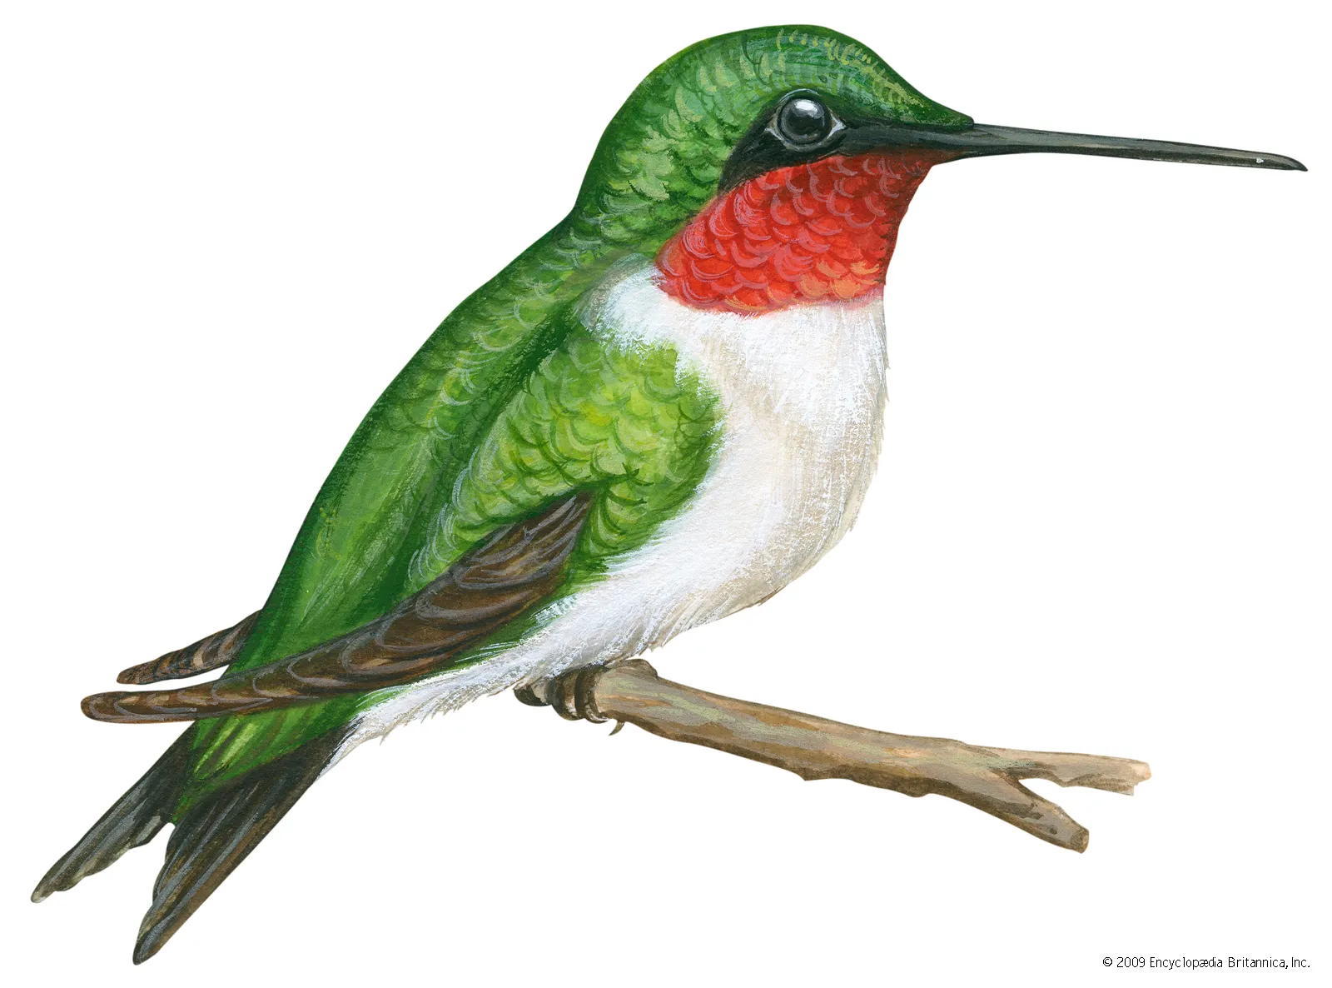
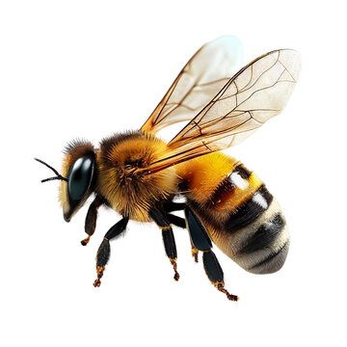
Pollinator isolation in Mimulus lewisii and M. cardinalis
Monkey Flowers
Different flowers attract different pollinators!
Bees vs. birds

Slide 30
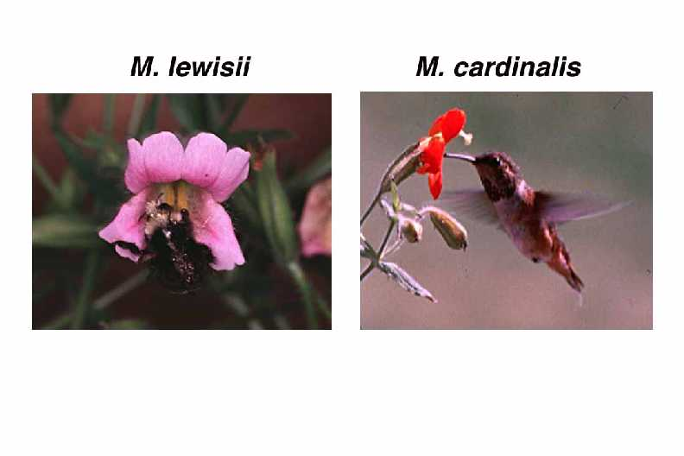
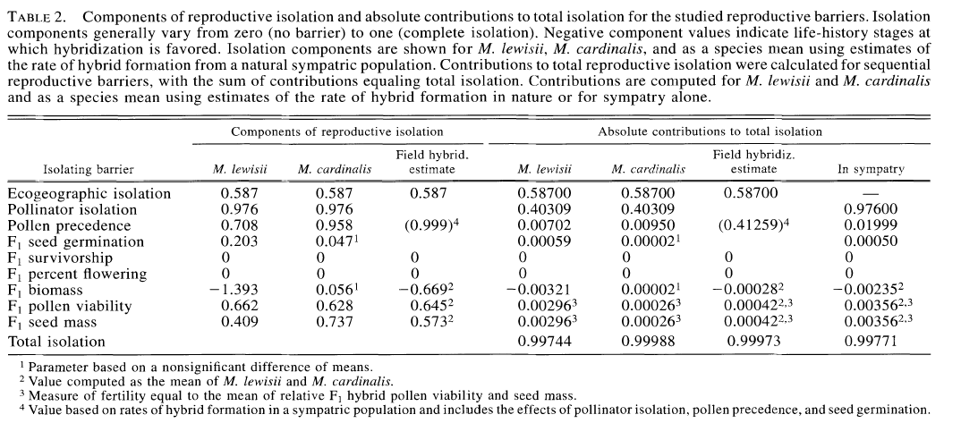
From Ramsey et al. 2003 Evolution 57:1520

Slide 31
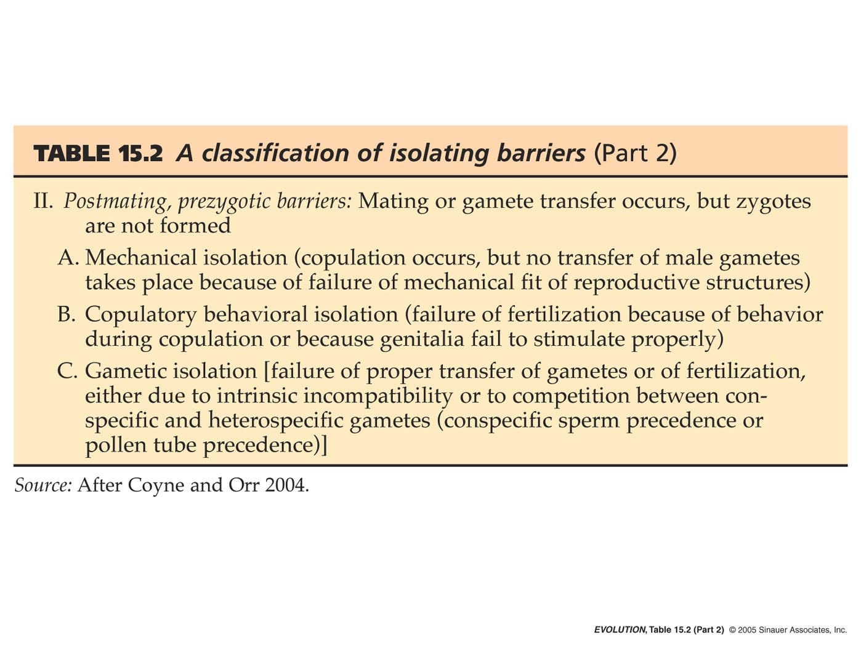
Prezygotic - Post-mating

Slide 32
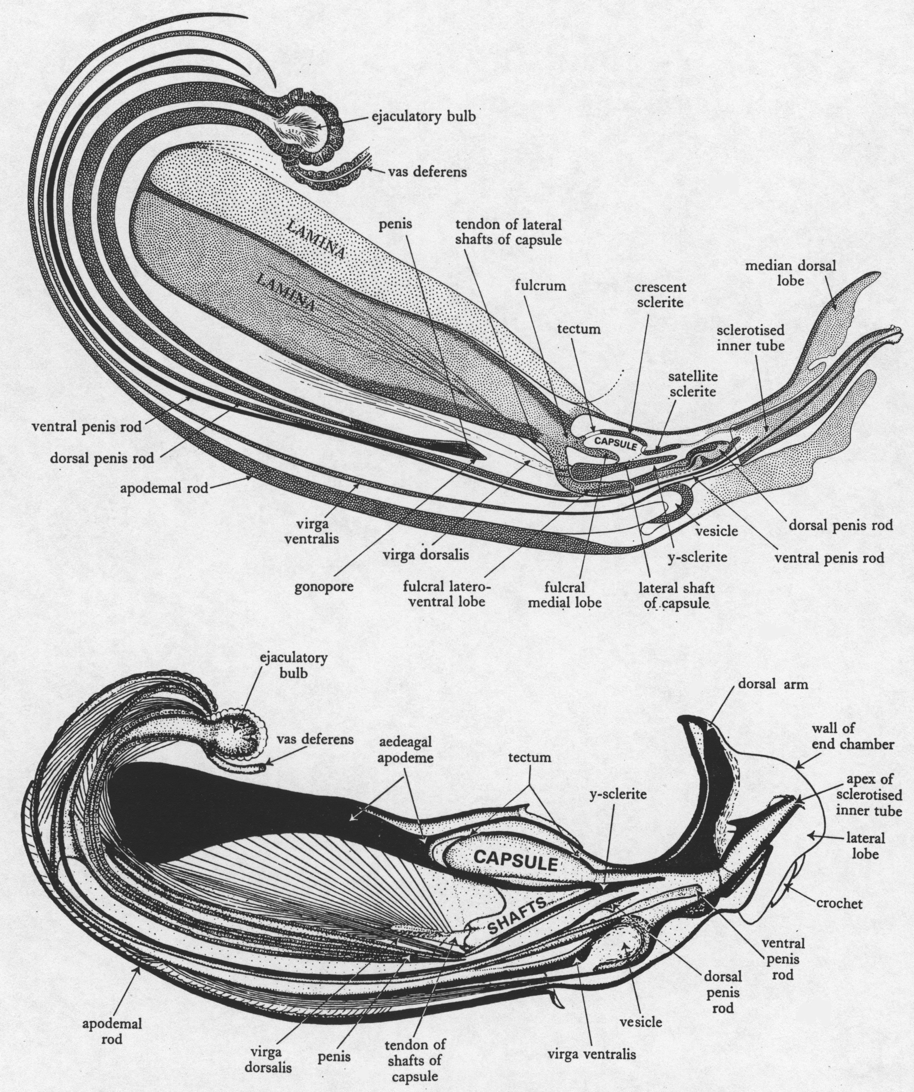
Fleas (Siphonaptera; ~2,500 spp.) have among the most elaborate genitalia in the animal kingdom, and each species differs in key aspects of the morphology
Spilopsyllus cuniculi
Ctenocephalides canis
*Flea penis can be 2.5X the length of the body.
http://fleasoftheworld.byu.edu/

Slide 33
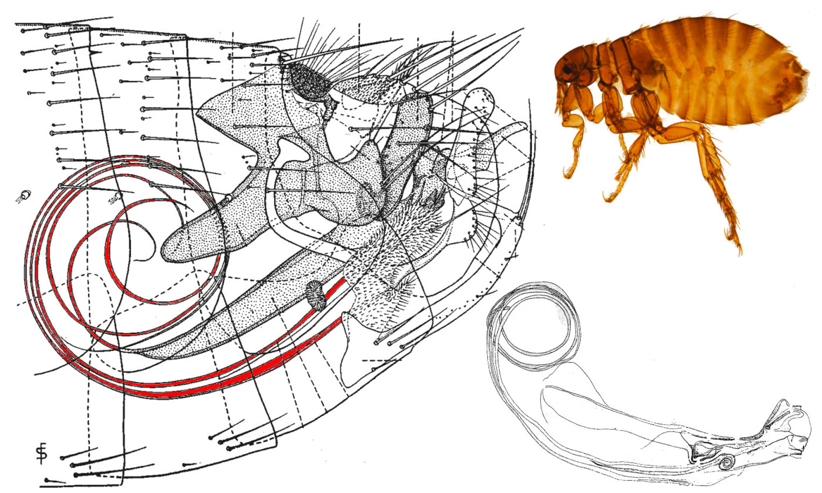
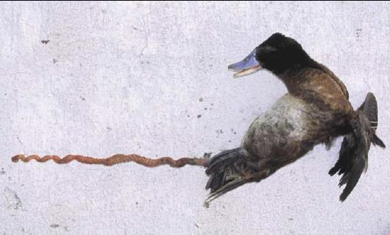
TB Cheetham 1987, Iowa State
KG McCracken et al. 2001, U Alaska
Antagonistic evolution prevents insemination.

Slide 34
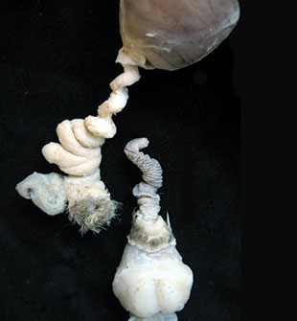
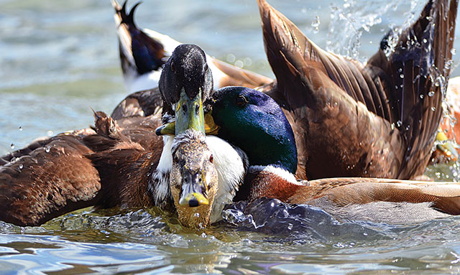
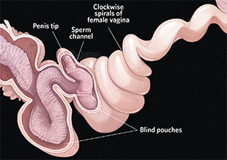
In cases where sexual selection has led to longer intromittent organs, females have evolved countermeasures to control the outcome of copulation.
The Scientist
The Hidden Side of Sex
Sexual selection doesn’t end when females choose a mate. Females and males of many animal species employ an array of tactics to stack the deck in their reproductive favor.
Jul 1, 2014
Patricia L.R. Brennan

Slide 35
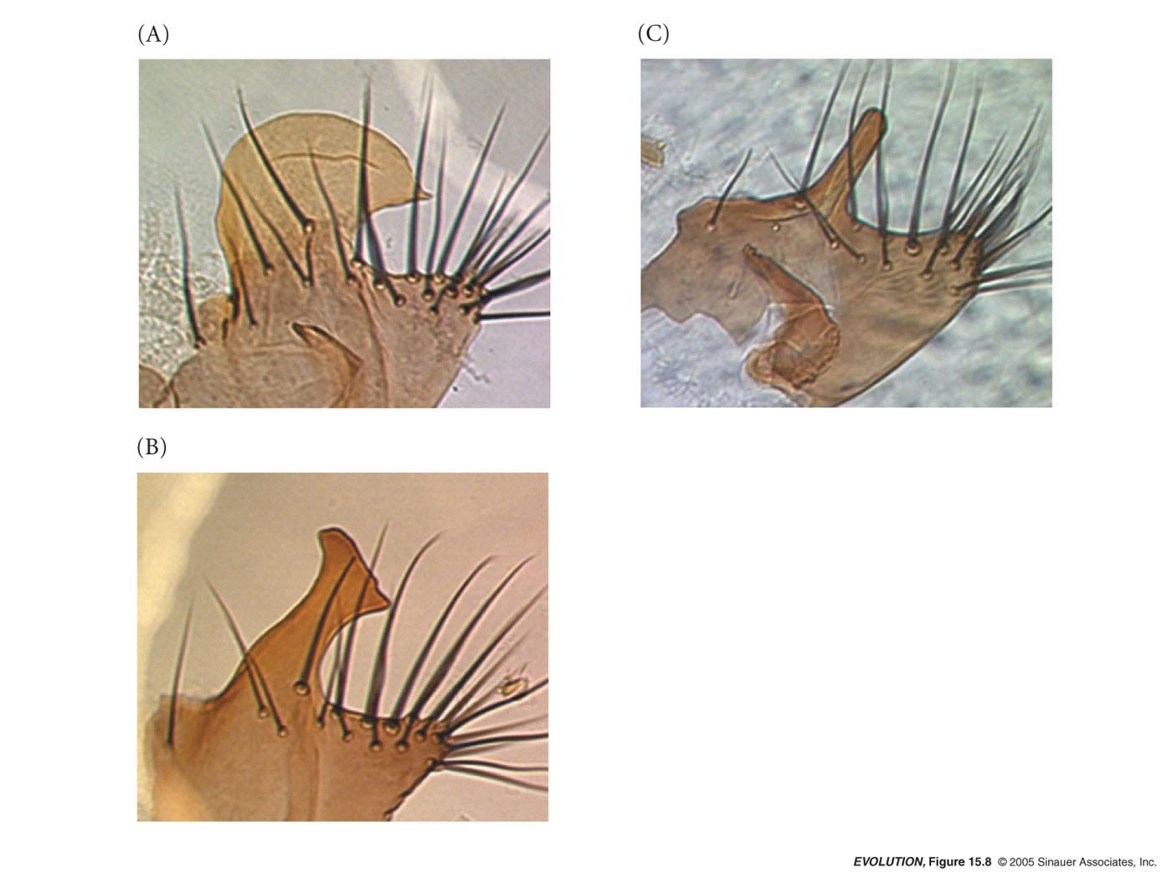
Drosophila posterior lobe of genital arch.
D. simulans,
D. sechellia,
D. mauitiana
In Drosophila, females terminate mating if tactile stimulation is not sufficient

Slide 36
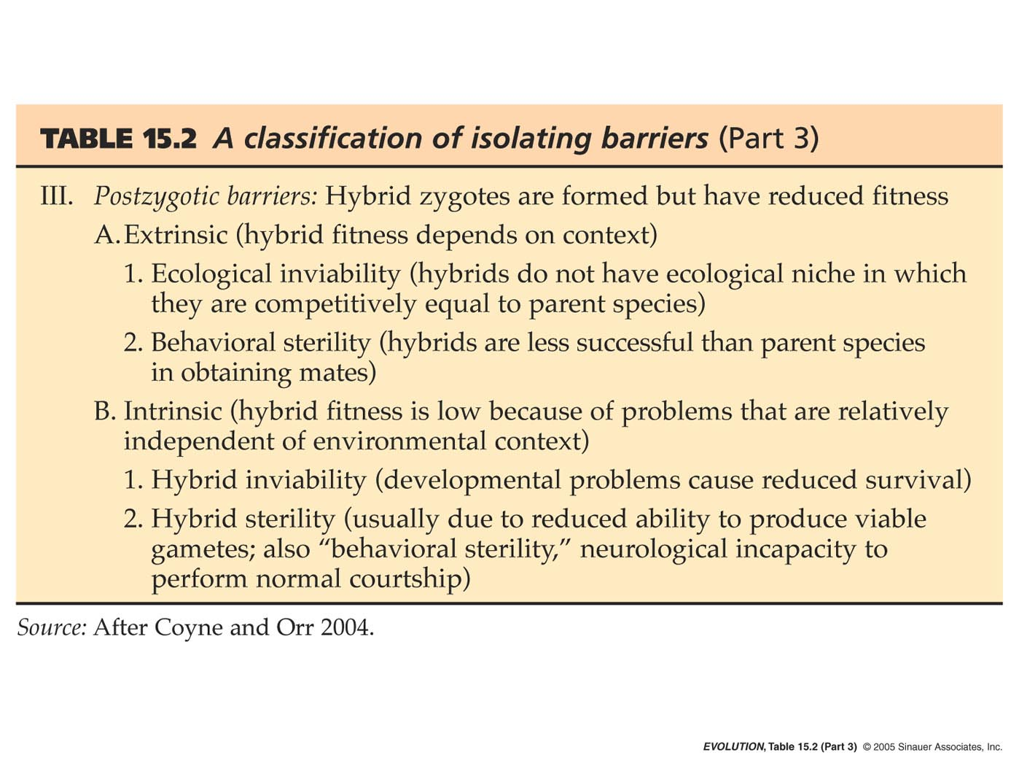
Postzygotic – Extrinsic & Intrinsic

Slide 37
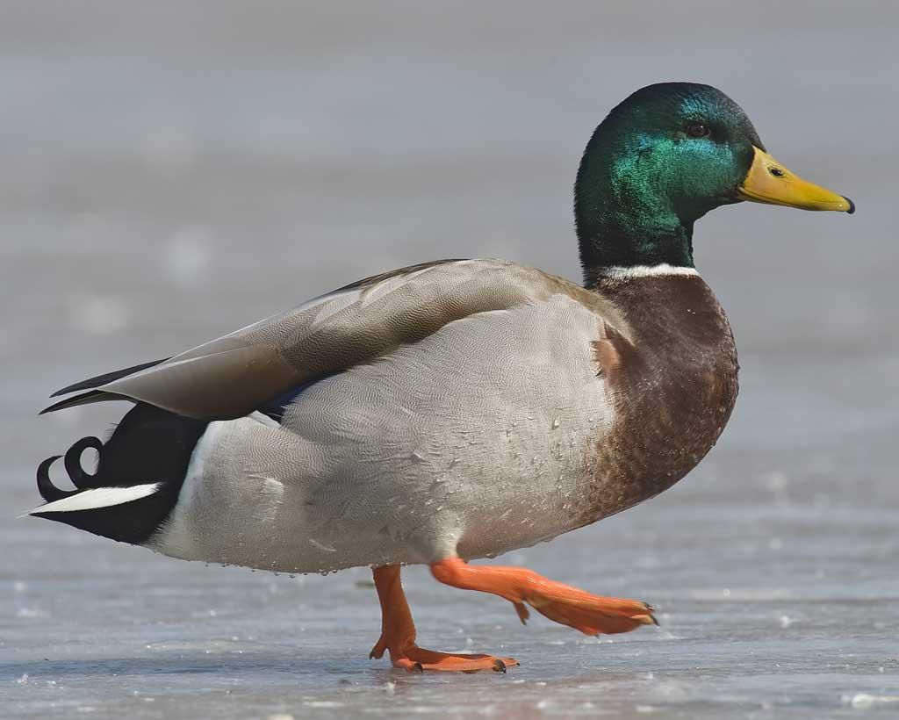
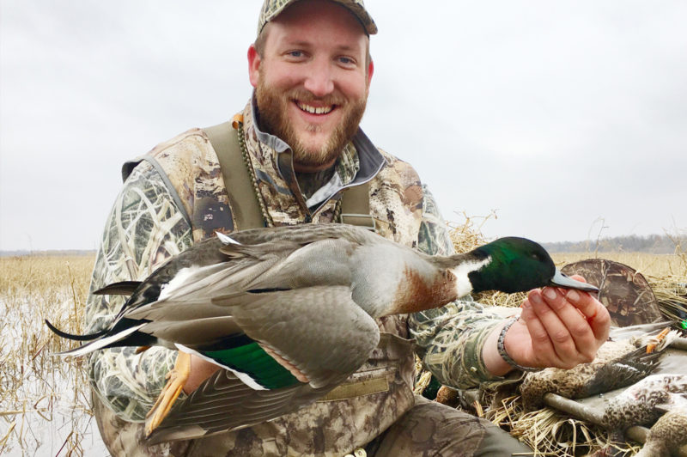
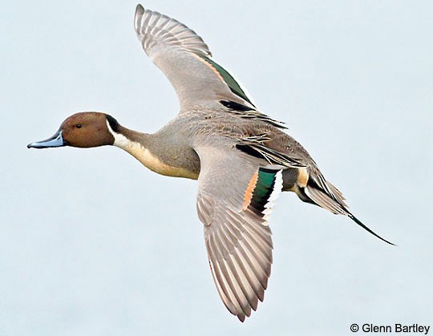
Hybrids may have difficulty backcrossing to either parental population.
X
deltawaterfowl.org

Slide 38
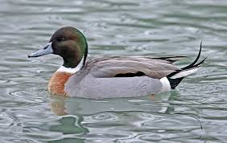
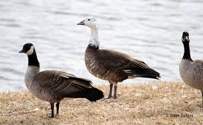
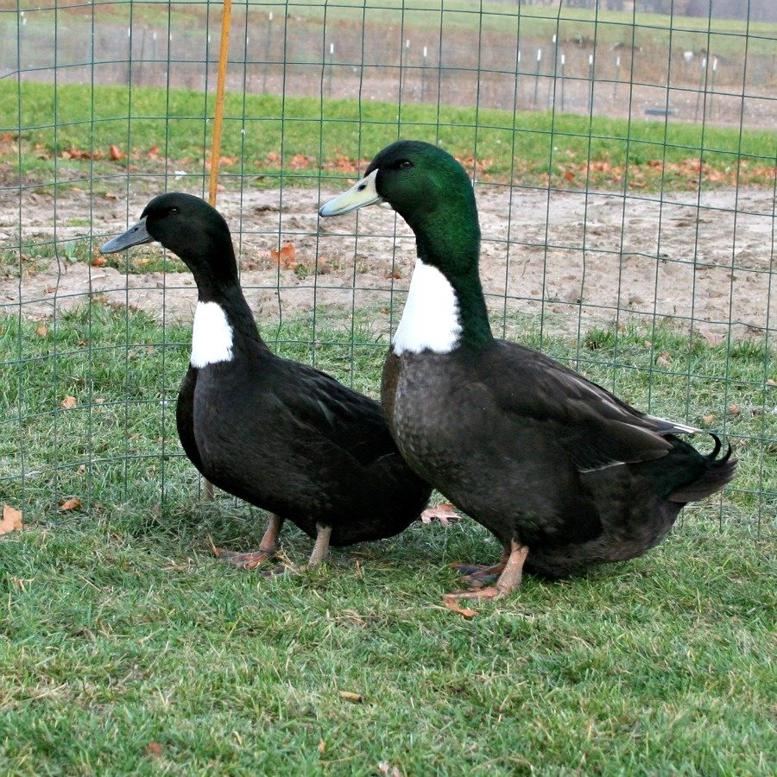
Ducks are an exception, as they hybridize extensively and seem to have little trouble backcrossing.
*although the latter is difficult to verify
Mallard x Pintail
Snow Goose x Canada Goose
Domestic hybrid cross

Slide 39

Why do ducks hybridize extensively?
One likely explanation is the “Desperation Hypothesis”, also known as the Hubbs Principle---first described in fish.
The Hubbs Principle states that when one species is common and one species is rare, the rare species will often seek to mate with the common species.
So abundance of conspecific mates is a factor.
But why for some species and not others?
https://www.youtube.com/watch?v=Vx09K1ovK60

Slide 40



X
Horse 64 chromosomes
Donkey 62 chromosomes
Mule 63 chromosomes & sterile

Slide 41


Zonkey
*Can occur in wild
*# chromosomes differ (62 vs. 32 or 46)
Sterile Males
Females can be Fertile
Liger
(male lion x female tiger)
*same # chromosomes
*Size & appearance differ from
Tigon (female lion x male tiger)
Fertile

Slide 42

Different #s of chromosomes is not usually tolerated in animals (hybrids are often sterile).
However, whole genome duplication can lead to instantaneous speciation and therefor reproductive isolation in plants.
Chromosome
doubling
14 x 2
+
Hybridization
event
28 + 14
http://www.sbs.utexas.edu/levin/bio213/evolution/speciation.html

Slide 43

Whole-Genome Duplication and Plant Macroevolution
Clark & Donoghue
(2018)
The Distribution of Known Whole-Genome Duplication (WGD) Events within the Plant Kingdom.
https://www.cell.com/trends/plant-science/fulltext/S1360-1385(18)30159-6
Key factor in radiation of the Gymosperms & Angiosperms.

Slide 44
The special case of chromosomal inversions

Slide 45


Locations of Inversions Distinguishing Humans and Chimps
Kirkpatrick M (2010) How and Why Chromosome Inversions Evolve. PLoS Biol 8(9): e1000501. doi:10.1371/journal.pbio.1000501
http://www.plosbiology.org/article/info:doi/10.1371/journal.pbio.1000501

Slide 46

Unequal crossing-over w/paracentric inversion:
(inversion does not include the centromere)
Results:
1 normal chromosome
2 deletion chromosomes
(inviable)
1 inversion chromosome
(all genes present; viable)
-------------------------------
50% gametes inviable

Slide 47

Unequal crossing-over w/pericentric inversion:
(inversion includes the centromere)
Results:
1 normal chromosome
2 deletion/duplication chromosomes
(inviable)
1 inversion chromosome
(all genes present; viable)
-------------------------------
50% gametes inviable

Slide 48
Chromosomal inversions suppress recombination in heterozygotes!
A
A
b
b
B
B
a
a
Heterozygote
A
b
B
a
Non-recombinant
Recombinant
A
b
A
b
B
a
a
B
Viable Gametes
All genes present
Inviable Gametes
Genes missing

Slide 49


Chromosomal inversions present a potent (albeit not complete) barrier to interbreeding!
Speciation in Anopheles gambiae — The Distribution of Genetic Polymorphism and Patterns of Reproductive Isolation Among Natural Populations
Gregory C. Lanzaro and Yoosook Lee
https://www.intechopen.com/chapters/44284

Slide 50

http://ib.bioninja.com.au/higher-level/topic-10-genetics-and-evolu/103-gene-pools-and-speciati/isolation-barriers.html

Slide 51
A. Species definitions
  1. Is a Species a cultural construct?
  2. Species definitions
    Morphospecies Concept
    Biological Species Concept
    Phylogenetic Species Concept
    Others
B. Isolating barriers
  Prezygotic
    a. Premating
    b. Postmating
  2. Postzygotic
  a. Extrinsic & intrinsic
  b. Dobzhansky-Muller incompatibilities
C. Models of speciation
  Allopatric
    Evidence
    Mechanisms for evolution of isolating barriers
      Dobzhasky-Muller incompatibilities
      Ecological isolation
      Sexual selection
      Reinforcement selection
  Peripatric
  Sympatric
Part I
Part II

