Slide 1
A. Species definitions
  1. Is a Species a cultural construct?
  2. Species definitions
    Morphospecies Concept
    Biological Species Concept
    Phylogenetic Species Concept
    Others
B. Isolating barriers
  Prezygotic
    a. Premating
    b. Postmating
  2. Postzygotic
  a. Dobzhansky-Muller incompatibilities
C. Models of speciation
  Allopatric
    Evidence
    Mechanisms for evolution of isolating barriers
      Dobzhansky-Muller incompatibilities
      Ecological isolation
      Sexual selection
      Reinforcement selection
  Peripatric
  Sympatric
Speciation - Continued

Slide 2
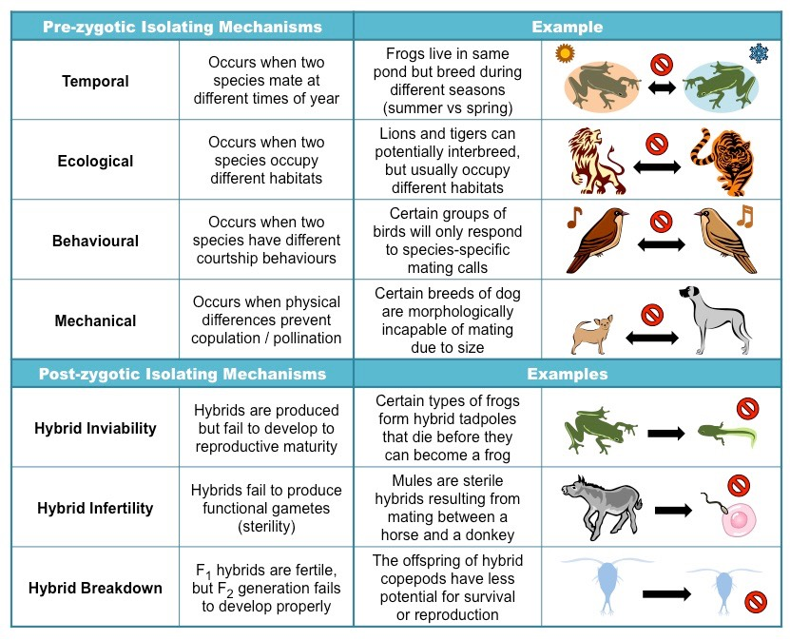
http://ib.bioninja.com.au/higher-level/topic-10-genetics-and-evolu/103-gene-pools-and-speciati/isolation-barriers.html

Slide 3
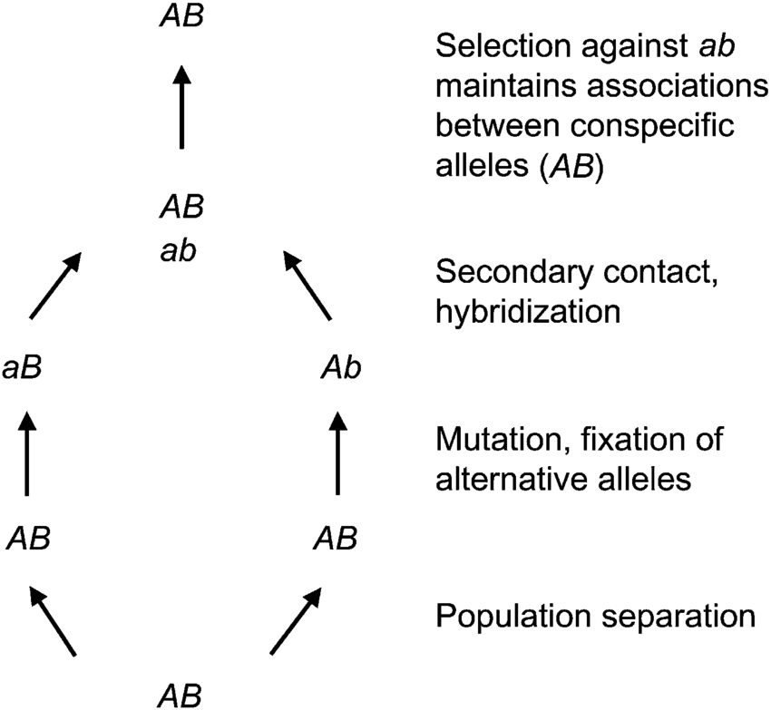
Genetic mechanism for hybrid inviability and hybrid sterility:
Dobzhansky-Muller Incompatibilities
substitutions must occur at >2 loci
derived alleles cause incompatibilities
Incompatibilities are asymmetric
https://www.researchgate.net/figure/A-simple-example-of-a-Dobzhansky-Muller-incompatibility-that-involves-two-loci_fig1_7617070

Slide 4
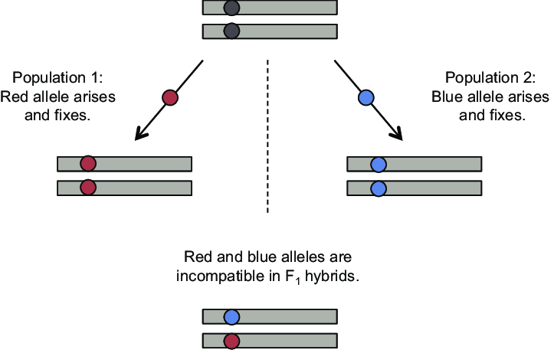
Dobzhansky-Muller Incompatibilities Eventually Accumulate at Many Loci
https://www.researchgate.net/figure/The-Dobzhansky-Muller-model-for-a-single-locus-hybrid-incompatibility_fig1_233909653

Slide 5
How do species arise under Biological Species Concept?
Allopatric model - population ranges do not overlap during speciation
Parapatric model – population ranges are adjacent during speciation
Sympatric model – population ranges overlap during speciation

Slide 6
Allopatric Speciation
Classical View
1) Speciation is a slow & rare event
2) 3 stage process
a) genetic isolation
b) divergence in traits
c) reproductive isolation
Modern View
Speciation can sometimes be very rapid, occurring over very few generations

Slide 7
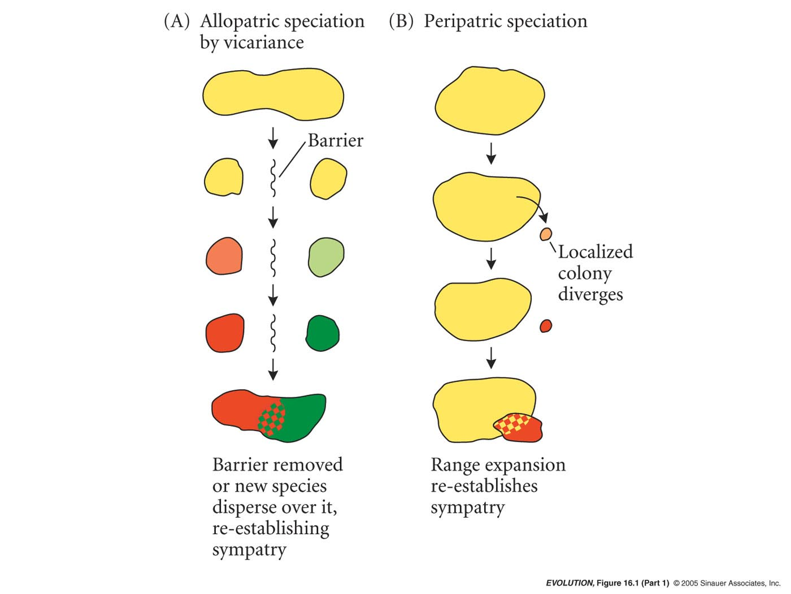
Allopatric Speciation
Vicariance model
Population occurs throughout an area
Area divided by physical barrier to gene flow
Intrinsic barriers to gene flow evolve (D-M incompatibilities)
In future, if populations hybridize there is at least partial isolation

Slide 8
Allopatric Speciation
Peripatric model
(special case of allopatric model)
Population occurs throughout an area
A population arises through founder effect on the perimeter of the existing range
Intrinsic barriers to gene flow evolve; these may be D-M effects or “transilient effects” involving genome rearrangement due to small population size (highly controversial)
In future if populations hybridize there is partial isolation

Slide 9
Allopatric speciation
Geographic separation is a prerequisite for divergence.
Isolating mechanisms are a byproduct of gentic drift and divergence.
Adaptation is coupled to divergence, but not the cause for speciation per se at the outset (see the contrasting example of sympatric speciation).
Geographic isolation sparks the speciation process.

Slide 10
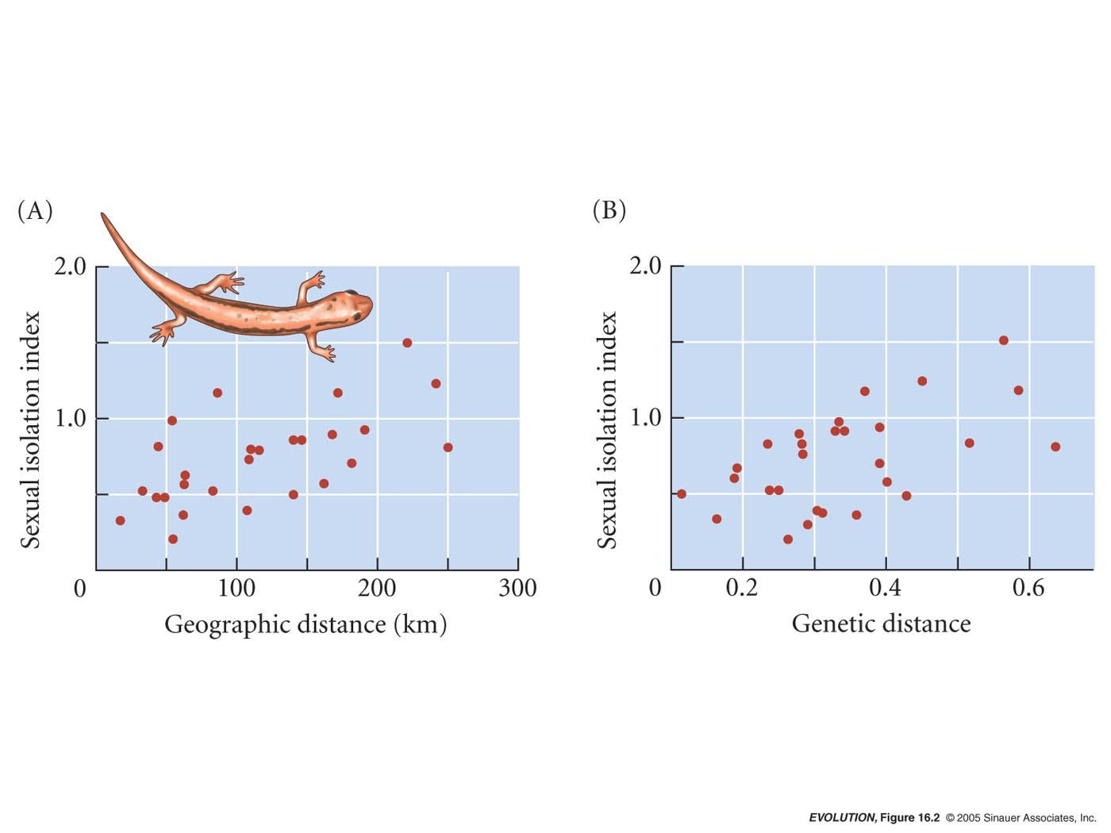
Evidence for allopatric speciation
1) Many species show increased incipient reproductive isolation as populations become more geographically separated.
Dusky Salamander (Desmognathus)

Slide 11

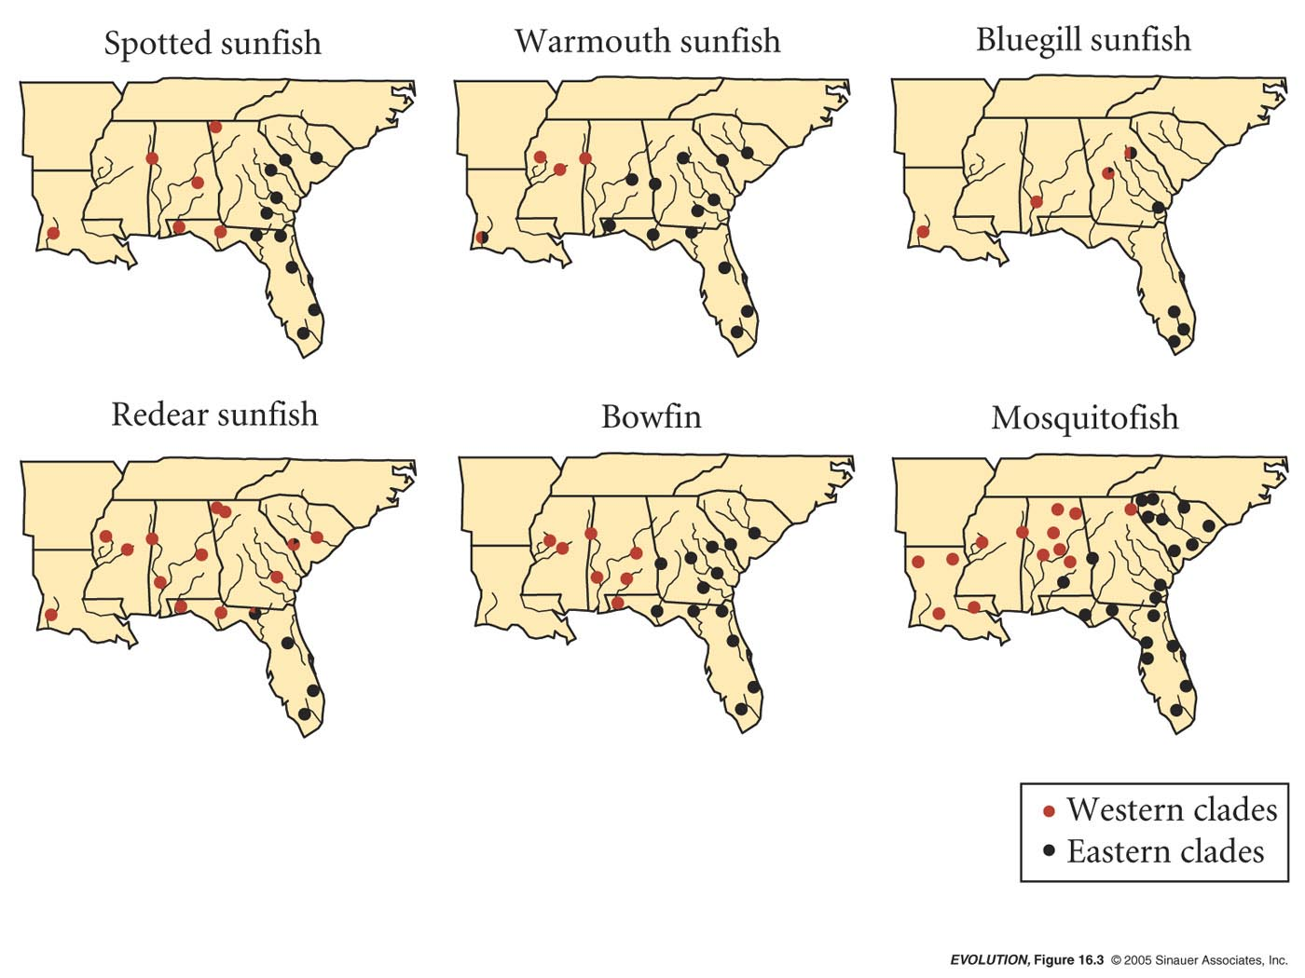
Evidence for allopatric speciation
2) Speciation can be related to the geological history of barriers. Contact zones for several species may be in the same geographic area.
Implies similar barriers to gene flow in the past
Isolation estimated at 3-4 Mya when sea level was higher than at present
Work by John Avise

Slide 12
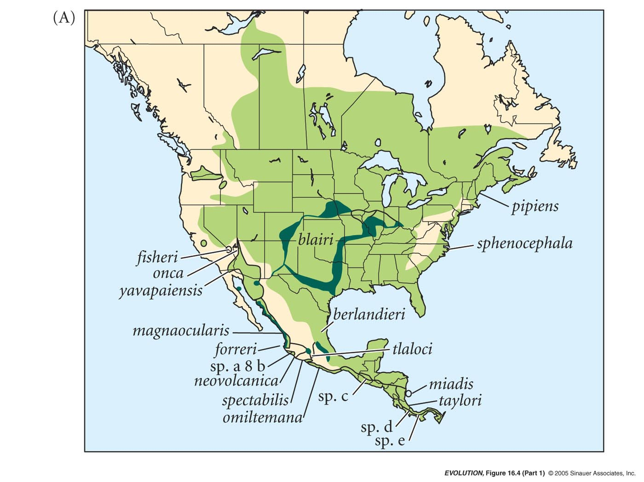
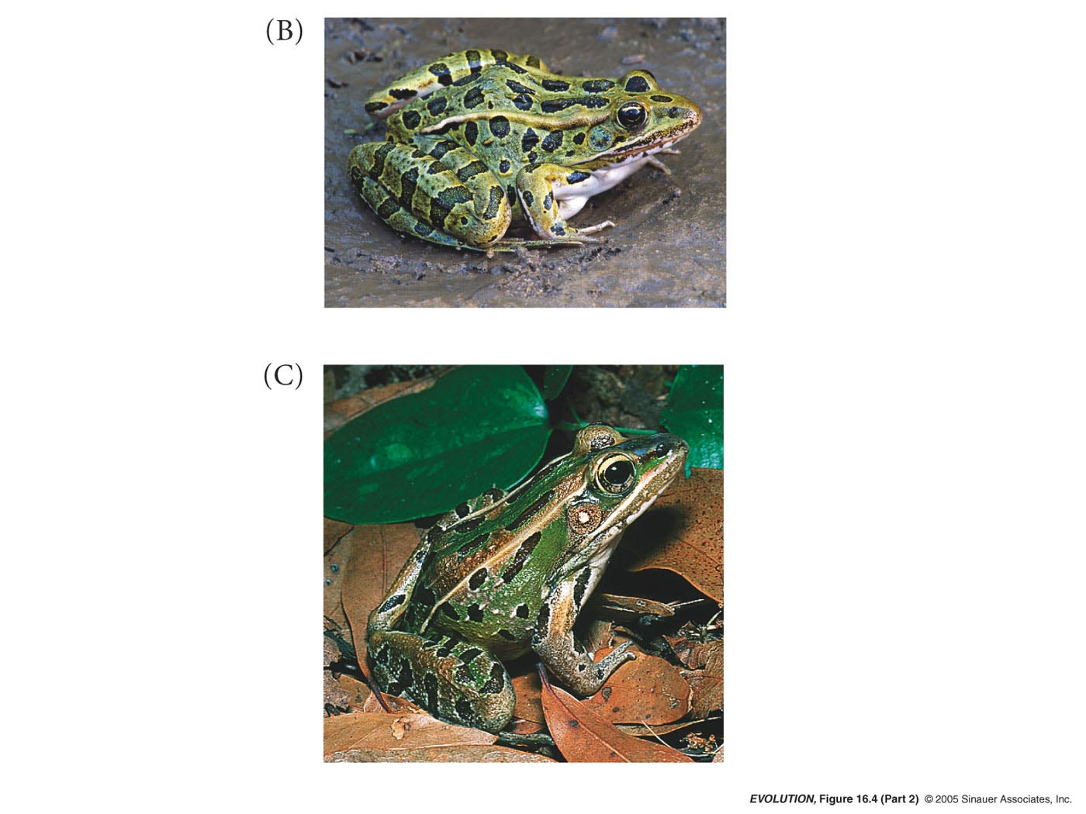
Evidence for allopatric speciation
3) In many cases, related species replace each other geographically (Genus Rana ranges do not overlap or overlap only slightly)

Slide 13
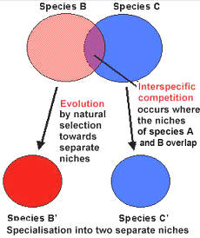
Why?
Two species that are complete competitors cannot coexist because they cannot occupy the same niche.
Gause’s Law
Competitive Exclusion Principle
https://www.saburchill.com/IBbiology/chapters02/035.html

Slide 14
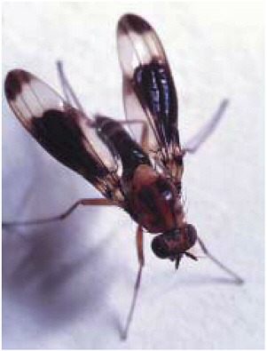
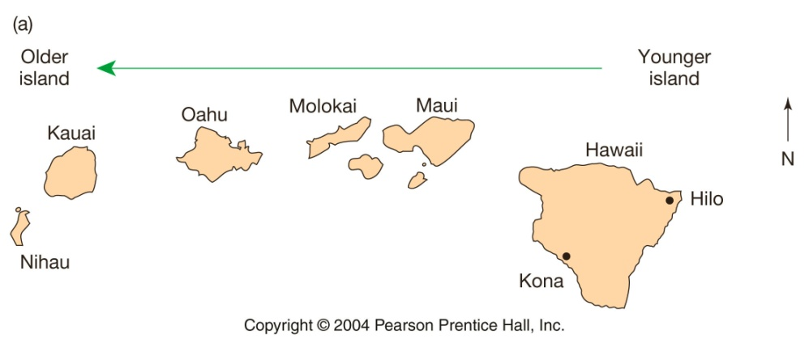
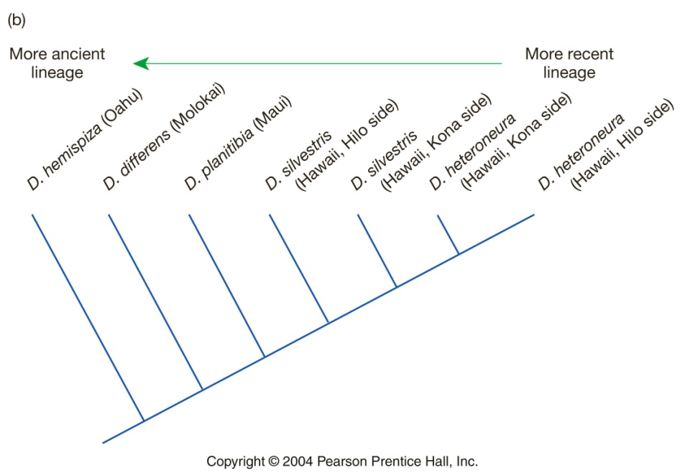
Evidence for allopatric speciation
4) Peripatric evolution in Hawaiian Drosophila
In most cases, nearest relatives reside on different islands
2) Almost all species are endemic to a single island
3) These observations suggest that every colonization event leads to either i) extinction of a colonist or ii) a speciation event
4) Relationship between phylogeny and island age is consistent with peripatric, stepping-stone model

Slide 15
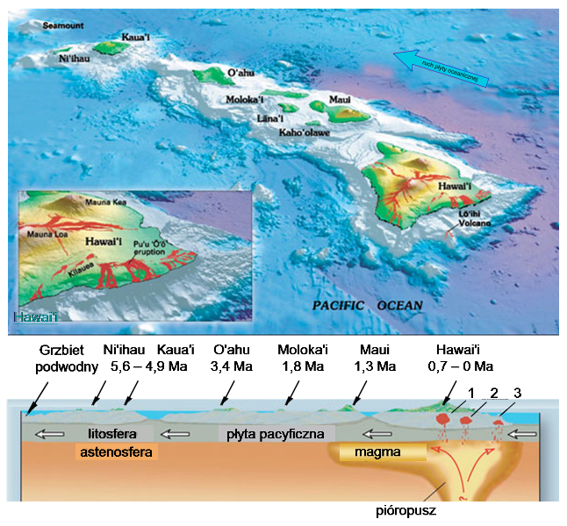
https://commons.wikimedia.org/wiki/File:Hawaii_hotspot_pl.svg

Slide 16
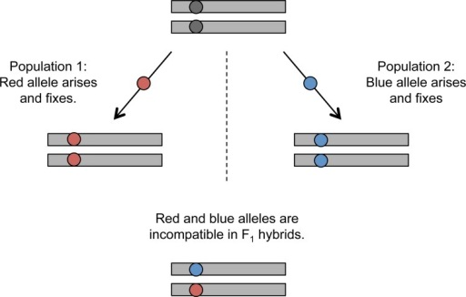
Mechanisms for the evolution of isolating barriers in allopatry
1) Dobzhansky-Muller incompatibilities may arise through drift
https://openi.nlm.nih.gov/detailedresult.php?img=PMC3515857_biolrep-04-23-g001&req=4

Slide 17
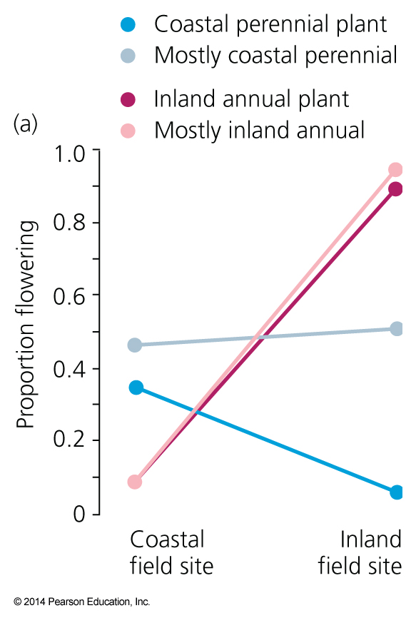
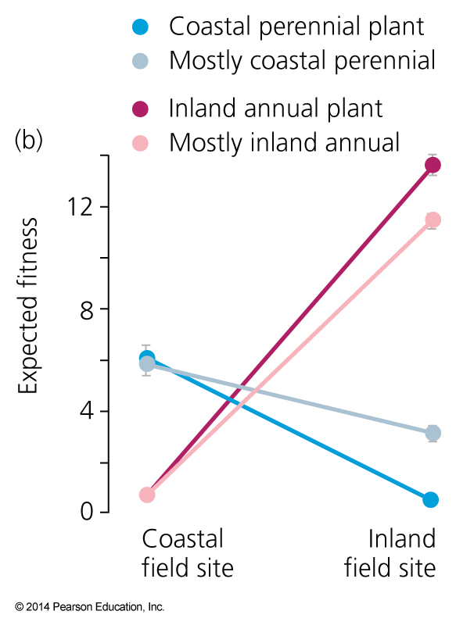
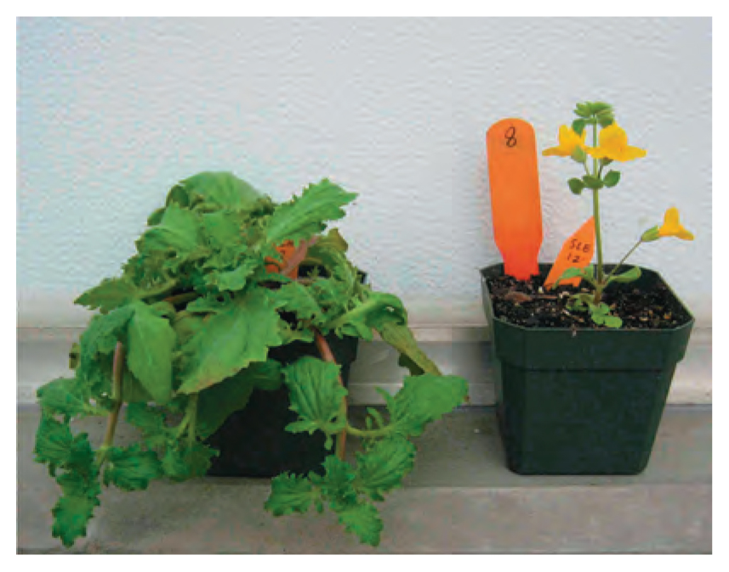
Mechanisms for the evolution of isolating barriers in allopatry
2) Reproductive isolation may arise as a byproduct of ecological adaptation
Coastal and interior Mimulus guttatus
SI = sexual isolation

Slide 18
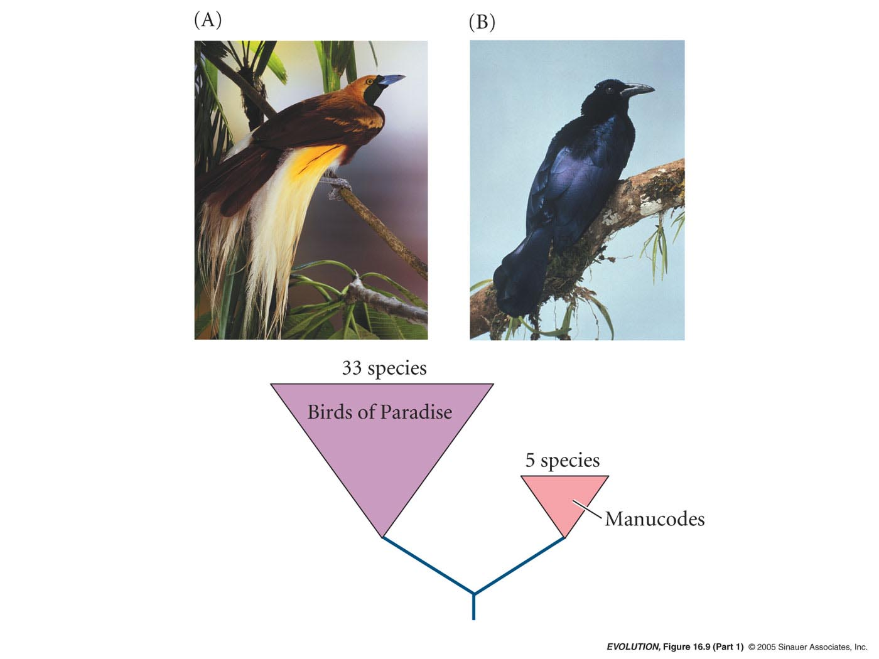
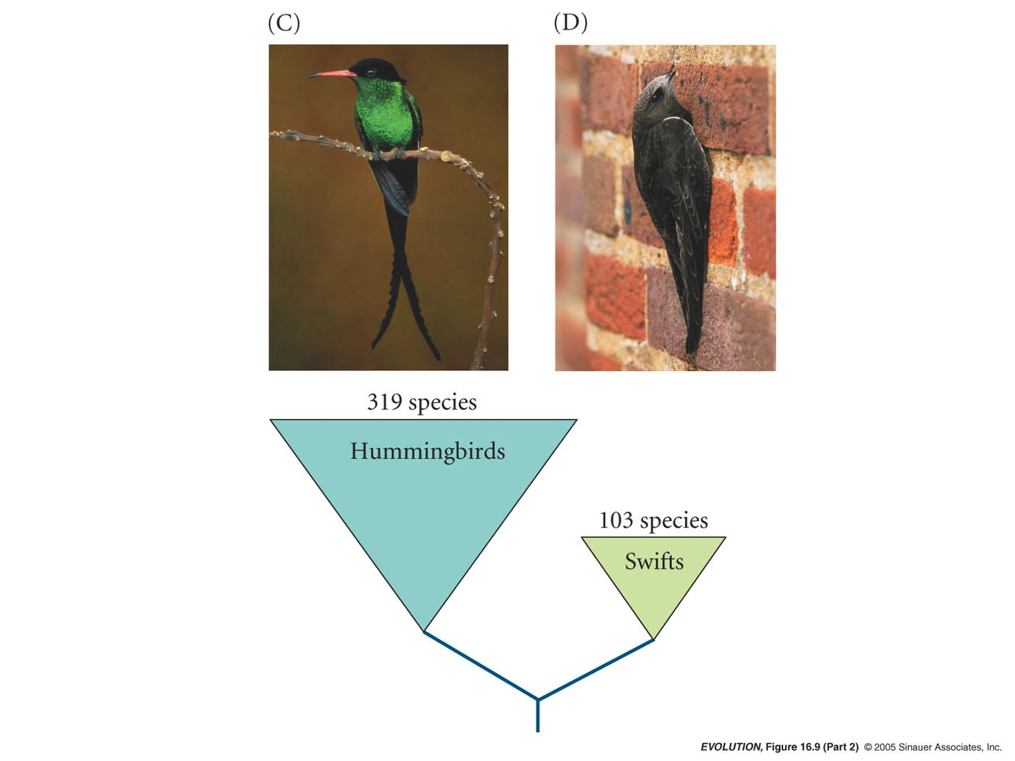
Mechanisms for the evolution of isolating barriers in allopatry
3) Sexual selection may influence speciation via the evolution of mate recognition or preferences. Comparing sister groups of promiscuous and non-promiscuous species suggests sexual selection has increased species diversity.
Promiscuous
Non -promiscuous
Promiscuous
Non -promiscuous

Slide 19
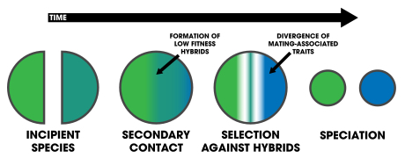
Mechanisms for the evolution of isolating barriers in allopatry
4) Reinforcement selection – adaptation to prevent the production of unfit hybrids
After closely related species evolve some (but not complete) postzygotic reproductive isolation, selective pressures should arise to favor the evolution of prezygotic isolating barriers
https://en.wikipedia.org/wiki/Reinforcement_(speciation)

Slide 20
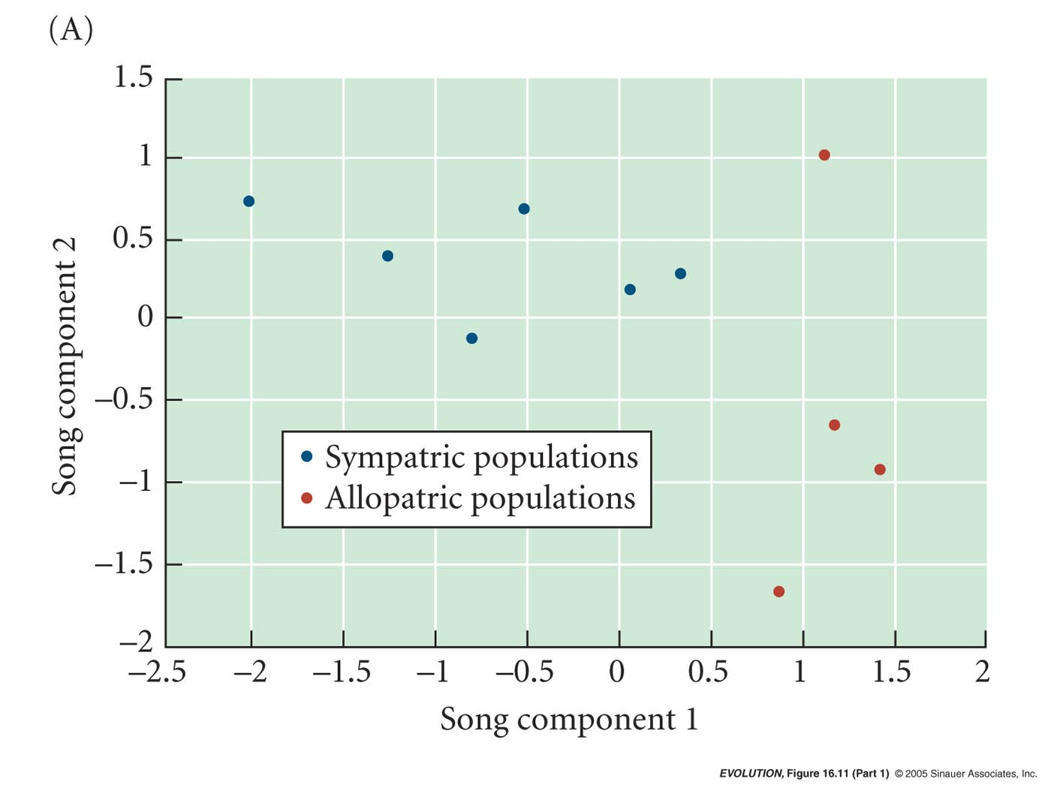
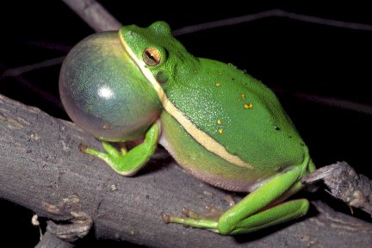
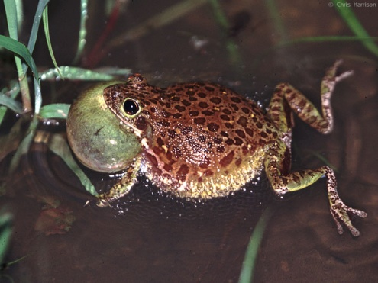
Evidence for reinforcement selection in Green Tree Frogs (Hyla cinerea) & Barking Tree Frogs (H. gratiosa)
Green and barking frogs sometimes hybridize. When in contact, hybrids have low fitness.
-> Have behaviors evolved in sympatry to limit hybridization?
In sympatry, the calls of the two species are more divergent than in allopatry (e.g., song component 1)

Slide 21
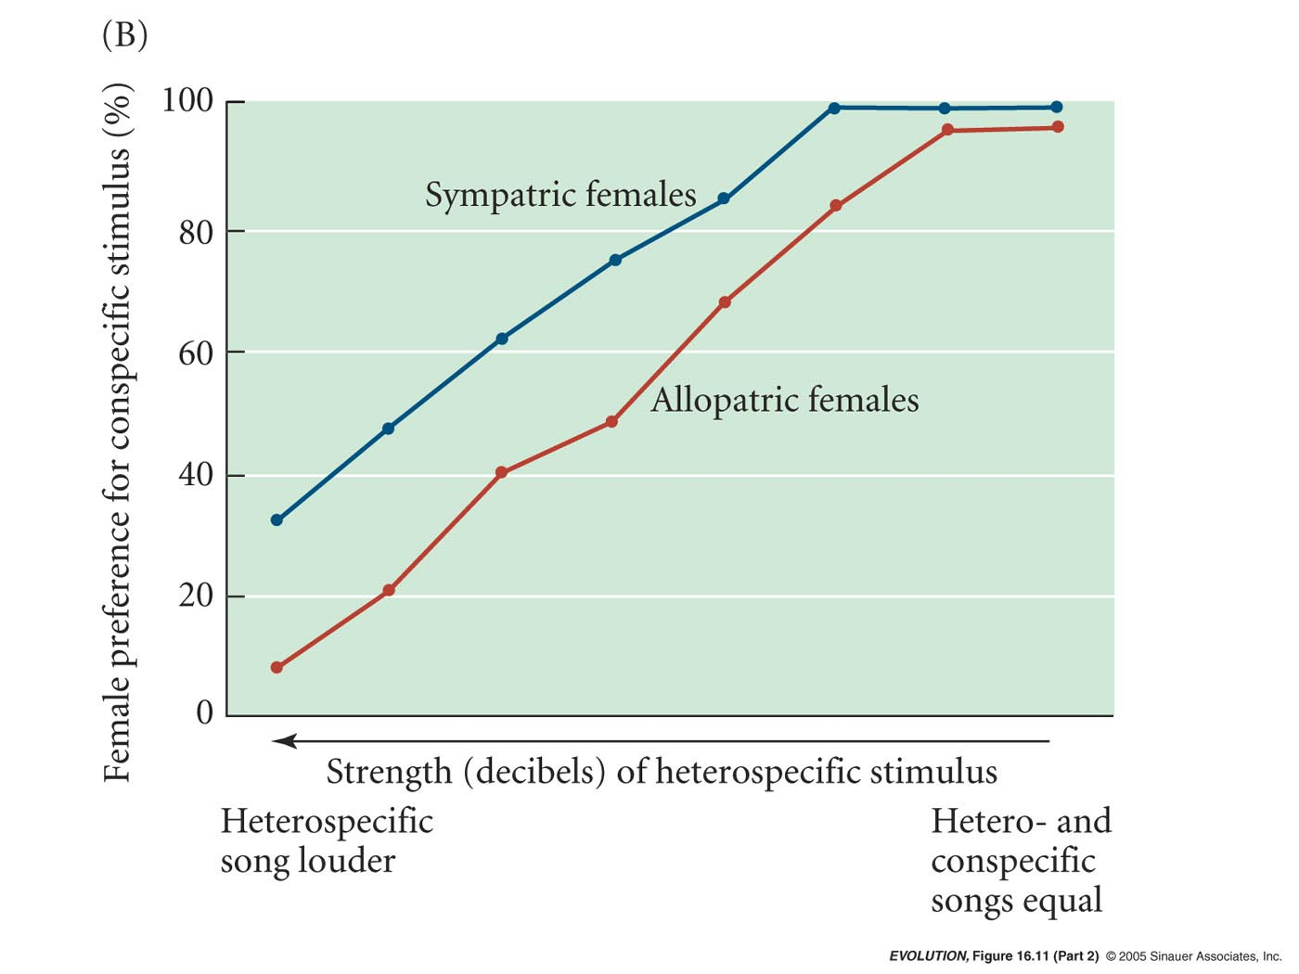
Evidence for reinforcement selection in Green Tree Frogs (Hyla cinerea) & Barking Tree Frogs (H. gratiosa)
Females from sympatric populations prefer conspecific calls more than females from allopatric populations.
Female preferences evolve to reinforce reproductive isolation.

Slide 22
In allopatry, reproductive isolation can arise because the absence of gene flow between populations allows divergence.
Continuum of Gene flow
low
high
Allopatric
(non-overlapping ranges)
Parapatric
(adjacent ranges)
Sympatric
(overlapping ranges)
Can populations evolve reproductive isolation in the face of gene flow?

Slide 23
Parapatric speciation – evolution of reproductive isolation between 2 populations that exchange genes, but not freely.
Yes, but difficult to prove in nature because we often don’t know the historical distributions of populations. For instance, reproductive isolation may have evolved in allopatry and subsequently the ranges shifted and are now adjacent.
Populations that are parapatric now could have been allopatric in the past and now experiencing secondary contact.

Slide 24
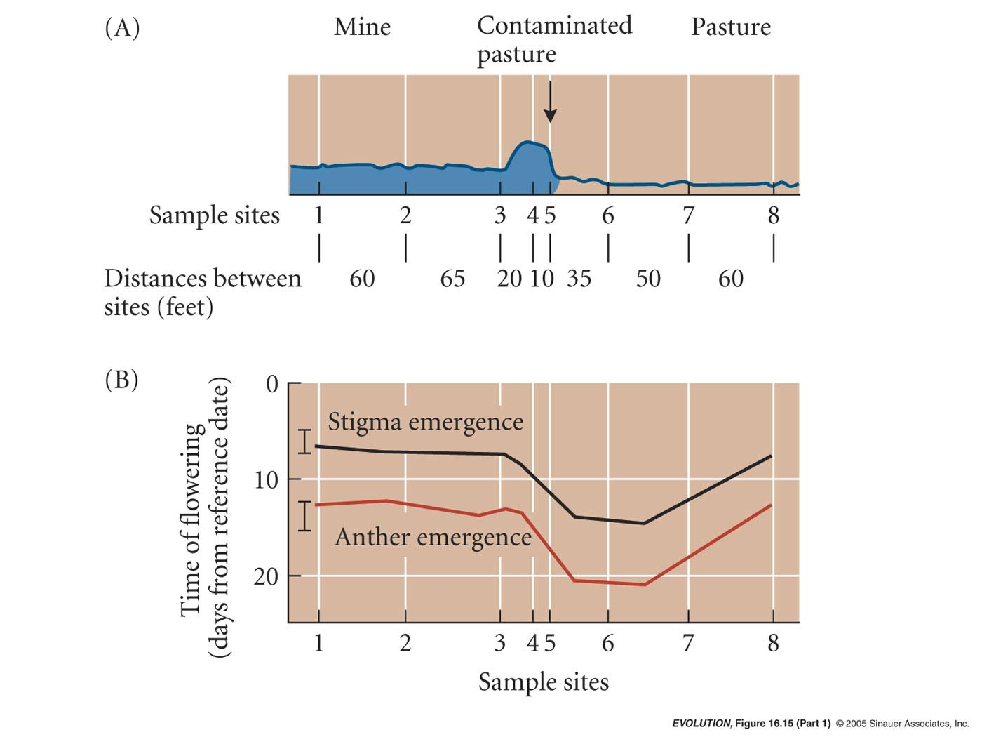
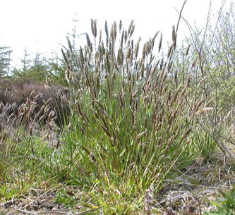

Example of parapatric evolution of reproductive isolation
Anthoxanthum odoratum - McNeilly & Antonovics. Plants on mine are tolerant of heavy metals
Cline – a gradual change in an allele frequency or in the mean of a character over a geographic transect
Steep cline
gradual cline
Clines reflect gene flow!
(required for parapatric speciation)
trait
distance

Slide 25
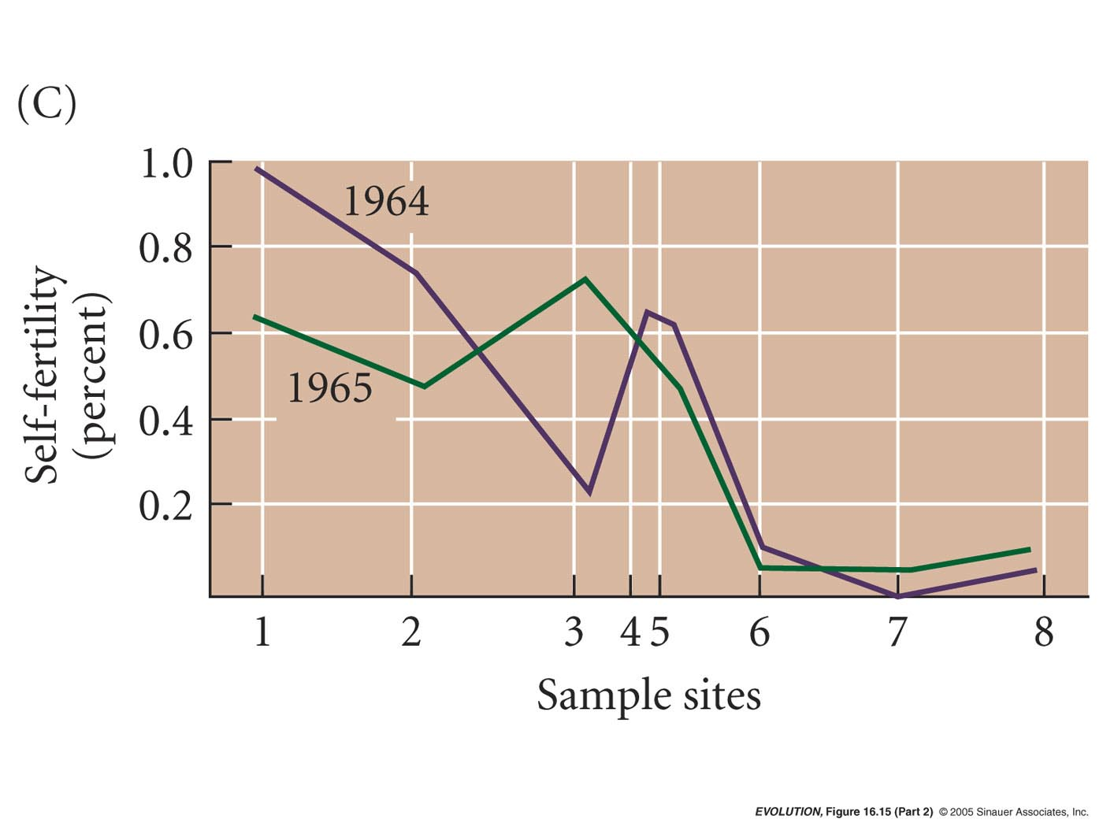
Example of parapatric evolution of reproductive isolation
Anthoxanthum odoratum - McNeilly & Antonovics
Spatially correlated changes in flowering time and self fertility across the mine-pasture gradient.

Slide 26
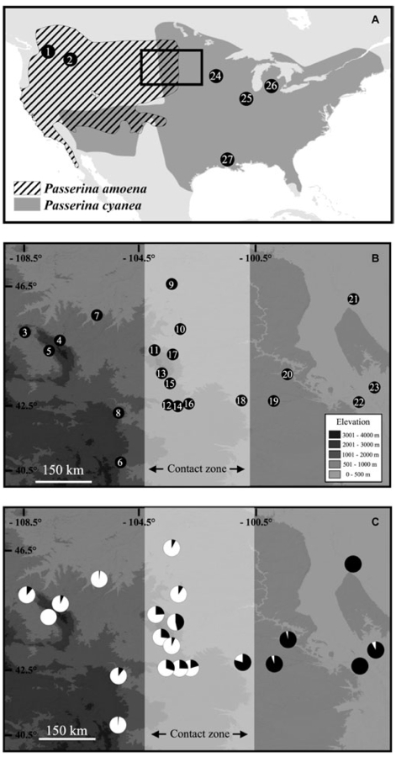
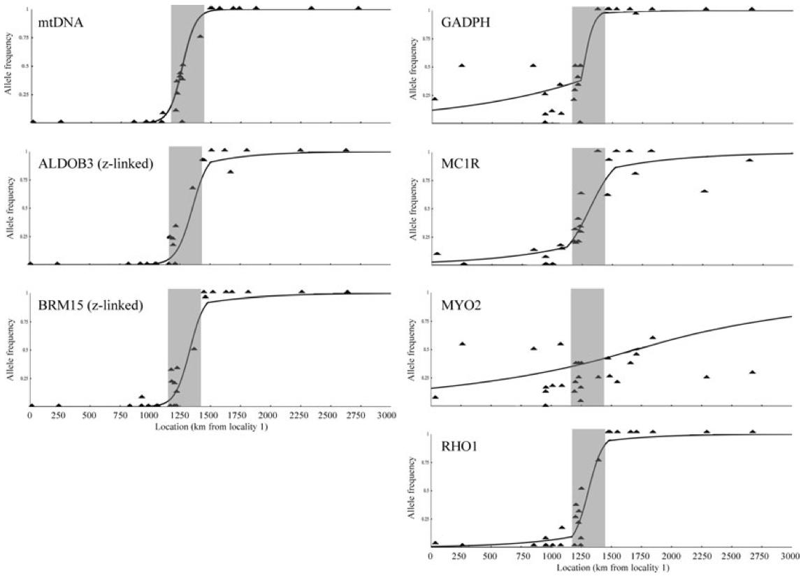
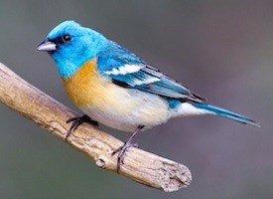
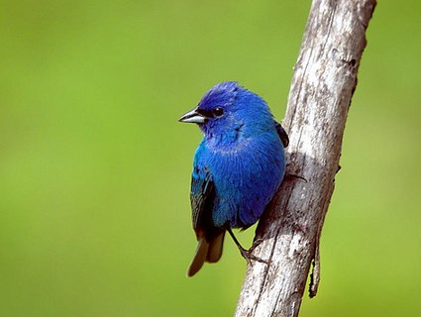
Cline – Narrow Hybrid Zone Reflects Parapatry
Lazuli Bunting
Indigo Bunting
Carling, MD and RT Brumfield (2008) Haldane’s rule in an avian system: Using cline theory and divergence population genetics to test for differential introgression of mitochondrial, autosomal and sex-linked loci across the Passerina bunting hybrid zone. Evolution 62:2600-2615.

Slide 27
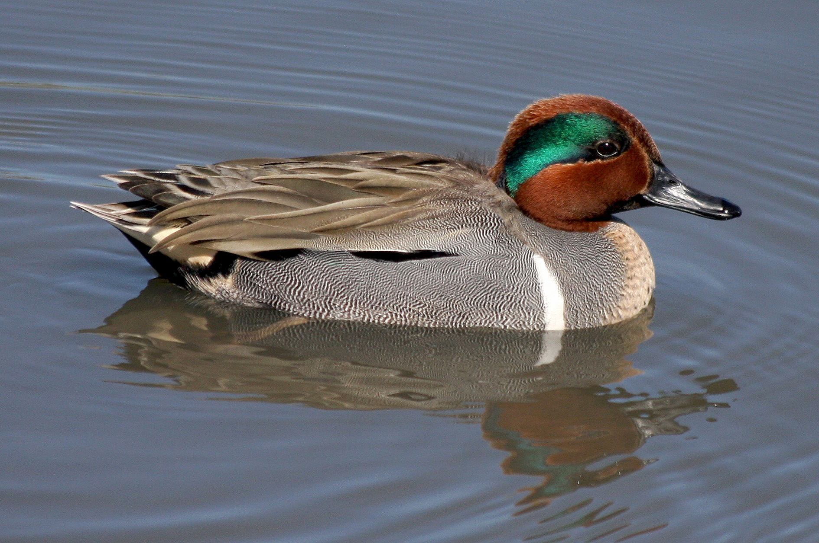
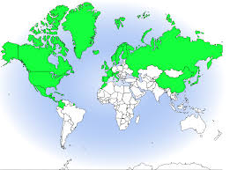
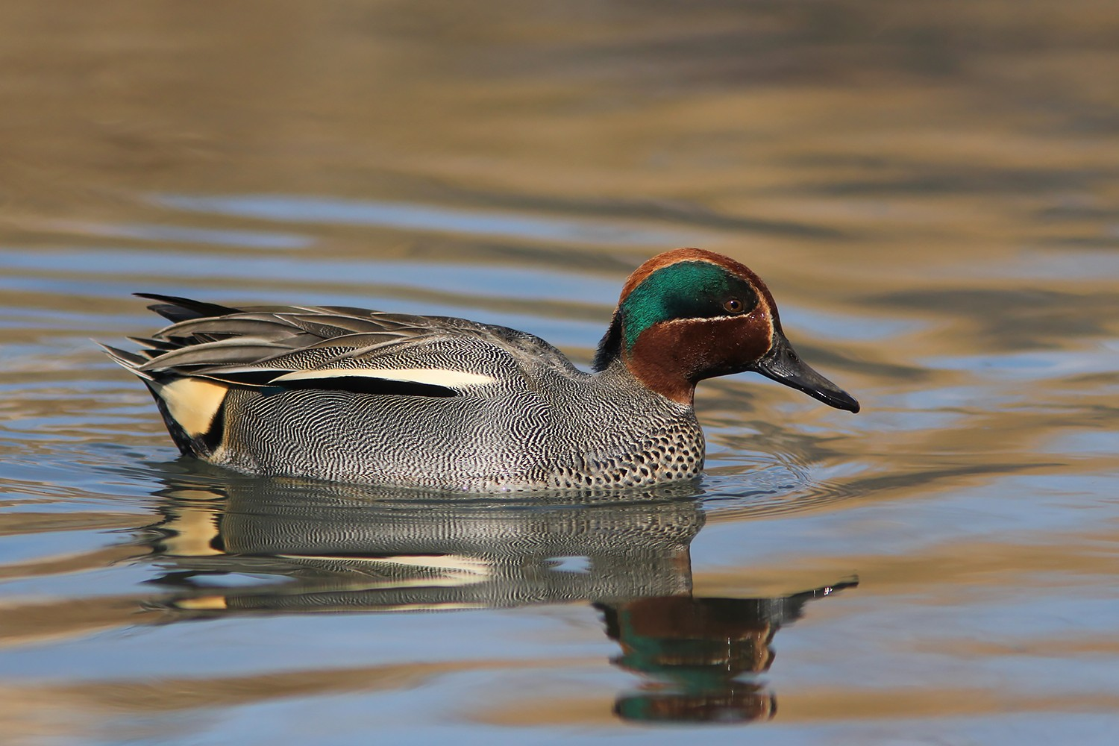
North American & Eurasian populations of Green-winged Teal (Anas crecca) are widely separated across the Atlantic Ocean.
Should be good example of allopatric duck populations right?
Two species, one per continent?

Slide 28
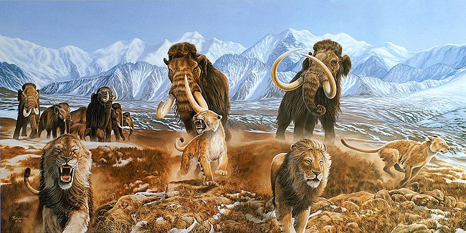
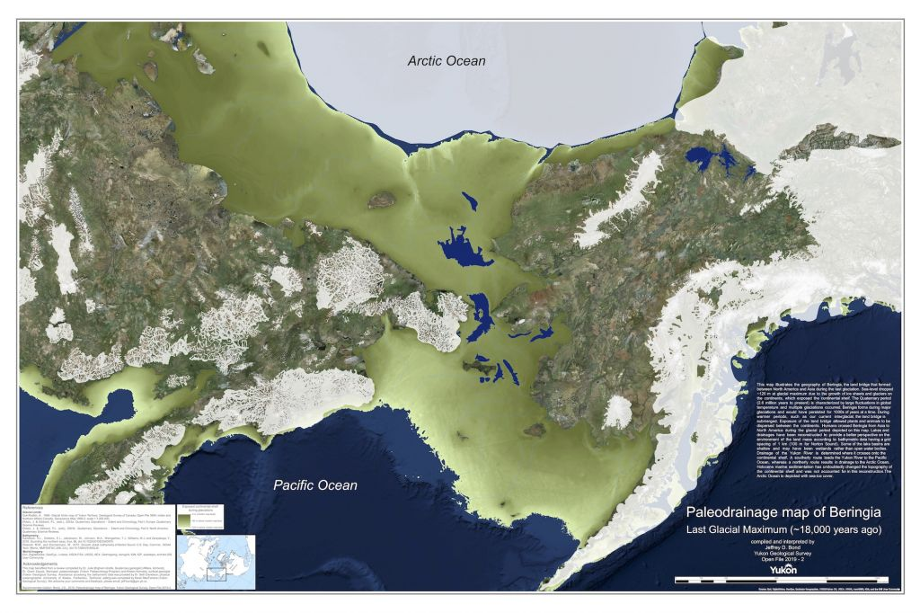
(Image: © Bond, J.D. 2019. Paleodrainage map of Beringia. Yukon Geological Survey, Open File 2019-2)
Peters, J. L., K. G. McCracken, C. L. Pruett, S. Rohwer, S. V. Drovetski, Y. Zhuravlev, I. Kulikova, D. D. Gibson, and K. Winker. (2012) A parapatric propensity for breeding may preclude the completion of speciation in common teal (Anas crecca, sensu lato). Molecular Ecology 21:4563-4577.

Slide 29

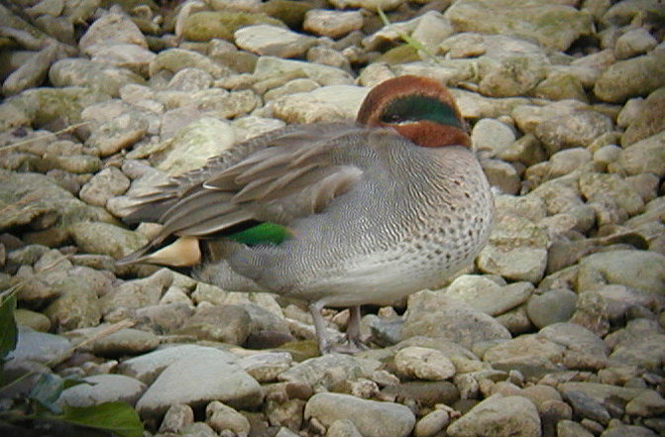
Dumbell Model of Speciation
Asia
N. America
Narrow zone of contact in the North Pacific

Slide 30
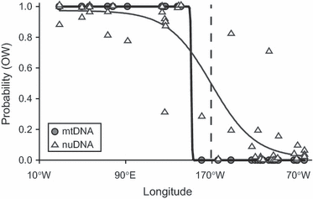
A parapatric propensity for breeding precludes the completion of speciation in common teal (Anas crecca, sensu lato)
Asia
N. America
Molecular Ecology, Volume: 21, Issue: 18, Pages: 4563-4577, First published: 31 July 2012, DOI: (10.1111/j.1365-294X.2012.05711.x)
Notes:
Assignment probabilities for being from the Old World for the 50 individuals sampled in this study, based on eight nuclear loci (open triangles) and mtDNA clade assignment (closed circles). The lines are three‐parameter sigmoidal curves fit to each data type (light and heavy lines, respectively).
IF THIS IMAGE HAS BEEN PROVIDED BY OR IS OWNED BY A THIRD PARTY, AS INDICATED IN THE CAPTION LINE, THEN FURTHER PERMISSION MAY BE NEEDED BEFORE ANY FURTHER USE. PLEASE CONTACT WILEY'S PERMISSIONS DEPARTMENT ON PERMISSIONS@WILEY.COM OR USE THE RIGHTSLINK SERVICE BY CLICKING ON THE 'REQUEST PERMISSIONS' LINK ACCOMPANYING THIS ARTICLE. WILEY OR AUTHOR OWNED IMAGES MAY BE USED FOR NON-COMMERCIAL PURPOSES, SUBJECT TO PROPER CITATION OF THE ARTICLE, AUTHOR, AND PUBLISHER.

Slide 31
Sympatric speciation – evolution of reproductive isolation among members of an interbreeding population.
2 Problems:
1) How can reproductive isolation evolve in sympatry?
Imagine 2 habitat patches, a species is adapted to red but not blue and has and allele R that confers higher fitness on red. The species prefers to spend time on the red habitat and has an allele P_{R}: prefers to go to the red habitat
  Assume a new allele B arises that allows the species to do well on blue, but not red.
  How does this allele spread? It does not prefer blue.
P_{R}
P_{R}
P_{R}
P_{R}
R
R
B
R
B
R
P_{R}
B
B
B
B
B
B
B
B
B
P_{R}
P_{R}
B
P_{R}
R
B
B
R
R
B
R
B
B
B

Slide 32
Allele R: higher fitness on red than blue.
New Allele B: higher fitness on blue than red.
  How does B spread?
P_{R}
P_{R}
P_{R}
P_{R}
R
R
B
R
B
R
P_{R}
B
B
B
B
B
B
B
P_{B}
B
B
P_{B}
P_{R}
P_{B}
P_{R}
P_{B}
B
P_{R}
P_{B}
R
B
B
P_{B}
P_{B}
R
R
R
B
B
B
B
P_{B}
P_{B}
Imagine an alternate allele arises to prefer the blue habitat (Note that it is unlikely for both allele to arise at once, but we will assume that they both arise at similar time).
Allele P_{R}: prefers to go to the red habitat
New Allele P_{B}: prefers to go to the blue habitat

Slide 33
Allele R: higher fitness on red than blue.
Allele B: higher fitness on blue than red.
Allele P_{R}: prefers to go to the red habitat
Allele P_{B}: prefers to go to the blue habitat
A genetic association (Linkage Disequilibrium) must arise between the R allele and the P_{R} allele or B allele and P_{R} allele.
How does this arise in the face of gene flow and recombination?
Requires the evolution of assortative mating, so that P_{R}R phenotypes mate with P_{R}R and P_{B}B phenotypes mate with P_{B}B.

Slide 34
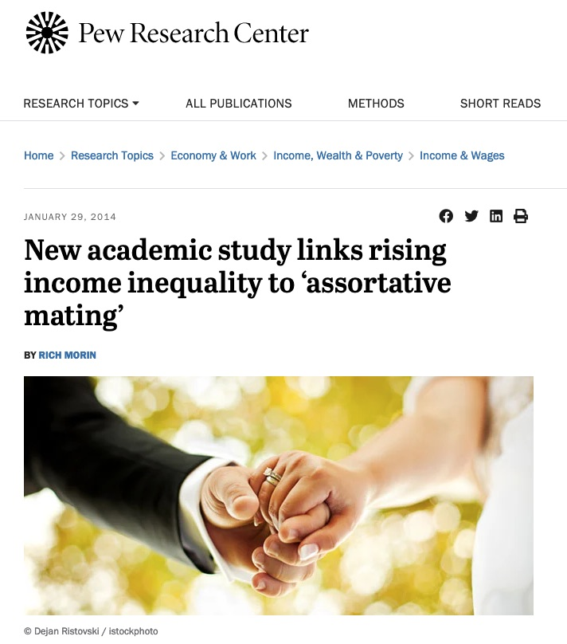
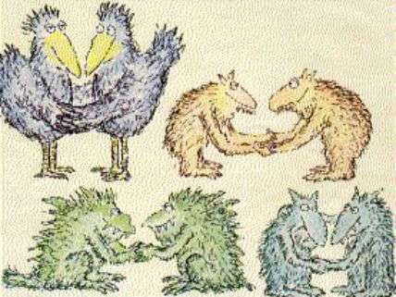
What is assortative mating?

Slide 35
Problem #2 for sympatric speciation:
Coexistence requires that populations develop sufficient ecological divergence to coexist after genetic divergence.
Sympatric speciation is fundamentally ecological (about selection), whereas allopatric and parapatric speciation are driven by geography (genetic drift).

Slide 36
2 Cases of sympatric speciation
Polyploid speciation
  > 2 sets of chromosomes
  ~50% of plant species are polyploids (wheat corn, cotton, potato)
  Caused by a mistake during meiosis
  Immediate reproductive isolation because 2x cannot mate and make viable offspring with 4x

Slide 37
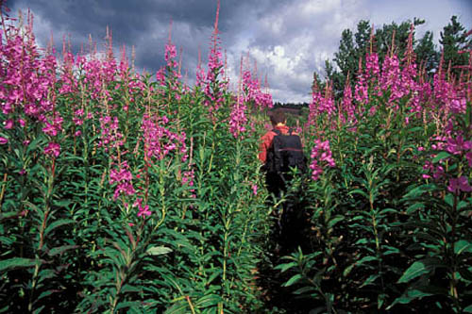
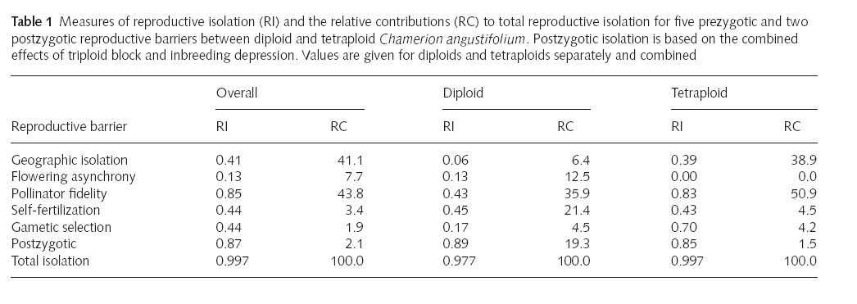
Polyploid speciation in fireweed
From Husband and Sabara 2003

Slide 38
2) Chichlid fish in a Nicaraguan Lake
Strong proof of sympatric speciation needs to satisfy the following criteria:
The sister species must have sympatric distributions throughout speciation
2) There must be genetic evidence for reproductive isolation
3) The sister species must be a monophyletic group (i.e. all descendants of a single common ancestor)
4) They must inhabit a setting in which allopatric speciation is unlikely yet leading to both reproductive isolation & ecological divergence

Slide 39
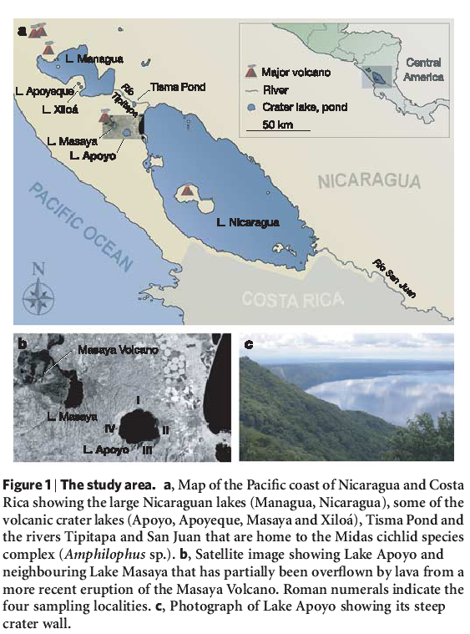
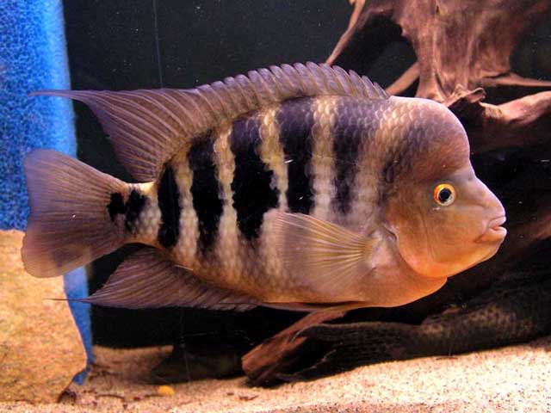
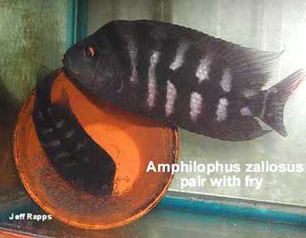
2) Chichlid fish in a Nicaraguan Lake
Lake Apoyo : Volcanic crater lake <23,000 yr old and completely isolated
Amphilophus citrinellus
Amphilophus zaliosus
(derived species)
Barluenga et al. 2006

Slide 40
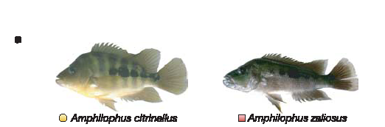
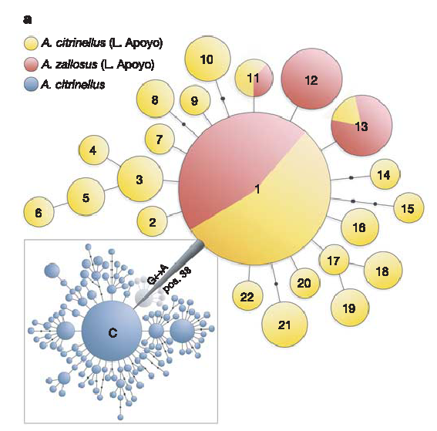
Analysis of mitochondrial gene variation
Mitochondrial genes form one clade and all Amphilophus zaliosus are nested within A. citrinellus haplotypes. This shows that these sister species (combined) are a monophyletic group.
A. citrinellus from other lakes

Slide 41

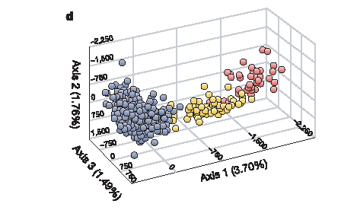
Analysis of nuclear gene variation (microsatellite loci)
Microsattelites show that A. zaliosus is genetically differentiated from A. citrinellus. This implies reproductive isolation.
Also, mate choice experiments show that they are reproductively isolated. (pre-zygotic)

Slide 42
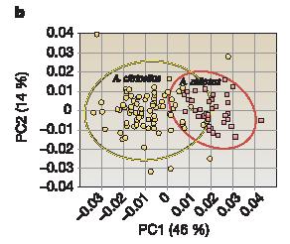
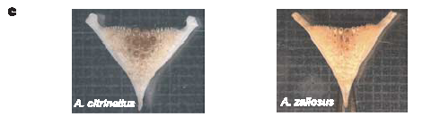


Differences in body shape
Benthic forager
Limnetic forager
Difference in pharyngeal jaw
Differences in diet
Shows ecological divergence

