Slide 1
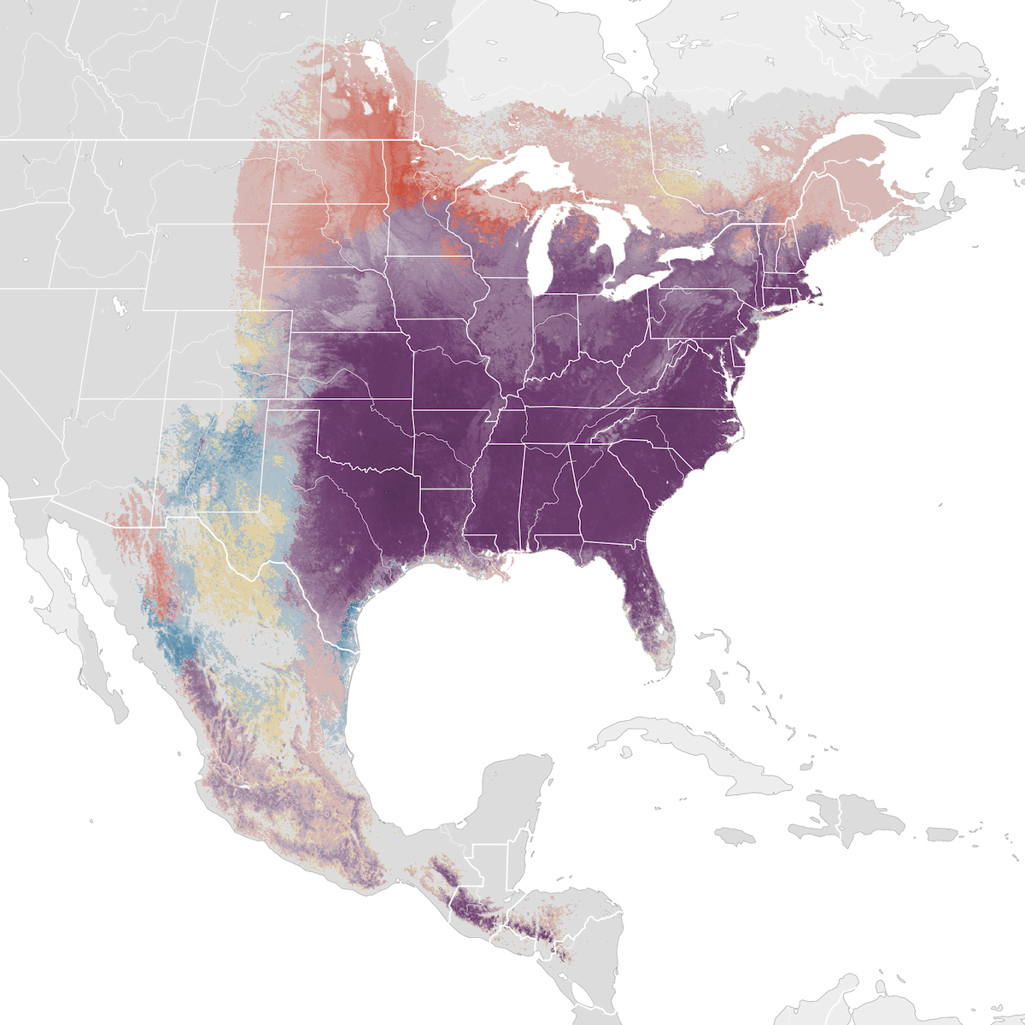
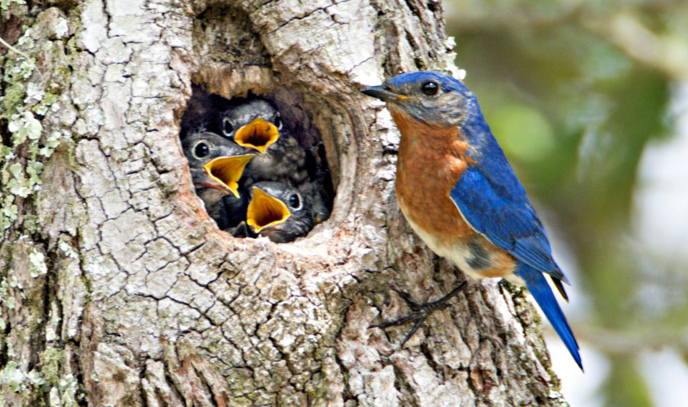
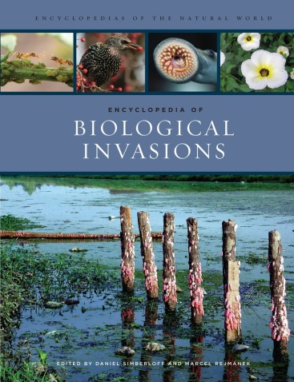
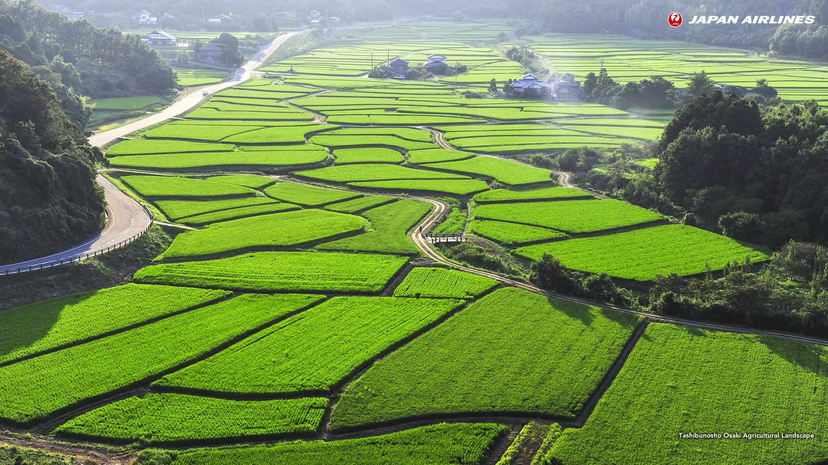
Introduction to Ecology:
Ecological Scales and Levels; Distributions

Slide 2
What is ecology?
Study of interactions between organisms, and between organisms and their environment
Source: Cornell Lab of Ornithology
Distribution & abundance of the Eastern Bluebird, Sialia sialis --- lays 2 to 7 eggs; Mean = 4.49
Notes:
Needs pics – consider adding people from our department…or map of distribution of species.

Slide 3
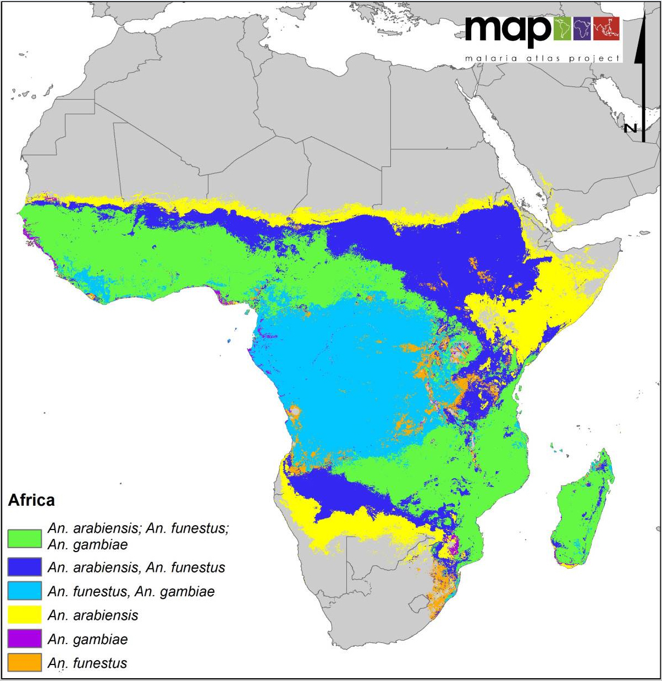
What determines distribution of a species?
Distribution map of major vectors of malaria: Anopheles mosquitoes
Notes:
Add an image

Slide 4
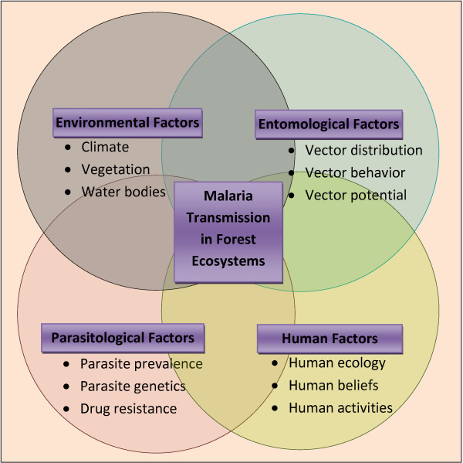
Kar, Narayani & Kumar, Ashwani & Singh, Om & Carlton, Jane & Nanda, Nutan. (2014). A review of malaria transmission dynamics in forest ecosystems. Parasites & Vectors. 7. 265. 10.1186/1756-3305-7-265.

Slide 5
Goals of ecology
  Basic Science:
    To understand the distribution (Where?) and abundance (How many?) of organisms.
    To understand the mechanisms behind the distribution and abundance contributing to ecosystem functioning.
  Applied Management:
    To use this knowledge to predict and mitigate natural and human impacts on the environment (e.g., through habitat destruction, climate change, introduction of species to new areas).
Notes:
Needs pics – consider adding people from our department…or map of distribution of species.

Slide 6
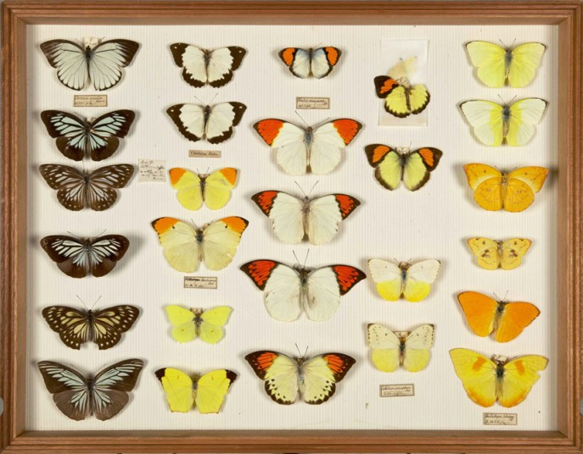

Common misconceptions about ecology
Ecology ≠ Natural History
  Natural history is critical to understanding organisms, and provides inspiration and questions but…
  Natural history documents what is different between species
  Ecology focuses on developing hypotheses and predictions that apply to more than one species or situation.
Ecology ≠ Environmentalism
  Ecologists are also environmentalists but…
  Ecology is a science, not a political or ideological movement
http://i.telegraph.co.uk/multimedia/archive/02411/NHM_Wallace_s-inse_2411480k.jpg
http://www.snohomishtimes.com/images/planet.jpg
Notes:
Ask a student what they think natural history is
Ask a student what they think environmentalism is, or how it is different from ecology

Slide 7
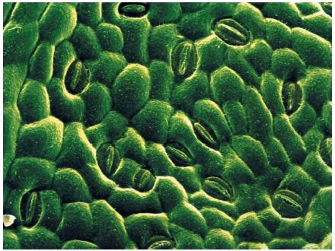
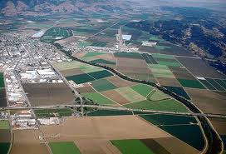
Ecology: Spatial Scales
Spatial Scale:
  AT or ABOVE the organismal level – that is, it does not focus solely on what happens inside an organism.
  BELOW or AT the landscape level; usually bounded by the areas over which species interact.
Stomates on the surface of a leaf
Interactions between patches in a landscape
Notes:
Need pictures and graphs

Slide 8
Ecology: Temporal Scales
Temporal Scale:
  Processes that happen over shorter periods than evolutionary processes – i.e., days to years to decades to hundreds of years, not thousands or millions.
  Relevant temporal scales depend on the organism: from < lifespan of an organism to several lifespans.
  For a short-lived organism (e.g., microbes, some insects) a lifespan may be <1 day; for a long-lived organism it might be >1000 years (e.g., some trees).
  Processes that take longer than physiological processes – e.g. not a tiny fraction of a life span.
Stomates on the surface of a leaf
Interactions between patches in a landscape
Notes:
Need pictures and graphs

Slide 9
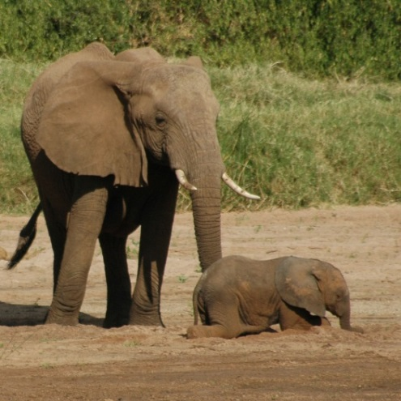
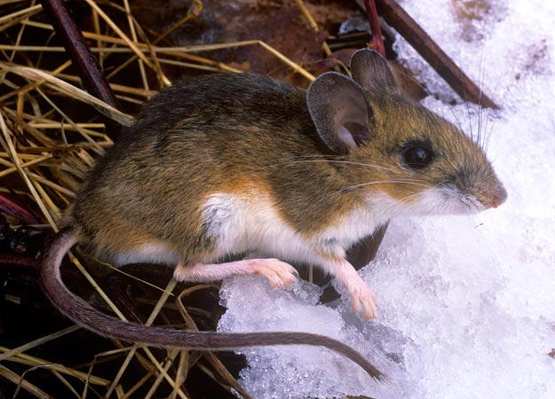
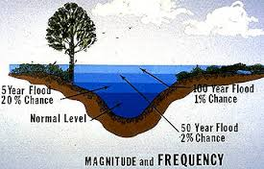
Spatial & temporal scales can be linked
Elephants are LARGE and SLOW:
Large body size
Move across large areas
Long life span (decades)
Long time to 1st reproduction
Few offspring
Mice are SMALL and FAST:
Small body size
Move along small areas
Short life span (weeks to months)
Short time to 1st reproduction
Lots of offspring
MAJOR disturbance are less frequent than MINOR disturbances:
A “100-year flood” is larger than a “5-year flood”

Slide 10
Different Subdisciplines of Ecology
Organismal Ecology
Population Ecology
Community Ecology
Ecosystem Ecology

Slide 11
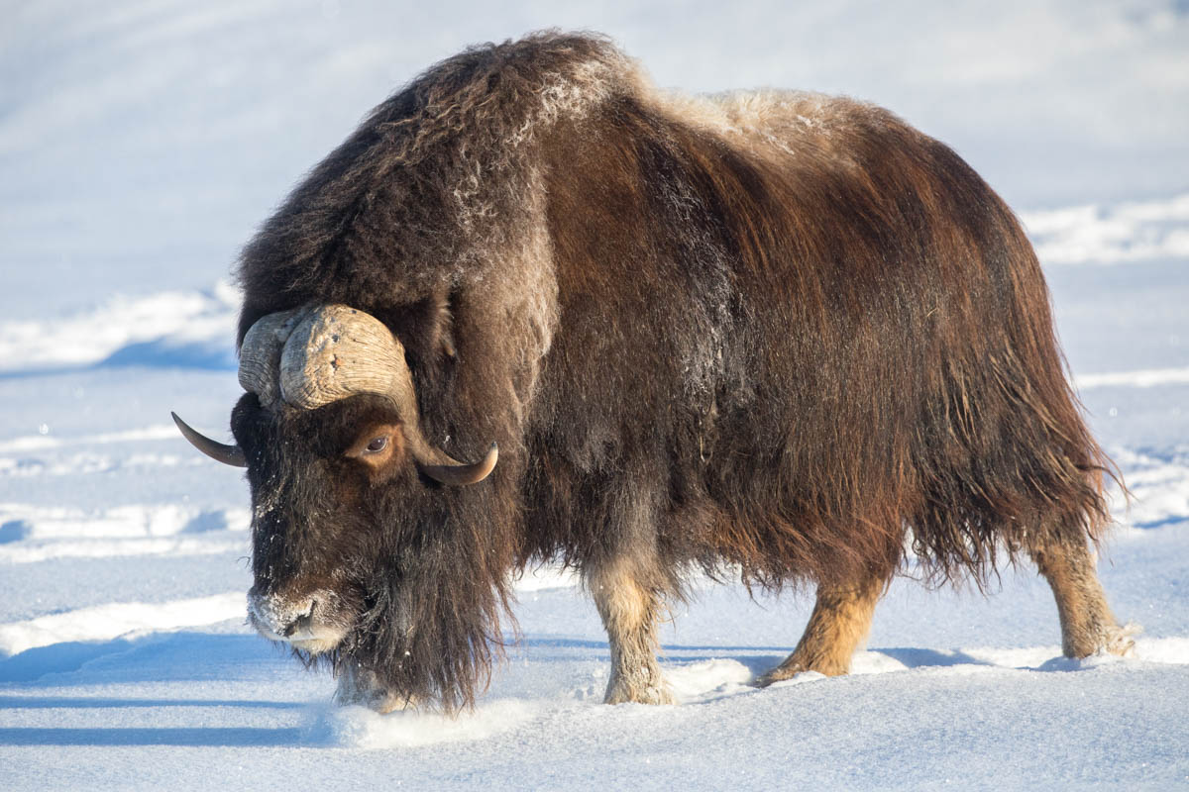
Organismal Ecology: How do characteristics of individuals (e.g., physiology, morphology, and behavior) allow them to survive in their environment?
  How does a muskox survive 10 months of winter during which it takes in fewer calories than it uses?
  e.g., physiological ecology (ecophysiology)
Notes:
Ask for another organismal question

Slide 12
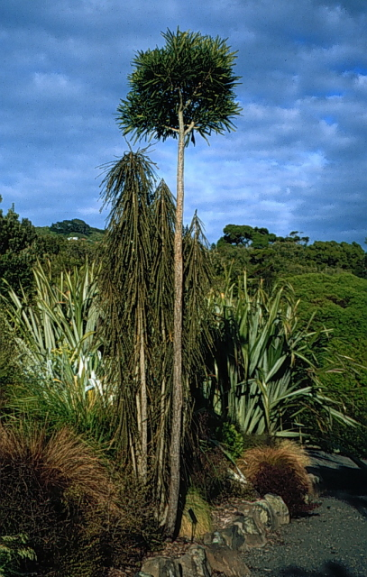
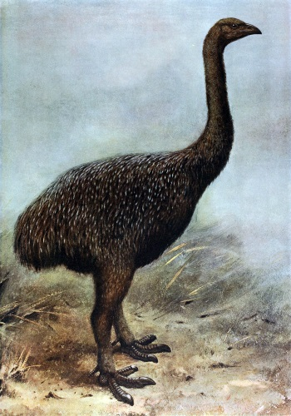
Organismal Ecology: How do characteristics of individuals (e.g., physiology, morphology, and behavior) allow them to survive in their environment?
Adult leaves
Juvenile leaves
  Does change in morphology between juvenile and adult leaves of this New Zealand species result from physiological changes in different light and humidity regimes?
  Or has this evolved as protection from consumption by extinct moas?
Notes:
Ask for another organismal question

Slide 13
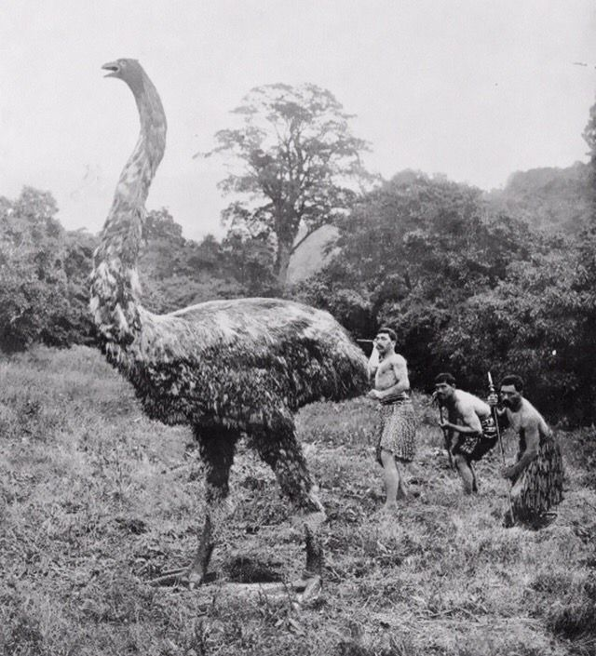
Moas comprised ~9 species some as tall as 3.6 m.
In 1280 the Moa population probably was about 58,000.
Moa extinction occurred 1300–1440 ± 20 years, due to overhunting by people first arriving to new Zealand.

Slide 14
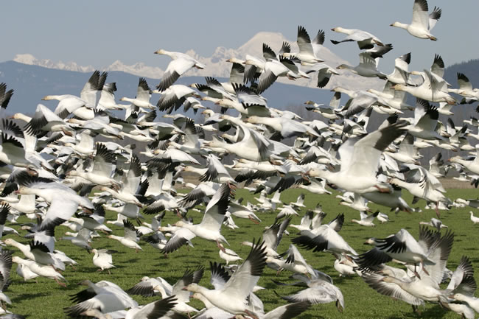
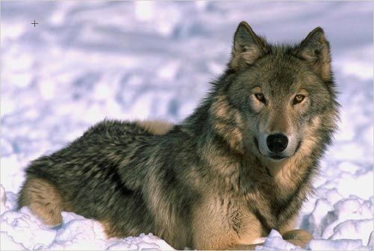
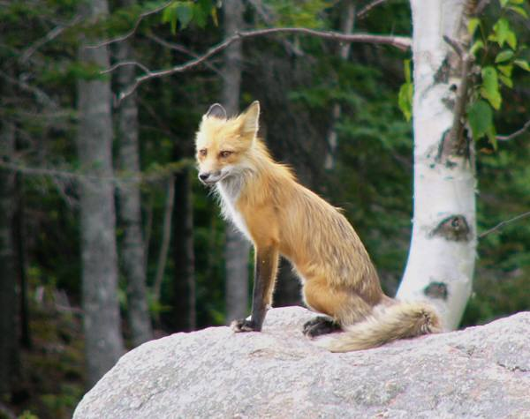
Population Ecology: how does the distribution and abundance of a species change over time?
A population is a group of individuals of the same species living in the same area at the same time.
  How does timing of snow melt affect reproductive success in snow geese?
  How does the expansion of wolves into an area affect the distribution and abundance of foxes or coyotes?
Photo credit: Ginger Halser, WEFW photo
Notes:
Ask a student to provide another population question about snow geese

Slide 15
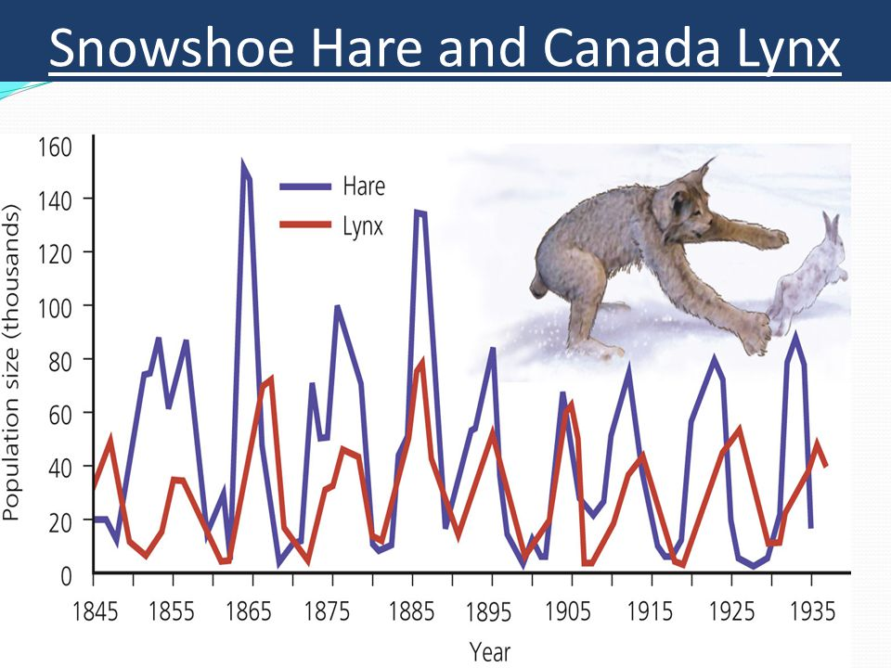
2.6 Ecosystem Changes by George Shepherd

Slide 16
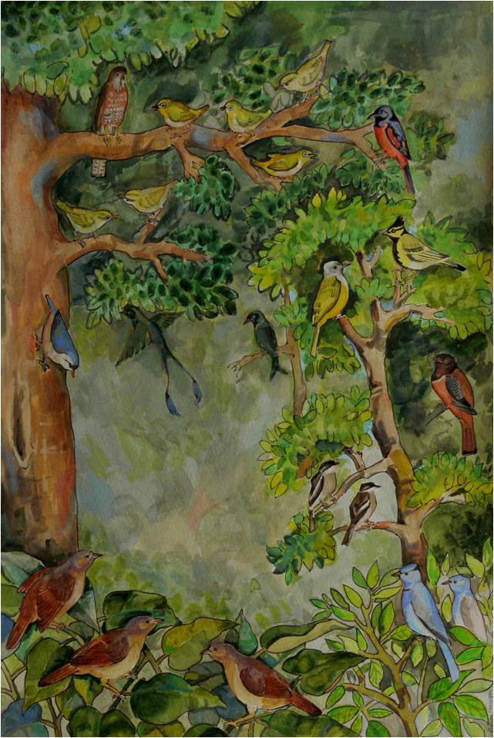
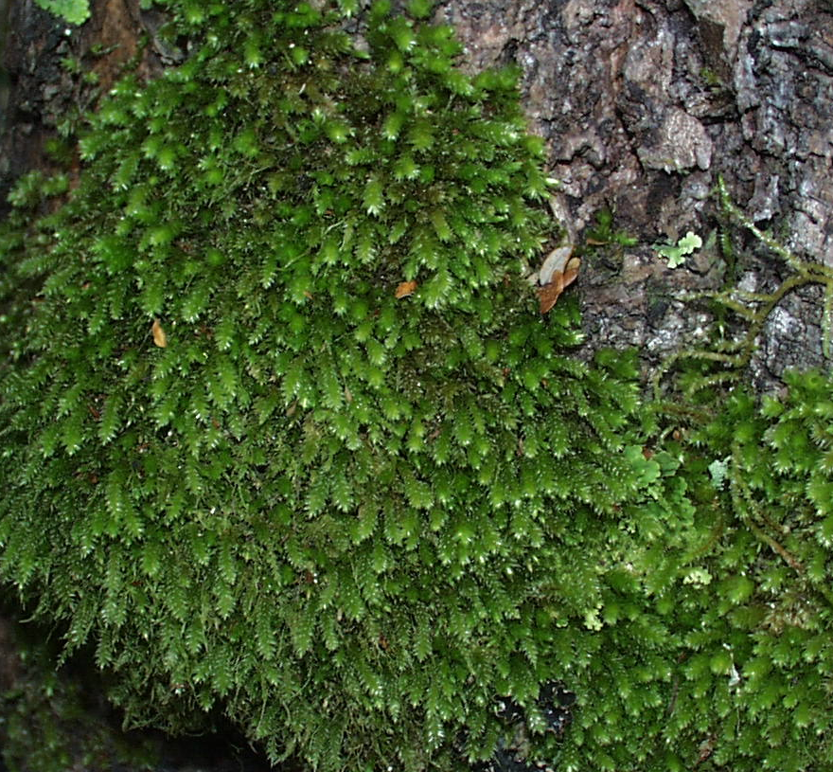
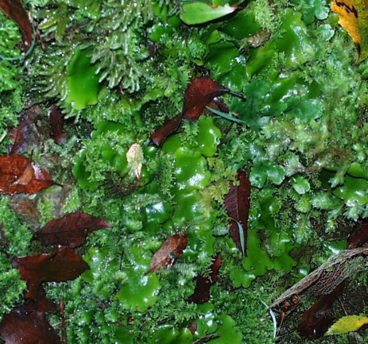
Community Ecology: what factors affect community structure and composition?
A community consists of the species that co-occur and interact with each other in a given area
  How does drought affect the community composition of a tropical bird community?
  Are more complex communities more stable than simple communities?
Photo credit: C. Mulder

Slide 17
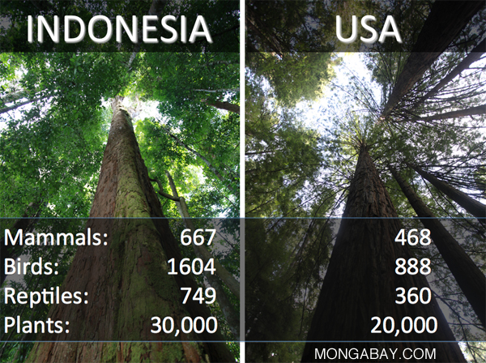
Tropical Rainforest is Among the Most Diverse
https://rainforests.mongabay.com/0301.htm

Slide 18
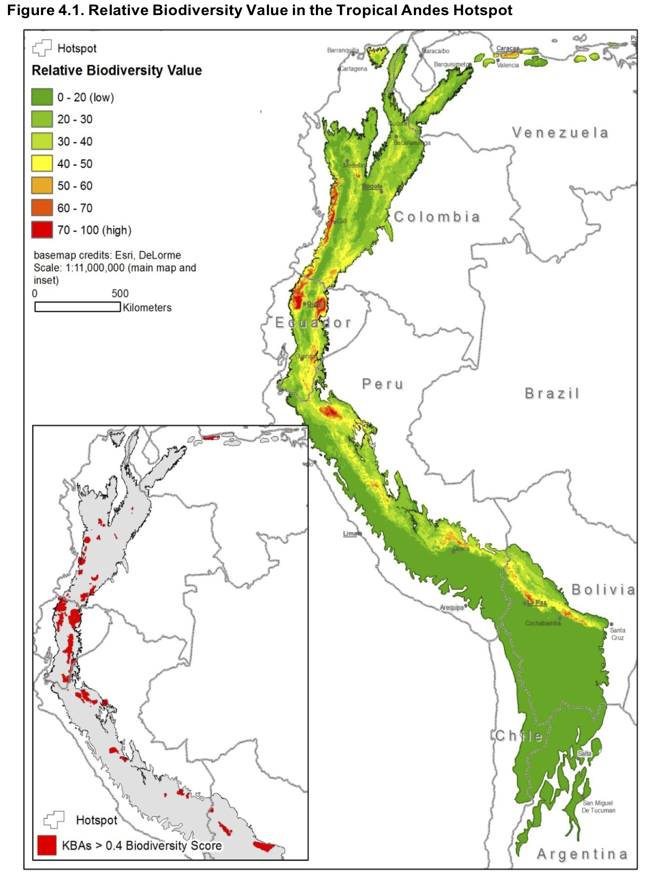
East Slope of the Andes is a Major Biodiversity Hotspot
Elevational patterns of replacement boost species
#s in the region
Ecosystem Profile Technical Summary: Tropical Andes Biodiversity Hotspot
NatureServe and EcoDecisión

Slide 19
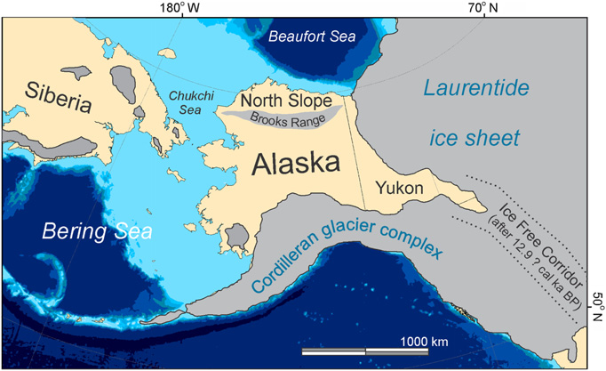
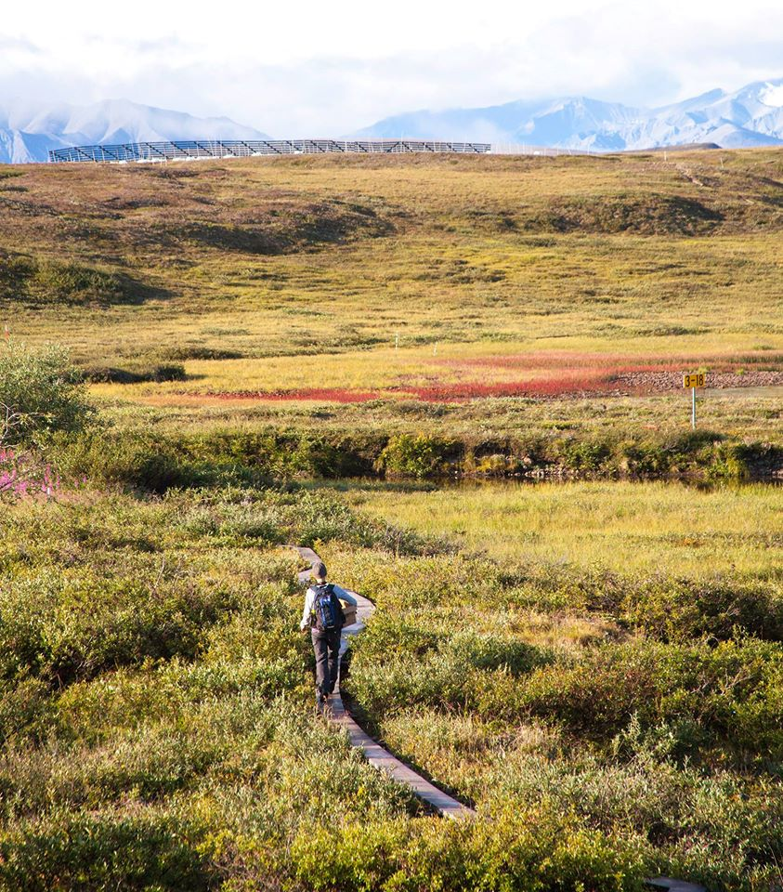
Tundra is also surprisingly diverse

Slide 20
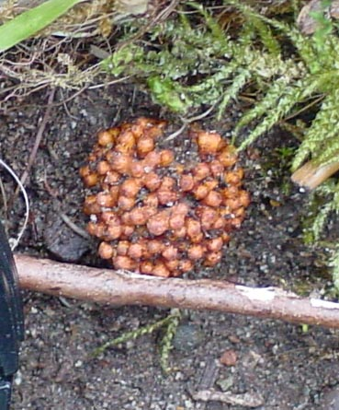
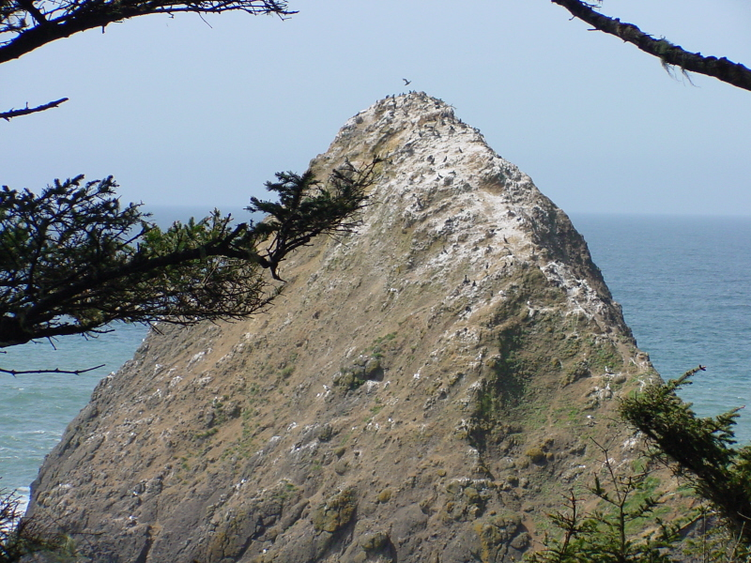
Ecosystem Ecology
Ecosystems include biotic (living) & abiotic (not living) components.
Ecosystem ecologists are often interested in how energy and matter (e.g., carbon, nutrients, and water) move through these components and affect populations and communities.
  How does the presence of N-fixing species alter nutrient cycling rates in the boreal forest?
  How does nutrient transfer from ocean to land in the form of seabird guano alter plant productivity?
Photo credit: D. .Uliassi
Photo credit: C. Mulder
Notes:
Ask students if anyone knows what this is a picture of

Slide 21
Which of the following is an example of a question asked by a population ecologist?
How does an influx of nitrogen from fertilizer alter the rate of carbon fixation in an aquatic plant?
Is an area with more species more difficult for a non-native species to invade?
Under increased temperatures, will pikas overheat in summer?
How does an increase in moose calf survival from 20% to 25% alter the number of individuals in a herd after 10 years?

Slide 22
Which of the following is an example of a question asked by a population ecologist?
How does an influx of nitrogen from fertilizer alter the rate of carbon fixation in an aquatic plant?
Is an area with more species more difficult for a non-native species to invade?
Under increased temperatures, will pikas overheat in summer?
How does an increase in moose calf survival from 20% to 25% alter the number of individuals in a herd after 10 years?

Slide 23
Which of the following is an example of a question asked by a community ecologist?
How does an influx of nitrogen from fertilizer alter the rate of carbon fixation in an aquatic plant?
Is an area with more species more difficult for a non-native species to invade?
Under increased temperatures, will pikas overheat in summer?
How does an increase in moose calf survival from 20% to 25% alter the number of individuals in a herd after 10 years?

Slide 24
Which of the following is an example of a question asked by a community ecologist?
How does an influx of nitrogen from fertilizer alter the rate of carbon fixation in an aquatic plant?
Is an area with more species more difficult for a non-native species to invade?
Under increased temperatures, will pikas overheat in summer?
How does an increase in moose calf survival from 20% to 25% alter the number of individuals in a herd after 10 years?

Slide 25
Which of the following is an example of a question asked by a ecosystem ecologist?
How does an influx of nitrogen from fertilizer alter the rate of carbon fixation in an aquatic plant?
Is an area with more species more difficult for a non-native species to invade?
Under increased temperatures, will pikas overheat in summer?
How does an increase in moose calf survival from 20% to 25% alter the number of individuals in a herd after 10 years?

Slide 26
Which of the following is an example of a question asked by a community ecologist?
How does an influx of nitrogen from fertilizer alter the rate of carbon fixation in an aquatic plant?
Is an area with more species more difficult for a non-native species to invade?
Under increased temperatures, will pikas overheat in summer?
How does an increase in moose calf survival from 20% to 25% alter the number of individuals in a herd after 10 years?

Slide 27
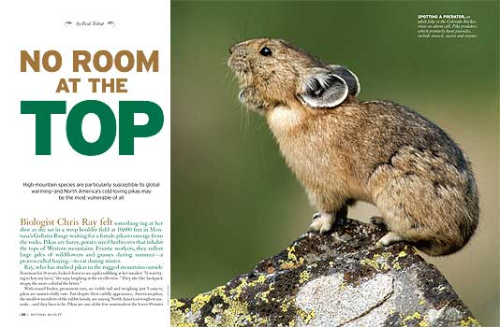
Under increased temperatures, will pikas overheat in summer?
Organismal Ecology
Population Ecology
Community Ecology
Ecosystem Ecology

Slide 28
Subdisciplines of Ecology are Integrated
Organismal Ecology
Population Ecology
Community Ecology
Ecosystem Ecology

Slide 29
Lower scales provide the mechanisms for higher scales
Ecosystem level
High nutrient cycling rates
Community level
High diversity of decomposers
Population level
Species is a good competitor
Large populations of nitrogen fixers
Organismal level
High photosynthetic rates of dominant plant
Large body size
Fast growth rate
Good defenses

Slide 30

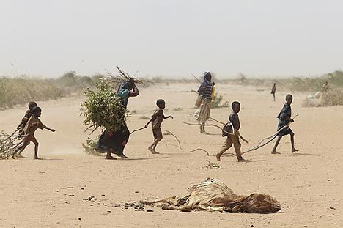
Other Areas of Ecology
Humans have had and are continuing to have enormous impacts on the planet and its inhabitants. Several areas of biology address this and are rapidly expanding:
Sir David Attenborough --- “We are a plague on Earth… and it’s coming home to roost.”

Slide 31
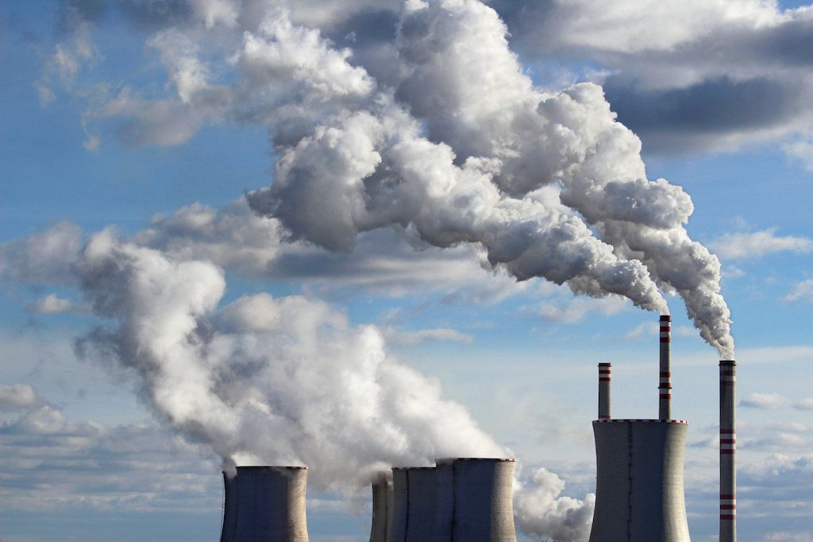
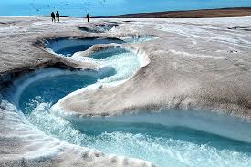
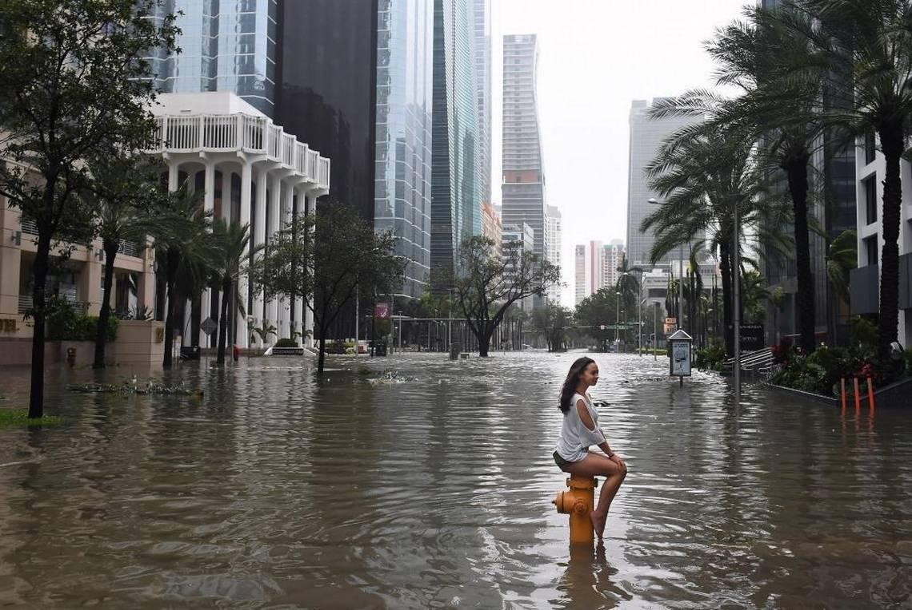

Slide 32
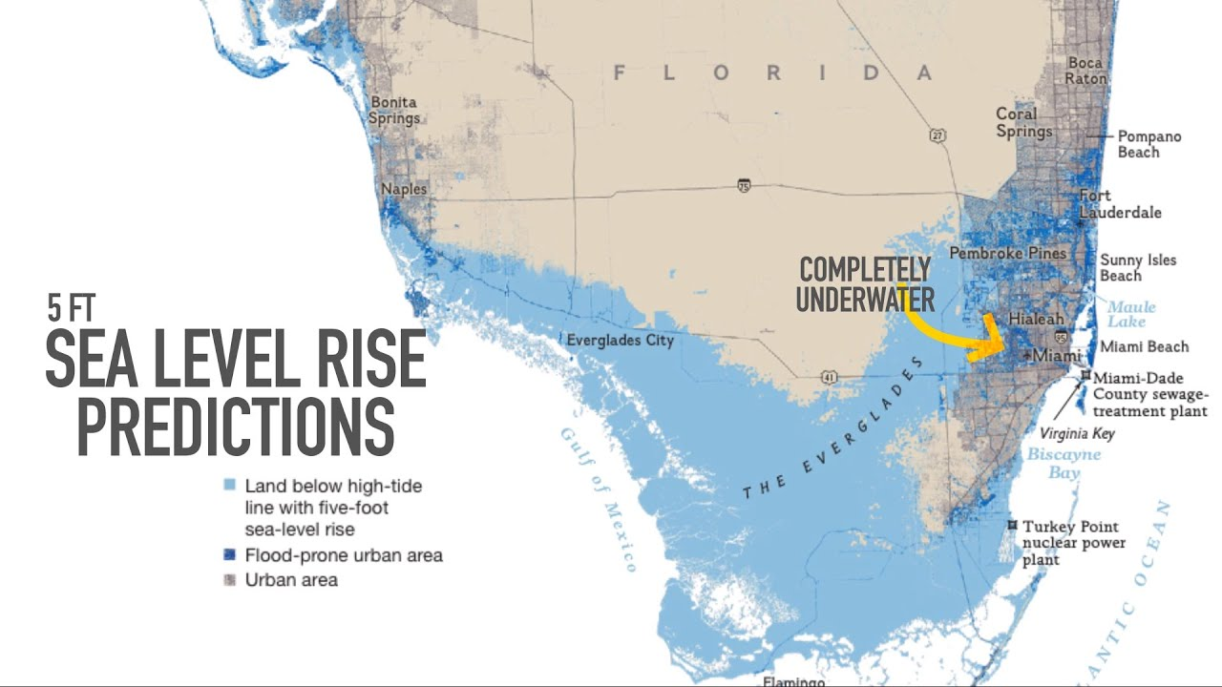
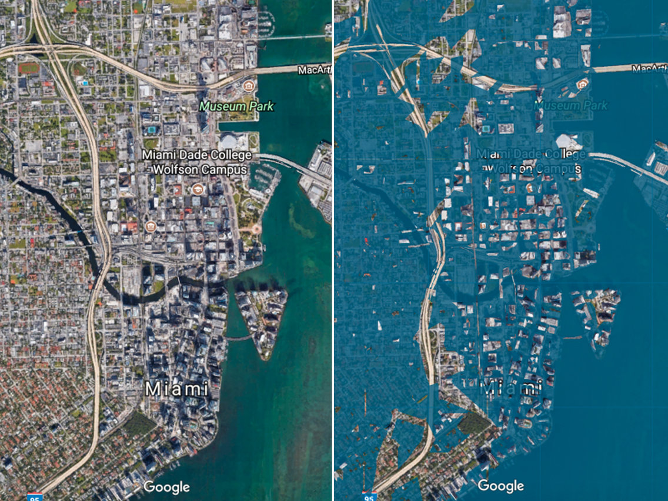
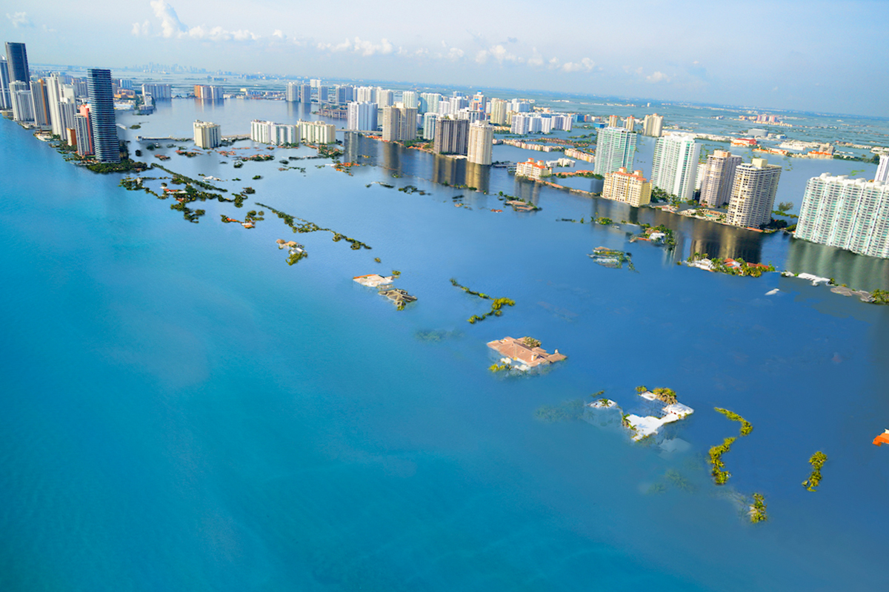

Slide 33


Slide 34
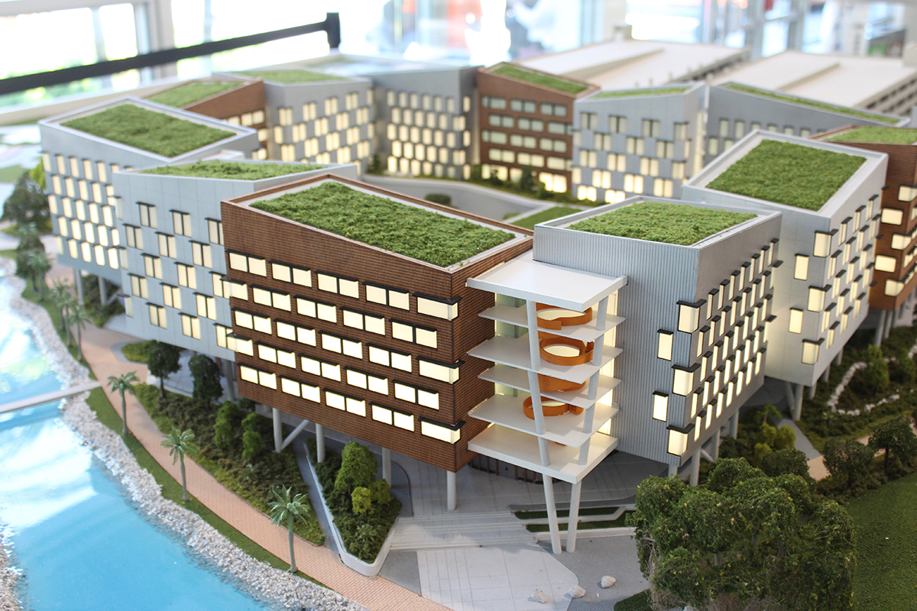
New Student Housing Village on Stilts for a Reason?

Slide 35
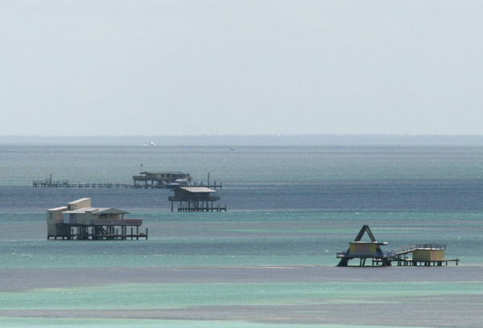
Stiltsville Redux?

Slide 36
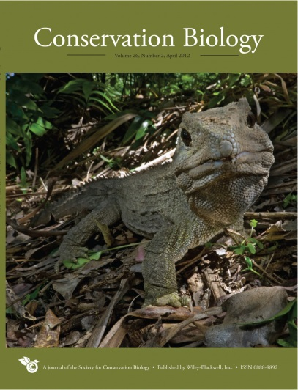
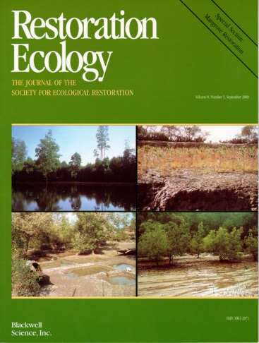
New Disciplines in Ecology:
Conservation Biology: Efforts to study and preserve biology at all levels: genetic diversity within populations, species diversity in communities, and ecosystem function.
Restoration Biology: Efforts to restore biological communities to their former (undisturbed or less disturbed) state.

Slide 37
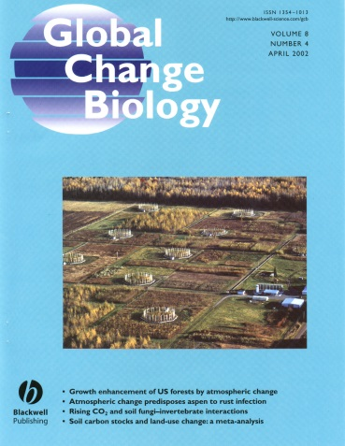
New Disciplines in Ecology:
Global Ecology: efforts to understand how global change (including changes in temperature and precipitation patterns, CO₂ levels in the atmosphere, pH levels in the ocean, and large-scale pollution) affects populations, communities and ecosystems.
Invasion Biology: the study of species expanding into areas where they were previously not present and their impacts on populations, communities, and ecosystem function.

Slide 38
