Slide 1
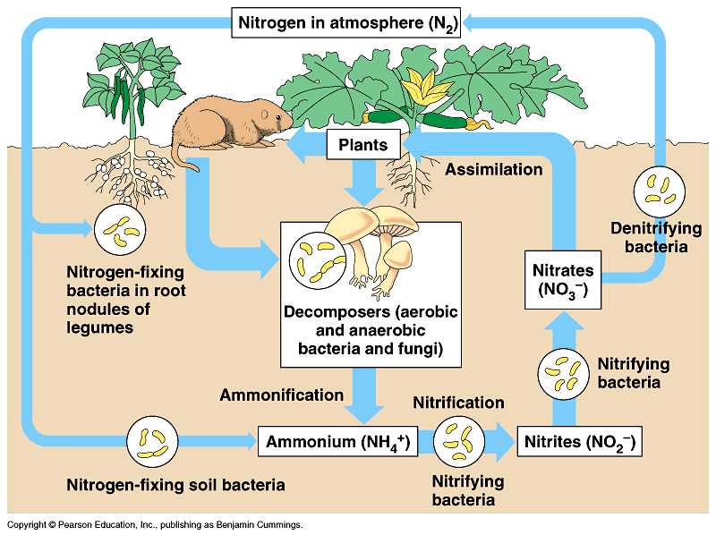
Ecosystem Ecology: Study of interactions between living (biotic) and non-living (abiotic) components of the ecosystem
Example:
Nitrogen Cycle
Notes:
Add pictures

Slide 2
Important dates:
Last day of class – Today Tue 5 December
Exam 4 will be a timed multiple choice (w/instructions provided to you by end of day Wed 6 December)
Thank you for taking this class! I wish you the best in all endeavors. I hope to see again.
Notes:
Add slide with clicker questions for timing of review session

Slide 3
Ecosystem Ecology
Ecosystem: A biological community (or multiple communities) along with their chemical and physical environments
Ecosystem ecology focuses on pools of resources (how much is in a compartment) and fluxes (how much moves between compartments) of energy, water, carbon, nutrients, and other abiotic components (elements and simple compounds).
There is greater movement of these resources within than between ecosystems

Slide 4
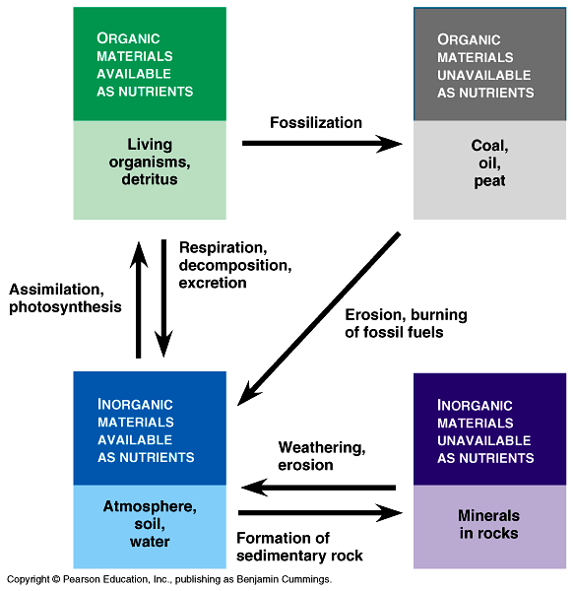

Slide 5
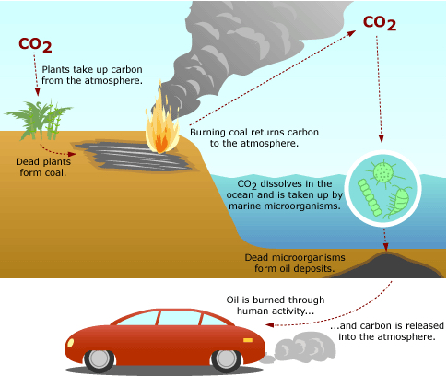
The carbon used to drive your car, where has it moved from and where will it go?
https://evolution.berkeley.edu/evolibrary/article/side_0_0/carbonatom_01

Slide 6
Combustion of gasoline:
C₈H₁₈ + 12.5 O₂ → 8 CO₂ + 9 H₂O
44,400 Joules for every gram of C₈H₁₈
4,600 kg CO₂ per 2,000 liters

Slide 7
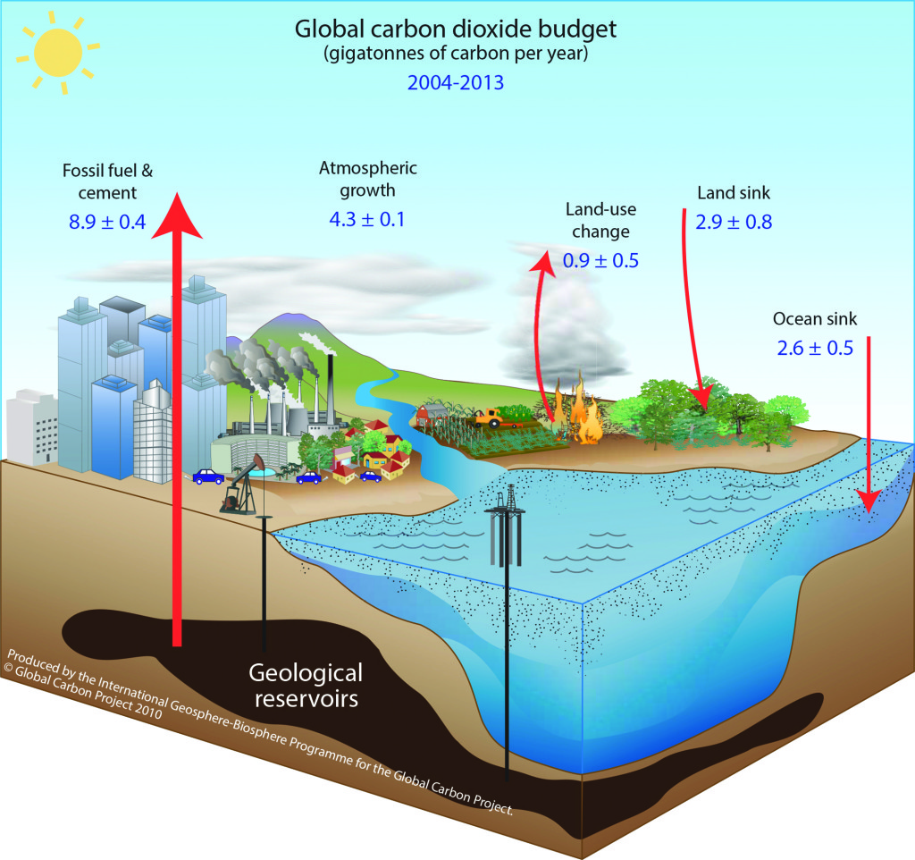
Global carbon cycle refers to exchanges of carbon within/between four major reservoirs:
Atmosphere
Oceans
Land
Fossil fuels
https://whrc.org/project/global-carbon/

Slide 8
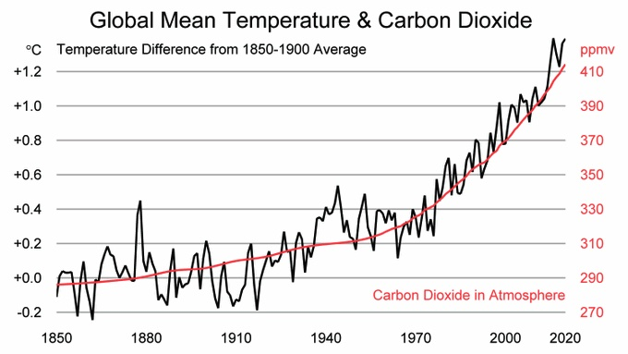

Slide 9
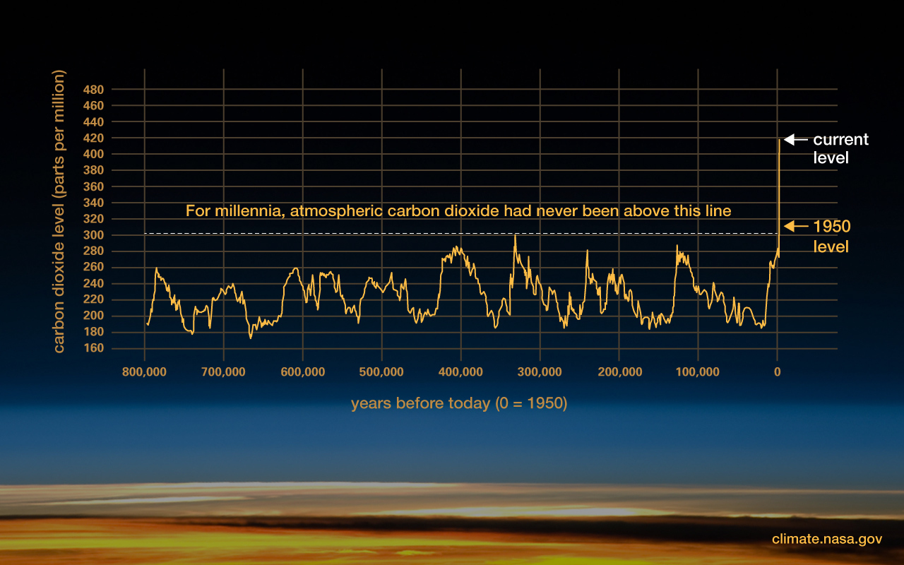

Slide 10
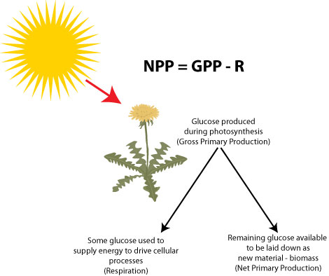
Net primary productivity (NPP)
Photosynthetic organisms (plants, algae, cyanobacteria, also known as primary producers) do two things during photosynthesis:
Take energy from sunlight and store it in short-term bonds
Take carbon from the air (CO₂) and, using energy produced in the previous step, combine it into organic compounds, in the process storing energy in long-term carbon bonds.
http://sciencebitz.com/

Slide 11
Net primary productivity (NPP)
NPP = amount of energy made available by primary producers to everything else: the total amount of carbon fixed minus the amount used in respiration during maintenance.
It is usually measured as carbon or dry mass in terrestrial plants, as chlorophyll concentrations in aquatic samples.
http://sciencebitz.com/

Slide 12
How much energy can plants get from the sun?

Slide 13
Productivity varies enormously across the globe

Slide 14
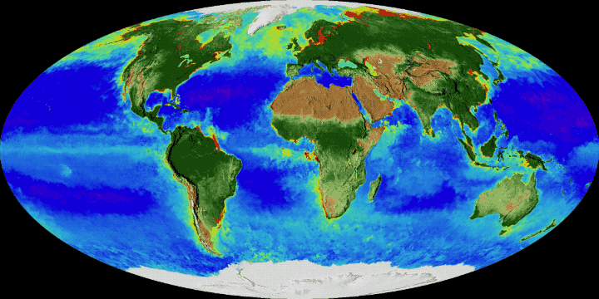

Slide 15
What usually determines primary productivity in terrestrial systems?
Temperature
Water
Nutrient
Temperature and water
Water and nutrients

Slide 16
What usually determines primary productivity in aquatics systems?
Temperature
Nutrients
Salinity
Temperature and nutrients

Slide 17
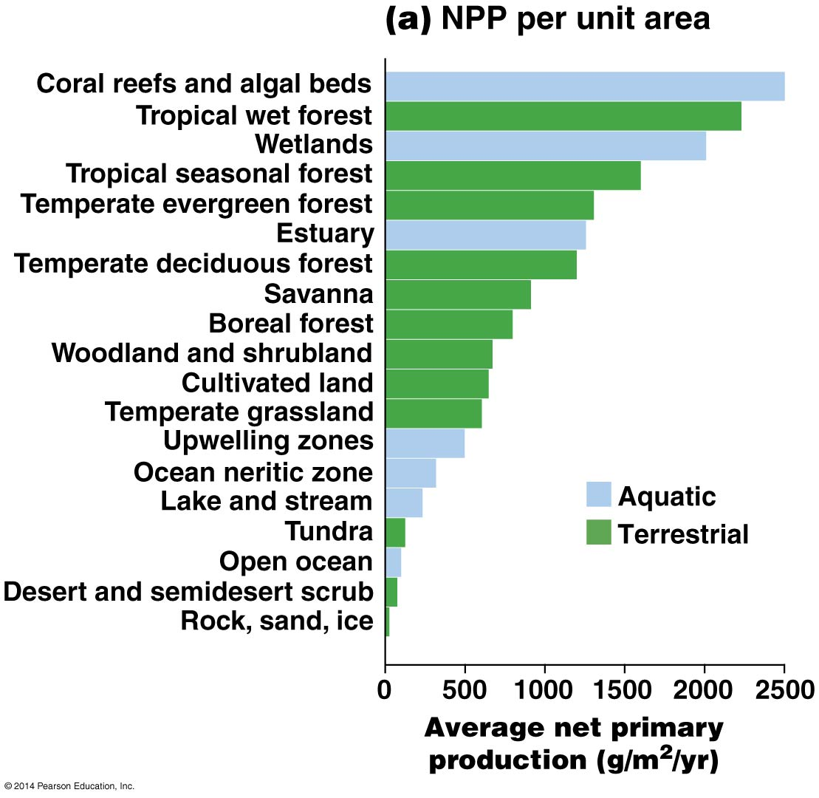

Slide 18
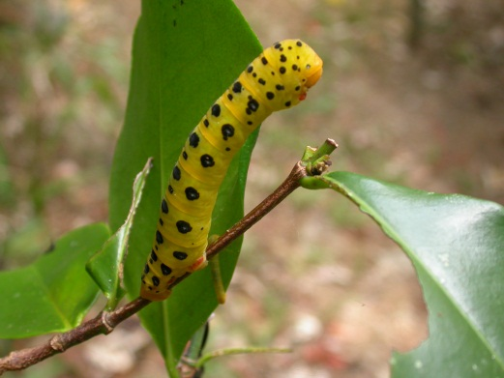
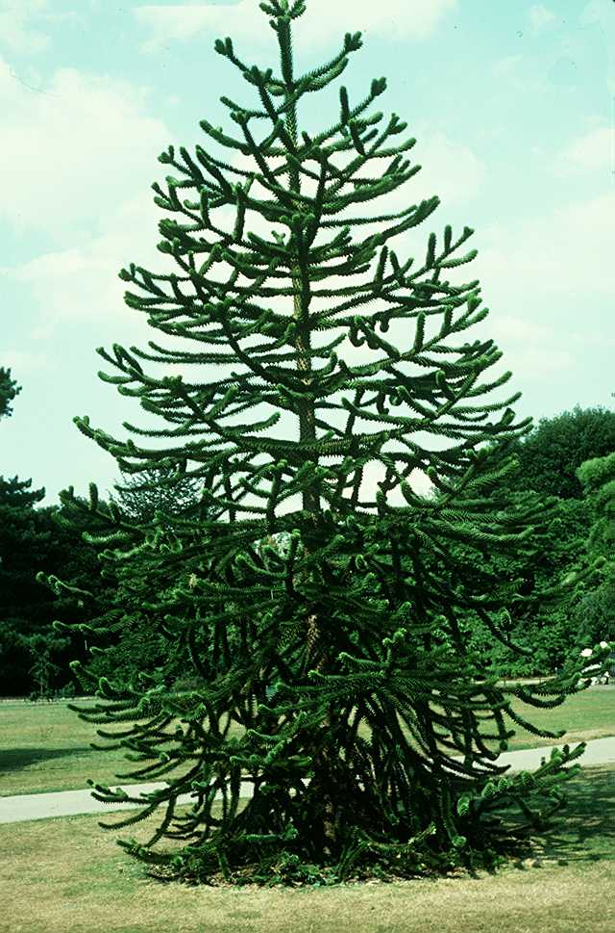
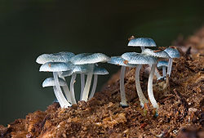
What happens to energy (organic compounds) after it enters the ecosystem?
Herbivores
CO₂
5-15%
Photo: A. Moles
85-95%
Detritivores Decomposers: bacteria, archaea, fungi
Respiration
Photo: Wisconsin teaching collection
http://en.wikipedia.org/wiki/Detritivore

Slide 19
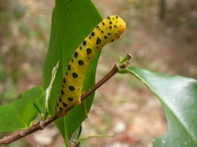
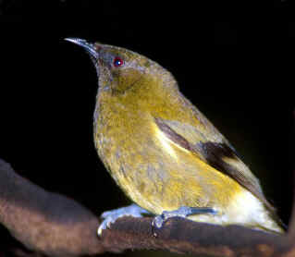
What happens to energy (organic compounds) after it enters the ecosystem?
CO₂
Photo: Wisconsin teaching collection
3º consumers
5-15%
85-95%
5-15%
5-15%
85-95%
Herbivores
2º consumers
Detritivores and respiration
85-95%

Slide 20
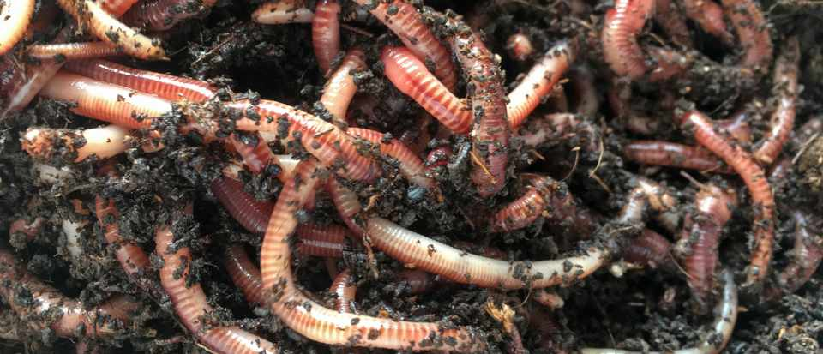
What happens to energy (organic compounds) after it enters the ecosystem?
Only 5-15% is transferred to herbivores or other consumers
85-95% always goes to the detritivores

Slide 21
Assume 15% of energy is transferred between trophic levels. If start with 100% at level 1 (primary productivity), what % will be transferred to level 4?
(15)⁴
1/(15)⁴
0.15+0.15+0.15+0.15
(0.15)⁴ * 100

Slide 22
How much energy is lost between trophic levels?
0.3% is available to tertiary consumers

Slide 23
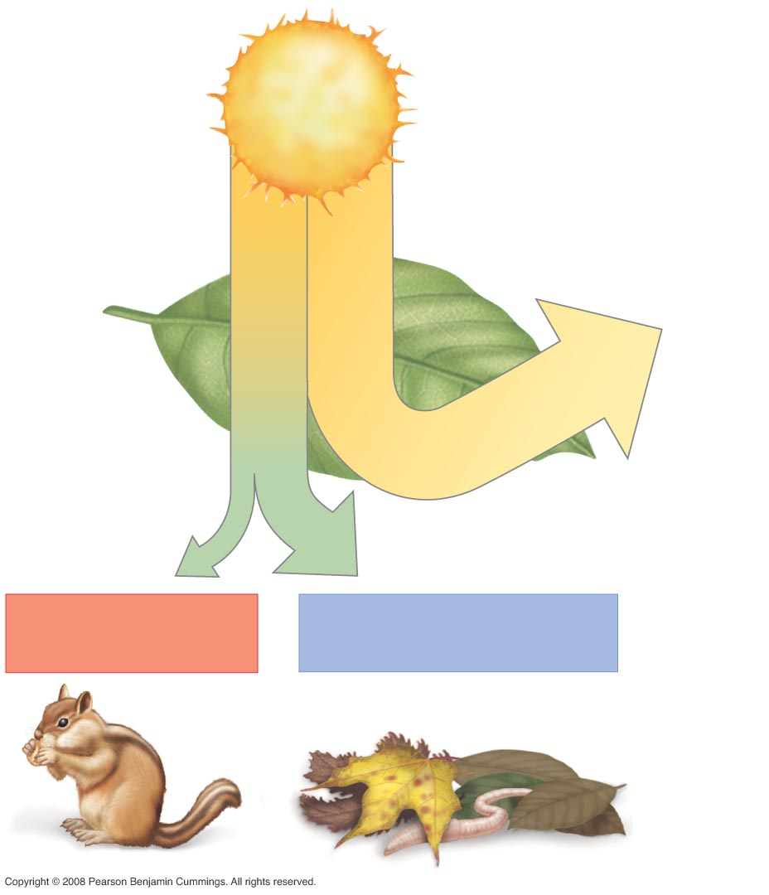
Figure 54-8
Much of the light that arrives can’t be used
All organisms use energy to keep themselves alive; all organisms lose carbon through respiration. This energy is NOT available to the next level.
Some of what is produced (growth/reproduction) is NOT available to the next level (indigestible, well-defended) → detritivores
Some of what is consumed is not assimilated → detritivores
Energy source:
1,254,000
kcal/m²/year
0.8% energy
captured by
photosynthesis.
Of this…
… 55% is lost to
maintenance activities
or as heat
… 45% supports (NPP)
…11% enters
consumer food web
… 34% enters decomposer
food web as dead material

Slide 24
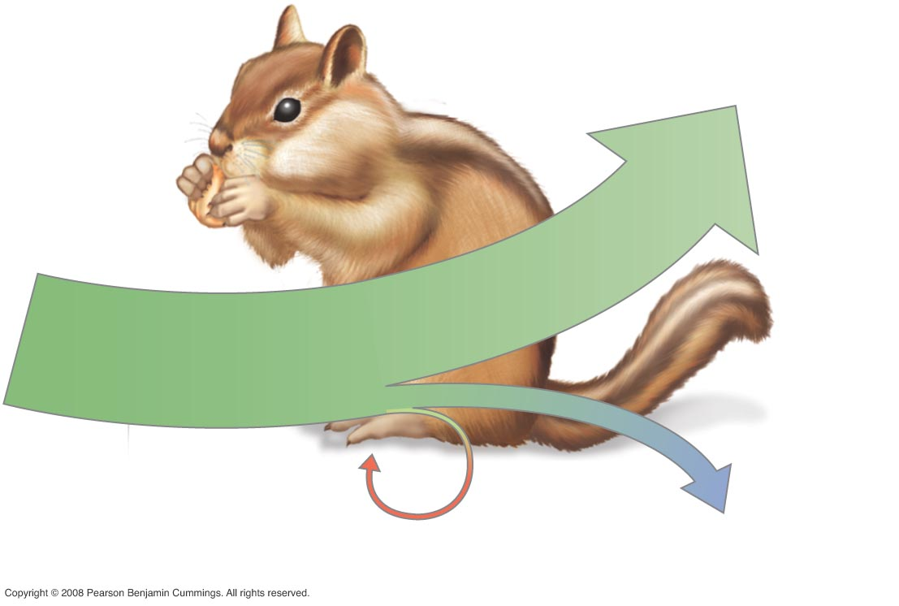
Figure 54-9
80.7% maintenance activities
Energy derived
from plants
1.6% growth and
reproduction
17.7% excretion

Slide 25
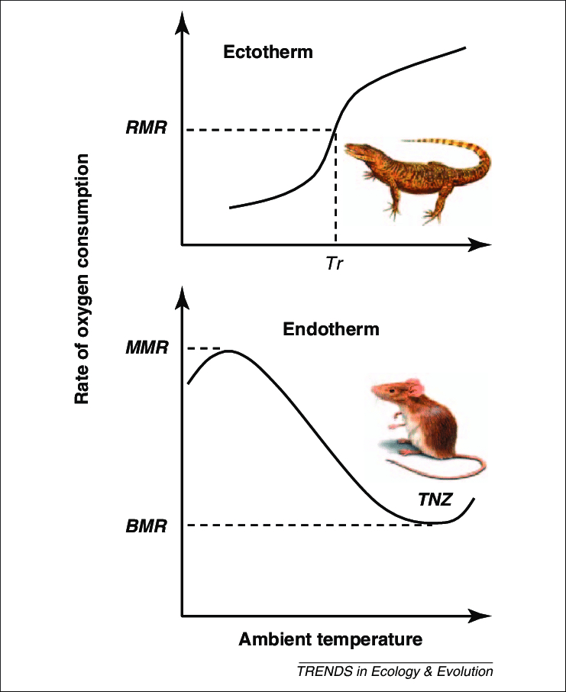
On average, which will have the higher energy efficiency (energy to growth and reproduction/energy taken in)?
Endotherms (“warm-blooded” animals)
Ectotherms (“cold-blooded” animals)
The same amount of food can usually maintain a larger population of similar-sized ectotherms.

Slide 26
How many nutrient cycles are there?
Carbon
Sulfur
Nitrogen
Water
Phosphorus
Iron
Oxygen
Hydrogen
Trace minerals
Others

Slide 27
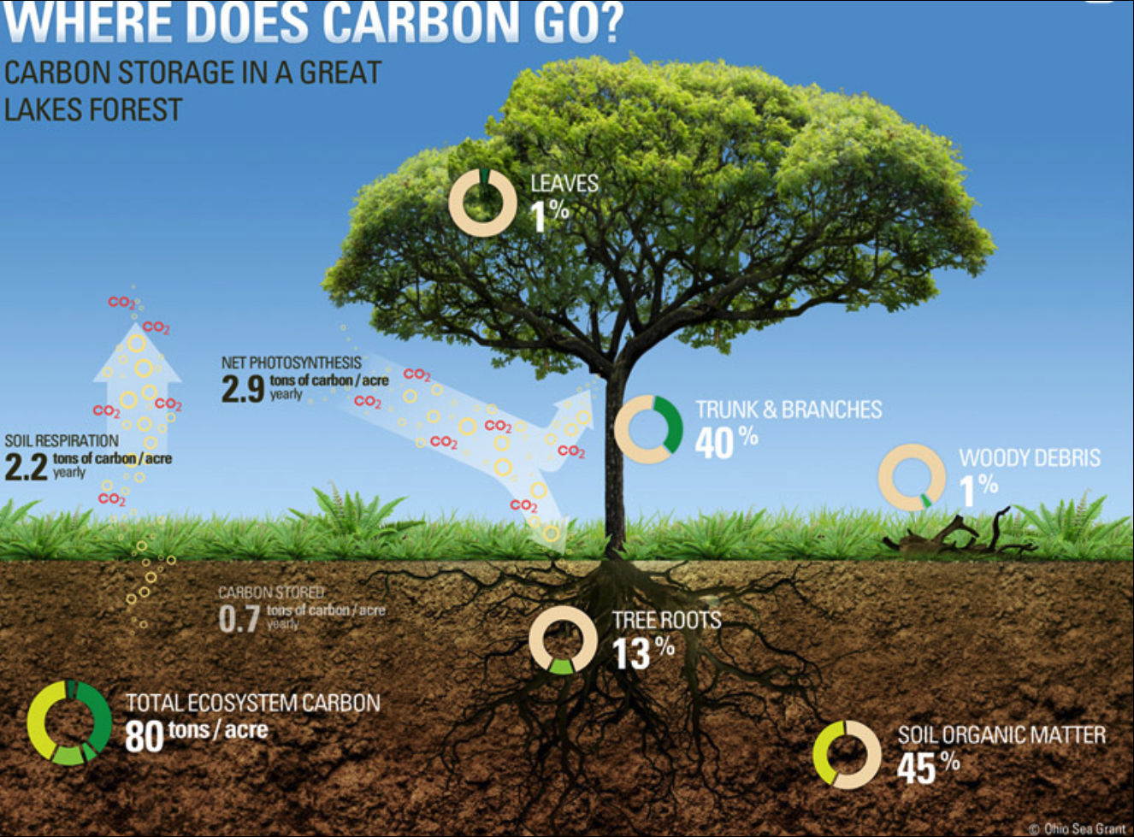
https://rgsgeogy.wordpress.com/mrcs-tree-carbon-content-calculator/

Slide 28
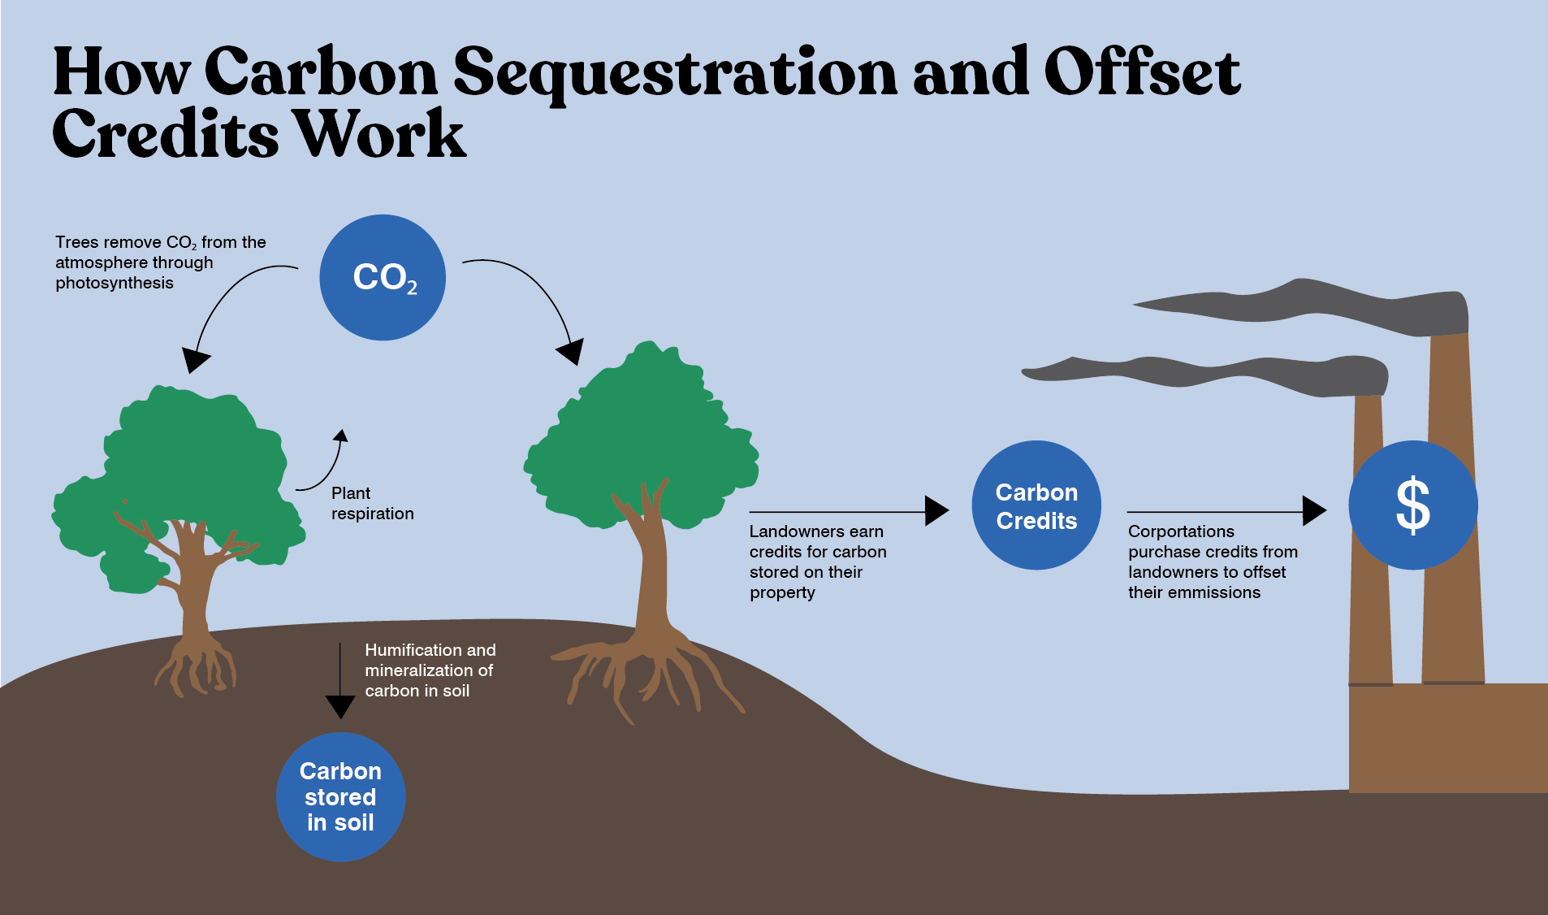
https://www.outdoors.org/resources/amc-outdoors/conservation-and-climate/how-amc-is-fighting-climate-change-through-carbon-credits/

Slide 29
Thank you for taking my class & enjoy your Christmas vacation

