Slide 1
BIL 160
Biology II - Evolution & Biodiversity
Fall 2024
Dr. Kevin McCracken
Course Website:
www.duckdna.org/evolution_biodiversity/
Contact:
kevin.g.mccracken@gmail.com
907-378-2100

Slide 2
Announcement
Workshop begins:
Thursday 29 August at 3:30 PM
Your 1st workshop is this week!
Your workshop leader will email you with instructions where to meet tomorrow Wednesday! Look for the email on your UM account.
Purchase this book & read Intro + Ch. 1:
The Evolution of Beauty: How Darwin's Forgotten Theory of Mate Choice Shapes the Animal World and Us (2017) by Richard O. Prum 1st Edition. Anchor. New York. ISBN-13: 978-0385537216

Slide 3
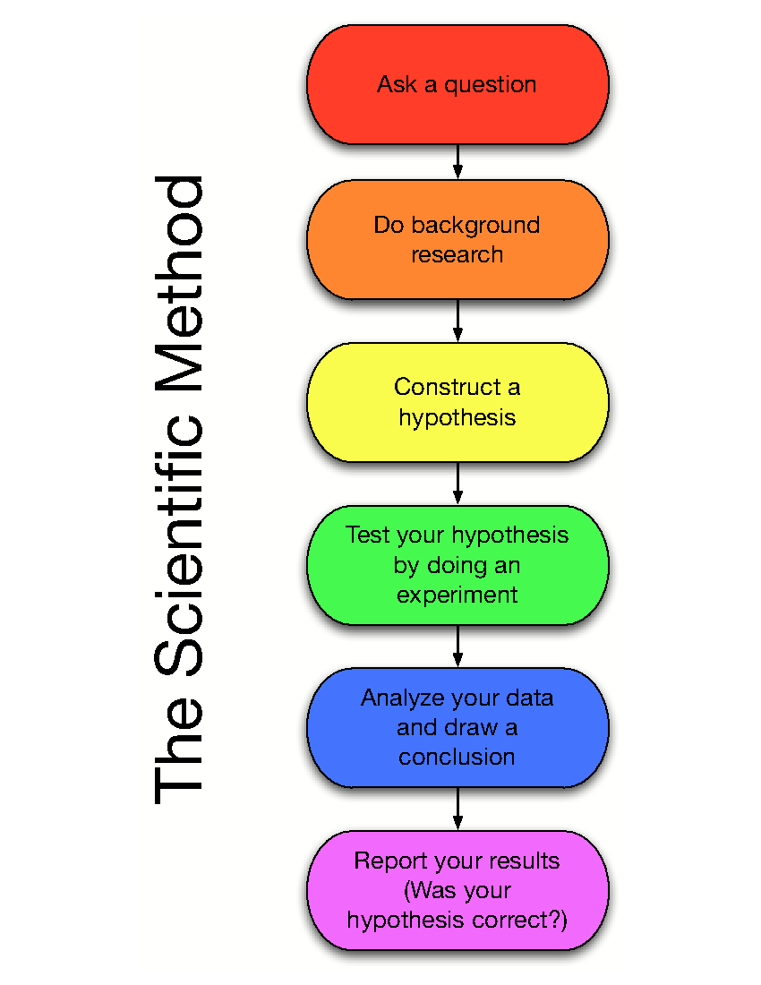
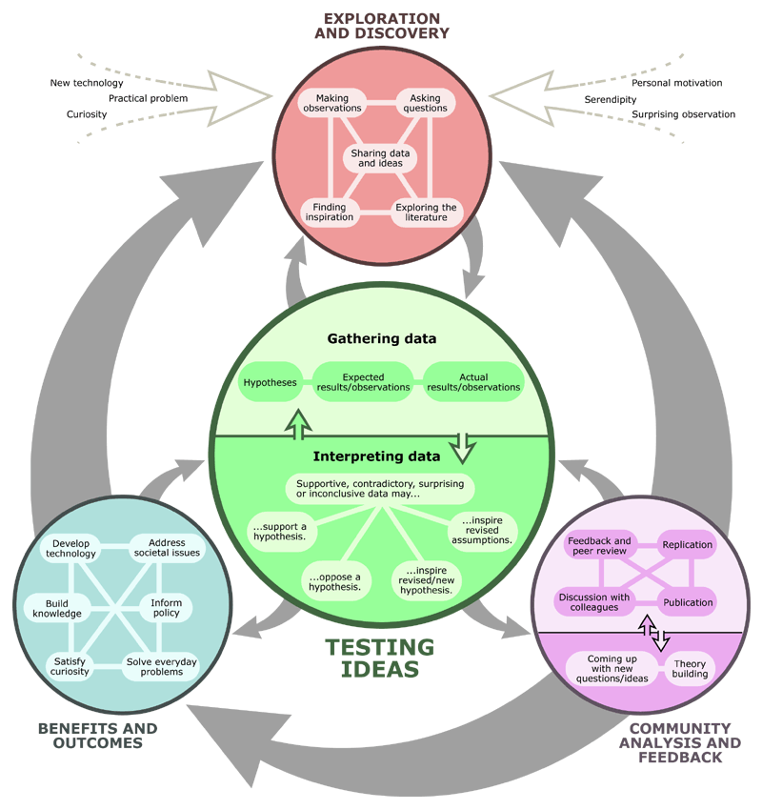
In the last lecture we talked about how science works.
We understand scientific inference
can be complicated…
i.e., facts can obscure the truth
… and we looked at some
of the first historical underpinnings for evolutionary theory.
Aristotle --> Lamarck

Slide 4
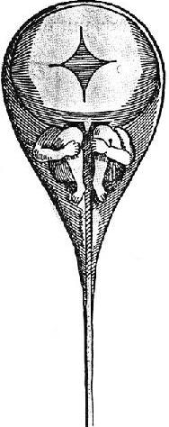
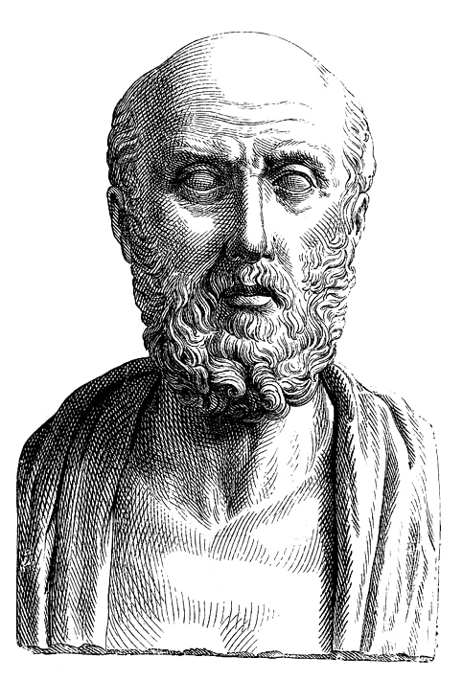
One of the 1st concepts of inheritance came from:
Hippocrates of Kos (460-370 BC)
-Hereditary material collects from throughout the body, and later, Aristotle stated that it is passed on through semen and menstrual blood
Homunculus
Latin for “little person” →
Shown here inside sperm

Slide 5
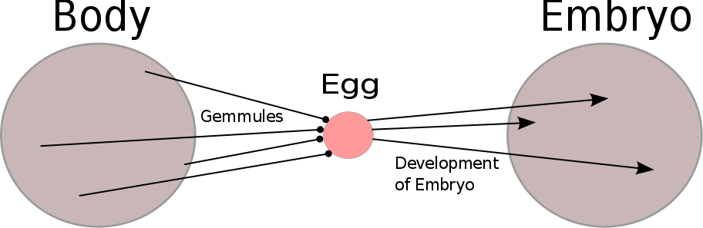
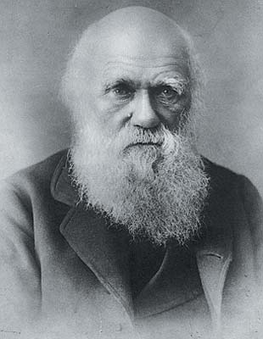
Darwin even proposed this radical old idea:
Pangenesis
Every part of the body emits tiny particles called gemmules which migrate to the gonads and are transferred to offspring.
Implied soft inheritance… a Lamarckian view.

Slide 6
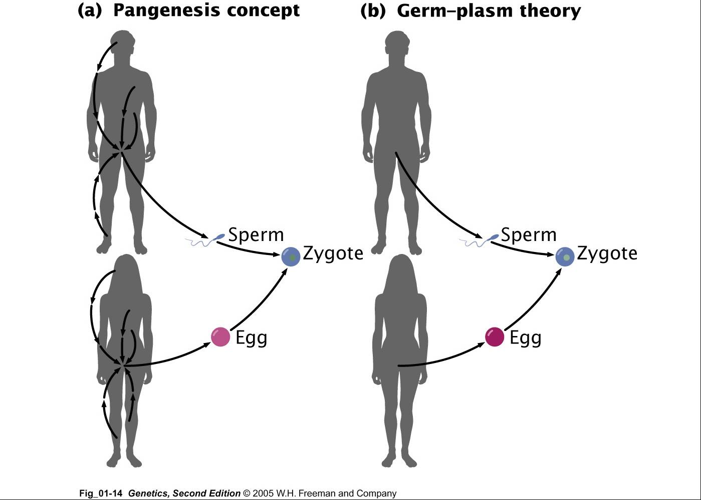
Genetic information is supplied from the entire body
Lamarckian -
Yes
Genetic information is supplied only from the gonads
Lamarckian - No

Slide 7
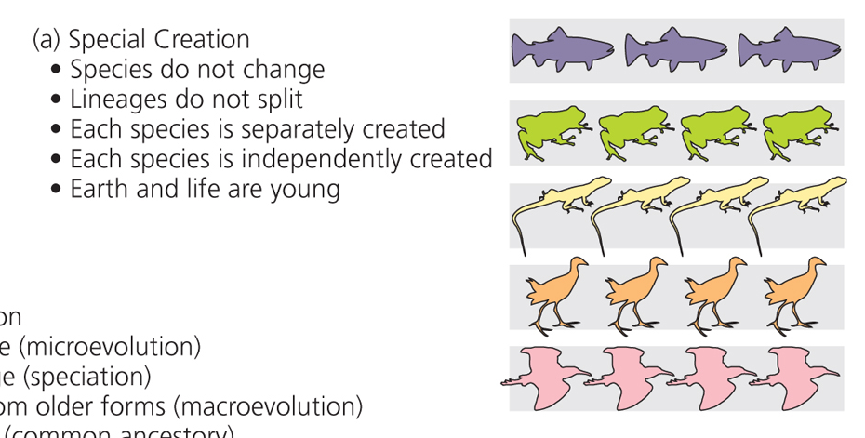
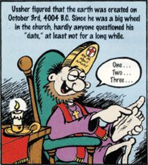
According to James Usher (1581-1656):

Slide 8
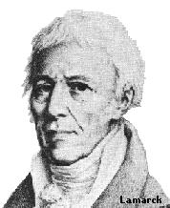
Ideas first changed when Lamarck proposed the 1st transformational hypothesis of evolution.
Jean-Baptiste Pierre Antoine de Monet, Chevalier de Lamarck (1744-1829)
1809 Philosophie Zoologique
->The mechanism of change was the
inheritance of acquired
characteristics.

Slide 9
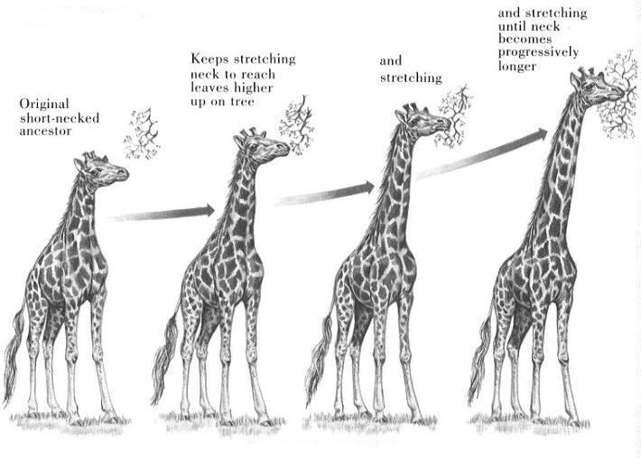
Only recently do we recognize that Lamarck described Epigenetic Inheritance without knowing the mechanism.

Slide 10
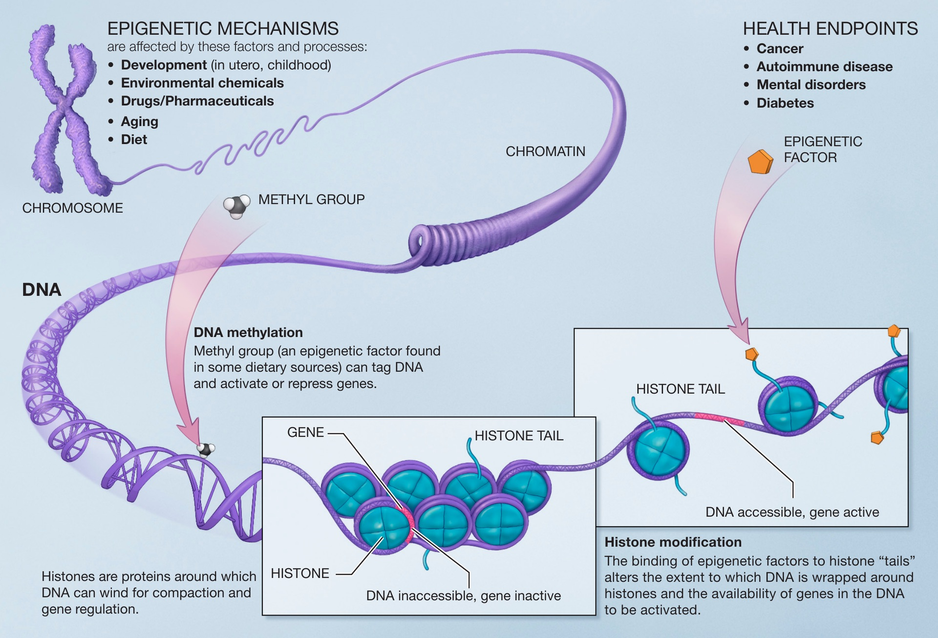
DNA expression is modified by environment and patterns inherited by DNA methylation and modification of chromatin---Wikipedia.

Slide 11
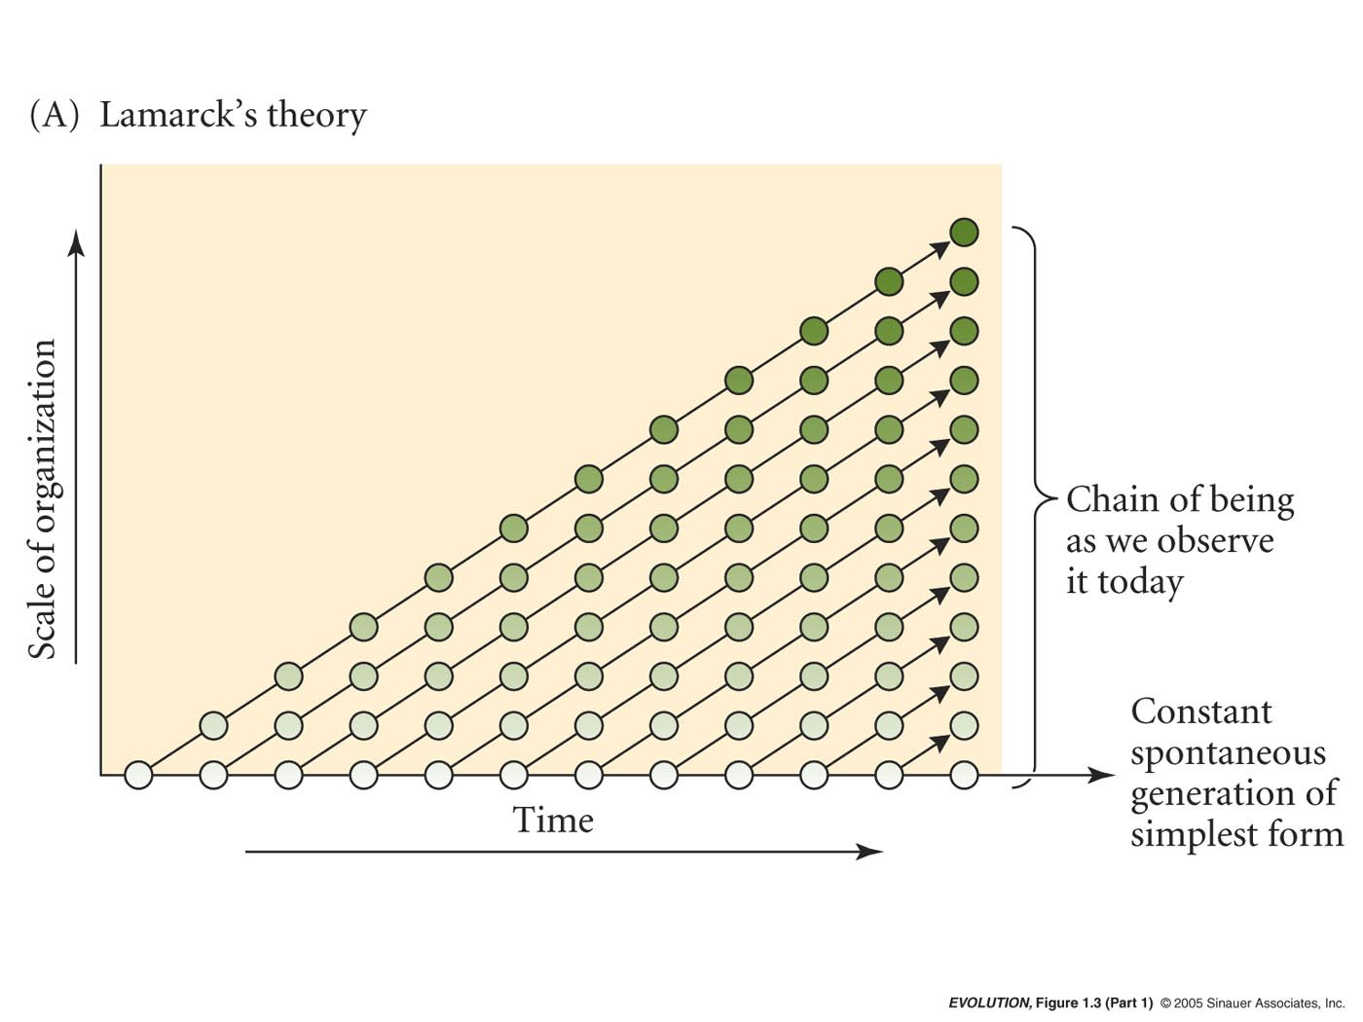
Lamarck’s Transformational Hypothesis of Evolution had appeal because it could account for the chain of being we observe today.
It implied improvement.

Slide 12
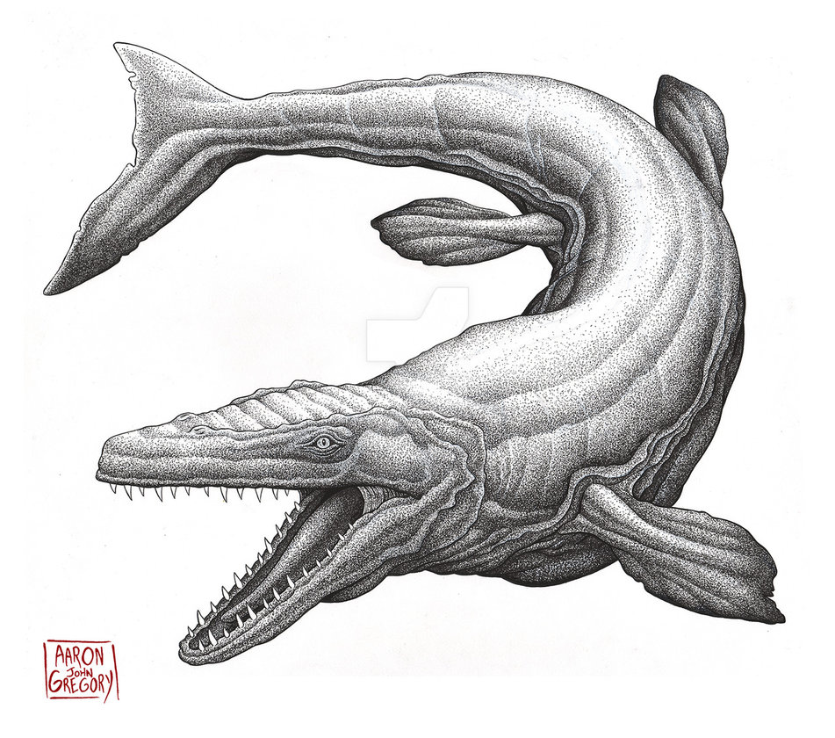
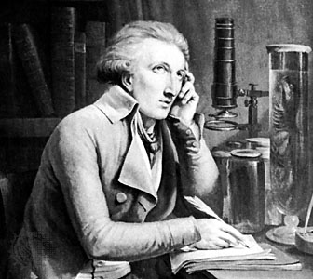
Georges Cuvier (1769-1832)
1825 Discours sur les Revolutions de la Surface du Globe
    About the same time Cuvier, a French paleontologist, argued that extinctions have occurred.
    Cited 32 spp. in fossil record that no longer exist.
    Compared living species to fossils.

Slide 13
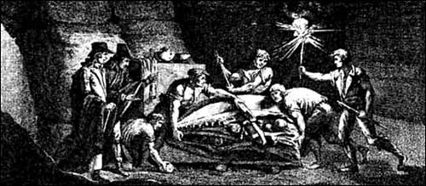
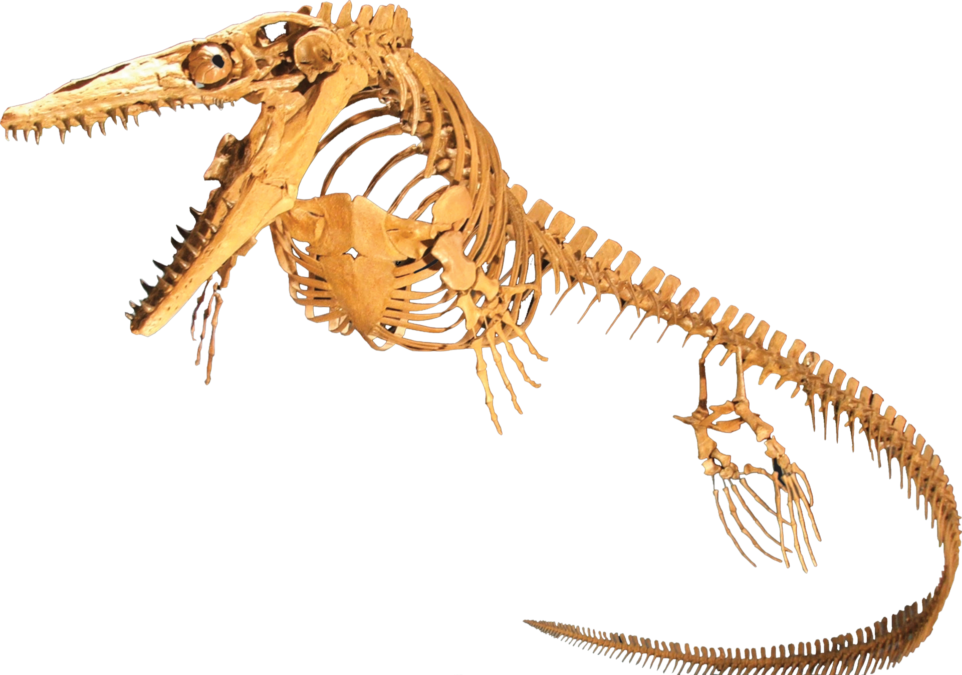
Discovery of the
1st Mososaur
in 1764
Cuvier’s discoveries presented a
challenge to special creation and the linearity of the scala naturae.
56 ft long

Slide 14
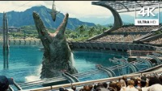
https://www.youtube.com/watch?v=UQQeSnrVSMw

Slide 15
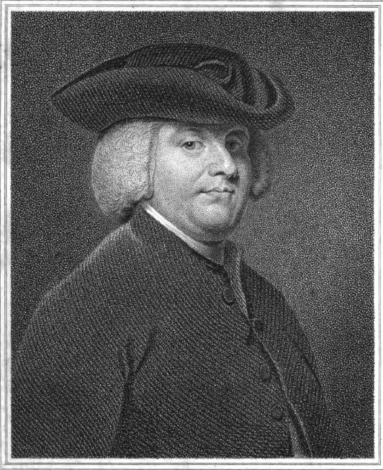
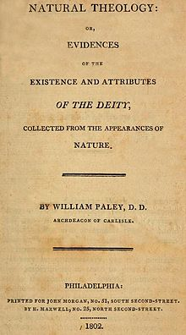
William Paley (1743-1805)
Christian Theologian
- Wrote a Natural Theology
Used organismal complexity to argue for the existence of God
Divine Watchmaker Analogy
In crossing a heath, suppose I pitched my foot against a stone, and were asked how the stone came to be there; I might possibly answer, that, for anything I knew to the contrary, it had lain there forever: nor would it perhaps be very easy to show the absurdity of this answer….... But suppose I had found a watch upon the ground, and it should be inquired how the watch happened to be in that place; I should hardly think of the answer I had before given, that for anything I knew, the watch might have always been there. ... There must have existed, at some time, and at some place or other, an artificer or artificers, who formed [the watch] for the purpose which we find it actually to answer; who comprehended its construction, and designed its use. ... Every indication of contrivance, every manifestation of design, which existed in the watch, exists in the works of nature; with the difference, on the side of nature, of being greater or more, and that in a degree which exceeds all computation.
—William Paley, Natural Theology (1802)

Slide 16
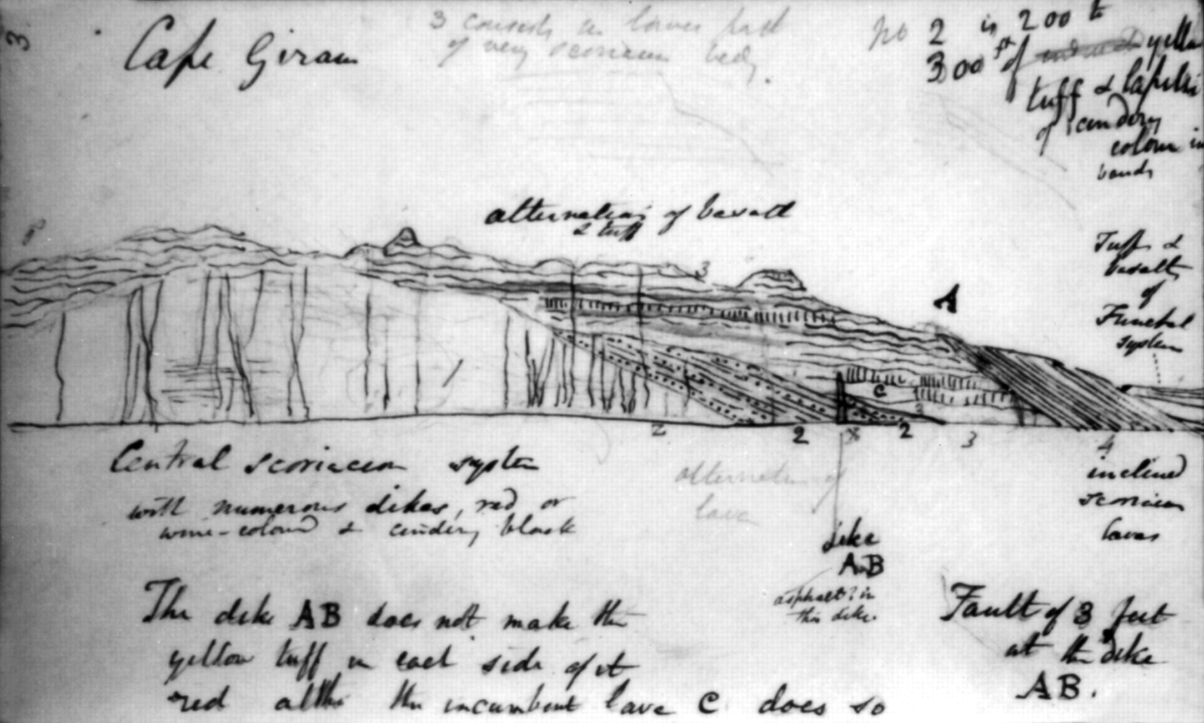
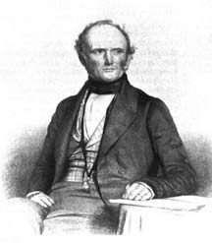
Charles Lyell (1797-1875)
1830-1833 Principles of Geology
      Uniformitarianism – Current processes
      have always occurred; very slow
      processes can lead to large changes
      over very long time periods.
      Argued that the age of the earth must be much older than explained by Theology
      Strong influence on Darwin

Slide 17
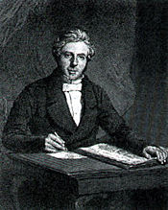
Robert Chambers
Vestiges of the Natural History of Creation
1844
      Argued that everything currently in existence (including species) had developed from earlier different forms, but did not provide a mechanism
      Popular book outsold “Origin of Species” until the 20th century
      But popular with neither the clergy or scientists.
      Nonetheless shifted popular opinion.

Slide 18
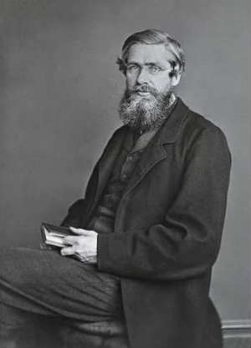
Darwin & Wallace - Theory of Natural Selection
Charles Darwin
1809-1882
Alfred Russell Wallace
1823-1913

Slide 19
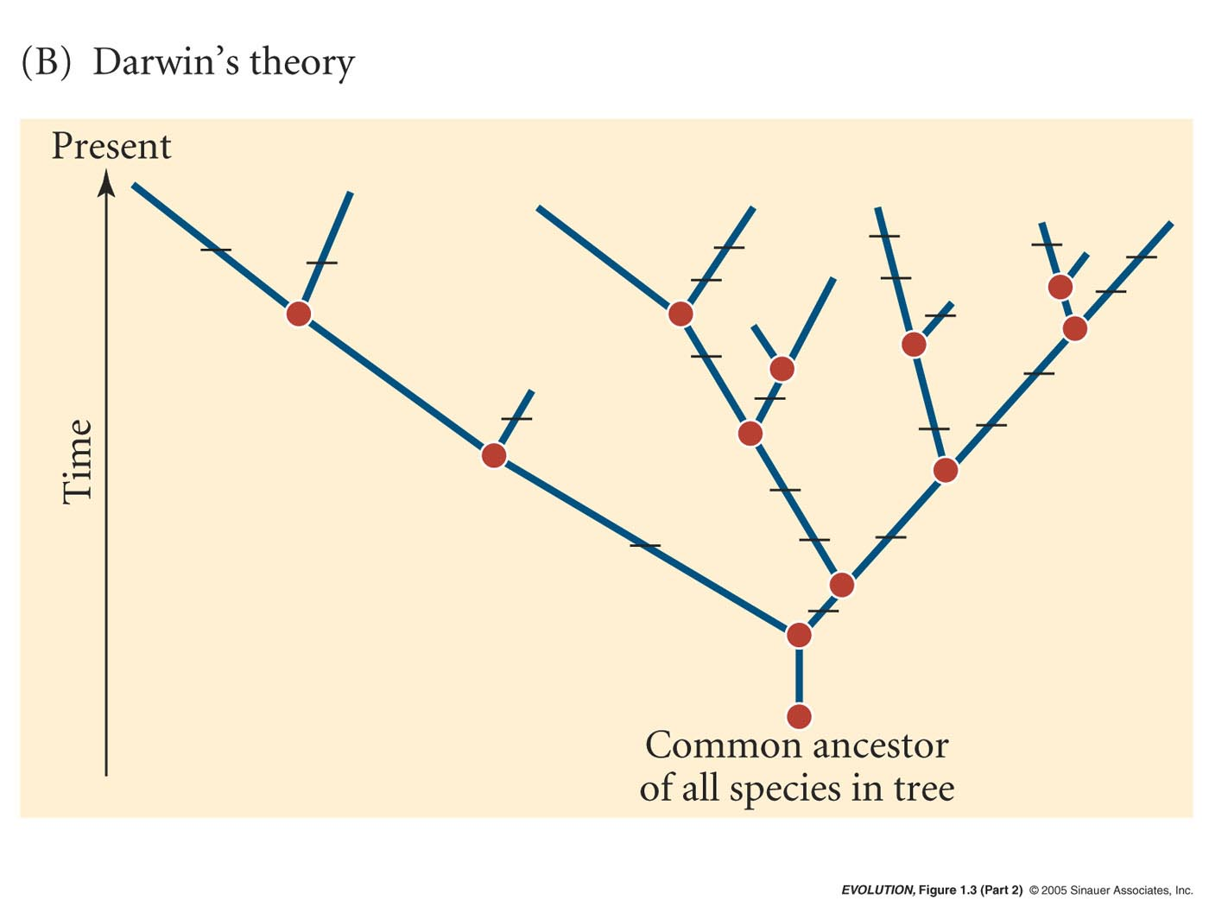
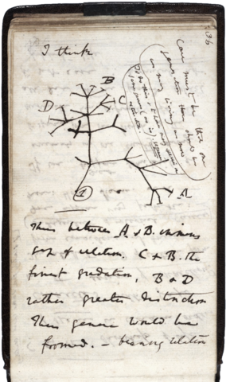
Darwin & Wallace
Variational Theory of Evolution
1937 Notebook

Slide 20
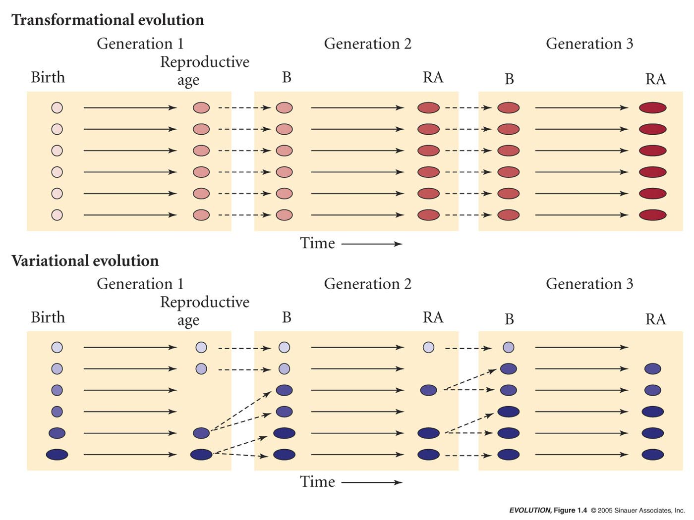
Transformational vs. Variational Theory

Slide 21
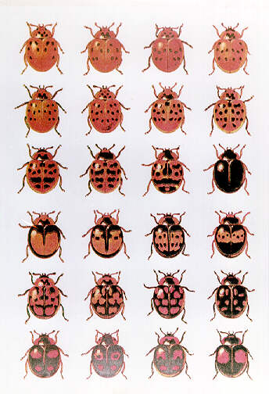
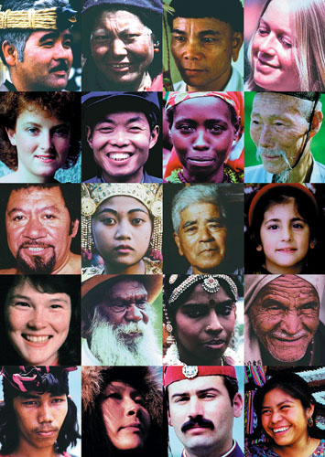
The structure of Darwin & Wallace’s argument for Natural Selection
A. Individuals within populations are variable

Slide 22
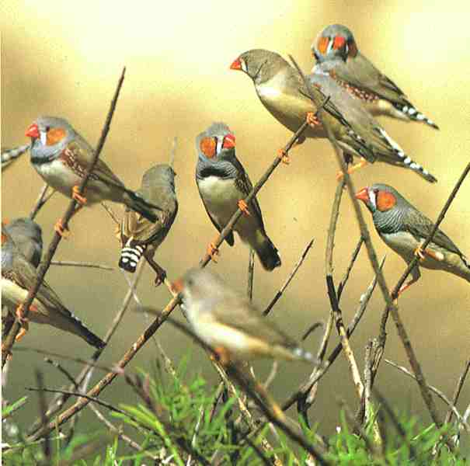
The structure of Darwin & Wallace’s argument for Natural Selection
B. The variations among individuals are, at least in part, passed from parents to offspring

Slide 23
The structure of Darwin & Wallace’s argument for Natural Selection
C. More individuals are produced that survive. In every generation some individuals are more successful at surviving and reproducing than others. (Darwin got this idea from Malthus)

Slide 24
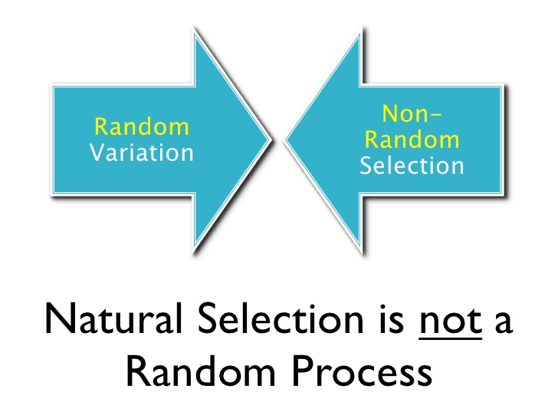
The structure of Darwin & Wallace’s argument for Natural Selection
D. The survival and reproduction of individuals is not random; it is tied to the variation among individuals. The individuals with the most favorable variations, those who are better at surviving and reproducing are naturally selected.
Natural selection is a directional process

Slide 25
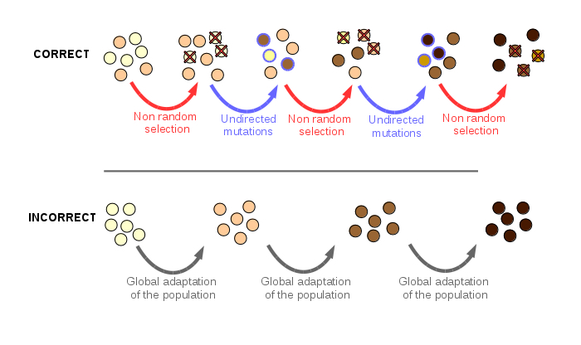
http://kinea.media/en/science-technology/four-misconceptions-about-evolution

Slide 26
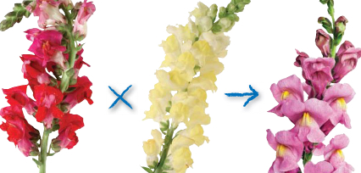
The main flaw in Darwin‘s Theory was that his mechanism for inheritance of traits was blending inheritance, which was incorrect.
= The blending theory is that the progeny inherits any characteristic as the average of the parents' values of that characteristic.

Slide 27
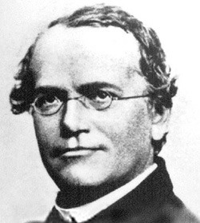
Development of Darwin & Wallace’s
Theory of Natural Selection
Gregor Mendel (1822-1884)
Discovered that inheritance is particulate.
That genes assort independently because they occur on different chromosomes (i.e., linkage).
Discovered dominance.

Slide 28
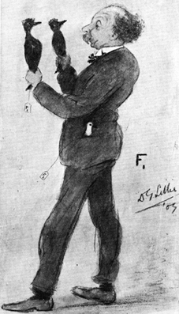
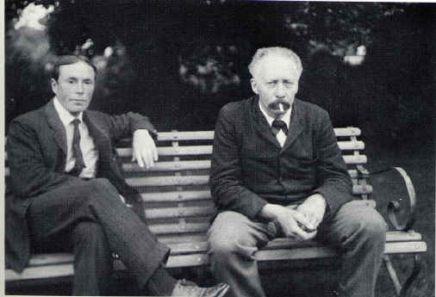
William Bateson
1861-1926
Animal geneticist experimenting on fowl.
Rediscovered Mendel in 1902 and first demonstrated that Mendelian principles applied to animals.
Incorrectly argued that mutation (not natural selection) was the most important force shaping variation in plants and animals.
William Bateson coined the terms: Genetics, Zygote, F₁, F₂, Allelemorph (⇒ allele)
Founded The Genetics Society in 1919

Slide 29
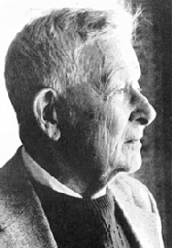
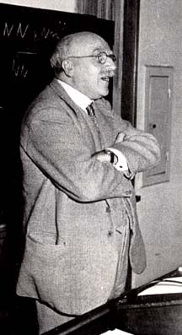
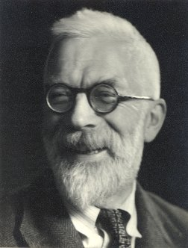
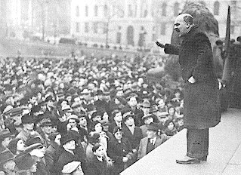
Theoretical & Mathematical Population Geneticists
Extended Mendel’s findings to natural populations and analysis of multiple genes.
Sewall Wright
J.B.S. Haldane
Sir Ronald Fisher
Major players of the Evolutionary Synthesis

Slide 30
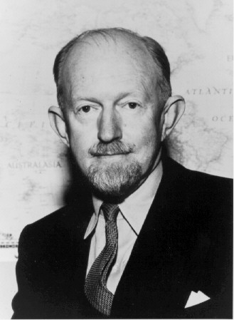
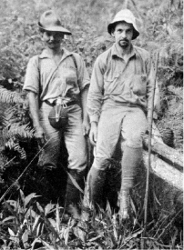
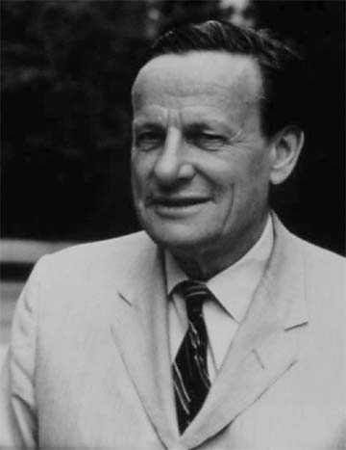
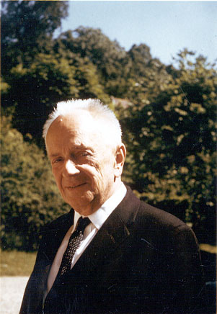
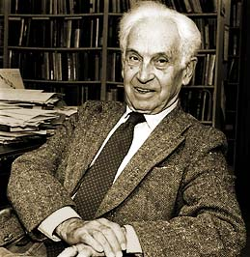
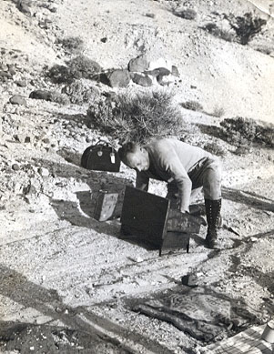
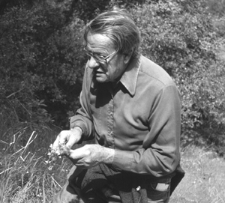
Followed by Empiricists
Ernst Mayr
Birds
Theodosius Dobzhansky
Insects
Ledyard Stebbins
Plants
Selection thinking was always very much the focus.
Selectionists prevailed over mutationists.
George Gaylord Simpson
Fossils

Slide 31
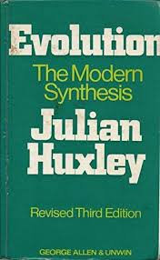
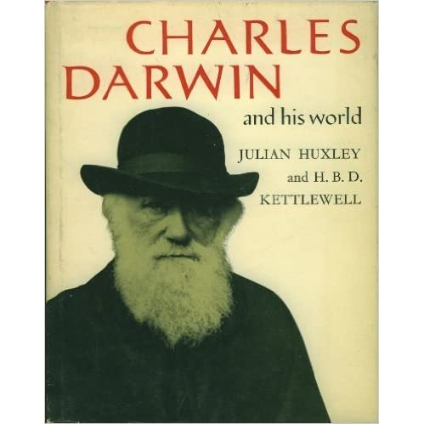
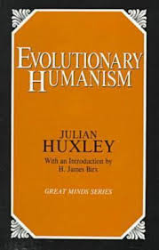

Julian Huxley
Important writer about Evolution
Grandson of Thomas H. Huxley
Brother of Aldous Huxley

Slide 32


Important Transition in Thinking
In the 1970s
Motoo Kimura and Tomoko Ohta
Neutral Theory of Evolution
Questions whether selection is the dominant force shaping genetic variation.
Stressed the importance of neutral processes such as genetic drift.
Stochasticity over selection

Slide 33
Where does evidence for Evolution come from?
1) Microevolution (change in allele frequencies)
2) Speciation
3) Macroevolution (large dramatic evolutionary change)
4) Evidence of common ancestry
5) The earth is old – geological record

Slide 34
1. Evidence for Microevolution
A. Selective Breeding
B. Direct observations of natural populations
C. Vestigial Structures

Slide 35


Selective breeding
Illinois long term selection experiment on maize
-started in 1896
Moose et al. 2004 Trends Plant Science 9:358-364

Slide 36


Direct Observation of Evolution in Nature
Soapberry bugs
Notes:
Soapberry bugs

Slide 37

Vestigial structures – functionless or rudimentary versions of a structure resulting from an evolutionary reduction from a more elaborate functional character.
Whales don’t have pelvic fins, but the bones are still there.

Slide 38

https://onlinelibrary.wiley.com/doi/full/10.1111/evo.12516

Slide 39

2. Evidence of Speciation
Contemporary evidence that species share common ancestors
Ring Species
->provide unique
illustration how
populations are
related
Notes:
Ensatina

Slide 40

3. Macroevolution
Evidence that species are related by descent from common ancestors and have changed in form through time
Law of succession – extinct forms are similar to extant forms in each biogeographical province
Giant Wombat
Glyptodont

Slide 41


Slide 42


Evidence that species change through time
Transitional forms
http://www.prehistoric-wildlife.com/species/h/hyracotherium.html
“How horses got their hooves” - New York Times 28 Aug 2017
https://www.nytimes.com/2017/08/28/science/horses-hooves-evolution.html
Vertebrate Paleontology by Alfred Sherwood Romer. Published by The University of Chicago Press.
Copyright © 1945, 1966 by The University of Chicago

Slide 43




Evidence that species change through time
Transitional forms
Tiktaalik intermediate between fish & amphibians (375 My)
Above:
loss of gill cover (blue)
Reduction in size of post-parietal bones (green)
Gradual reshaping of skull

Slide 44


