Slide 1
First Life

Slide 2
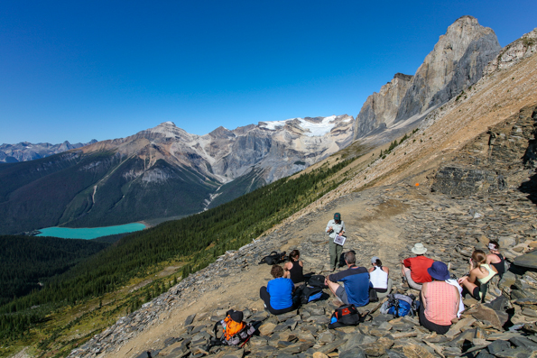
What is the Burgess Shale?
Fossil deposit in Canadian Rockies, 508 million years old, discovered by Charles Walcott in 1909 and led us to understand the Cambrian Explosion.
A vast profusion of life of almost every form, like an evolutionary experiment that changed our view of evolution.

Slide 3
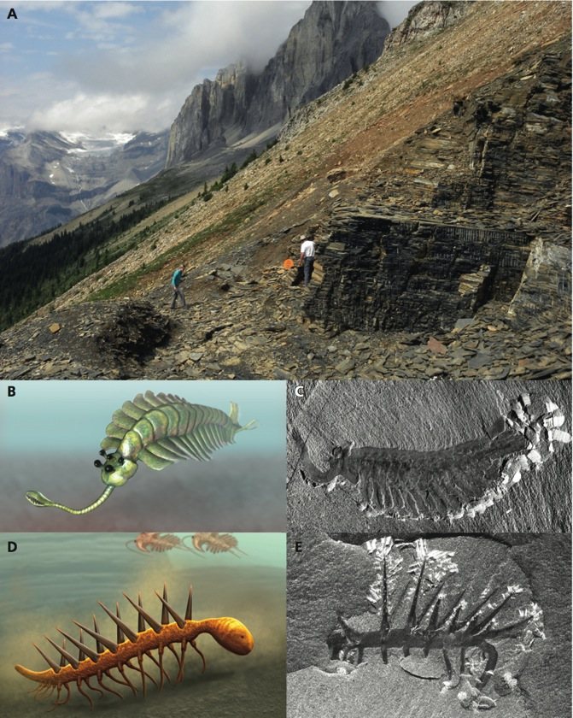
Burgess Shale
505 million years ago
>65,000 specimens
~93 species

Slide 4
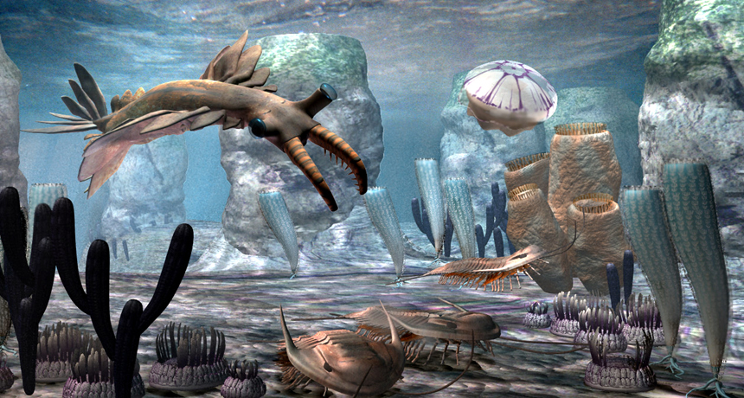
https://www.hunebednieuwscafe.nl/2017/10/lezing-vroegste-leven/

Slide 5
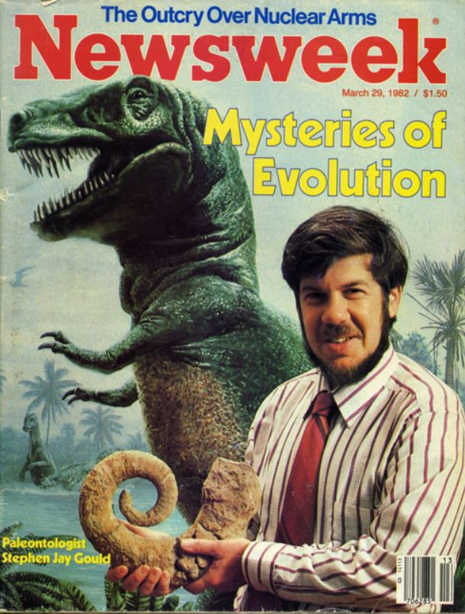

Slide 6
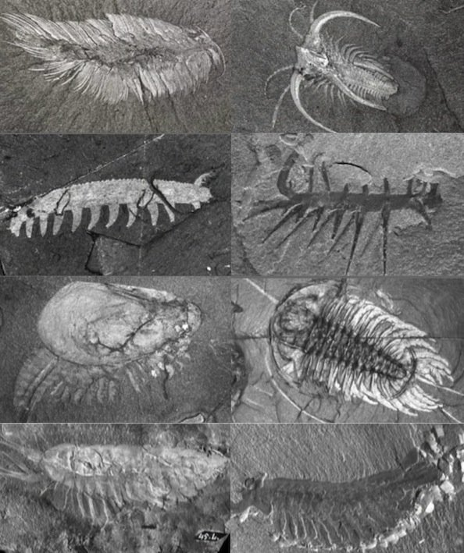
Annelid Canadia
Arthropod Marrella
Velvet Worm-Aysheaia
Hallucigenia
Arthropod-Canadaspis
Trilobite- Olenoides
Arthropod-Leanchoillia
Opabinia
https://answersingenesis.org/fossils/types-of-fossils/burgess-shales-cambrian-fossils-should-change-our-view-of-evolution/

Slide 7
Evolutionary Big Bang, ancestors of most forms of life on earth
appearance in the fossil record of diverse life-forms with no discernible ancestral forms
phyla of animals to which no evolutionary descendants could be assigned
https://answersingenesis.org/fossils/types-of-fossils/burgess-shales-cambrian-fossils-should-change-our-view-of-evolution/

Slide 8
Evolution is both predictable & idiosyncratic
“If one could somehow turn the clock back to the Cambrian and run the game again, there is no reason to think the outcome would be the same. These little creatures, entombed in rock for a half-billion years, are a reminder that we are so very lucky to be here.”
--- Jerry Adler

Slide 9
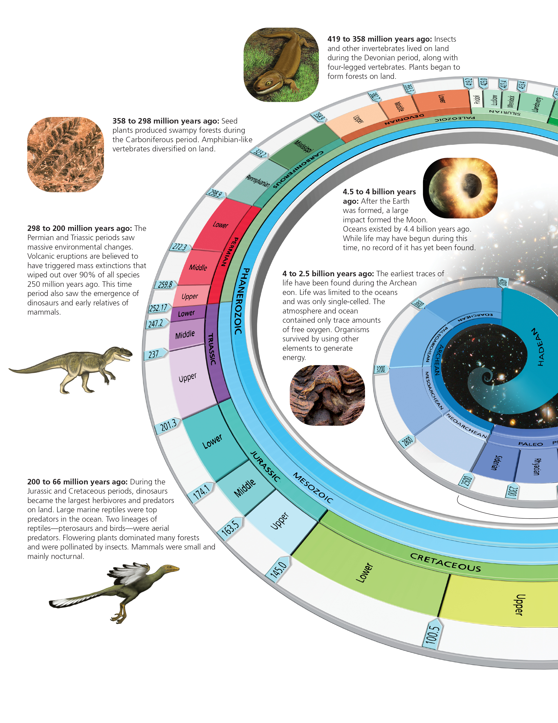
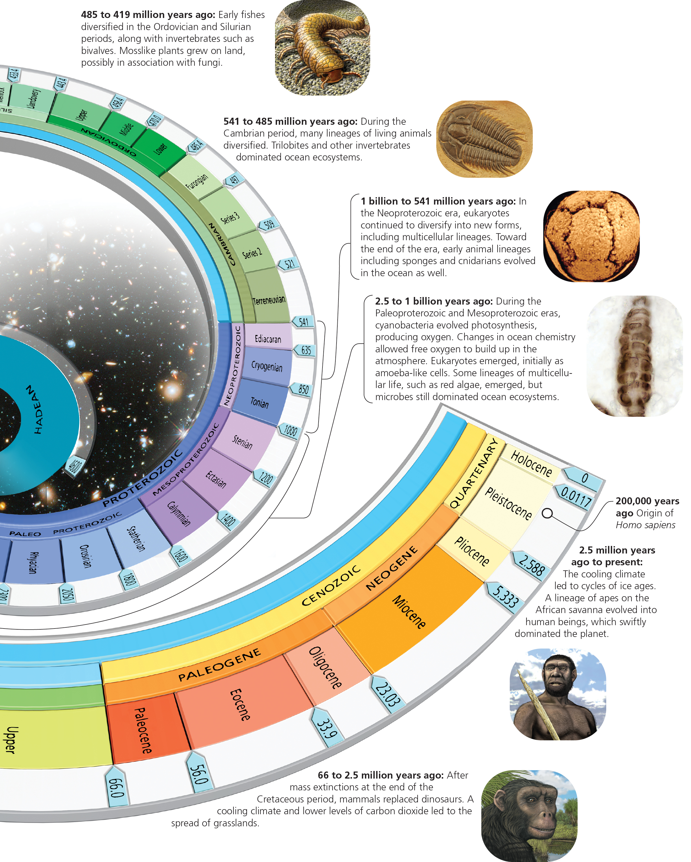
Radiometric dating estimates the age of the earth at 4.56 billion years old

Slide 10
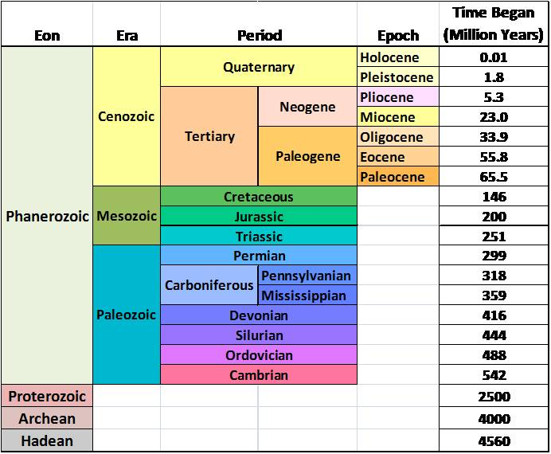
Radiometric dating allows for precise estimates of the age of geological formations
For the exam:
There will be questions on the Eons, Eras and Periods in the Phanerozoic, time from present, and major events discussed in lecture

Slide 11
The nature of the fossil record
Fossil – any trace of an organism that lived in the past
Types
Compression fossil – organic remains are flattened by overlying strata during fossilization
Impression fossil – an imprint of an organism is produced during fossilization
Permineralization fossil – structures are buried in sediments and dissolved minerals precipitate into the cells.

Slide 12
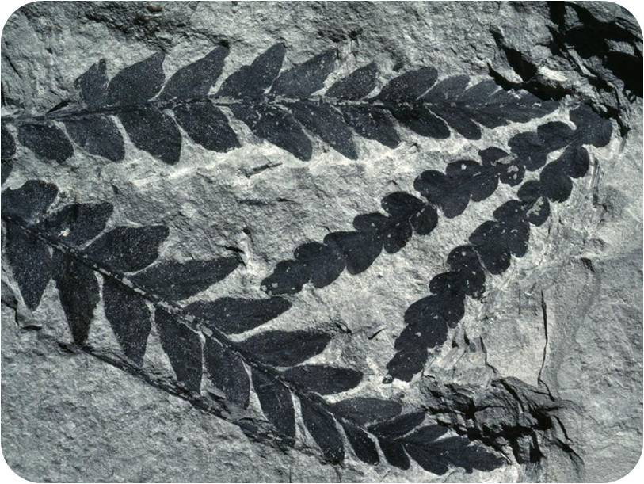
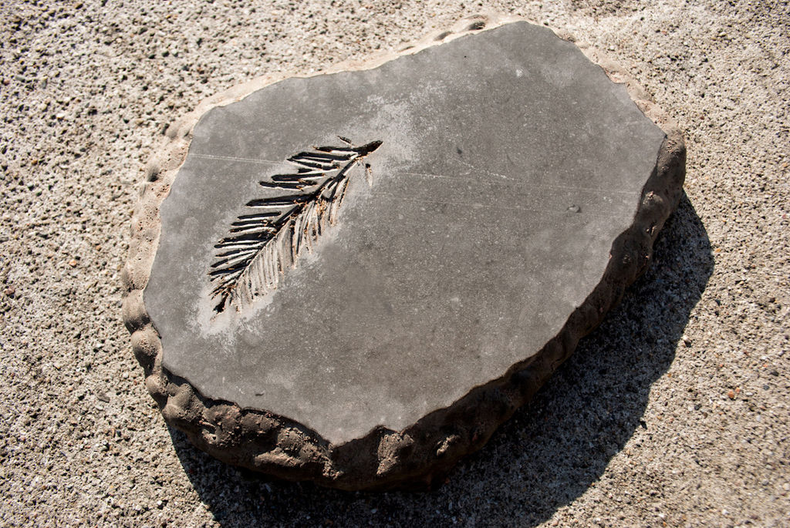
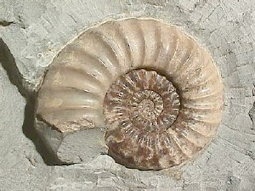
Compression fossil
Impression fossil
Permineralized fossil

Slide 13
Types Continued
Molds – unfilled spaces formed after remains decay after being buried in sediment.
Casts – When molds are filled with new material that hardens
Unaltered remains – preserved traces of organisms such as mummies, organisms embedded in amber, dried dung, etc.

Slide 14
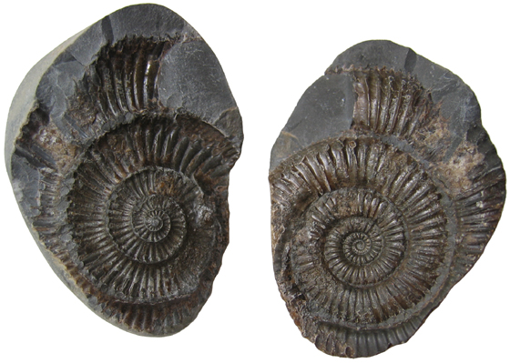
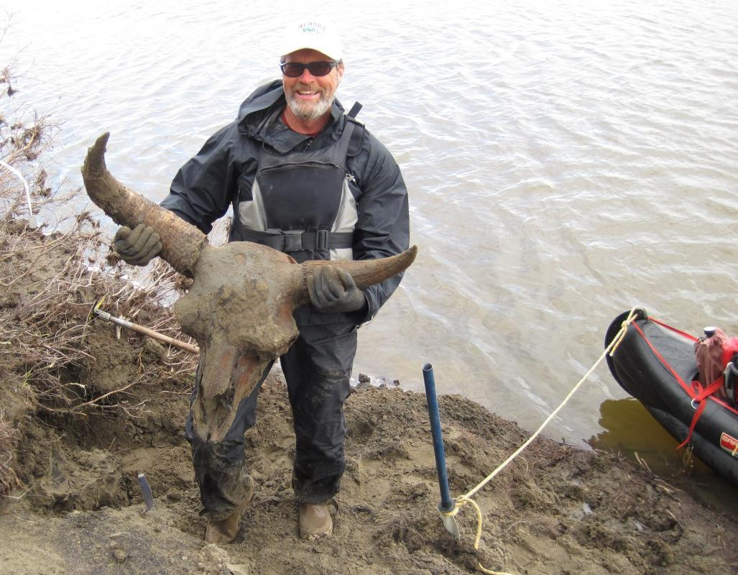
mold
cast
Bison Bob
https://www.gi.alaska.edu/alaska-science-forum/bison-bob-big-discovery-north-slope

Slide 15
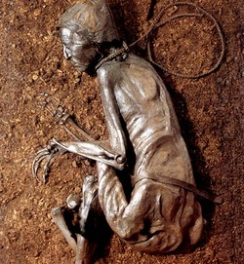
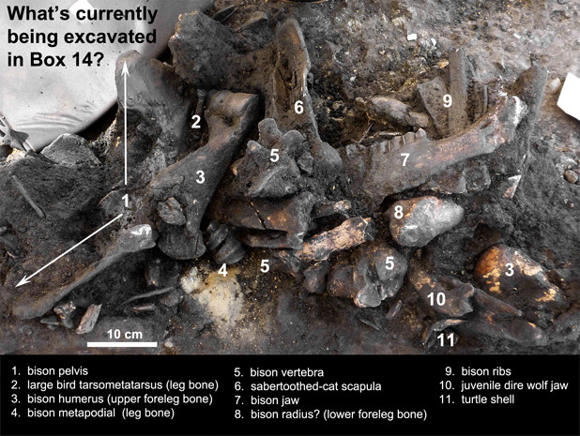
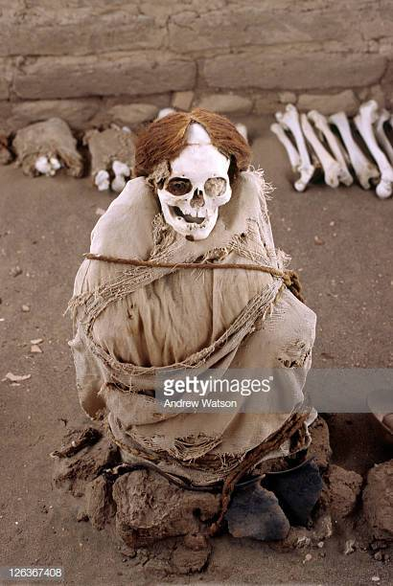
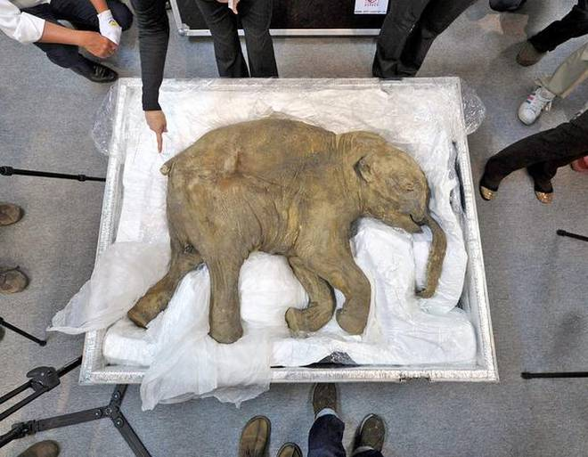
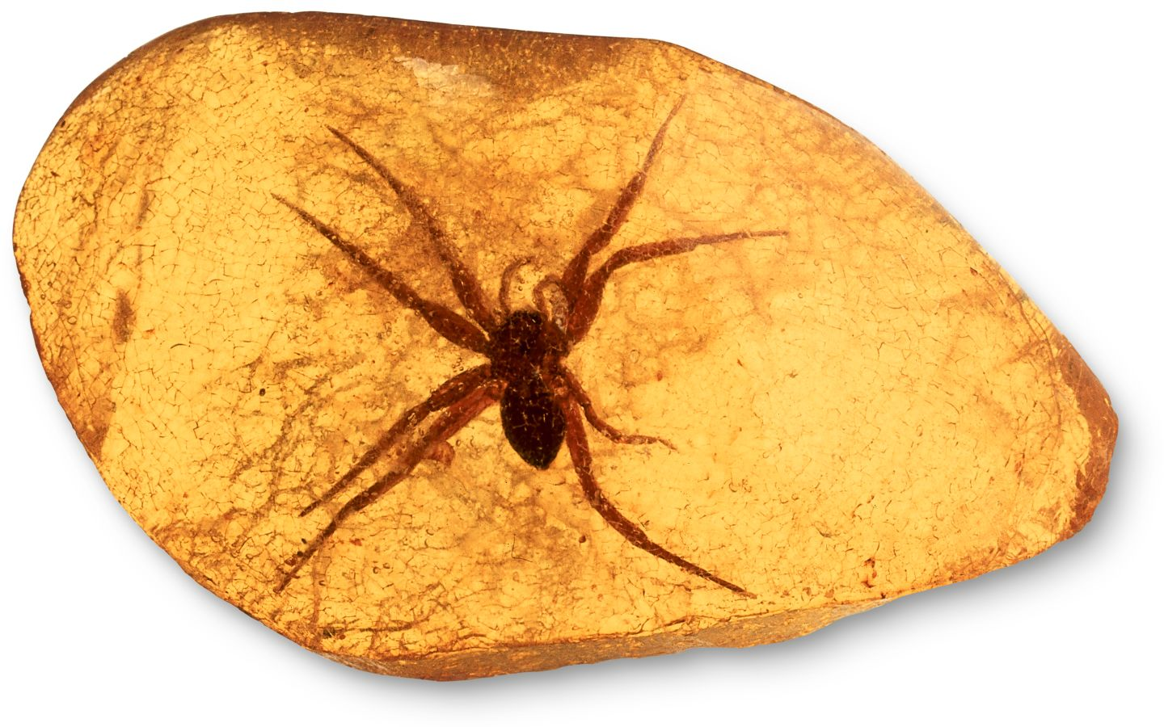
Ways in which fossils can be preserved unaltered:
Peat bogs
Amber
Tar pit
Mummification or desiccation
Frozen

Slide 16
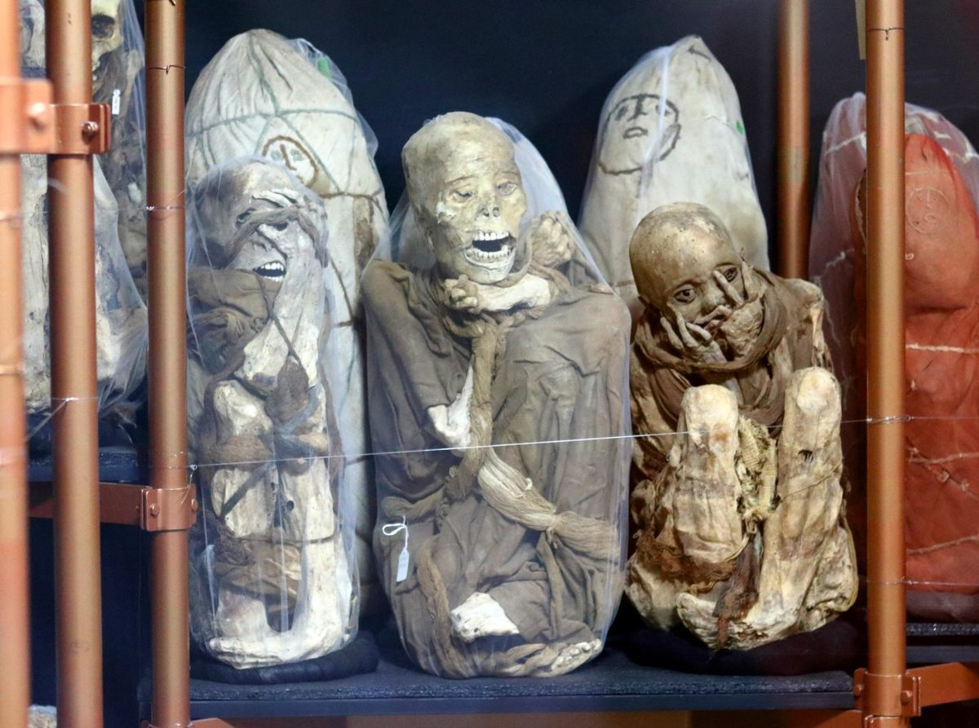
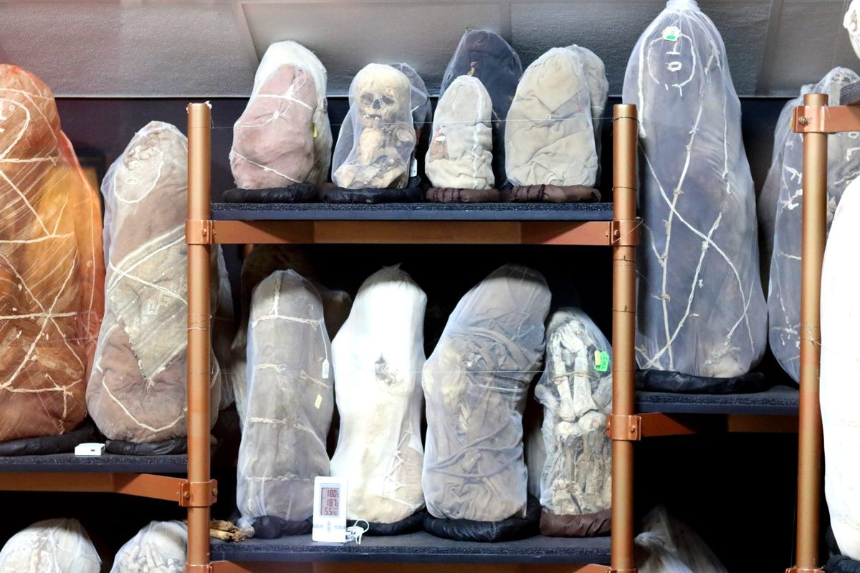
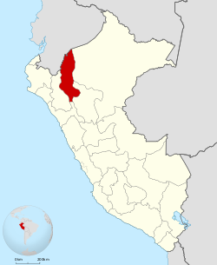
Mummies of Museo Leymebamba
Leymebamba Museum
Leymebamba, Peru
https://www.atlasobscura.com/places/mummies-of-museo-leymebamba

Slide 17
The fossil record is extremely incomplete.
~250,000 fossil spp; << 1% of past species
Geographical bias – most fossils from lowland and marine habitats; areas where decay is fast generate fewer fossils
Taxonomic bias – most fossils are marine, but only 10% of current taxa are marine; organisms that lack hard parts do not fossilize
Temporal bias – sediment formation varies episodically

Slide 18
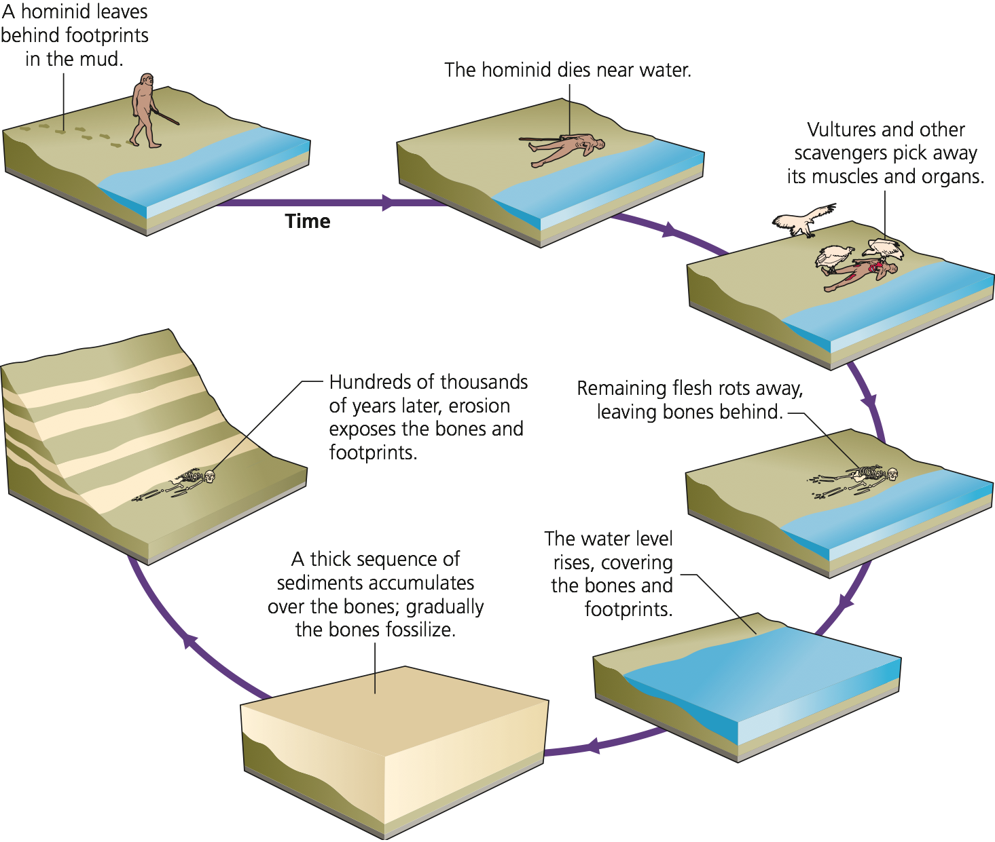
Most organisms don’t fossilize

Slide 19
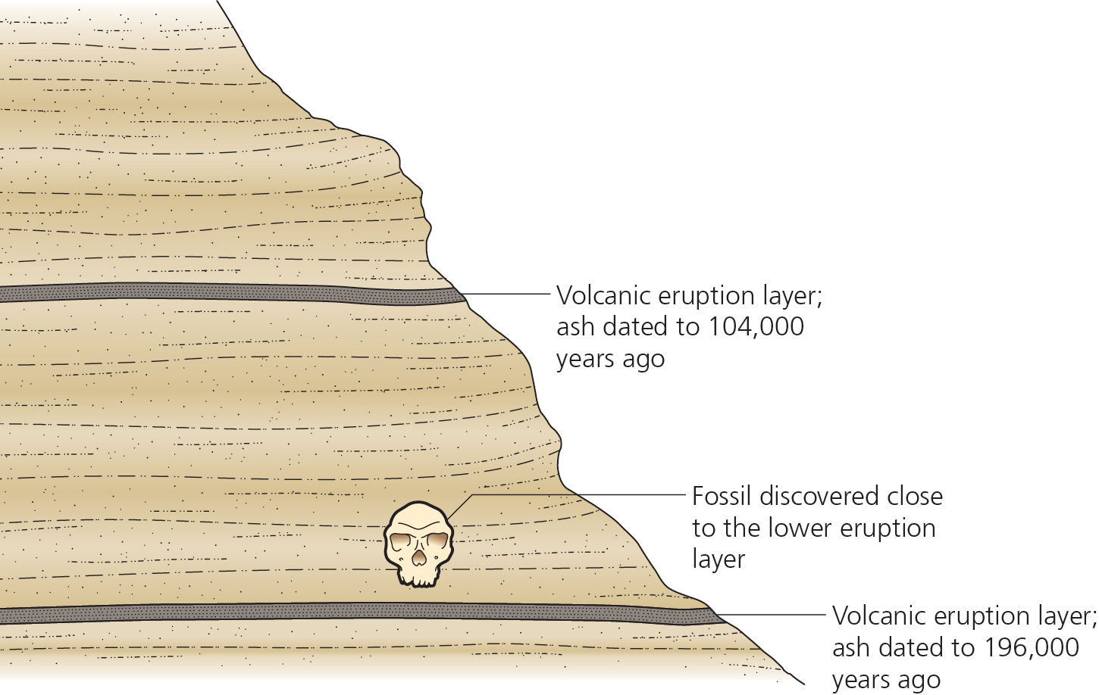
Age of fossils can be estimated
Fossils don’t usually have radioactive isotopes
To estimate the age of fossils, we age rock layers above and below fossils

Slide 20
Key Concept
The fossil record can never be complete because most organisms don’t fossilize

Slide 21
Fossils allow us to learn about extinct species
Behavior
Development
Morphology

Slide 22
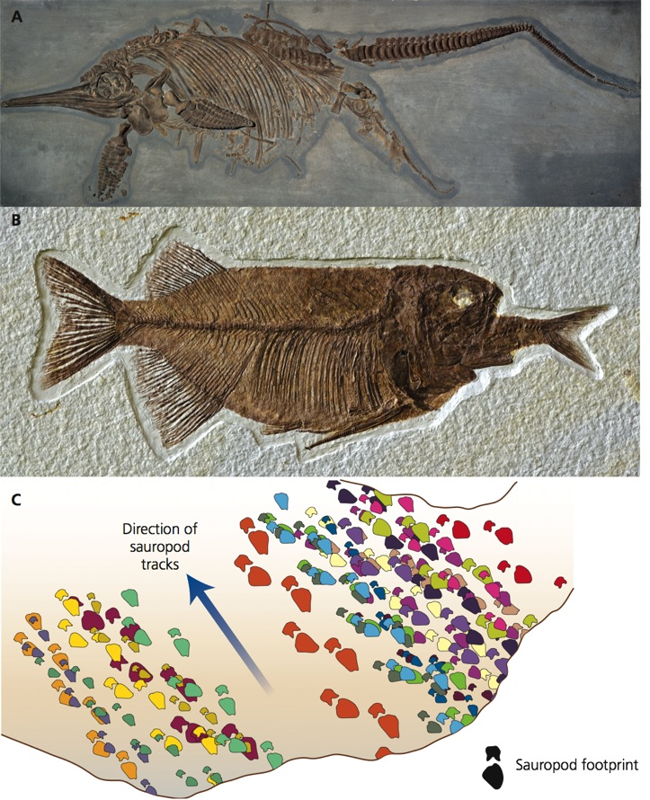
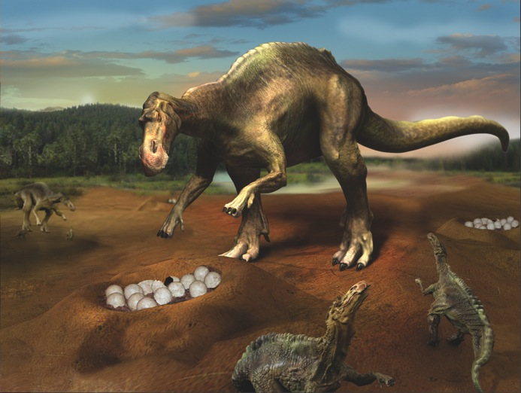
Fossils provide clues about behavior
A. Live birth
B. Diet
C. Migration patterns
D. Parental care (Maiasaura)
Notes:
Live birth
Diet
Migration patterns
Parental care Maiasaura cared for their young

Slide 23
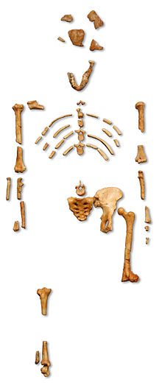
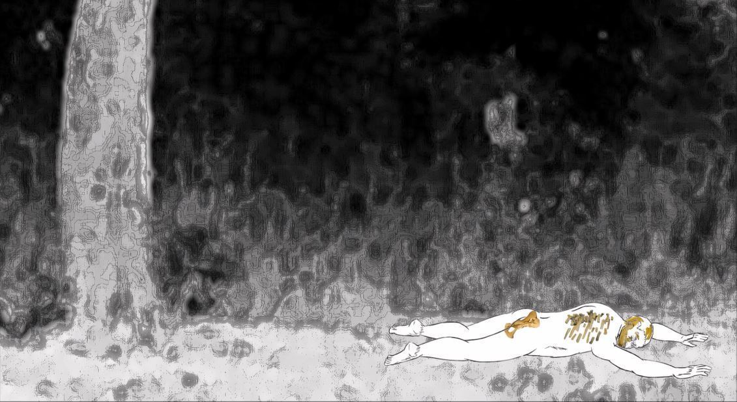
Lucy fell from a tree
https://youtu.be/ODuZsLQ5ZgQ
Australopithecus afarensis

Slide 24
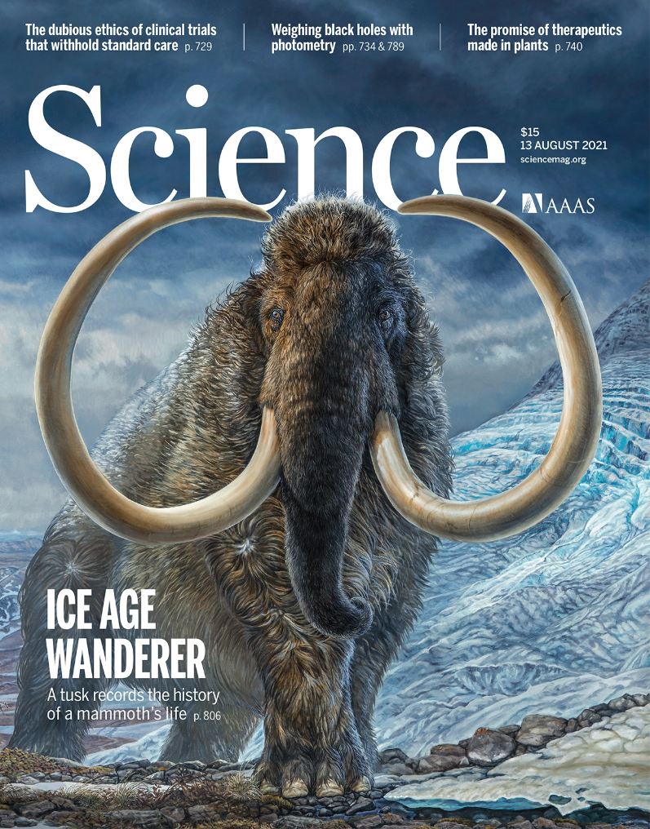
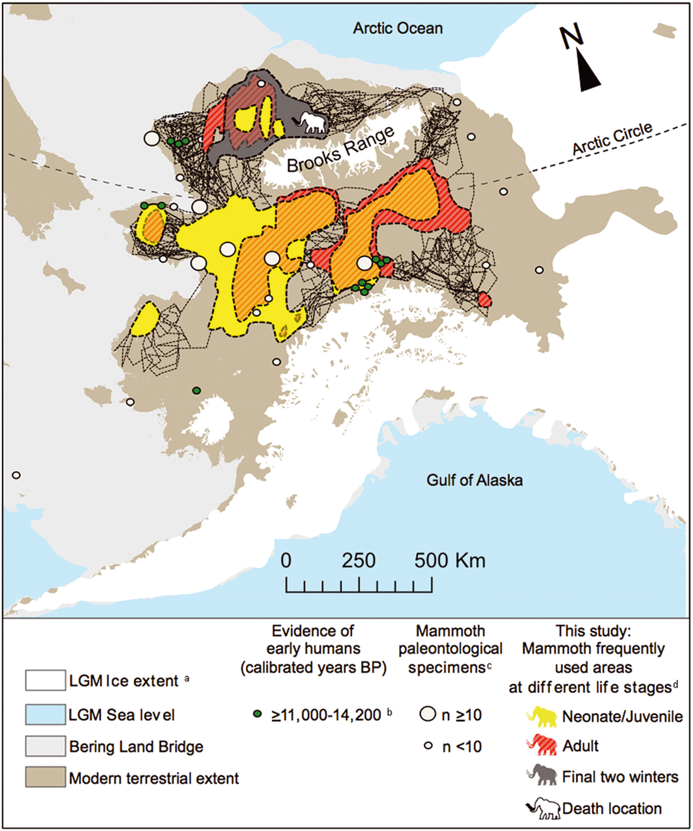
Movements of a 17ky-old mammoth tracked across Alaska using stable isotopes in the tusk.

Slide 25
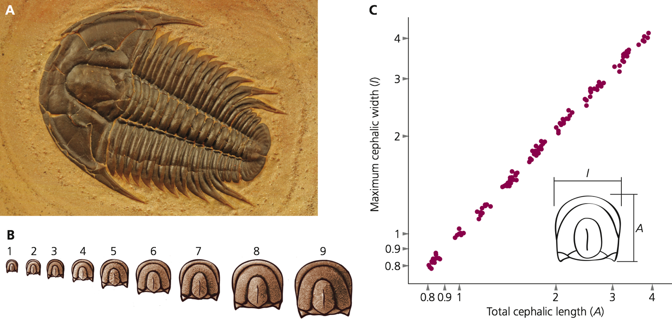
Fossils provide clues about development
Notes:
trilobyte

Slide 26
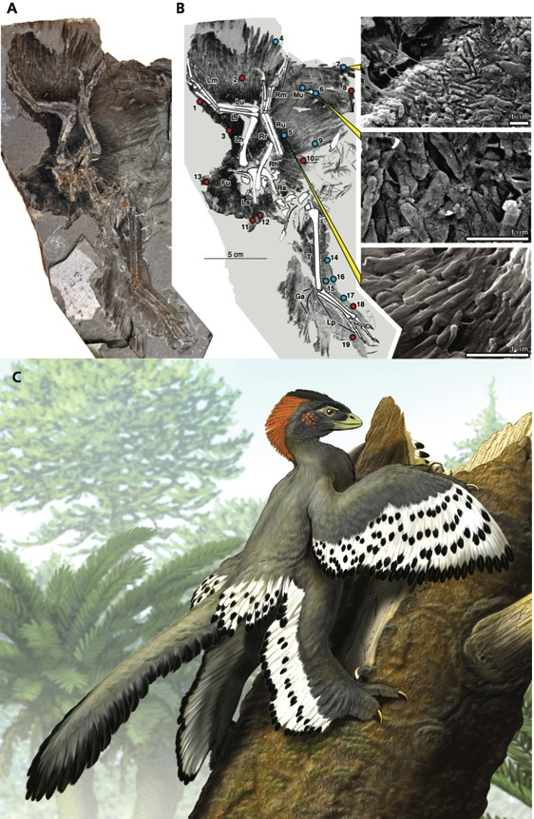
Scanning electron microscopy (CT scan) provides evidence of cellular structure
Structure of melanosomes suggests striking plumage
Fossils of a 150 Million year old dinosaur called Anchionis huxleyi preserved feathers.
The feathers retain cellular structures called melanosomes that help produce color.
The melanosomes produced a complex pattern of colors on Anchiornis. The size, shape and organization of the melanosomes allows paleontologists to reconstruct their original color

Slide 27
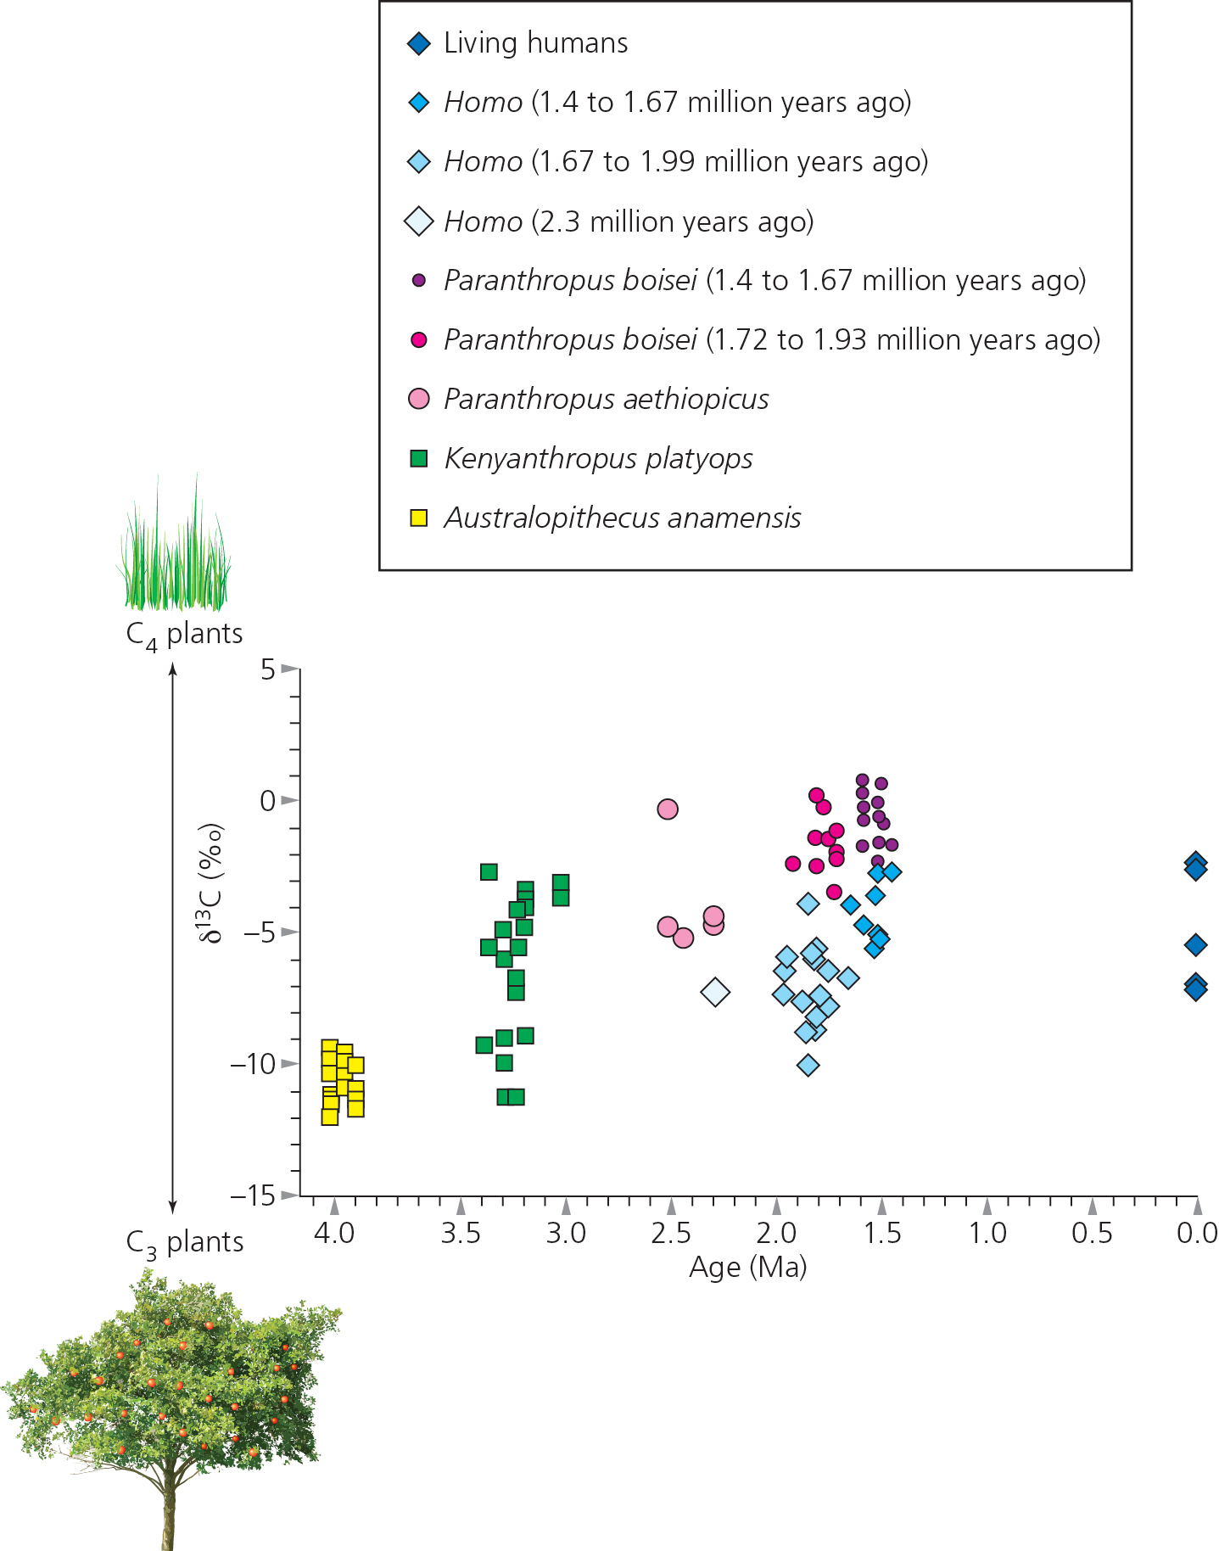
Carbon isotopic signatures used to infer diet of early hominins
C₄ plants have higher C₁₃ than C₃ plants
C₁₃/C₁₂ ratio used to infer types of plants eaten

Slide 28
Key Concept
Technology allows scientists to gain insights into the natural history, behavior, and appearance of extinct organisms

Slide 29
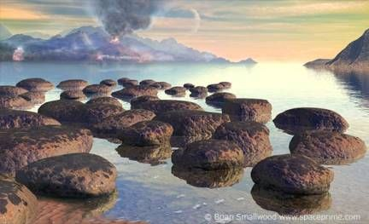
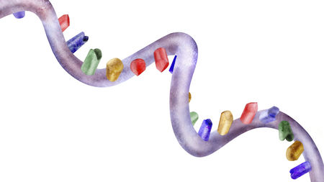
The First Life
Oparin Haldane model
DNA or RNA world?
The Cenancestor

Slide 30
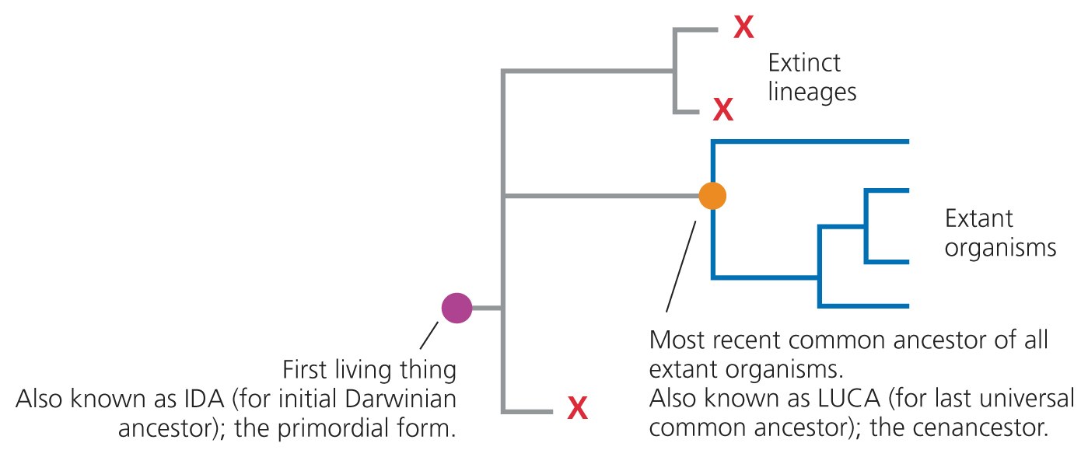

Slide 31
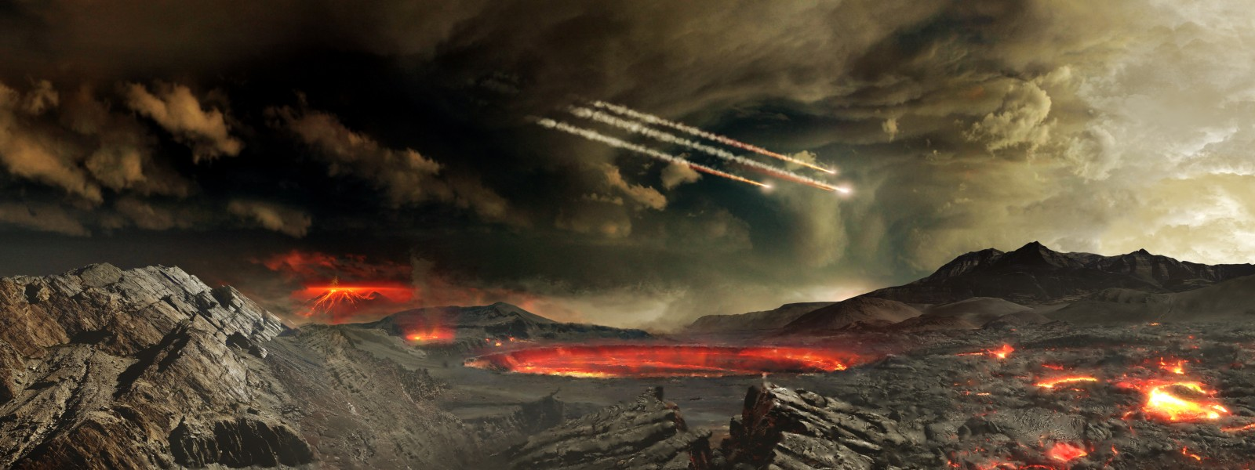
Early Earth
No free oxygen
Mostly methane (CH₄), ammonia (NH₃), and water
Magmatic history
https://wallhere.com/en/wallpaper/908017

Slide 32
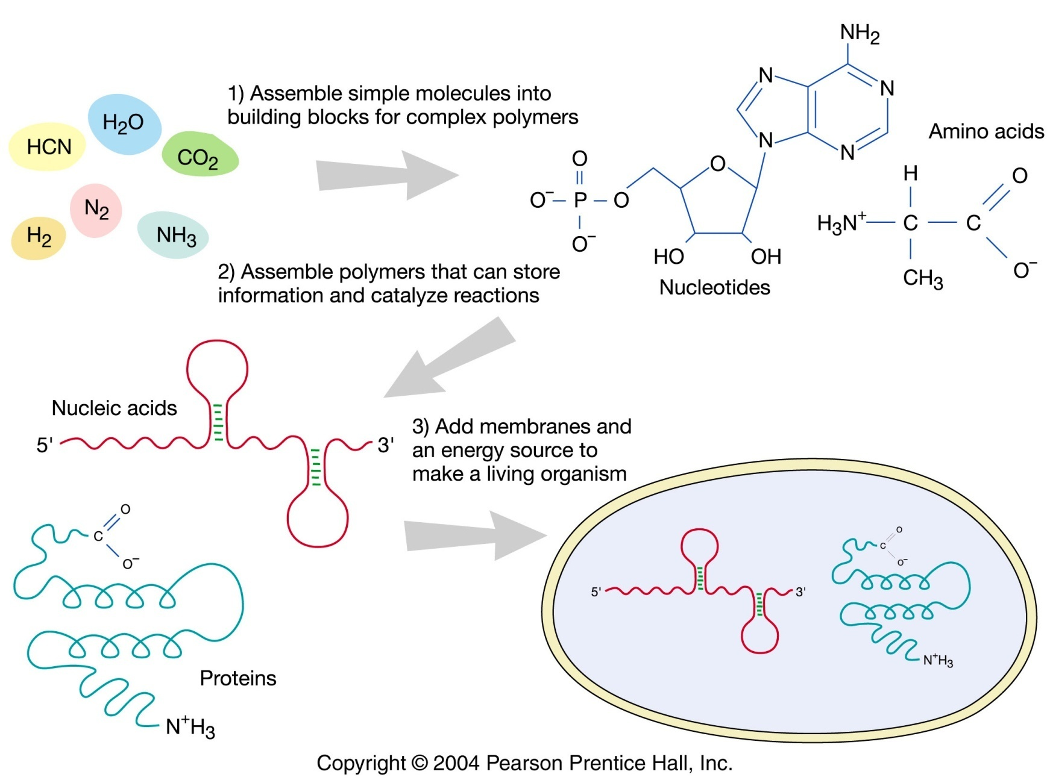
Oparin-Haldane Model of the origin of life
J.B.S. Haldane

Slide 33
What was the original hereditary material?
RNA probably arose first and DNA arose later
Reasoning:
1. RNA does it all
a. enzyme
b. information storage
c. possesses genotype & phenotype
2. Machinery to process RNA into proteins is highly conserved and built around RNA molecules (e.g. tRNA, rRNA).
3. ATP & GTP are currency of bioenergy
- both are ribonucleoside triphosphates (building blocks of RNA)

Slide 34
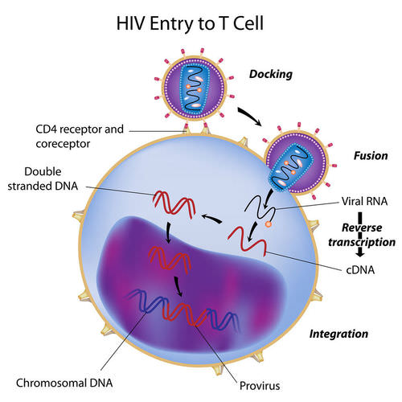
What was the original hereditary material?
RNA probably arose first and DNA arose later
Gap in Understanding:
No self-replicating catalytic RNA has yet been discovered. cDNA is a necessary intermediate in RNA viruses
But see:
Lincoln & Joyce 2009
Science 323:1229

Slide 35
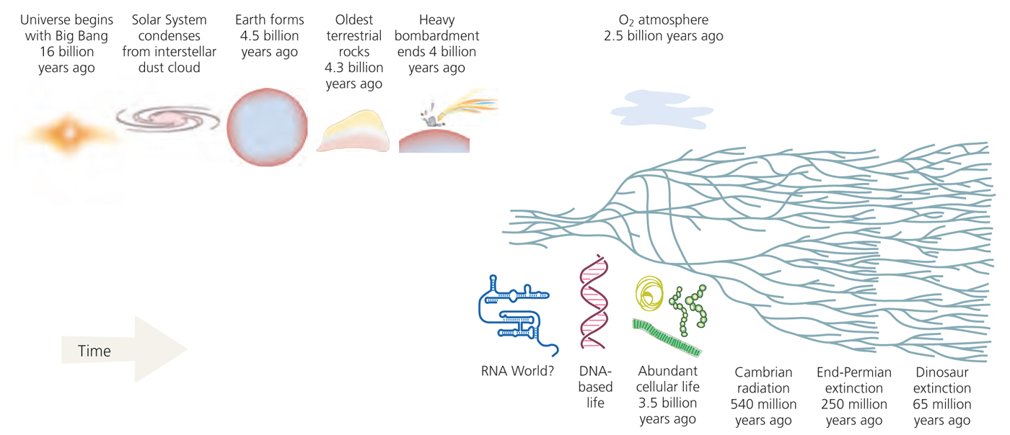
Cenancestor is the most recent ancestral specie from which all extant living species have evolved.

Slide 36
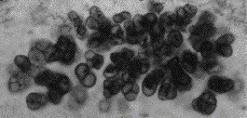
What was the Cenancestor like?
Plesiomorphies of extant organisms
1) All life uses DNA and protein
2) All life shares the same 20 amino acids
3) All life shares the same basic genetic code, variations in the code are relatively minor.

Slide 37
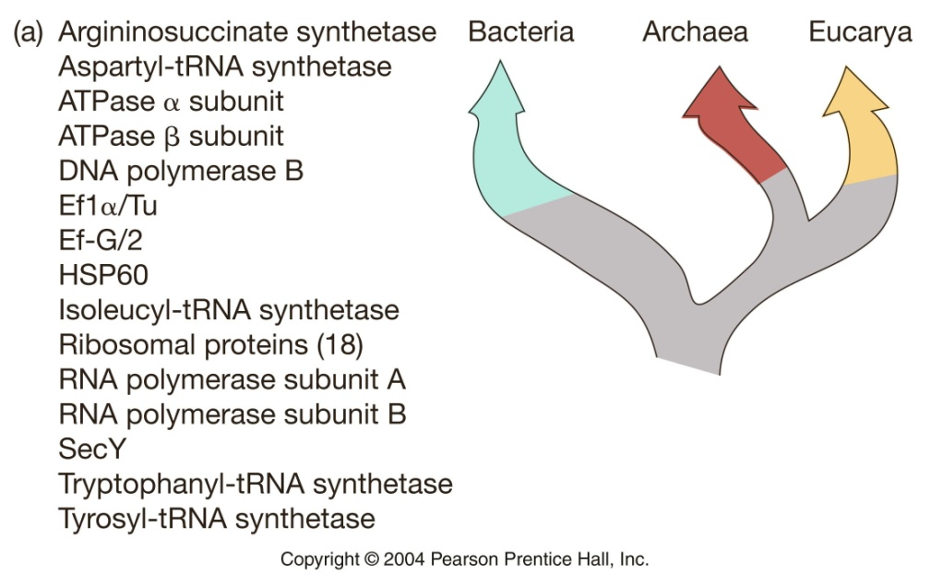
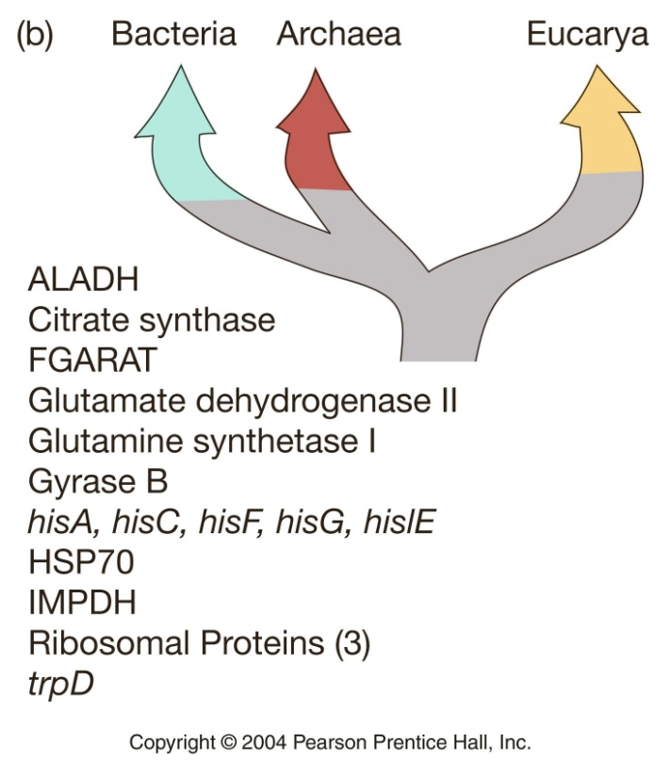
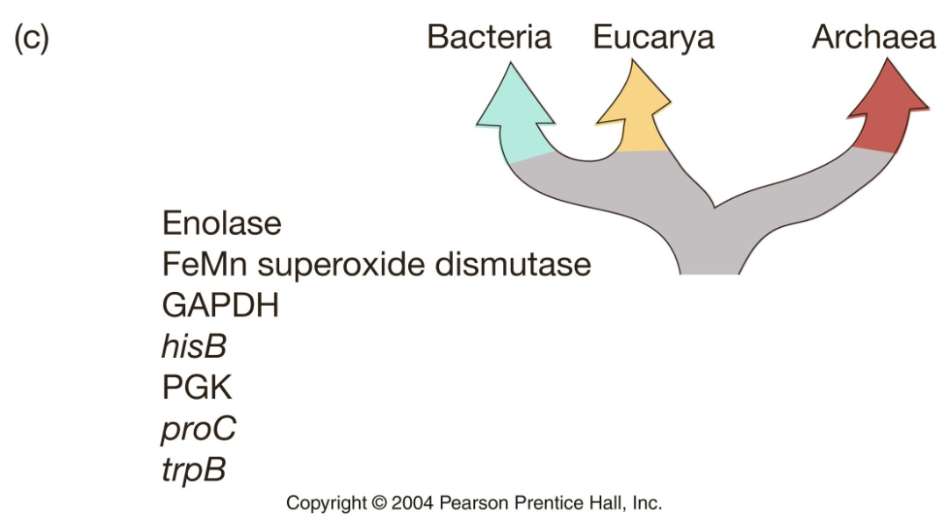
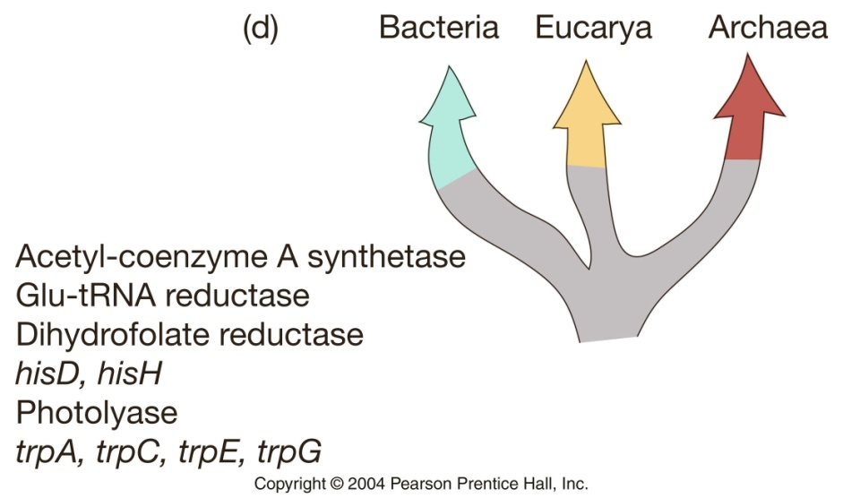
Gene trees among extant groups conflict…
… but this is to be expected.

Slide 38
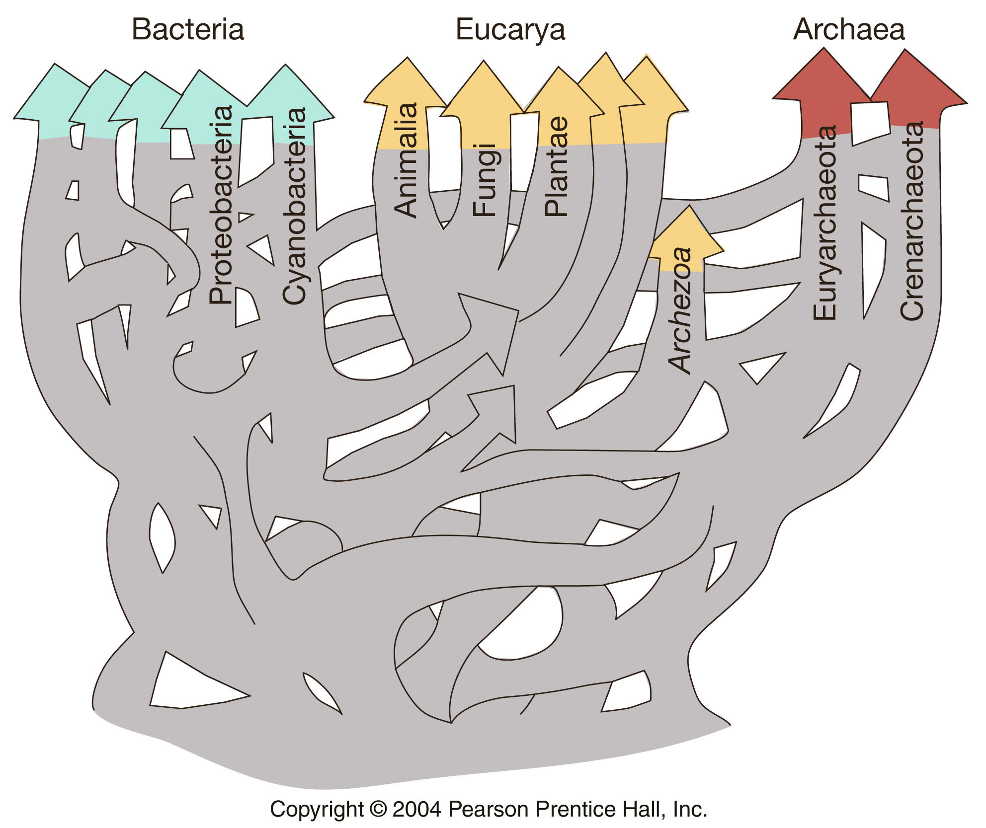
Extensive
Horizontal Transfer & Hybridization
probably characterized the early origin of life.
i.e., gene flow

Slide 39
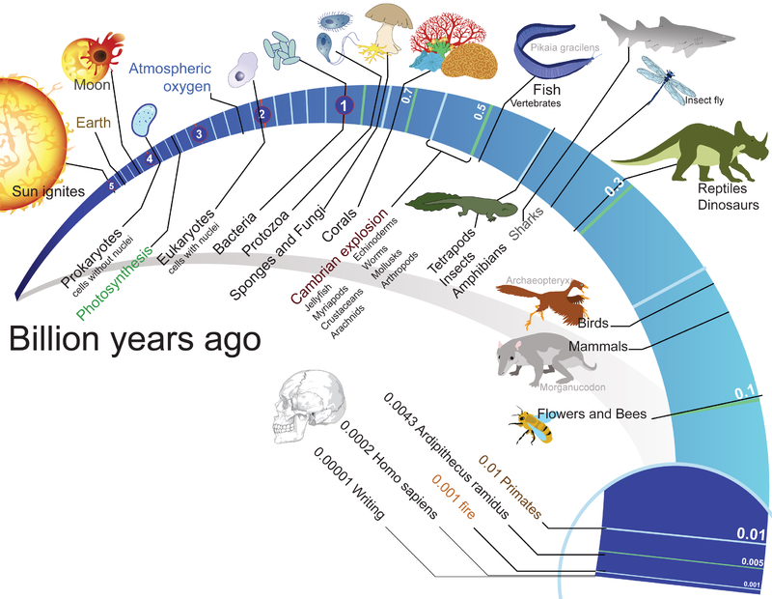
II. A Brief History of Life
A. Precambrian
B. Cambrian explosion
C. Origins of land plants
D. Vertebrates colonize land
E. Amniotes
F. Dinosaurs & Birds
G. Mammals
https://www.researchgate.net/figure/Timeline-for-history-of-life-on-Earth_fig2_287374326

Slide 40
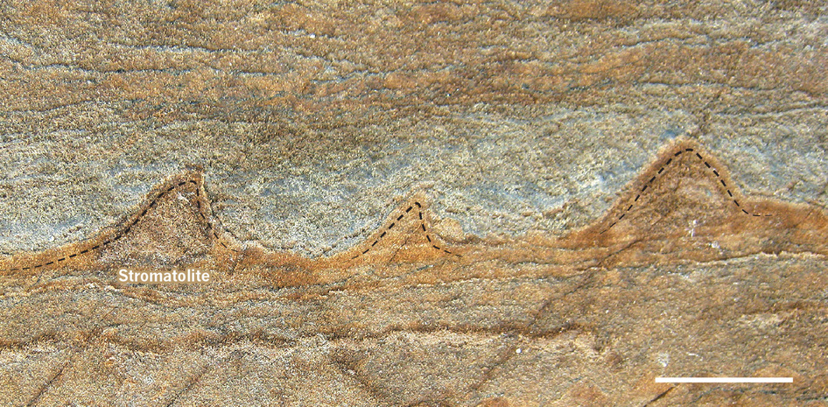
In the Archean (4 - 2.5 bya), microbial life was abundant
Stromatolites in Greenland nearly 3.7 bya
Consistent with stromatolites - layered mats built by early microbes

Slide 41
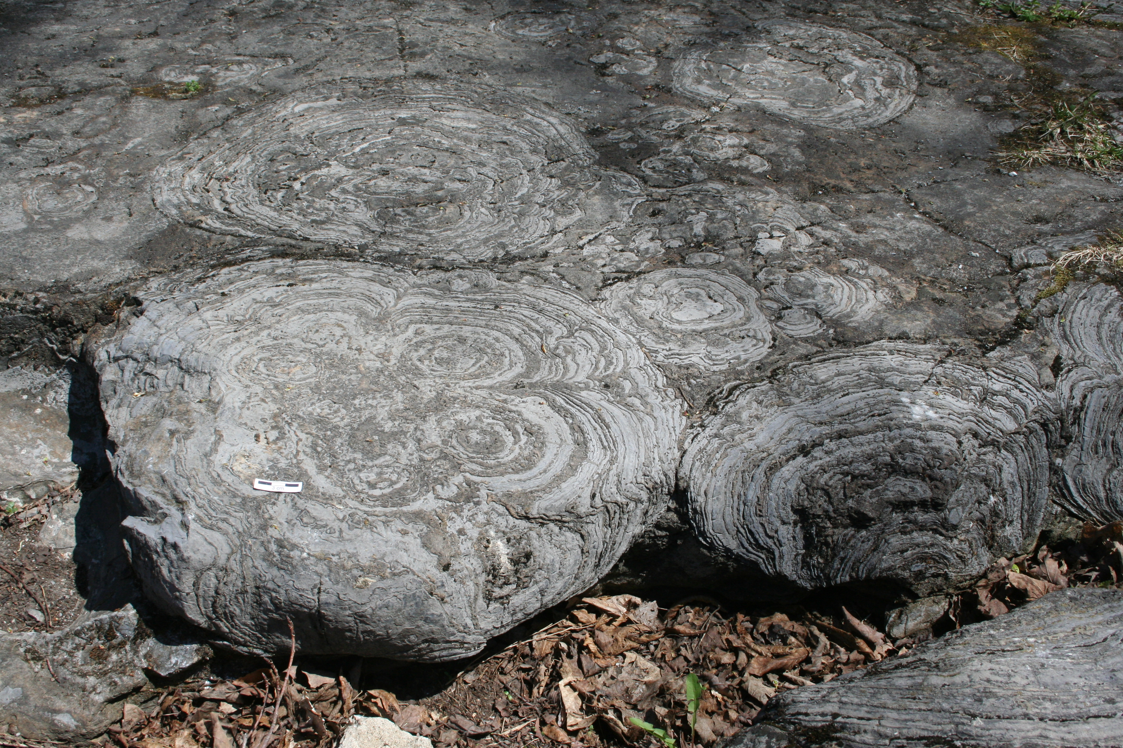
Fossil stromatolites from Saratoga Spring, New York. Stromatolites are among the oldest fossils of life, some dating to 3.5 bya

Slide 42
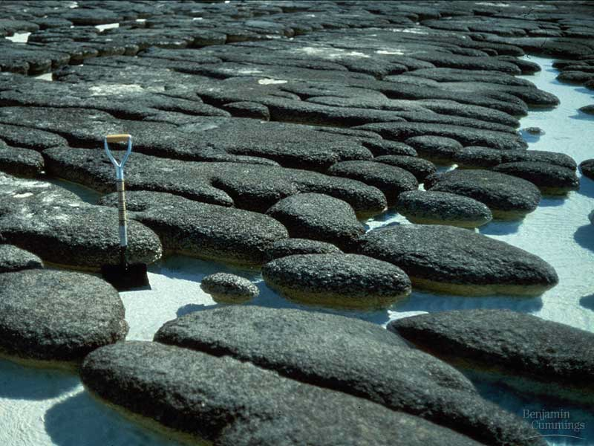
Present-day stromatolites
Stromatolites – layers/mounds formed by bacteria-like fossils

Slide 43
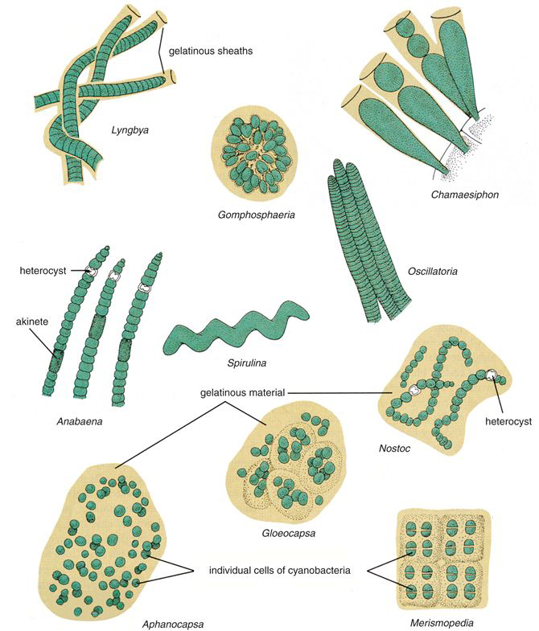
The concentration of free oxygen increased in late Archean/early Proterozoic. Why?
~3.4 bya first photosynthetic bacteria arise
Ancestors of extant cyanobacteria

Slide 44
The presence of oxygen greatly increased the potential efficiency of metabolism
Respiration, Krebs cycle, oxydative phosphorylation
Produce 26-30 ATP/ glucose vs 2 ATP/glucose molecule from fermentation
https://sites.google.com/site/biochemhelper/biochemicke-drahy/dychaci-retazec

Slide 45
Proterozoic (2.5 bya – 542 mya)
First eukaryotic fossils 1.9 bya
A, B, and C:
Fossils from ~1.2 billion year old rocks
D, E, and F:
Modern red algae of the genus Bangia
Butterfield & Swett 1990 Science 250:104-107
http://www.sciencemag.org/content/250/4977/104.abstract

Slide 46
Eukarya
Bacteria
Archaea
Chloroplast
Mitochondria
1st eukaryotic fossils 1.9bya
(Proterozoic)
Endosymbiosis – single celled organism living inside another organism.
Origin of mitochondria & Chloroplasts

Slide 47
Evidence of Endosymbiotic Theory
Mitochondria and chloroplasts have 2 membranes
mtDNA & cpDNA about same size as prokaryotic genomes

Slide 48
Mitochondria - derived from a photosynthetic purple bacterium that entered a eukaryotic cell >billion years ago.
Chloroplasts - derived from a photosynthetic cyanobacterium.

Slide 49
rRNA phylogeny of all living things

Slide 50
Eukaryota
Bacteria
Archaea

Slide 51
Archaea show more overall similarity to eukaryotes
 | Eubacteria | Archaea | Eukaryotes
Nucleus | N | N | Y
Nucleosomes/histones | N | Y | Y
Operons | Y | Y | N
Introns | N | N | Y
TATA box binding protein | N | Y | Y
Organelles | N | N | Y
> 1 chromosomes | N | N | Y
> 1 RNA polymerase | N | Y | Y
N-formyl methionine initiator | Y | N | N
Sensitivity to diptheria toxin | N | Y | Y
Peptidoglycan | Y | N | N
Protein synthesis simiilarity | N | Y | Y
https://megakharisma.wordpress.com/2010/10/03/similarities-between-archaea-and-eukaryotes/

Slide 52
Radiations within the Bacteria &
Archaea
Hug et al. Nature Microbiology 1:16048 (2016)

Slide 53
Ediacaran 635 – 541 mya
Last period of Proterozoic
Immediately preceded Cambrian explosion
First:
Organized, differentiated multicellular construction
Sizes larger than centimeters
Almost all forms of symmetry
Perhaps first embyros
Diversification coincided with a large increase in atmospheric oxygen
Fauna was soft and sessile

Slide 54
Ediacaran 635 – 541 mya
Last period of Proterozoic
Dickinsonia
Springgina
Kimberella
Perhaps an early ancestor of molluscs
Did early animals begin to diversify at this time?

Slide 55
Phanerozoic
Know the periods and eras and their dates
C
O
S
D
M
P
P
T
J
C
T
Q

