Slide 1
Effective Population Size
Population Genomics
Spring ’25

Slide 2
N vs N_{e}
Census Population Size (N) = # of adult (all) individuals (breeding or non-breeding) within a population. This # can be counted by observation.
Effective Population Size (N_{e}) = The # of individuals in an idealized population (one that meets Wright-Fisher Model) that has the same magnitude of genetic drift as the actual population.

Slide 3
Wright-Fisher Model
2N diploid individuals, with 2 alleles each. Generations are non-overlapping. At each generation, each chromosome inherits its genetic material from a randomly chosen chromosome from the previous generation, independently from all other chromosomes.
Model Assumptions
Constant population
Discrete/non-overlapping generations
Random mating (panmixia)
Equal sex ratio
One locus
No recombination
No population structure
No selection

Slide 4
Effective population size (N_{e}): the size of an idealized population that would experience drift the same as the actual population.
So N_{e} depends on:
Sex ratio
Breeding structure/overlap of generations
Mean and variance of family size
Variance in population size over time
Etc.
Empirical estimates of Ne usually show that changes in allele frequencies due to drift are faster than predicted by N. So N_{e} is almost always < N.

Slide 5

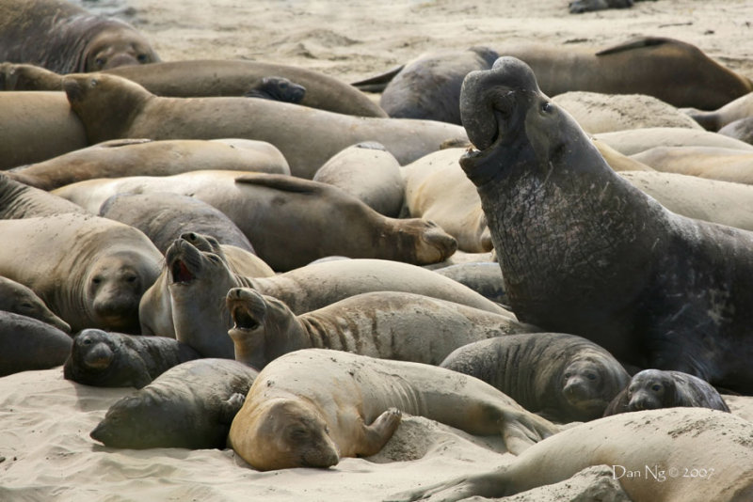
Factors Affecting Ne:
If sex ratios are unequal.
N_{e} depends more on the rarer sex. Effect of drift is greater if sex ratios are skewed.
Elephant Seals
Elephant seal harems average ~12 females per male.
N = 100,000
N_{f} = 50,000
N_{m} = 50,000/12 = 4,167
N_{e} = 15,384

Slide 6
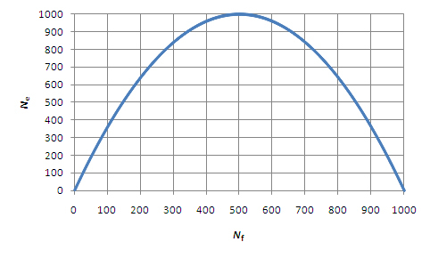
The relationship between Ne and Nf in a population of 1000 mating individuals.
https://www.nature.com/scitable/topicpage/genetic-drift-and-effective-population-size-772523

Slide 7

Factors Affecting Ne:
If the variance in family (K) size is >2:
If all individuals leave the same # offspring, V_{k} = 0, and N_{e} = 2N
Thus, in captive breeding programs, it is possible to increase the Ne by controlling (equalizing) reproductive output!
Simply maximizing number of offspring is not necessarily the best strategy.
This is especially important for endangered species.

Slide 8

Factors Affecting Ne:
If the population size fluctuates over time:
N_{e} is calculated as a harmonic mean in this case.
Harmonic means have different mathematical properties.
N_{e} is disproportionately affected by time periods with small population sizes, because inbreeding is higher during those times.
Genetics diversity declines, and takes a long time to recover.
(because mutation acts very slowly)
where N_{i} is the population size in generation i.

Slide 9
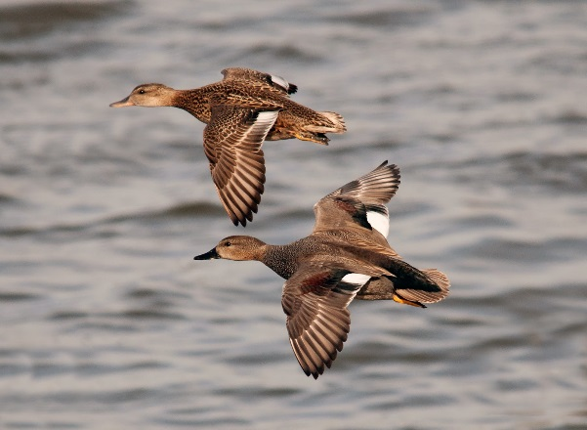
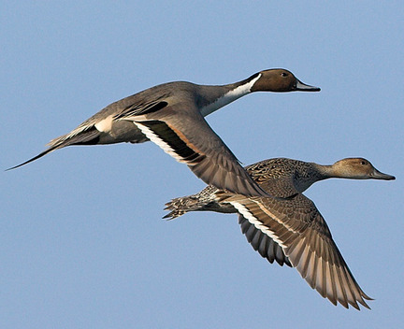
N_{e} = 1.5 million
N_{e} = 3.4 million

Slide 10
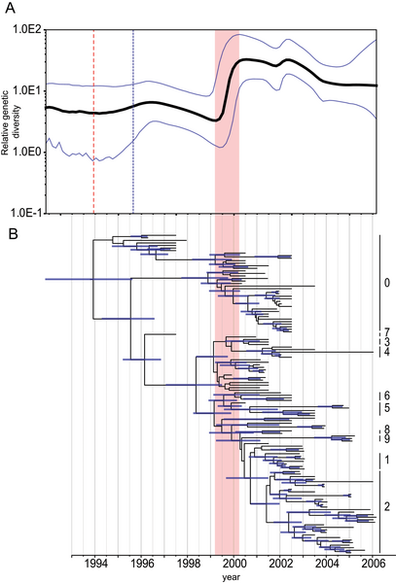
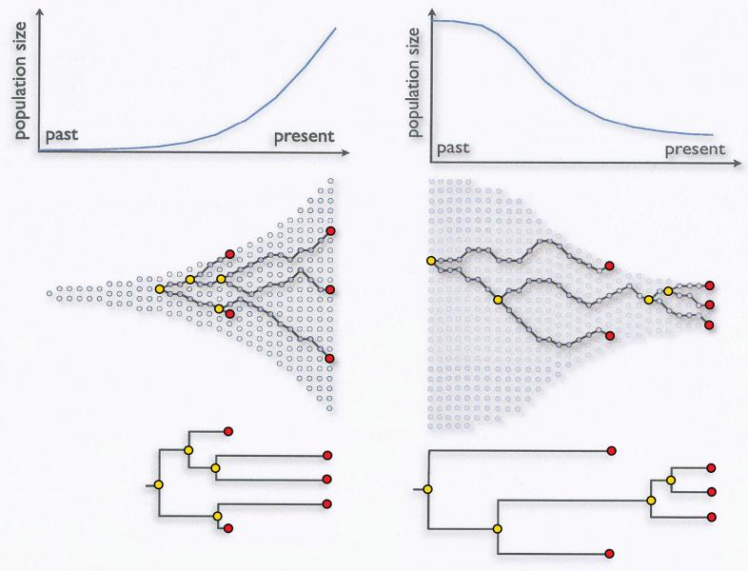
Can use analysis of 1000s of loci to calculate N_{e} across the genealogy
Note that there are waves of coalescence corresponding to periods of population expansion and contraction per coalescent theory.
Example – Bayesian Skyline Plot
Vijaykrishna D, Bahl J, Riley S, Duan L, Zhang JX, et al. (2008) Evolutionary Dynamics and Emergence of Panzootic H5N1 Influenza Viruses. PLOS Pathogens 4(9): e1000161.

Slide 11
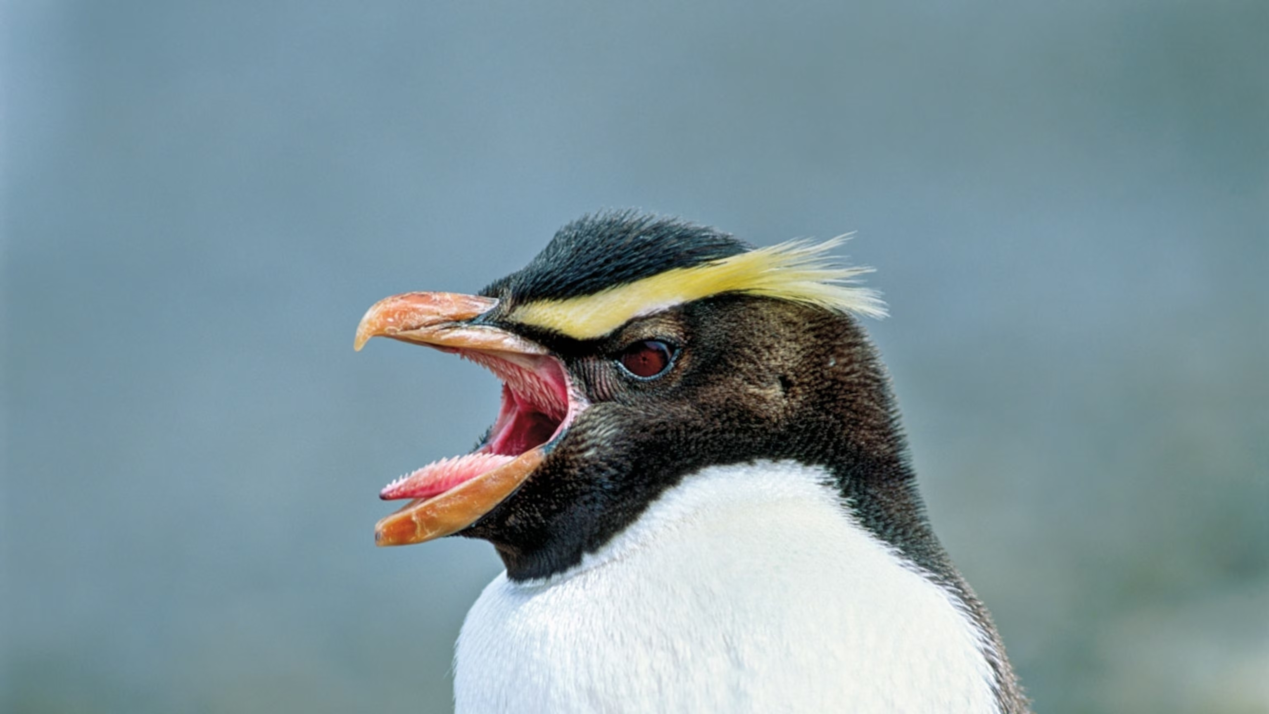
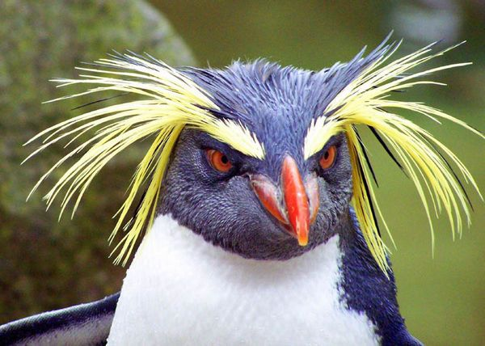
Coalescent genealogy samplers are inherently slow – use the site frequency spectrum and δaδi to speed up the analysis.
Fjordland Penguin
Rockhopper
Penguin
White, J., P. Lavretsky, Díaz, A., P. Garcia-Borboroglu, U. Ellenberg, D. Houston, R. Long, T. Mattern, H. L. Mays Jr, K. Putz, P. Seddon, and K. G. McCracken (2025). Population structure of three New Zealand crested penguins identifies current conservation challenges: Fiordland Penguin/Tawaki, Erect-crested Penguin, and Eastern Rockhopper Penguin. PLoS ONE (in review).
δaδi citation = Gutenkunst, RN, RD Hernandez, SH Williamson, CD Bustamante (2009) Inferring the joint demographic history of multiple populations from multidimensional SNP data" PLoS Genetics 5:e1000695.

Slide 12
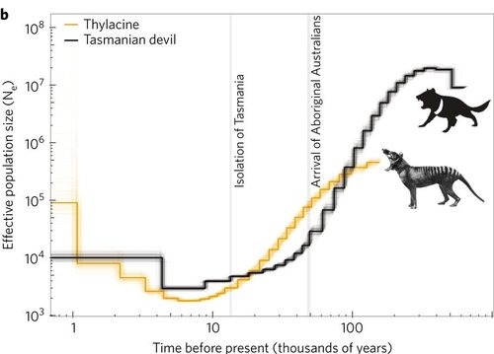
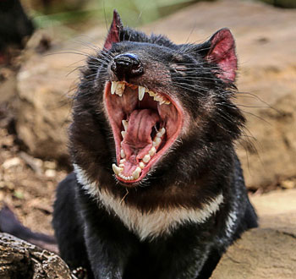
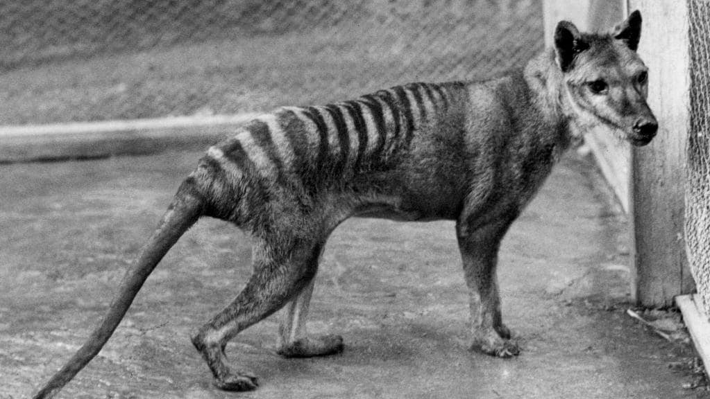
Effective population size through time: showing a steady decline in Tassie tigers and devils over thousands of years. However, populations appear to have stabilised and even increased approx. 6,000 years ago.
https://www.nature.com/scitable/topicpage/genetic-drift-and-effective-population-size-772523

Slide 13
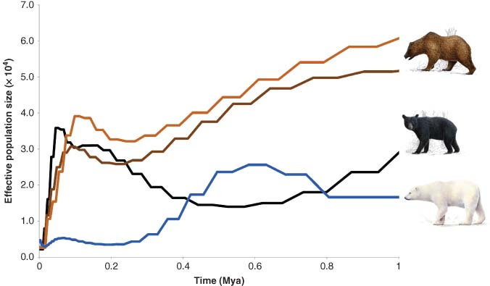
Evolutionary History of Polar and Brown Bears
Frank Hailer, Cardiff University, Cardiff, UK, Andreanna J Welch, Durham University, Durham, UK
http://www.els.net/WileyCDA/ElsArticle/refId-a0026303.html
Published online: July 2016

Slide 14
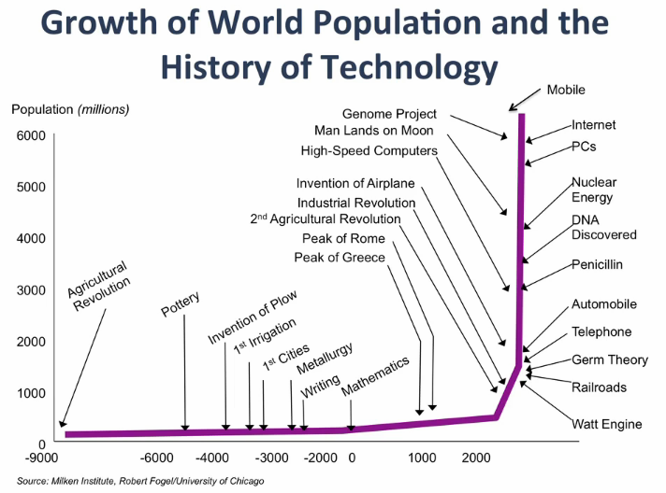
N_{e} for the human population is ~10,000

Slide 15
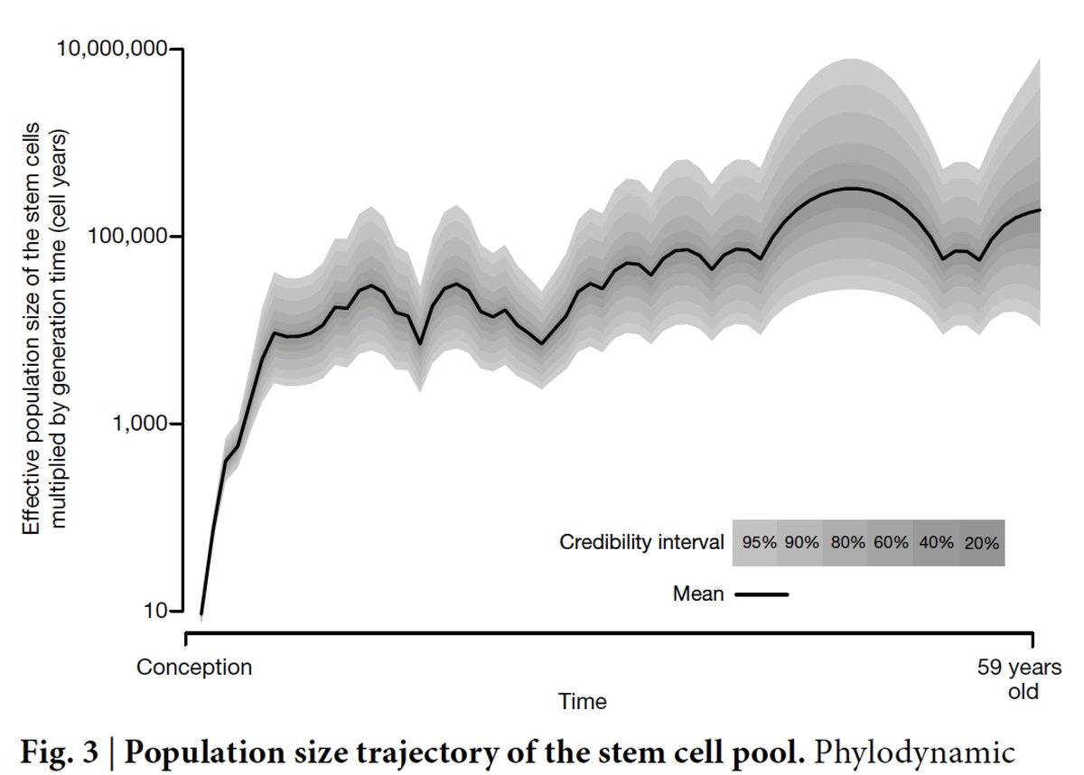
https://twitter.com/erictopol/status/1037693383370715138

Slide 16
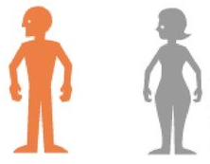
Autosomal DNA
Y-linked DNA
mtDNA
X-linked DNA
♂
♀
♂
♀
♂
♀
♂
♀
×
Biparental
Inheritance
Paternal
Inheritance
Maternal
Inheritance
Sex-linked
Inheritance

Slide 17



Factors Affecting Ne:
For different modes of chromosomal inheritance:
mtDNA
X-linked
Y-linked
Sex-linked alleles become lost or fixed faster than autosomal alleles, because genetic drift has a larger effect on sex-linked loci.

Slide 18
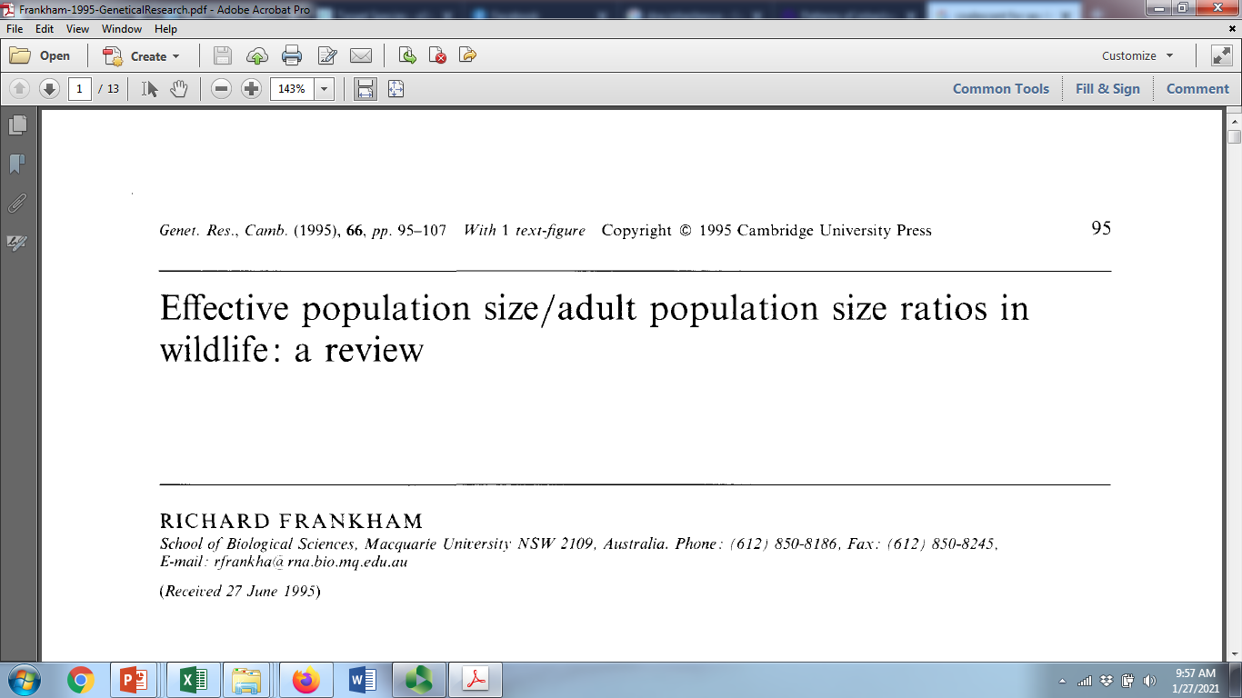
On average, N_{e} = 0.1N

Slide 19
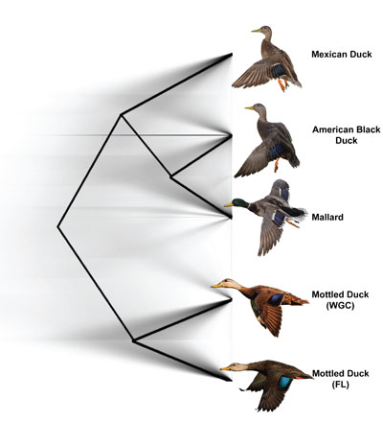
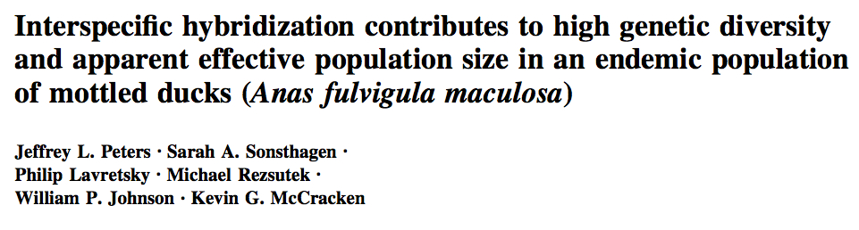
Gene flow strongly influences N_{e}
Species | N_{C} | N_{e}
Mallard | 9,330,000 | 640,000
Mottled Duck | 135,000 | 360,000
*
*
Mottled Ducks & Mallards are closely related but not sister taxa.
Because of recurrent hybridization, gene has driven Mottled Duck N_{e} > N_{C}.
Interspecific gene flow has been occurring for a long time.
Mottled Ducks have high genetic diversity because of Mallard introgression.

Slide 20
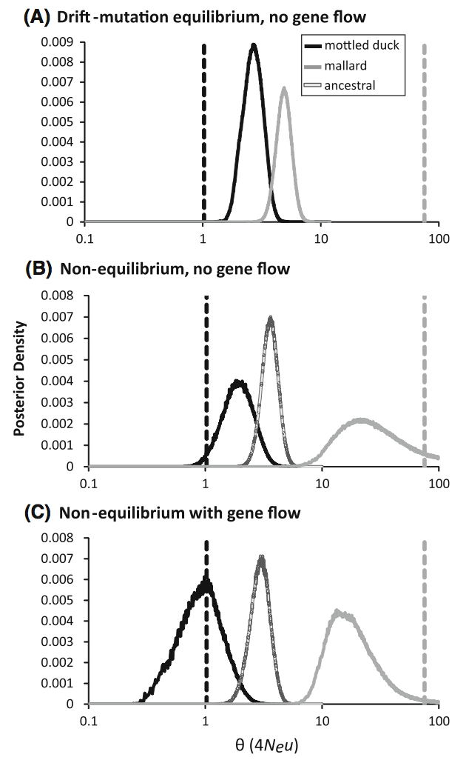

Slide 21
Adaption/Extinction
Ne is a genetic diversity measure, usually derived from other such measures such as heterozygosity.
Except in the cases of introgression Ne is usually proportional to census population size N (albeit usually smaller)
In so far that Ne reflects genetic diversity, Ne reflects the adaptive potential of a population.
Therefore it can also reflect potential for extinction because loss of genetic diversity makes species vulnerable to extinction.

Slide 22
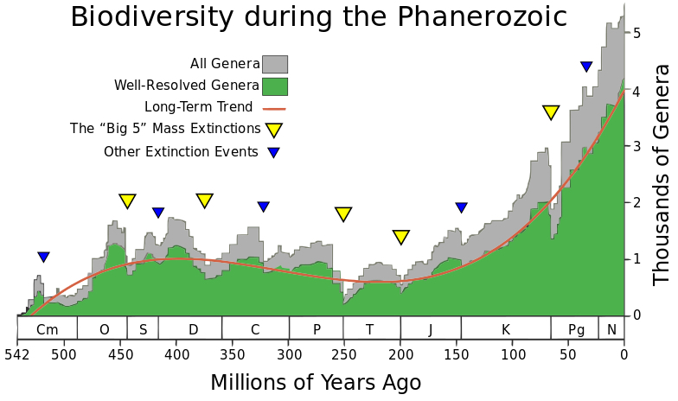
https://en.wikipedia.org/wiki/Population_ecology

Slide 23
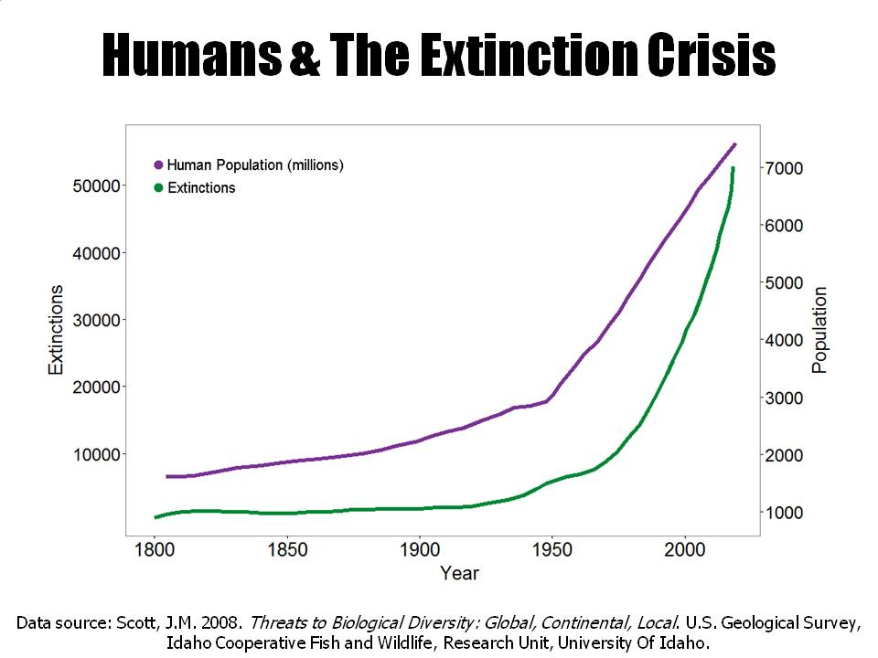

Slide 24
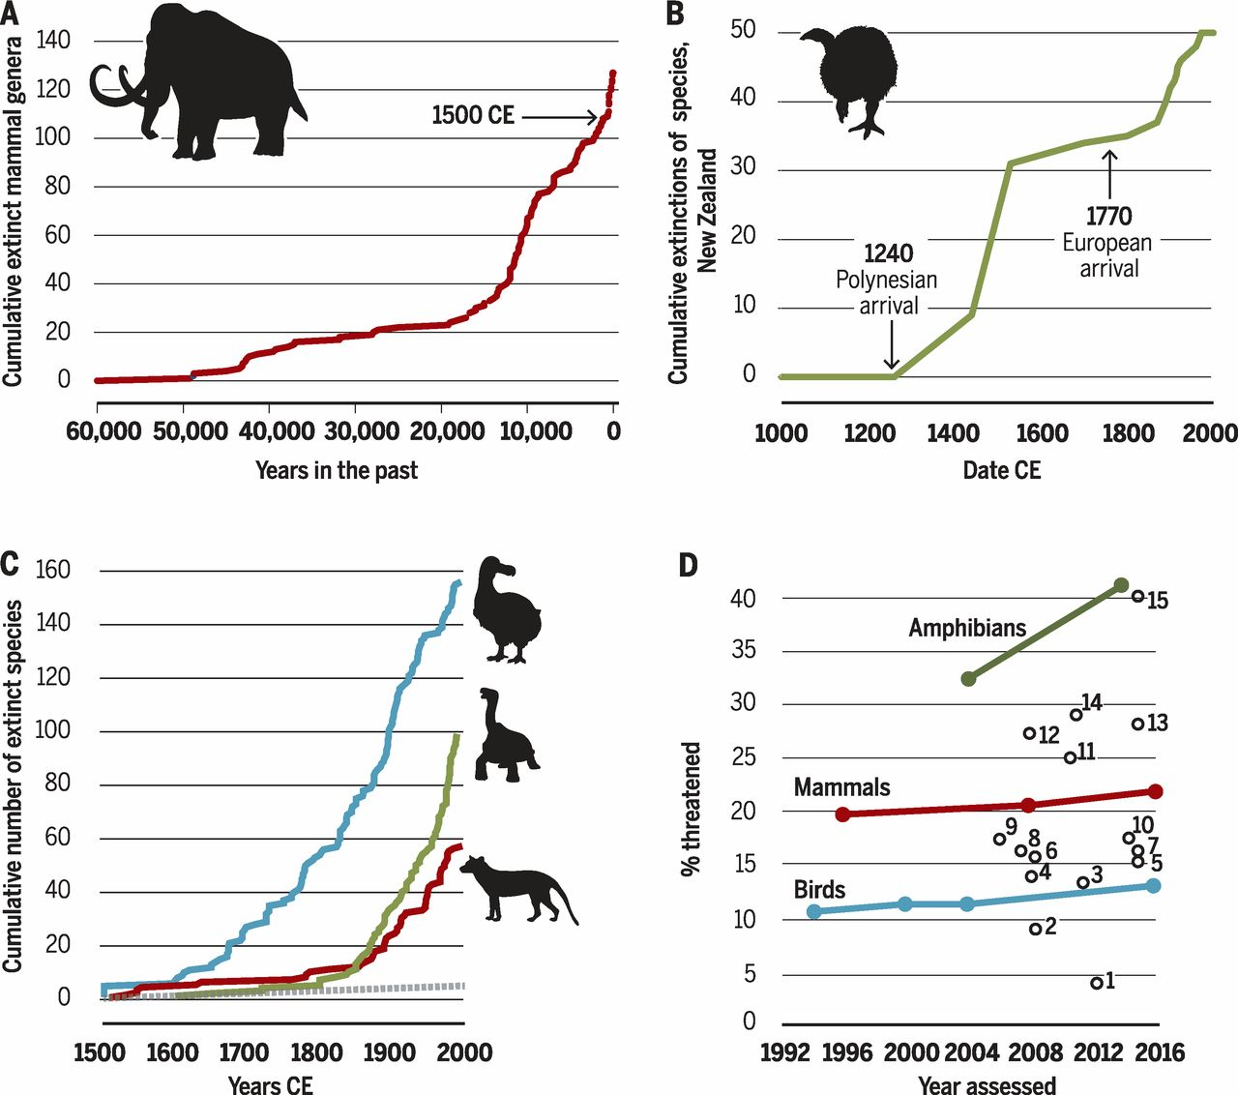
http://science.sciencemag.org/content/356/6335/270

