Slide 1
Recombination & Linkage Disequilibrium
University of Miami
Spring 2025

Slide 2
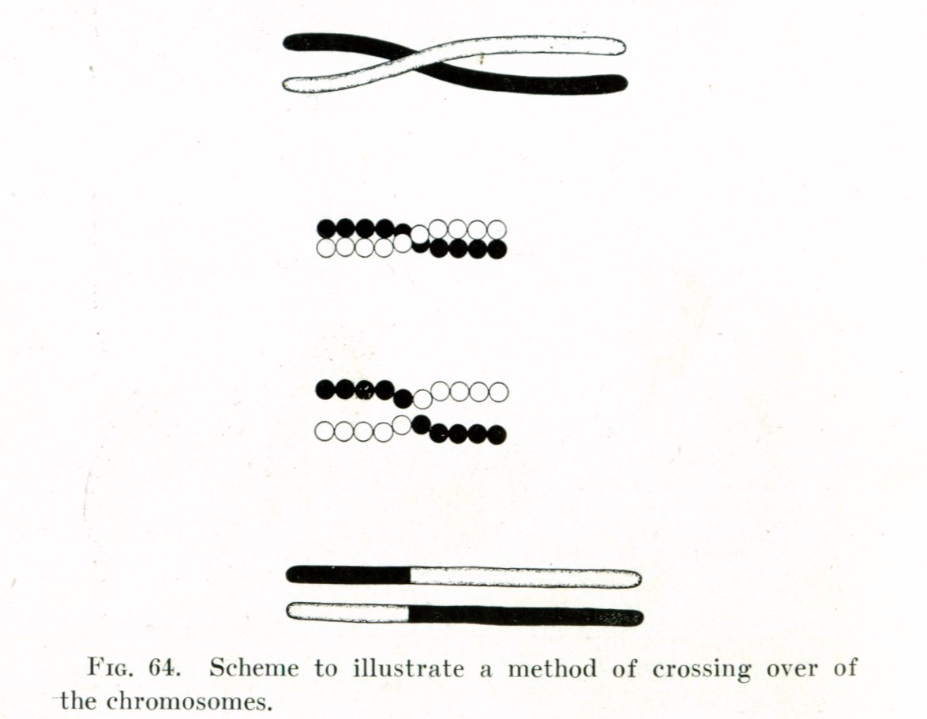
Genetic Recombination
Creates new combinations of alleles at two or more loci during meiosis.
Crossing Over = exchange of DNA between chromosomes.
    Reciprocal or nonreciprocal (in case of gene conversion)
    Homologous or nonhomologous (translocations)
Independent Assortment = random pairing of nonhomologous chromosomes. Together with crossing over increases genetic diversity by producing novel genetic combinations.
Thomas Hunt Morgan (1916)

Slide 3
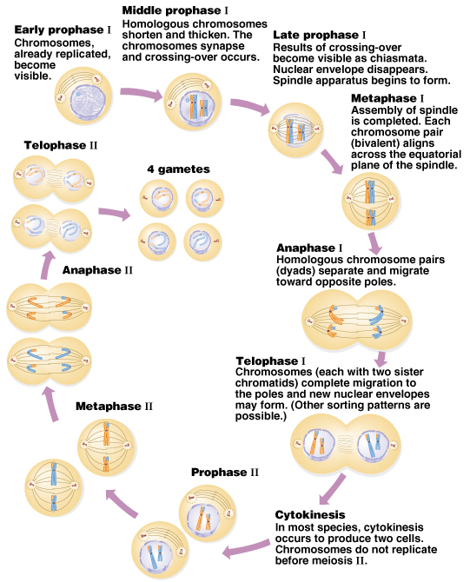
Crossing-over
Meiosis
Random
Assortment
Peter J. Russell, iGenetics: Copyright © Pearson Education, Inc., publishing as Benjamin Cummings.

Slide 4
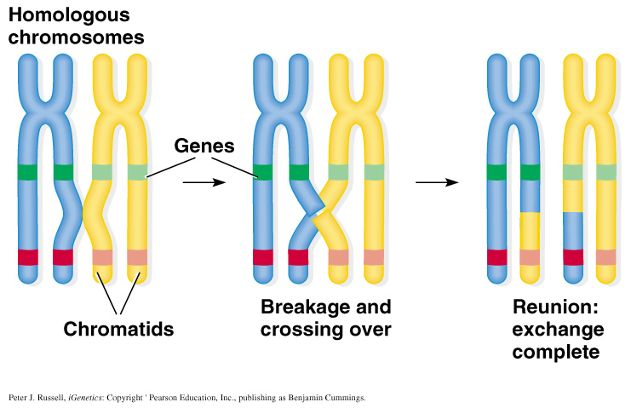
Crossing Over

Slide 5
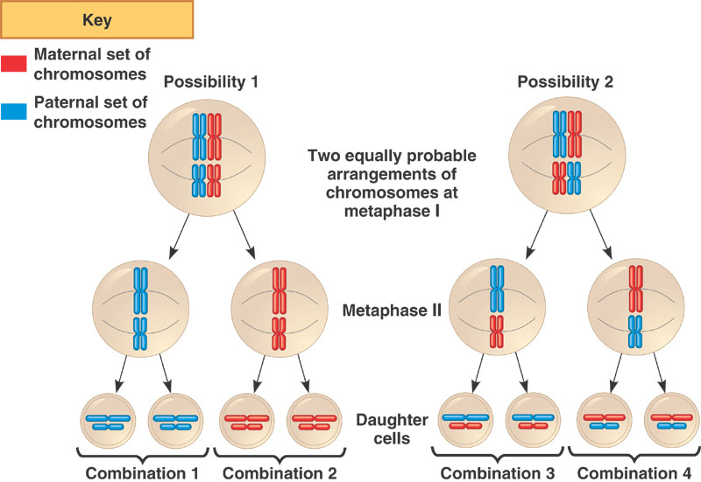
Random Assortment
http://12biohvhs.blogspot.com/2013/09/independent-assortment.html
    For 22 human autosomes there are 2,097,152 possible arrangements!

Slide 6
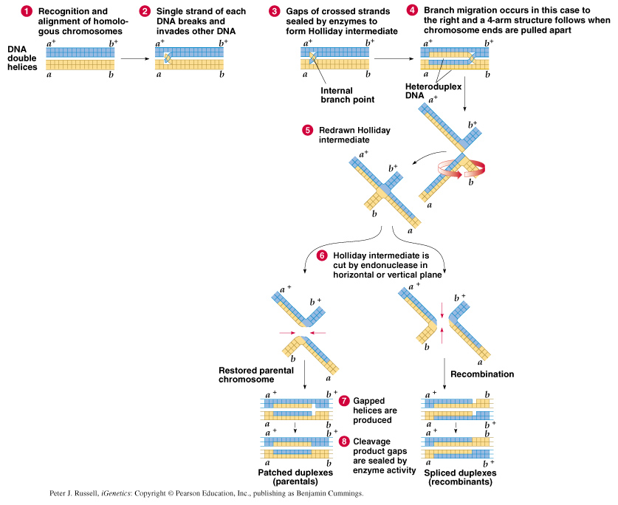
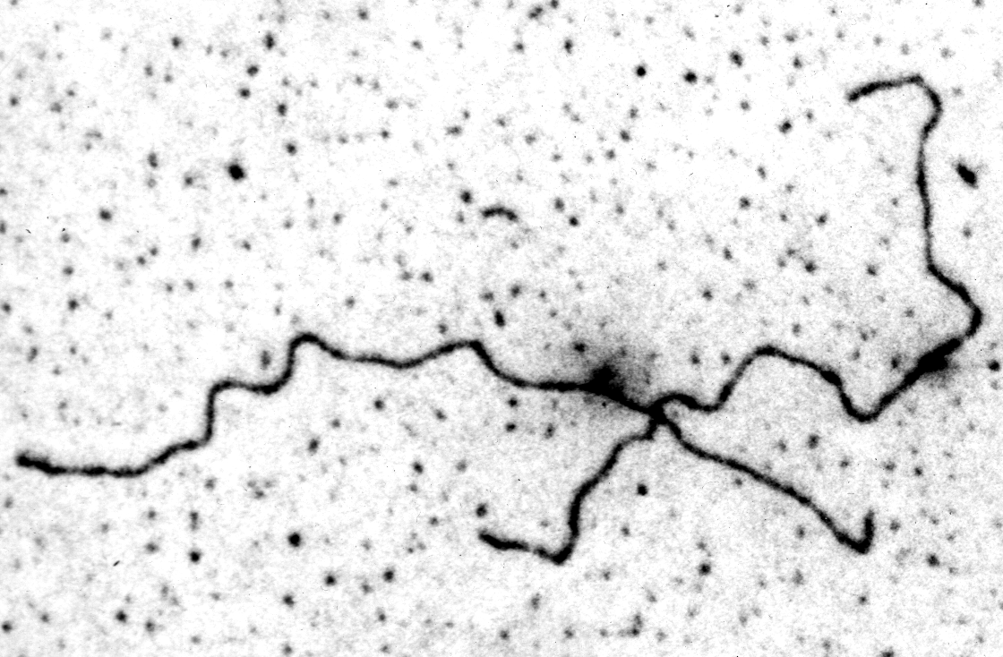
Holliday Intermediate
parentals
Recombinants
50% max.
if no linkage

Slide 7
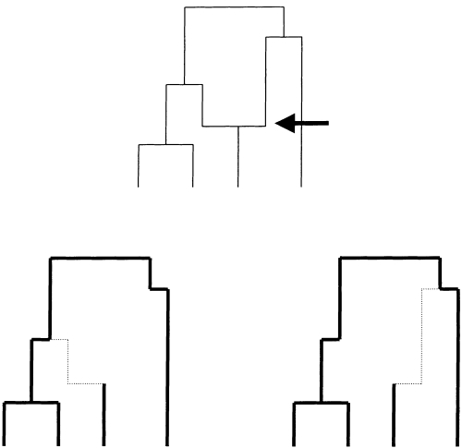
Effect of recombination on the genealogy
recombination event
Sequence on one side of the genealogy has this genealogy
Sequence on other side of the genealogy has this genealogy

Slide 8
What determines the locus-specific rate of recombination?

Slide 9
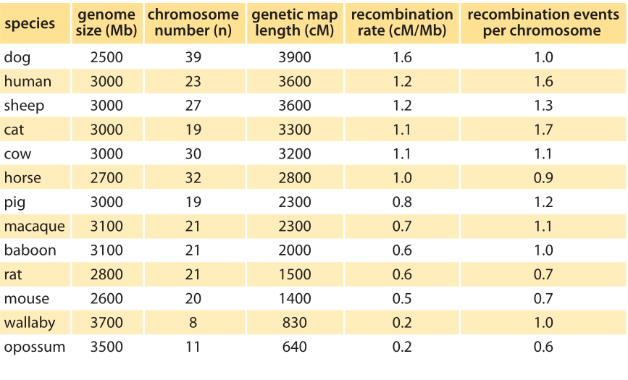
For c = 0.01, there is a recombination event every ~1 Mb in the human genome. Average recombination rate between ~21,000 genes is 0.00142. After 1,000 generations (~25 Kya) D decays to about 24% of the starting value---lots of ancestral LD persists to the present day.
http://book.bionumbers.org/what-is-the-rate-of-recombination/

Slide 10
This is influenced by epistasis:
Interactions among genes
Genes can interact in a positive or negative way to produce specific trait(s), e.g., quantitative traits.
There can also be G x E interactions

Slide 11
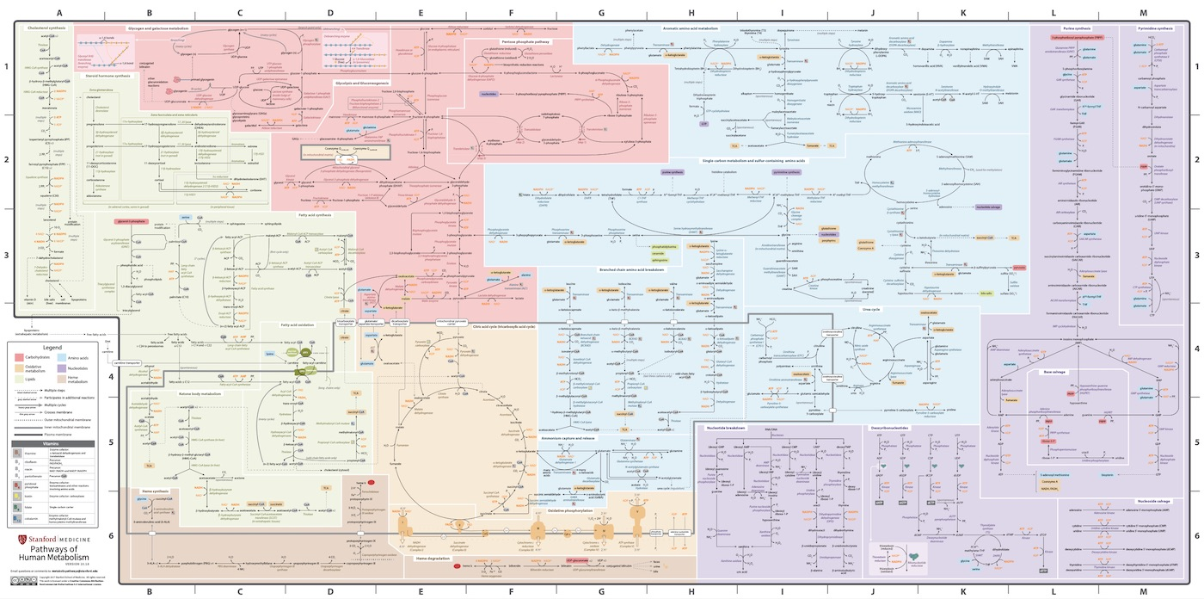
Pathways of Human Metabolism
https://metabolicpathways.stanford.edu/

Slide 12
How is recombination rate influenced?
  If interactions between two genes are favorable (positive epistasis), then recombination rate may be selected against, and decrease.
  If the interactions are deleterious (negative epistasis), then recombination rate may be favored, and increase.
  Recombination rates (like everything else) are subject to selection and evolve up or down.

Slide 13
Heterozygosity is required to detect recombination
X
X
Did recombination occur?
Heterozygosity is required to detect recombination

Slide 14
For two linked loci interacting in pathway to produce the same phenotype…
linkage pattern favorable
linkage pattern unfavorable
recombination suppressed
recombination favored
X

Slide 15
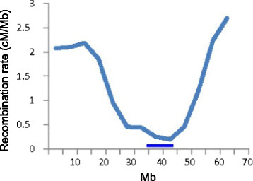
  Recombination rates (like everything else) are subject to selection and evolve up or down…
  … and this varies across the genome.

Slide 16
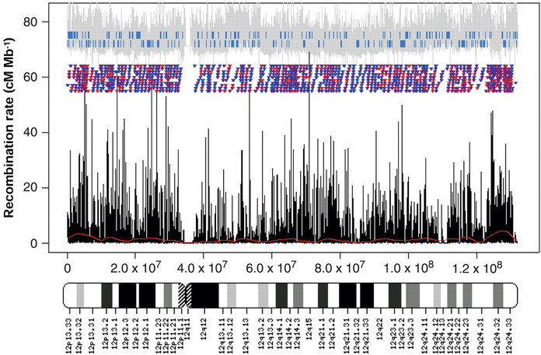
A Fine-Scale Map of Recombination Rates and Hotspots Across the Human Genome, Volume: 310, Issue: 5746, Pages: 321-324,
DOI: (10.1126/science.1117196)

Slide 17

Why is recombination beneficial?
Recombination is not always beneficial. It can be costly (recombination load) because it reshuffles beneficial combinations of alleles that are well suited to the environment.
But environments are variable and changing, so allelic combinations that are well suited to one environment may not be well suited to future environments.
A theory for the evolution of sexual reproduction!
  Otto, S. P., & Lenormand, T. (2002). Resolving the paradox of sex and recombination. Nature Reviews Genetics, 3, 252-261.
Sally Otto (UBC)

Slide 18
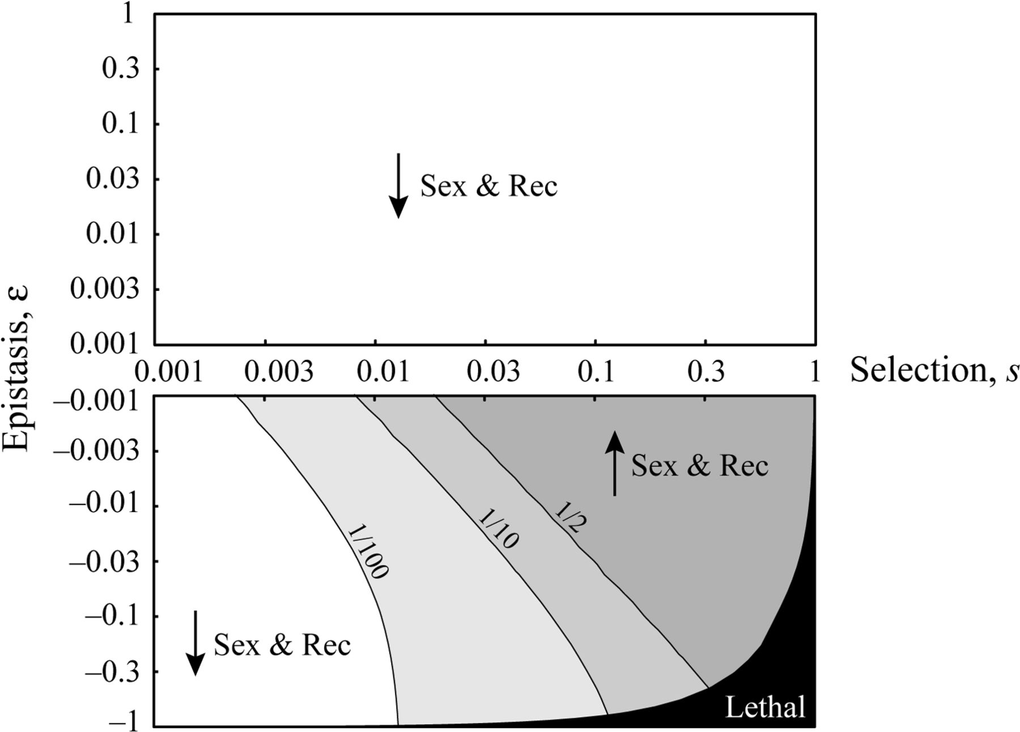
Recombination is favored when selection is strong and epistasis is weak and negative.
Otto, S. P., & Gerstein, A. C. (2006). Why have sex? The population genetics of sex and recombination. Biochemical Society Transactions 34:519-522.

Slide 19
Linkage Disequilibrium
When recombination is limited between two or more loci on the same chromosome, patterns of genetic linkage are created (recombine ≤ 50% of the time sensu Thomas Hunt Morgan).
Linkage Equilibrium
Random association of alleles at two or more loci = free recombination between loci; genotypes at two or more loci are independent
→ does not imply population is in genetic equilibrium
Linkage Disequilibrium (LD)
Nonrandom association of alleles at two or more loci (gametic disequilibrium); genotypes at two or more loci are associated/not independent.
→ does not imply population is not in genetic equilibrium
Terms simply refer to linkage relationships

Slide 20
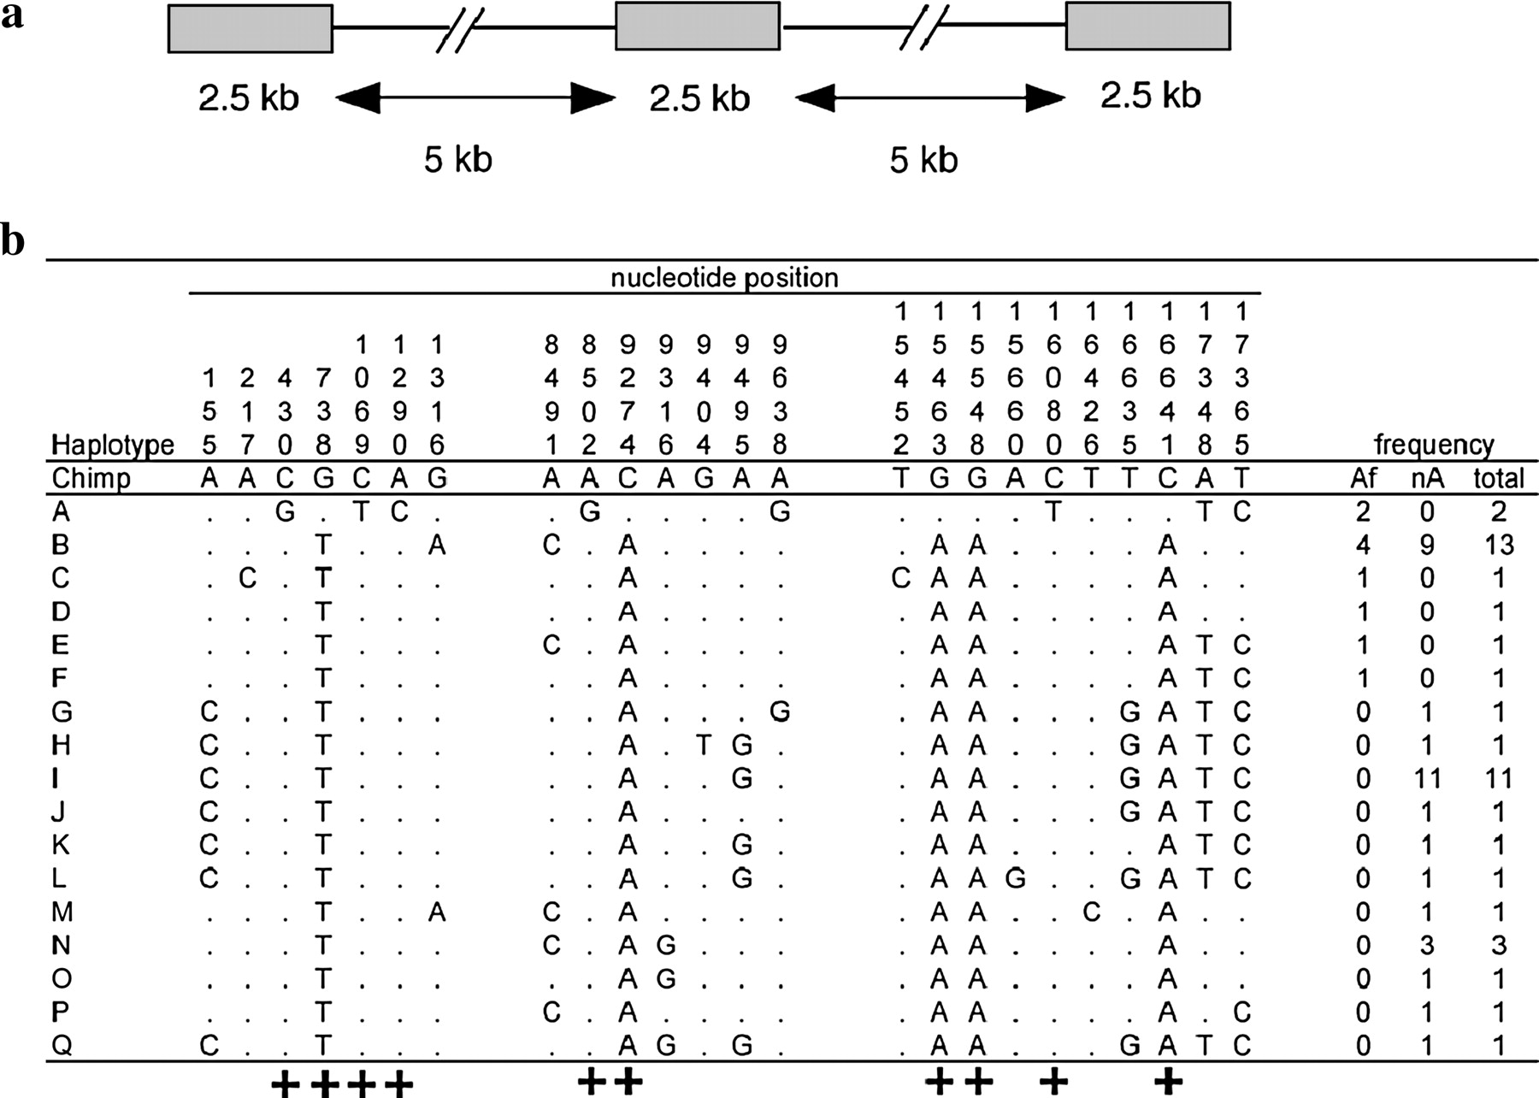
Garrigan et al. (2005) - Genetics 170:1849-1856. The Xp21.1 polymorphism data set. (a) Schema of the locus trio design to assay nucleotide divergence among haplotypes and linkage disequilibrium. (b) Nucleotide variation found at Xp21.1. A dot indicates identity with the chimpanzee and gorilla outgroup sequences, which are assumed to be the ancestral human state. Congruent sites are labeled with “+.” The last three columns list the frequency of each haplotype in African, non-African, and the total sample. The mutation occurring at site 9638 occurs in a guanine/cytosine dinucleotide repeat, making it unclear whether this is a recombination event or a parallel mutation.

Slide 21
Factors Contributing to LD
Selection
Rate of recombination
Mutation
Genetic drift
Population subdivision
Mating system

Slide 22
Coefficient of LD - D Statistic
The D statistic is the Coefficient of Linkage Disequilibrium; D = 0 at equilibrium or D ≠ 0 for linkage disequilibrium.
If presence of alleles at the two loci is independent, the probability that they occur together is the product of their allele frequencies.
Every allele pair has its own D (e.g., Aa & Bb):
D_{AB} = f_{AB} – f_{A}f_{B}
D_{aB} = f_{aB} – f_{a}f_{B}
D_{Ab} = f_{Ab} – f_{A}f_{b}
D_{ab} = f_{ab} – f_{a}f_{b}
f_{AB} = observed frequency of AB genotype
f_{A} = frequency of A
f_{B} = frequency of B

Slide 23
Coefficient of LD - D Statistic
When there are only two alleles per locus, there is a simple relationship between the four coefficients of LD.
D_{Ab} = D_{aB’} D_{AB} = D_{ab’}, and D_{AB} = -D_{Ab}
D can be either positive or negative - sign depends on which alleles you start with (A & B or A & b).
Since D depends on the frequency of different alleles, how do you decide if D is large or small?
Solution is to standardize D and calculate D’ (Lewontin 1964).
D’ = ratio of |D| to its maximum possible value.

Slide 24
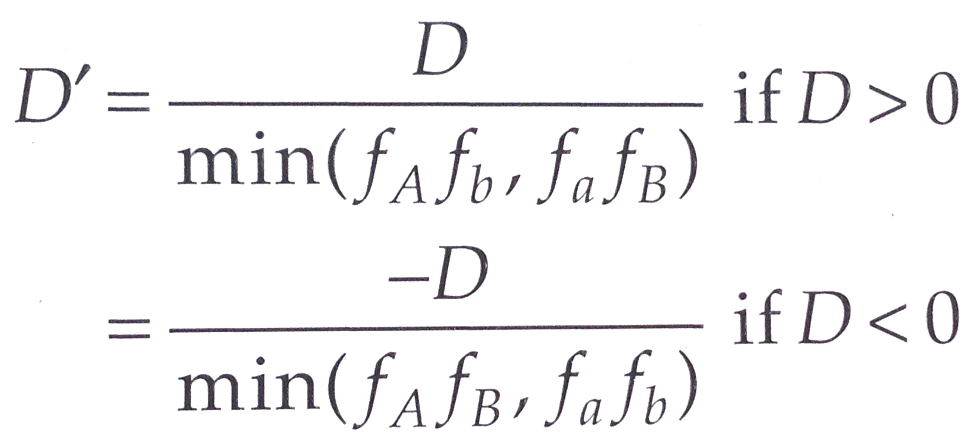
Standardized D
This normalizes D-values where D’ is bounded by 0 and 1.
If D’ = 1, at least one haplotype is missing (one of the haplotype frequencies has to be zero).
D’ = 1 also occurs every time a single new mutation occurs at one locus → mutation creates linkage disequilibrium.

Slide 25
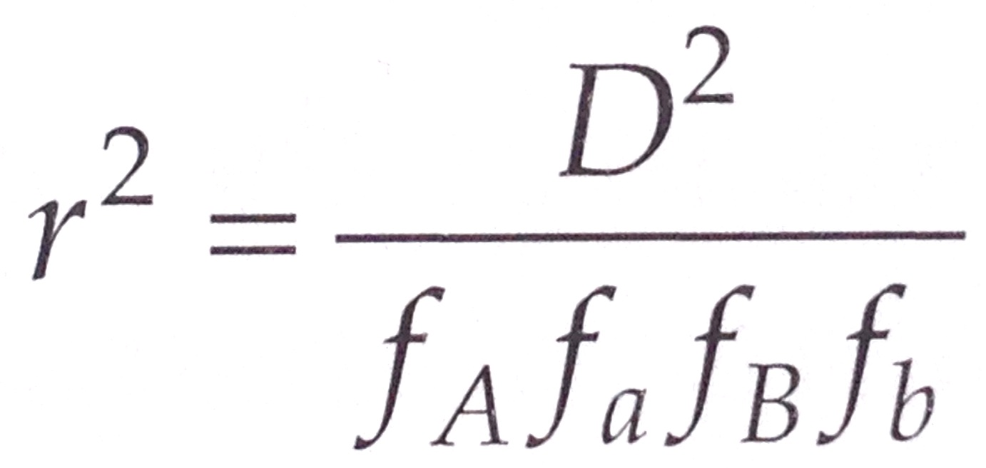
Correlation Coefficient - r²
Significance is tested using a contingency table and Χ².
n = # chromosomes; f = allele frequency
Compute X² for observed and expected. Calculations simplify to:
X² = n x D² / f_{A}f_{a}f_{B}f_{b} = n x r₂
df = 1
 | A | a | Total B
B | nf_{AB} | nf_{aB} | nf_{B}
b | nf_{Ab} | nf_{ab} | nf_{b}
Total A | nf_{A} | nf_{a} | n

Slide 26
Evolution of Linkage Disequilibrium
If D = 0 there is no LD.
In a random mating population there is no change in allele frequency.
D(t + 1) = (1 – c) D(t) where c is the recombination rate.
c by definition is greater than zero but < ½ (Mendel’s 2nd Law).
So D does not go to zero after one generation of random mating.
It can only be reduced by a factor of ½.
So to achieve, linkage equilibrium may require much longer.
If c is small, LD decreases only slightly.

Slide 27
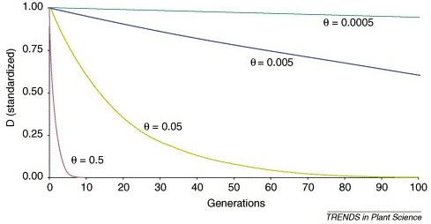
Decay of Linkage Disequilibrium
c = 0.0005
c = 0.005
c = 0.05
c = 0.5
D(t) = (1 – c)^{t} x D(0)
For tightly linked loci, c is small, LD will persist for a long time.
For less tightly linked loci, c is larger, LD decays more rapidly.
Illustration: Mackay, I., & Powell, W. (2007) Methods for linkage disequilibrium mapping in crops.
Trends in Plant Science 12:57-63.

Slide 28
Gurung, S., Mamidi, S., Bonman, J. M., Xiong, M., Brown-Guedira, G., & Adhikari, T. B. (2014) Genome-wide association study reveals novel quantitative trait loci associated with resistance to multiple leaf spot diseases of spring wheat.
PLoS One 9:e108179.

Slide 29
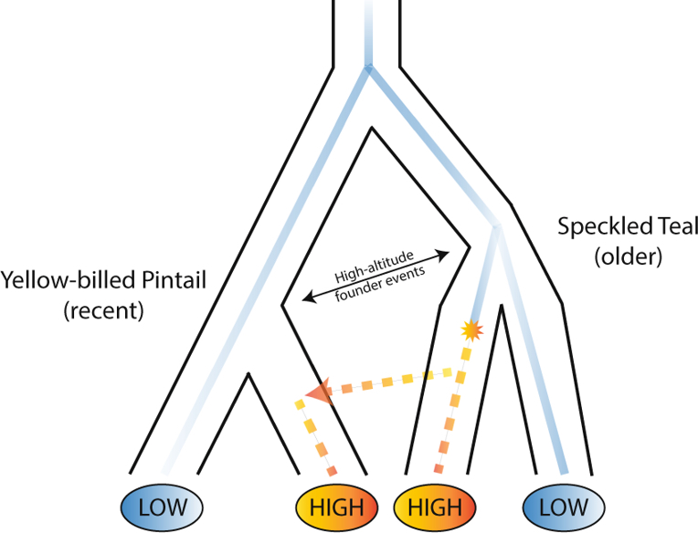
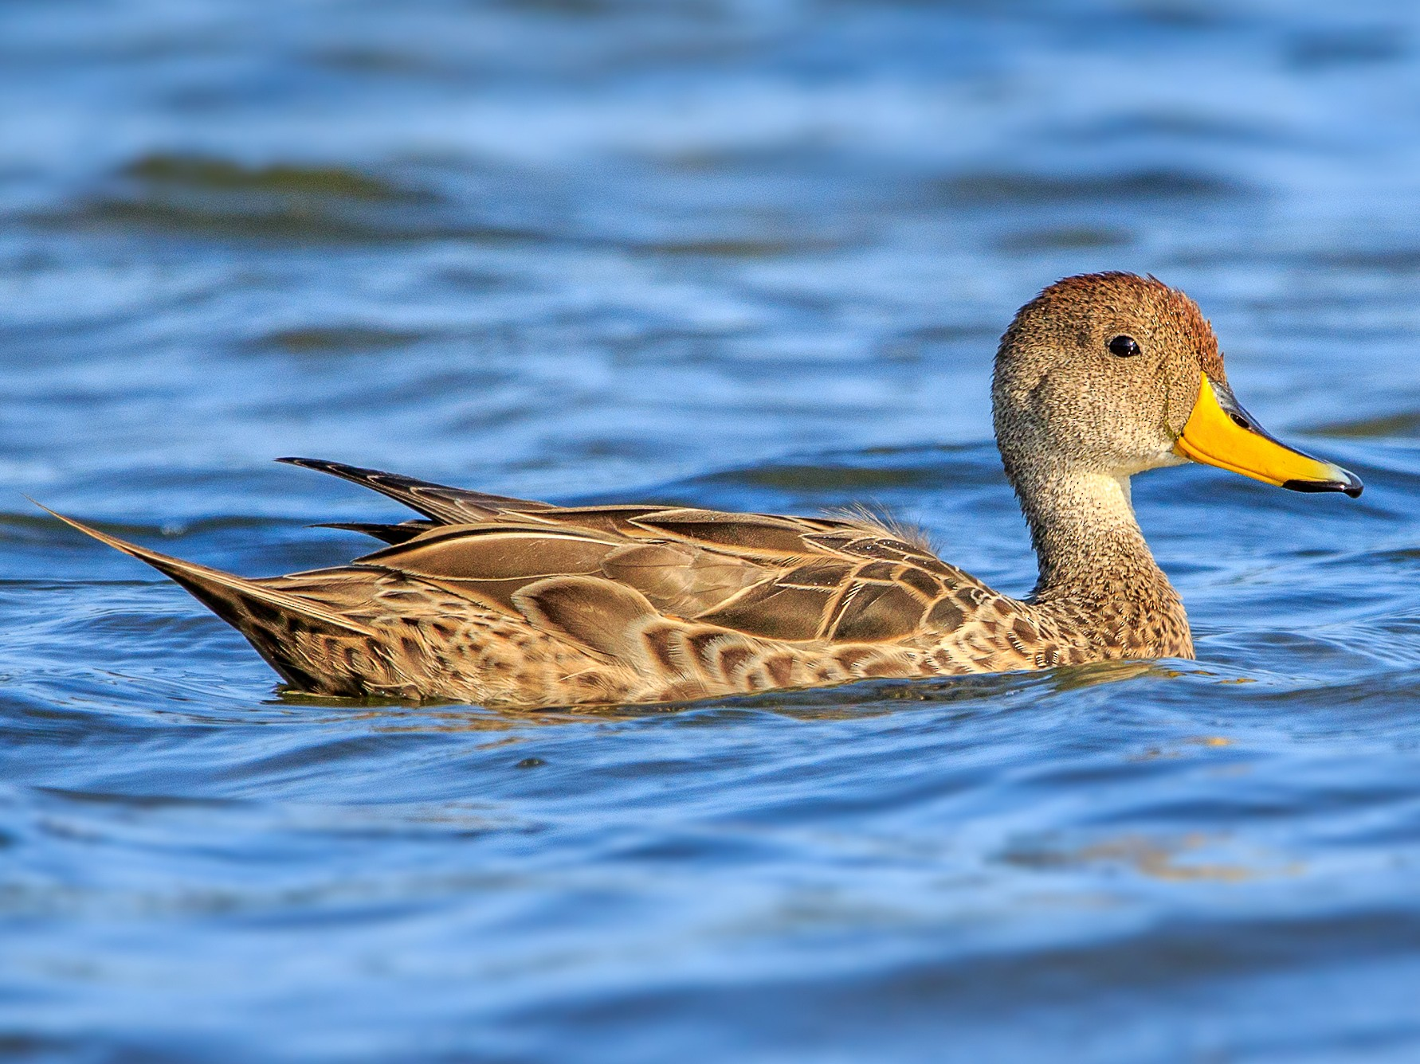
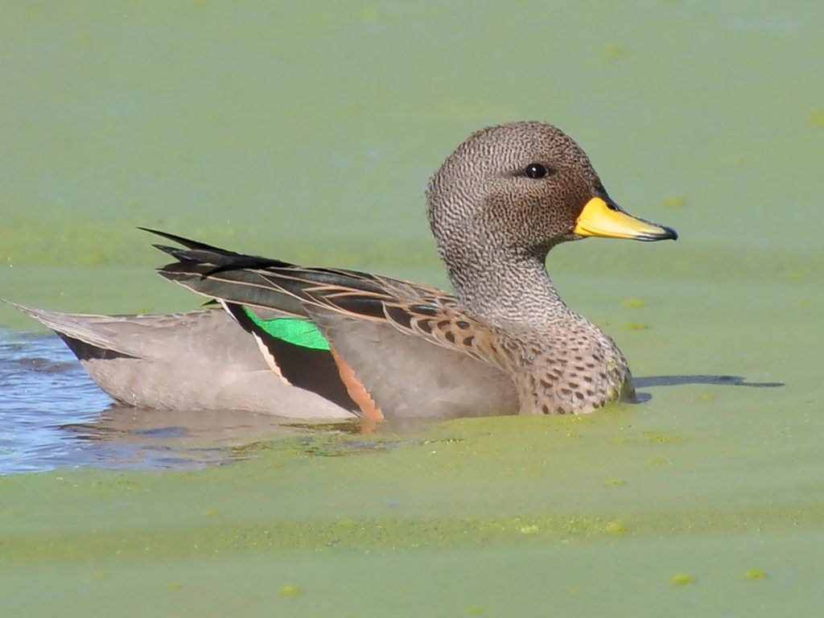

Slide 30
LD decay is consistent with old selective sweep on speckled teal and much more recent selective sweep on pintail, therefore more LD.

Slide 32
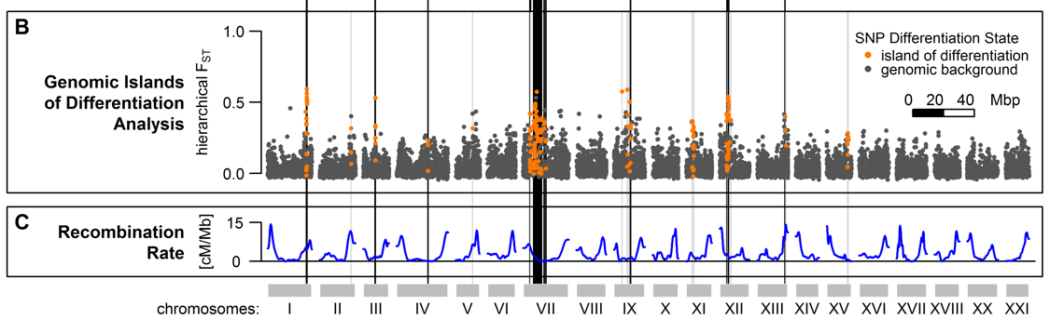
F_{ST} (a measure of LD) and Recombination Rate Show Inverse Relationship
Marques, David A., et al. (2016) Genomics of Rapid Incipient Speciation in Sympatric Threespine Stickleback. PLoS Genet 12.2:e1005887.

Slide 33
Two-Locus Wahlund Effect
Wahlund Effect = decrease in Heterozygosity below what is expected from Hardy-Weinberg predictions in subdivided populations.
Population subdivision creates LD even if there is no LD (i.e., linkage equilibrium) in each respective population.
Pop1 = 100% AB, Pop2 = 100% ab → draw sample ½ AABB & ½ aabb → D = ¼
LD appears because you inadvertently mixed two populations with different allele frequencies, despite D = 0 in both populations.
Creates + inbreeding coefficient.
Same pattern could result from selection on single locus (as seen in the previous slide).
To tell the difference sequence many loci (LD among many sites → implies population subdivision; few adjacent sites → selection).

Slide 34
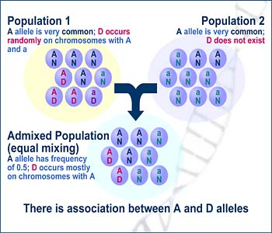
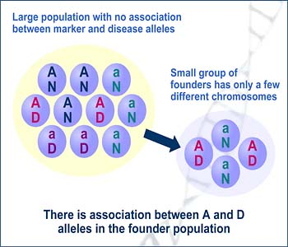
Factors Causing LD to be Apparent When Samples from Populations are Pooled
Population Subdivision – drift causes allele frequencies to diverge
Founder Events & Bottlenecks – stochastic sampling results in a daughter population with different allele frequencies
Population Subdivision
Founder Event/Bottleneck
http://hihg.med.miami.edu/code/http/modules/education/Design/Print.asp?CourseNum=5&LessonNum=2

Slide 35
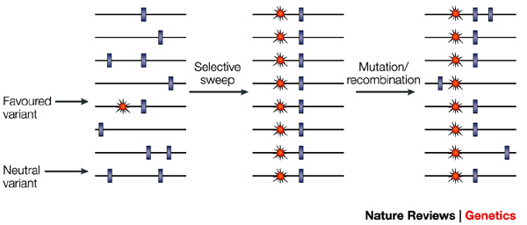
Recurrent Mutation
When a new mutation appears, LD is created because only three of the four possible haplotypes are present, D’ = 1.
aB AB Ab is missing; only 3 haplotypes until another
ab ab mutation or recombination event.
The most visible example is with a selective sweep. D’ → 1 and decreases from 1 only through recombination.

Slide 36
3 Haplotypes | Site 1 | Site 2
1 | 0 | 0
2 | 1 | 0
3 | 0 | 1
4 Haplotype | Site 1 | Site 2
1 | 0 | 0
2 | 1 | 0
3 | 0 | 1
4 | 1 | 1
←
This is the basis for the Four-Gamete Test.
Presence of the 4th gamete (1, 1) can only have arisen through recombination or recurrent mutation.
If μ is >> c, recurrent mutation (homoplasy) creates patterns that look like recombination.

Slide 37
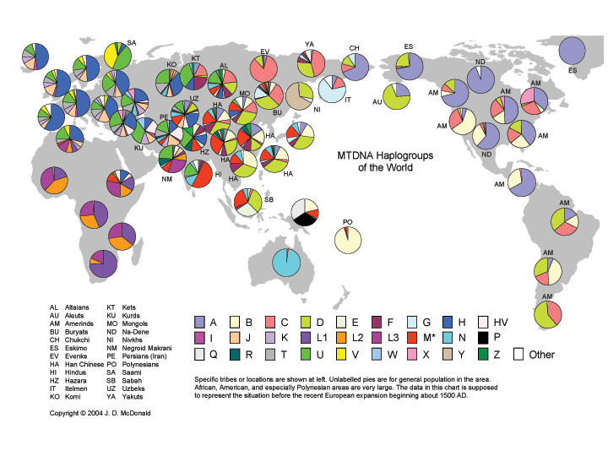
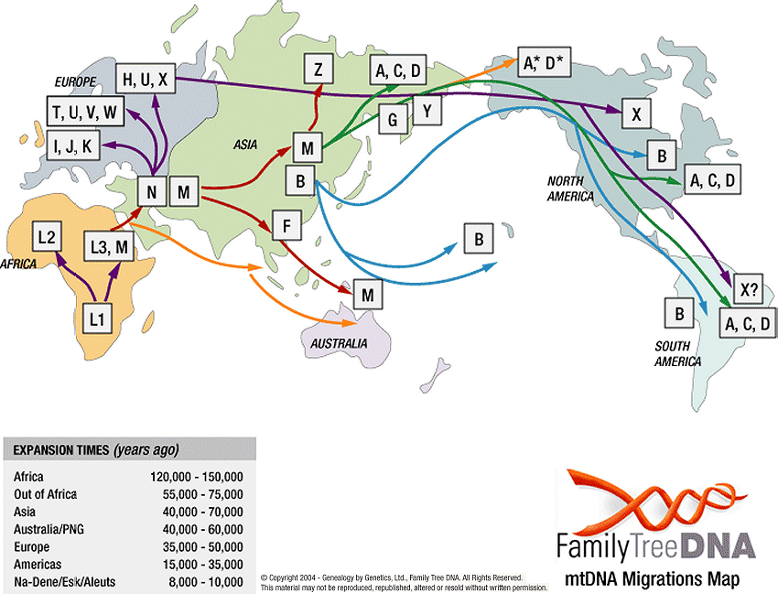
Why do humans have so much LD?
Most species do not!
Humans appear to be exceptional in this regard.
Human populations diverged in allopatry (different places), and drift caused allele frequencies to diverge.
Then humans migrated and populations have become extensively admixed throughout the world.
Some populations more admixed than others.
Time for recombination to remove LD has been insufificient.

Slide 38
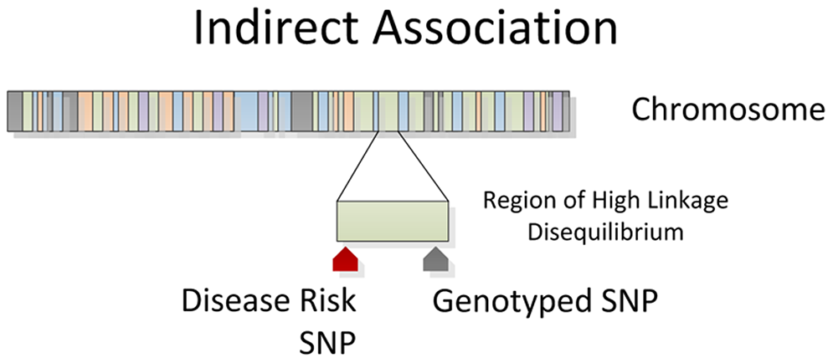
Genome Wide Association Study (GWAS)
https://www.slideshare.net/ruchibioinfo/genome-mapping

Slide 39
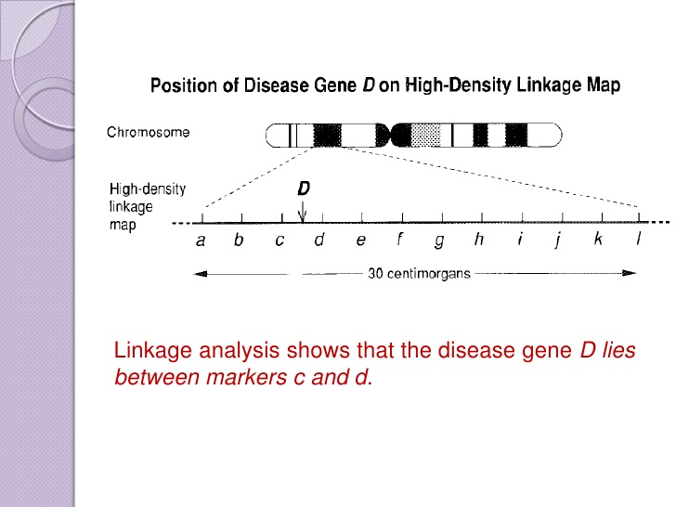
https://www.slideshare.net/ruchibioinfo/genome-mapping

Slide 40
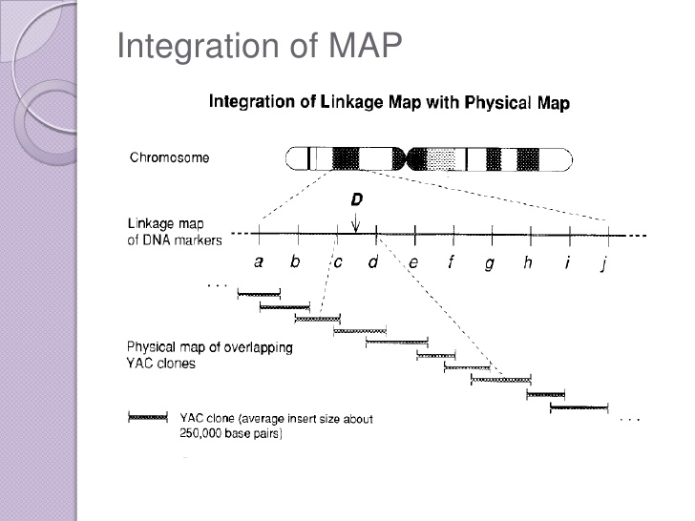
https://www.slideshare.net/ruchibioinfo/genome-mapping

Slide 41
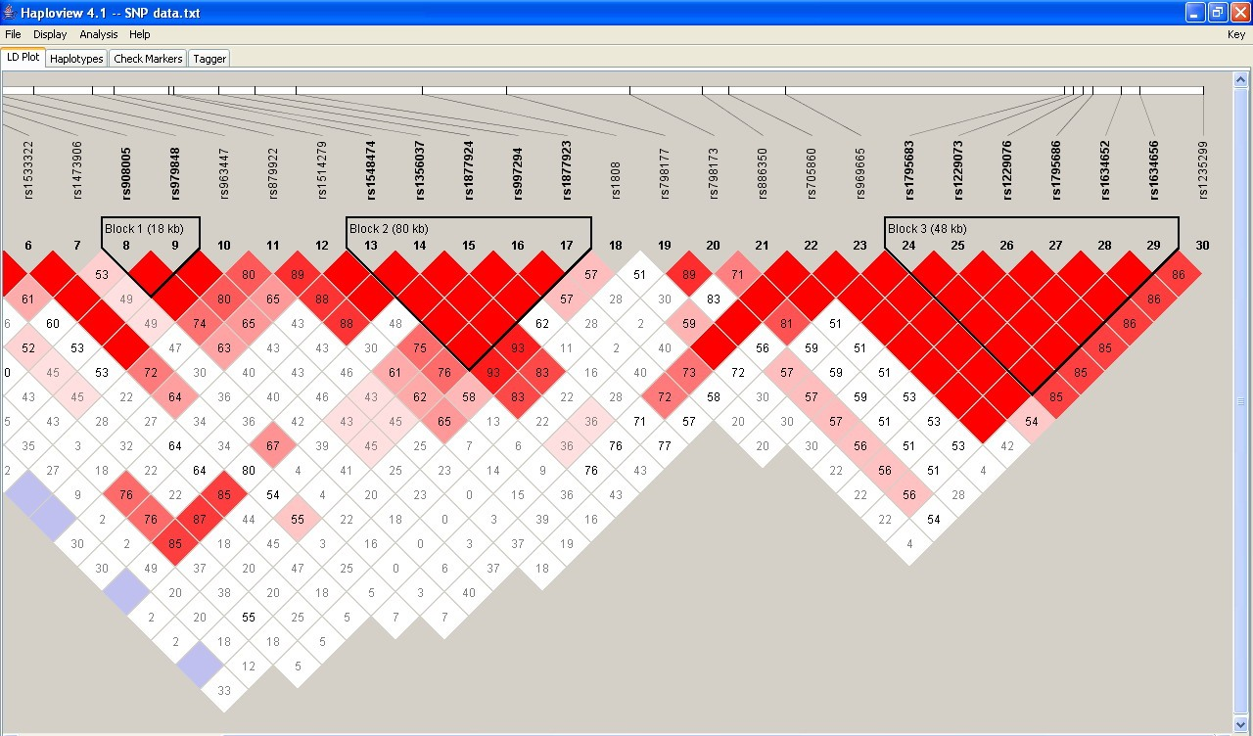
Haploview Plot of LD Scores - Software from Broad Institute
https://sumrandee.wordpress.com/
Summary statistics include D’, LOD, r², and base frequencies.

Slide 42
Requires Phased Data
Phased genetic data = separating and identifying the maternal and paternal chromosomal haplotypes (a.k.a., haplotype estimation or genome phasing).
Single-molecule sequencing (PacBio, Nanopore)
Familial sequencing
Can be estimated statistically if the recombination rate is low (PHASE, LAMARC).

Slide 43
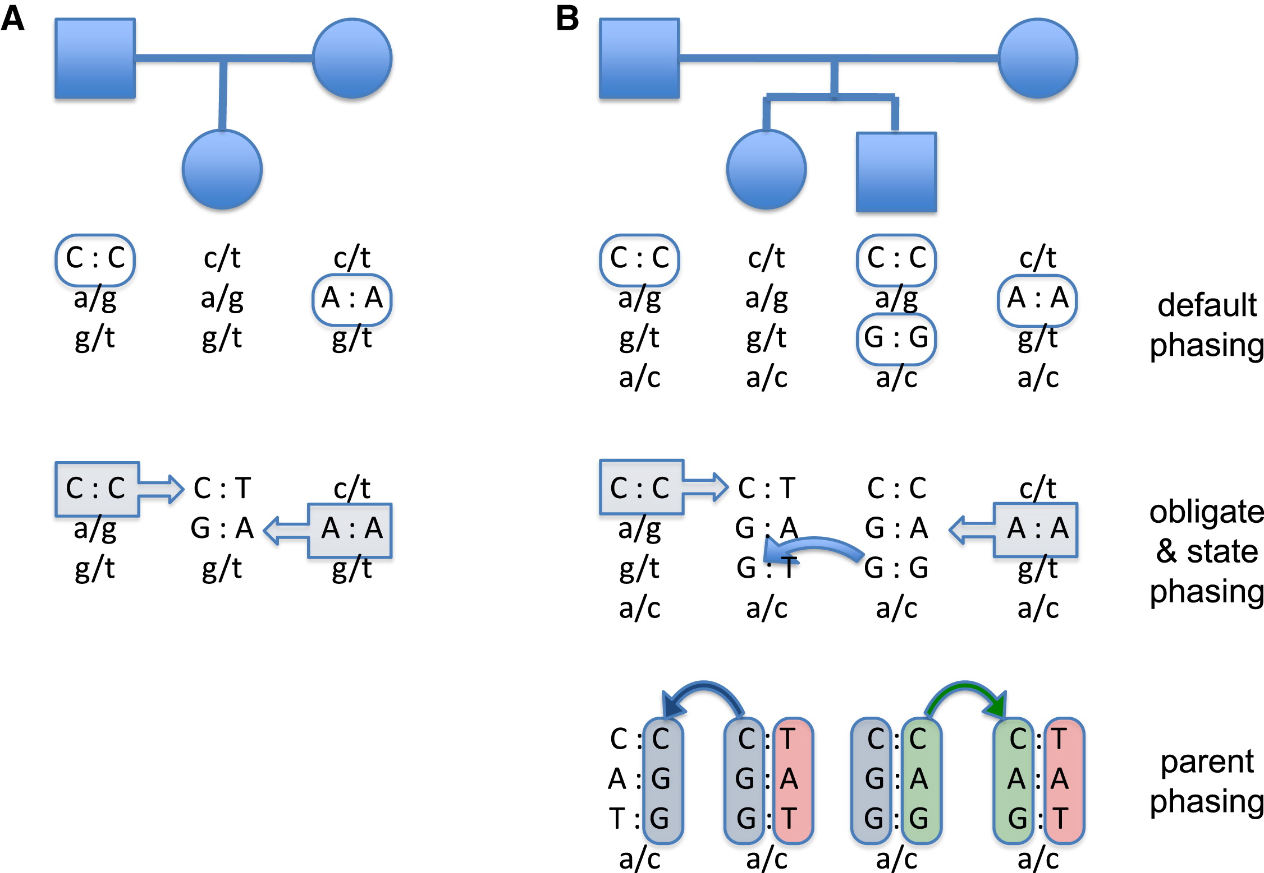
Upper-case alleles are phased genotypes; lower-case alleles are unphased.
Haplotyping can be performed as a series of steps.
1st step, default or trivial phasing, assigns phase to all homozygous positions.
2nd step phases alleles in children or siblings that are identical by descent to alleles phased in the first step.
3rd step phases parental alleles for nuclear families with more than one child.
See Fig. 4
Chromosomal Haplotypes by Genetic Phasing of Human Families
Roach, Jared C. et al.
The American Journal of Human Genetics, Volume 89, Issue 3, 382 - 397

Slide 44
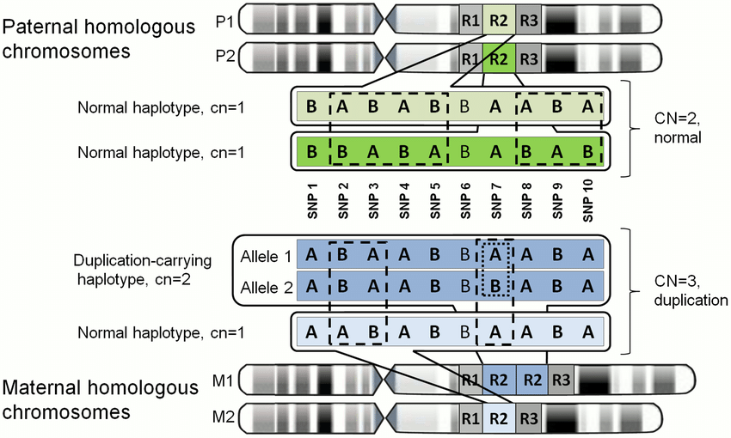
Phased data give information about structural variants.
Palta, Priit & Kaplinski, Lauris & Nagirnaja, Liina & Veidenberg, Andres & Möls, Märt & Nelis, Mari & Esko, Tõnu & Laan, Maris & Remm, Maido. (2015). Haplotype Phasing and Inheritance of Copy Number Variants in Nuclear Families. PLoS ONE. 10. e0122713. 10.1371/journal.pone.0122713.

Slide 45

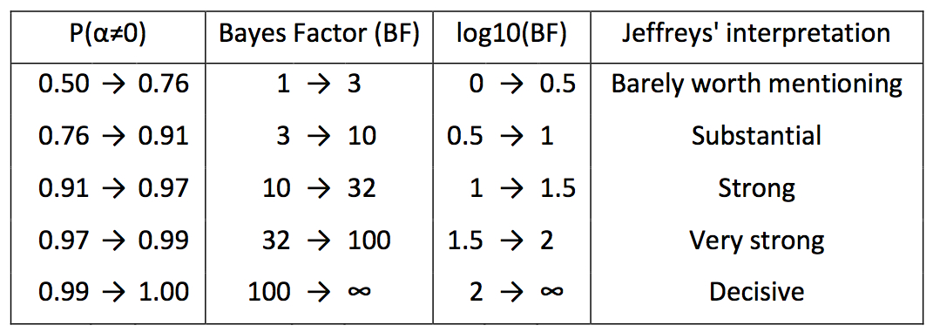
Calculate Lod Score (Logarithm of the Odds):
Lod = log of the odds ratio that two loci (or a locus and a trait) are linked with a recombination factor (q) greater than 0 and less than 0.5.
z = log₁₀ {Prob(data|q)/Prob(data|0.5)}
Lod score of +3.00 (odds of 1000:1) or greater is regarded as acceptable evidence for linkage.
Lod 3 = 1000:1
Lod 2 = 100:1
Lod 1 = 10:1
Similar to Bayes Factors (BF), i.e., Log₁₀(BF)
Helps control for false positives:
500,000 genes → 500 significant
  SNPs at P = 0.001
BayeScan 2.1 Documentation

Slide 46
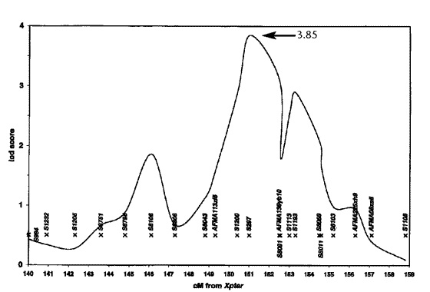
Figure 1. Graph of multipoint lod scores assuming heterogenity
The peak multipoint lod score of 3.85 is located between DXS1200 and DXS297.
Nature Genetics 20, 175 - 179 (1998)
Evidence for a prostate cancer susceptibility locus on the X chromosome.
Jianfeng Xu et al.

Slide 47
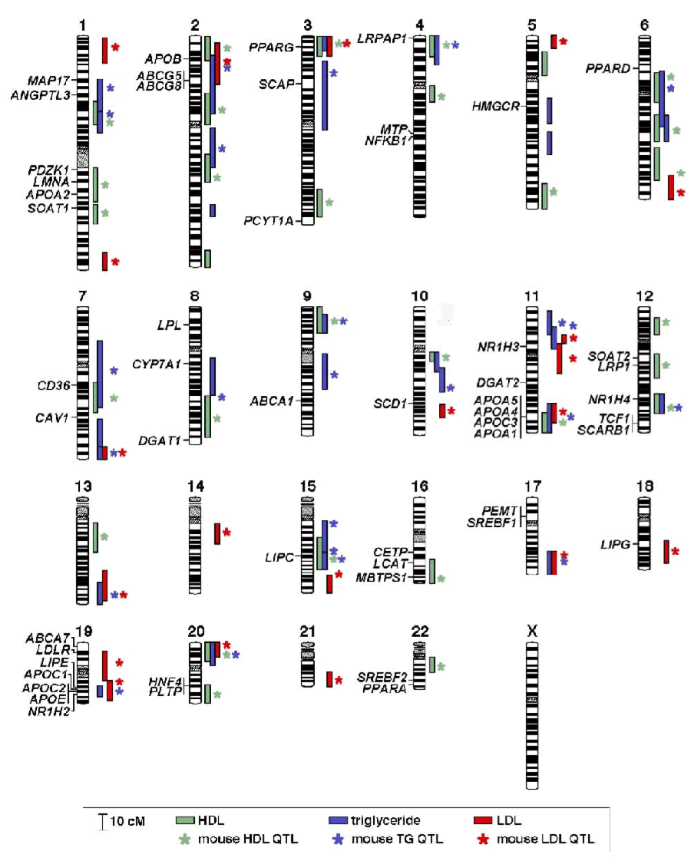
Chromosome map of human QTLs for plasma concentrations of HDL-C, LDL-C and triglyceride levels. 2007. The Jackson Laboratory

