Slide 1
Population Subdivision
Core 2 – Spring 2023

Slide 2

Population Subdivision for Two Populations
2N_{e}μ
Genetic variation; Allele or genotype frequencies
Mutation
Genetic Drift
Migration
2N_{e}μ
Genetic variation; Allele or genotype frequencies
Mutation
Genetic Drift
Mutation and genetic drift (and selection) act independently in each population.
Gene flow homogenizes allele frequencies, offsets drift by increasing Ne.

Slide 3
Different Estimates of Heterozygosity:
HI = mean Obs. H over all subpops = (∑Hobs) / x
*HI per subpop = Hobs = obs f(AB)
HS = Exp. H over all subpops = (∑(2pq)) / x
*Exp. HS per subpop = 2pq based on H-W eq.
HT = Exp. H of random mating total pop = 2pq of total pop
If HT ≠ HS → population subdivision

Slide 4
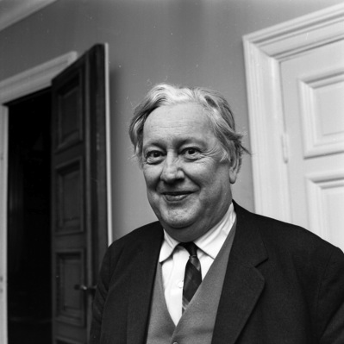
Wahlund Effect
The deficiency of heterozygosity that results from treating multiple populations as a single population.
Even if the subpopulations themselves are in H-W equilibrium.
Caused by geographic barriers + genetic drift.
Sten Wahlund, Uppsala University, Sweden – 1928

Slide 5
Example
 | SUBPOPS
 | A | B | C
f (AA) | 0.64 | 0.20 | 0.30
f (AT) | 0.32 | 0.50 | 0.40
f (TT) | 0.04 | 0.30 | 0.30
f (A) | 0.80 | 0.45 | 0.50
f (T) | 0.20 | 0.55 | 0.50
Total Population
f (A) = (0.80 + 0.45 + 0.50)/3 = 0.58
f (T) = 1 - 0.58 = 0.42
H_{I} = (0.32 + 0.50 + 0.40)/3 = 0.407
H_{S} = (0.32 + 0.495 + 0.50)/3 = 0.438
H_{T} = 2 x (0.58) x (0.42) = 0.487
H_{T} > H_{S} => Pop Structure!
H_{I} = obs (subdivided)
H_{S} = exp (subdivided)
H_{T} = pooled (H-W)
H_{obs} = f (AT) | 0.32 | 0.50 | 0.40
Hexp = 2 x f (A) f (T) | 0.32 | 0.495 | 0.50

Slide 6
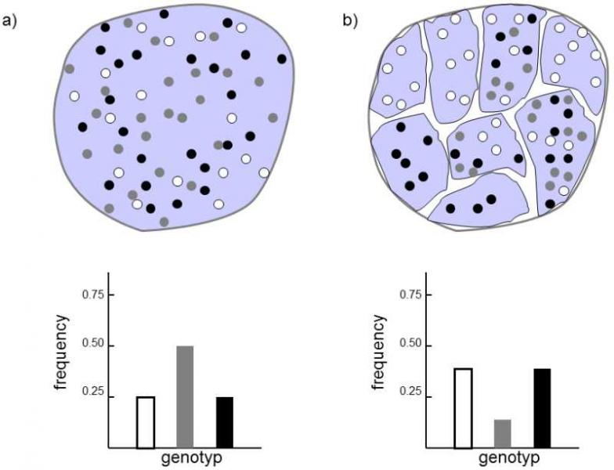
No Population
Subdivision
Population
Subdivision
Heterozygotes disappear from metapopulation
https://www.frozenevolution.com/v21-number-homozygotes-increases-after-large-population-splits-number-smaller-ones

Slide 7
How do we measure population structure?
We use F statistics.
F_{st} = Sewall Wright’s Fixation Index
F_{st} = deviation in allele frequencies among subpopulations relative to what is expected under panmixia (random mating).
F_{st} = H_{t} - H_{s} / H_{t}
F_{st} is bounded by 0 and 1
  0 = populations have identical allelic frequencies.
  1 = populations fixed for different alleles.
Pop1
Pop2

Slide 8
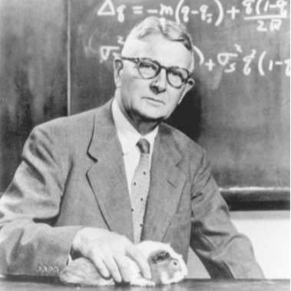
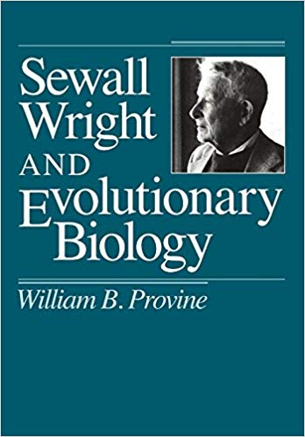
F_{ST} – developed by Sewall Wright

Slide 9
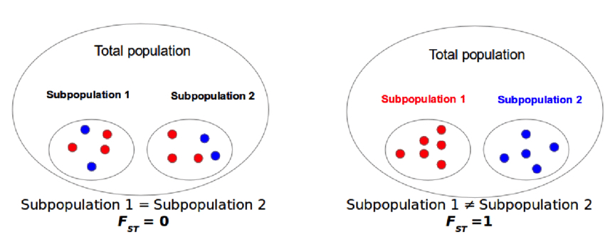
https://www.researchgate.net/figure/Genetic-differentiation-an-example-of-the-behavior-of-fixation-index-FST-If-allele_fig9_306018124

Slide 10
Example F_{ST} Calculation
 | SUBPOPS
 | A | B | C
f (AA) | 0.64 | 0.20 | 0.30
f (AT) | 0.32 | 0.50 | 0.40
f (TT) | 0.04 | 0.30 | 0.30
f (A) | 0.80 | 0.45 | 0.50
f (T) | 0.20 | 0.55 | 0.50
Total Population
f (A) = (0.80 + 0.45 + 0.50)/3 = 0.58
f (T) = 1 - 0.58 = 0.42
H_{I} = (0.32 + 0.50 + 0.40)/3 = 0.407
H_{S} = (0.32 + 0.495 + 0.50)/3 = 0.438
H_{T} = 2 x (0.58) x (0.42) = 0.487
H_{T} > H_{S} => Pop Structure!
H_{obs} = f (AT) | 0.32 | 0.50 | 0.40
Hexp = 2 x f (A) f(T) | 0.32 | 0.495 | 0.50
F_{st} = H_{t} - H_{s} / H_{t} = (0.487 – 0.438)/0.487 = 0.10062
*This is the % reduction in heterozygosity due to genetic differentiation among pops.

Slide 11
Pairwise F_{ST} for Three Subpopulations
Subpop | HS
A | 0.320
B | 0.495
C | 0.500
Mean HS | 0.4383
HT | 0.4870
HT (1 - FST) = HS
0.487 x (1 - FST) = 0.4383
FST = -[(0.4383 / 0.487) -1]
FST = 0.10
*Do this across subpopulations for all pair-wise comparisons:
F_{st} A-B = (((2*((0.8+0.45)/2)*((0.2+0.55)/2))) – ((0.32+0.5)/2)) / ((2*((0.8+0.45)/2)*((0.2+0.55)/2))) =
0.125
F_{st} A-C = (((2*((0.8+0.5)/2)*((0.2+0.5)/2))) – ((0.32+0.4)/2)) / ((2*((0.8+0.5)/2)*((0.2+0.5)/2))) =
0.209
F_{st} B-C = (((2*((0.45+0.5)/2)*((0.55+0.5)/2))) – ((0.5+0.4)/2)) / ((2*((0.45+0.5)/2)*((0.55+0.5)/2))) =
0.0977

Slide 12
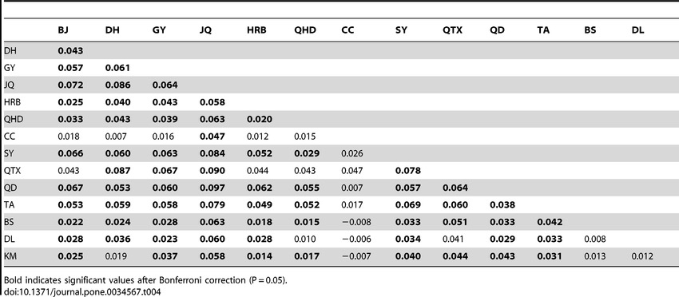
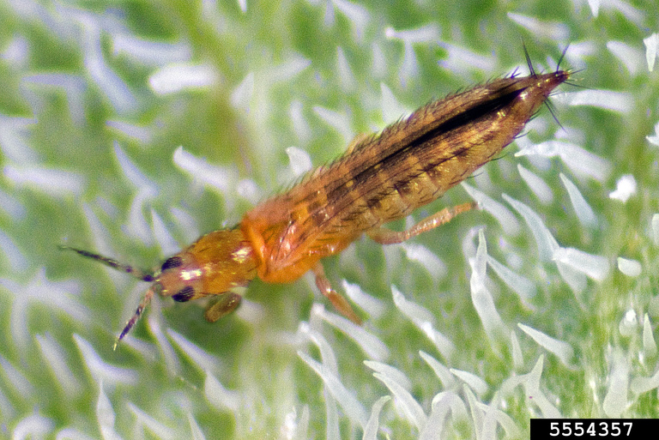
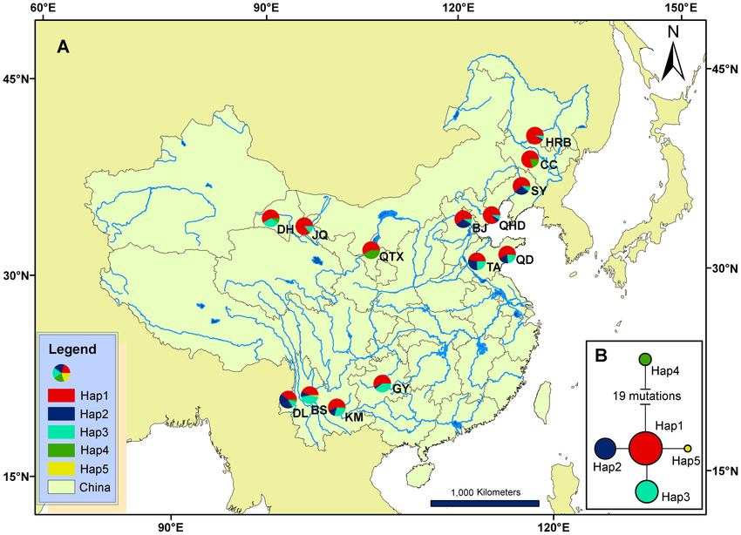
Pairwise F_{ST} for microsatellite loci among 13 localities in China
Invasion Genetics of the Western Flower Thrips in China: Evidence for Genetic Bottleneck, Hybridization and Bridgehead Effect
Xian-Ming Yang,
Jing-Tao Sun,
Xiao-Feng Xue,
Jin-Bo Li,
Xiao-Yue Hong
Published: April 3, 2012
https://doi.org/10.1371/journal.pone.0034567

Slide 13
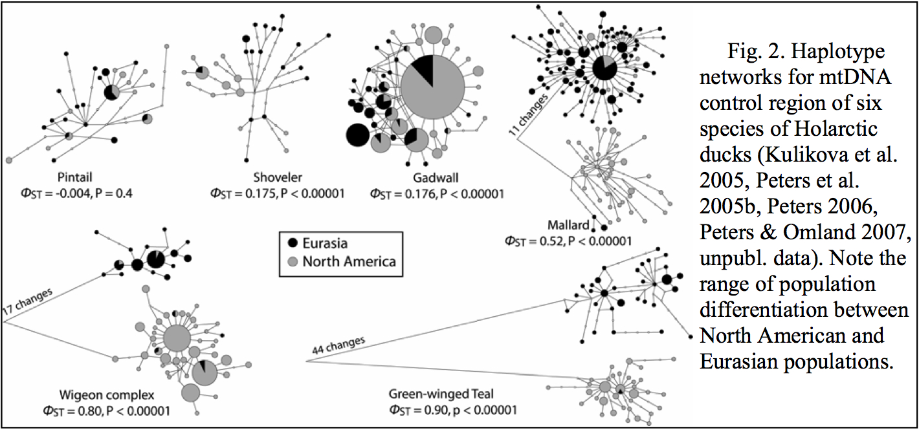

Slide 14


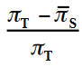
Multiple Loci
Nei (1977, 1987) → F_{st} = H_{t} - H_{s} / H_{t}
---calculate H per locus and avg across all loci
Weir & Cocherham → = Wright’s FST →
ΦST = is the best estimator for lots of DNA sequence data.
*Calculating the proportion of nucleotide diversity among subpopulations, relative to the total.
*However we require a means to statistically test and verify differences among and between estimators.

Slide 15
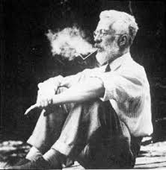
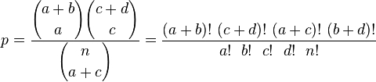
Fisher’s Exact Test
Useful for small samples.
Significance of the deviation from a null hypothesis can be calculated exactly (instead of approximation).
 | Category 1 | Category 2 | Row Total
Group 1 | a | b | a + b
Group 2 | c | d | c + d
Column total | a + c | d + d | n

Slide 16
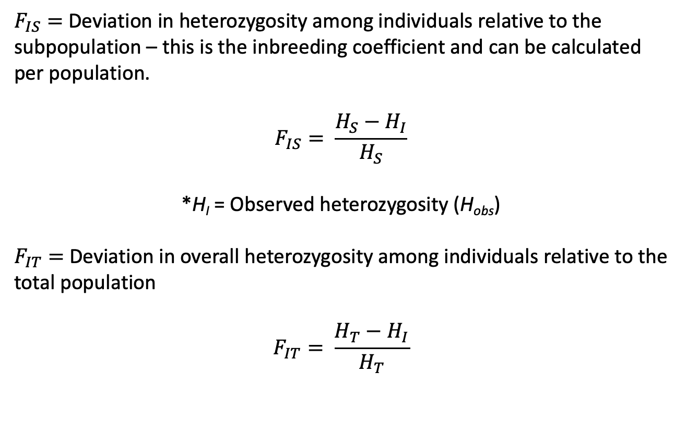
Related F coefficients
$F_{IS}=$Deviation in heterozygosity among individuals relative to the subpopulation – this is the inbreeding coefficient and can be calculated per population.
$$F_{IS}= \frac{H_{S}−H_{I}}{H_{S}}$$
*H_{I} = Observed heterozygosity (H_{obs})
$F_{IT}=$Deviation in overall heterozygosity among individuals relative to the total population
$$F_{IT}= \frac{H_{T}−H_{I}}{H_{T}}$$

Slide 17
Analysis of Molecular Variance (AMOVA)
Tests for hierarchical population subdivision.
*Proportion of genetic diversity is partitioned among groups vs. among subpopulations within groups
Population 1
Population 2
A
B
Among groups
Ф_{ct}
D
E
C
F
Among subpopulations within regions
Ф_{sc}
Among subpopulations within regions
Ф_{sc}
= sample sites

Slide 18
Difference between F_{ST} and Φ_{ST}
F_{ST} is based on allelic frequencies.
Φ_{ST} incorporates a nucleotide substitution model that accounts for different rates for transitions (TIs) and transversions (TVs), % invariant sites, etc.
HKY & Tamura-Nei are common.
Calculated using nucleotide diversity (π), the per site heterozygosity

Slide 19
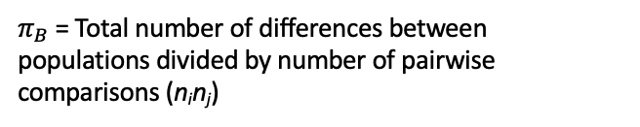









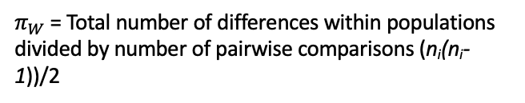

Calculating F_{st} from sequence data: Φ_{ST} (Phi-ST)
$${\text{F}}_{ST}=\frac{π_{B}−π_{W}}{π_{B}}$$
$π_{B}$ = the average number (or proportion) of nucleotide differences between populations (divergence)
$π_{W}$ = the average number (or proportion) of nucleotide differences within subpopulations (nucleotide diversity)
Pop1 Pop2
28 50
22 0
…GCTGTGGGCAAGAAGGCAGATTGAGCCCCGTGTACGCTGC… allele A
…GCTGTGGGCAAGGAGGCAGATTGAGCCCCGTGTACGCTGC… allele B
For two populations,
$π_{B}$ = Total number of differences between populations divided by number of pairwise comparisons (n_{i}n_{j})
$π_{W}$ = Total number of differences within populations divided by number of pairwise comparisons (n_{i}(n_{i}-1))/2
$$π_{B}=(22∗50∗1)/(50∗50)$$
$π_{W1}$ = (28*22*1)/((50*(50-1))/2)
$$π_{B}=(1100)/(2500)$$
$π_{W1}$ = 588/1225
$\overline{π_{W}}$ = (0.48 + 0)/2
$$π_{B}=0.44$$
$π_{W1}$ = 0.48
$\overline{π_{W}}$ = 0.24
$π_{W2}$ = 0.0

Slide 20
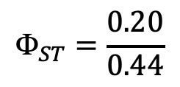
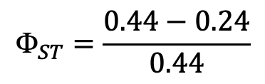



Calculating F_{st} from sequence data: Φ_{ST} (Phi-ST)
$${\text{F}}_{ST}=\frac{π_{B}−π_{W}}{π_{B}}$$
$π_{B}$ = the average number (or proportion) of nucleotide differences between populations (divergence)
$π_{W}$ = the average number (or proportion) of nucleotide differences within subpopulations (nucleotide diversity)
Pop1 Pop2
28 50
22 0
…GCTGTGGGCAAGAAGGCAGATTGAGCCCCGTGTACGCTGC… allele A
…GCTGTGGGCAAGGAGGCAGATTGAGCCCCGTGTACGCTGC… allele B
$$π_{B}=0.44$$
$${\text{F}}_{ST}=\frac{0.44−0.24}{0.44}$$
45.5% of the total variation is explained by differences in allele frequencies between populations.
Strong population structure.
$\overline{π_{W}}$ = 0.24
$${\text{F}}_{ST}=\frac{0.20}{0.44}$$
$${\text{F}}_{ST}=0.455$$

Slide 21
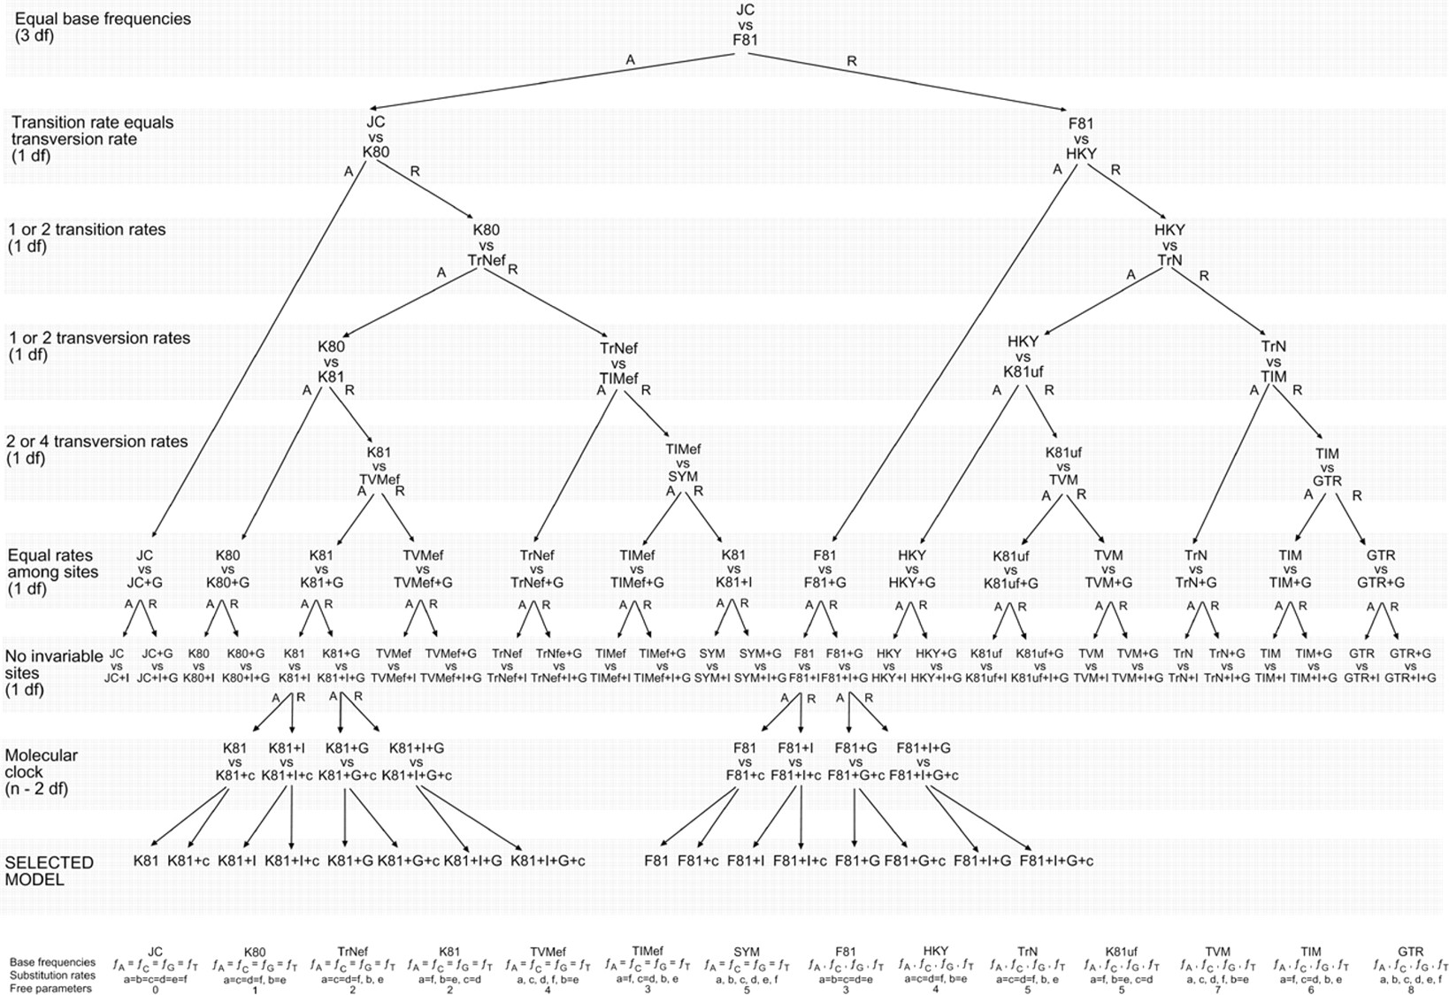
DNA substitution models:

Slide 22

How do we choose among models?
Akaike Information Criterion (AIC)
Measure of relative quality of statistical models for given data.
Tradeoff between goodness-of-fit (likelihood) and complexity of the model (degrees of freedom).
Adding parameters to a model usually improves fit, but also adds complexity. A simpler model may be preferable.
AIC = 2k – 2ln(L), where k = # free parameters
AICc is corrected for sample size.

Slide 23
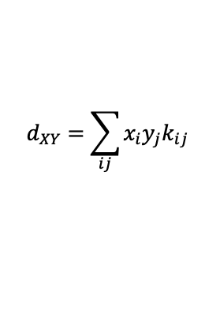
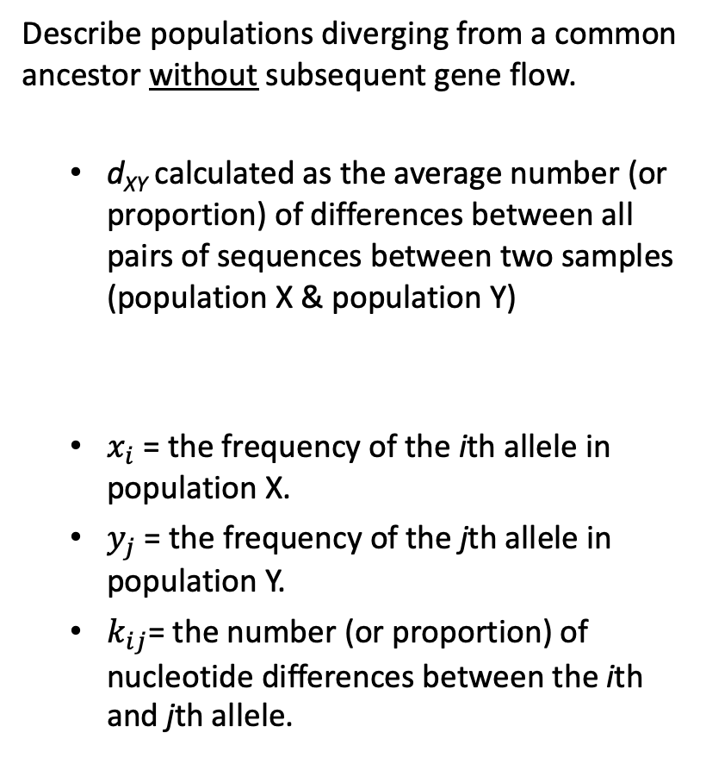
Divergence models (d_{XY})
Describe populations diverging from a common ancestor without subsequent gene flow.
  d_{XY} calculated as the average number (or proportion) of differences between all pairs of sequences between two samples (population X & population Y)
  $x_{i}$ = the frequency of the ith allele in population X.
  $y_{j}$ = the frequency of the jth allele in population Y.
  $k_{ij}$= the number (or proportion) of nucleotide differences between the ith and jth allele.
X
Y
X
Y
m
d_{xy}
d_{xy}
$$d_{XY}=\sum_{ij}{x_{i}y_{j}k_{ij}}$$
Recent common ancestor
Old common ancestor

Slide 24
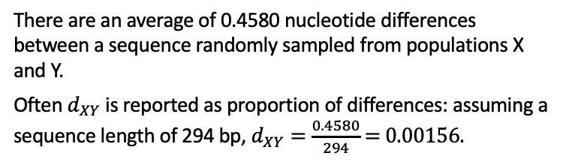
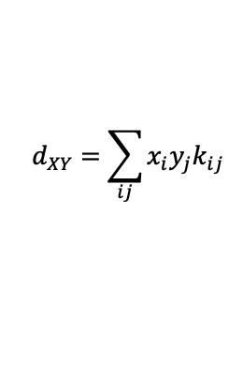

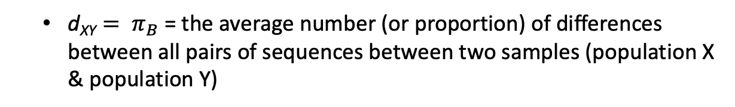
Divergence models (d_{XY})
  ${\text{d}\text{XY}= π}_{B}$ = the average number (or proportion) of differences between all pairs of sequences between two samples (population X & population Y)
$$d_{XY}=\sum_{ij}{x_{i}y_{j}k_{ij}}$$
Pop X Pop Y
0.46 0.98
0.42 0.00
0.02 0.00
0.00 0.02
…GCTGTGGGCAAGAAGGCAGATTGAGCCCCGTGTACGCTGC… allele A
…GCTGTGGGCAAGGAGGCAGATTGAGCCCCGTGTACGCTGC… allele B
…GCTGTGGGCAAGAAGGCAGATTGAGCCCTGTGTACGCTGC… allele C
…GCTGTGGGCAAGAAGGCAGATTGAGCCCCGTGTACGCCGC… allele D
$d_{XY}=x_{A}y_{D}k_{AD}+$ $x_{B}y_{A}k_{BA}+x_{B}y_{D}k_{BD}+x_{C}y_{A}k_{CA}+x_{C}y_{D}k_{CD}$
$d_{XY}=(0.46∗0.02∗1)+$ $(0.42∗0.98∗1)+(0.42∗0.02∗2)+(0.02∗0.98∗1)+(0.02∗0.02∗2)$
$d_{XY}=0.0092+$ 0.4116 $+ \text{0.0168}+\text{0.0196}+\text{0.0008}$
$d_{XY}=\text{0.458}$0
There are an average of 0.4580 nucleotide differences between a sequence randomly sampled from populations X and Y.
Often $d_{XY}$ is reported as proportion of differences: assuming a sequence length of 294 bp, $d_{XY}=\frac{0.4580}{294}$ = 0.00156.

Slide 25
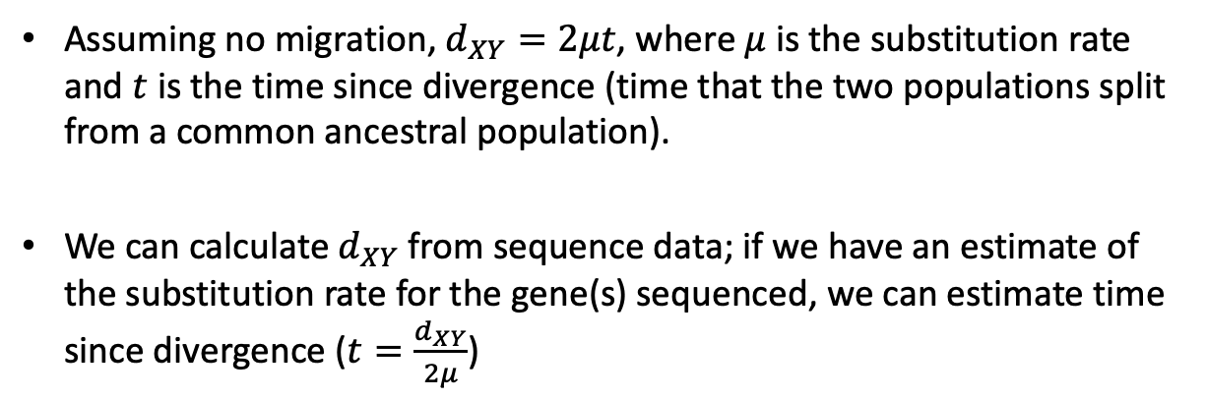
Divergence models (d_{XY})
Assuming no migration, $d_{XY}=2μt$, where $μ$ is the substitution rate and $t$ is the time since divergence (time that the two populations split from a common ancestral population).
We can calculate $d_{XY}$ from sequence data; if we have an estimate of the substitution rate for the gene(s) sequenced, we can estimate time since divergence ($t=\frac{d_{XY}}{2μ}$)
X
Y
X
Y
m
t2
t1
Recent common ancestor
Old common ancestor

Slide 26
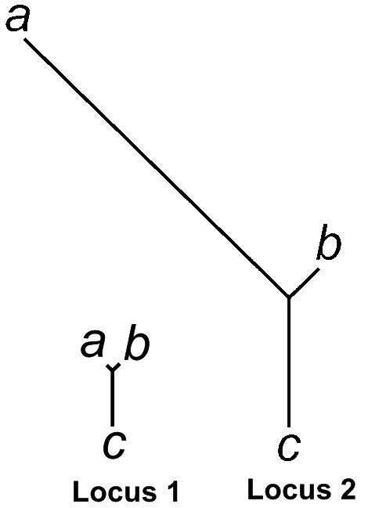
Population Branch Statistic (PBS)
Yi et al.(2010) --- A summary statistic that utilizes pairwise F_{ST} values among three populations to quantify sequence differentiation along each branch of the corresponding three-population tree.
Allow for detection of positions
with unusually high differentiation
across the genome.

Slide 27
How to test for population structure using probabilistic assignment tests

Slide 28
Maximum Likelihood & Bayesian Parameter Estimation
Data = true (not estimated) measure of a population
Parameter estimate = a quantity of interest that defines a group; this is the item of biological interest.
Maximum Likelihood (-lnL) = Method for estimating unknown parameter from data using a statistical model.
Bayesian - specifies some prior probability, which is then updated to a posterior probability with the addition of new, relevant data.
Prior - a prior probability distribution.
Posterior - conditional probability assigned after data are collected (e.g., such as the results of an experiment or set of genealogies).

Slide 29
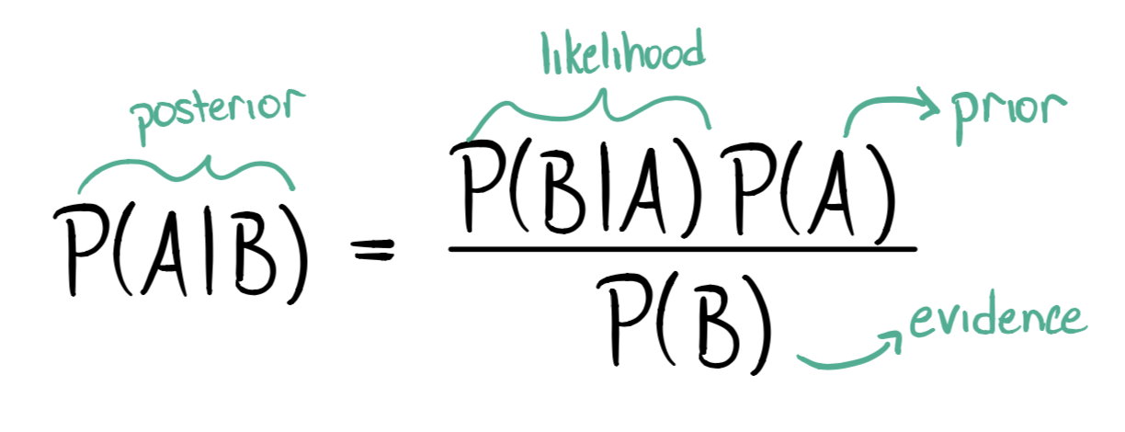
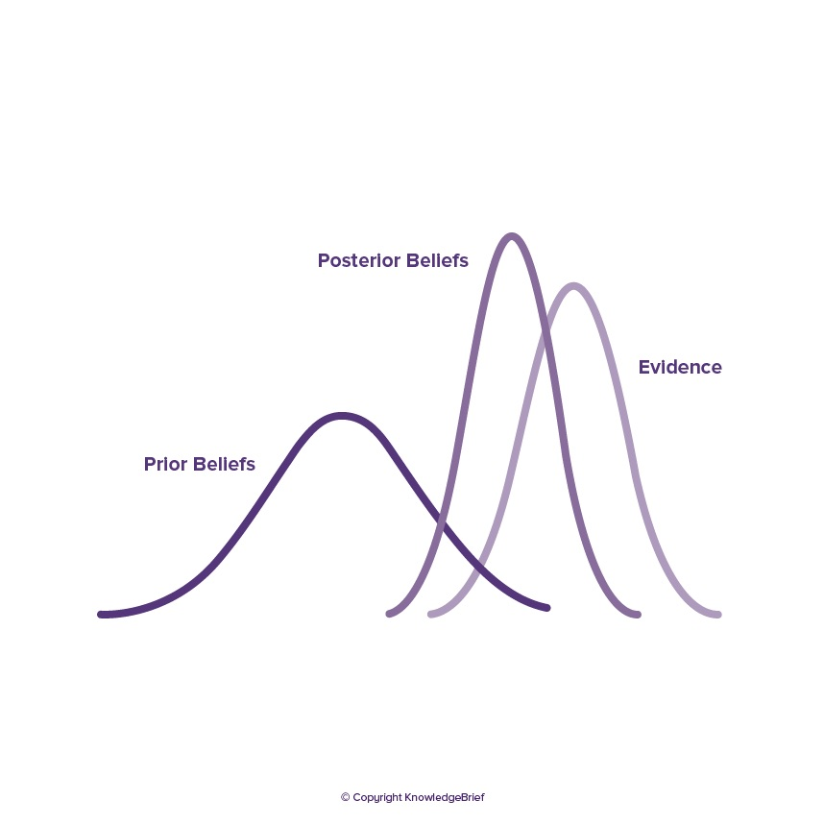

Slide 30
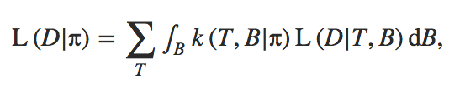
Maximum Likelihood Steps
(1) Specify mathematical relationship between parameter being estimated (e.g., tree length) and data observed (e.g., genealogies built using nucleotide substitution models).
(2) Calculate probability of observing data assuming a particular parameter value.
(3) Repeat step 2 for each possible parameter value.
Best parameter estimate maximizes the probability of observing the data given a model:
where k(T, B|π) is the Kingman coalescent probability density and L(D|T, B) is the likelihood of the data given the genealogy.

Slide 31
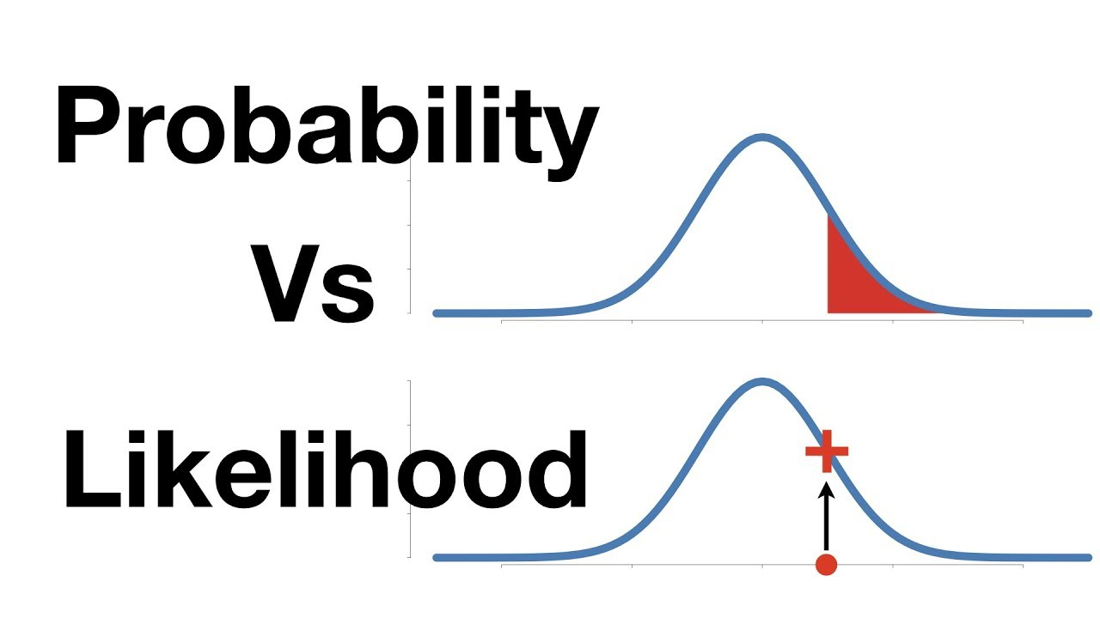
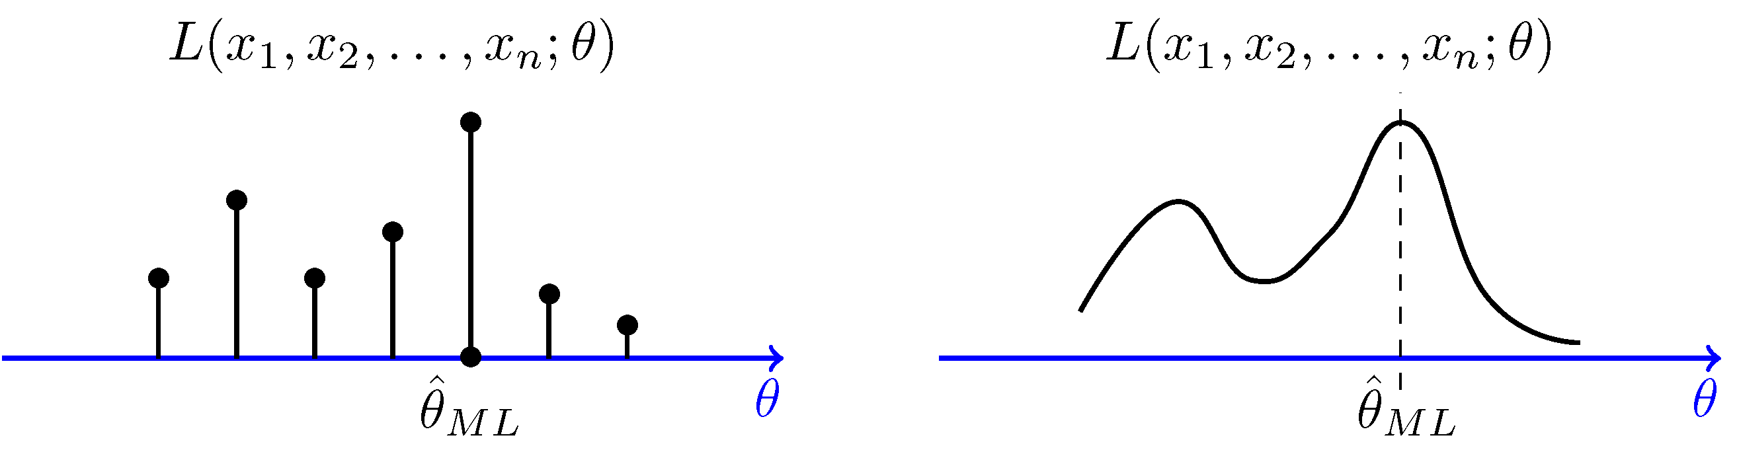
https://www.probabilitycourse.com/chapter8/8_2_3_max_likelihood_estimation.php

Slide 32
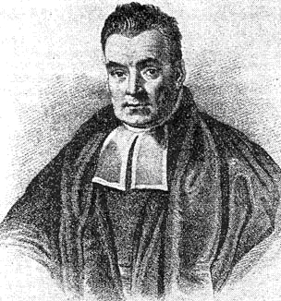

Bayesian Estimation
Named after Rev. Thomas Bayes (1701-1761).
Incorporates Maximum Likelihood but proceeds differently.
Allows direct probabilistic test of a parameter given the data (with confidence intervals).
Posterior distribution is approximated over many samples, in genetics there are often genealogies.
<-- a posterior probability

Slide 33
The difference in sum:
In ML, the best parameter estimate maximizes the probability of observing the data given a model.
L(Data|Model)
Bayesian allows direct probabilistic test of a parameter given the data (with confidence intervals).
f(Model|Data x Prior)
Posterior probability

Slide 34

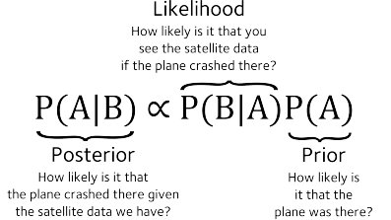
In Bayesian Estimation each prior piece of information is multiplied by the likelihood to obtain what is called a posterior.
This provides the relative importance location in the search space.

Slide 35
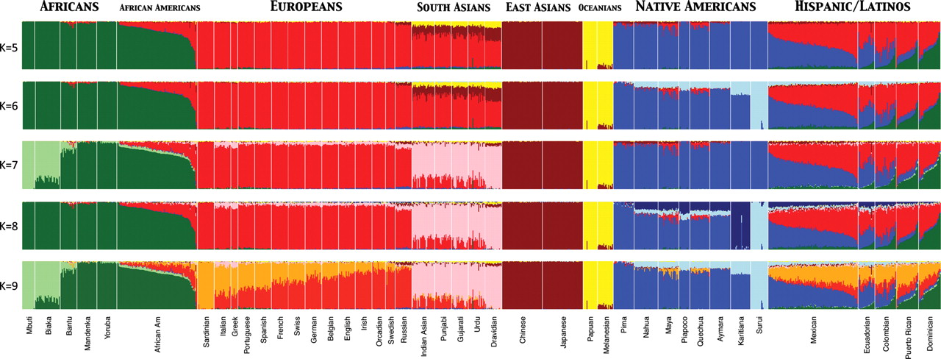
Assignment Tests to Study Structure of Worldwide Human Populations
Used ADMIXTURE clustering algorithm to infer genomic assignments/ individual
K = number of assumed populations
73,901 autosomal SNP markers & 1,112 individuals from 42 global pops
Assignment Tests – Maximize Hardy-Weinberg equilibrium & minimize LD to assign individuals to populations based on genotypes at many loci.
Henn B M et al. Hum. Mol. Genet. 2010;19:R221-R226
© The Author 2010. Published by Oxford University Press. All rights reserved. For Permissions, please email: journals.permissions@oxfordjournals.org

Slide 36
Principal Components Analysis (PCA)
An exploratory technique first developed by Karl Pearson used to reduce a large number of variables in a data set to fewer variables that still contain the information.
  Variables in a data set are often highly correlated.
  PCA identifies correlations among variables in a data set and creates new variables that capture that information.
  The new variables, called principal components (PCs) or eigenvalues, are uncorrelated.
Can be used to:
  Find patterns in high-dimensional data
  Visualize data of high dimensionality
Population genetics applications:
  Detect population structure using genomic data (large number of loci sequenced from the genome)
  Identify admixed individuals

Slide 37
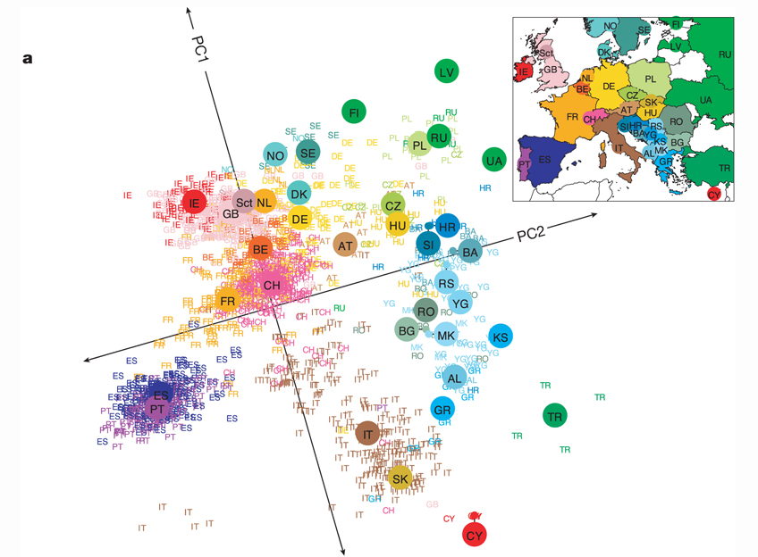
Principal Components Analysis (PCA)
Transforms genotypic data into components that account for correlations in genotypes among multiple loci. Results in clustering of individuals with similar genotypes.
Human Population structure within Europe.
Novembre et al. (2008) Nature 456, 98-101

Slide 38
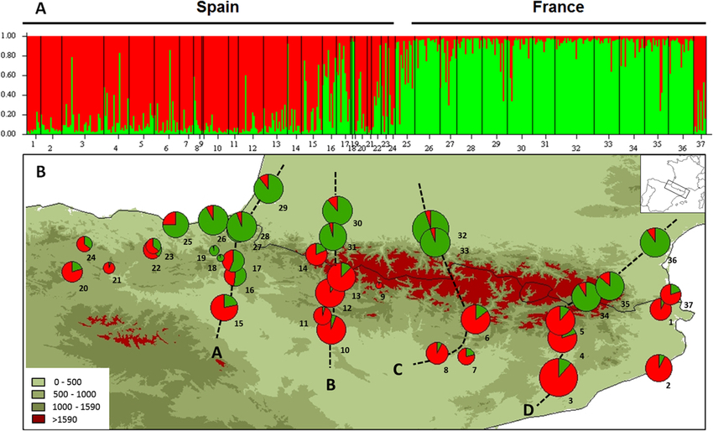
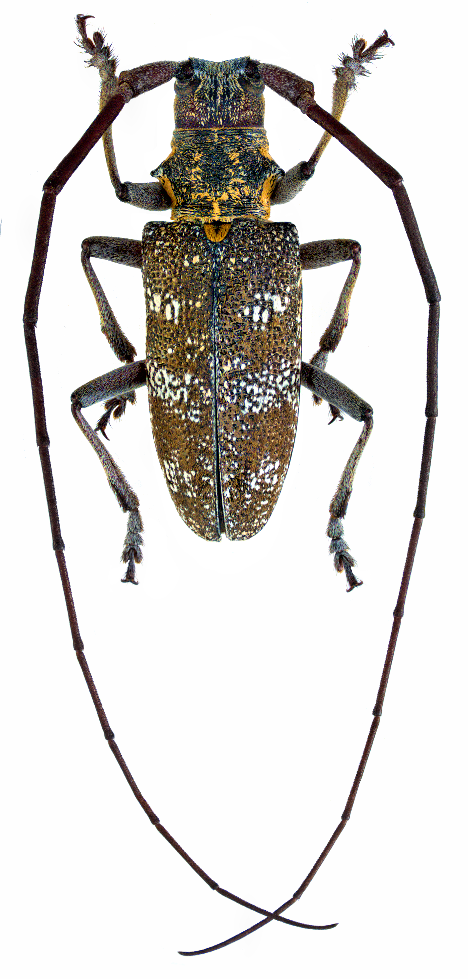
Altitudinal Barrier to the Spread of an Invasive Species: Could the Pyrenean Chain Slow the Natural Spread of the Pinewood Nematode?
July 2015
PLoS ONE DOI: 10.1371/journal.pone.0134126
Population genetic structure of the native vector, Monochamus galloprovincialis, a type of long-horned beetle.

Slide 39
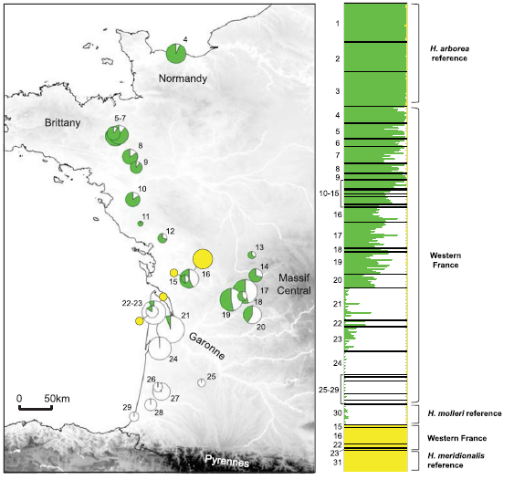
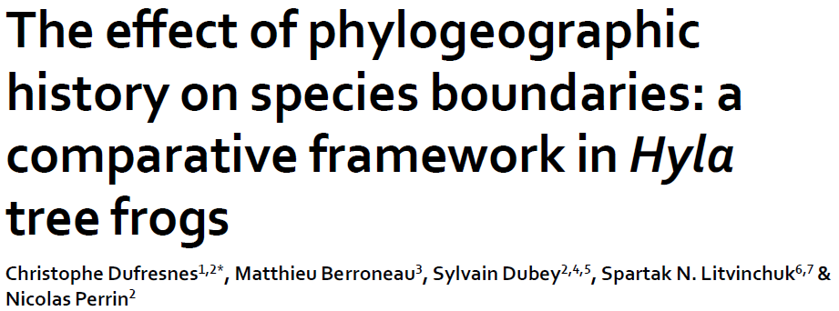
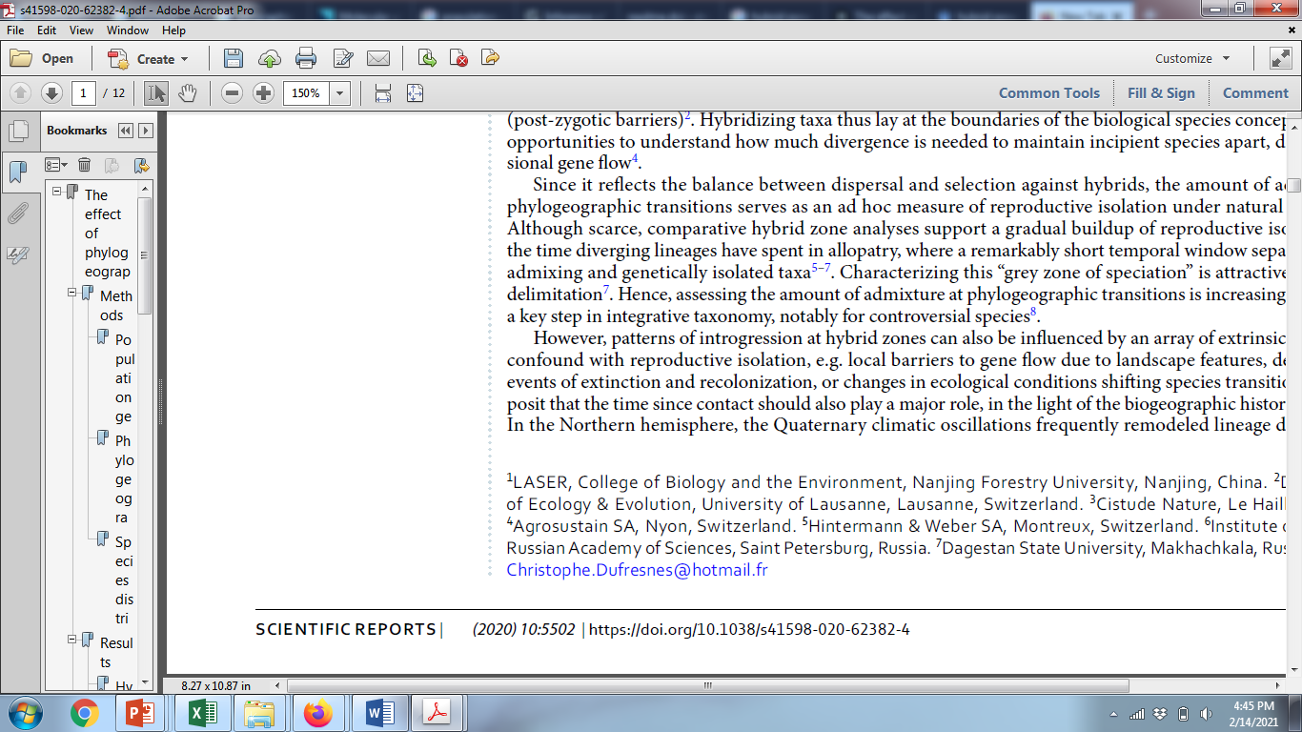
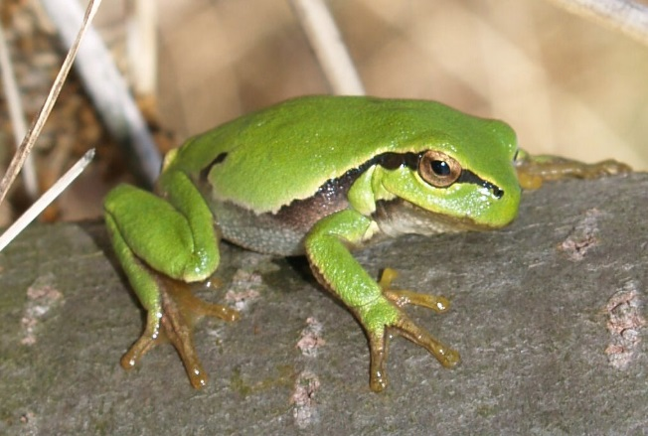
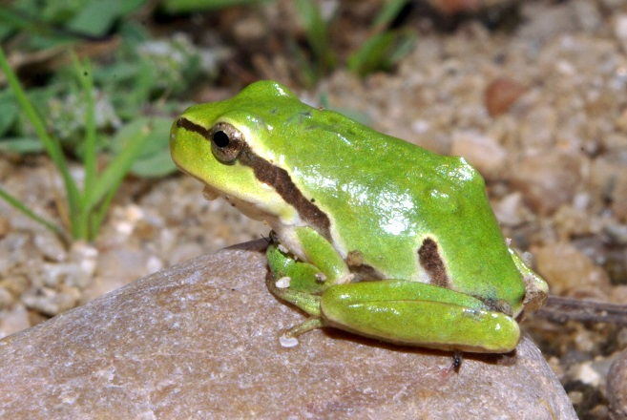
Studying hybrid zones
Hybrid zone
Hyla arborea
Hyla molleri
Assignment based on 26 microsatellite loci

Slide 40
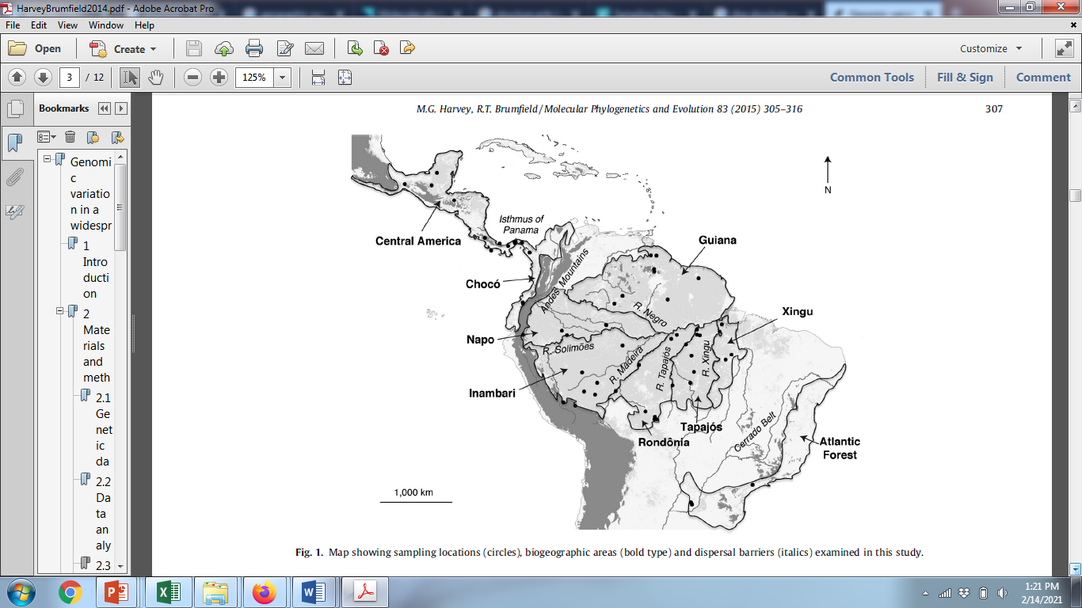
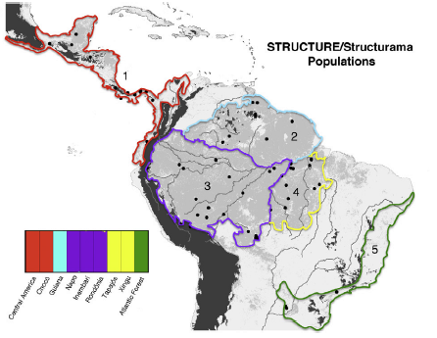

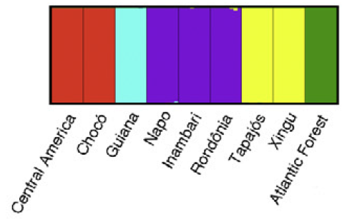
Genomic variation in a widespread Neotropical bird (Xenops minutus) reveals divergence, population expansion, and gene flow
Identifying population boundaries & assigning individuals to populations

Slide 41
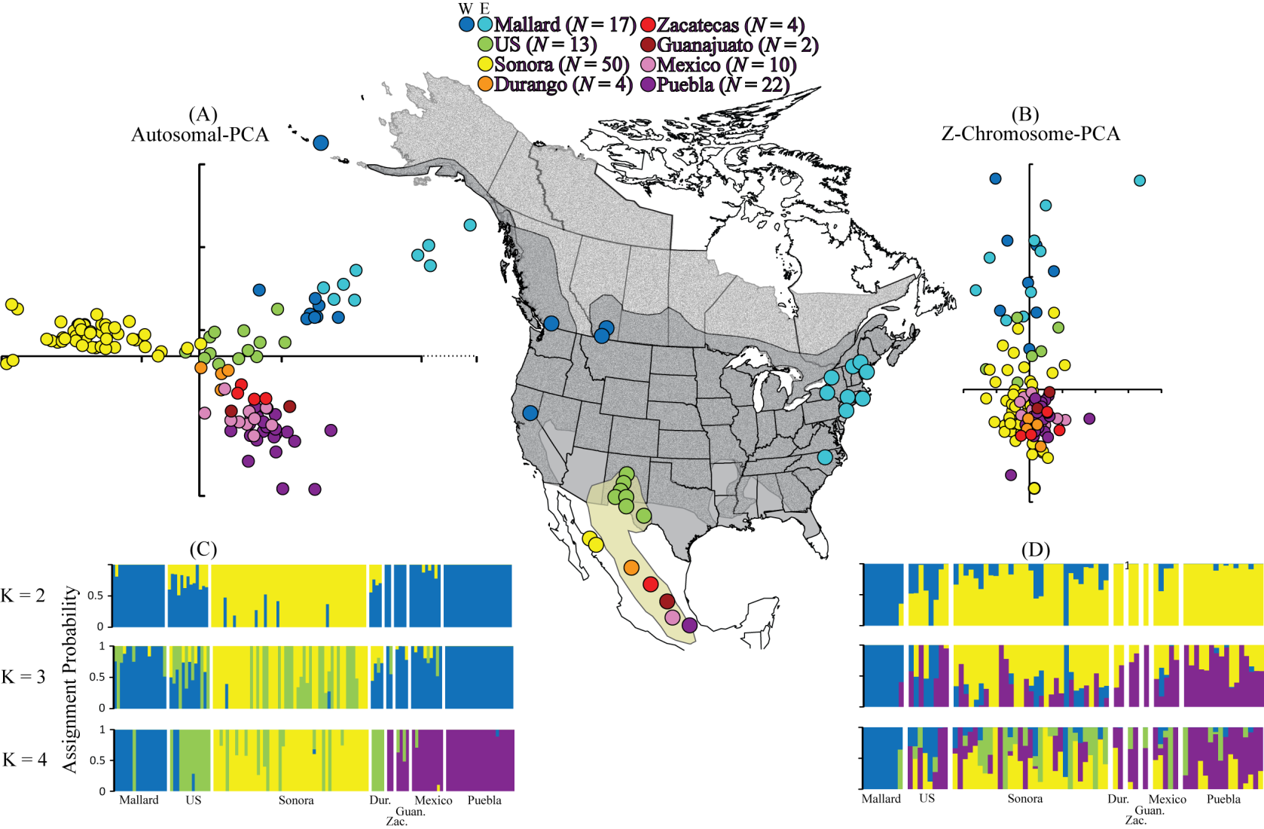
Mexican Duck Data – Lavretsky et al. (2015) Speciation genomics and a role for the Z chromosome in the early stages of divergence between Mexican ducks and mallards. Molecular Ecology 24:5364–5378.

Slide 42
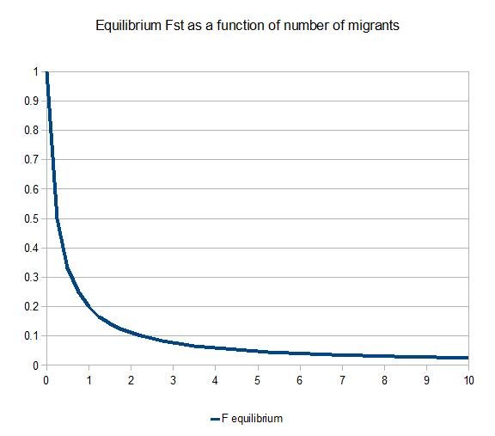
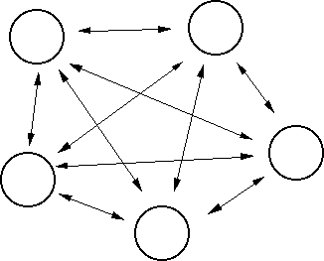
For the Island Model, with equal sample sizes per population:
1 _
1 + 4Nm_{T}
F_{ST} =
F_{ST}
Nm
Island Model
1 migrant per generation prevents fixation

Slide 43
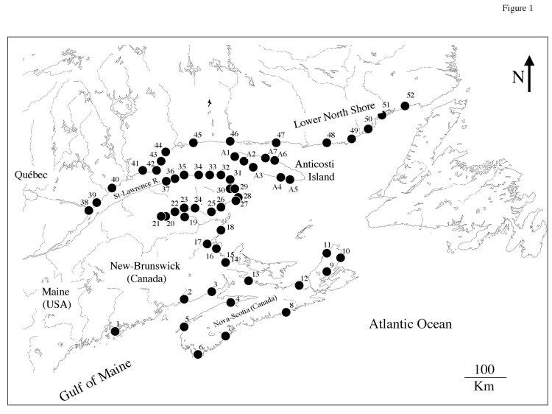
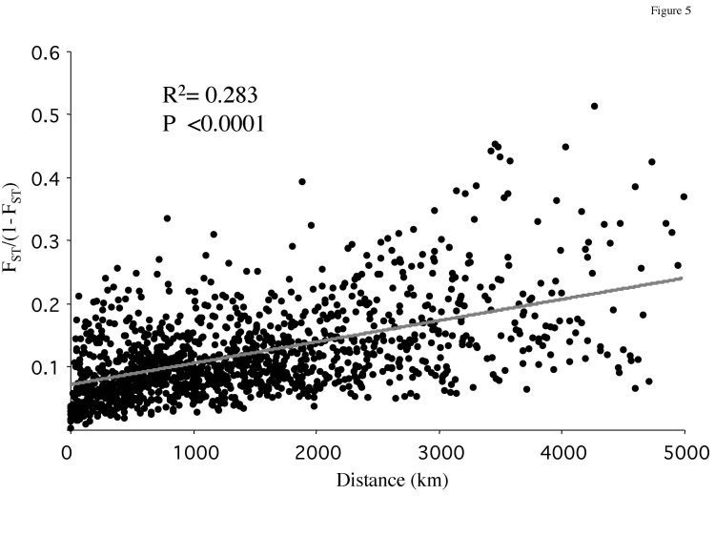
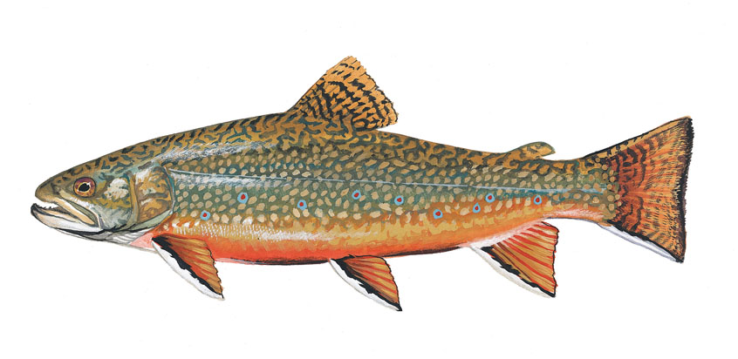
Isolation by Distance - the other IBD
Typically plotted against geographic distance as F_{ST}/(1 - F_{ST}) to obtain a linear relationship.
The rise and fall of isolation by distance in the anadromous brook charr Salvelinus fontinalis Mitchill
http://theses.ulaval.ca/archimede/fichiers/20348/ch04.html

Slide 44

Island Model
Stepping Stone Model

Slide 45

https://xianblog.wordpress.com/2013/07/13/the-original-xkcd-entry-on-bayes-with-its-mistake/

