Slide 1
Natural Selection 1
Core 2 – Spring 2023

Slide 2
Intro to Selection
Until now we have mostly ignored fitness effects of alleles.
This approach was helpful for understanding evolutionary forces such mutation, genetic drift, & migration between subdivided populations.
Fitness equates to differences in survival and reproductive success. Often different alleles affect fitness differently.
Our understanding of how evolutionary forces shape gene frequencies therefore can’t be complete without a basic understanding of natural selection.

Slide 3
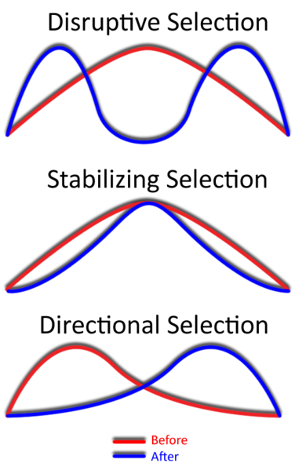
Let’s first think about selection in a broad ecological sense before considering specific details related to gene frequencies.
http://en.wikipedia.org/wiki/Directional_selection

Slide 4
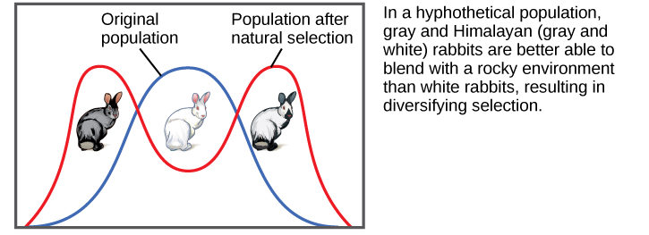
Disruptive of Diversifying Selection
https://courses.lumenlearning.com/wm-biology2/chapter/adaptive-evolution/

Slide 5
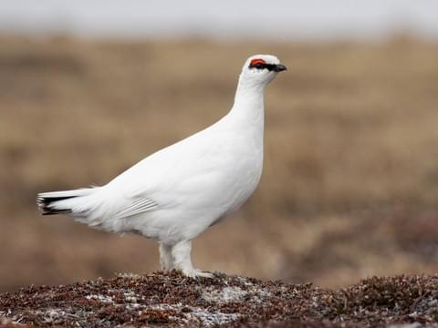
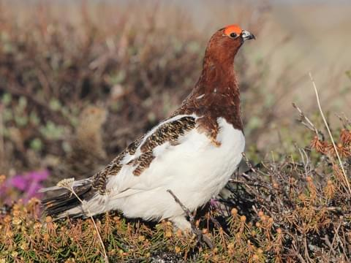
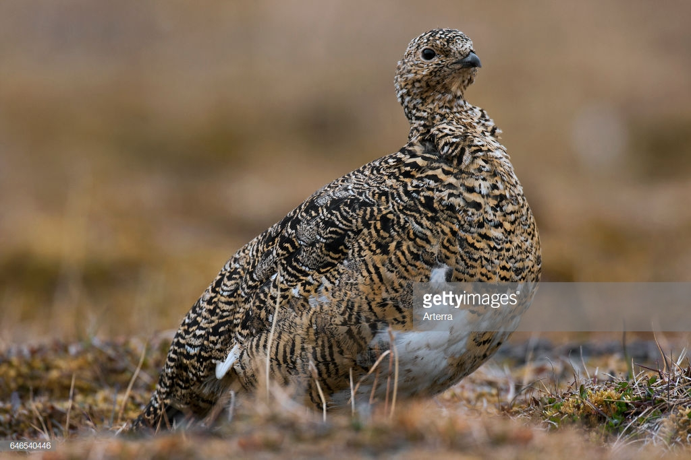
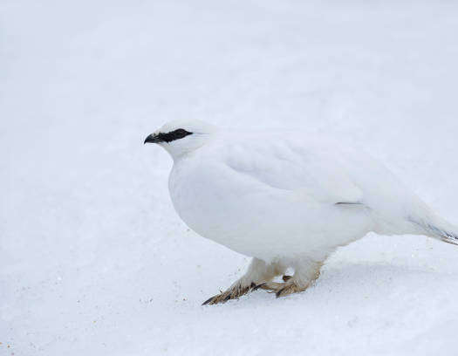
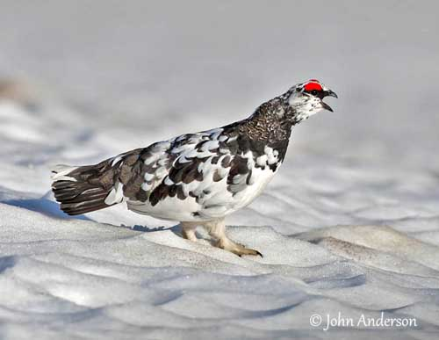
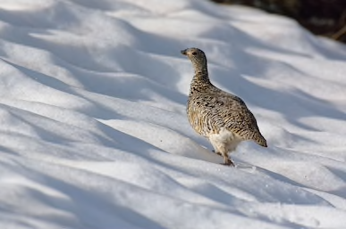
Gets Eaten
Selected Against
Rock Ptarmigan
Blends In
Selected For
Winter Plumage
Summer Plumage
Spring Molt Plumage
Is A Bit
Risky
Timing & Location are Key!
Blends In
Selected For
Gets Eaten
Selected Against

Slide 6
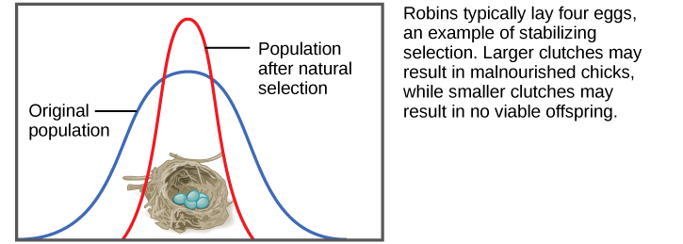
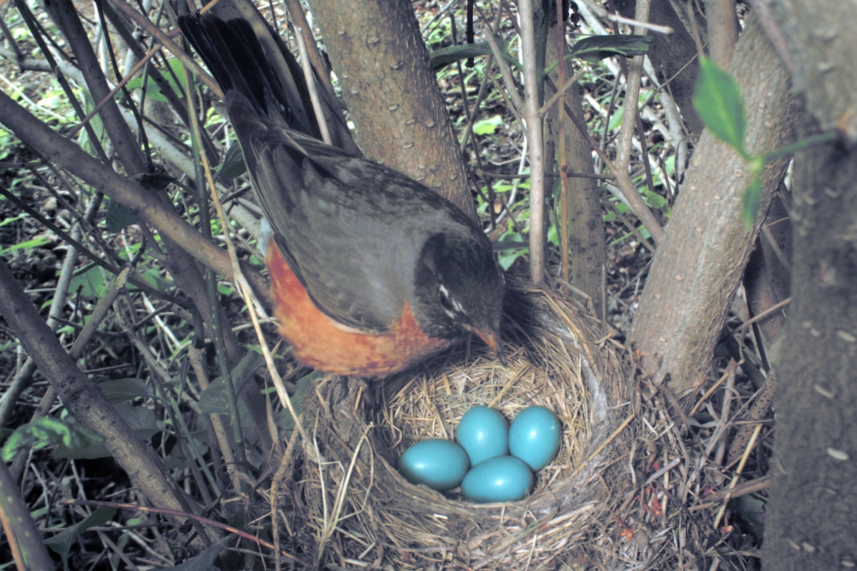
Stabilizing Selection
This type of selection appears very common in birds as clutch size is highly constrained for most species.
https://courses.lumenlearning.com/wm-biology2/chapter/adaptive-evolution/

Slide 7
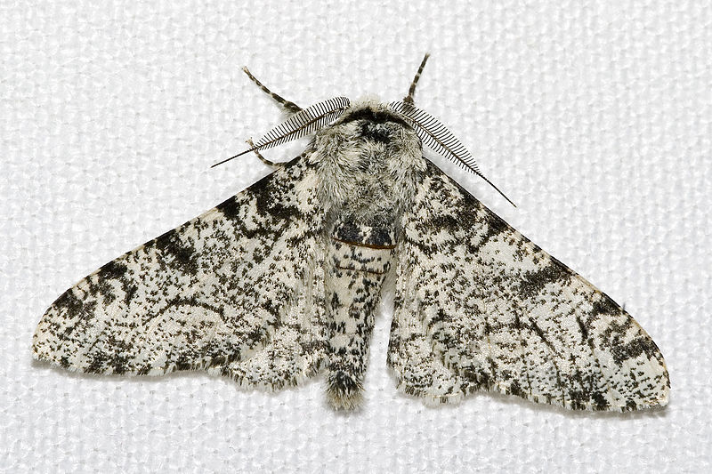
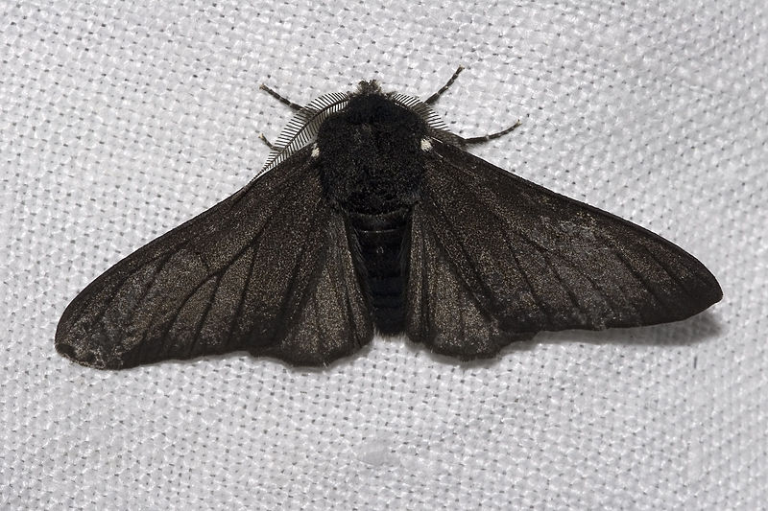
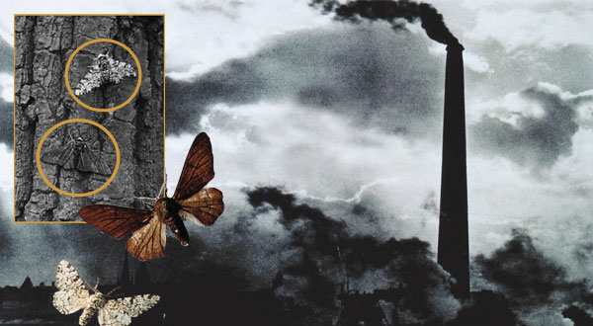
The English pepper moth provides a classic example of directional selection in response to a change in the environment.
Effect of Pollution

Slide 8
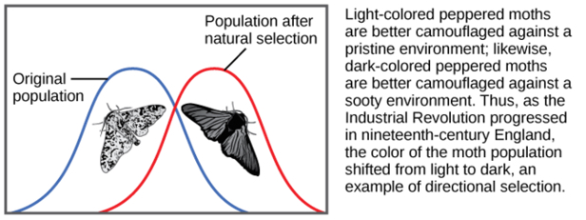
When the environment later improved, selection reversed in the opposite direction ➔ also creating an example of balancing selection with two color morphs maintained in the population.
https://courses.lumenlearning.com/wm-biology2/chapter/adaptive-evolution/

Slide 9

Our Understanding of Selection goes back to Charles Darwin
Populations growth occurs exponentially; more individuals are produced than can be supported by available resources resulting in a struggle for existence (e.g., Malthus, Swift).
No two individuals are the same, natural populations display enormous variation.
Variation is at least partly heritable.
Survival is not random, but depends in part on the hereditary makeup of offspring. Over generations, this process leads to gradual change of populations and evolution of new species.

Slide 10
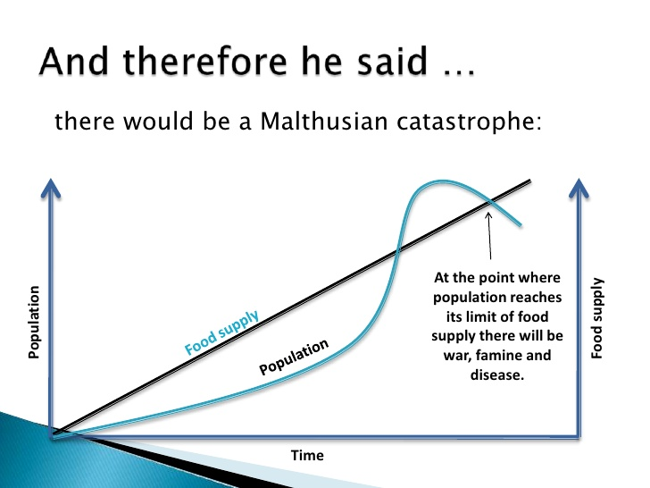
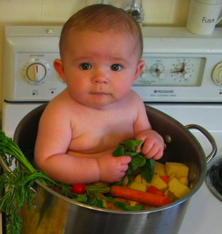
Malthusian Population Catastrophe

Slide 11
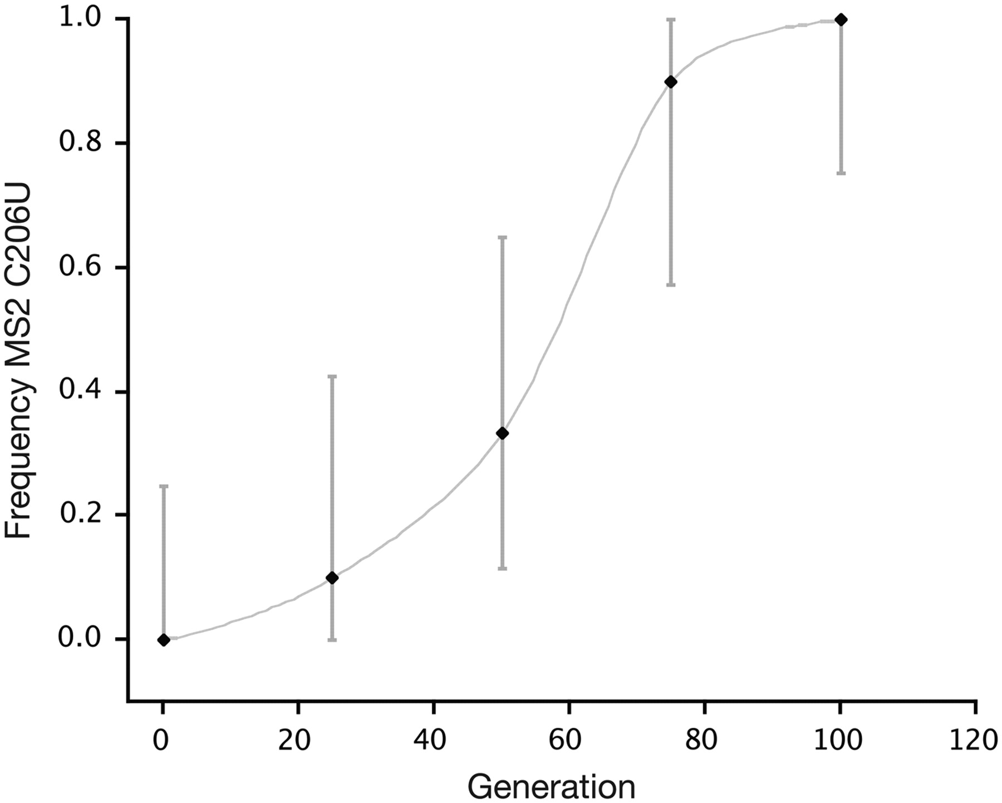
Haploid organisms like bacteriophages illustrate simple examples how selection changes allele frequency.
In this case, the C206U mutation increases in frequency when bacteriophage MS2 is exposed to high temperatures (Bollback & Huelsenbeck, 2007).
One allele has become fixed and the other lost after 100 generations
Mutation presumably results in some advantage/acting quickly.

Slide 12
Can define differences in fitness among alleles:
Absolute fitness
w_{A} & w_{a}
Relative fitness
w_{a}/w_{A}
Selection coefficient
s = 1 – w

Slide 13
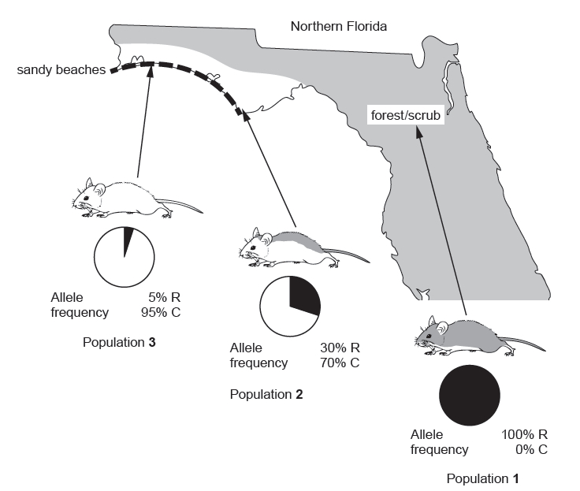
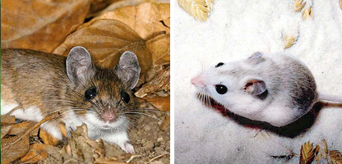
Selection on Diploids is a Little Different
Diploids contribute ½ their genes to each offspring, and offspring possess copies from the mother and father.
Hoekstra et al. - Harvard University
all homozygotes in this population
Mostly homozygotes
Lots of heterozygotes

Slide 14
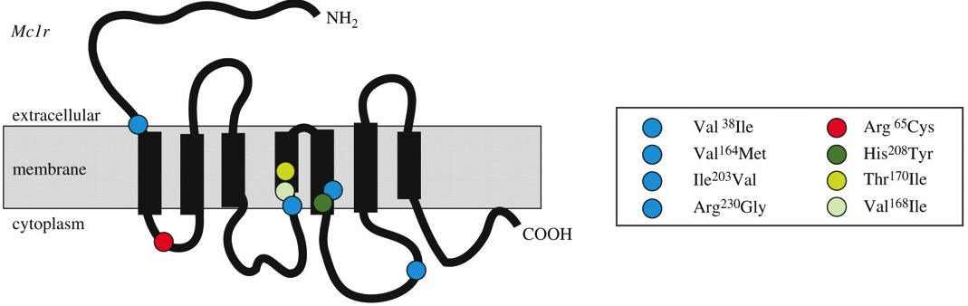
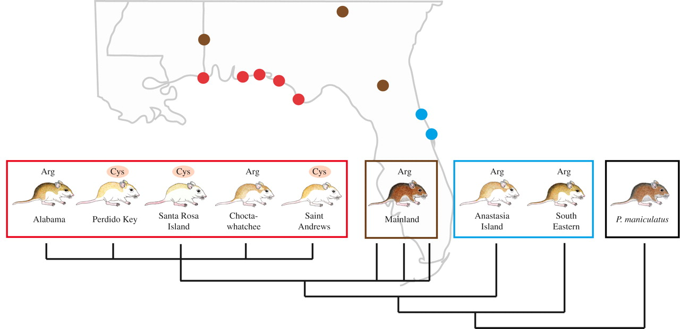
Changes in coat color result from specific mutations in the Mc1r gene.
Manceau, M., Domingues, V. S., Linnen, C. R., Rosenblum, E. B., & Hoekstra, H. E. (2010). Convergence in pigmentation at multiple levels: mutations, genes and function. Philosophical Transactions of the Royal Society B: Biological Sciences, 365(1552), 2439-2450.

Slide 15
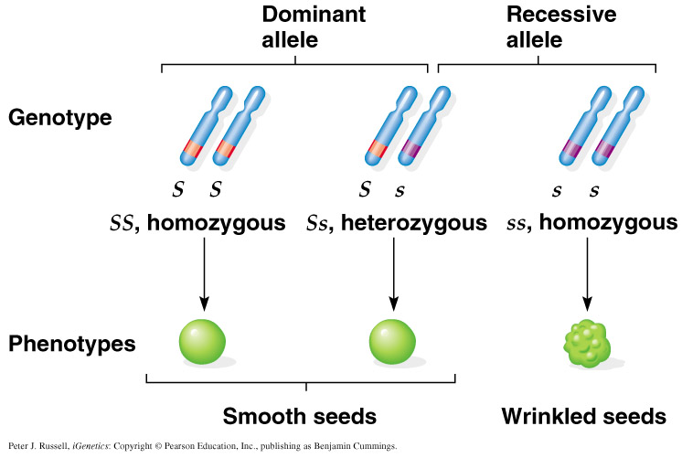
Similar to Mendel’s Peas, with effects of dominance

Slide 16
In the case of diploids we need to consider fitness of three or more genotypes:
w_{AA}, w_{Aa}, and w_{aa}
In the beach mice, w_{RC} is 80-90% of w_{CC}; slightly darker coat color reduces survival 10-20%.
Hardy-Weinberg & relative fitness (e.g., w_{AA}/w_{MEAN}) determines the change in allele frequency after selection.
 | AA | Aa | aa
Initial genotypic frequencies | p² | 2pq | q²
Fitness | W_{AA} | W_{Aa} | W_{aa}
Frequency after selection | p² W_{AA} | 2pq W_{Aa} | q² W_{aa}
Relative frequency after selection | p² W_{AA}/W_{MEAN} | 2pq W_{Aa} /W_{MEAN} | q² W_{aa} /W_{MEAN}
*Note, we have not yet discussed dominance.

Slide 17
But we can deduce much about fitness and begin to deduce something about dominance:
w_{AA} = w_{Aa} = w_{aa}: no natural selection
w_{AA} = w_{Aa} < 1.0 and w_{aa} = 1.0: natural selection and complete dominance operate against a dominant allele.
w_{AA} = w_{Aa} = 1.0 and w_{aa} < 1.0: natural selection and complete dominance operate against a recessive allele.
w_{AA} < w_{Aa} < 1.0 and w_{aa} = 1.0: heterozygote shows intermediate fitness; natural selection operates without effects of complete dominance.
w_{AA} and w_{aa} < 1.0 and w_{Aa} = 1.0: heterozygote has the highest fitness; natural selection/codominance favor the heterozygote (also called overdominance).
w_{Aa} < w_{AA} and w_{aa} = 1.0: heterozygote has lowest fitness; natural selection favors either homozygote.

Slide 18
Types of Genic Selection
#1 Directional Selection
Selection favors fixation of one particular advantageous allele and eliminates all other deleterious alleles.
  Rate of change depends on the selection coefficient (s).
  s = 0.01 , may require 100s of generations to change the allele frequency.
  s = 0.1 may only require 10s of generations.
  The difference in selection coefficients in this case is an “order of magnitude”
  Large selection coefficients cause rapid changes, whereas smaller by order of magnitude selection coefficients may effect large changes in allele frequency over long evolutionary times scales.

Slide 19
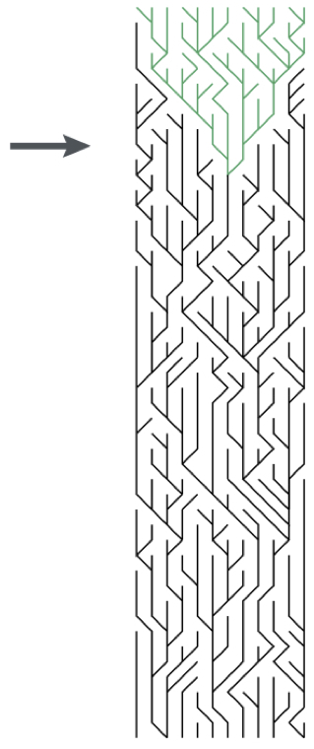
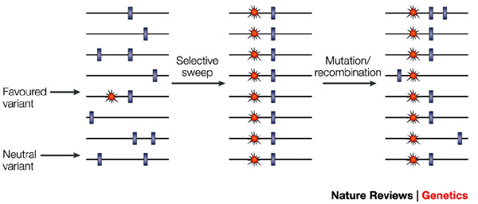
Hitchhiking
Selective sweep with hitchhiking caused by directional selection
Results in loss of variation in linked genomic regions.
Directional selection reduces variation and creates pronounced linkage disequilibrium.

Slide 20
Types of Genic Selection
#2 Balancing Selection (or Diversifying Selection)
Selection favors presence of two or more alleles in the population that are maintained at frequencies above the mutation rate.
Two of the most cited examples are the Major Histocompatibility Complex (MHC) genes and Self-Incompatibility (SI) genes that prevent self-fertilization in angiosperm plants.
Heterozygote advantage is a type of balancing selection (also called Overdominance or Heterosis).

Slide 21

Directional
Balancing
In contrast to directional
selection, coalescence is deeper because polymorphism has been maintained in the population by the selection.
These types of genes have lots of polymorphism.

Slide 22
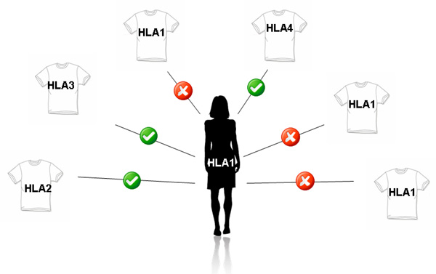
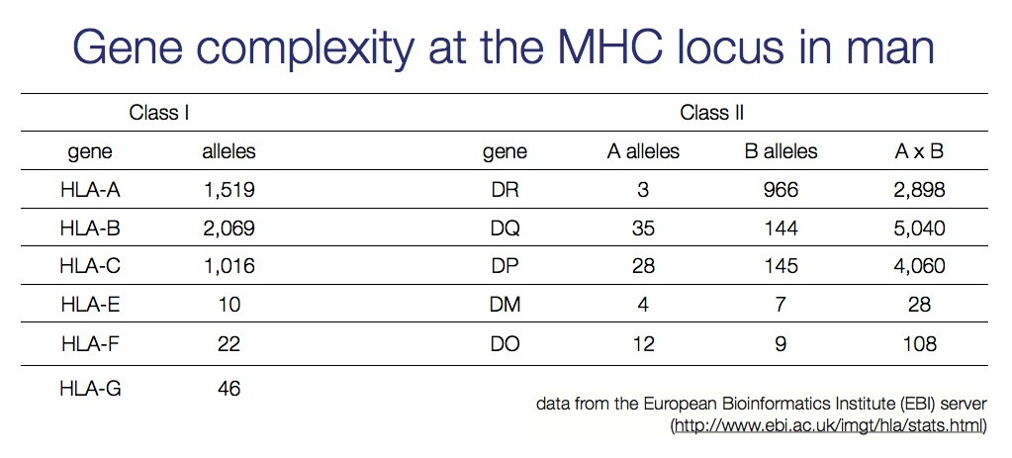
Major Histocompatibility Complex (MHC)
Genes are important in immune response and are under selective pressure to diversify (diversifying selection).
~90% of humans receive different MHC genes from each parent.
Sample of 200 humans will have 15-30 different alleles.
Important mechanism for outcrossing in humans.

Slide 23
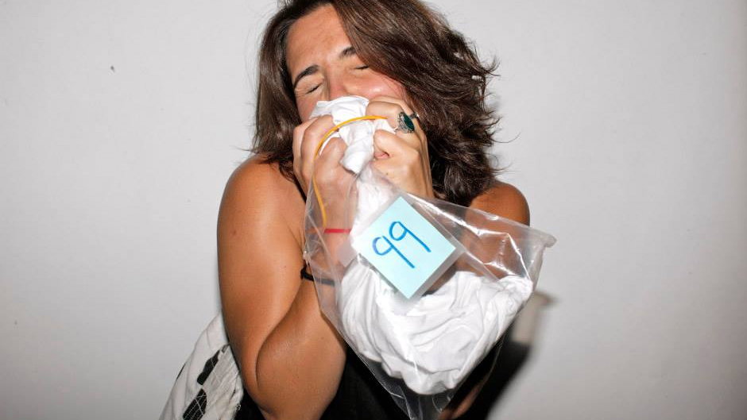
Smell Dating by MHC compatibility? Can’t just do this online, requires a dirty t-shirt.
https://www.abc.net.au/news/2016-05-28/smell-dating-swaps-tinder-for-smelly-t-shirts/7444134?nw=0&r=HtmlFragment

Slide 24
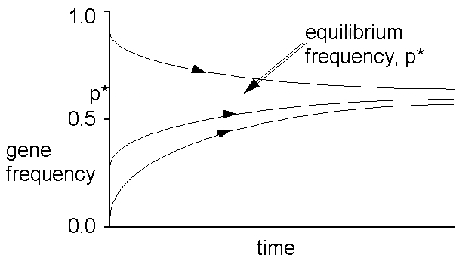
Heterozygote Advantage
Heterozygote advantage is defined by these fitness relationships:
w_{AA} < w_{Aa} > w_{aa}
p_{A} = 0 or 1 are unstable equilibria.
Equilibrium will fall between somewhere:

Slide 25
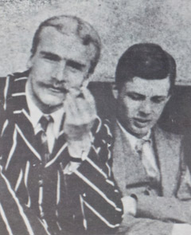
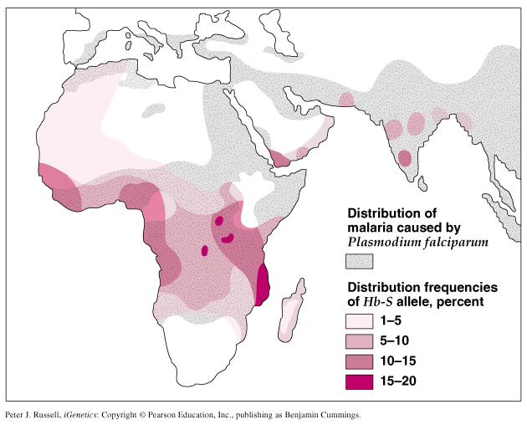
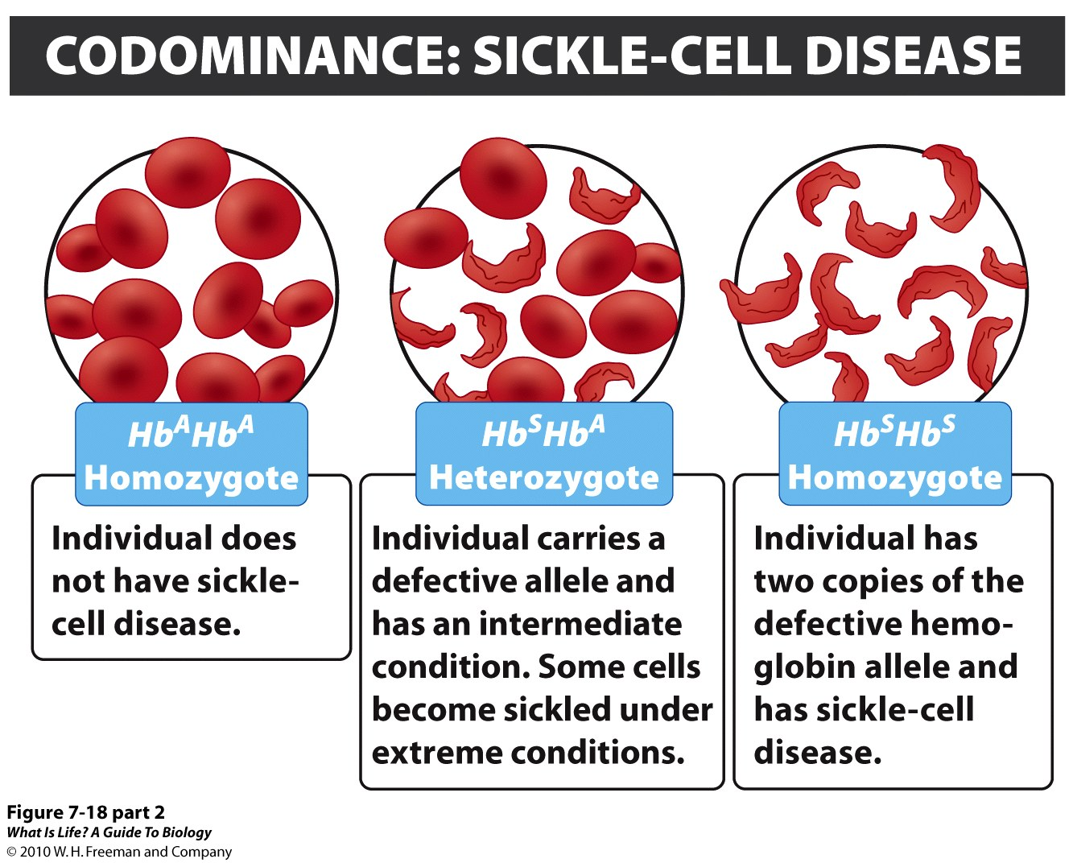
J.B.S. Haldane
First to show (1948) β-globin heterozygotes had resistance to malaria.
Aldous Huxley
 | AA | AS | SS
Numbers | 25,374 | 5,482 | 67
Frequency | 0.821 | 0.177 | 0.002
HW frequency | 0.826 | 0.165 | 0.008
HW exp | 25,542 | 5,012 | 247
Newborns | 33,040 | 6,600 | 320
w | 0.768 | 0.830 | 0.209

Slide 26
Types of Genic Selection
#3 Purifying/Negative Selection
Eliminates deleterious (lethal) alleles, which are continuously introduced by the mutation process (e.g., Muller’s Ratchet).
Eliminates most non-synonymous substitutions that radically change amino acid properties in proteins.
When linked variation is removed called Background Selection.
Has a stabilizing effect = stabilizing selection
Reduces genetic variation

Slide 27
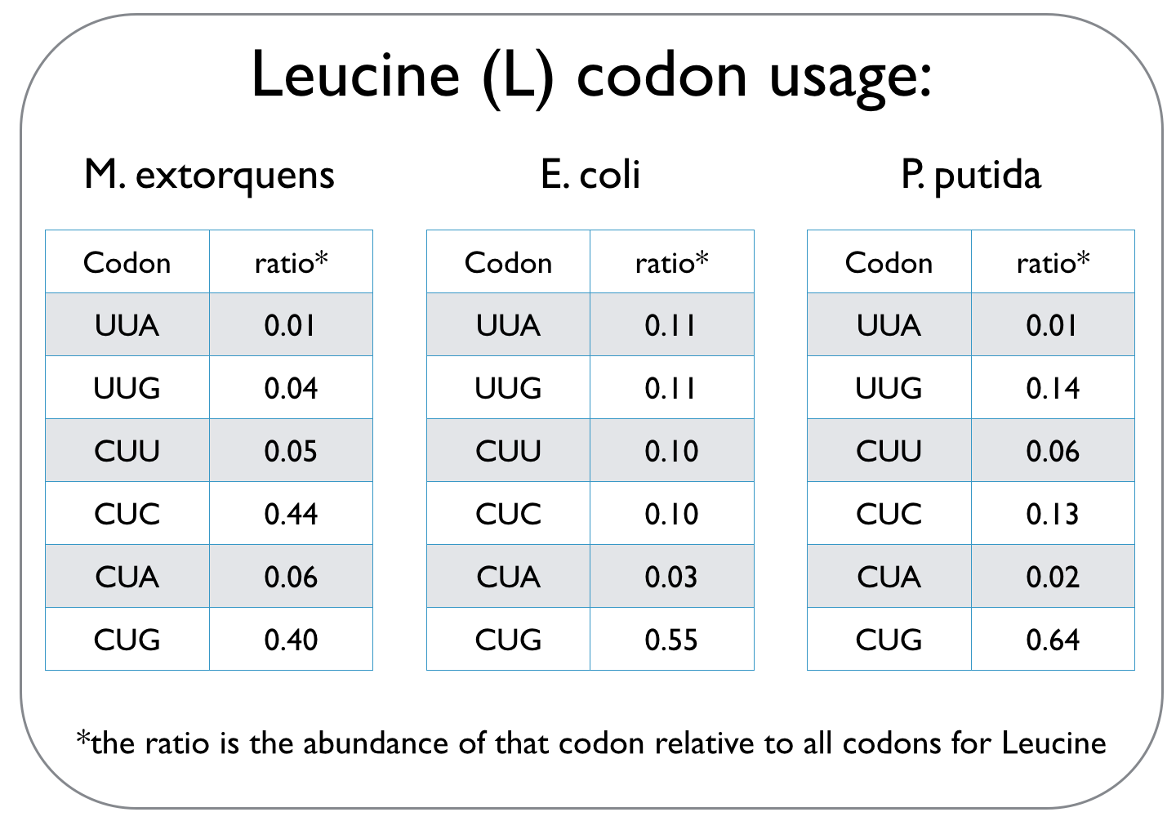
A common type of purifying selection is: Codon Usage Bias
Some synonymous codons are favored over others. In yeast Leu codons: 6 possible codons/80% are UUG
Possible explanations:
All involve selection.
Some tRNAs may be more abundant or efficient; bonding energy may differ due to differences in base pairs.
Codon usage bias permits smaller # of tRNAs (e.g., Wobble effect).
This type of selection is expected to be more intense for genes expressed at higher levels/organisms with short generation times.
http://2014.igem.org/Team:Oxford/codon_optimisation

Slide 28
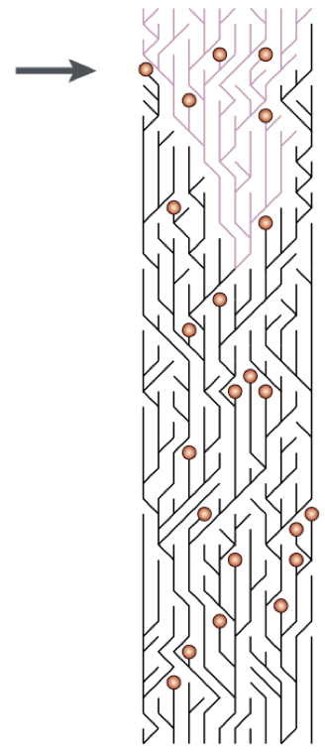
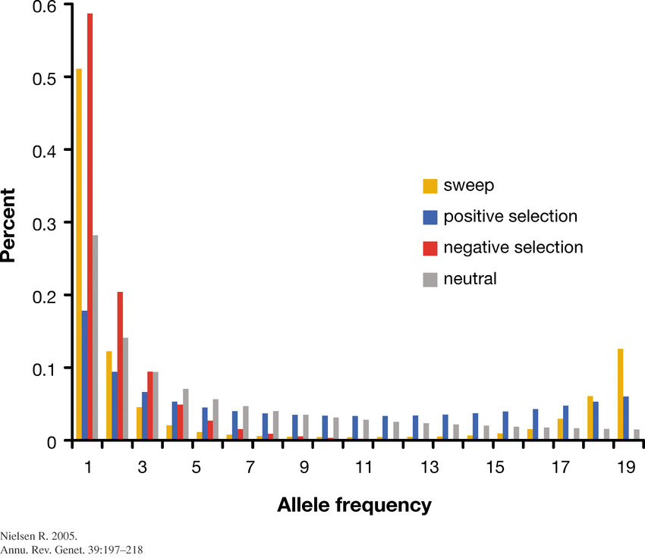
Purifying selection does not radically alter allele frequencies, but reduces variation and creates allele-frequency spectra similar to directional selection.

Slide 29
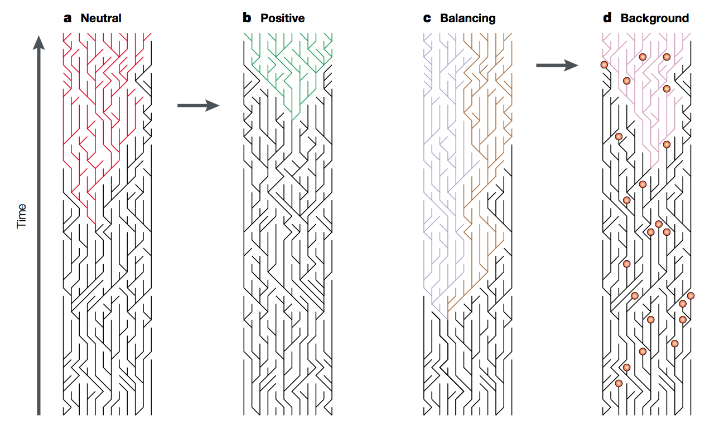
Summary of different types of selection (following Bamshad & Wooding 2003)
No Selection
Allele frequencies change due to genetic drift
Directional
One particular allelic variant is favored
Balancing/Diversifying
Two or more allelic variants are favored
Purifying
Deleterious (lethal) alleles are eliminated

Slide 30
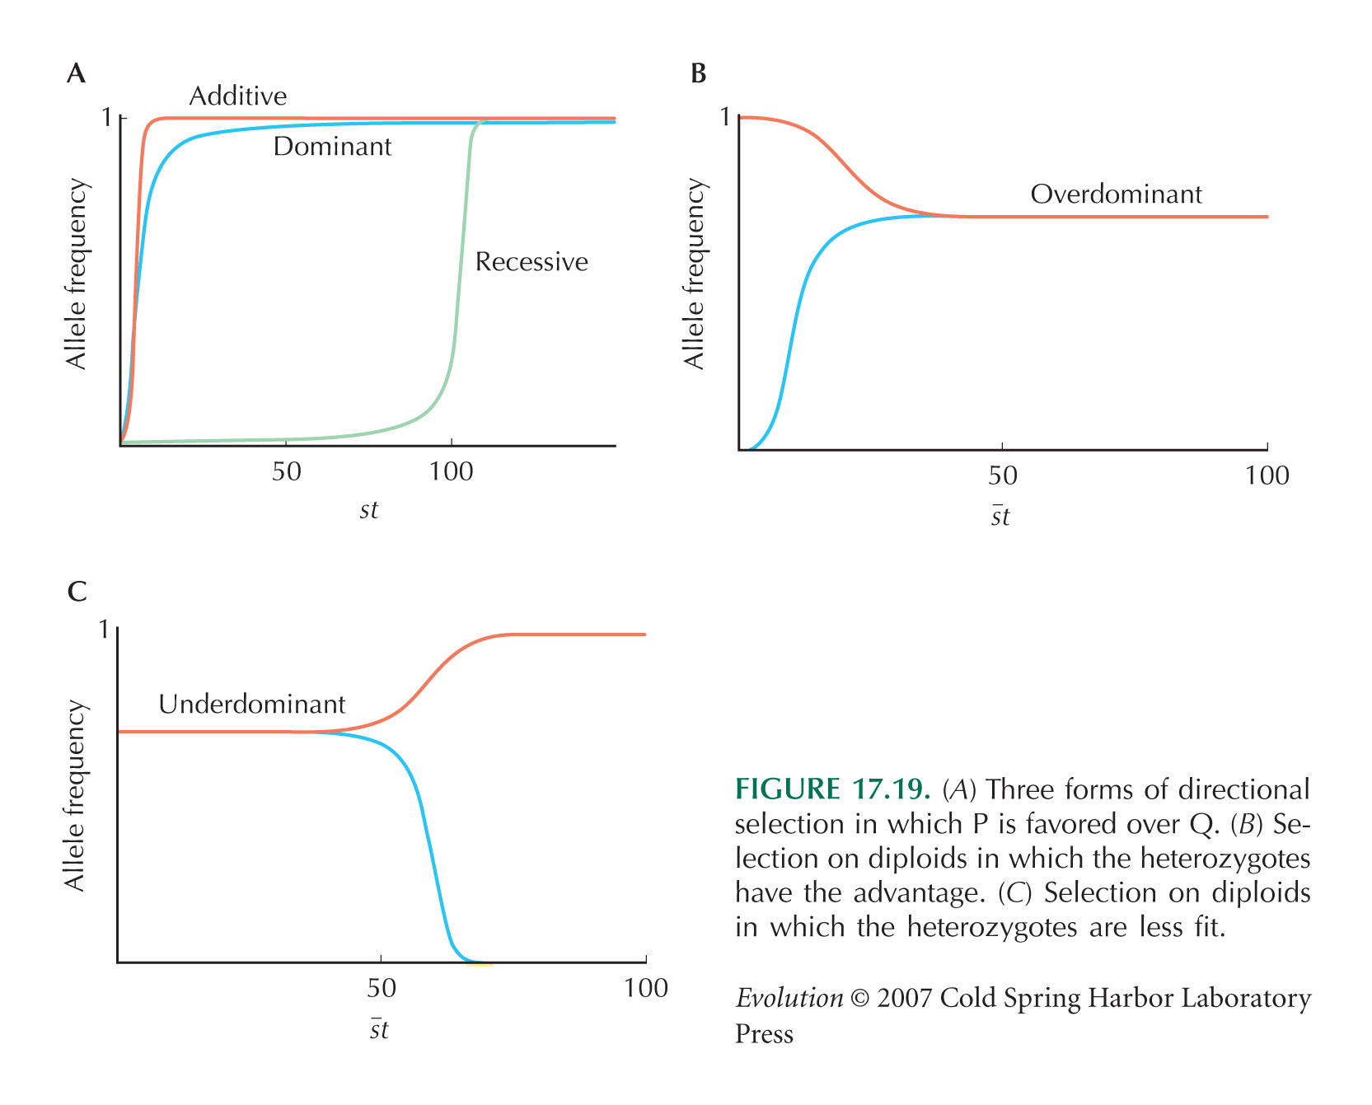

Slide 31
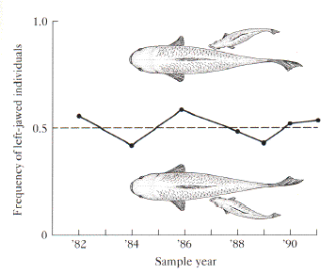
Frequency Dependent Selection
Fitness depends on the composition of the population
e.g., Perissodus microlepis - scale-eating cichlid fish from Lake Tanganyika in Africa.
Assymetrical jaw - frequency of left-and right jawed morphs fluctuates around 0.5 because prey are on lookout for more common morph.
http://bio.research.ucsc.edu/~barrylab/classes/evolution/Image61.gif

Slide 32
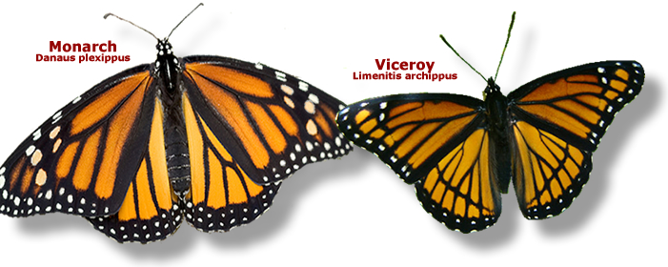
Frequency Dependent Selection
Mimicry is another example.
If the mimic is less frequent compared to the non-palatable model, the mimic is more protected.
https://bybio.wordpress.com/tag/mullerian-mimicry/

Slide 33
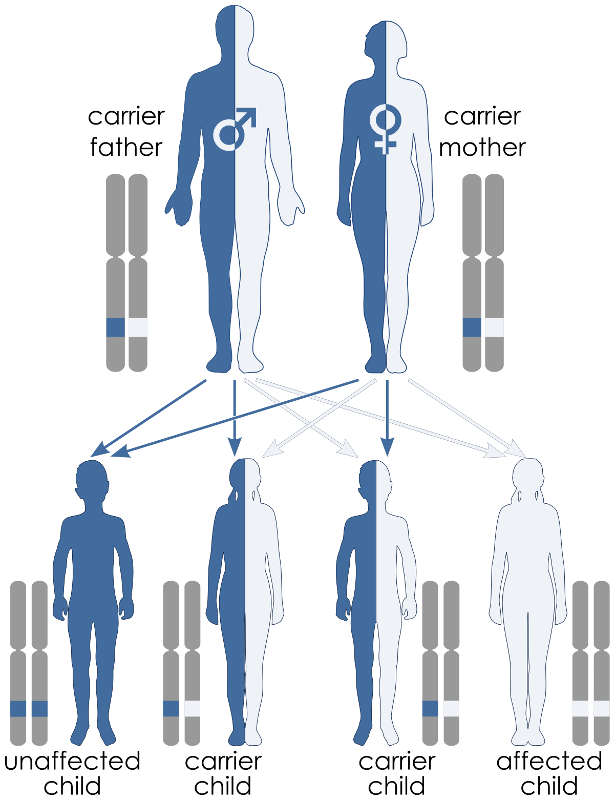
Selection for or against recessive alleles:
Recessive traits often result in reduced fitness.
If so, there is selection against homozygous recessives, thus reducing the frequency of the recessive allele.
However, the recessive allele is difficult to remove from the population; rare, lethal recessive alleles occur in the heterozygote (protected polymorphism).
Lots of lethal genetic diseases function this way.
Frequency of disease can be low.
However, many individuals can be carriers.

Slide 34
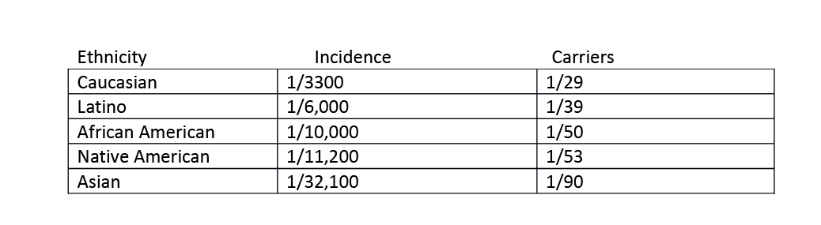
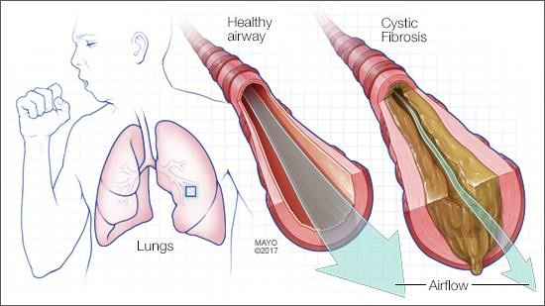
Incidence and prevalence of Cystic Fibrosis
https://www.cancertherapyadvisor.com/pulmonary-medicine/cystic-fibrosis/article/626039/

Slide 35
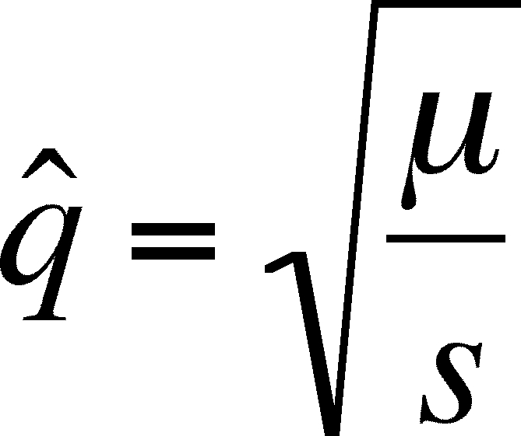
Mutation – Selection Balance
Mutations can be neutral and subject to genetic drift.
Or subject to selection, directional, balancing, or purifying.
In these cases the frequency of the allele can increase, be maintained as a stable polymorphism, or decrease and be eliminated.
Lethal and deleterious alleles can arise repeatedly.
This creates mutation-selection balance (similar to mutation-drift balance).
For a complete recessive allele at equilibrium:
    If homozygote is lethal (s = 1) then

Slide 36
Mutation – Selection Balance
Lethal alleles never go away because they are always reintroduced to the population by mutation.
Consider sq. root of human mutation rate 10⁻⁸ = 10⁻⁴
Lethal genetic diseases should occur at about a rate of q² = 1/10,000^{^2}.
But what about the most common diseases due to single gene defects?
Hypercholesterolemia 1/500 Autosomal dominant Cystic fibrosis 1/2,500 Autosomal recessive Tay Sachs 1/4,000 Autosomal recessive Marfan Syndrome 1/10,000 Autosomal dominant Phenylketonuria 1/12,000 Autosomal recessive
Huntington Disease 1/15,000 Autosomal dominant
Frequencies for are far higher than predicted in cases.

Slide 37
Factors that push the frequency of genetic disease far above the mutation rate:
Founder events and/or bottlenecks
– Cystic Fibrosis, Tay Sachs
Heterozygote advantage – one copy of the allele is beneficial. – Sickle Cell, Cystic Fibrosis (possibly)
Mutation rate is variable across the genome.
Can breed before disease results in mortality.
Disorder can be both beneficial and troublesome, such as certain mental health disorders → balancing selection.
Environment & G x E interactions

Slide 38
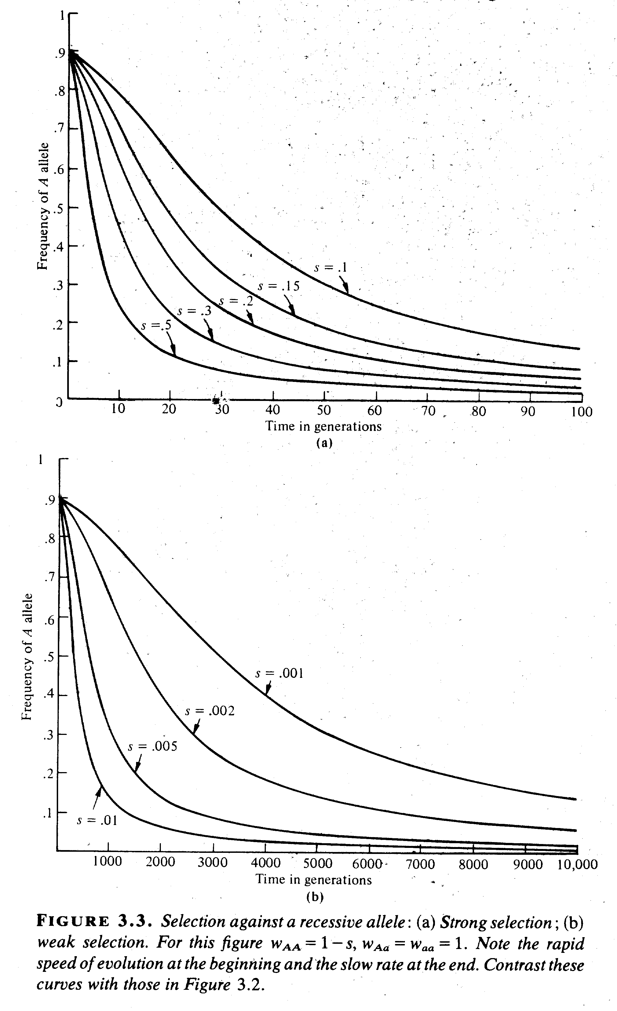
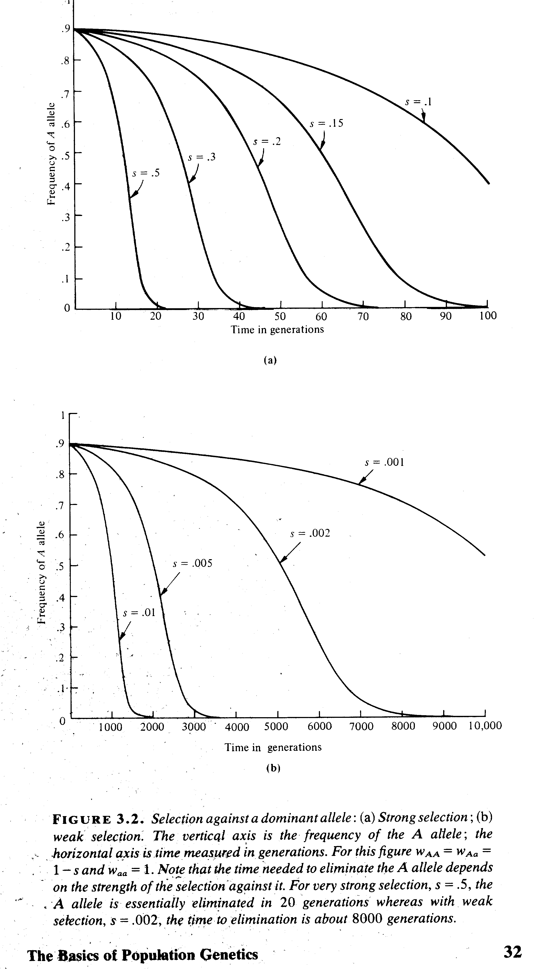
Selection against a recessive allele a
favoring dominant allele A
Selection favoring a recessive allele a
against dominant allele A
J. Roughgarden. 1979. Theory of Population Genetics and Evolutionary Ecology: An Introduction. MacMillan, New York.

Slide 39
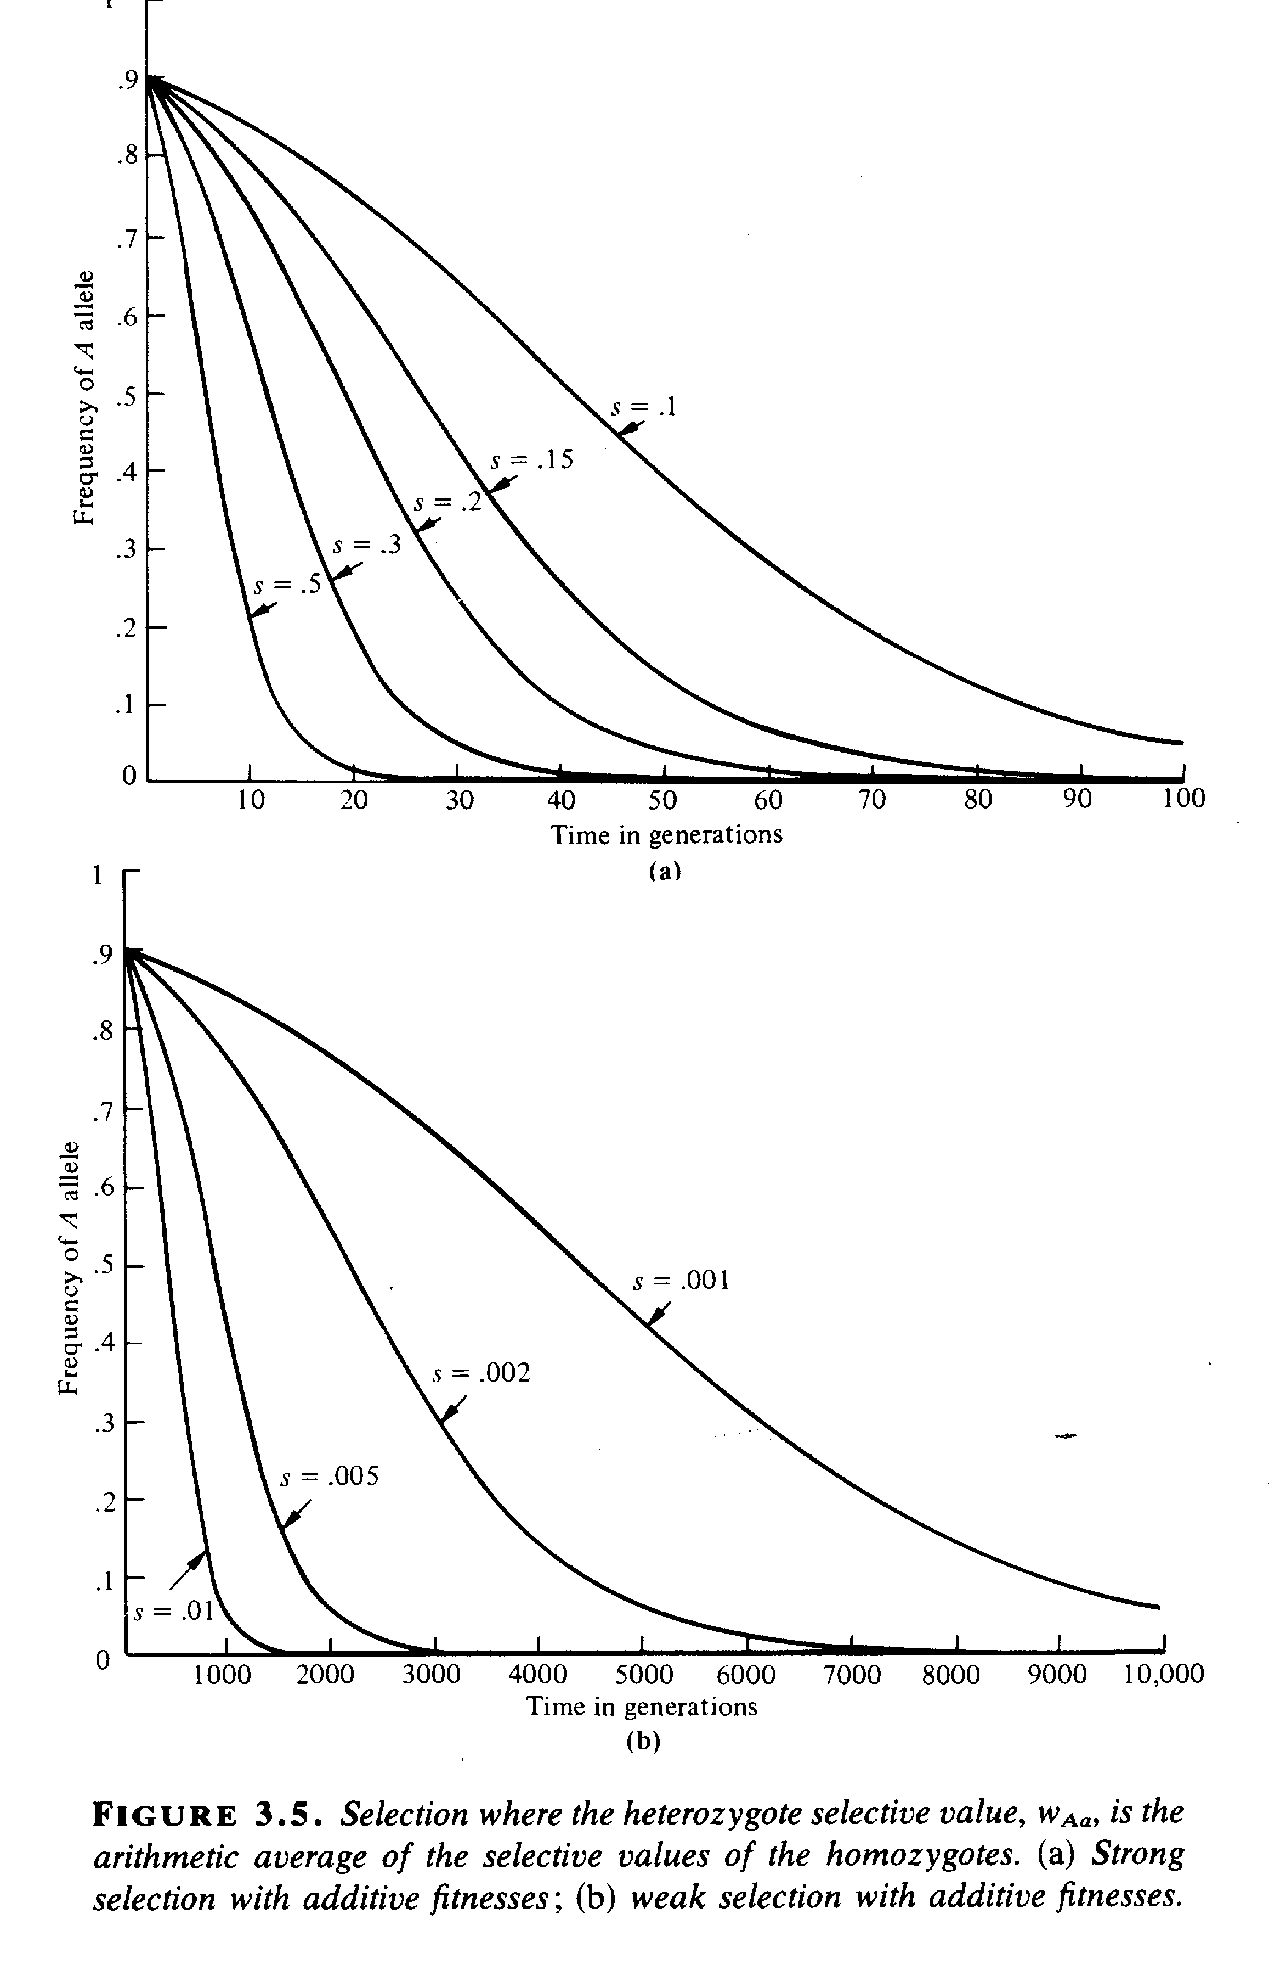
Selection against recessive allele A
with complete dominance
Selection against recessive allele A
with incomplete dominance
J. Roughgarden. 1979. Theory of Population Genetics and Evolutionary Ecology: An Introduction. MacMillan, New York.

Slide 40
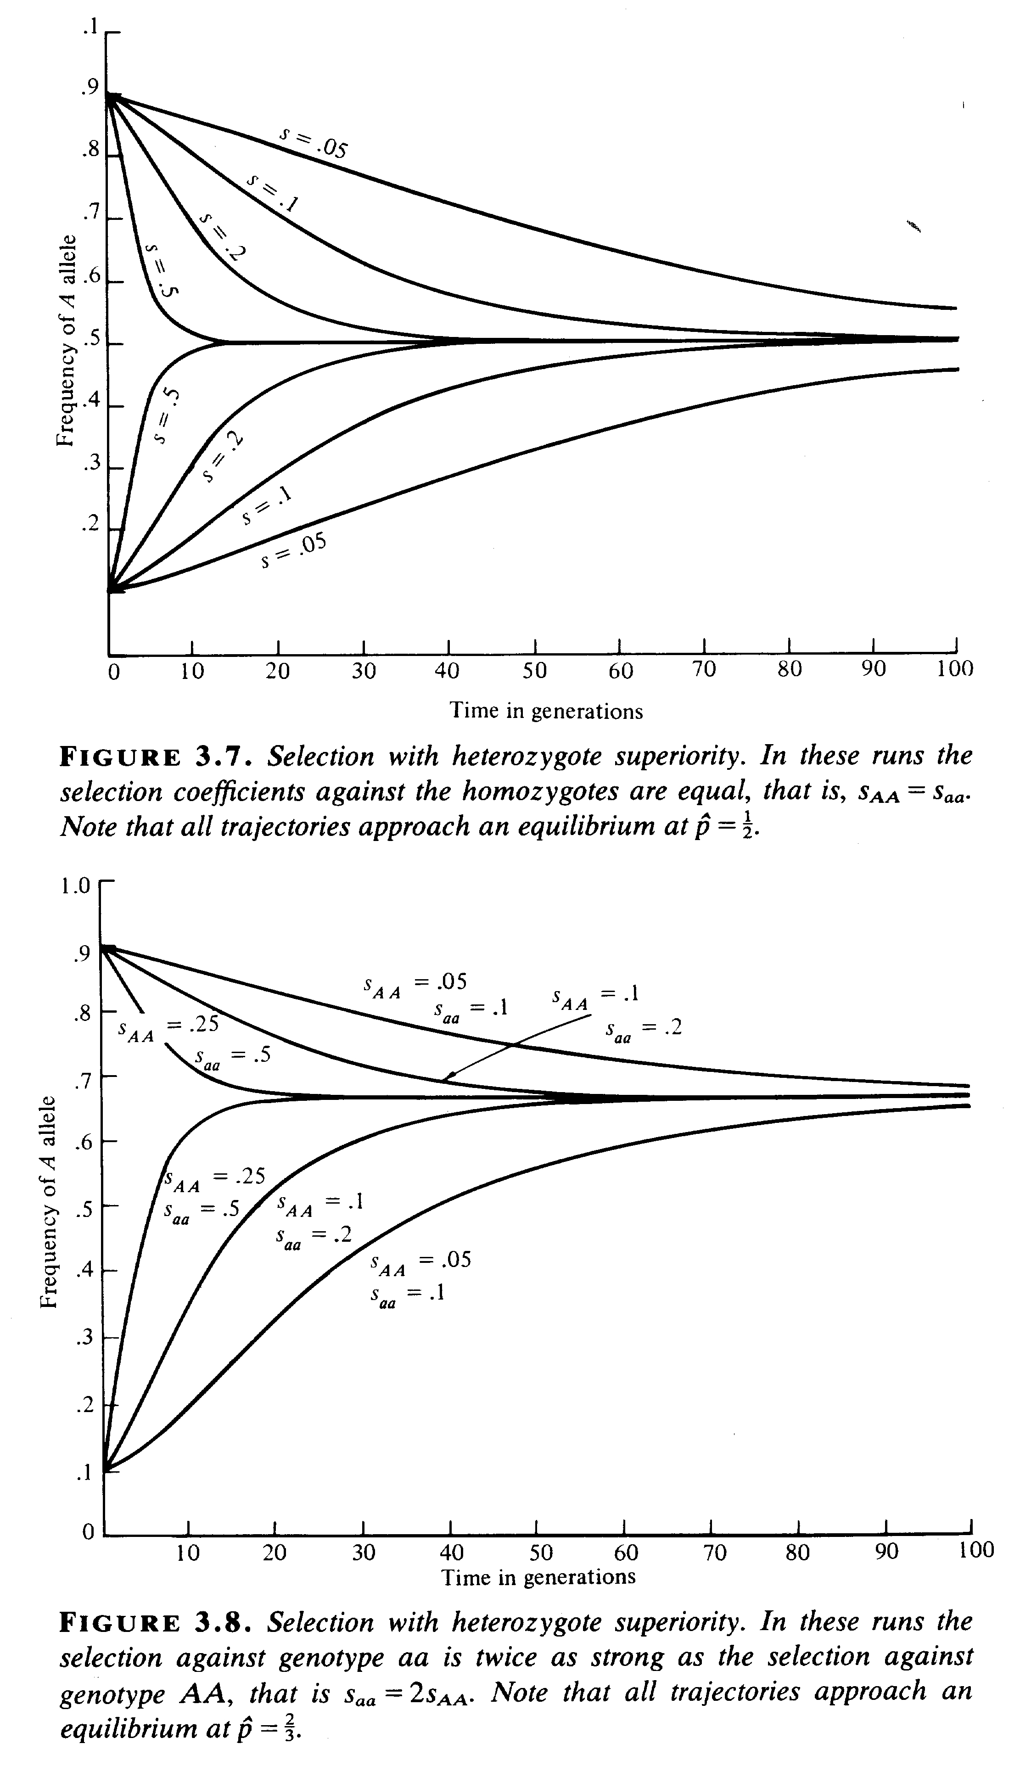
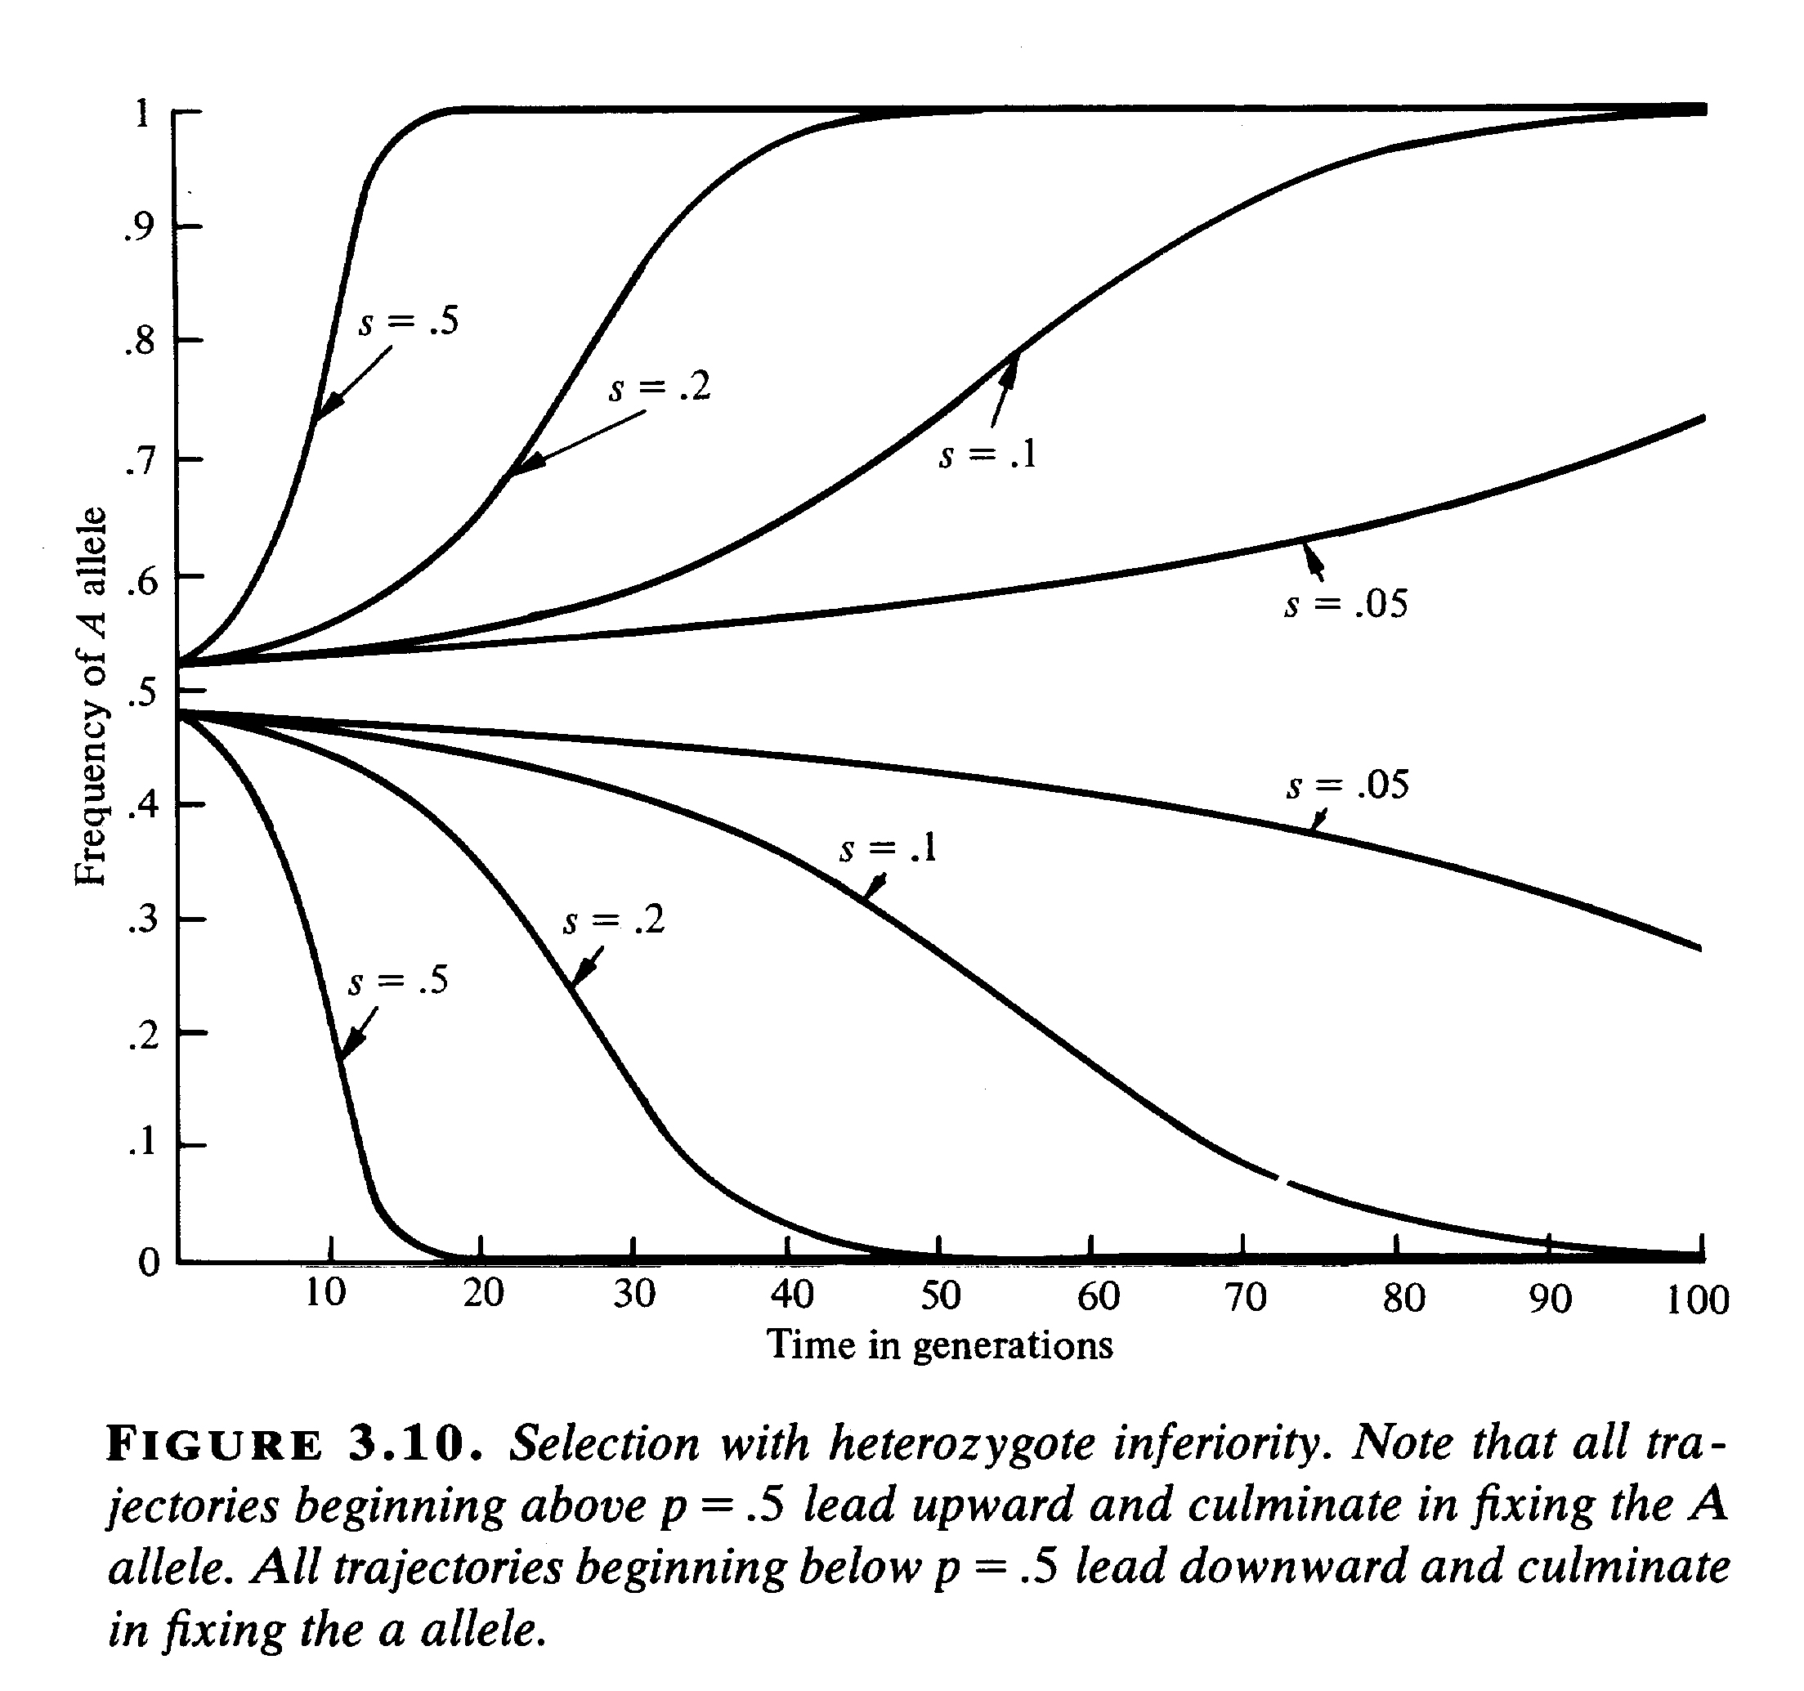
Heterozygote Superiority
Heterozygote Inferiority
J. Roughgarden. 1979. Theory of Population Genetics and Evolutionary Ecology: An Introduction. MacMillan, New York.

Slide 41
Summary
Then environment can be quite complex
Most diseases are very complex – relatively few diseases have a simple genetic basis.
Effects of selection are complex and nuanced.
What might be good in one environment can be bad in another and vice versa, or fluctuate seasonally.
Selection is frequently directional but
also balancing.
How well is the molting ptarmigan adapted?

Slide 42
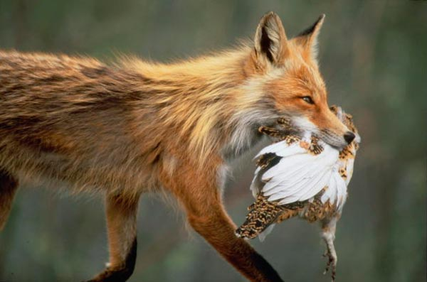
Examples w = 0 & 1.

