Slide 1
Alleles, Genotypes,
Hardy-Weinberg Equilibrium, & Other Diversity Measures
Population Genomics
Jardin Botanico de Missouri, Oxapampa
Gen-Pob’24

Slide 2
Ways to describe genetic structure of populations:
---Genotypes & Alleles – terms first introduced by William Bateson (1861-1926)
---All methods of characterizing genetic variation include counting and describing genetic polymorphism directly or phenotypic traits linked to genetic variation.
Genotypic frequencies
Allelic frequencies
Multiple alleles
Sex-linked loci

Slide 3
Genotypic frequency
Count individuals with one genotype and divide by total number of individuals. Repeat for each genotype in the population:
f(BB) = 452/497 = 0.909
f(Bb) = 43/497 = 0.087
f(bb) = 2/497 = 0.004
Total = 1.000

Slide 4
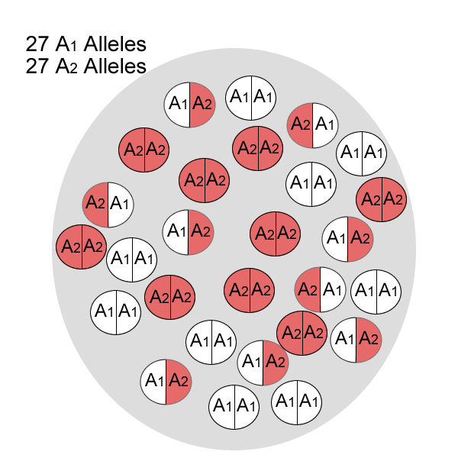
Genotypic frequencies are equal, and allelic frequencies are equal.
A₁A₁ = 9/27 = 33.3%
A₁A₂ = 9/27 = 33.3%
A₂A₂ = 9/27 = 33.3%
http://bio.vtn2.com/bio-home/harvey/lect/lectures.html?flnm=nsln&ttl

Slide 5
Allelic frequency
Allelic frequencies offer more information than genotypic frequencies and can be calculated in two different ways:
  Allele (gene) counting method:
  p = f(A) = (2 x count of AA) + (1 count of Aa)/ 2 x total number of individuals
  Genotypic frequency method:
  p = f(A) = (frequency of the AA homozygote) + (1/2 x frequency of the Aa heterozygote)
  p = f(a) = (frequency of the aa homozygote) + (1/2 x frequency of the Aa heterozygote)

Slide 6
Allelic frequencies with multiple alleles:
Example: A¹, A², and A³
p = f(A¹) = (2 x A¹A¹) + (A¹A²) + (A¹A³)/2 x total individuals
q = f(A²) = (2 x A²A²) + (A¹A²) + (A²A³)/2 x total individuals
r = f(A³) = (2 x A³A³) + (A¹A³) + (A²A³)/2 x total individuals
Or
p = f(A¹) = f(A¹A¹) +f(A¹A²)/2 + f(A¹A³)/2
q = f(A²) = f(A²A²) + f(A¹A²)/2 + f(A²A³)/2
r = f(A³) = f(A³A³) + f(A¹A³)/2 + f(A²A³)/2

Slide 7
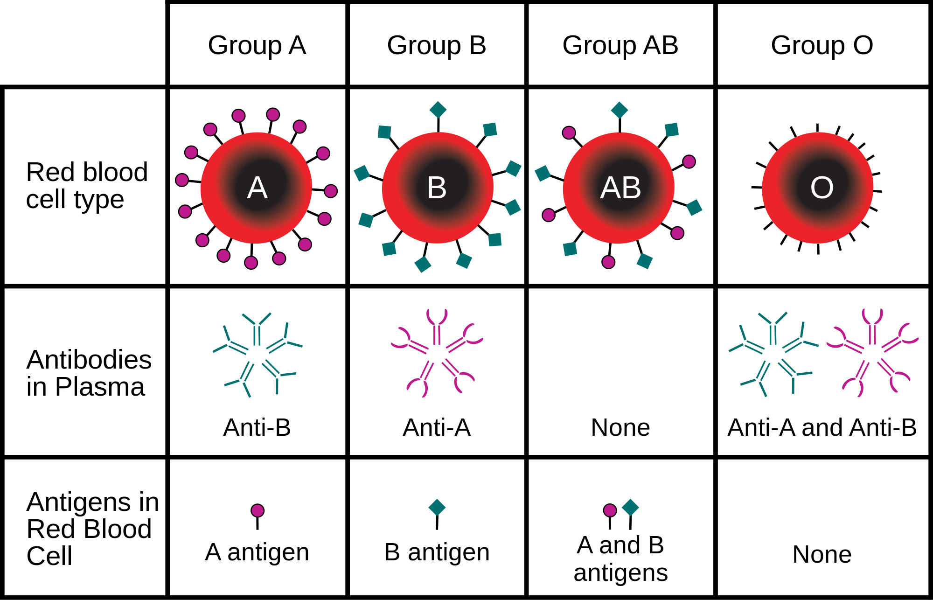
AA
BB
AB
--
Blood groups are example of six possible genotypes comprised of three alleles:
i^{A}, i^{B}, & i
https://en.wikipedia.org/wiki/Allele

Slide 8
Number of alleles (n) and number of genotypes:
# genotypes = n(n + 1)/2
  Homozygotes = n
  Heterozygotes = n(n - 1)/2
# alleles | # genotypes | Homozygotes | Heterozygotes
1 | 1 | 1 | 0
2 | 3 | 2 | 1
3 | 6 | 3 | 3
4 | 10 | 4 | 6
5 | 15 | 5 | 10

Slide 9
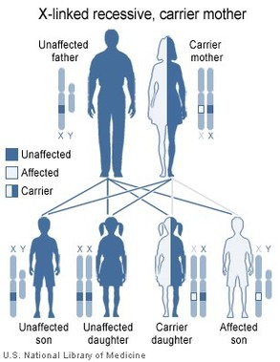
Sex-linked Traits
Father is hemizygous and possesses only one copy of X chromosome. Mother possesses no Y chromosome. So this affects allelic and genotypic frequencies differently.

Slide 10
Allelic frequencies at X-linked loci:
Females have 2 X-linked alleles, and males have 1 X-linked allele.
p = f(X^{A}) = (2 x X^{A} X^{A} females) + (X^{A} Xª females) + (X^{A} Y males)/
(2 x # females) + (# males)
q = f(Xª) = (2 x Xª Xª females) + (X^{A} Xª females) + (Xª Y males)/
(2 x # females) + (# males)
If number of females and males are equal:
p = f(X^{A}) = 2/3[f(X^{A}X^{A}) +1/2f(X^{A}Xª)] + 1/3f(X^{A}Y)
q = f(Xª) = 2/3[f(XªXª) +1/2f(X^{A}Xª)] + 1/3f(XªY)

Slide 11
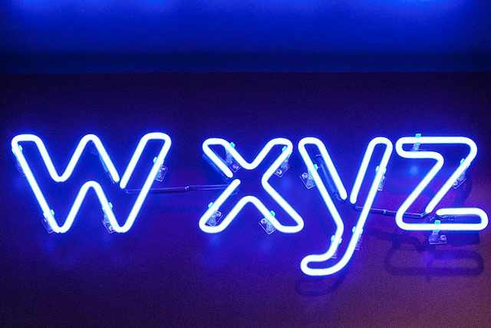

But not all organisms have XY sex chromosomes…

Slide 12
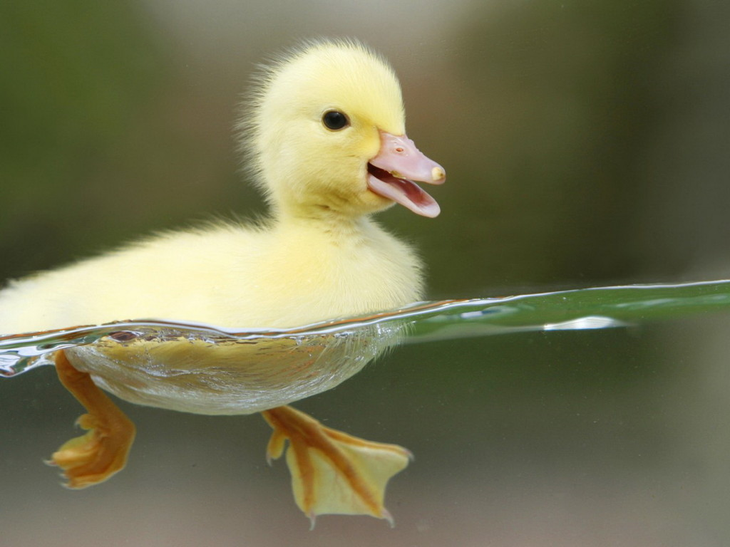
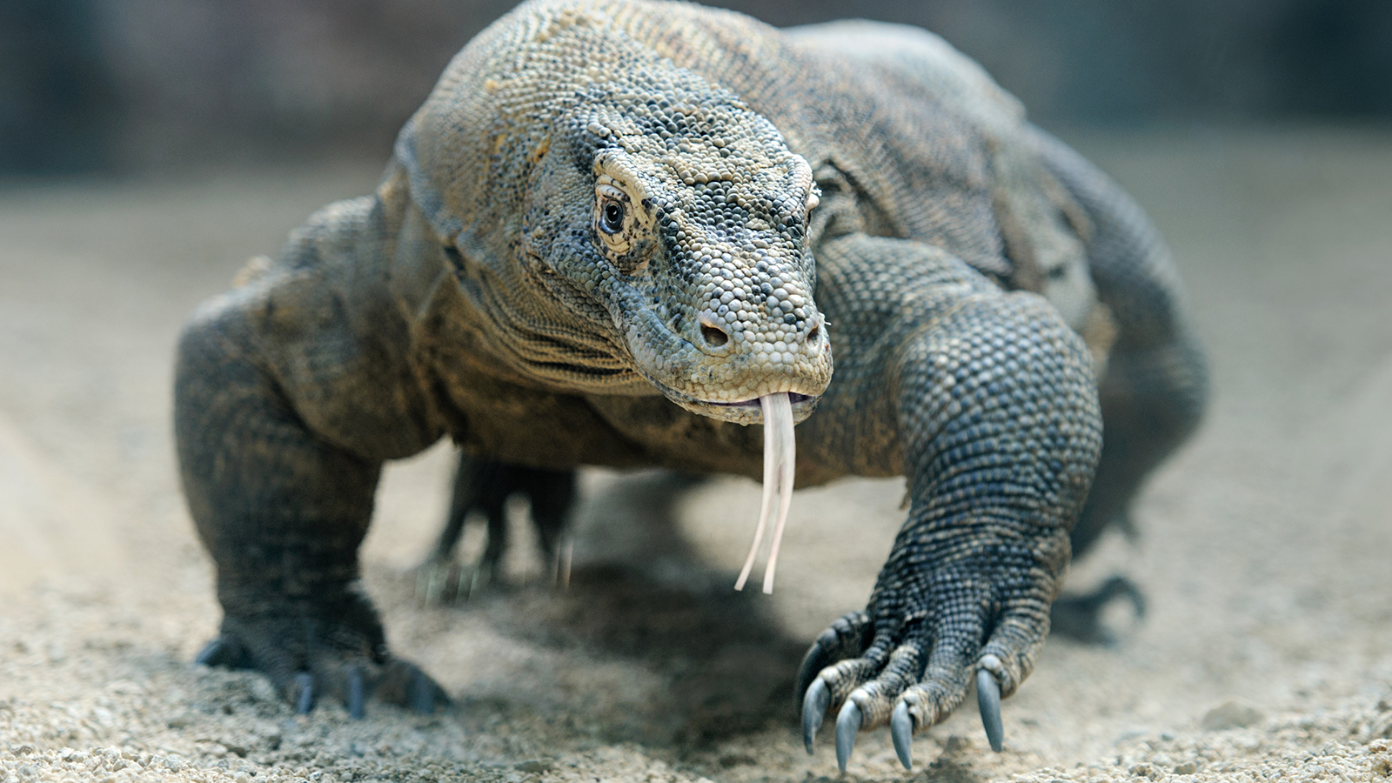
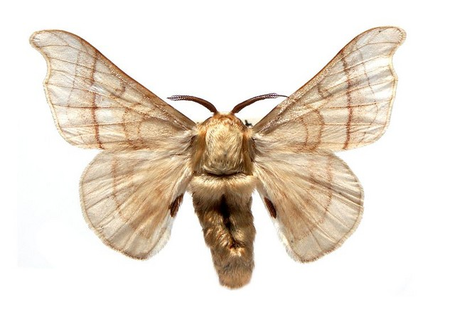
Sex chromosomes are denoted by W & Z if the female is heterogametic:
ZZ = Male & ZW = Female
Birds, some fish and crustaceans, some insects (butterflies & moths), and some reptiles.
Ovum (not sperm) determine sex.
Z chromosome is larger & W chromosome is smaller.

Slide 13
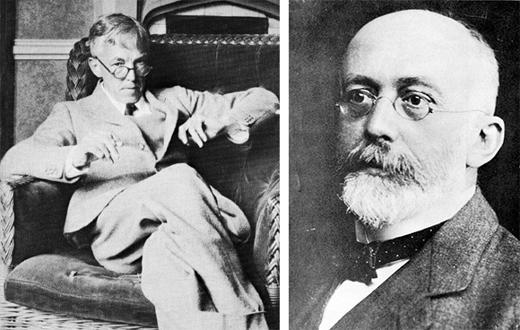
Hardy Weinberg Equilibrium
Godfrey Hardy & Wilhelm Weinberg
Both published independently in 1908 about 42 years after Mendel published
Godfrey Hardy
Wilhelm Weinberg

Slide 14
Hardy-Weinberg Equilibrium Law:
Explains how Mendel’s 2nd Principle of Segregation influences allelic and genotypic frequencies in a population and creates a steady state of equilibrium.
If assumptions are met, population will be in genetic equilibrium.
Allele frequencies do not change over generations.
After one generation of random mating, genotypic frequencies will remain in the following proportions:
p² (frequency of AA)
2pq (frequency of Aa)
q² (frequency of aa)
*p = allelic frequency of A
*q = allelic frequency of a
*p² + 2pq + q² = 1

Slide 15
Basis of the Hardy-Weinberg Law:
Hardy-Weinberg state: p² + 2pq + q² = 1 at equilibrium
Zygotes form by random combinations of alleles, in proportion to the abundance of the alleles in the population.
If f(p) = 0.5 and f(q) = 0.5, outcome is as follows:
When population is at equilibrium:
p² + 2pq + q² = 1
 | A(p) | a(q)
A(p) | AA(p²) 0.5 x 0.5 = 0.25 | Aa(pq) 0.5 x 0.5 = 0.25
a(q) | Aa(pq) 0.5 x 0.5 = 0.25 | aa(q²) 0.5 x 0.5 = 0.25

Slide 16
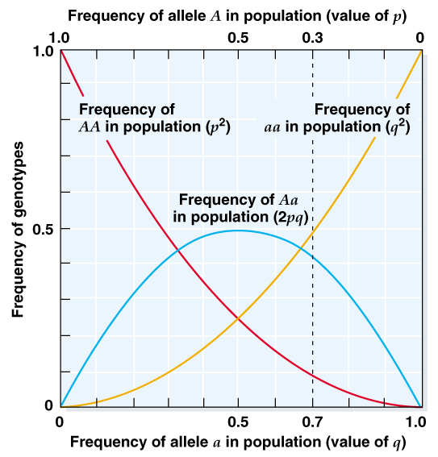
Frequencies of genotypes AA, Aa, and aa relative to the frequencies of alleles A and a at Hardy-Weinberg equilibrium.
Max. heterozygosity
@ p = q = 0.5

Slide 17
Assumptions I didn’t mention previously:
Population is infinitely large, to avoid changes in allele frequencies due to chance (this is the effect of genetic drift).
Mating is random (with regard to traits under study; this is the opposite of assortative mating and inbreeding).
  Population structure is a form of non-random mating; two populations will not be in HWE if they are treated as one population.
  A reduction in heterozygosity will be observed of two populations are treated as one (this is the Wahlund effect).
No natural selection (for traits under study; as selection can quickly increase or decrease the frequency of specific alleles).
No significant mutation (mutation adds new alleles, but usually slowly, e.g., 10⁻⁹).
No migration (gene flow adds or eliminates alleles).

Slide 18
Good News:
Large populations are mathematically similar to infinitely large populations, so the effects of genetic drift can often be discounted.
Single finite populations with rare mutations, rare migrants, and weak selection generally fit Hardy-Weinberg proportions.
Hardy-Weinberg applies to any locus for which mating occurs randomly, even if mating is non-random for other loci, because loci on different chromosomes assort independently due to recombination (Mendel’s 3rd Principle).
We will spend the remainder of the semester looking at many examples that cause genotypic frequencies to deviate from HWE, … or exhibit more or less variation than predicted.

Slide 19
Hardy-Weinberg can be applied to loci with more than two alleles:
For three alleles (A, B, and C) with frequencies p, q, and r:
Binomial expansion ⇒
(p + q + r) ² = p²(AA) + 2pq(AB) + q²(BB) + 2pr(AC) + 2qr(BC) + r²(CC)
For four alleles (A, B, C, and D) with frequencies p, q, r, and s:
(p + q + r + s) ² = p²(AA) + 2pq(AB) + q²(BB) + 2pr(AC) + 2qr(BC) + r²(CC) + 2ps(AD) + 2qs(BD) + 2rs(CD) + s²(DD)

Slide 20
Hardy-Weinberg for X-linked alleles is a bit different for males:
e.g., Humans and Drosophila (XX = female, XY = male is hemizygous)
Females
Hardy-Weinberg frequencies are the same for any other locus:
p² + 2pq + q² = 1
Males
Genotype frequencies are the same as allele frequencies:
p + q = 1
 | X^{A}(p) | Xª(q) | Y
X^{A}(p) | X^{A}X^{A} p² | X^{A}Xª pq | X^{A}Y p
Xª(q) | X^{A}Xª qp | XªXª q² | XªY q

Slide 21
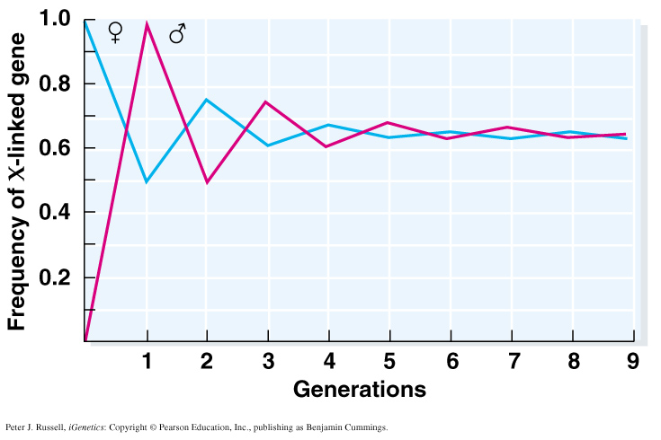
Hardy-Weinberg for X-linked alleles:
If alleles are X-linked and sexes differ in allelic frequency, Hardy-Weinberg equilibrium is approached over several generations.
Allelic frequencies oscillate each generation until the allelic frequencies of males and females are equal.

Slide 22
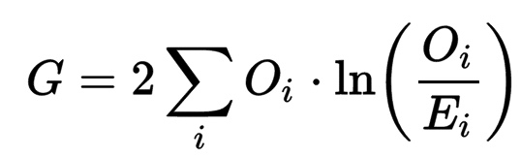
We use Goodness of Fit test to determine if allele frequencies meet HW predictions:
Pearson’s Chi-Square Test
χ² = Σ (# observed - # expected)² / # expected
G-test
Phenotype | # obs. | # exp. | obs - exp | (O - E)² | (O - E)²/E
Smooth/ yellow | 136 | 142 | -6 | 36 | 0.25
Smooth/ green | 138 | 142 | -4 | 16 | 0.11
Wrinkled/ yellow | 144 | 142 | +2 | 4 | 0.03
Wrinkled/ green | 146 | 142 | +4 | 16 | 0.11
df = 4 -1 =3, Critical χ² for P = 0.05 and 3 df = 7.82 |  |  |  |  | 0.50

Slide 23
Finally, can use HWE equation to estimate allelic frequencies:
Problem: If one or more alleles are recessive, cant distinguish between heterozygous and homozygous dominant individuals.
Use Hardy-Weinberg Equation to calculate allele frequencies based on the number of homozygous recessive individuals.
If q² = 0.0043, then q = 0.065; p = 1 - q = 0.935
p² = 0.8742, 2pq = 0.1216
2pq can be quite high even if q² is is small #
Has implications for # of carriers of a recessive disease.

Slide 24
Inbreeding Coefficient
Non-random mating and inbreeding leave specific signals and can be detected.
F_{IS} = (2f_{A} f_{a} – f_{Aa}) / 2f_{A} f_{a}
H_{e} is the expected proportion of heterozygotes under HW, whereas H_{o} is the observed proportion of heterozygotes.
Positive F values mean there is a deficiency of heterozygotes, implying positive assortative mating.
Negative F values mean there is an excess of heterozygotes, implying negative assortative mating.
Population structure mimics inbreeding and results in positive F_{IS} values.
***More about Inbreeding to come in following lecture***
H_{O}
H_{E}
H_{O}

Slide 25
Linkage Disequilibrium
Recombination – creates new combinations of alleles at two or more loci during meiosis.
Independent Assortment – random pairing of nonhomologous chromosomes.
Crossing Over – exchange of DNA between homologous chromosomes.
When recombination is limited between two or more loci on the same chromosome, patterns of genetic linkage are created (recombine < than 50% of the time sensu Thomas Hunt Morgan).
Linkage Equilibrium
Random association of alleles at two or more loci = free recombination between loci; genotypes at two or more loci are independent.
Linkage Disequilibrium (LD)
Nonrandom association of alleles at two or more loci (gametic disequilibrium); genotypes at two or more loci are associated/not independent.
***More about Linkage Disequilibrium to come in following lecture***

Slide 26
Common Measures of Genetic Diversity
Allelic Diversity (A)
# of alleles per locus in a population (e.g., A, a)
Haplotype diversity (H)
Same as allelic diversity, but also used for haploid genomes
(mtDNA, cpDNA)
Allelic richness
Allelic diversity standardized for unequal sample sizes;
usually standardized by rarefaction.
*same calculation to measure species richness

Slide 27
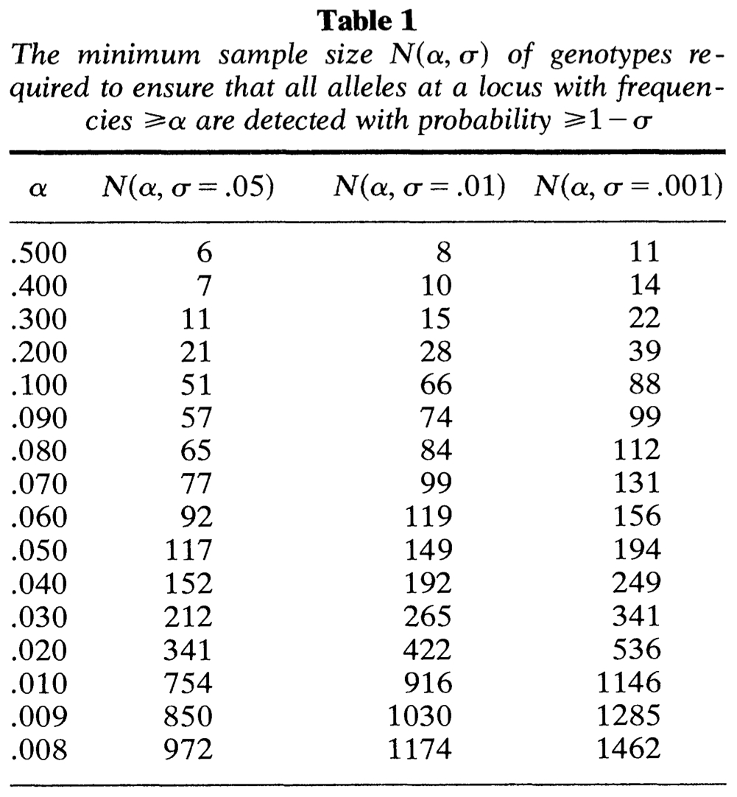
95 percent probability of detecting all alleles with frequency (α) greater than:
20%
5%
Gregorius (1980) - Biometrics
Small sample sizes likely to capture fewer alleles, and less likely to capture rare alleles.

Slide 28

Heterozygosity
Also called gene diversity (H_{E} = exp & H_{O} = obs)
Probability that two randomly chosen alleles are different
where N is the total of samples of alleles, p_{i} is the frequency of ith allele, and k is the number of different alleles.

Slide 29
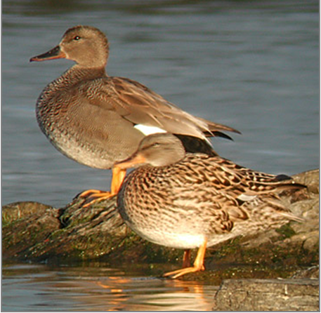





H_{O} & H_{E} Calculated
Gadwall (Anas strepera)
f(A) = (0.28)+(0.56/2) = 0.56
f(B) = (0.12)+(0.04/2)+(0.56/2) = 0.42
f(C) = (0.04/2) = 0.02

Slide 30
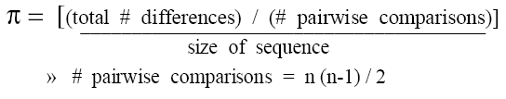
Nucleotide Diversity
Nucleotide diversity (π): the average proportion of nucleotide differences per site among samples (average H among sites)
N
28
21
1
…GCTGTGGGCAAGAAGGCAGATTGAGCCCCGTGTACGCTGC… allele A
…GCTGTGGGCAAGGAGGCAGATTGAGCCCCGTGTACGCTGC… allele B
…GCTGTGGGCAAGAAGGCAGATTGAGCCCTGTGTACGCTGC… allele C
... (total of 294 nucleotides sequenced) …
Total # differences
A-B = 1 difference * 28*21 comparisons = 588 differences
A-C = 1 difference * 28*1 comparison = 28 differences
B-C = 2 differences * 21*1 comparisons = 42 differences
Total = 588 + 28 + 42 = 658 differences
π = (658/1225)/294
# pairwise comparisons
π = 0.00183
(50*(50-1))/2 = 1225 comparisons
On average, there are 0.00183 nucleotide differences per base pair among sequences.

Slide 31

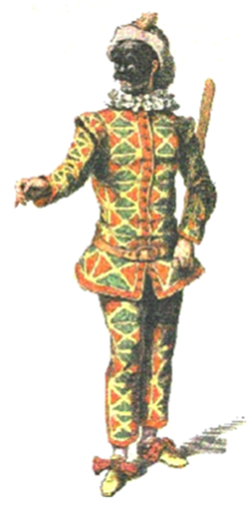
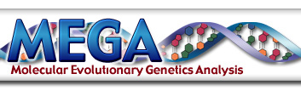
A bit more about Nucleotide Diversity:
Equates to average per site heterozygosity
Commonly used to calculate F_{ST} for example
First introduced by Nei & Li (1979)
Similar to expected heterozygosity (H_{E})
Some good programs to calculate π
  DnaSP
  MEGA
  Arlequin

Slide 32
Summary of Genetic Variation
N
28
21
1
…GCTGTGGGCAAGAAGGCAGATTGAGCCCCGTGTACGCTGC… allele A
…GCTGTGGGCAAGGAGGCAGATTGAGCCCCGTGTACGCTGC… allele B
…GCTGTGGGCAAGAAGGCAGATTGAGCCCTGTGTACGCTGC… allele C
Allelic diversity
A = 3
Heterozygosity
H_{E} = 0.52
Nucleotide diversity
π = 0.00183
Gadwall (Anas strepera)

