Slide 1
Double-digest Restriction-Associated-DNA sequencing (ddRAD-seq)

Slide 2
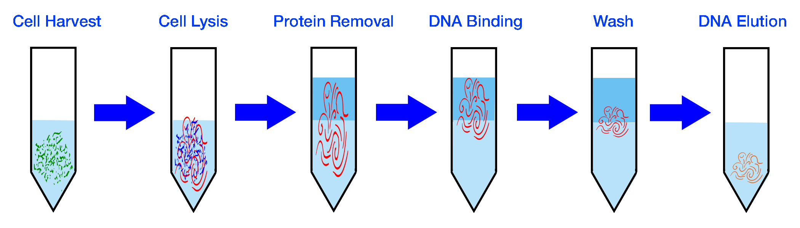
Step 1
Extract DNA from samples
  1 μg high-quality DNA
    Concentration 20 ng/μl
    50 μl reaction
    0.5 μg typically works fine; some success using 0.25 μg

Slide 3
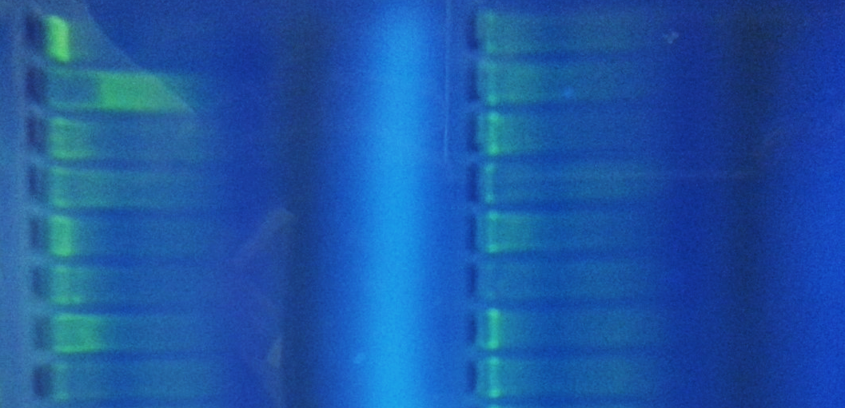
Step 1A
Optional: DNA quality check
  2% agarose gel
  Single band with high molecular weight = high quality DNA
  Smeared DNA = low quality, fragmented DNA
High Quality
Low Quality

Slide 4
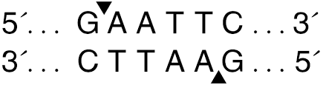
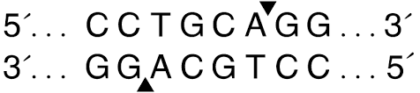

Step 2
Fragment DNA with restriction enzymes
  EcoRI SbfI
DNA
Fragmented DNA with sticky ends

Slide 5
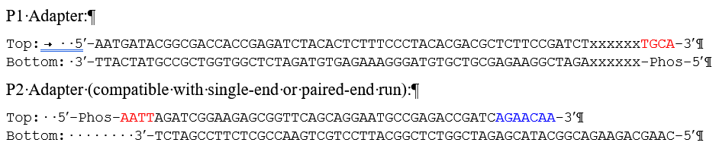
Step 3
Ligation
Divergent Y
barcode
Ligation of Adaptors
P1
P2

Slide 6
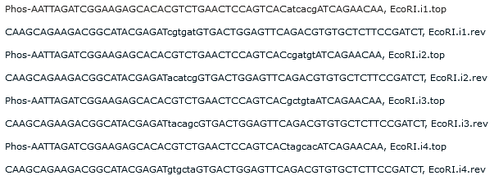
EcoRI P2 adapters

Slide 7
barcode

Slide 8
4 EcoRI indexes & 48 SbfI barcodes
  4 * 48 = 192 possible combinations
  We can uniquely label up to 192 individual samples that can be sequenced simultaneously.
    Substantially reduces the cost of sequencing

Slide 9
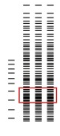

Step 4
Size selection
  Gel electrophoresis to separate fragments by size
  Cut fragments between 300 nucleotides and 450 nucleotides from gel.
  Purify fragments
450 bp
300 bp
300 – 450 bp

Slide 10
Step 4
Size selection
  Gel electrophoresis to separate fragments by size
  Cut fragments between 350 nucleotides and 450 nucleotides from gel.
  Purify fragments
450 bp
300 bp
300 – 450 bp

Slide 11
Step 5
PCR amplification
  Gel electrophoresis to separate fragments by size
X

Slide 12
Step 5
PCR Amplification of fragments with both P1 and P2 adaptors = billions of copies

Slide 13
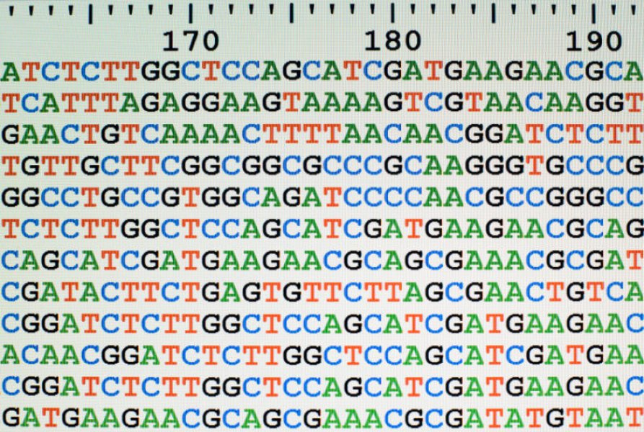
Final steps
Purify PCR products with magnetic beads
Quantify using quantitative PCR
Pool samples with different index-barcode combinations in equimolar concentrations
Sequence of high-throughput sequencer
Loci 1
Loci 2
Loci 3
Loci n
Product

