Slide 1
05-Coalescence Theory
Population Genomics
Jardín Botánico de Missouri, Oxapampa
Gen-Pob’24

Slide 2
Part I – Introduction to Coalescence Theory
Learning Outcomes
Compare and contrast coalescence theory with the Wright-Fisher Model.
Define and calculate the probability that two random copies of a gene will coalesce in one generation, two generations, etc.
Explain the expectation for time to coalescence.
Interpret geometric distributions and waiting times.

Slide 3
Introduction to coalescence theory
Phylogenetics: trees & genealogies
Population
Genetics: allele frequencies
Coalescence
Theory
Coalescence theory: A theory that describes the ancestry of a sample of genetic variation in terms of a genealogy.
  Moving back in time, alleles join at a common ancestor with a predictable probability

Slide 4

Introduction to coalescence theory
Coalescence theory: moving back in time, alleles join at a common ancestor with a predictable probability
Coalescence event: the process of lineages merging at a common ancestor
coalescence
1 generation
ago:
Probability = $\frac{1}{2N}$
Sample of gene copies from a population
Present:

Slide 5
Introduction to coalescence theory
Coalescence theory: moving back in time, alleles join at a common ancestor with a predictable probability
Coalescence event: the process of lineages merging at a common ancestor
1 generation
ago:
Sample of gene copies from a population
Present:

Slide 6
The Wright - Fisher Model of Genetic Drift
Coalescence theory is similar to the Wright-Fisher Model
  Wright-Fisher models allele frequencies forward in time (into the future - predictive)
    Follow entire population
  Coalescence models allele frequencies backward in time (into the past)
    Trace the genealogical history of a sample
    Relates directly to real data sampled from populations
    Offers flexibility for analyzing data under diverse models of population history
Wright-Fisher
Coalescence
t
t - 6
t + 1
t - 5
t + 2
t - 4
t + 3
t - 3
t + 4
t - 2
t + 5
t - 1
t + 6
t*

Slide 7
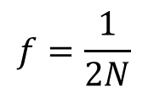
Introduction to coalescence theory: fundamental questions
What is the probability that two random copies will coalesce into a common ancestor?
$$f=\frac{1}{2N}$$
What is the expected time for coalescence to a common ancestor for two random samples?
Past
MRCA
Past
Generations
Present
Generations
What is the expected time for coalescence to the most recent common ancestor (MRCA) of all samples?
[TMRCA – time to most recent common ancestor]
Present

Slide 8
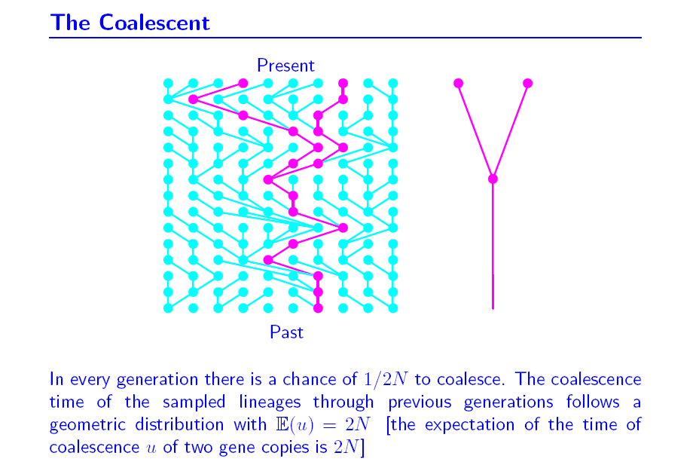
(k = 2 gene copies)
2N generations

Slide 9

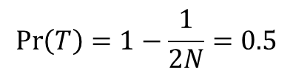
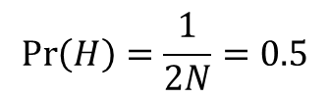
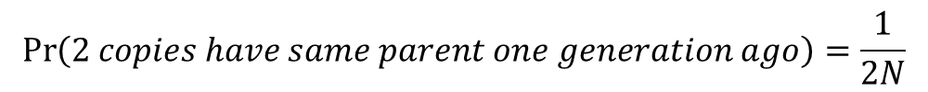
The coalescence time follows a geometric distribution with $E\left(u\right)=2N$
$$\operatorname{Pr}\left(2 copies have same parent one generation ago\right)=\frac{1}{2N}$$
$$\operatorname{Pr}\left(2 copies do not have same parent one generation ago\right)=1−\frac{1}{2N}$$
Coalescence modeled with coin tosses (2N = 2):
Ancestor
$$\operatorname{Pr}\left(H\right)=\frac{1}{2N}=0.5$$
H =
2nd copy coalesces with 1st copy
Present
2nd copy does not coalesce with 1st copy
Ancestor
$$\operatorname{Pr}\left(T\right)=1−\frac{1}{2N}=0.5$$
T =
Present

Slide 10


Coalescence modeled with coin tosses (2N = 2):
50% did not coalesce (tails).
What is the probability of coalescence two generations ago?
t -2
H =
2nd copy coalesces with 1st copy
$$0.5×Pr\left(H\right)=0.5×0.5=0.25$$
Present
t -2
2nd copy does not coalesce with 1st copy
T =
Present
$$0.5×Pr\left(T\right)=0.5×0.5=0.25$$

Slide 11
Coalescence modeled with coin tosses (2N = 2):
50% did not coalesce (tails).
What is the probability of coalescence two generations ago?
t -2
H =
2nd copy coalesces with 1st copy
$$0.5×Pr\left(H\right)=0.5×0.5=0.25$$
Present
t -2
2nd copy does not coalesce with 1st copy
T =
Present
$$0.5×Pr\left(T\right)=0.5×0.5=0.25$$

Slide 12

Coalescence modeled with coin tosses (2N = 2):
25% did not coalesce (tails) yet.
What is the probability of coalescence three generations ago?
t -3
H =
2nd copy coalesces with 1st copy
$$0.25×Pr\left(H\right)=0.25×0.5=0.125$$
Present
t -3
2nd copy does not coalesce with 1st copy
T =
$$0.25×Pr\left(T\right)=0.25×0.5=0.125$$
Present

Slide 13
Coalescence modeled with coin tosses (2N = 2):
25% did not coalesce (tails) yet.
What is the probability of coalescence three generations ago?
t -3
H =
2nd copy coalesces with 1st copy
$$0.25×Pr\left(H\right)=0.25×0.5=0.125$$
Present
t -3
2nd copy does not coalesce with 1st copy
T =
$$0.25×Pr\left(T\right)=0.25×0.5=0.125$$
Present

Slide 14


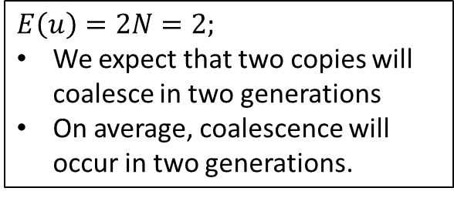
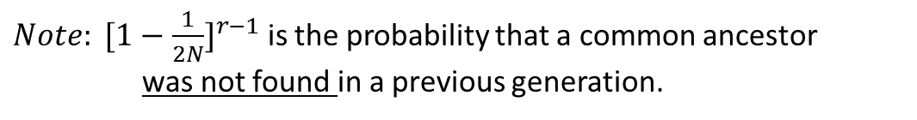
Coalescence modeled with coin tosses (2N = 2):
What is the probability of coalescence n generations ago?
$$E\left(u\right)=2$$
$$Generation t−1: Pr\left(H\right)=0.5$$
$$Generation t−2:0.5 ×Pr\left(H\right)=0.5 ×0.5=0.25$$
$$Generation t−3:0.25×Pr\left(H\right)=0.25×0.5=0.125$$
$$Generation t−4:0.125×Pr\left(H\right)=0.125×0.5=0.0625$$
$Generation t−5:0.0625×Pr\left(H\right)=0.0625×0.5=0.0$3125
$Generation t−6:0.03125×Pr\left(H\right)=0.03125×0.5=0.0$1525
.
.
.
$E\left(u\right)=2N=2;$
We expect that two copies will coalesce in two generations
On average, coalescence will occur in two generations.
$$\operatorname{Pr}\left(2 gene copies find common ancestor in generation r\right)={[1−\frac{1}{2N}]}^{r−1}[\frac{1}{2N}]$$
$Note: {[1−\frac{1}{2N}]}^{r−1}$ is the probability that a common ancestor was not found in a previous generation.

Slide 15
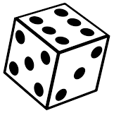
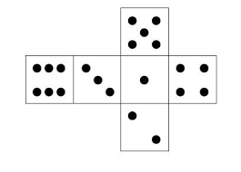
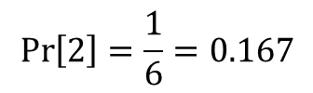
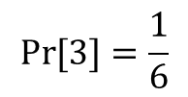
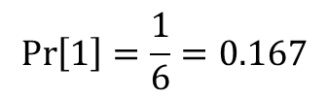
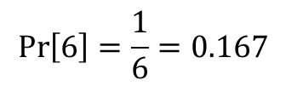
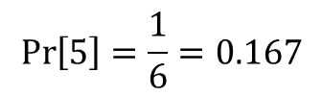
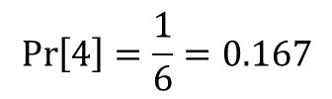
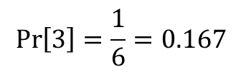
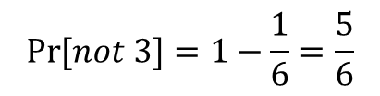
Coalescence of n = 2 samples in a population of $2N=6$ gene copies.
Sampled gene copies
Population:
Unsampled gene copies
$$\operatorname{Pr}\left(2 copies have same parent one generation ago\right)=\frac{1}{2N}$$
$$\operatorname{Pr}\left(2 copies do not have same parent one generation ago\right)=1−\frac{1}{2N}$$
Sample 1:
$$\operatorname{Pr}\left[1\right]=\frac{1}{6}=0.167$$
$$\operatorname{Pr}\left[2\right]=\frac{1}{6}=0.167$$
?
$$\operatorname{Pr}\left[3\right]=\frac{1}{6}=0.167$$
n = 2, 2N =6
Sample 2:
$$\operatorname{Pr}\left[4\right]=\frac{1}{6}=0.167$$
$$\operatorname{Pr}{[3]}=\frac{1}{6}$$
$$\operatorname{Pr}\left[5\right]=\frac{1}{6}=0.167$$
$$\operatorname{Pr}\left[6\right]=\frac{1}{6}=0.167$$
$$\operatorname{Pr}{[not 3]}=1−\frac{1}{6}=\frac{5}{6}$$

Slide 16
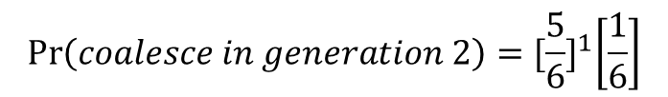

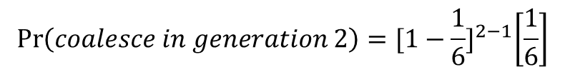
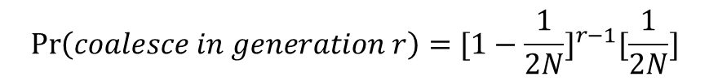
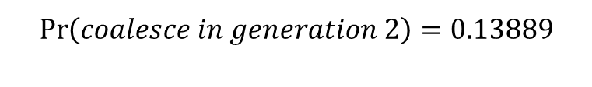
Coalescence of n = 2 samples in a population of $2N=6$ gene copies.
$\operatorname{Pr}{[coalesce one generation ago]}=\frac{1}{6}$ = 0.167
$\operatorname{Pr}{[does not coalesce one generation ago]}=1−\frac{1}{6}=\frac{5}{6}$ = 0.833
$$\operatorname{Pr}\left(coalesce in generation r\right)={[1−\frac{1}{2N}]}^{r−1}[\frac{1}{2N}]$$
$$\operatorname{Pr}\left(coalesce in generation 2\right)={[1−\frac{1}{6}]}^{2−1}\left[\frac{1}{6}\right]$$
$$\operatorname{Pr}\left(coalesce in generation 2\right)={[\frac{5}{6}]}^{1}\left[\frac{1}{6}\right]$$
$$\operatorname{Pr}\left(coalesce in generation 2\right)=0.13889$$

Slide 17
Coalescence of n = 2 samples in a population of $2N=6$ gene copies.
$\operatorname{Pr}{[coalesce one generation ago]}=\frac{1}{6}$ = 0.167
$\operatorname{Pr}{[does not coalesce one generation ago]}=1−\frac{1}{6}=\frac{5}{6}$ = 0.833
$$\operatorname{Pr}\left(coalesce in generation r\right)={[1−\frac{1}{2N}]}^{r−1}[\frac{1}{2N}]$$
$$\operatorname{Pr}\left(coalesce in generation 2\right)={[1−\frac{1}{6}]}^{2−1}\left[\frac{1}{6}\right]$$
$$\operatorname{Pr}\left(coalesce in generation 2\right)={[\frac{5}{6}]}^{1}\left[\frac{1}{6}\right]$$
$$\operatorname{Pr}\left(coalesce in generation 2\right)=0.13889$$

Slide 18
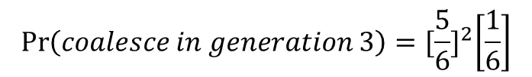
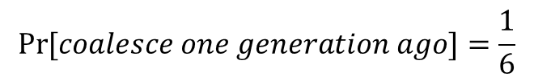
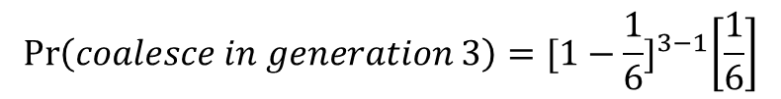
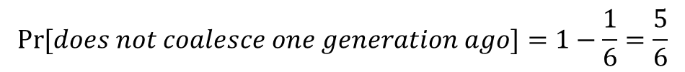
Coalescence of n = 2 samples in a population of $2N=6$ gene copies.
$$\operatorname{Pr}{[coalesce one generation ago]}=\frac{1}{6}$$
$$\operatorname{Pr}{[does not coalesce one generation ago]}=1−\frac{1}{6}=\frac{5}{6}$$
$$\operatorname{Pr}\left(coalesce in generation r\right)={[1−\frac{1}{2N}]}^{r−1}[\frac{1}{2N}]$$
$$\operatorname{Pr}\left(coalesce in generation 3\right)={[1−\frac{1}{6}]}^{3−1}\left[\frac{1}{6}\right]$$
$$\operatorname{Pr}\left(coalesce in generation 3\right)={[\frac{5}{6}]}^{2}\left[\frac{1}{6}\right]$$
$$\operatorname{Pr}\left(coalesce in generation 3\right)=\text{0.694444}×0.166667$$
$$\operatorname{Pr}\left(coalesce in generation 3\right)=\text{0.115741}$$

Slide 19
Coalescence of n = 2 samples in a population of $2N=6$ gene copies.
$$\operatorname{Pr}{[coalesce one generation ago]}=\frac{1}{6}$$
$$\operatorname{Pr}{[does not coalesce one generation ago]}=1−\frac{1}{6}=\frac{5}{6}$$
$$\operatorname{Pr}\left(coalesce in generation r\right)={[1−\frac{1}{2N}]}^{r−1}[\frac{1}{2N}]$$
$$\operatorname{Pr}\left(coalesce in generation 3\right)={[1−\frac{1}{6}]}^{3−1}\left[\frac{1}{6}\right]$$
$$\operatorname{Pr}\left(coalesce in generation 3\right)={[\frac{5}{6}]}^{2}\left[\frac{1}{6}\right]$$
$$\operatorname{Pr}\left(coalesce in generation 3\right)=\text{0.694444}×0.166667$$
$$\operatorname{Pr}\left(coalesce in generation 3\right)=\text{0.115741}$$

Slide 20

Coalescence of n = 2 samples in a population of $2N=6$ gene copies.
The coalescence time follows a geometric distribution with $E\left(u\right)=2N=6$
The time to coalescence is called the waiting time. How long do you have to wait until a 3 is rolled?
$$E\left(u\right)=2N=6$$

Slide 21
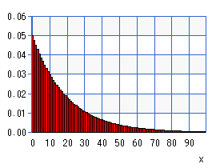
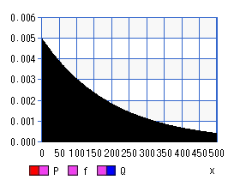
Coalescence: Waiting time follows a geometric distribution
N = 10
E(u₂) = 20
Proportion
N = 100
E(u₂) = 200
Generations
Coalescence has a high variance which is related to N

Slide 22
Summary
The probability of coalescence is inversely correlated with population size (N)
  The probability of coalescence is larger in smaller population sizes
The waiting time for coalescence is positively correlated with population size
  Coalescence requires more time in larger populations
There is wide variance in coalescence times, especially for large populations
Coalescence is a stochastic process—the outcome of any one (coalescent) event is not predictable, but the average outcome of many events is predictable.

Slide 23
Part 2—the n-coalescent
Learning Outcomes
Extend coalescence to n > 2 samples.
  Calculate probabilities of coalescence for n samples.
  Calculate expected time to coalescence for n samples.
  Calculate TMRCA for n samples.

Slide 24
Review:
(k = 2 gene copies)
2N generations
N = 10
E(u₂) = 20
Proportion

Slide 25
(n gene copies)
Ex. If k = 4 and N = 100, then [4*(4-1)]/(4*100) = 0.03]
There is a 3% chance that 4 sampled copies from a population of 100 will coalesce to 3 ancestors one generation ago.

Slide 26
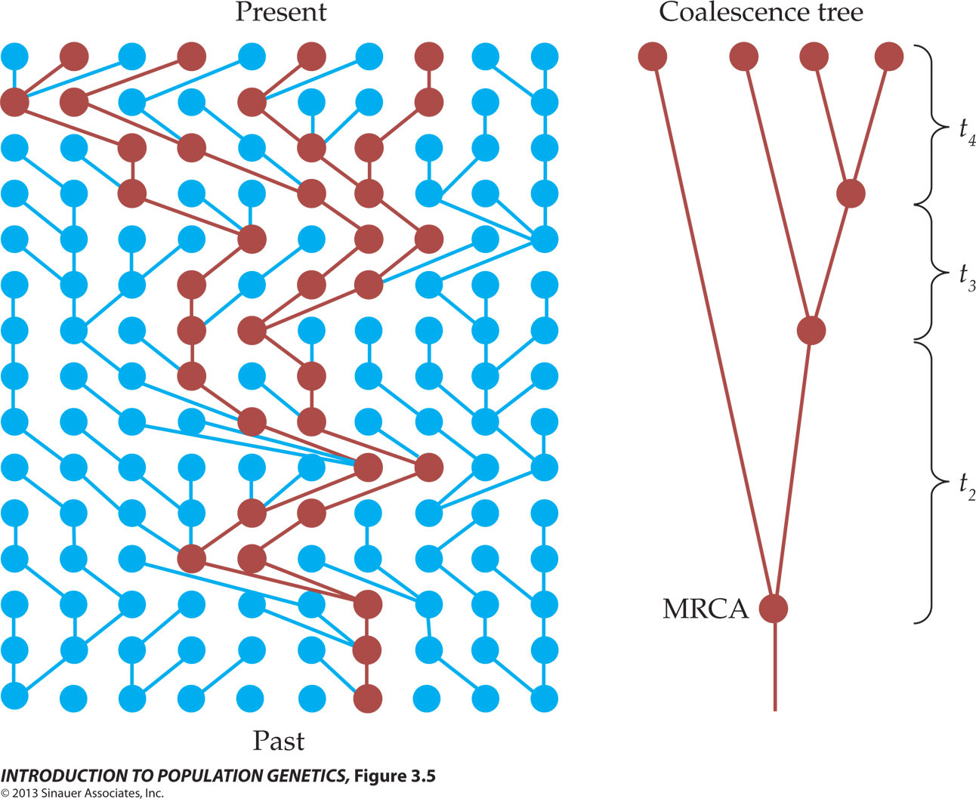

Slide 27
Ex. If k = 4 and N = 100, then 4 copies are expected to coalesce to 3 ancestors in {(4*100)/[4*(4-1)]} generations; or 33.3 generations

Slide 28
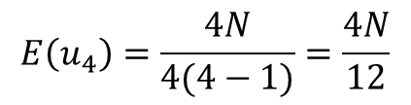
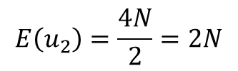

$$E\left(u_{4}\right)=\frac{4N}{4(4−1)}=\frac{4N}{12}$$
$$E\left(u_{3}\right)=\frac{4N}{6}$$
$$E\left(u_{2}\right)=\frac{4N}{2}=2N$$

Slide 29
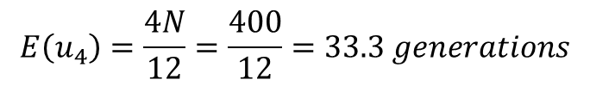
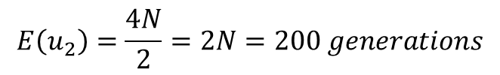
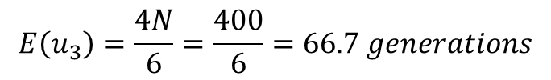
N = 100
$$E\left(u_{4}\right)=\frac{4N}{12}=\frac{400}{12}=33.3 generations$$
$$E\left(u_{3}\right)=\frac{4N}{6}=\frac{400}{6}=66.7 generations$$
$$E\left(u_{2}\right)=\frac{4N}{2}=2N=200 generations$$
The probability of coalescence decreases as you move back further in time (as the number of gene copies decreases)

Slide 30
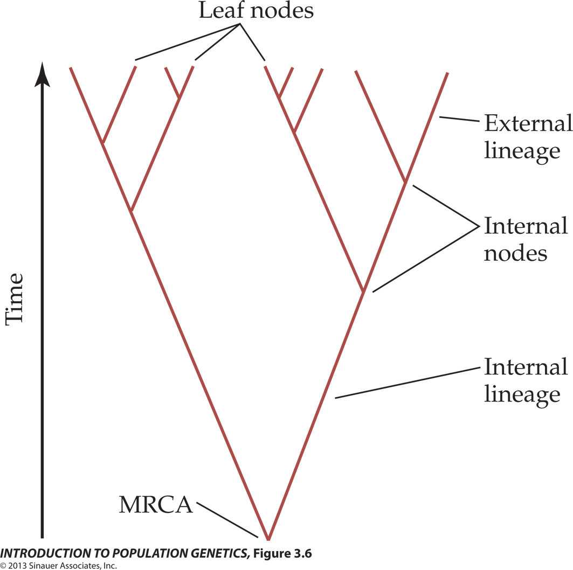
(Present-day samples)
The probability of coalescence decreases as you move back further in time (as the number of gene copies decreases)
  External lineages are shorter than internal lineages
(Common ancestors)
Figure 3.6 An example of a coalescence tree

Slide 31
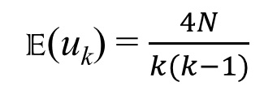
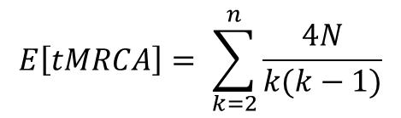
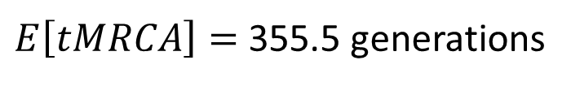
Time to Most Recent Common Ancestor
E(u_{k}) = $\frac{4N}{k(k−1)}$
$$E\left[tMRCA\right]= \sum_{k=2}^{n}{\frac{4N}{k(k−1)}}$$
E(u₁₀) = (4*100)/(10*(10-1)) = 4.4 generations
E(u₉) = (4*100)/(9*(9-1)) = 5.6 generations
E(u₈) = (4*100)/(8*(8-1)) = 7.1 generations
E(u₇) = 9.5 generations
E(u₆) = 13.3 generations
E(u₅) = 20.0 generations
E(u₄) = 33.3 generations
E(u₃) = 66.7 generations
E(u₂) = 200 generations
$E\left[tMRCA\right]=$ 355.5 generations

Slide 32

The value of adding samples to estimate TMRCA
$$E\left[tMRCA\right]$$
Number of gene copies sampled (n)
A sample size of n = 8 provides a 95% chance of sampling the deepest coalescence (MRCA) in a population.

Slide 33
Coalescence is a noisy process—it is stochastic
Think of coalescence events being randomly draw from the geometric distribution
Results in high variation in the shape of genealogies
10 genealogies generated under the same population size (N = 10,0000)

Slide 34
Summary
If we know N, we can estimate the geometric distribution of coalescent events and the TMRCA in a genealogy.
Application: If we have a genealogy, we can estimate N based on the geometric distribution of coalescent events and the TMRCA.

Slide 35
Part 3—Effective Population Size
Learning Outcomes
Define and interpret effective population size.
Calculate effective population sizes for unequal sex ratios, variance in family sizes, fluctuating population sizes, and different modes of inheritance.

Slide 36
Empirical data usually show that heterozygosity is lower than predicted by N.
i.e., genetic drift appears to be a more powerful force in real populations than expected given N.

Slide 37
Coalescent Theory & Wright-Fisher Model
Model Assumptions (idealized populations)
Constant population sizes
Discrete/non-overlapping generations
Random mating (panmixia)
Equal sex ratio
One locus
No recombination
No population structure
No selection

Slide 38
Population size vs. effective population size
Census Population Size (N) = # of adult (all) individuals (breeding or non-breeding) within a population. This # can be counted by observation.
Effective Population Size (N_{e}) = The # of individuals in an idealized population (one that meets Wright-Fisher Model) that has the same magnitude of genetic drift as the actual population.
In an idealized population (meets the assumptions of our models), N = N_{e}.

Slide 39

N_{e} and breeding structure
Models to date assume that any gamete has an equal probability of combining with any other gamete (i.e., self-fertilization is possible).
If self-fertilization is not allowed, then
No self-fertilization reduces the probability that two alleles will be identical by descent.

Slide 40

N_{e} and sex ratios
If the number of breeding males (N_{m}) and the number of breeding females (N_{f}) differ, then
N_{e} depends more heavily on the rarer sex
- Each sex contributes half the gametes
- On average, the rarer sex will contribute more gametes per individual than the more common sex
The greater the skew in the breeding sex ratio, the greater the influence of drift.

Slide 41
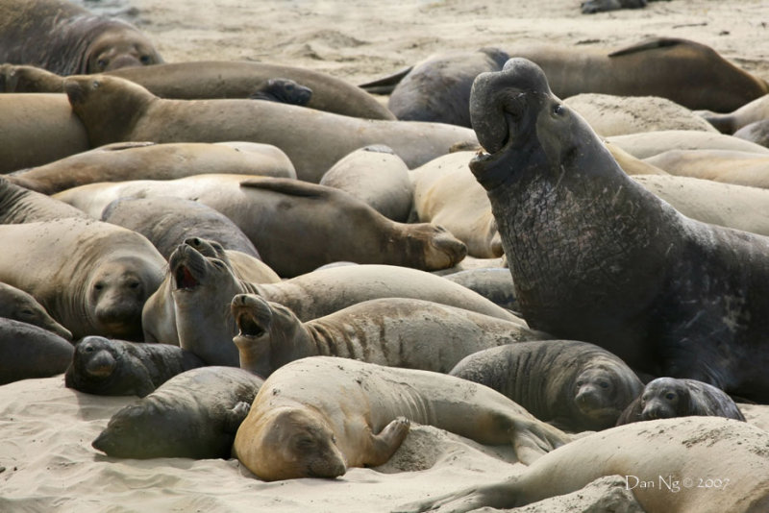

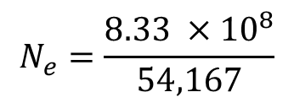
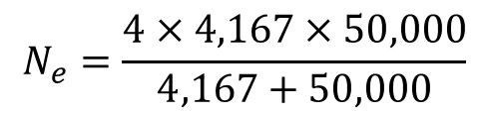
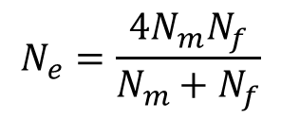
N_{e} in Northern elephant seals (Mirounga angustirostris)
Males fight to gain access to harems that can consist of 100s of females (average size = 12 females).
Females mate exclusively (almost) with the dominant male.
Given a population size of about 100,000 individuals, and assuming an overall sex ratio of 1:1, what is N_{e}?
N_{f} = number of breeding females
N_{f} = 50,000
$$N_{e}=\frac{4×4,167×50,000}{4,167+50,000}$$
$$N_{e}=\frac{4N_{m}N_{f}}{N_{m}+N_{f}}$$
N_{m} = number of breeding males
N_{m} = 50,000/12
N_{m} = 4,167
$$N_{e}=\frac{8.33 ×{10}^{8}}{54,167}$$
$$N_{e}=15,384 individuals$$
Genetic drift will affect this population of 100,000 individuals as if it was an idealized population consisting of 15,384 individuals.

Slide 42

N_{e} and family size
When the variance in family size (K) is greater than two (V_{k} > 2), then
If all individuals leave exactly the same number of offspring, then V_{k} = 0, and N_{e} = 2N
Thus, in captive breeding programs, it is possible to increase the effective size by controlling reproductive output!
This is especially important for endangered species.
Maximizing the number of offspring produced is not necessarily the best strategy!

Slide 43

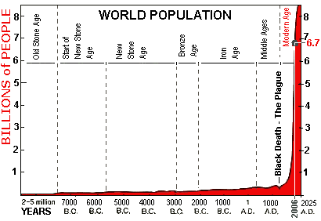
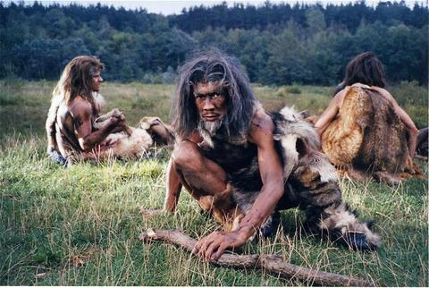
N_{e} and population size changes
Population sizes rarely (if ever) remain stable over time, but rather fluctuate.
If population sizes fluctuate, then the effective size over t generations is
where N_{i} is the population size in generation i.
N_{e} is disproportionately affected by small population sizes, because inbreeding is higher during those times.
N_{e} = 10,000

Slide 44
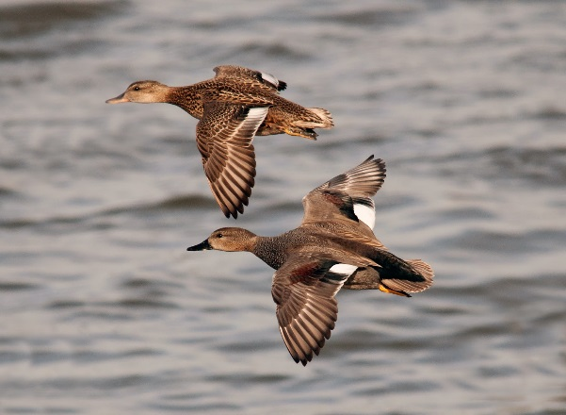
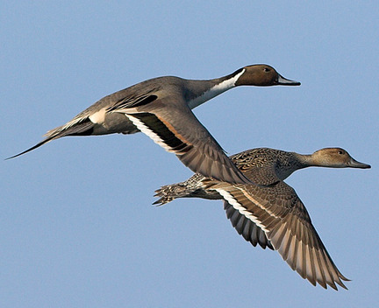
N_{e} and population size changes
N_{e} = 1.5 million
N_{e} = 3.4 million

Slide 45
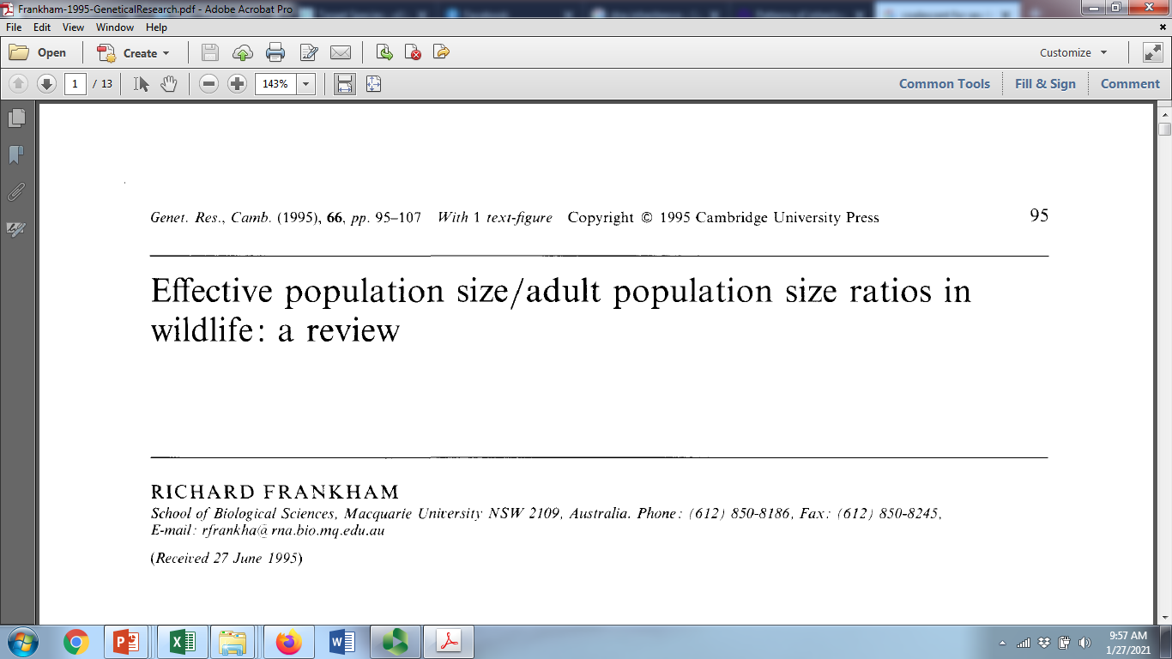
On average, N_{e} = 0.1N

Slide 46
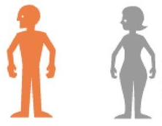
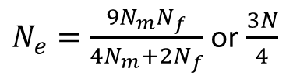


N_{e} and modes of inheritance
Autosomal DNA
Y-linked DNA
Mitochondrial DNA
X-linked DNA
♂
♀
♂
♀
♂
♀
♂
♀
Parents
×
Offspring
Biparental inheritance
Paternal inheritance
Maternal inheritance
Sex-linked inheritance
$N_{e}=\frac{N_{m}}{2}$ or $\frac{N}{4}$
$N_{e}=\frac{N_{f}}{2}$ or $\frac{N}{4}$
$N_{e}=\frac{{9N}_{m}N_{f}}{4N_{m}+2N_{f}}$ or $\frac{3N}{4}$
N_{m} = number of breeding males; N_{f} = number of breeding females

Slide 47
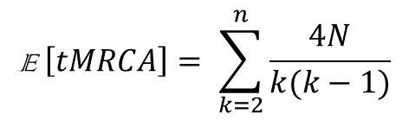


Review:
E (u_{k}) = $\frac{4N}{k(k−1)}$
$$\text{E} \left[tMRCA\right]= \sum_{k=2}^{n}{\frac{4N}{k(k−1)}}$$
$$f=\frac{1}{2N}$$
N = number of diploid individuals
2N = number of haploid individuals or number of gene copies in diploids

Slide 48



Review:
E (u_{k}) = $\frac{4N_{e}}{k(k−1)}$
$$\text{E} \left[tMRCA\right]= \sum_{k=2}^{n}{\frac{4N_{e}}{k(k−1)}}$$
$$f=\frac{1}{2N_{e}}$$

Slide 49
Summary
N rarely (if ever) accurately predicts the effects of genetic drift (e.g., geometric distribution of coalescent events) in real populations.
The effective population (N_{e}) of real populations is the # of individuals in an idealized population that has the same magnitude of genetic drift as the actual population.
  Many life history characteristics of organisms cause N_{e} to be much less than N.
  When applying coalescent models, we estimate N_{e} rather than N.

Slide 50
Part 4—Applications of Coalescence Theory
Learning Outcomes
List the two problems associated with applying coalescence theory to populations.
Explain how we measure time in genealogies.
Define Θ and use estimators to calculate it.
Explain how we account for uncertainty in genealogies and the stochasticity of genetic drift when applying coalescence theory to real populations.
Interpret posterior distributions.
Compare strategies for improving estimates of parameters using coalescence theory.

Slide 51
Applying coalescent theory to populations
Given that coalescence occurs with a predictable probability that is a function of N_{e}, if we know the genealogy, we can estimate N_{e} from the frequencies of coalescent times.
Problems:
We cannot determine time directly from a genealogy.
We do not know the precise genealogy.

Slide 52
Applying coalescent theory to populations
Problem: We cannot determine time directly from a genealogy
Solution
Time is scaled to the mutation rate (µ)
  In r generations since coalescence, we expect µr mutations to have occurred on a lineage.
  The number of mutations separating two randomly-selected gene copies is given by 4N_{e}µ.
  We define Ө = 4N_{e}µ
  By scaling to the mutation rate, we can estimate Ө directly from the genealogy.

Slide 53

Infinite sites model of mutation
Mutations are rare, so each new mutation creates a new variable site.
No site experiences >1 mutation (i.e., there is no homoplasy).
Applies to DNA sequence data (SNPs)
Shared mutations indicate common ancestry
  Construct genealogies
Note that more complex substitution models have been developed.
  E.g., Applying different weights to different mutations.
    Transitions > tranversions
    Invariable sites (some nucleotide positions are conserved)
    Etc.
Kimura (1969) The Number of Heterozygous Nucleotide Sites Maintained in a Finite Population Due to Steady Flux of Mutations. Genetics 61:893–903.

Slide 54

Estimators of Θ
Tajima’s estimator = average number (or proportion) of pairwise differences (π)
$${\hat{θ}}_{T}=π=\frac{\sum_{i<j}{d_{ij}}}{n(n−1)/2}=4N_{e}μ$$
^ (“hat”) indicates that this is an estimator

Slide 55




Estimators of Θ
Watterson’s estimator = number (or proportion) of segregating sites (S)
Segregating site—a position in a DNA sequence that differs between two or more individuals
n
28
21
1
…GCTGTGGGCAAGAAGGCAGATTGAGCCCCGTGTACGCTGC… allele A
…GCTGTGGGCAAGGAGGCAGATTGAGCCCCGTGTACGCTGC… allele B
…GCTGTGGGCAAGAAGGCAGATTGAGCCCTGTGTACGCTGC… allele C
There are two segregating sites (S = 2) in this sample of DNA sequences
$${\hat{θ}}_{W}=\frac{S}{\sum_{k=1}^{n−1}{\frac{1}{k}}}=4N_{e}μ$$
$${\hat{θ}}_{W}=\frac{2}{\frac{1}{1}+\frac{1}{2}+\frac{1}{3}…\frac{1}{49}}$$
n is the number of samples, and k is all from 1 to $n−1$
$${\hat{θ}}_{W}=\frac{2}{\text{4.479205}}$$
$${\hat{θ}}_{W}=\text{0.446508}$$

Slide 56









Estimators of Θ
n
28
21
1
…GCTGTGGGCAAGAAGGCAGATTGAGCCCCGTGTACGCTGC… allele A
…GCTGTGGGCAAGGAGGCAGATTGAGCCCCGTGTACGCTGC… allele B
…GCTGTGGGCAAGAAGGCAGATTGAGCCCTGTGTACGCTGC… allele C
Tajima’s estimator
Watterson’s estimator
$${\hat{θ}}_{T}=\text{0.537143}$$
$${\hat{θ}}_{W}=\text{0.446508}$$
*Both are estimates of $4N_{e}μ$*
$4N_{e}μ$ = 0.537143
$4N_{e}μ$ = $\text{0.446508}$
$$N_{e}=\frac{\text{0.537143}}{4μ }$$
$$N_{e}=\frac{\text{0.446508} }{4μ }$$
If µ = 10⁻⁷ substitutions per locus per generation, then
$$N_{e}=1,342,857 individuals$$
$$N_{e}=\text{1}\text{,}\text{116}\text{,}\text{269} individuals$$
These estimators only provide point estimates of Θ. Do the two estimates differ from each other? What is our confidence interval for Θ?
Applying coalescence theory provides a measure of uncertainty in estimates of Θ.

Slide 57

Construct genealogies and infer time from mutations.
Map mutations onto a genealogy.
Mutations occur with an associated probability given by the mutation rate (µ).
We expect µr mutations to occur on a lineage, where r is the number of generations since coalescence.
Mutation is a stochastic force—the sequence of events are random, but they occur at a predictable frequency (the outcome of a single event cannot be predicted, but the average over many replicates can be predicted)

Slide 58
Applying coalescent theory to populations
Given that coalescence occurs with a predictable probability that is a function of N_{e}, if we know the genealogy, we can estimate N_{e} from the frequencies of coalescent times.
Problems:
We cannot determine time directly from a genealogy.
We do not know the precise genealogy.

Slide 59


Applying coalescent theory to populations
Problem: We do not know the precise genealogy
One possible genealogy consistent with the data:
N
TCGAGGTATTAAC 3
TCTAGGTATTAAC 6
TCGAGGCATTAAC 5
TCTAGGTGTTAAC 3
TCGAGGTATTAGC 3
TCTAGGTATCAAC 2

Slide 60
Applying coalescent theory to populations
Problem: We do not know the precise genealogy
Solution
Estimate Ө for many genealogies that are consistent with the data
Use Markov Chain Monte Carlo to update genealogies and obtain estimates of Ө
Markov Chain Monte Carlo: a class of algorithms for sampling from a probability distribution

Slide 61
Applying coalescent theory to populations
Markov Chain Monte Carlo
Considers millions or even billions of genealogies consistent with the data
Estimate time to coalescence from each genealogy
  Expect µr mutations per lineage, and
  An average of 4N_{e}µ mutations to separate two random copies
Provides a posterior distribution of values of Θ and the probability associated with each value
Peak of the distribution is the “best” estimate of Θ
Variance (95% HPD—highest posterior density) around estimate provides measure of confidence
  Incorporates the influence of stochastic variance in both mutation and drift
Posterior distribution of estimates of Θ
Best estimate
Posterior probability
95% HPD
Ө (4N_{e}µ)

Slide 62




mtDNA genealogies in two species of ducks
American Wigeon
Anas americana
Gadwall
Anas strepera
Which has the larger N_{e}?

Slide 63
Coalescence methods: estimate Ө from all possible genealogies consistent with the data
Best estimates
Posterior probability
Some overlap – cannot reject null hypothesis of no difference in N_{e}
Ө (N_{e}µ for mtDNA)
Estimated using the coalescent program Lamarc

Slide 64
mtDNA genealogies in two species of ducks
American Wigeon
Gadwall
Θ = 0.0187
95% HPD = 0.012 – 0.029
Θ = 0.0086
95% HPD = 0.0050 – 0.014
Cannot reject null hypothesis of equal effective population sizes (e.g., Θ = 0.012 – 0.014 can generate either genealogy some of the time).

Slide 65
How can we improve our estimates to better account for stochasticity generated by genetic drift?
Adding individuals to a coalescent analysis will only help parameter estimates slightly, and it will greatly slow down computational time. ✔✔✔
Adding additional base pairs from a single locus will only help slightly.
  Adds more information (more sites with mutations) for constructing genealogy & estimating coalescence times. ✔
  The locus is evolving as a single unit (only a single outcome of the stochastic process). ✔
  The presence of recombination will lead to upward bias in ϴ. ✔✔✔
However, genetic drift is independent across unlinked loci, so adding multiple loci short enough to be non-recombining is the best way to go. ✔✔✔

Slide 66
Multiple unlinked loci provide independent estimates of Θ
*Multiple outcomes of the stochastic process
Four trees generated using a standard coalescent model
for a sample size of ten.

Slide 67
Estimates of Ө from 20 independent autosomal loci
Posterior distribution
ϴ (4N_{e}µ)
Wigeons have a significantly larger N_{e} than gadwalls (stochastic drift is insufficient for explaining differences in genetic diversity)

Slide 68
Summary
Coalescence theory can be applied to estimate N_{e} from genealogies sampled from natural population.
When applying coalescence theory, time is scaled to the mutation rate.
  Thus, N_{e} is scaled to the mutation rate (Ө = 4N_{e}µ)
Estimating Ө from many genealogies that are consistent with the genetic data compensates for not knowing the true genealogy.
Analyzing many loci is the best way to improve coalescent estimates of Ө.

