Slide 1
08: Population Subdivision
Population Genomics
Sucre, Bolivia 2022

Slide 2
Learning Outcomes
Define F statistics.
Calculate and interpret F_{st} from allele frequencies.
Calculate and interpret Φ_{ST} .

Slide 3

Fundamental Evolutionary Processes
Immigration
Emigration
Population: Genetic Diversity
$$f=\frac{1}{2N_{e}}$$
2N_{e}µ
Genetic Drift
Mutation
Natural selection
Mutation – heritable change in DNA
Genetic drift – random fluctuations of allele frequencies resulting from the random sampling of gametes
Natural selection – the process by which heritable traits that increase the survivability or the reproductive potential of individuals become more common over time
Gene flow – exchange of genes between populations
immigration – movement of genes into a population
Nonrandom mating – Individuals more likely to mate with genetically similar (positive assortative mating) or dissimilar (negative assortative mating) individuals

Slide 4
Fundamental Evolutionary Processes
Immigration
Emigration
Population: Genetic Diversity
$$f=\frac{1}{2N_{e}}$$
2N_{e}µ
Genetic Drift
Mutation
Natural selection
Mutation – heritable change in DNA
Genetic drift – random fluctuations of allele frequencies resulting from the random sampling of gametes
Natural selection – the process by which heritable traits that increase the survivability or the reproductive potential of individuals become more common over time
Gene flow – exchange of genes between populations
immigration – movement of genes into a population
Nonrandom mating – Individuals more likely to mate with genetically similar (positive assortative mating) or dissimilar (negative assortative mating) individuals

Slide 5

Population Subdivision for Two Populations
2N_{e}μ
Genetic variation; Allele or genotype frequencies
Mutation
Genetic Drift
Migration
2N_{e}μ
Genetic variation; Allele or genotype frequencies
Mutation
Genetic Drift
Mutation and genetic drift (and selection) act independently in each population & cause populations to diverge over time.
Gene flow homogenizes allele frequencies, offsets drift by increasing N_{e}.

Slide 6
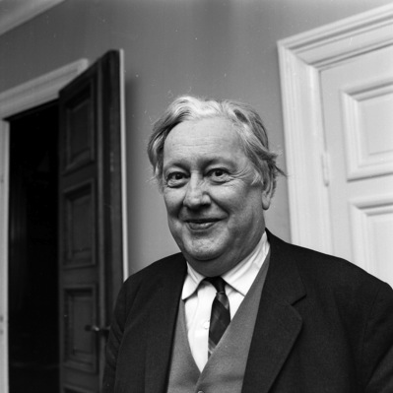
Wahlund Effect
The deficiency of heterozygosity that results from treating multiple populations as a single population.
Even if the subpopulations themselves are in H-W equilibrium.
Caused by geographic barriers + genetic drift.
Sten Wahlund, Uppsala University, Sweden – 1928

Slide 7
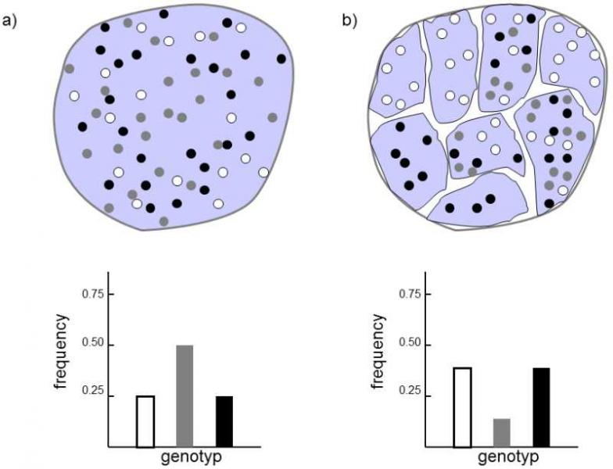
No Population
Subdivision
Population
Subdivision
Population subdivision (population structure)—allele frequencies differ between different geographic regions as a result of individuals being more likely to mate with individuals from the same region (similar to positive assortative mating)
Heterozygotes disappear from metapopulation
https://www.frozenevolution.com/v21-number-homozygotes-increases-after-large-population-splits-number-smaller-ones

Slide 8

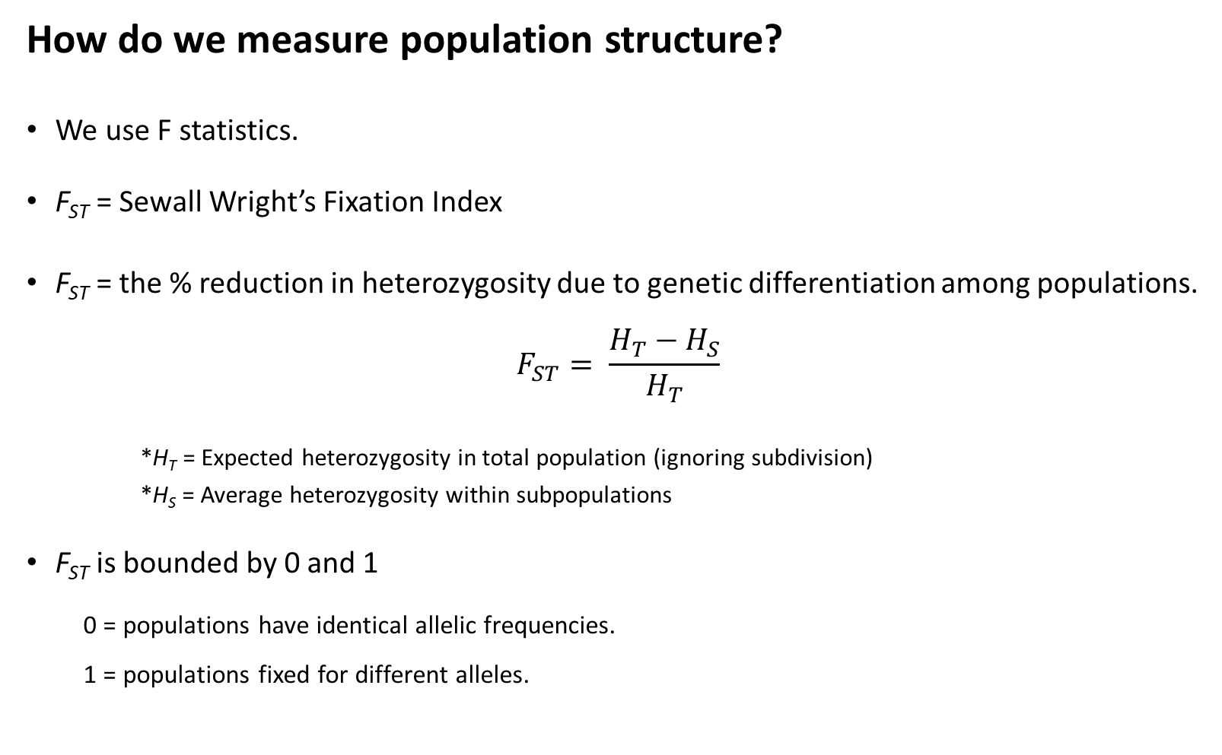
How do we measure population structure?
We use F statistics.
F_{st} = Sewall Wright’s Fixation Index
F_{st} = the % reduction in heterozygosity due to genetic differentiation among populations.
$$F_{ST}= \frac{H_{T}−H_{S}}{H_{T}}$$
*H_{T} = Expected heterozygosity in total population (ignoring subdivision)
*H_{S} = Average heterozygosity within subpopulations
F_{st} is bounded by 0 and 1
  0 = populations have identical allelic frequencies.
  1 = populations fixed for different alleles.
F_{st}
1.0
0.5
0.0
or

Slide 9
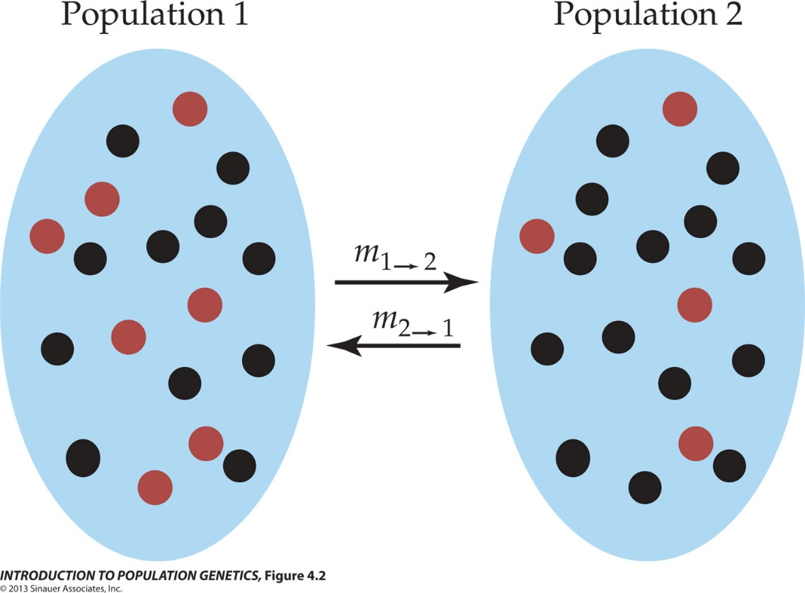

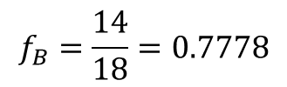



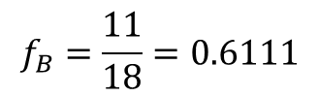



How do we measure population structure?
H_{T} = Expected heterozygosity in total population
  When measuring population structure, use average allele frequencies.
$$H_{E}=1−\sum_{i=j}{f_{i}^{2}}$$
Population | f_{R} | f_{B}
1 | 0.3889 | 0.6111
2 | 0.2222 | 0.7778
Mean | 0.3056 | 0.6944
$f_{R}=\frac{7}{18}$ = 0.3889
$f_{R}=\frac{4}{18}$ = 0.2222
$$H_{T}=1−{(0.3056}^{2}+{0.6944}^{2})$$
$$f_{B}=\frac{11}{18}=0.6111$$
$$f_{B}=\frac{14}{18}=0.7778$$
$$H_{T}=1−(0.0934+0.4823)$$
$$H_{T}=1−(0.5756)$$
$$H_{T}=0.4244$$

Slide 10


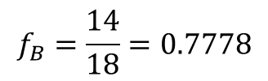






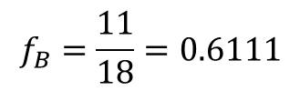





How do we measure population structure?
H_{S} = Average heterozygosity with subpopulations
$$H_{E}=1−\sum_{i=j}{f_{i}^{2}}$$
Population | f_{R} | f_{B}
1 | 0.3889 | 0.6111
2 | 0.2222 | 0.7778
Mean | 0.3056 | 0.6944
$$H_{S1}=1−{(0.3889}^{2}+{0.6111}^{2})$$
$$H_{S2}=1−{(0.2222}^{2}+{0.7778}^{2})$$
$$H_{S2}=1−(0.0494+0.6049)$$
$f_{R}=\frac{7}{18}$ = 0.3889
$f_{R}=\frac{4}{18}$ = 0.2222
$$H_{S1}=1−(0.1512+0.3735)$$
$$H_{S1}=1−(0.5247)$$
$$H_{S2}=1−(0.6543)$$
$$f_{B}=\frac{11}{18}=0.6111$$
$$f_{B}=\frac{14}{18}=0.7778$$
$$H_{S1}=0.4753$$
$$H_{S2}=0.3457$$
$$H_{S}=(0.4753+0.3457)/2$$
$$H_{S}=0.4105$$

Slide 11
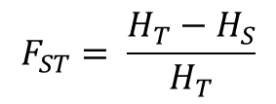


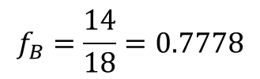


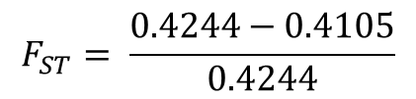
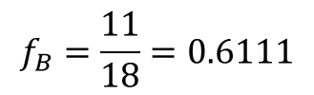

How do we measure population structure?
F_{st} = the % reduction in heterozygosity due to genetic differentiation among populations.
$$F_{ST}= \frac{H_{T}−H_{S}}{H_{T}}$$
$$H_{T}=0.4244$$
$$H_{S}=0.4105$$
$$F_{ST}= \frac{0.4244−0.4105}{0.4244}$$
$$F_{ST}=0.0327$$
$f_{R}=\frac{7}{18}$ = 0.3889
$f_{R}=\frac{4}{18}$ = 0.2222
3.3% of the total genetic variation is explained by differences between populations.
*Weak population structure
$$f_{B}=\frac{11}{18}=0.6111$$
$$f_{B}=\frac{14}{18}=0.7778$$

Slide 12
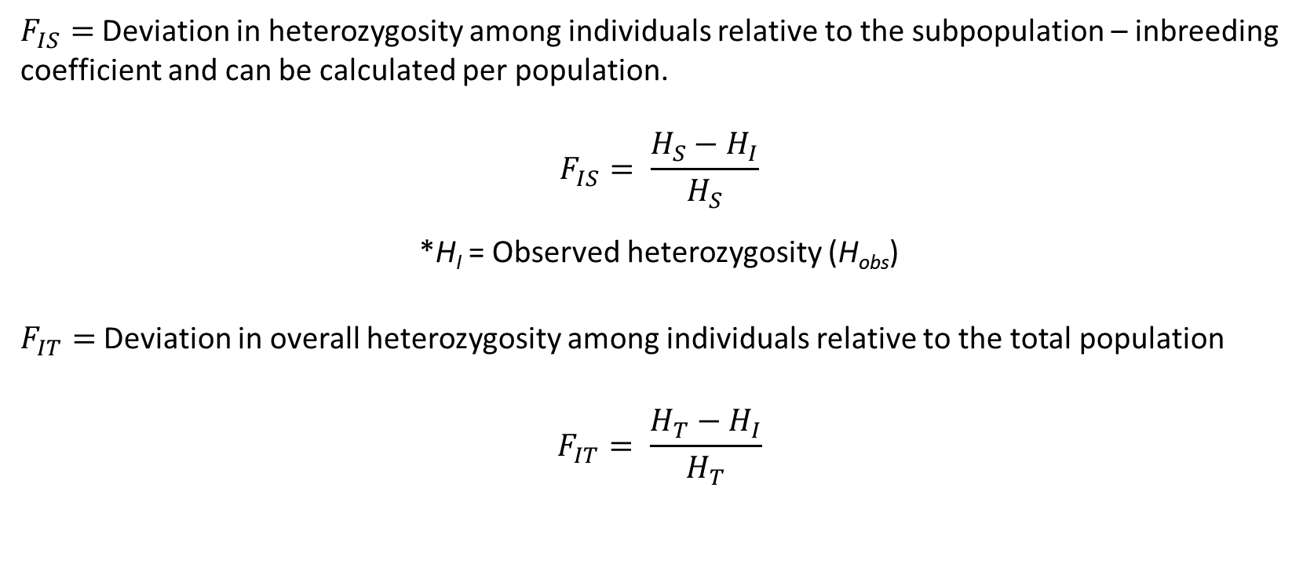
Related F coefficients
$F_{IS}=$Deviation in heterozygosity among individuals relative to the subpopulation – inbreeding coefficient and can be calculated per population.
$$F_{IS}= \frac{H_{S}−H_{I}}{H_{S}}$$
*H_{I} = Observed heterozygosity (H_{obs})
$F_{IT}=$Deviation in overall heterozygosity among individuals relative to the total population
$$F_{IT}= \frac{H_{T}−H_{I}}{H_{T}}$$

Slide 13
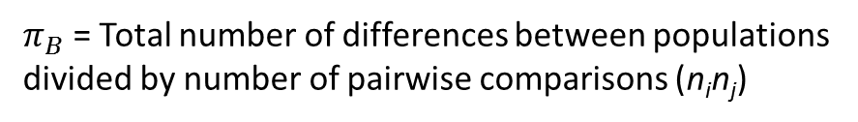



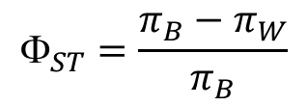
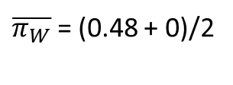





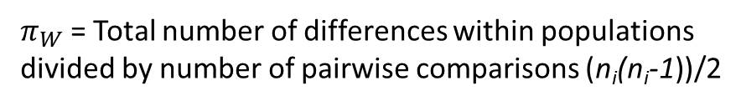
Calculating F_{st} from sequence data: Φ_{ST} (Phi-ST)
$${\text{F}}_{ST}=\frac{π_{B}−π_{W}}{π_{B}}$$
$π_{B}$ = the average number (or proportion) of nucleotide differences between populations (divergence)
$π_{W}$ = the average number (or proportion) of nucleotide differences within subpopulations (nucleotide diversity)
Pop1 Pop2
28 50
22 0
…GCTGTGGGCAAGAAGGCAGATTGAGCCCCGTGTACGCTGC… allele A
…GCTGTGGGCAAGGAGGCAGATTGAGCCCCGTGTACGCTGC… allele B
For two populations,
$π_{B}$ = Total number of differences between populations divided by number of pairwise comparisons (n_{i}n_{j})
$π_{W}$ = Total number of differences within populations divided by number of pairwise comparisons (n_{i}(n_{i}-1))/2
$$π_{B}=(22∗50∗1)/(50∗50)$$
$π_{W1}$ = (28*22*1)/((50*(50-1))/2)
$$π_{B}=(1100)/(2500)$$
$π_{W1}$ = 588/1225
$\overline{π_{W}}$ = (0.48 + 0)/2
$π_{W1}$ = 0.48
$\overline{π_{W}}$ = 0.24
$$π_{B}=0.44$$
$π_{W2}$ = 0.0

Slide 14
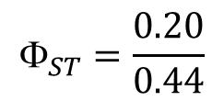
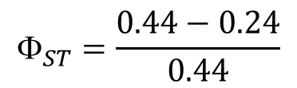
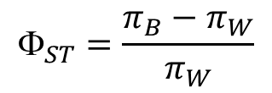



Calculating F_{st} from sequence data: Φ_{ST} (Phi-ST)
$${\text{F}}_{ST}=\frac{π_{B}−π_{W}}{π_{W}}$$
$π_{B}$ = the average number (or proportion) of nucleotide differences between populations (divergence)
$π_{W}$ = the average number (or proportion) of nucleotide differences within subpopulations (nucleotide diversity)
Pop1 Pop2
28 50
22 0
…GCTGTGGGCAAGAAGGCAGATTGAGCCCCGTGTACGCTGC… allele A
…GCTGTGGGCAAGGAGGCAGATTGAGCCCCGTGTACGCTGC… allele B
$$π_{B}=0.44$$
$${\text{F}}_{ST}=\frac{0.44−0.24}{0.44}$$
45.5% of the total variation is explained by differences in allele frequencies between populations.
Strong population structure.
$\overline{π_{W}}$ = 0.24
$${\text{F}}_{ST}=\frac{0.20}{0.44}$$
$${\text{F}}_{ST}=0.455$$

Slide 15
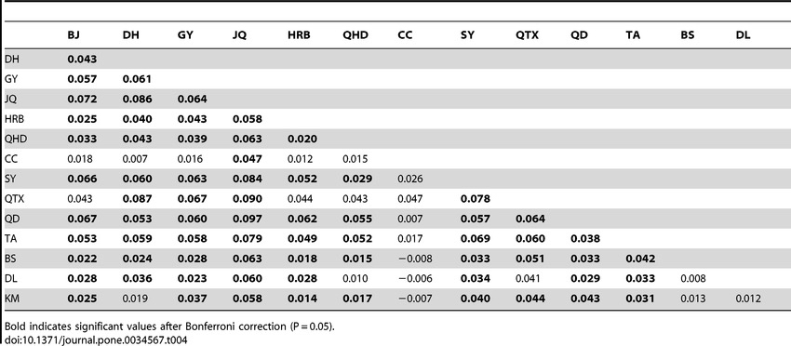
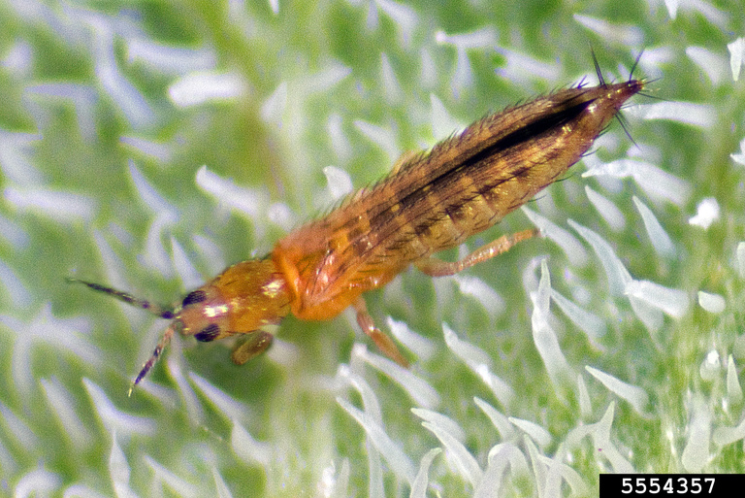
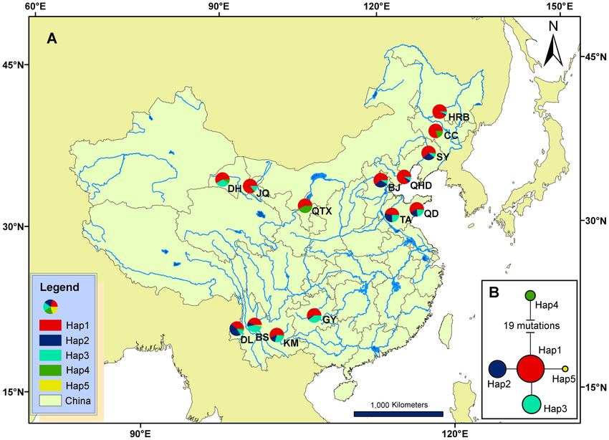
Pairwise F_{ST} for microsatellite loci among 13 localities in China
Invasion Genetics of the Western Flower Thrips in China: Evidence for Genetic Bottleneck, Hybridization and Bridgehead Effect
Xian-Ming Yang,
Jing-Tao Sun,
Xiao-Feng Xue,
Jin-Bo Li,
Xiao-Yue Hong
Published: April 3, 2012
https://doi.org/10.1371/journal.pone.0034567

Slide 16
Analysis of Molecular Variance (AMOVA)
Tests for hierarchical population subdivision.
*Proportion of genetic diversity is partitioned among groups vs. among subpopulations within groups
Population 1
Population 2
A
B
Among groups
Ф_{ct}
D
E
C
F
Among subpopulations within regions
Ф_{sc}
Among subpopulations within regions
Ф_{sc}
= sample sites

Slide 17
Part II—Subdivision and Migration
Learning Outcomes
Calculate the expected changes in allele frequencies resulting from migration.
Describe how migration rates and genetic drift interact in changing allele frequencies over time.
Describe various migration models.
Explain isolation-by-distance.
Calculate F_{ST}/(1 - F_{ST}), and explain why we use it.

Slide 18
Population Subdivision for Two Populations
2N_{e}μ
Genetic variation; Allele or genotype frequencies
Mutation
Genetic Drift
Migration
2N_{e}μ
Genetic variation; Allele or genotype frequencies
Mutation
Genetic Drift
Migration: movement of individuals between populations with subsequent breeding (i.e., gene flow caused by recruitment into the gene pool, not migration in the sense of seasonal movements)

Slide 19
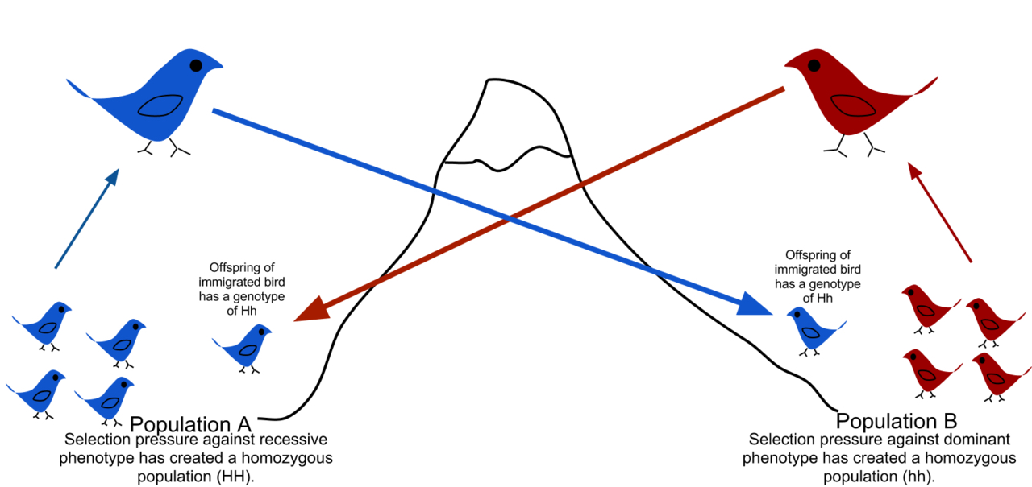
Gene flow is the transfer of alleles from one population to another.
Transfer of h allele
Transfer of H allele
Alleles are maladapted to
the opposite “non-native”
environment.
Each population has low frequency of heterozygotes due to immigrants backcrossing to other population.

Slide 20
The Wright-Fisher Model with Migration
Assumes two populations of constant size, N
Models changes in allele frequencies into future generations (forward in time)
  Occasionally, an individual from one population is replaced by an individual from another population
  m_{1→2} is the probability that an individual from population 1 migrates to population 2.
  m_{2→1} is the probability that an individual from population 2 migrates to population 1.
Migration causes allele frequencies to become more similar between populations.
  Reduces F_{st}

Slide 21
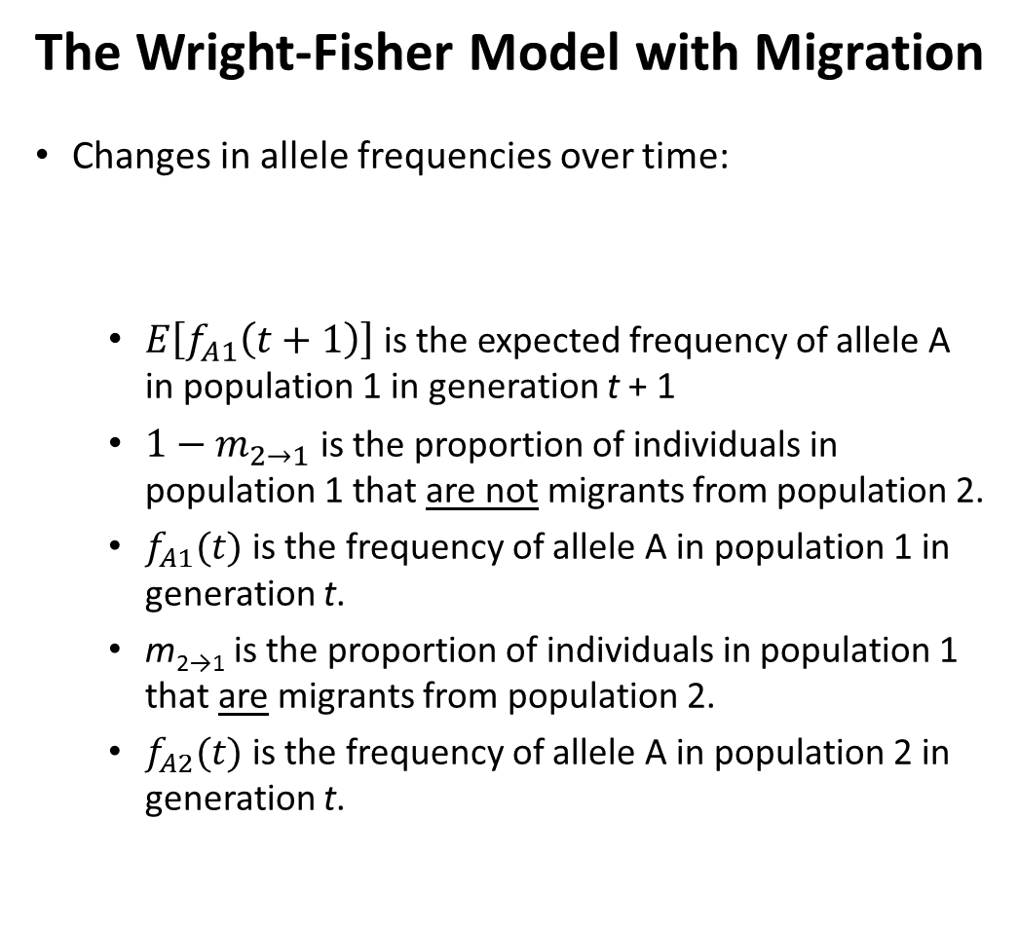
The Wright-Fisher Model with Migration
Changes in allele frequencies over time:
  $E\left[f_{A1}\left(t+1\right)\right]$ is the expected frequency of allele A in population 1 in generation t + 1
  $1−m_{2→1}$ is the proportion of individuals in population 1 that are not migrants from population 2.
  $f_{A1}(t)$ is the frequency of allele A in population 1 in generation t.
  m_{2→1} is the proportion of individuals in population 1 that are migrants from population 2.
  $f_{A2}(t)$ is the frequency of allele A in population 2 in generation t.
$E\left[f_{A1}\left(t+1\right)\right]=\left(1−m_{2→1}\right)f_{A1}\left(t\right)+$ ${m_{2→1}f}_{A2}\left(t\right)$
$E\left[f_{A2}\left(t+1\right)\right]=\left(1−m_{1→2}\right)f_{A2}\left(t\right)+$ ${m_{1→2}f}_{A1}\left(t\right)$

Slide 22
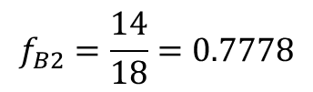

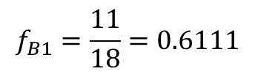


The Wright-Fisher Model with Migration
$E\left[f_{A1}\left(t+1\right)\right]=\left(1−m_{2→1}\right)f_{A1}\left(t\right)+$ ${m_{2→1}f}_{A2}\left(t\right)$
$E\left[f_{A2}\left(t+1\right)\right]=\left(1−m_{1→2}\right)f_{A2}\left(t\right)+$ ${m_{1→2}f}_{A1}\left(t\right)$
0.1111
  m_{2→1} = m_{1→2} = $\frac{2}{18}$ = 0.1111
    Equal migration rates in each direction (symmetrical migration)
    11.11% of individuals in population 1 are migrants from population 2 each generation
    Equivalent to 1 diploid migrant per generation in our model
  $f_{A1}\left(t\right)=f_{R1}=0.3889$, which is the frequency of the red allele in population 1 in generation t.
  $f_{A2}\left(t\right)=f_{R2}=0.2222$, which is the frequency of the red allele in population 2 in generation t.
0.1111
$f_{R1}=\frac{7}{18}$ = 0.3889
$f_{R2}=\frac{4}{18}$ = 0.2222
$$f_{B1}=\frac{11}{18}=0.6111$$
$$f_{B2}=\frac{14}{18}=0.7778$$

Slide 23



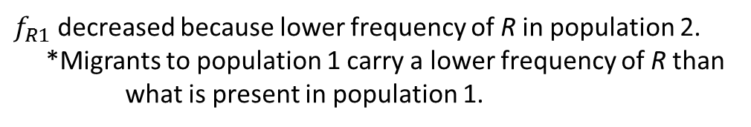


The Wright-Fisher Model with Migration
$E\left[f_{A1}\left(t+1\right)\right]=\left(1−m_{2→1}\right)f_{A1}\left(t\right)+$ ${m_{2→1}f}_{A2}\left(t\right)$
$E\left[f_{R1}\left(t+1\right)\right]=\left(1−m_{2→1}\right)f_{R1}\left(t\right)+$ ${m_{2→1}f}_{R2}\left(t\right)$
$E\left[f_{R1}\left(t+1\right)\right]=\left(1−0.1111\right)(0.3889)+$ $(0.1111)(0.2222)$
0.1111
$E\left[f_{R1}\left(t+1\right)\right]=\left(0.8889\right)(0.3889)+$ $(0.1111)(0.2222)$
$E\left[f_{R1}\left(t+1\right)\right]=(\text{0.345}7)+$ $(0.0247)$
$$E\left[f_{R1}\left(t+1\right)\right]=\text{0.370}4$$
0.1111
$f_{R1}$ decreased because lower frequency of R in population 2.
*Migrants to population 1 carry a lower frequency of R than what is present in population 1.
$f_{R1}=\frac{7}{18}$ = 0.3889
$f_{R2}=\frac{4}{18}$ = 0.2222
$E\left[f_{R2}\left(t+1\right)\right]=\left(1−m_{1→2}\right)f_{R2}\left(t\right)+$ ${m_{1→2}f}_{R1}\left(t\right)$
$E\left[f_{R2}\left(t+1\right)\right]=\left(1−0.1111\right)\left(0.2222\right)+$ $(0.1111)(0.3889)$
$$f_{B1}=\frac{11}{18}=0.6111$$
$$f_{B2}=\frac{14}{18}=0.7778$$
$E\left[f_{R2}\left(t+1\right)\right]=\left(0.1975\right)+$ $(0.0432)$
$$E\left[f_{R2}\left(t+1\right)\right]=0.2407$$
$f_{R2}$ increased because migrants to population 2 carry a higher frequency of R than what is present in population 2.

Slide 24








The Wright-Fisher Model with Migration
What will the allele frequencies be in generation t + 2?
$E\left[f_{R1}\left(t+2\right)\right]=\left(1−m_{2→1}\right)f_{R1}\left(t+1\right)+$ ${m_{2→1}f}_{R2}\left(t+1\right)$
A recursive formula always uses the preceding term to define the next term of the sequence.
0.1111
$E\left[f_{R1}\left(t+2\right)\right]=\left(1−0.1111\right)(0.3704)+$ $(0.1111)(0.2407)$
$E\left[f_{R1}\left(t+2\right)\right]=\left(0.8889\right)(0.3704)+$ $(0.1111)(0.2407)$
0.1111
$E\left[f_{R1}\left(t+2\right)\right]=(\text{0.3292})+$ $(0.0267)$
$$E\left[f_{R1}\left(t+2\right)\right]=\text{0.3559}$$
$f_{R1}$ continues to decrease.
$$E\left[f_{R1}\left(t+1\right)\right]=\text{0.370}4$$
$E\left[f_{R2}\left(t+2\right)\right]=\left(1−m_{1→2}\right)f_{R2}\left(t+1\right)+$ ${m_{1→2}f}_{R1}\left(t+1\right)$
$$E\left[f_{R2}\left(t+1\right)\right]=0.2407$$
$E\left[f_{R2}\left(t+2\right)\right]=\left(1−0.1111\right)\left(0.2407\right)+$ $(0.1111)(0.3704)$
$E\left[f_{R2}\left(t+2\right)\right]=\left(0.2140\right)+$ $(0.0411)$
$$E\left[f_{R2}\left(t+2\right)\right]=0.2551$$
$f_{R2}$ continues to increase.

Slide 25
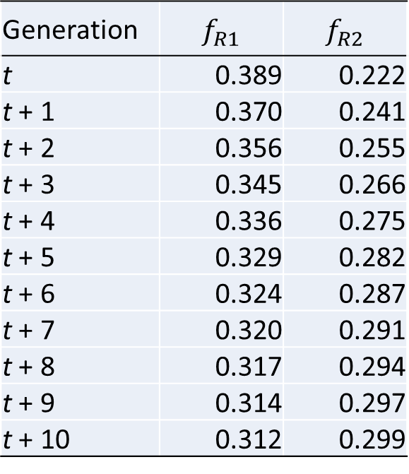
The Wright-Fisher Model with Migration
What will the allele frequencies be in generation t + n?
Generation | $$f_{R1}$$ | $$f_{R2}$$
t | 0.389 | 0.222
t + 1 | 0.370 | 0.241
t + 2 | 0.356 | 0.255
t + 3 | 0.345 | 0.266
t + 4 | 0.336 | 0.275
t + 5 | 0.329 | 0.282
t + 6 | 0.324 | 0.287
t + 7 | 0.320 | 0.291
t + 8 | 0.317 | 0.294
t + 9 | 0.314 | 0.297
t + 10 | 0.312 | 0.299
0.1111
0.1111
Note that I rounded the final values to three decimal places; however, when carrying out the math, I kept all decimal places.

Slide 26
The Wright-Fisher Model with Migration
What will the allele frequencies be in generation t + n?
0.1111
0.1111
Migration homogenizes allele frequencies

Slide 27
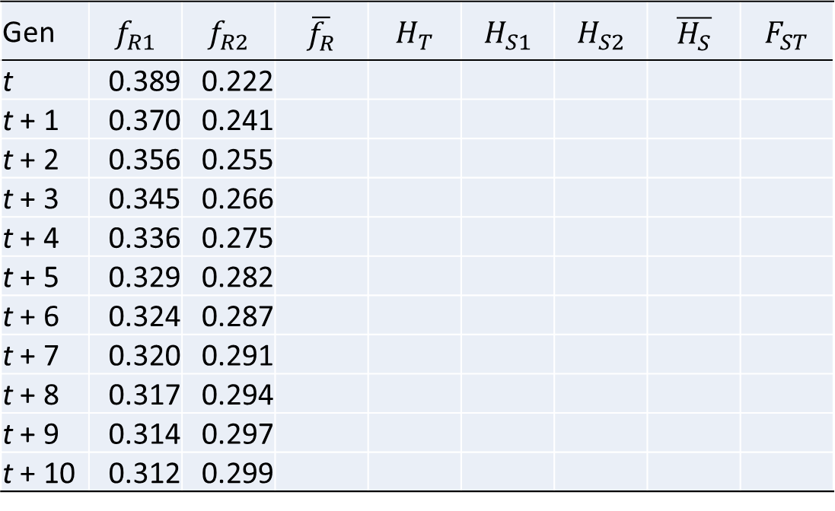
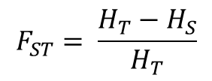
The Wright-Fisher Model with Migration
How will F_{ST} change over time?
$$F_{ST}= \frac{H_{T}−H_{S}}{H_{T}}$$
Gen | $$f_{R1}$$ | $$f_{R2}$$ | $$\overline{f_{R}}$$ | $$H_{T}$$ | $$H_{S1}$$ | $$H_{S2}$$ | $$\overline{H_{S}}$$ | $$F_{ST}$$
t | 0.389 | 0.222
t + 1 | 0.370 | 0.241
t + 2 | 0.356 | 0.255
t + 3 | 0.345 | 0.266
t + 4 | 0.336 | 0.275
t + 5 | 0.329 | 0.282
t + 6 | 0.324 | 0.287
t + 7 | 0.320 | 0.291
t + 8 | 0.317 | 0.294
t + 9 | 0.314 | 0.297
t + 10 | 0.312 | 0.299
0.1111
0.1111
Note that I rounded the final values to three decimal places; however, when carrying out the math, I kept all decimal places.

Slide 28
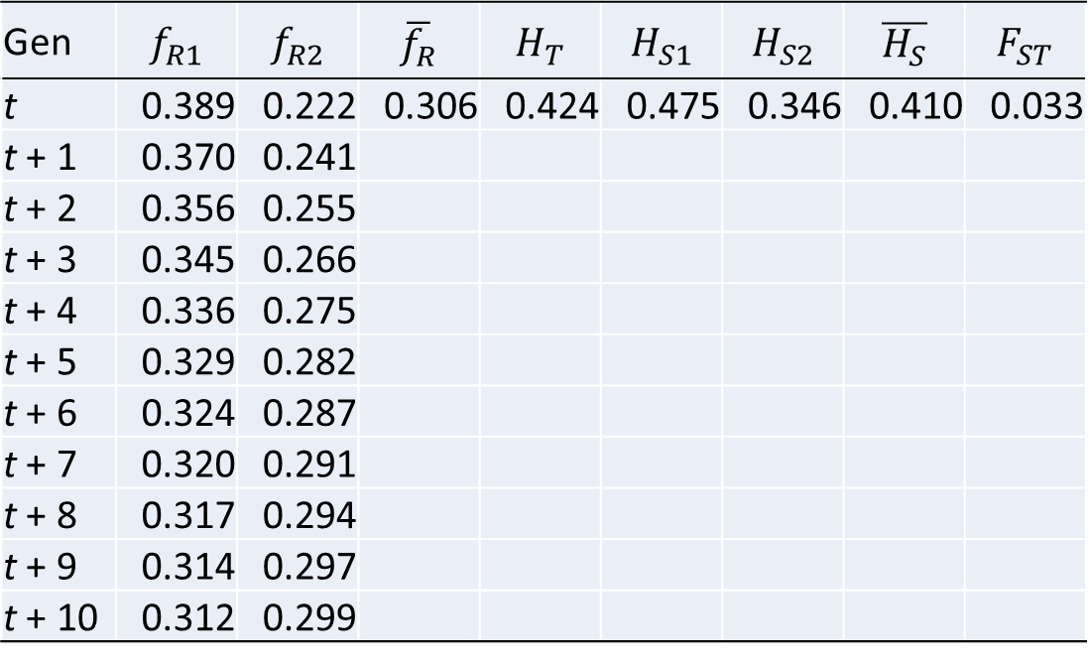
The Wright-Fisher Model with Migration
How will F_{ST} change over time?
$$F_{ST}= \frac{H_{T}−H_{S}}{H_{T}}$$
Gen | $$f_{R1}$$ | $$f_{R2}$$ | $$\overline{f_{R}}$$ | $$H_{T}$$ | $$H_{S1}$$ | $$H_{S2}$$ | $$\overline{H_{S}}$$ | $$F_{ST}$$
t | 0.389 | 0.222 | 0.306 | 0.424 | 0.475 | 0.346 | 0.410 | 0.033
t + 1 | 0.370 | 0.241
t + 2 | 0.356 | 0.255
t + 3 | 0.345 | 0.266
t + 4 | 0.336 | 0.275
t + 5 | 0.329 | 0.282
t + 6 | 0.324 | 0.287
t + 7 | 0.320 | 0.291
t + 8 | 0.317 | 0.294
t + 9 | 0.314 | 0.297
t + 10 | 0.312 | 0.299
0.1111
0.1111
Note that I rounded the final values to three decimal places; however, when carrying out the math, I kept all decimal places.

Slide 29
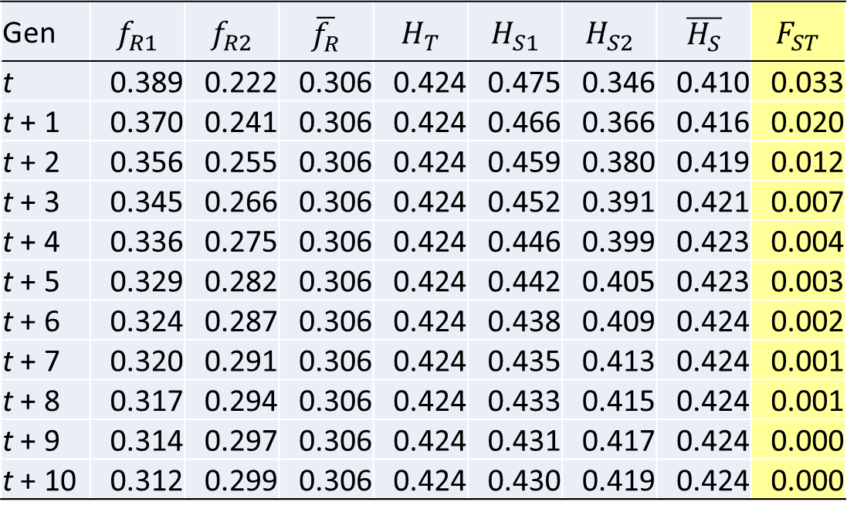
The Wright-Fisher Model with Migration
How will F_{ST} change over time?
$$F_{ST}= \frac{H_{T}−H_{S}}{H_{T}}$$
Gen | $$f_{R1}$$ | $$f_{R2}$$ | $$\overline{f_{R}}$$ | $$H_{T}$$ | $$H_{S1}$$ | $$H_{S2}$$ | $$\overline{H_{S}}$$ | $$F_{ST}$$
t | 0.389 | 0.222 | 0.306 | 0.424 | 0.475 | 0.346 | 0.410 | 0.033
t + 1 | 0.370 | 0.241 | 0.306 | 0.424 | 0.466 | 0.366 | 0.416 | 0.020
t + 2 | 0.356 | 0.255 | 0.306 | 0.424 | 0.459 | 0.380 | 0.419 | 0.012
t + 3 | 0.345 | 0.266 | 0.306 | 0.424 | 0.452 | 0.391 | 0.421 | 0.007
t + 4 | 0.336 | 0.275 | 0.306 | 0.424 | 0.446 | 0.399 | 0.423 | 0.004
t + 5 | 0.329 | 0.282 | 0.306 | 0.424 | 0.442 | 0.405 | 0.423 | 0.003
t + 6 | 0.324 | 0.287 | 0.306 | 0.424 | 0.438 | 0.409 | 0.424 | 0.002
t + 7 | 0.320 | 0.291 | 0.306 | 0.424 | 0.435 | 0.413 | 0.424 | 0.001
t + 8 | 0.317 | 0.294 | 0.306 | 0.424 | 0.433 | 0.415 | 0.424 | 0.001
t + 9 | 0.314 | 0.297 | 0.306 | 0.424 | 0.431 | 0.417 | 0.424 | 0.000
t + 10 | 0.312 | 0.299 | 0.306 | 0.424 | 0.430 | 0.419 | 0.424 | 0.000
0.1111
0.1111
Note that I rounded the final values to three decimal places; however, when carrying out the math, I kept all decimal places.
Migration homogenizes allele frequencies and causes F_{st} to decrease over time.

Slide 30
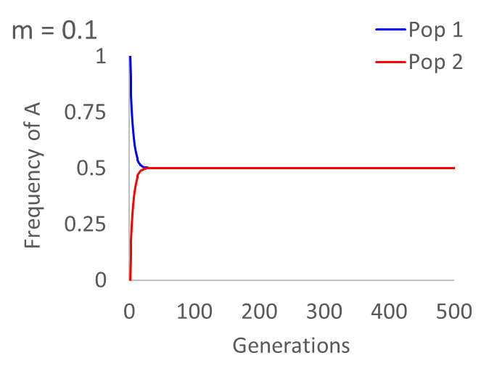
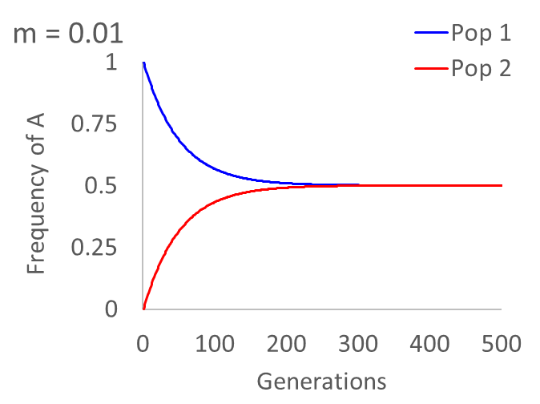
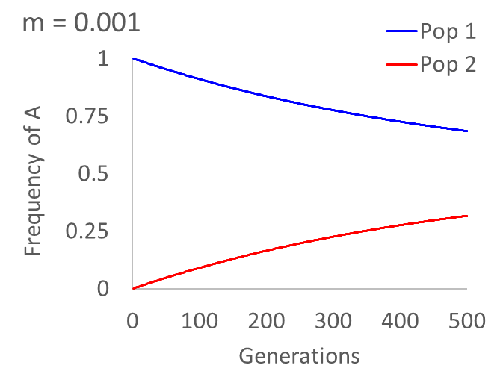
The Wright-Fisher Model with Migration
How do migration rates influence the homogenization of allele frequencies?
The lower the migration rate, the more generations that are required for allele frequencies to become the same.

Slide 31
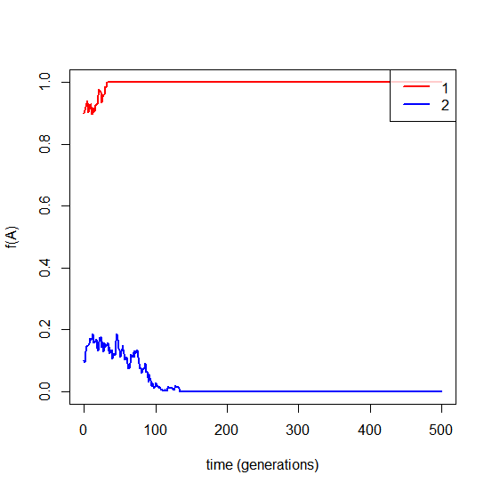
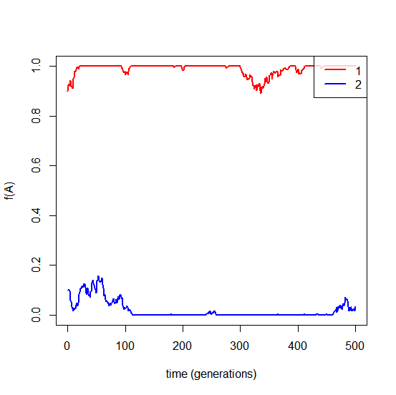
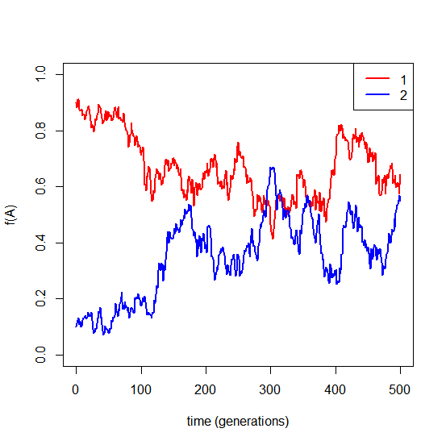
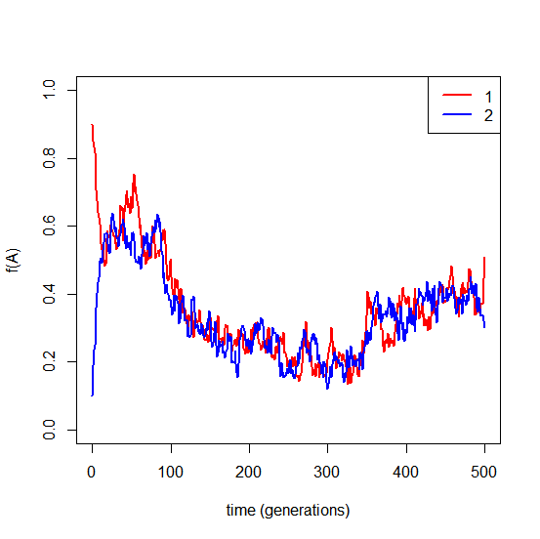
The Wright-Fisher Model with Genetic Drift and Migration
N_{e} = 200, m = 0.0
N_{e} = 200, m = 0.0001
N_{e} = 200, m = 0.005
N_{e} = 200, m = 0.1
No migration: Allele frequencies are independent in the subpopulations.
Low migration: Allele frequencies can drift to fixation, but are reintroduced through migration.
Moderate migration: Allele frequencies are influenced by drift in the other subpopulation.
High migration: Allele frequencies are strongly dependent; behaves as if large effective population size.

Slide 32

Assuming drift-migration equilibrium, it is possible to calculate the number of migrants from F_{st}
Nm is the number of migrants (individuals) per generation;
2Nm is the number of migrant gene copies per generation.
Additional assumptions
Diploid population
Island model of population structure
Mutation follows infinite alleles model (no homoplasy)
No selection
Constant population size
Note: Replace Nm with N_{e}m to get effective number of migrants per generation.

Slide 33
Learning Outcomes
Calculate and interpret d_{XY}.
Describe the influence of population subdivision on coalescence.
Describe the influence of migration on coalescence.
Compare and contrast migration, divergence, and isolation-with-migration coalescence models.

Slide 34
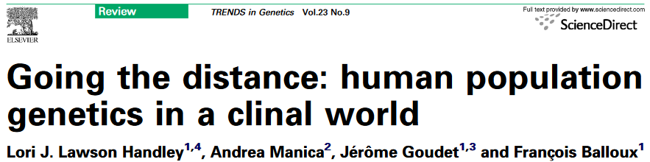
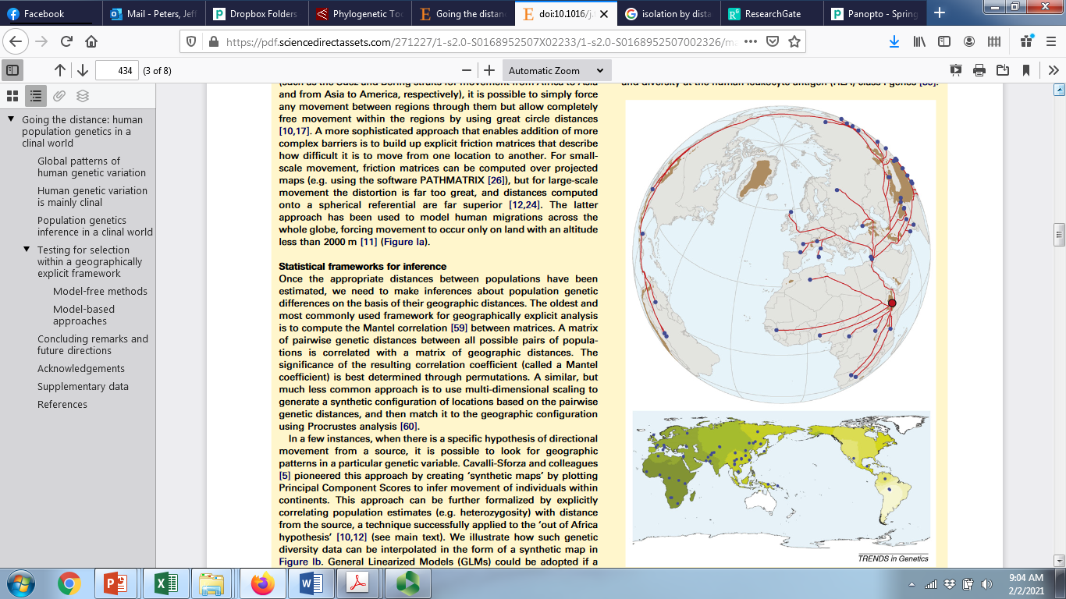
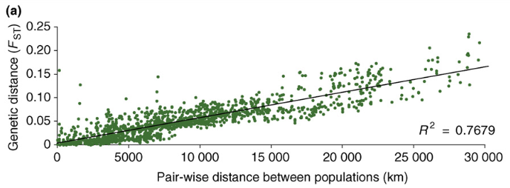
Global colonization routes of humans
Isolation-by-distance: stepping stone models of gene flow or sequential divergence events?

Slide 35

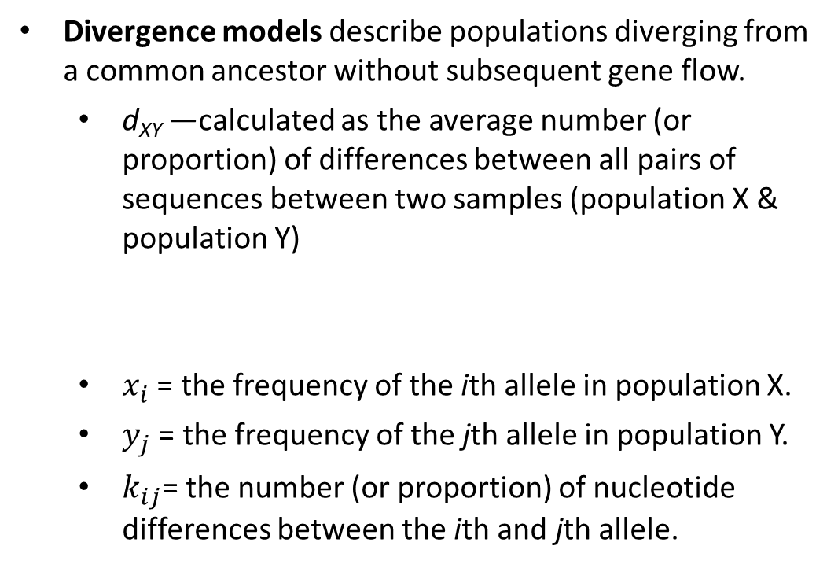
Divergence models
Our migration models assume that populations diverged a long time ago and similarities in allele frequencies are a result of gene flow.
However, recent divergence can result in genetic differences that are similar to those expected from ongoing gene flow.
Divergence models describe populations diverging from a common ancestor without subsequent gene flow.
  d_{XY} —calculated as the average number (or proportion) of differences between all pairs of sequences between two samples (population X & population Y)
  $x_{i}$ = the frequency of the ith allele in population X.
  $y_{j}$ = the frequency of the jth allele in population Y.
  $k_{ij}$= the number (or proportion) of nucleotide differences between the ith and jth allele.
X
Y
X
Y
m
d_{xy}
Recent common ancestor
Old common ancestor
$$d_{XY}=\sum_{ij}{x_{i}y_{j}k_{ij}}$$

Slide 36
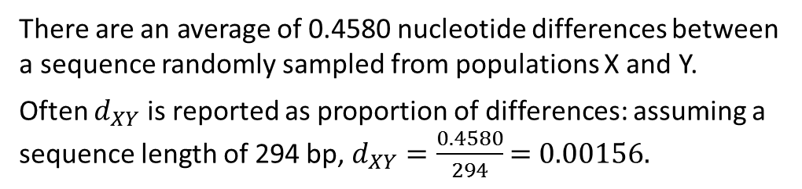
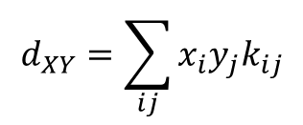

Divergence, d_{XY}
  ${\text{d}\text{XY}= π}_{B}$ = the average number (or proportion) of differences between all pairs of sequences between two samples (population X & population Y)
$$d_{XY}=\sum_{ij}{x_{i}y_{j}k_{ij}}$$
Pop X Pop Y
0.46 0.98
0.42 0.0
0.02 0.0
0.0 0.02
…GCTGTGGGCAAGAAGGCAGATTGAGCCCCGTGTACGCTGC… allele A
…GCTGTGGGCAAGGAGGCAGATTGAGCCCCGTGTACGCTGC… allele B
…GCTGTGGGCAAGAAGGCAGATTGAGCCCTGTGTACGCTGC… allele C
…GCTGTGGGCAAGAAGGCAGATTGAGCCCCGTGTACGCCGC… allele D
$d_{XY}=x_{A}y_{D}k_{AD}+$ $x_{B}y_{A}k_{BA}+x_{B}y_{D}k_{BD}+x_{C}y_{A}k_{CA}+x_{C}y_{D}k_{CD}$
$d_{XY}=(0.46∗0.02∗1)+$ $(0.42∗0.98∗1)+(0.42∗0.02∗2)+(0.02∗0.98∗1)+(0.02∗0.02∗2)$
$d_{XY}=0.0092+$ 0.4116 $+ \text{0.0168}+\text{0.0196}+\text{0.0008}$
$d_{XY}=\text{0.458}$0
There are an average of 0.4580 nucleotide differences between a sequence randomly sampled from populations X and Y.
Often $d_{XY}$ is reported as proportion of differences: assuming a sequence length of 294 bp, $d_{XY}=\frac{0.4580}{294}$ = 0.00156.

Slide 37

Divergence, d_{XY}
Assuming no migration, $d_{XY}=2μt$, where $μ$ is the substitution rate and $t$ is the time since divergence (time that the two populations split from a common ancestral population).
We can calculate $d_{XY}$ from sequence data; if we have an estimate of the substitution rate for the gene(s) sequenced, we can estimate time since divergence ($t=\frac{d_{XY}}{2μ}$)

Slide 38















Mitochondrial DNA divergence in four groups of Holarctic ducks
Peters et al. 2014. Molecular Ecology 23:2961-2974.
*$d_{XY}$ was calculated as the proportion of nucleotide differences between populations.
What is t (time since divergence)?
$$d_{XY}=2μt$$
$μ=4.8×{10}^{−8}$ substitutions/site/year
Green-winged Teal
$$0.086=2×(4.8×{10}^{−8})×t$$
$$t=\frac{0.086}{{9.6×10}^{−8}}$$
$$\frac{substitutions per site}{substitutions per site per year}$$
$t=900,000$ years
$t=27$,000 years
$t=26$0,000 years
$t=360,000$ years
Green-winged Teal
American & Eurasian Wigeon
Mallard
Gadwall

Slide 39




Figure 4.6. The coalescence process in a model with population subdivision
T = time since divergence
Coalescence is independent in each population
$$f_{1}=\frac{1}{2N_{1}}$$
$$f_{2}=\frac{1}{2N_{2}}$$
tMRCA
*For real populations, use N_{e}
Moving back in time, populations merge into a common ancestor of size N_{A}.
$$f=\frac{1}{2N_{A}}$$
Samples from different populations can coalescence only after populations merge.
*Assumes no migration
Notes:
IntroPopGen-Fig-04-06-0.jpg

Slide 40

Figure 4.6. The coalescence process in a model with population subdivision
Applications to real populations
Time can be scaled to the substitution rate (µ) or to the effective population size (2N_{e})
  Define $t=Tμ$ or $t=2N_{e}T$
When we scale to µ, t can be estimated from the proportion of nucleotides that differ between samples from different populations (similar to d_{XY}).
  i.e., between-population coalescence
If we know the genealogy and µ, we can estimate time since divergence (T)
T = time since divergence
tMRCA
*Assumes no migration
Notes:
IntroPopGen-Fig-04-06-0.jpg

Slide 41
Coalescent model with deep population subdivision
Barrier to gene flow
Population 1
Population 2
Present
Time
Time of divergence (T)

Slide 42
Coalescence with recent divergence
Present
Divergence time
Time

Slide 43



Figure 4.3. The coalescence process in a model with migration
Moving back in time, lineages move to the other population with probability, m.
Probability that an individual was not a migrant one generation ago = $1−m$
Probability that an individual was not a migrant r generation ago = ${(1−m)}^{r}$
*Assumes infinite divergence times
Notes:
IntroPopGen-Fig-04-03-0.jpg

Slide 44

Figure 4.3. The coalescence process in a model with migration
Applications to real populations
Migration rates can be scaled to the substitution rate (µ) or to the effective population size (2N_{e})
  Define $M=m/μ$ or $M=2N_{e}m$
  When we scale to µ, M can be estimated from the genealogy as the probability of migration relative to the probability of mutation
*Assumes infinite divergence times
Notes:
IntroPopGen-Fig-04-03-0.jpg

Slide 45

Figure 4.3. The coalescence process in a model with migration
Applications to real populations
We can determine the effective number of migrants ($2N_{e}m$) from coalescence genealogies without knowing the substitution rate
  We simultaneously estimate $θ$ ($4N_{e}μ$) and M ($m/μ$) from the genealogy
    $θ=4N_{e}(m/M)$
    $θM=4N_{e}m$
    $\frac{θM}{2}=2N_{e}m$
    $2N_{e}m$ is the effective number of migrants
*Assumes infinite divergence times
Notes:
IntroPopGen-Fig-04-03-0.jpg

Slide 46

Figure 4.3. The coalescence process in a model with migration
✔
Immigrant
Green-winged Teal
Immigrant
*Assumes infinite divergence times

Slide 47

Figure 4.3. The coalescence process in a model with migration
X
Gadwall
Recent divergence, high migration rates, or both?
*Assumes infinite divergence times

Slide 48


Isolation-with-migration models
Simultaneously estimate 6 parameters, each scaled to the substitution rate:
Procedure (simplified)
Estimate parameters from many genealogies consistent with the data
Examine many combinations of divergence and migration rates
Determine which combinations best fit the data
Best accomplished with many loci to account for the stochastic effects of genetic drift

Slide 49

Isolation-with-migration models
N_{e} = 510,000 individuals
N_{e} = 430,000 individuals
✔
N_{A} = 240,000 individuals
T = 64,000 years ago
2Nm = 0 migrants/generation
2Nm = 18 migrants/generation
Gadwall
Peters, Winker, & McCracken. 2012. PLoS One 7:e319722.

Slide 50
Immigration
2N_{e}m
2N_{e}μ
Genetic variation; Allele or genotype frequencies
Mutation
Genetic Drift
Natural selection
Migration: The influence of gene flow on the genetic diversity of a population depends on 2N_{e}m, which is the effective number of immigrant copies each generation

