Slide 1
07: Population Assignment
BIO 4600/6600
Population Genetics

Slide 2
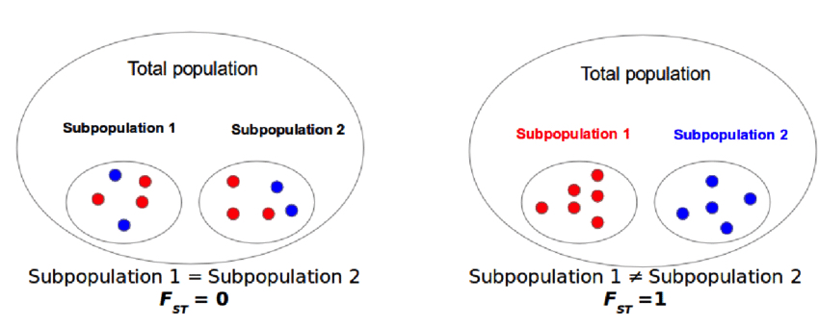

Review: Population subdivision & F_{st}
$$F_{ST}= \frac{H_{T}−H_{S}}{H_{T}}$$
https://www.researchgate.net/figure/Genetic-differentiation-an-example-of-the-behavior-of-fixation-index-FST-If-allele_fig9_306018124

Slide 3
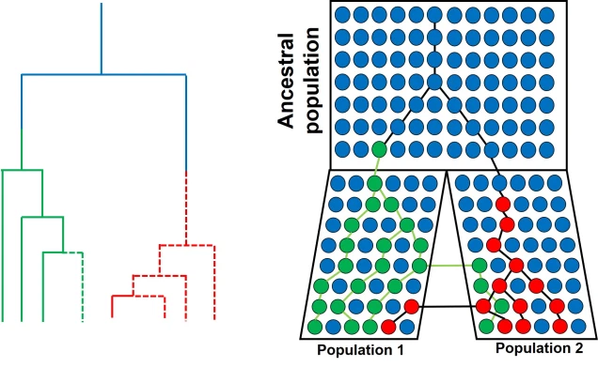
Review: Population subdivision & coalescence
Isolation-with-migration Model
Applying coalescence theory to a subdivided population, can estimate:
  Effective sizes of each subpopulation and the ancestral population,
  Migration rates between populations, and
  Time since divergence.
Calculating F_{st} and applying coalescence theory require prior knowledge on population boundaries.
How many populations?
Which individuals belong to which population?

Slide 4
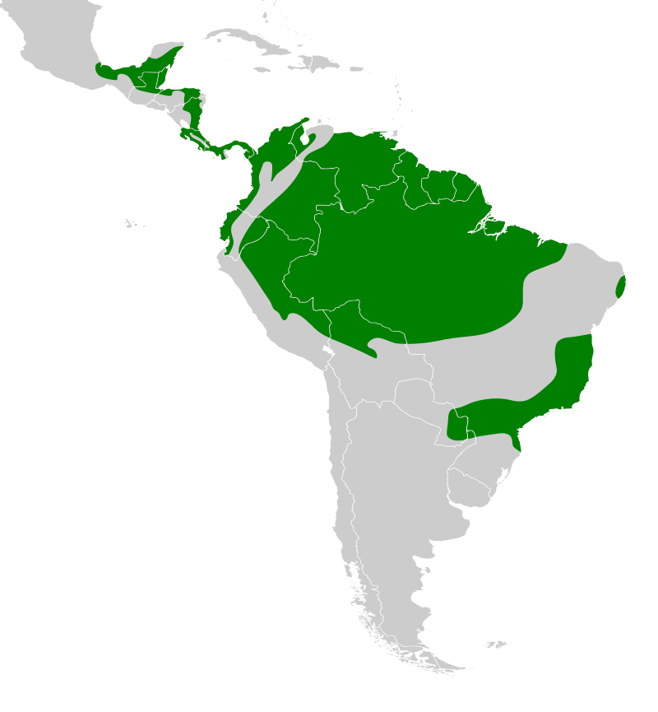

Genomic variation in a widespread Neotropical bird (Xenops minutus) reveals divergence, population expansion, and gene flow
How many populations?
Which individuals belong to which population?

Slide 5
Learning Outcomes
Calculate match probabilities.
Interpret assignment probabilities and discuss the applications of assignment tests.
Describe and Interpret results from principal components analyses.
  Identify population clusters, migrants, and admixed individuals (hybrids).

Slide 6
Match Probabilities
Match probability = f_{i}² for homozygotes, 2f_{i}f_{j} for heterozygotes
Allele frequencies at two loci from two populations
Locus 1: Genotype AA,
Match probability₁ = f_{A}² = 0.9² = 0.81
Match probability₂ = f_{A}² = 0.2² = 0.04
There is an 81% chance of obtaining this genotype from Population 1 and a 4% chance from Population 2
 |  | Population 1 | Population 2
Locus 1 | f_{A} | 0.9 | 0.2
 | f_{B} | 0.1 | 0.8
Locus 2 | f_{Y} | 0.7 | 0.1
 | f_{Z} | 0.3 | 0.9
Locus 2: Genotype YZ,
Match probability₁ = 2f_{Y}f_{Z} = 2*0.7*0.3 = 0.42
Match probability₂ = 2f_{Y}f_{Z} = 2*0.1*0.9 = 0.18
There is an 42% chance of obtaining this genotype from Population 1 and a 18% chance from Population 2
Genotype of unknown individual: AA/YZ
Multiply probabilities to determine probability of the two-locus genotype for each population
Population 1: Pr(AA)*Pr(YZ) = 0.81*0.42 = 0.3402
Population 2: Pr(AA)*Pr(YZ) = 0.04*0.18 = 0.0072
Individual is more likely to be from population 1.
*Used in forensics to determine the probability that a suspect matches DNA found at a crime scene.

Slide 7
Problem:
Without knowing which population individuals belong to, we do not know the allele frequencies
Solution:
  Simultaneously estimate allele frequencies and assign individuals to populations based on their genotypes using Markov chain Monte Carlo (MCMC)

Slide 8
Learning Outcomes
Calculate match probabilities.
Interpret assignment probabilities and discuss the applications of assignment tests.
Describe and interpret results from principal components analyses.
  Identify population clusters, migrants, and admixed individuals (hybrids).

Slide 9
MCMC (oversimplified):
Assume a model of K populations.
Step 1:
  Cluster individuals into K populations either randomly or based on genetic similarity.
  Calculate allele frequencies
  Determine the probability/likelihood of the model given the data
Step 2:
  Move one individual from population i into population j.
  Calculate allele frequencies
  Determine the probability/likelihood of the model given the data
  Compare probability/likelihood with that from Step 1.
  If worse fit, move individual back to population i and repeat process.
  If better fit, choose another individual to move.
Steps 3+:
  Repeat step 2 over millions of iterations.
  Determine optimal K by comparing models (e.g., K = 1–10 populations)
    Calculate the likelihood of the data given K

Slide 10
Assignment Probabilities
The amount of time individuals spend in each population becomes the assignment probability.
  Individual 1—99.9% Population 1
  Individual 2—50% Pop 1, 50% Pop 2
    Admixed Individual (hybrid)
    Insufficient data???
  Individual 3—99.9% Population 2
Assumptions
  Diploid organisms
  Random mating
  Hardy-Weinberg equilibrium within populations
  Multiple, independent loci (they are not closely linked on the same chromosome)

Slide 11
Applications
Identifying population boundaries & assigning individuals to populations
Studying hybrid zones
Identifying migrants and admixed individuals.

Slide 12
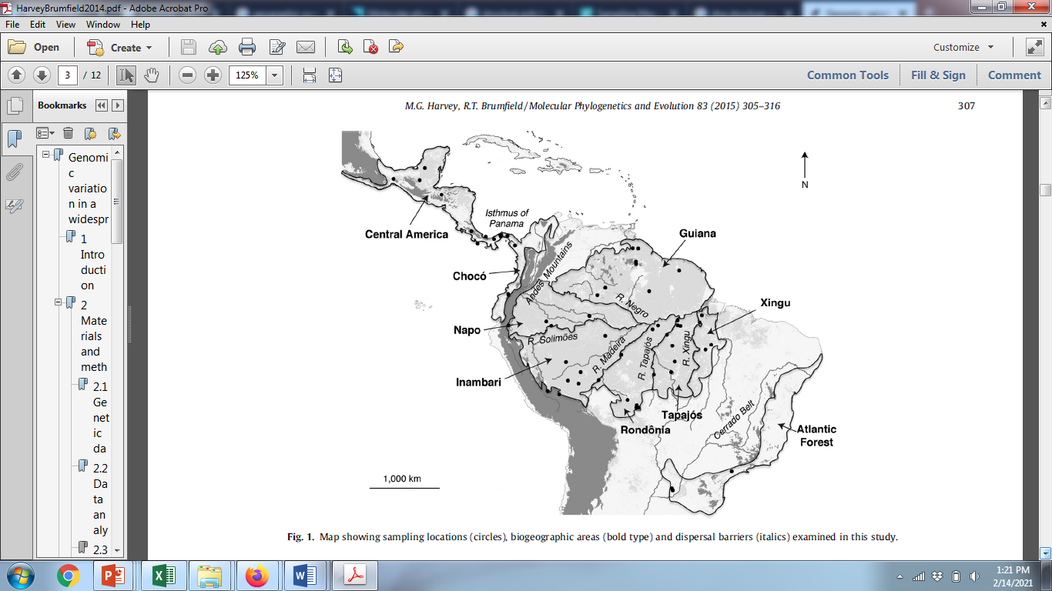
Genomic variation in a widespread Neotropical bird (Xenops minutus) reveals divergence, population expansion, and gene flow
Identifying population boundaries & assigning individuals to populations

Slide 13
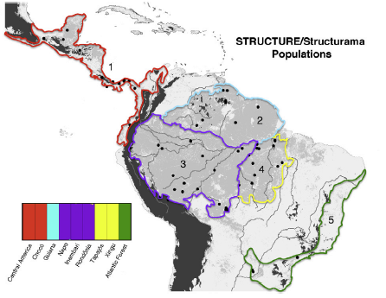
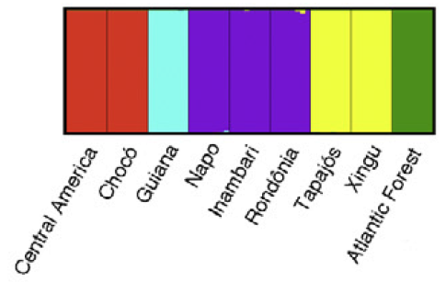
Genomic variation in a widespread Neotropical bird (Xenops minutus) reveals divergence, population expansion, and gene flow
Identifying population boundaries & assigning individuals to populations

Slide 14
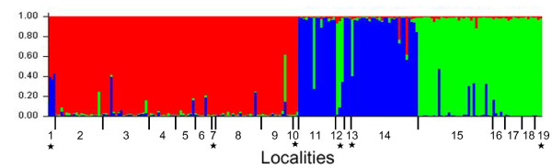
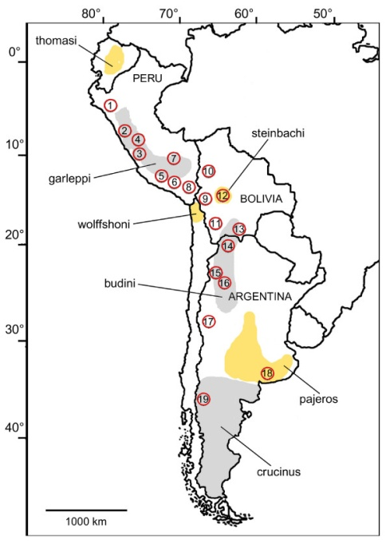
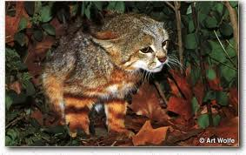
Identifying population boundaries & assigning individuals to populations
Assignments based on 5 microsatellite loci
Assignment probability
Pampas cat (Leopardus colocolo)
Cossíos et al. 2009. BMC Evolutionary Biology 2009, 9:68

Slide 15
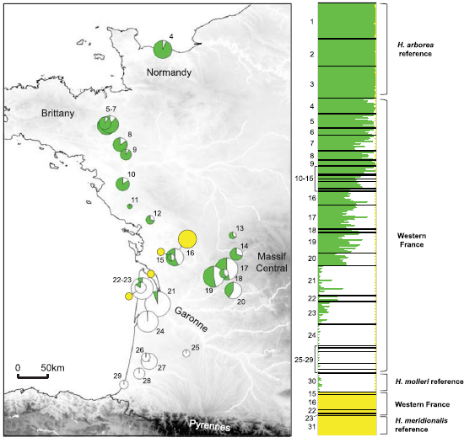
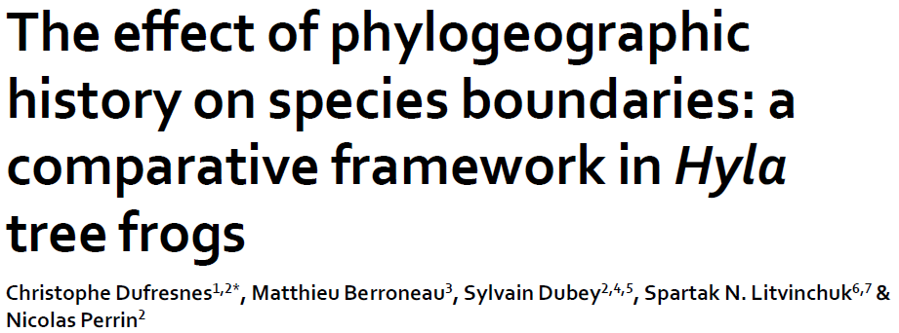
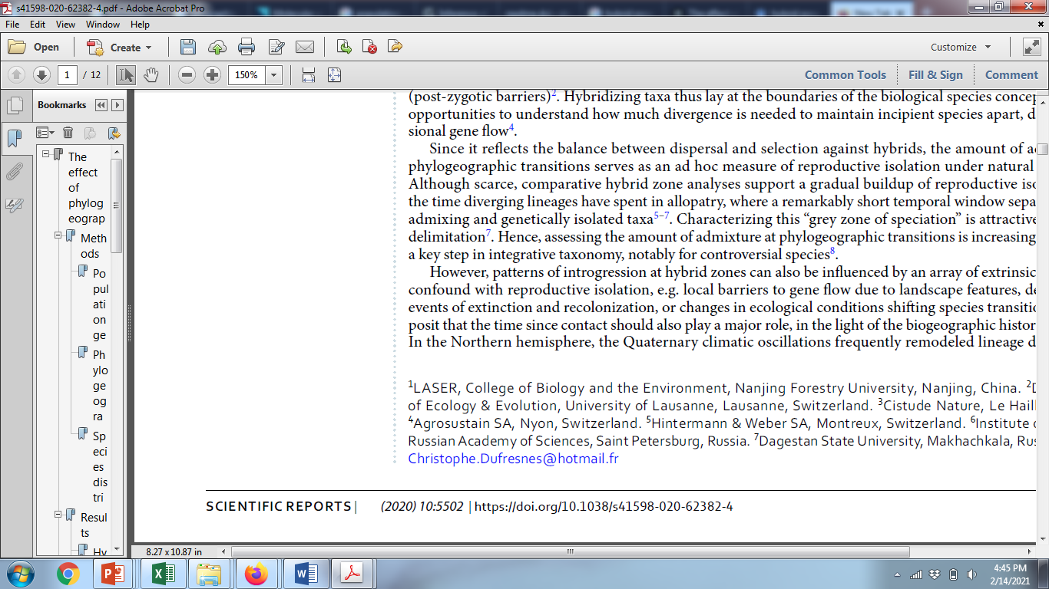
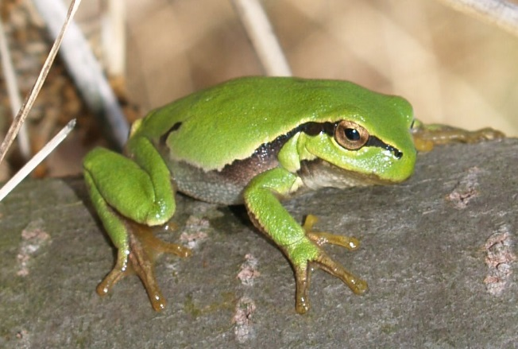
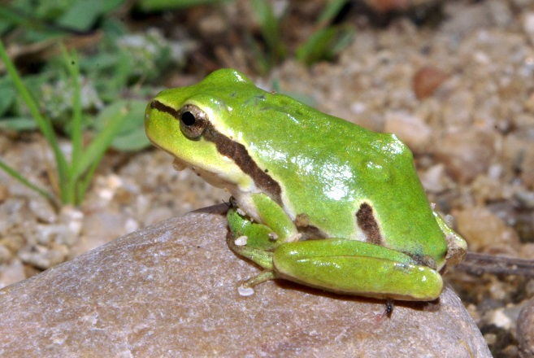
Studying hybrid zones
Hybrid zone
Hyla arborea
Hyla molleri
Assignment based on 26 microsatellite loci

Slide 16
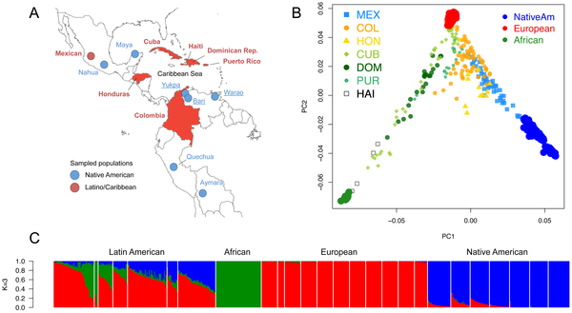
Identifying migrants and admixed individuals
Figure 1. Population structure of Caribbean and neighboring populations of humans.
Moreno-Estrada A, Gravel S, Zakharia F, McCauley JL, et al. (2013) Reconstructing the Population Genetic History of the Caribbean. PLoS Genet 9(11): e1003925.

Slide 17
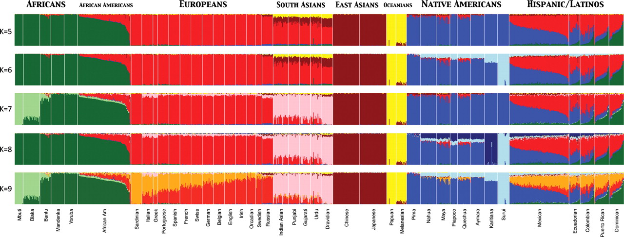
Assignment Tests to Study Structure of Worldwide Human Populations
Used ADMIXTURE clustering algorithm to infer genomic assignments/ individual
K = number of assumed populations (K = 5-9)
73,901 autosomal SNP markers & 1,112 individuals from 42 global pops
Henn B M et al. Hum. Mol. Genet. 2010;19:R221-R226

Slide 18
Learning Outcomes
Calculate match probabilities.
Interpret assignment probabilities and discuss the applications of assignment tests.
Describe and interpret results from principal components analyses.
  Identify population clusters, migrants, and admixed individuals (hybrids).

Slide 19
Principal Components Analysis (PCA)
An exploratory technique used to reduce a large number of variables in a data set to fewer variables that still contain the information
  Variables in a data set are often highly correlated.
  PCA identifies correlations among variables in a data set and creates new variables that capture that information.
  The new variables, called principal components (PCs) or eigenvalues, are uncorrelated.
Can be used to:
  Find patterns in high-dimensional data
  Visualize data of high dimensionality
Population genetics applications
  Detect population structure using genomic data (large number of loci sequenced from the genome)
  Identify admixed individuals

Slide 20

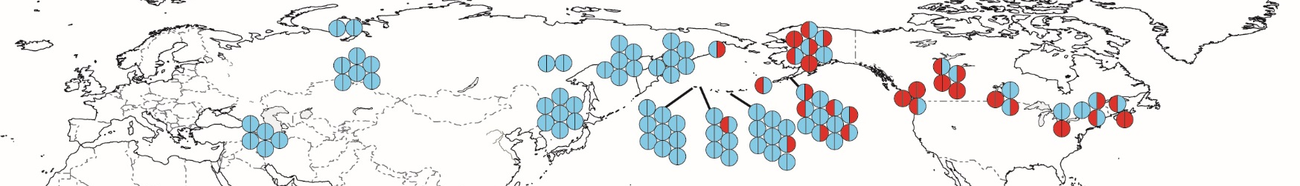
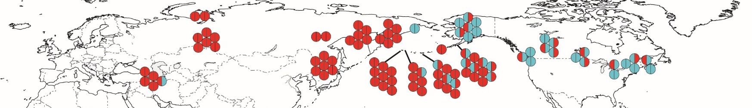
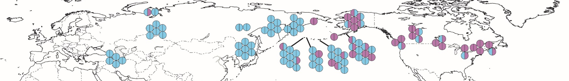
Three strongly correlated SNPs in Green-winged Teal
C
T
C
T
C
G
Over-simplification: PCA creates a single variable that captures the variability in these three SNPs (and other similarly correlated SNPs)

Slide 21
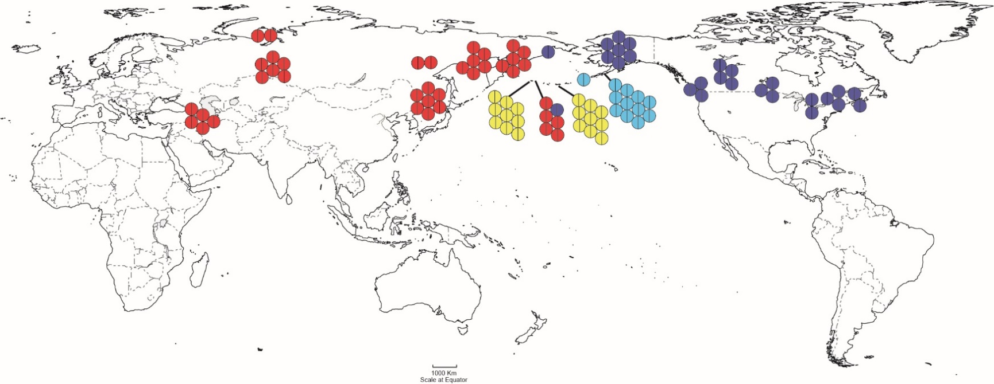
Principal Component Analysis of 3,448 loci in Green-winged Teal
Migrants
PCA clusters mapped over geography
Admixed
PC1 and PC2 capture 2.4% and 2.0% of variability in the data set, respectively.
Clusters individuals with similar genotypes.

Slide 22
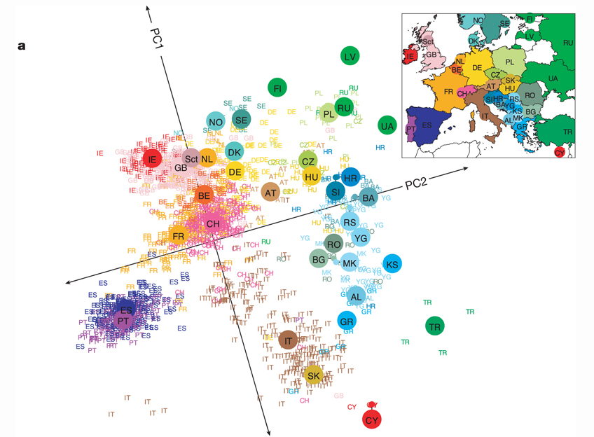
Applications: detect population structure using genomic data
Population structure within Europe
Note the pattern of isolation-by-distance
  Populations that cluster geographically also cluster genetically
  PC1 separates populations along a north-south gradient.
  PC2 separates populations along an east-west gradient.
Novembre et al. (2008) Nature 456, 98-101

Slide 23
Identifying migrants and admixed individuals
Figure 1. Population structure of Caribbean and neighboring populations of humans.
Moreno-Estrada A, Gravel S, Zakharia F, McCauley JL, et al. (2013) Reconstructing the Population Genetic History of the Caribbean. PLoS Genet 9(11): e1003925.

Slide 24
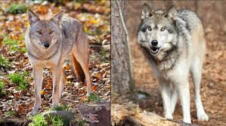
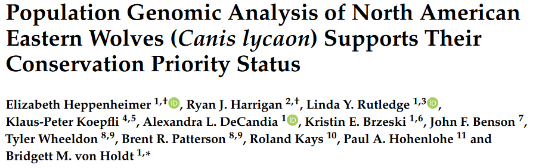
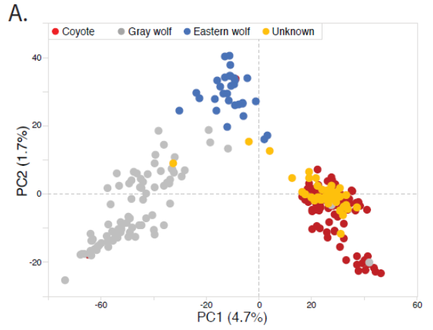
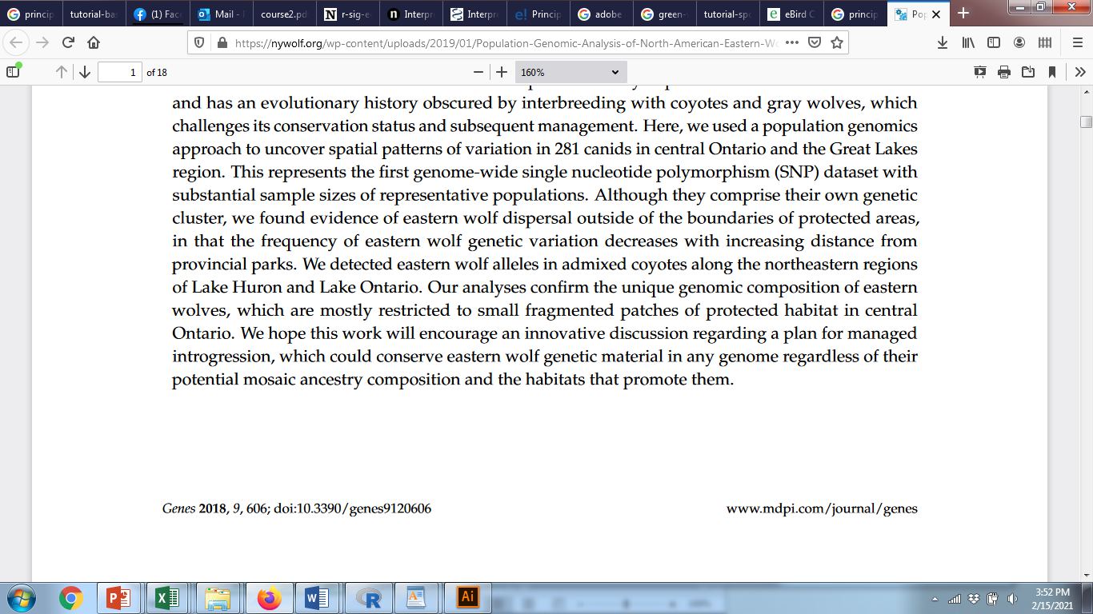
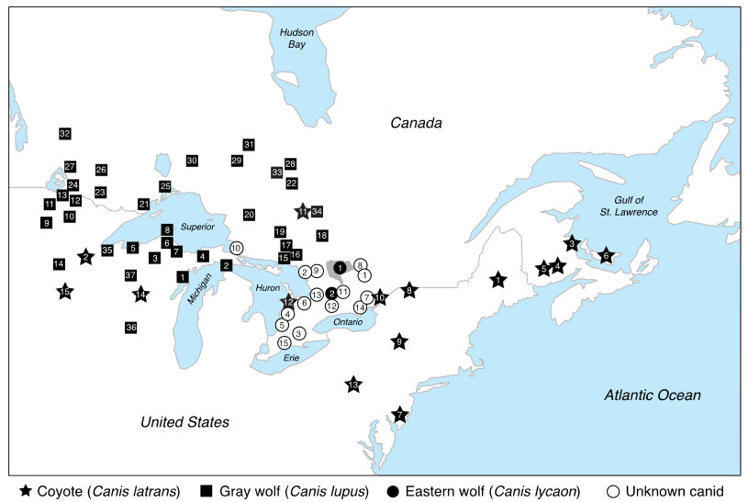
Identifying unknown individuals
Two clusters of wolves
Possible hybrids
Most “unknowns” clustered with coyotes
Examined 16,587 SNPs for 304 canid samples

