Slide 1
08.5: Islands of Divergence
BIO 4600/6600
Population Genetics

Slide 2
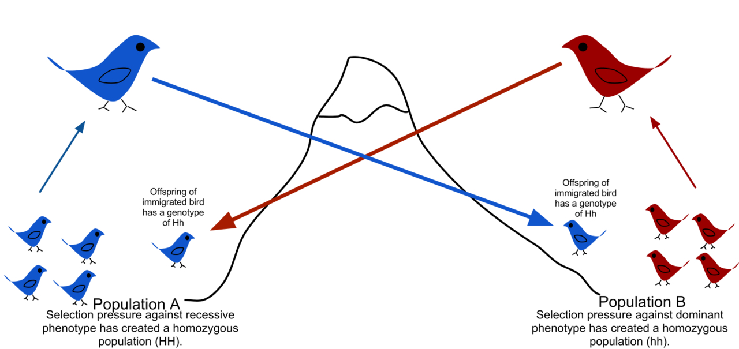
Review: Gene flow is the transfer of alleles from one population to another.
Transfer of h allele
Transfer of H allele
What if alleles are maladapted to the opposite “non-native” environment?
Recessive h can persist at low frequencies
Each population has low frequency of heterozygotes due to immigrants backcrossing to other population.
Selection removes maladapted immigrant alleles from each population.

Slide 3
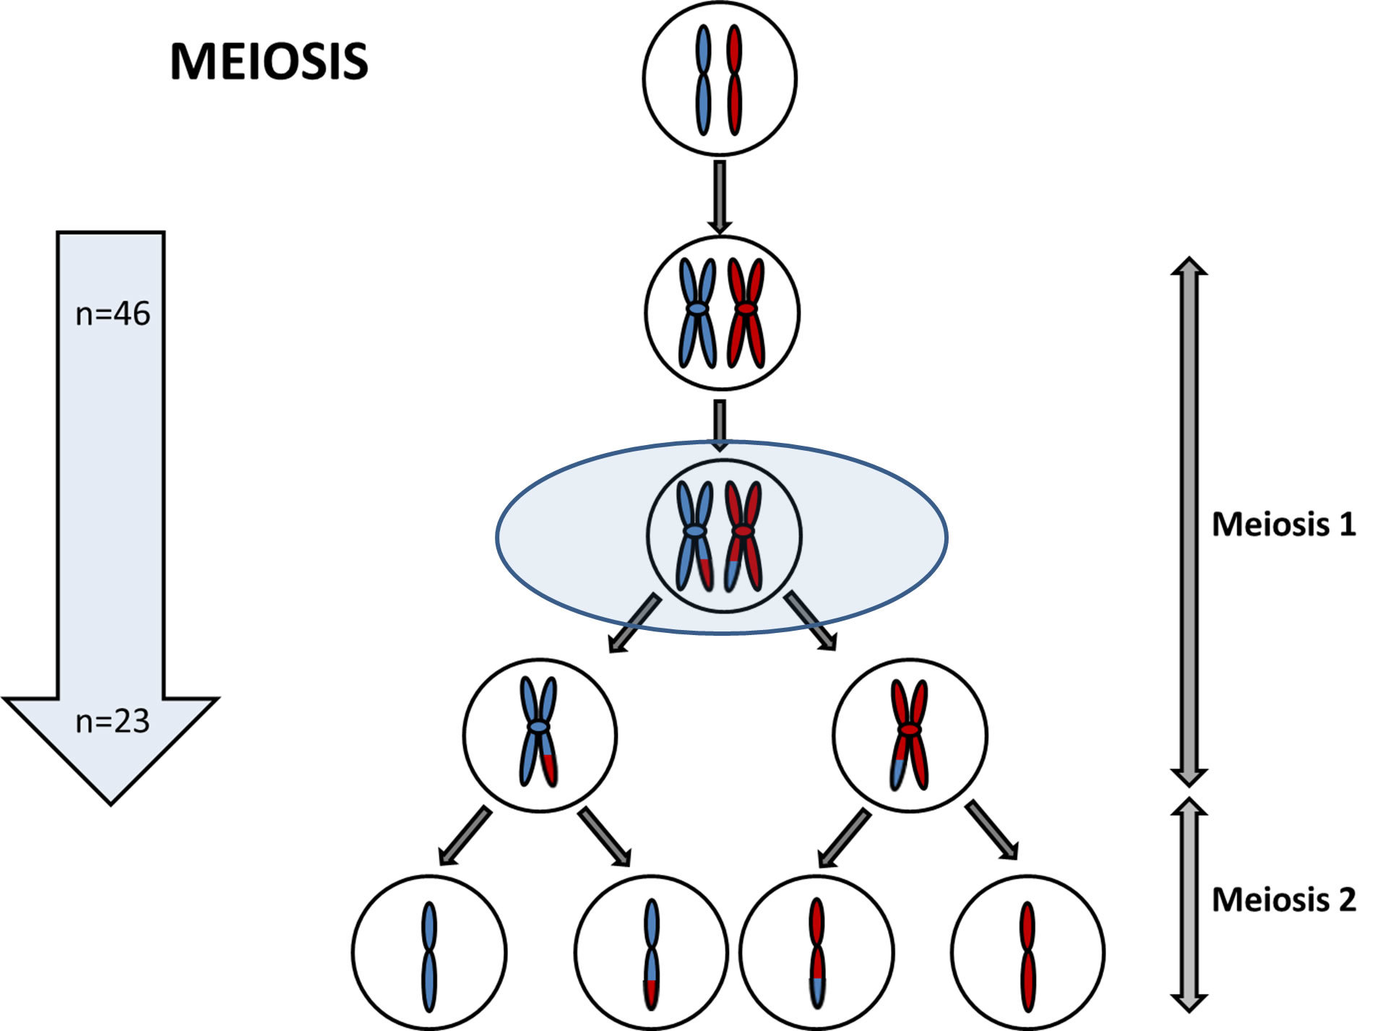

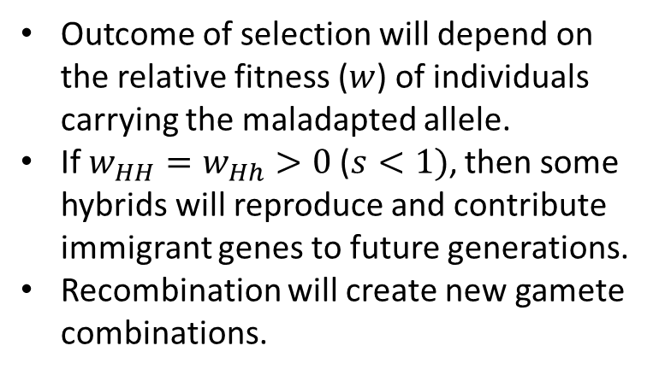






Selection & migration
$$0<s_{HH}<1$$
H
H
h
h
$$s_{hh}=0$$
Hybrid
offspring:
H
h
h
h
$$0<s_{Hh}<1$$
Recombination
Gametes:
H
h
H
h
h
Outcome of selection will depend on the relative fitness ($w$) of individuals carrying the maladapted allele.
If $w_{HH}=w_{Hh}>0$ ($s<1)$, then some hybrids will reproduce and contribute immigrant genes to future generations.
Recombination will create new gamete combinations.
Escaped selection
F2 offspring:
H
h
h
h
H
h
h
h
$$0<s_{Hh}<1$$
$$s_{hh}=0$$
$$0<s_{Hh}<1$$
$$s_{hh}=0$$

Slide 4




Selection & migration
Many generations backcrossing, recombination, genetic drift, and selection, will result in heterogeneous genomes.
The proportion of introgressed “blue” genes in the “red” population will depend on distance from “H” and the strength of selection against “H”.
  Introgression—the transfer of genetic information from one species to another as a result of hybridization and repeated backcrossing
F2 offspring:
H
h
h
h
H
h
h
h
$$0<s_{Hh}<1$$
$$s_{hh}=0$$
$$0<s_{Hh}<1$$
$$s_{hh}=0$$
Neutral: Drift-migration balance
Selection
Neutral
H

Slide 5
Selection & migration
Selection
Selection creates islands of divergence between hybridizing species.
When comparing species, F_{st} is elevated at loci under selection and closely linked loci (genetic hitchhiking).
Background levels of F_{st} reflect drift-migration equilibrium.
Can result in speciation with gene flow (or perhaps better phrased as “speciation despite gene flow”).
H
Island of divergence

Slide 6
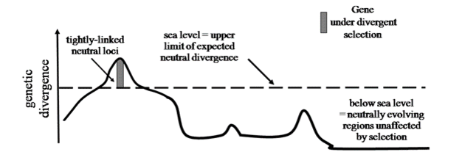
Islands of Divergence
Safran, R. J. & Nosil, P. (2012) Speciation: The Origin of New Species. Nature Education Knowledge 3(10):17

Slide 7
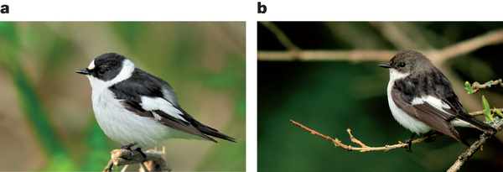
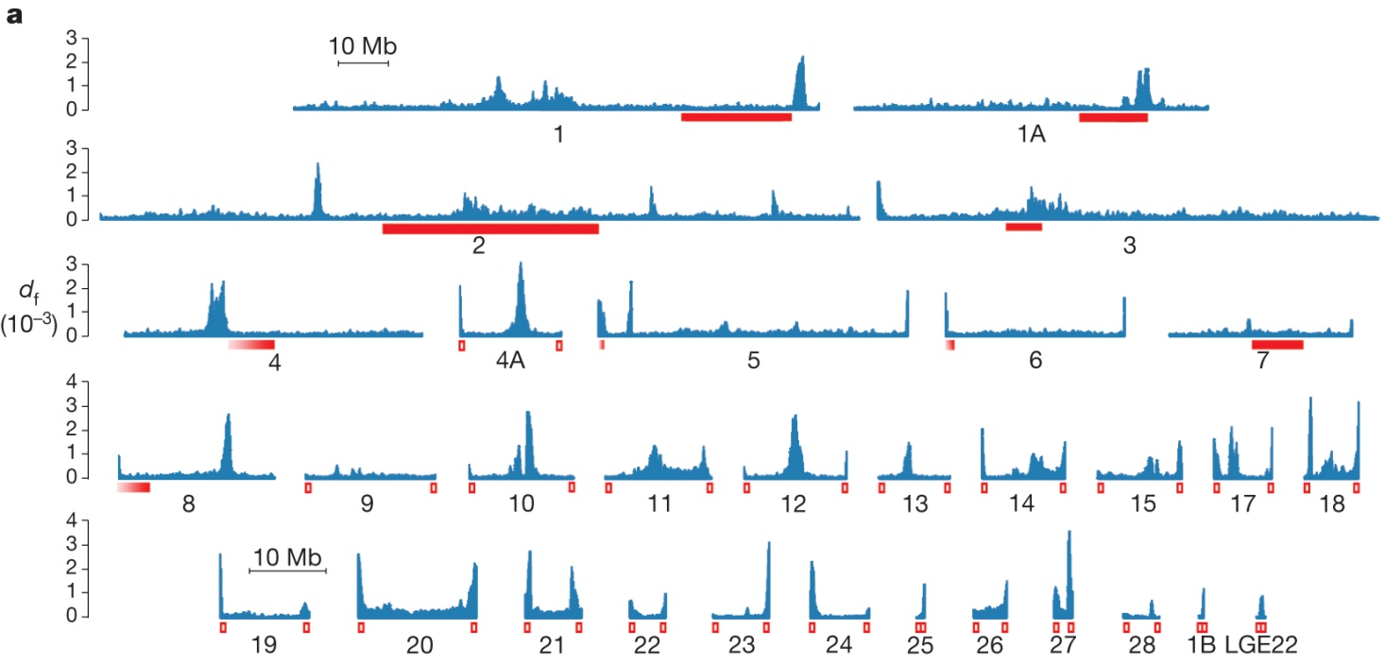

Islands of Divergence in Ficedula flycatchers
Islands of divergence = Peaks indicate regions of the genome subjected to selection and restricted gene flow.
Ellegren et al. 2012. The genomic landscape of species divergence in Ficedula flycatchers. Nature, 491:756-760.

