Slide 1
10: Population History and Demography
Population Genomics
Medellin, Colombia

Slide 2
Part I—Population Demography
Learning Outcomes
Define Population History.
Describe the expected variance in population genetics statistics.
Distinguish between species trees and gene trees.
Explain the influence of ancestral variation (and ancestral population sizes) on time of coalescence events between populations.

Slide 3

Population History—the study of changes in the size and structure of populations in the past
  How geography, climate, or other environmental factors contributed to those changes.
  Used interchangeably with population demography
Population History
Immigration
2N_{e}m
2N_{e}μ
Genetic variation; Allele or genotype frequencies
Mutation
Genetic Drift
  Population parameters of interest
    Effective population sizes (Θ = 4N_{e}μ)
    Migration rates (2N_{e}m migrants per generation)
    Divergence times
    Long-term changes in population sizes (population expansions, bottlenecks, etc.)
    Ancestral ranges (e.g., The “Out-of-Africa” hypothesis for humans)

Slide 4
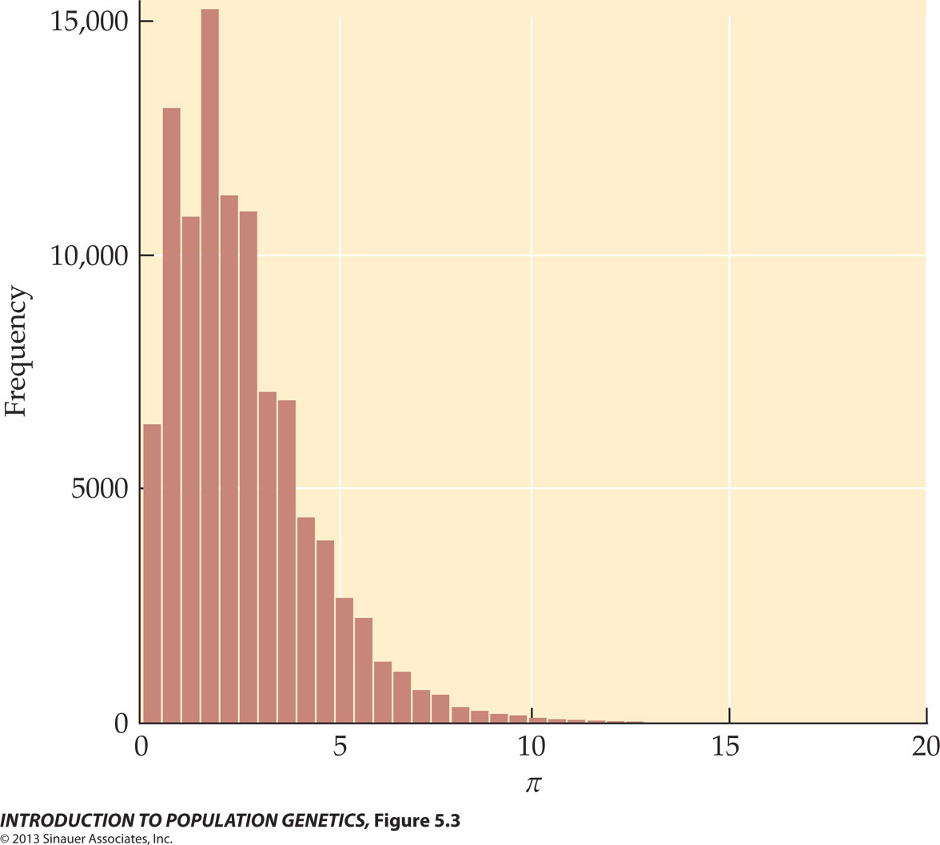
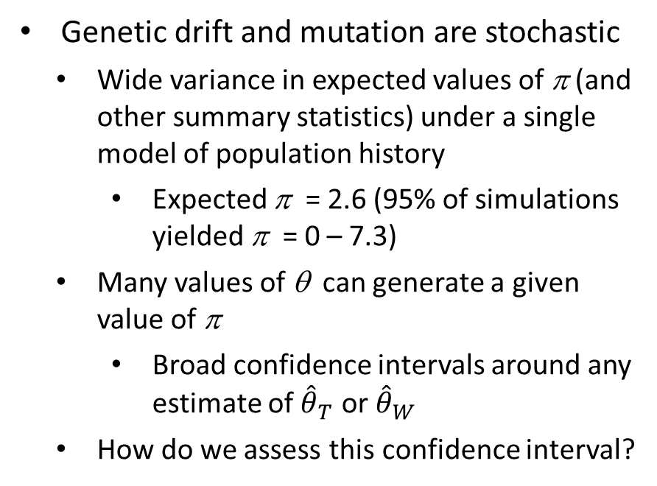
Figure 5.3 Distribution of values of π in 100,000 coalescence simulations under the standard coalescence model θ = 2.6
Genetic drift and mutation are stochastic
  Wide variance in expected values of π (and other summary statistics) under a single model of population history
    Expected π = 2.6 (95% of simulations yielded π = 0 – 7.3)
  Many values of θ can generate a given value of π
    Broad confidence intervals around any estimate of ${\hat{θ}}_{T}$ or ${\hat{θ}}_{W}$
  How do we assess this confidence interval?
(average number of differences)
Notes:
IntroPopGen-Fig-05-03-0.jpg

Slide 5
How do we assess confidence intervals?
Simulate new data under Wright-Fisher or coalescence models
  Advantages of coalescence models
    Only need to simulate the history (i.e., genealogy) of the sample.
      Wright-Fisher requires simulating data for the entire population.
    Can be adapted for complex models of population history that include population subdivision, migration, and changes in population sizes.
Determine the probability of obtaining the empirical data given the models of population history that were simulated.

Slide 6
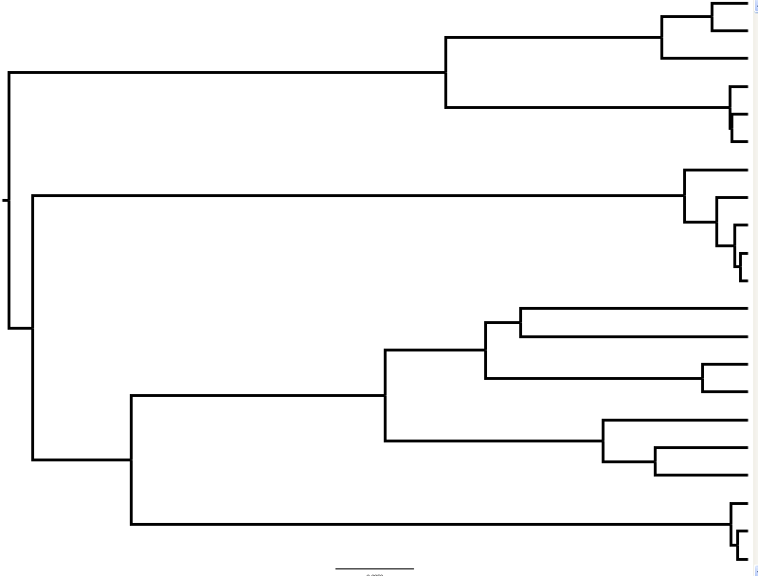
Review: Applying Coalescent Theory to Populations (Over-simplified)
One possible genealogy consistent with the data
Posterior distribution of estimates of Θ
Best estimate
Posterior probability
Consider many genealogies consistent with the data.
  Estimate coalescent depths from each genealogy
  Time to coalescence for two copies = 2N_{e}
  Time scaled to the mutation rate (µ)
Provides “best” estimate of θ
Variance around estimate provides measure of the influence of stochastic variance and uncertainty.
95% HPD
Ө (4N_{e}µ)
Probability of the observed data given θ

Slide 7
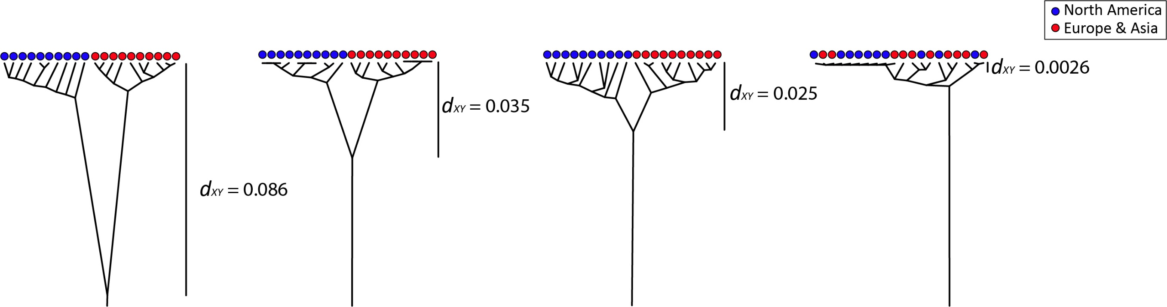

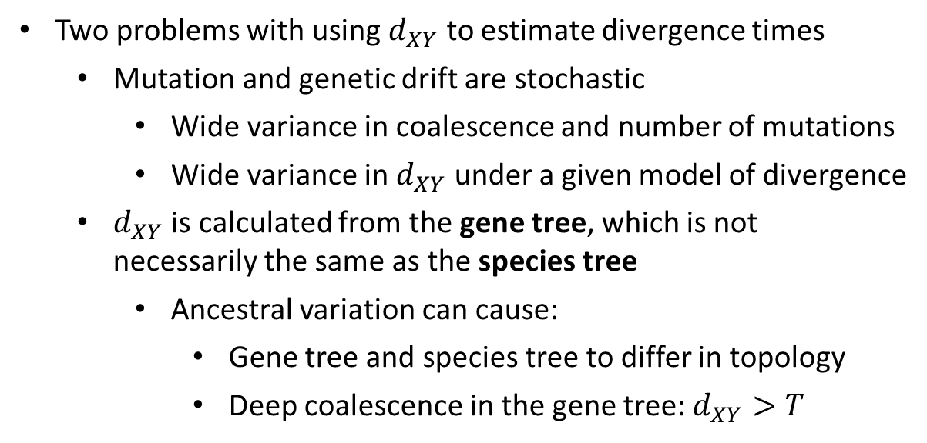
Time since divergence (T)
Determine when two species split from a common ancestor
Examine the role of geologic and climatic events on speciation
Test models of community assembly (when did different species show up in a biological community)
Test models of co-speciation in symbiotic relationships (parasitism, mutualism, commensalism)
$$d_{XY}=2μT$$
Two problems with using $d_{XY}$ to estimate divergence times
  Mutation and genetic drift are stochastic
    Wide variance in coalescence and number of mutations
    Wide variance in $d_{XY}$ under a given model of divergence
  $d_{XY}$ is calculated from the gene tree, which is not necessarily the same as the species tree
    Ancestral variation can cause:
      Gene tree and species tree to differ in topology
      Deep coalescence in the gene tree: $d_{XY}>T$

Slide 8
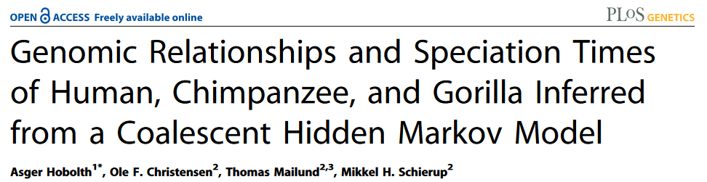
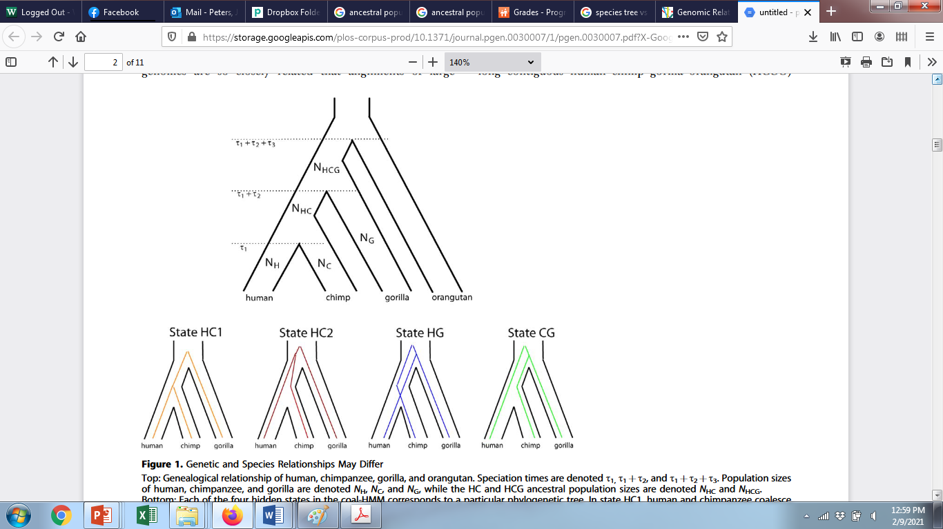



Species trees versus gene trees
Species tree—a phylogenetic tree depicting the evolutionary relationships of species
Gene tree—a phylogenetic tree inferred from DNA sequences sampled from a single gene or locus
*Often used as an estimate of the species tree
Species tree
Gene trees
Proportion of gene trees:
$$\frac{2}{3}$$
$$\frac{1}{6}$$
$$\frac{1}{6}$$

Slide 9
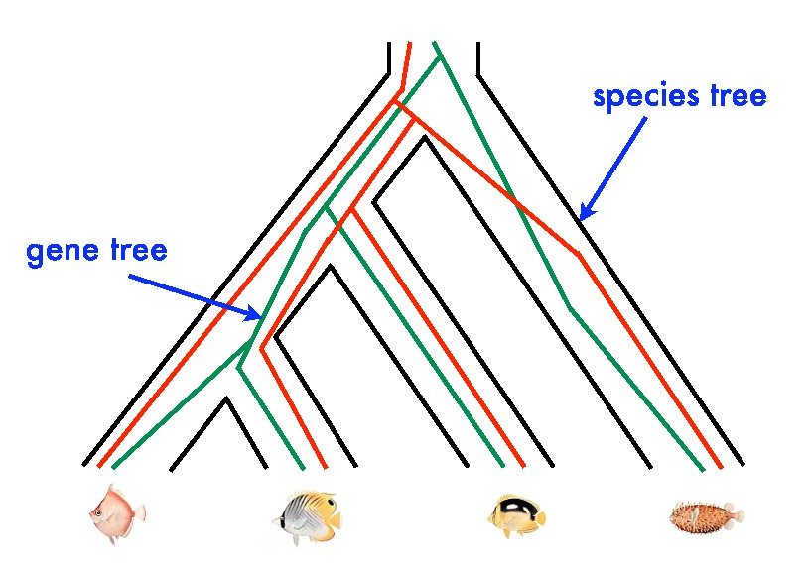
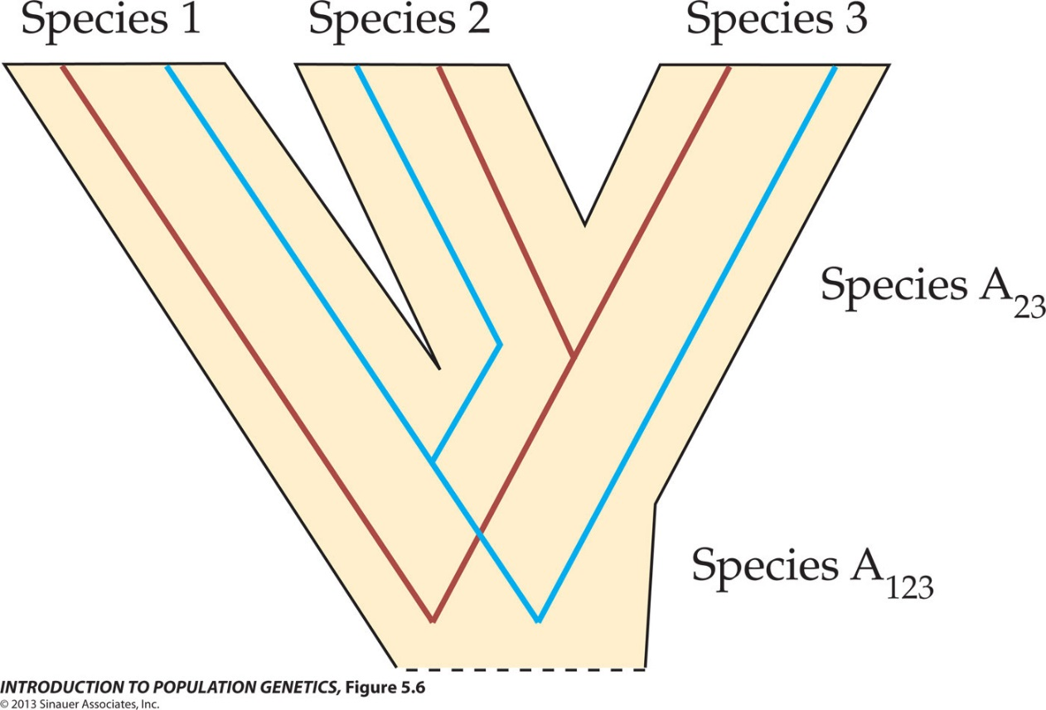
Figure 5.6 The coalescence tree may (red) or may not (blue) match the structure of the species tree (black)
Notes:
IntroPopGen-Fig-05-06-0.jpg

Slide 10
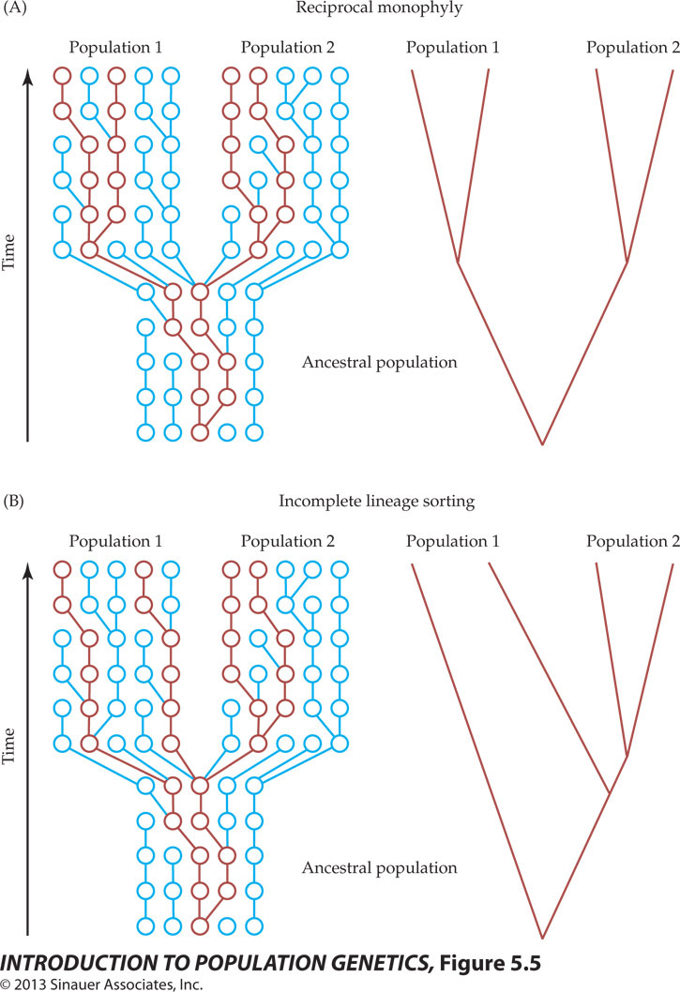
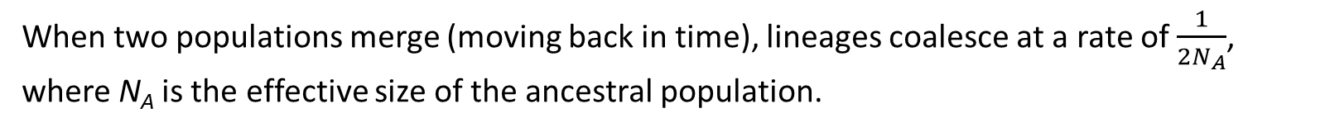
Ancestral variation and divergence times
When two populations merge (moving back in time), lineages coalesce at a rate of $\frac{1}{{2N}_{A}}$, where N_{A} is the effective size of the ancestral population.
Figure 5.6A. Reciprocal monophyly
Reciprocal monophyly—All members of a group share a more recent common ancestor with each other before they share a common ancestor with any members of the other group.
When reciprocal monophyly has been achieved, the expected time to coalescence after merging is 2N_{A} generations.
d_{XY} > T
d_{XY}
T

Slide 11
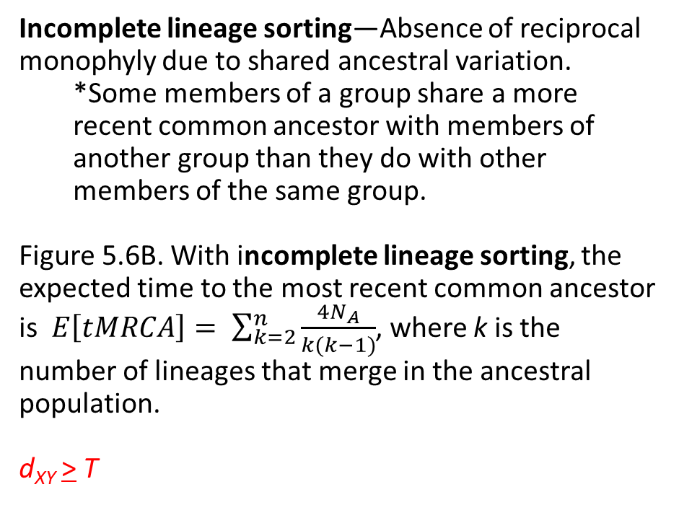
Ancestral variation and divergence times
When two populations merge (moving back in time), lineages coalesce at a rate of $\frac{1}{{2N}_{A}}$, where N_{A} is the effective size of the ancestral population.
Figure 5.6B. Incomplete lineage sorting
Incomplete lineage sorting—Absence of reciprocal monophyly due to shared ancestral variation.
*Some members of a group share a more recent common ancestor with members of another group than they do with other members of the same group.
Figure 5.6B. With incomplete lineage sorting, the expected time to the most recent common ancestor is $E\left[tMRCA\right]= \sum_{k=2}^{n}{\frac{4N_{A}}{k(k−1)}}$, where k is the number of lineages that merge in the ancestral population.
d_{XY} > T
d_{XY}
T

Slide 12
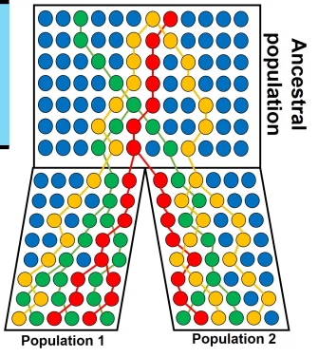
Ancestral variation and divergence times
When estimating gene trees from DNA sequences, we can only estimate coalescence times, not divergence times.
  If T is large and the N_{A} is small (low ancestral variation), then d_{XY} approximates T reasonably well.
  If T is small and N_{A} is large (high ancestral variation), then d_{XY} is a poor estimation of T.
Methods for estimating T from DNA sequences benefit from information about N_{A}.

Slide 13

When divergence was recent, there is a lot of information about N_{A} (assuming no migration)
T
With ancestral variation, can estimate coalescence times both within and between populations
Examine many genealogies consistent with the data using coalescent software
  Incorporates stochastic variance
  Simultaneously estimate N_{A} and T
Analyzing multiple independent loci improves estimates
Ancestral variation
Gadwall

Slide 14
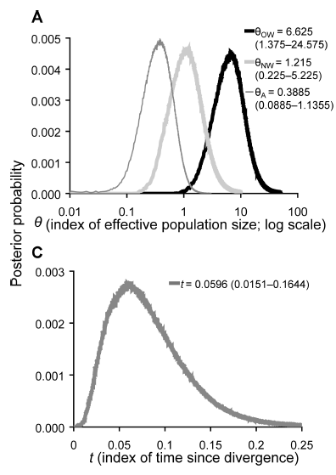
When divergence was recent, there is a lot of information about N_{A} in gene trees (assuming no migration)
Best estimate of N_{A}
41,000 individuals
T
Ancestral variation
95% HPD = 2,700–330,000 individuals
Best estimate of T:
~80,000 years ago
Gadwall
95% HPD = 40,000–450,000 years ago
Estimates can be improved by evaluating many independent loci.

Slide 15

When reciprocal monophyly has been achieved, information about N_{A} in the gene tree has been lost
No ancestral variation—only a single coalescence between populations
  Cannot estimate N_{A}
  Can estimate T, but only by making assumptions about N_{A}
Multiple independent loci can help
No ancestral variation
Green-winged Teal
Variance in tMRCA reflects ancestral variation

Slide 16
Part II—Population Assignment
Learning Outcomes
Population Assignment Probabilities
Principal Component Analysis

Slide 17
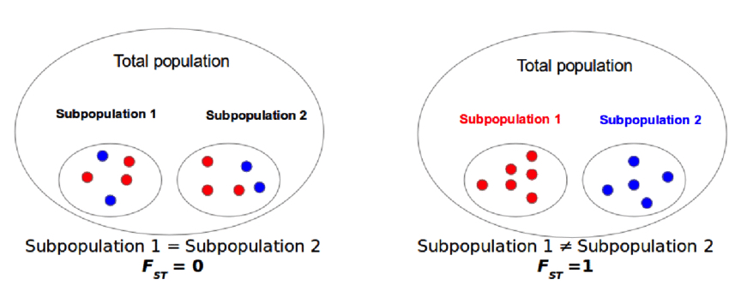

Review: Population subdivision & F_{st}
$$F_{ST}= \frac{H_{T}−H_{S}}{H_{T}}$$
https://www.researchgate.net/figure/Genetic-differentiation-an-example-of-the-behavior-of-fixation-index-FST-If-allele_fig9_306018124

Slide 18
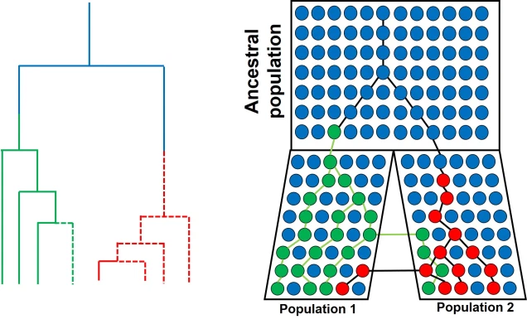
Review: Population subdivision & coalescence
Applying coalescence theory to a subdivided population, can estimate:
  Effective sizes of each subpopulation and the ancestral population,
  Migration rates between populations, and
  Time since divergence.
Calculating F_{st} and applying coalescence theory require prior knowledge on population boundaries.
Which individuals belong to which population?

Slide 19
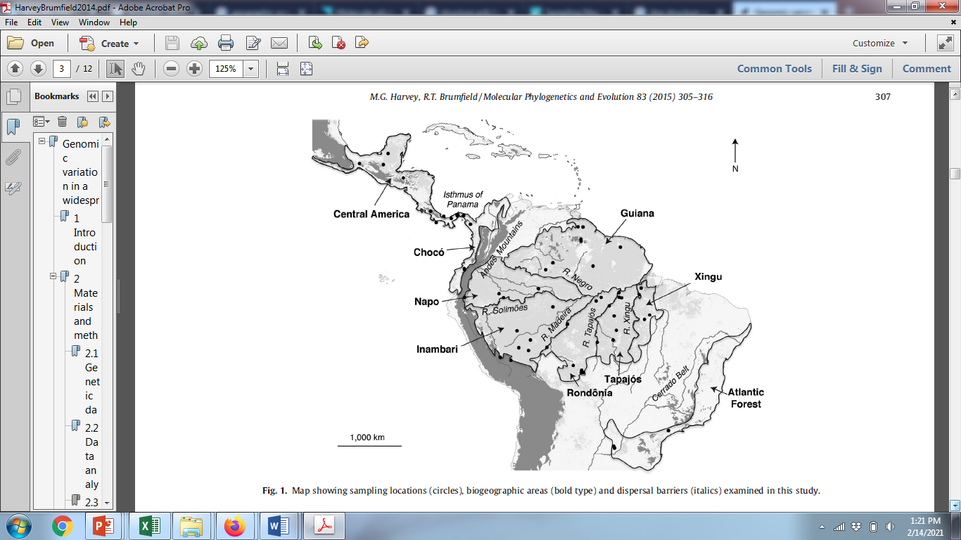

Genomic variation in a widespread Neotropical bird (Xenops minutus) reveals divergence, population expansion, and gene flow

Slide 20
Match Probabilities
Match probability = f_{i}² for homozygotes, 2f_{i}f_{j} for heterozygotes
Allele frequencies at two loci from two populations
Locus 1: Genotype AA,
Match probability₁ = f_{A}² = 0.9² = 0.81
Match probability₂ = f_{A}² = 0.2² = 0.04
There is an 81% chance of obtaining this genotype from Population 1 and a 4% chance from Population 2
 |  | Population 1 | Population 2
Locus 1 | f_{A} | 0.9 | 0.2
 | f_{B} | 0.1 | 0.8
Locus 2 | f_{Y} | 0.7 | 0.1
 | f_{Z} | 0.3 | 0.9
Locus 2: Genotype YZ,
Match probability₁ = 2f_{Y}f_{Z} = 2*0.7*0.3 = 0.42
Match probability₂ = 2f_{Y}f_{Z} = 2*0.1*0.9 = 0.18
There is an 42% chance of obtaining this genotype from Population 1 and a 18% chance from Population 2
Genotype of unknown individual: AA/YZ
Multiply probabilities to determine probability of the two-locus genotype for each population
Population 1: Pr(AA)*Pr(YZ) = 0.81*0.42 = 0.3402
Population 2: Pr(AA)*Pr(YZ) = 0.04*0.18 = 0.0072
Individual is more likely to be from population 1.
*Used in forensics to determine the probability that a suspect matches DNA found at a crime scene.

Slide 21
Problem:
Without knowing which population individuals belong to, we do not know the allele frequencies
Solution:
  Simultaneously estimate allele frequencies and assign individuals to populations based on their genotypes using Markov chain Monte Carlo (MCMC)

Slide 22
MCMC (oversimplified):
Assume a model of K populations.
Step 1:
  Cluster individuals into K populations either randomly or based on genetic similarity.
  Calculate allele frequencies
  Determine the probability/likelihood of the model given the data
Step 2:
  Move one individual from population i into population j.
  Calculate allele frequencies
  Determine the probability/likelihood of the model given the data
  Compare probability/likelihood with that from Step 1.
  If worse fit, move individual back to population i and repeat process.
  If better fit, choose another individual to move.
Steps 3+:
  Repeat step 2 over millions of iterations.
  Determine optimal K by comparing models (e.g., K = 1–10 populations)
    Calculate the likelihood of the data given K

Slide 23
Assignment Probabilities
The amount of time individuals spend in each population becomes the assignment probability.
  Individual 1—99.9% Population 1
  Individual 2—50% Pop 1, 50% Pop 2
    Admixed Individual (hybrid)
    Insufficient data???
  Individual 3—99.9% Population 2
Assumptions
  Diploid organisms
  Random mating
  Hardy-Weinberg equilibrium within populations
  Multiple, independent loci (they are not closely linked on the same chromosome)

Slide 24
Applications
Identifying population boundaries & assigning individuals to populations
Studying hybrid zones
Identifying migrants and admixed individuals.

Slide 25
Genomic variation in a widespread Neotropical bird (Xenops minutus) reveals divergence, population expansion, and gene flow
Identifying population boundaries & assigning individuals to populations

Slide 26
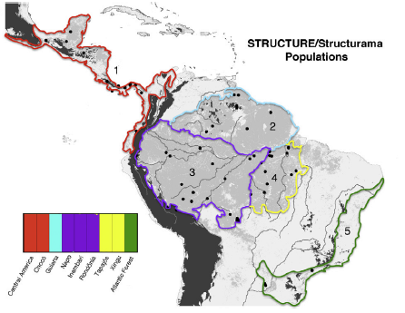
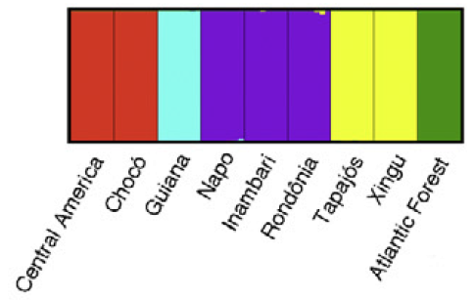
Genomic variation in a widespread Neotropical bird (Xenops minutus) reveals divergence, population expansion, and gene flow
Identifying population boundaries & assigning individuals to populations

Slide 27
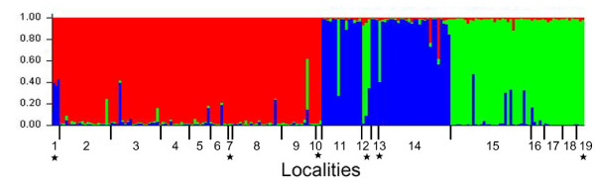
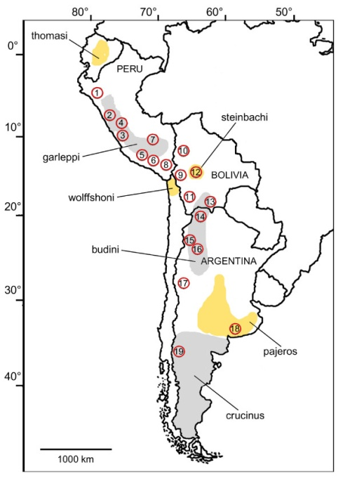

Identifying population boundaries & assigning individuals to populations
Assignments based on 5 microsatellite loci
Assignment probability
Pampas cat (Leopardus colocolo)
Cossíos et al. 2009. BMC Evolutionary Biology 2009, 9:68

Slide 28
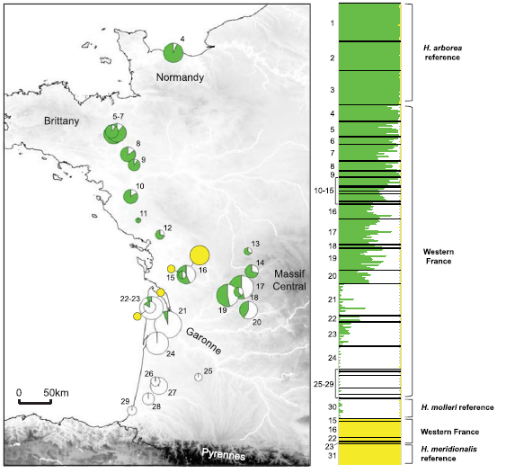
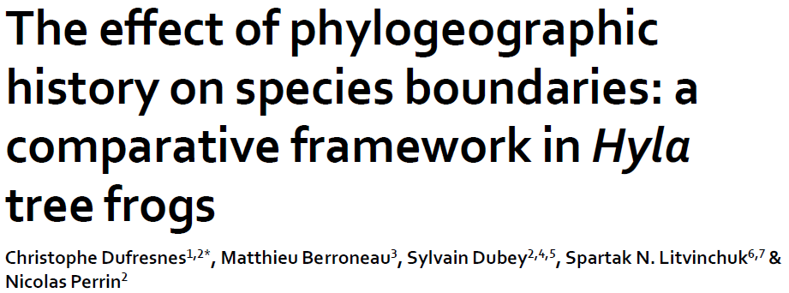
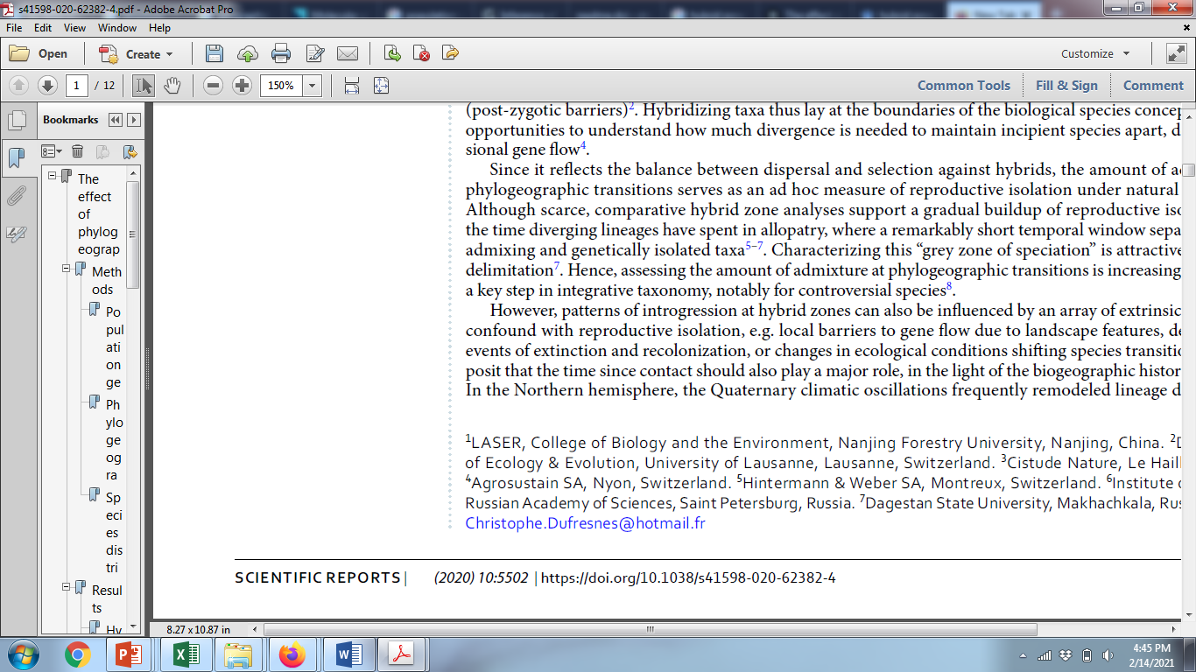
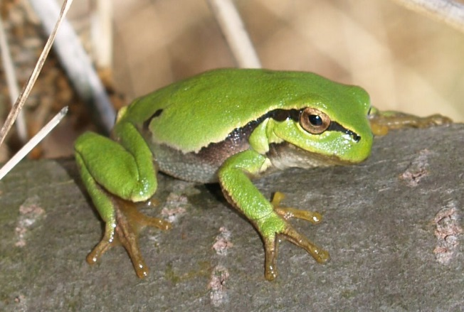
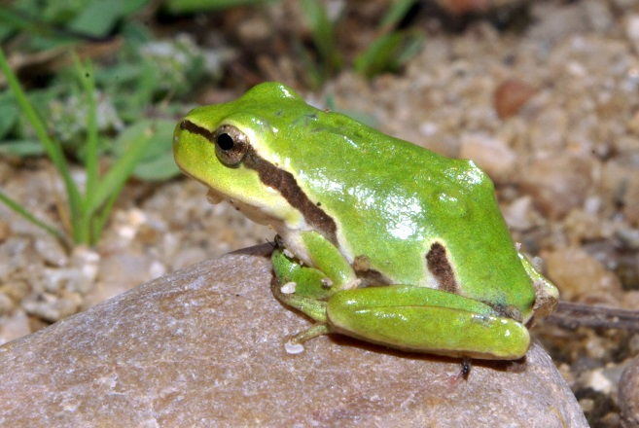
Studying hybrid zones
Hybrid zone
Hyla arborea
Hyla molleri
Assignment based on 26 microsatellite loci

Slide 29
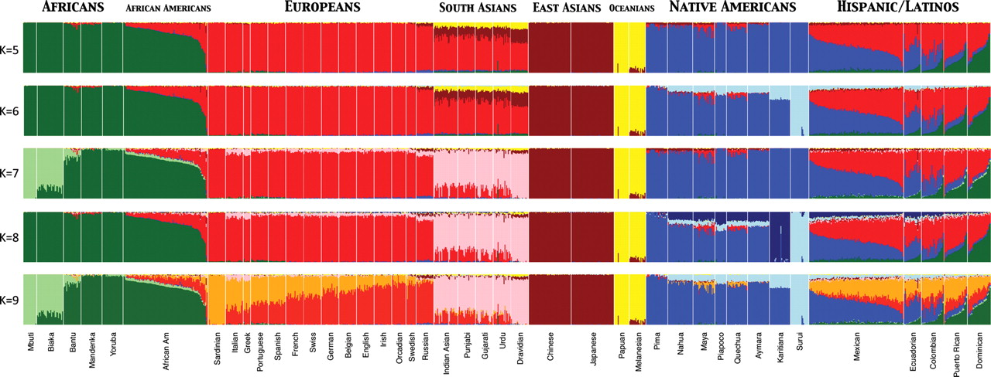
Assignment Probabilities in Worldwide Human Populations
Used ADMIXTURE clustering algorithm to infer genomic assignments/ individual
K = number of assumed populations (K = 5-9)
73,901 autosomal SNP markers & 1,112 individuals from 42 global pops
Henn B M et al. Hum. Mol. Genet. 2010;19:R221-R226

Slide 30
Principal Components Analysis (PCA)
An exploratory technique used to reduce a large number of variables in a data set to fewer variables that still contain the information
  Variables in a data set are often highly correlated.
  PCA identifies correlations among variables in a data set and creates new variables that capture that information.
  The new variables, called principal components (PCs) or eigenvalues, are uncorrelated.
Can be used to:
  Find patterns in high-dimensional data
  Visualize data of high dimensionality
Population genetics applications
  Detect population structure using genomic data (large number of loci sequenced from the genome)
  Identify admixed individuals

Slide 31

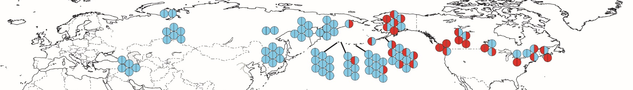
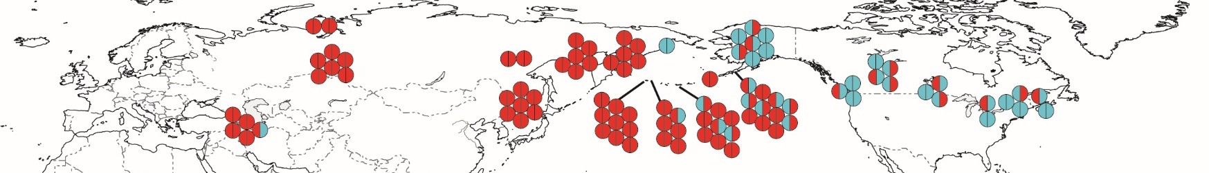
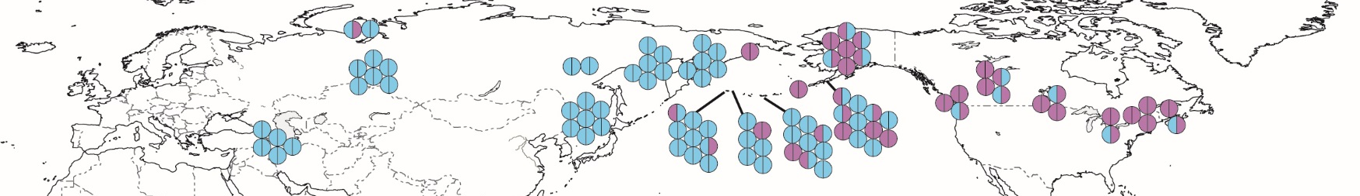
Three strongly correlated SNPs in Green-winged Teal
C
T
C
T
C
G
Over-simplification: PCA creates a single variable that captures the variability in these three SNPs (and other similarly correlated SNPs)

Slide 32
Population genetics applications—Detect population structure
Three distinct genetic clusters

Slide 33
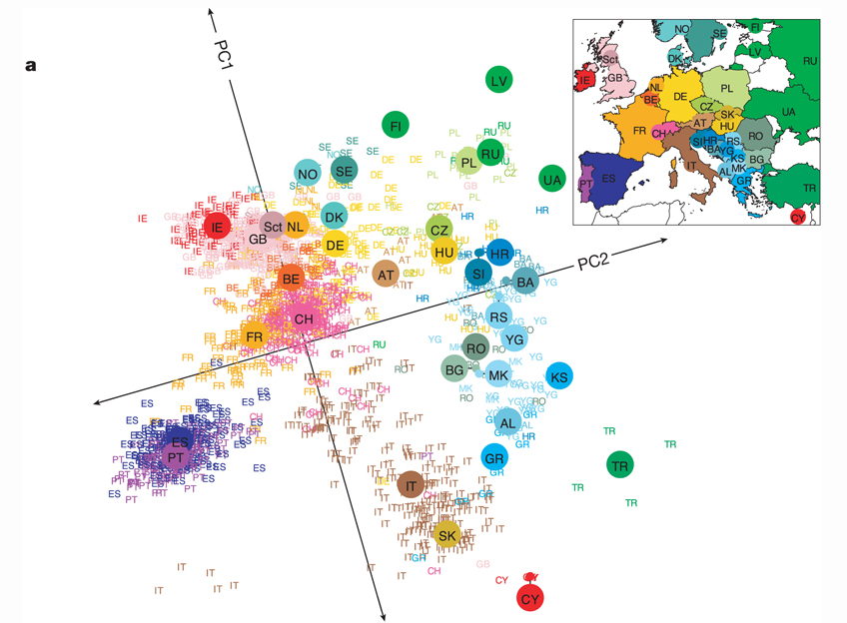
Applications: detect population structure using genomic data
Population structure within Europe
Note the pattern of isolation-by-distance
  Populations that cluster geographically also cluster genetically
  PC1 separates populations along a north-south gradient.
  PC2 separates populations along an east-west gradient.
Novembre et al. (2008) Nature 456, 98-101

Slide 34
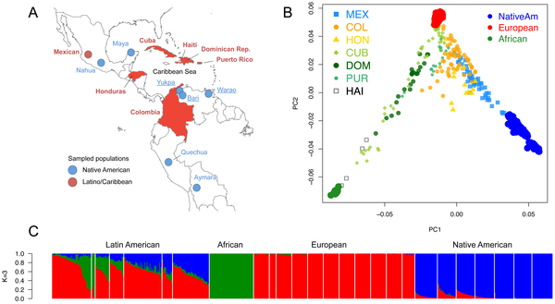
Identifying migrants and admixed individuals
Figure 1. Population structure of Caribbean and neighboring populations of humans.
Moreno-Estrada A, Gravel S, Zakharia F, McCauley JL, et al. (2013) Reconstructing the Population Genetic History of the Caribbean. PLoS Genet 9(11): e1003925.

Slide 35
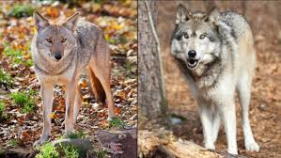
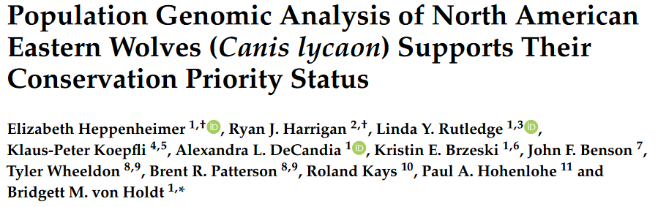
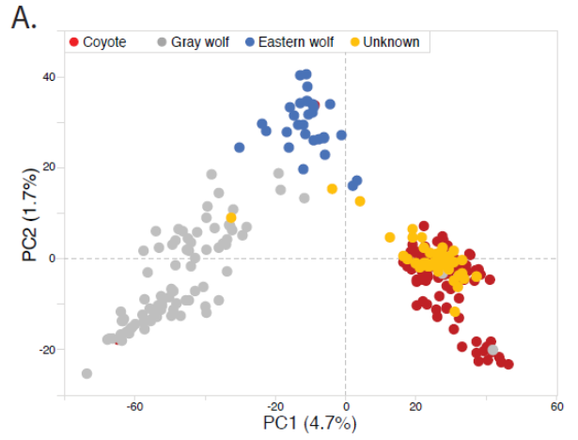
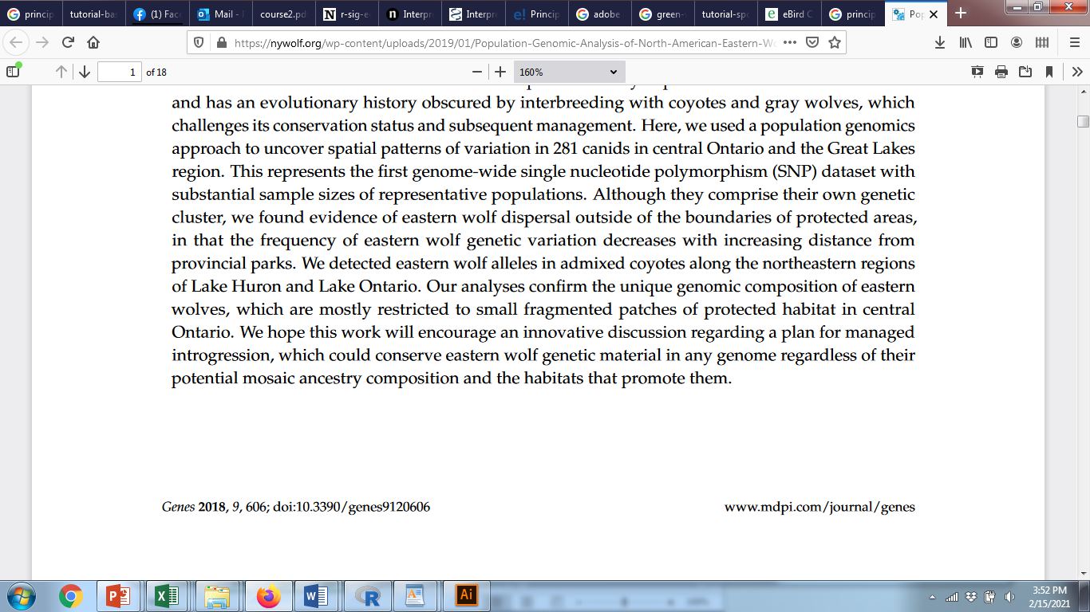
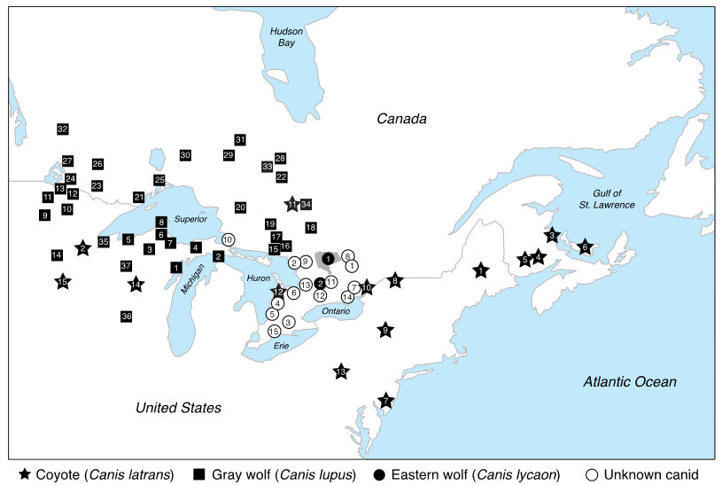
Identifying unknown individuals
Two clusters of wolves
Possible hybrids
Most “unknowns” clustered with coyotes
Examined 16,587 SNPs for 304 canid samples

Slide 36
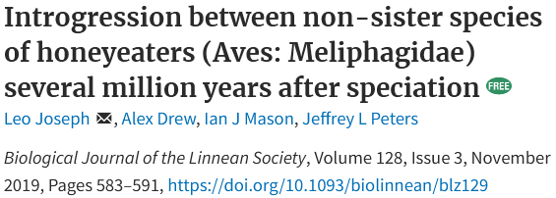
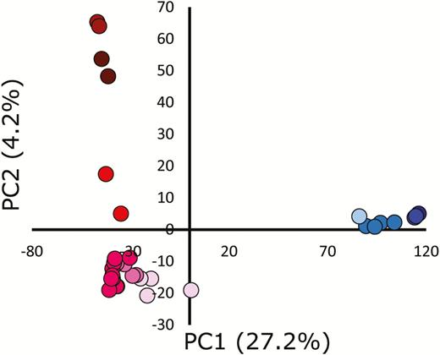
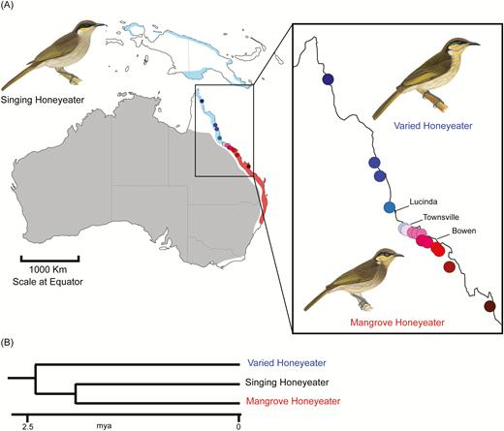

Slide 37
Part III—Complex Histories
Learning Outcomes
Explain the benefits of using Approximate Bayesian Computation (ABC), rather than genealogy-based methods, for examining complex population histories.
Describe the steps involved in ABC.
Distinguish between prior and posterior distributions.
Explain joint site frequency spectra.

Slide 38
Complex Models of Population History
Problems:
Different population histories (e.g., recent divergence vs. high migration rates) can generate similar patterns in genealogies.

Slide 39
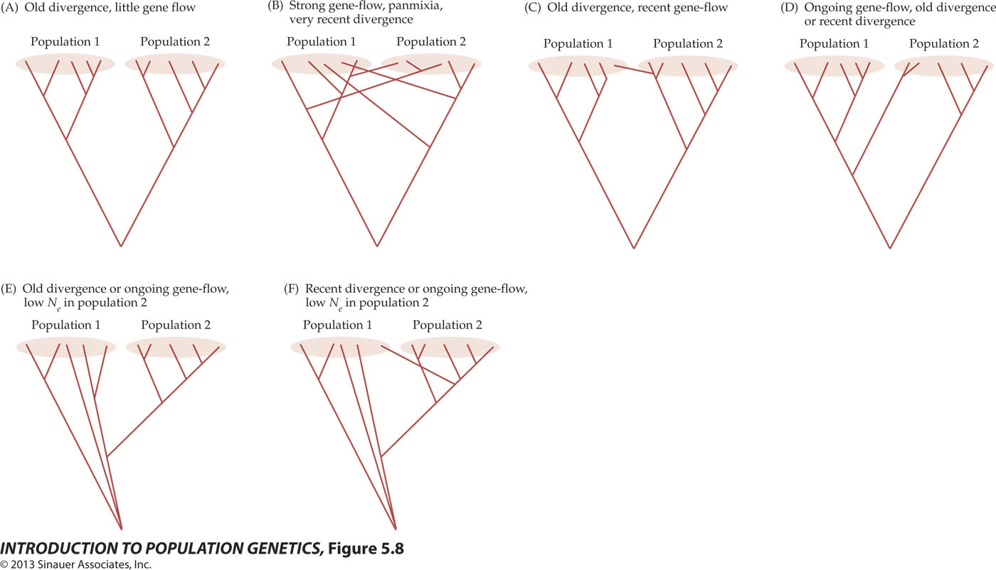
Figure 5.8 Coalescence trees produced by different demographic and historical processes
Notes:
IntroPopGen-Fig-05-08-0.jpg

Slide 40
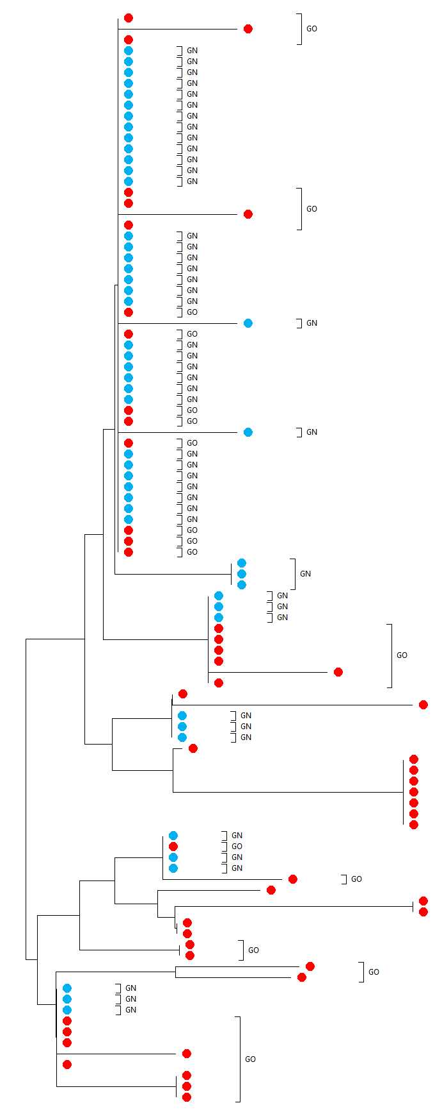
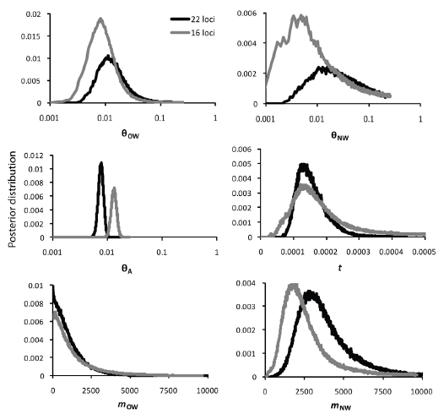
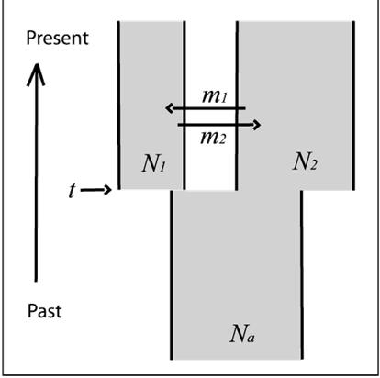
Review: Isolation-with-migration coalescence models (Review)
N_{e} = 510,000 individuals
N_{e} = 430,000 individuals
N_{A} = 240,000 individuals
T = 64,000 years ago
2Nm = 0 migrants/generation
2Nm = 18 migrants/generation
Gadwall
Peters, Winker, & McCracken. 2012. PLoS One 7:e319722.

Slide 41
Complex Models of Population History
Problems:
Different population histories (e.g., recent divergence vs. high migration rates) can generate similar patterns in genealogies.
Genomic data containing 1000s of loci are not amenable to methods based on coalescence theory.
  Coalescence methods estimate parameters from many genealogies consistent with the data.
  Each locus has its own independent genealogy.
    Examining multiple loci benefits coalescence analyses, because each genealogy is an independent outcome of stochastic drift and mutation.
      Improves estimates of parameters when examining population history.
      The more loci examined, the more computationally intensive the analysis.
    In large data sets, the number of genealogies that need to be examined overwhelms computational efficiency.
    More complex population histories = more parameters to estimate from each genealogy
      Each parameter added increases computational demands exponentially.

Slide 42
Complex Models of Population History
Solution:
Approximate Bayesian Computation (ABC).
  Avoids estimating coalescence times from genealogies reconstructed from the data
    Computationally, less intensive than genealogy-based methods
  Simulates genealogies under various population parameters (e.g., θ, m, t, etc.) using coalescence theory
  Calculates summary statistics from simulated genealogies (e.g., π, S, F_{ST}, Tajima’s D, etc.) and compares those statistics to the empirical data

Slide 43
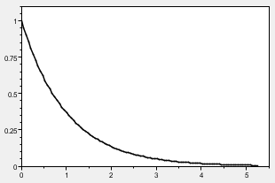
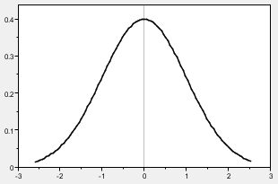
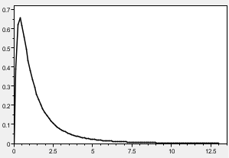
Approximate Bayesian Computation (ABC)
Requires a user-defined prior distribution (coalescence methods also require a prior)
  Informs the algorithm how to sample parameter values
Examples of prior distributions
Normal prior
Lognormal prior
Exponential prior
Flat prior

Slide 44
Approximate Bayesian Computation (ABC)
2. Define prior distribution
1. Compute summary statistic π from observational data; set threshold, ε
3. Randomly sample parameters from the prior & simulate data using coalescent
θ
θ₁
θ₂
θ₃
…
θ_{n}
π
4. Compute summary statistic for each simulation
…
5. Based on ε, decide whether summary statistic is sufficiently close to empirical data and accept or reject parameter value
π₁
π₂
π₃
π_{n}
✓
×
✓
×
Best estimate of θ
6. Use the accepted values to approximate the posterior distribution
95% HPD
θ

Slide 45
ABC and Complex Models of Population History
  High flexibility for testing models of population history
    Estimate as many parameters as desired
      Effective population sizes
      Population growth rates
      Migration rates
      Time estimates
    Can handle large data sets
  Some limitations
    Risk of over-fitting models
    There might be insufficient signal in the data to estimate many parameters

Slide 46
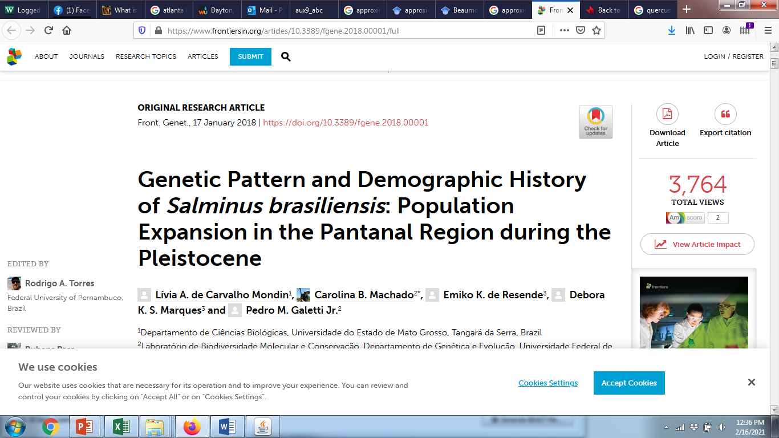

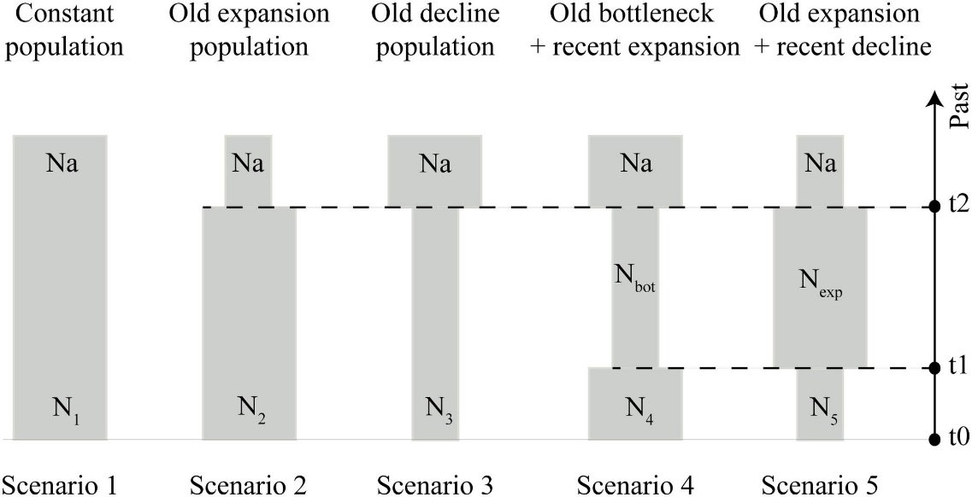
Best-supported model: Old expansion ~62,000 years ago

Slide 47



ABC and Complex Models of Population History
Best-supported model

Slide 48


ABC and Complex Models of Population History

Slide 49

ABC and Choice of Summary Statistics
Population Parameter | Summary Statistic
Effective population size | Segregating sites, nucleotide diversity
Population subdivision & migration | F_{ST}
Changes in effective population sizes | Tajima’s D; site frequency spectrum
Review: Site frequency spectrum (SFS)—the distribution of the allele frequencies of a given set of segregating sites from DNA sequences sampled from a population
Can calculate S, π, and Tajima’s D from SFS

Slide 50

Figure 5.14 The joint site frequency spectrum (SFS) for a Tibetan and a Han Chinese population estimated for a genome-wide data set of all protein-coding genes
Site frequency spectrum and population subdivision: the joint SFS
The joint SFS compares allele frequencies between populations
  The number of SNPs at a frequency of X in population 1 and at a frequency of Y in population 2
  Powerful summary statistic for inferring many aspects of population history using ABC
  In addition to S, π, and Tajima’s D , F_{ST} can be calculated from the joint SFS.
Number of SNPs
Notes:
IntroPopGen-Fig-05-14-0.jpg

