Slide 1
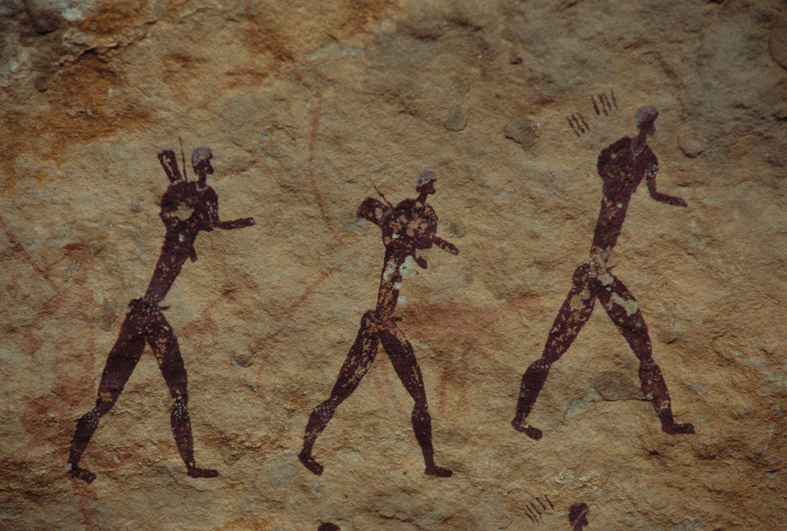
Human Population Genetics
Population Genomics
Universidad de Antioquia
Gen-Pob’23

Slide 2
Learning Outcomes
Distinguish between the replacement (out-of-Africa) and the multiregional hypotheses of human evolution.
Describe evidence in support of the out-of-Africa hypothesis.

Slide 3

Fundamental model of population genetics
Population
History
Immigration (gene flow)
2N_{e}m
+
Genetic Variation within Population
$$\frac{1}{2N_{e}}$$
2N_{e}µ
Genetic Drift
Mutation
-
+
2N_{e}s
Natural selection
Applications to human evolution

Slide 4
Fundamental model of population genetics
Population
History
Immigration (gene flow)
2N_{e}m
+
Genetic Variation within Population
$$\frac{1}{2N_{e}}$$
2N_{e}µ
Genetic Drift
Mutation
-
+
2N_{e}s
Natural selection
Applications to human evolution

Slide 5
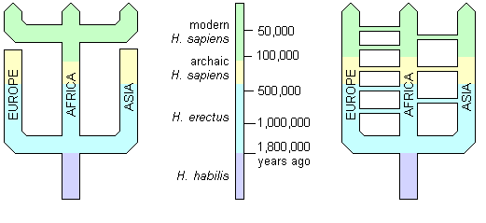
Models of human evolution
Replacement hypothesis (Out-of-Africa; OoA): transition from archaic to anatomically modern humans in Africa, followed by migration to the rest of the world.
Multiregional hypothesis: Anatomically modern humans trace their origin to multiple hominin groups (Homo erectus) living in multiple regions throughout the world, but connected by gene flow.
OoA
Multiregional

Slide 6
Review: Four fundamental aspects of genetic drift (Lecture 02.2)
The direction of genetic drift is unpredictable.
The magnitude of genetic drift depends on population size.
Genetic drift reduces genetic variation over the long-term.
Genetic drift causes populations to diverge.

Slide 7
Review: bottlenecks and founder events
Population bottleneck: a severe reduction in population size
Genetic consequences of a bottleneck
The post-bottleneck population will have less genetic variation than the pre-bottleneck population.
  The survivors will carry a subset of genetic variation.
  Drift will cause a further loss of diversity, especially while the population is small.
Allele frequencies will differ between pre- and post-bottleneck population.

Slide 8
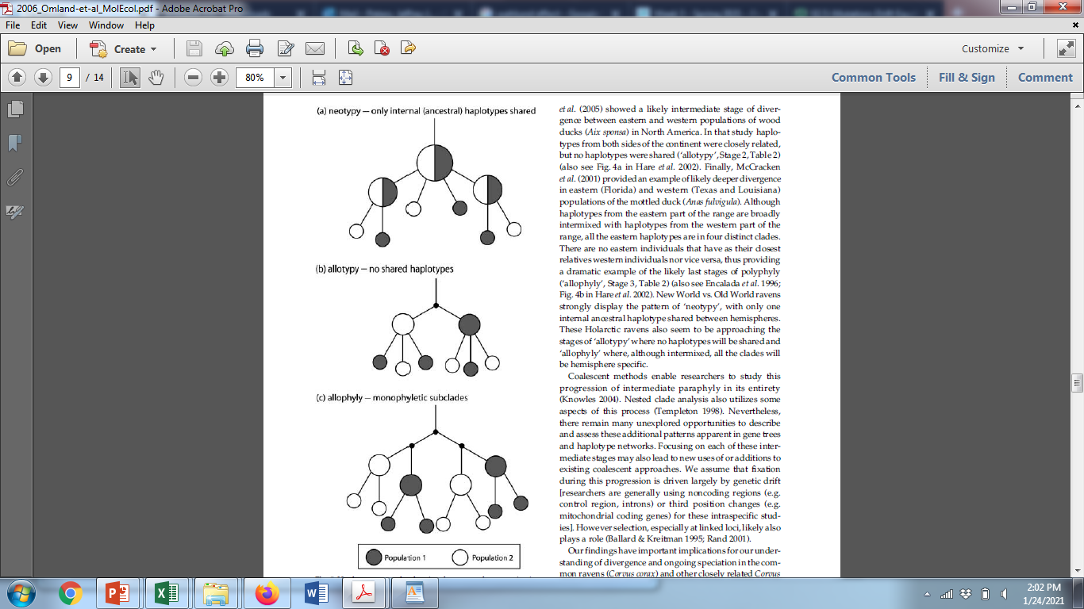
Founder Event
(bottleneck)
Review: Genetic drift & mutation
Genetic drift & mutation act together to cause populations to diverge over time
  New mutations arise
  Genetic drift causes ancestral variation to be lost
Omland, Baker & Peters. 2006. Genetic signatures of intermediate divergence: population history of Old and New World Holarctic ravens (Corvus corax). Molecular Ecology 15:795-808.
Multiregional hypothesis
Replacement hypothesis

Slide 9
mtDNA phylogeny: maternal lineage
Africa
Asia
America
Europe
Full mitochondrial genomes (Lab 5)
Restriction fragment length polymorphisms in total mitochondrial DNA
Cann et al. 1987. Nature 325:31-36.

Slide 10
mtDNA phylogeny
Africa
Asia
America
Europe
Time to most recent common ancestor (TMRCA) for African lineages 2.3-times older than rest of the world (Lab 6)
Present-day mtDNA variation throughout the world traces back to an African ancestor
Larger effective population size in Africa
Consistent with OoA hypothesis, but not multiregional hypothesis
N_{e} (Asia) = 80,000 females
N_{e} (America) = 50,000 females
N_{e} (Europe) = 40,000 females
TMRCA = 57,000 YBP
TMRCA = 130,000 YBP
N_{e} (Africa) = 90,000 females

Slide 11
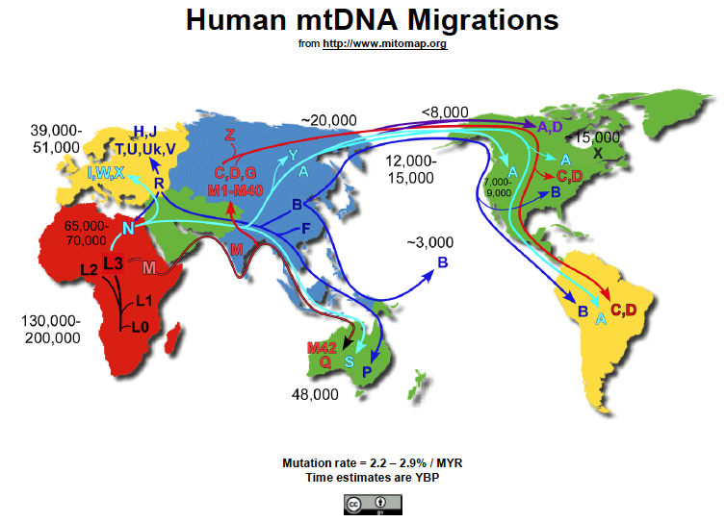

Slide 12
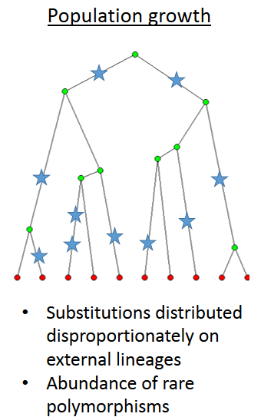
Review: Effects of Variation in Population
N_{e}
Time
Changes in Population Size produce waves of coalescence
Coalescence
events
Time

Slide 13
Bayesian Skyline Plots:
Full mitochondrial genomes (Lab 7)
Fairly stable N_{e}
Rapid expansion ~12,000 YBP
Relatively stable N_{e} in Africa consistent with lack of a bottleneck
Rapid expansions in Asia & America (& Europe) consistent with bottleneck associated with founder event
Consistent with OoA hypothesis, but not multiregional hypothesis
Rapid expansions ~40,000 YBP & 20,000 YBP

Slide 14
Review: Coalescence is a noisy process—it is stochastic
10 genealogies generated under the same population size (N = 10,0000)
However, genetic drift is independent across unlinked loci, so adding multiple loci short enough to be non-recombining is the best way to improve inferences of population history. ✔✔✔ (Lecture 03.4)
Is there independent evidence supporting the out-of-Africa hypothesis?

Slide 15
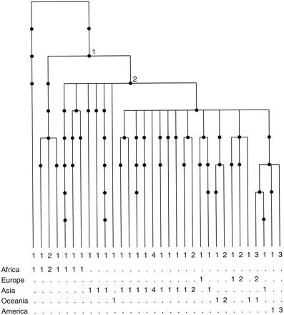
Y-chromosome phylogeny: paternal lineage
Y-chromosome diversity traces back to African ancestor
Thompson et al. 2000.

Slide 16
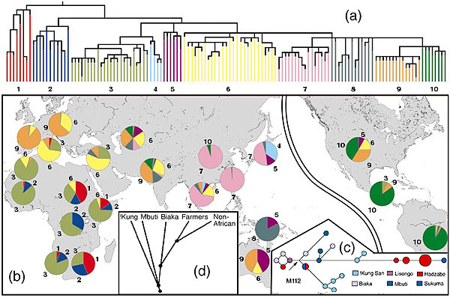
Y-chromosome phylogeny
Y-chromosome diversity traces back to African ancestor

Slide 17
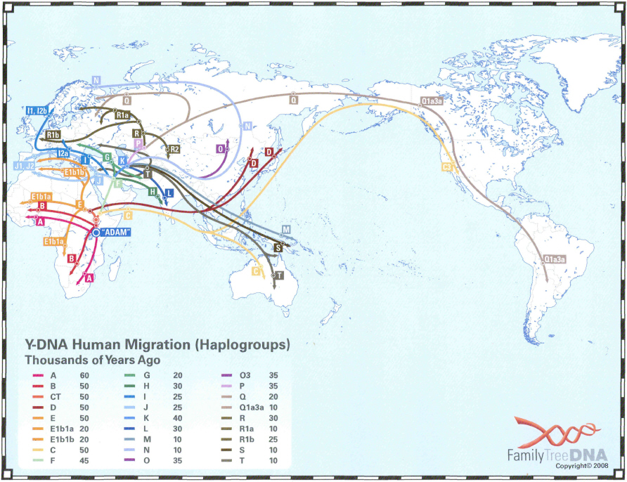
https://phillipsdnaproject.com/faq-sections/114-haplogroup-migration-map
Y-chromosome data is consistent with mtDNA & independently supports out-of-Africa

Slide 18
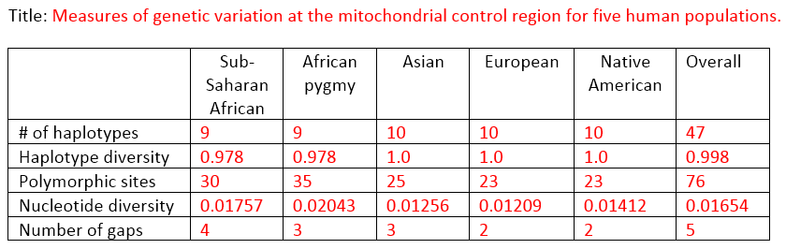
Genetic diversity
Replacement hypothesis (Out-of-Africa; OoA): expect higher genetic variation in Africa.
Multiregional hypothesis: differences in genetic variation not expected.
Lab 2:
We found higher mitochondrial diversity in African populations.
Consistent with out-of-Africa hypothesis.

Slide 19
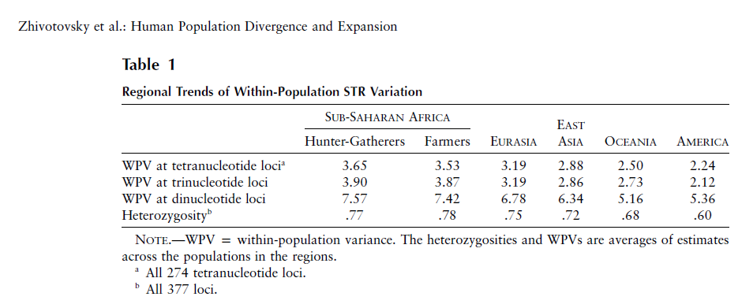
Genetic diversity: 377 microsatellite loci
Replacement hypothesis (Out-of-Africa; OoA): expect higher genetic variation in Africa.
Multiregional hypothesis: differences in genetic variation not expected.
Higher nuclear variation in Africa.
Consistent with OoA, but not multiregional hypothesis.

Slide 20
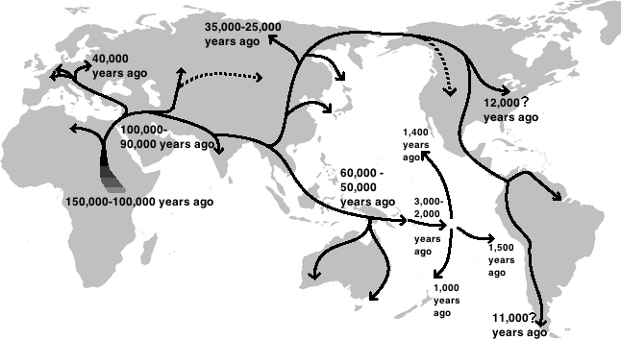
Human global expansion
Out-of-Africa hypothesis strongly supported by multiple lines of population genetics evidence.

Slide 21
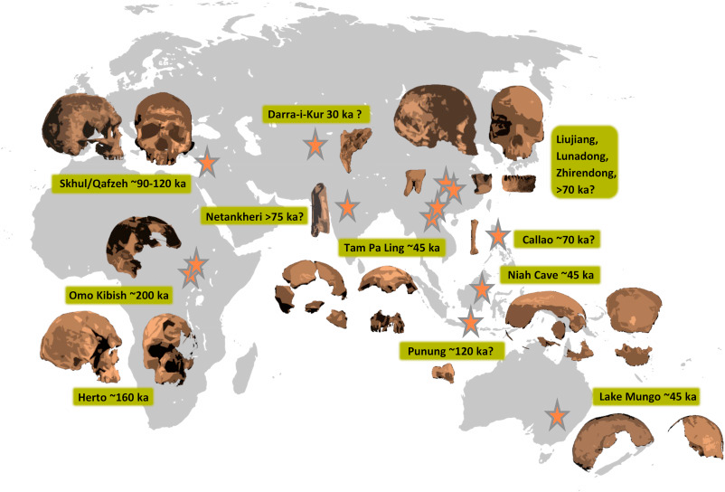
Human global expansion: fossil evidence
“Genetic and fossil evidence has accumulated in support of an African origin for modern humans. Competing models differ primarily by the number of dispersals, their geographic route, and the extent to which expanding modern humans interacted with other hominins.”
Reves-Centeno, H. 2016. Out of Africa and into Asia: Fossil and genetic evidence on modern human origins and dispersals. Quaternary International 416:249-262

Slide 22
Learning Outcomes
Describe the history of introgression from archaic hominids in human evolution.
Interpret the results of ABBA-BABA tests.
Explain the role of selection for introgressed genes during human evolution.

Slide 23
Fundamental model of population genetics
Population
History
Immigration (gene flow)
2N_{e}m
+
Genetic Variation within Population
$$\frac{1}{2N_{e}}$$
2N_{e}µ
Genetic Drift
Mutation
-
+
2N_{e}s
Natural selection

Slide 24

Fundamental model of population genetics
Population
History
Immigration (gene flow)
2N_{e}m
+
Genetic Variation within Population
$$\frac{1}{2N_{e}}$$
2N_{e}µ
Genetic Drift
Mutation
-
+
2N_{e}s
Natural selection
Applications to human evolution

Slide 25
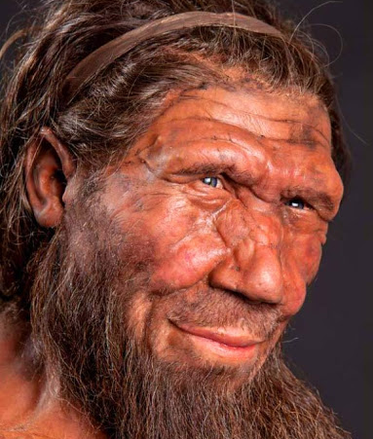
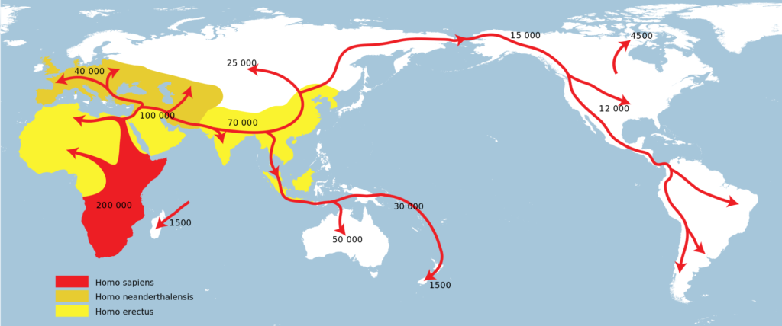
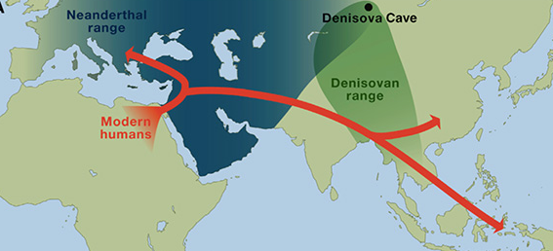
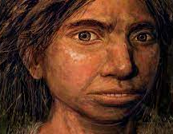
Human migration & archaic hominids
As anatomically modern humans spread across the globe, they came into contact with other forms of archaic humans.
(Extinction ~100,000 YBP)
https://www.zmescience.com/science/news-science/neanderthal-dna-influence-06102017/
https://www.uctv.tv/shows/CARTA-Ancient-DNA-and-Human-Evolution-Neandertal-and-Denisovan-Genomes-and-What-They-Tell-Us-A-Map-of-Neandertal-Genes-in-Present-Day-Humans-The-Phenotypic-Legacy-of-Neandertal-Interbreeding-on-Modern-Humans-30971

Slide 26
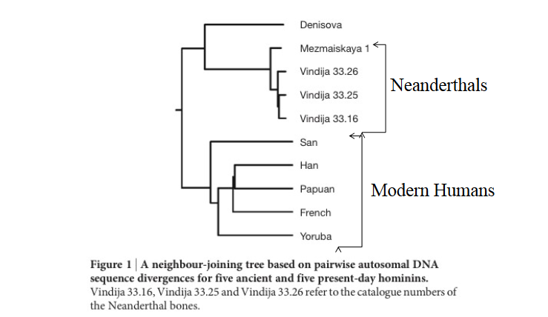
Ancient DNA (extracted from fossils) phylogeny
Reich et al. 2010. Genetic history of an archaic hominin group from Denisova Cave in Siberia. Nature 468:1053-1060.

Slide 27
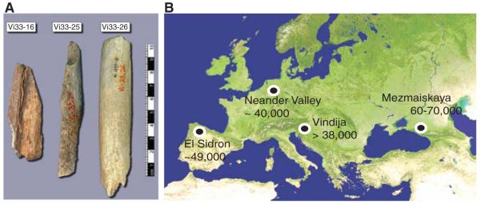
Whole genome sequencing of Neanderthal
Did anatomically modern humans interbreed with archaic hominids?
Green et al. 2010. A Draft Sequence of the Neandertal Genome. Science 325:710-722.

Slide 28
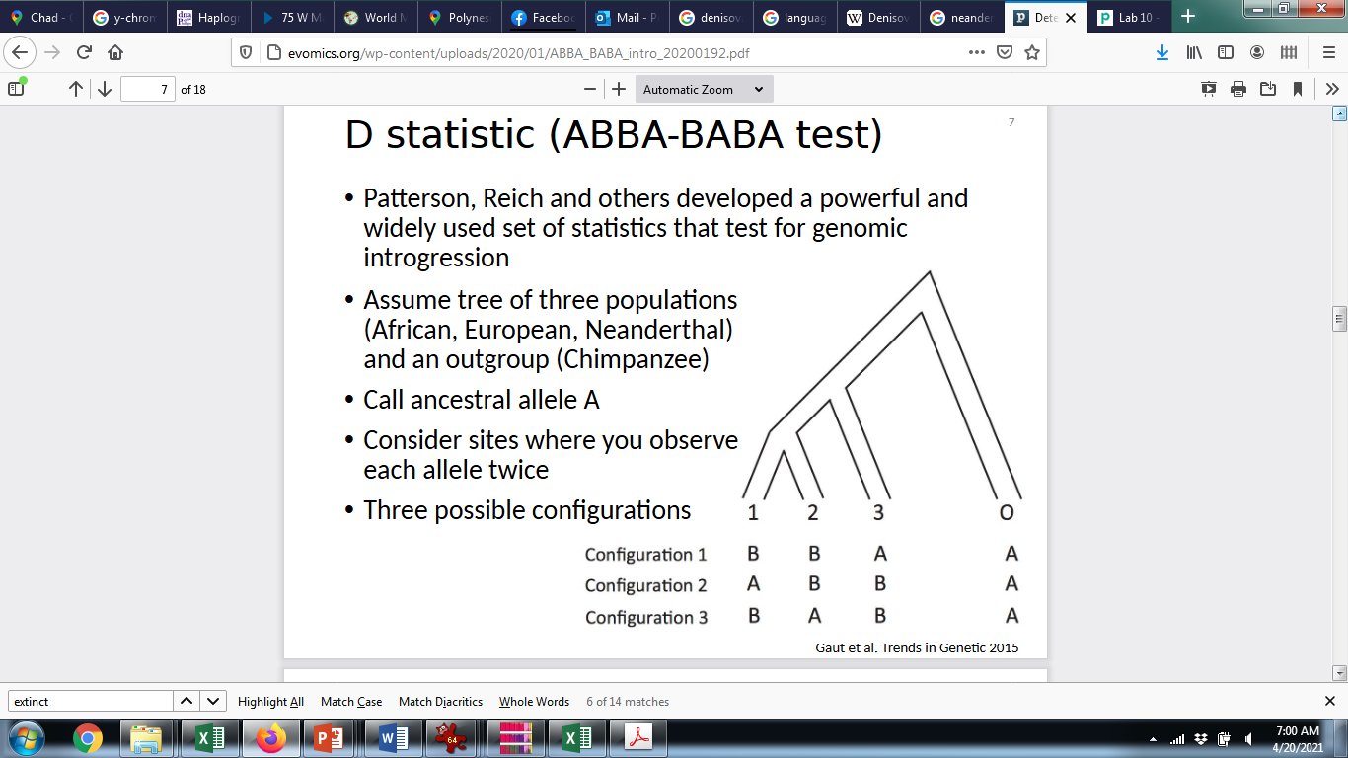
ABBA-BABA test
Did anatomically modern humans interbreed with archaic hominids?
Compare four genomes, including an outgroup (O), two “ingroup” taxa (1,2), and a taxon (3) that is suspected to have hybridized with one (but not both) of the ingroup taxa.
Examine all SNPs that occur at a frequency of 50%
  Each allele is shared between two taxa
  The allele found in the outgroup is always called “A”; the alternative allele is “B”
Three possible configurations of allele sharing
  BBAA—B is shared between taxa 1 & 2.
    The ingroup is monophyletic.
  ABBA—B is shared between taxa 2 & 3.
  BABA—B is shared between taxa 1 & 3,
Green et al. 2010. A Draft Sequence of the Neandertal Genome. Science 325:710-722.

Slide 29
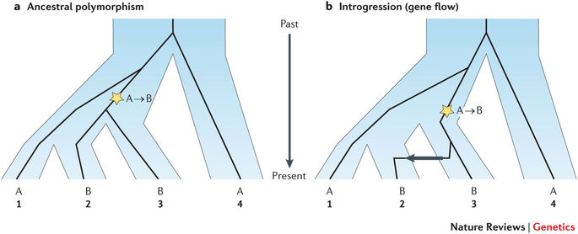
ABBA-BABA test
ABBA & BABA are expected due to incomplete lineage sorting or introgression (gene flow)
Incomplete lineage sorting—Some members of a group share a more recent common ancestor with members of another group than they do with other members of the same group.
Sousa and Hey. 2013. Nature Reviews Genetics

Slide 30
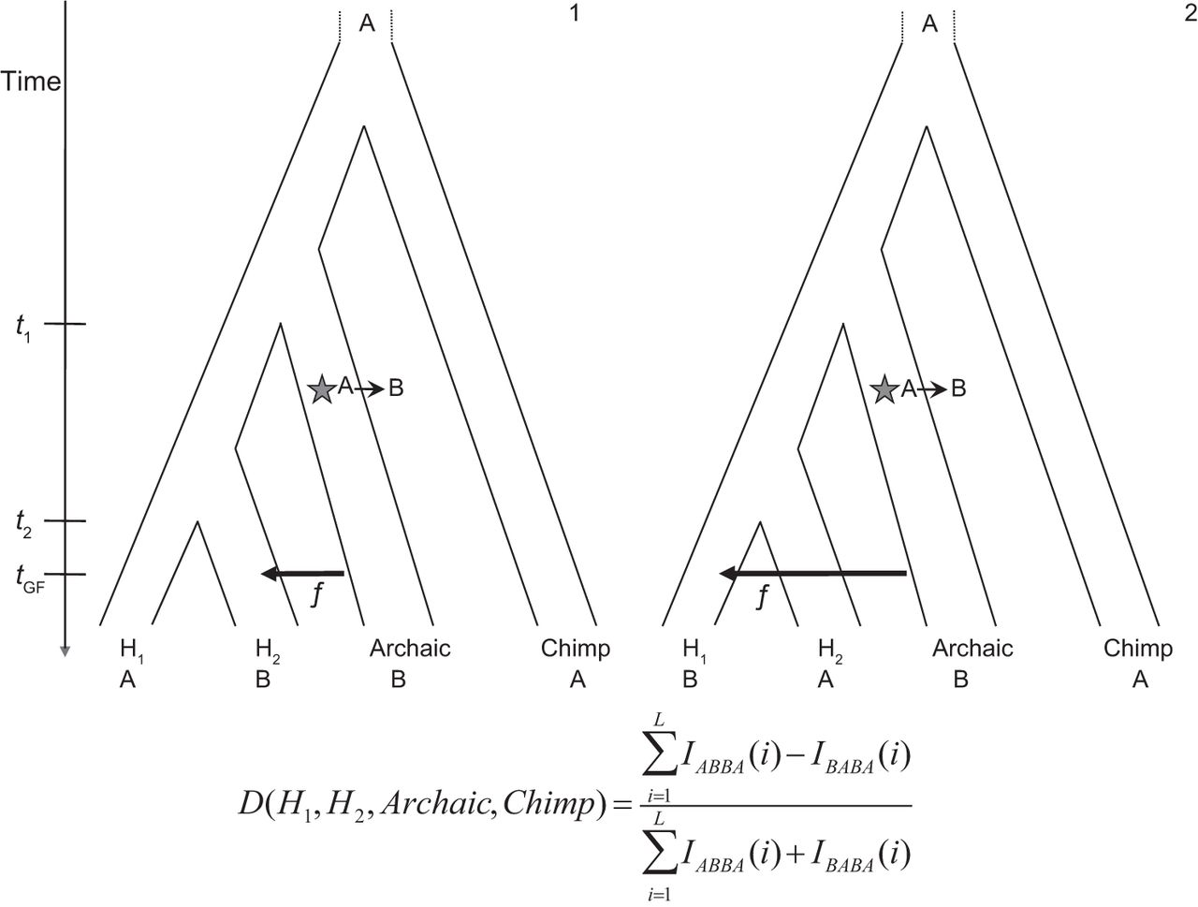
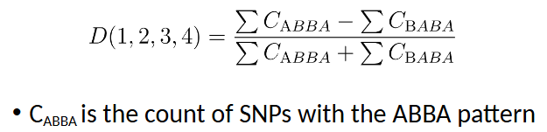
ABBA-BABA test
If ABBA = BABA, then D = 0
  Incomplete lineage sorting
If ABBA > BABA, then D > 0
  Gene flow between taxa 3 & 2
If ABBA < BABA, then D < 0
  Gene flow between taxa 3 & 1

Slide 31
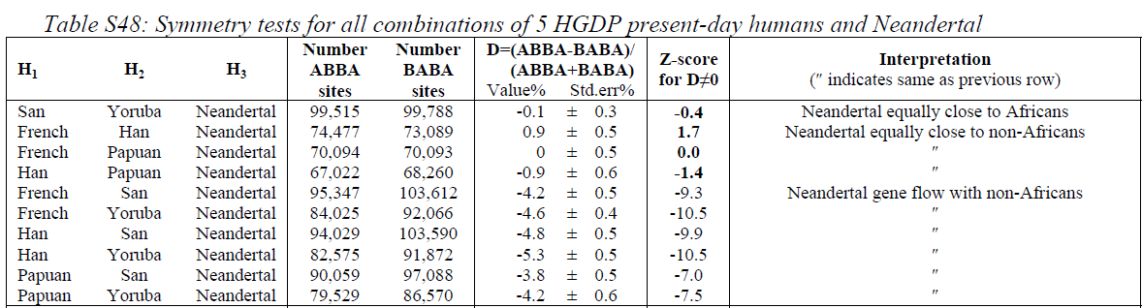
ABBA-BABA results
ABBA = BABA
ABBA < BABA
ABBA < BABA
San (Africa)
Yoruba (Africa)
Neanderthal
Chimp
Yoruba (Africa)
Neanderthal
Chimp
Han (Asia)
Yoruba (Africa)
Neanderthal
Chimp
French (Europe)
Significant gene flow between Neanderthal and humans from Europe, Asia, and Papua, but not Africans

Slide 32
Human migration & archaic hominids
As anatomically modern humans spread across the globe, they came into contact with other forms of archaic humans.
Interbreeding
https://www.zmescience.com/science/news-science/neanderthal-dna-influence-06102017/

Slide 33
Proportion of human genome derived from Neanderthal ancestry
Africans: 0.0%
East Asians: 2.3-2.6%
Western Eurasians: 1.8-2.4%
*Note that some estimates reach as high as 7% of genome
Prüfer et al. (2017)

Slide 34
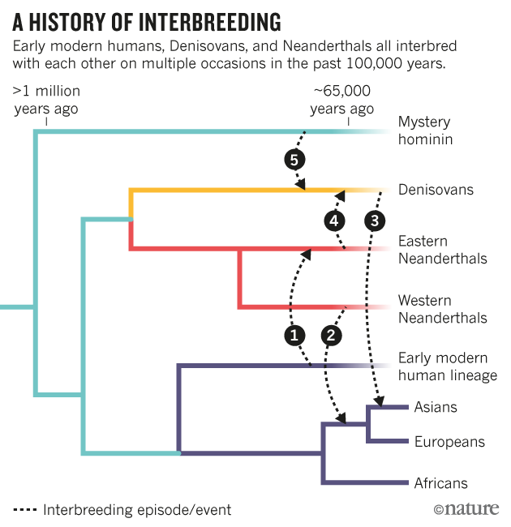

Slide 35
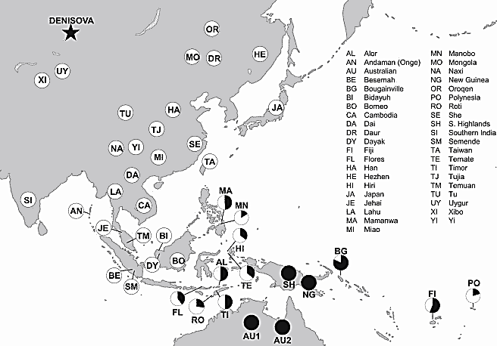
Denisovan admixture
Denisovan admixture proportions
(filled circles indicate 5% Denisovan; others are scaled accordingly)
Reich et al. 2011. Denisova Admixture and the First Modern Human Dispersals into Southeast Asia and Oceania. Am J Hum Genet. 89: 516–528.

Slide 36
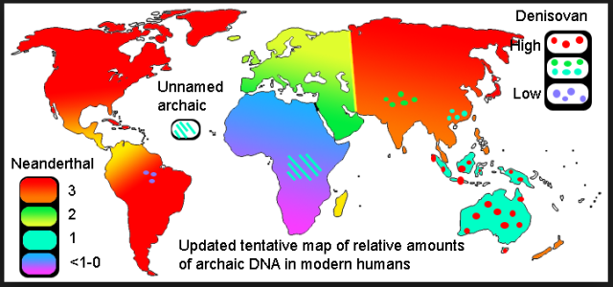
Geographic distribution of introgressed DNA
https://evolutionistx.wordpress.com/2016/04/21/updated-tentative-map-of-neanderthal-dna/

Slide 37
Fundamental model of population genetics
Population
History
Immigration (gene flow)
2N_{e}m
+
Genetic Variation within Population
$$\frac{1}{2N_{e}}$$
2N_{e}µ
Genetic Drift
Mutation
-
+
2N_{e}s
Natural selection
Applications to human evolution

Slide 38
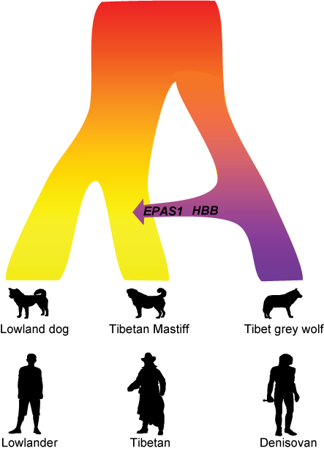
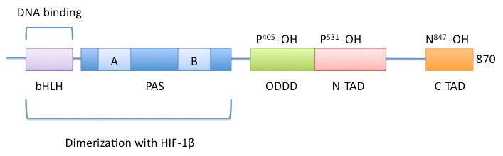
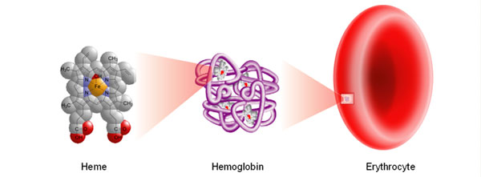
Adaptive introgression of alleles adaptive to high-altitude environments
Two genes associated with high-altitude adaptation
Ancient interbreeding with the Tibet grey wolf made the Tibetan Mastiff adapt to the high altitude. A similar evolutionary mechanism occurred in parallel in the Tibetan people, who received their high altitude adaptation after inbreeding with the Denisovans. Credit: Zhen Wang, Shanghai Institutes for Biological Sciences, Chinese Academy of Sciences, Shanghai, P. R. China
Read more at: https://phys.org/news/2016-12-tibetan-mastiff-gained-high-altitude.html#jCp
EPAS1
HBB
Parallel Evolution in people and their pets!

Slide 39
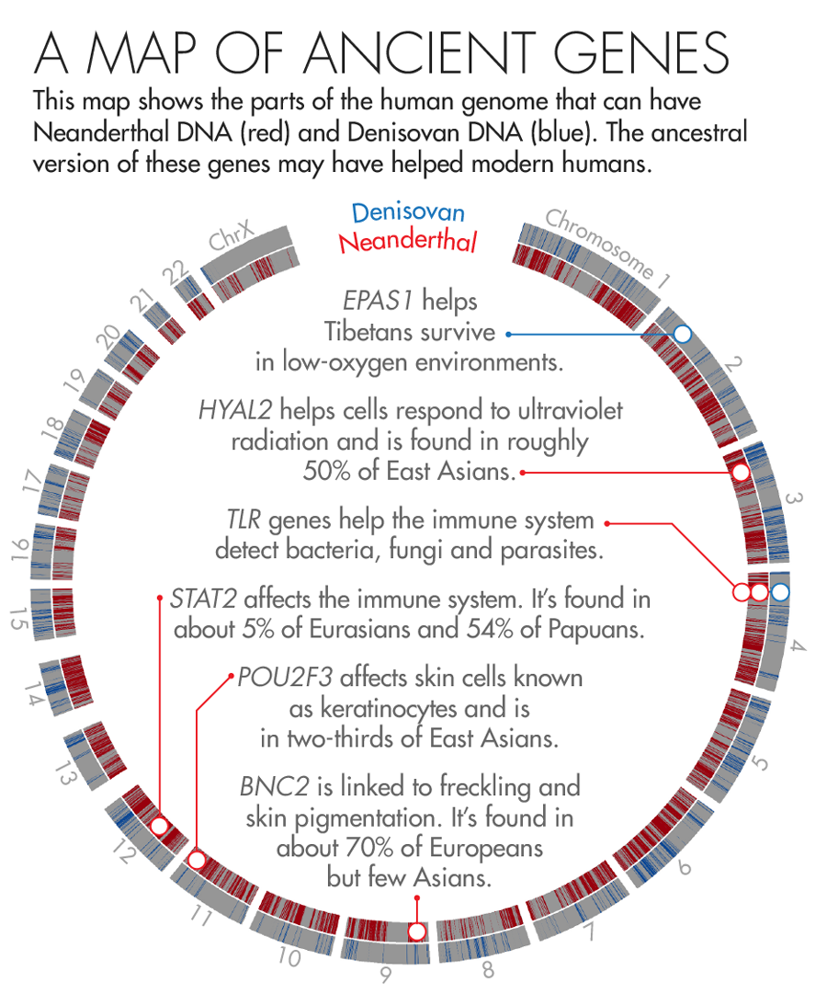
Adaptive introgression from archaic hominids
https://www.quantamagazine.org/how-neanderthal-dna-helps-humanity-20160526/

Slide 40
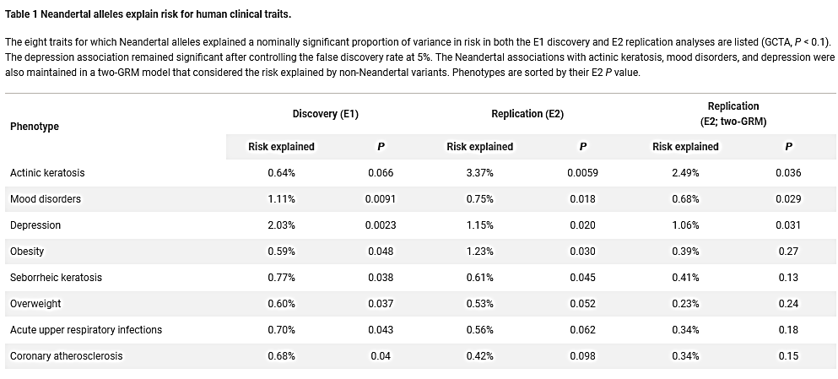
Negative consequences of introgression from archaic hominids
Simonti et al. 2016. The phenotypic legacy of admixture between modern humans and Neandertals. Science 351:737-741

Slide 41
Part III—Population Subdivision
Learning Outcomes
Describe the clinal genetic variation in humans.
Summarize how mutation, genetic drift, gene flow, & natural selection contributed to clinal variation in allele frequencies and phenotypes.

Slide 42
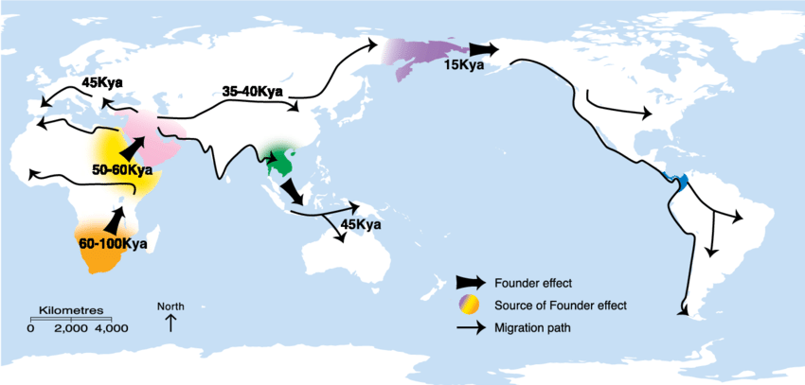
Feary et al. 2014. Chapter 4, Earth’s cultural heritage. Pp. 81-115 in Protected Area Governance and Management, 8th edition (Worboys et al., Editors). ANU Press.

Slide 43
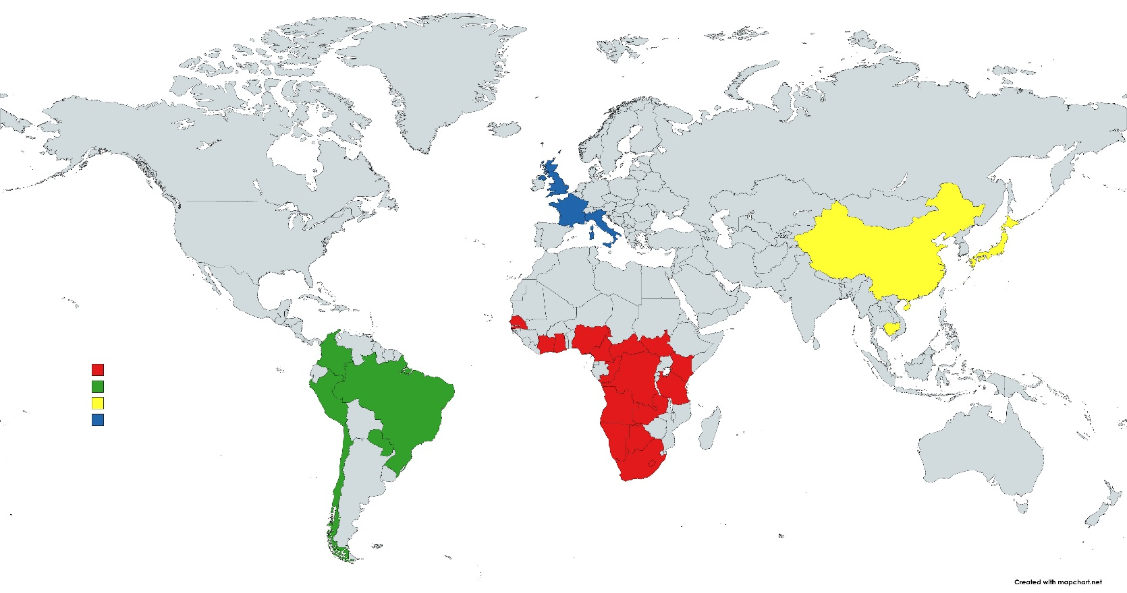
Throughout the semester, we focused on four groups of humans during our lab exercises.
These groups were presented as if they were discrete population units.
However, we ignored the majority of global diversity.
Principal Component Analysis of 645 microsatellite loci
Data from: Pemberton, DeGiorgio, & Rosenberg. 2013. Population Structure in a Comprehensive Genomic Data Set on Human Microsatellite Variation. G3 (Bethesda) 3(5): 891–907

Slide 44
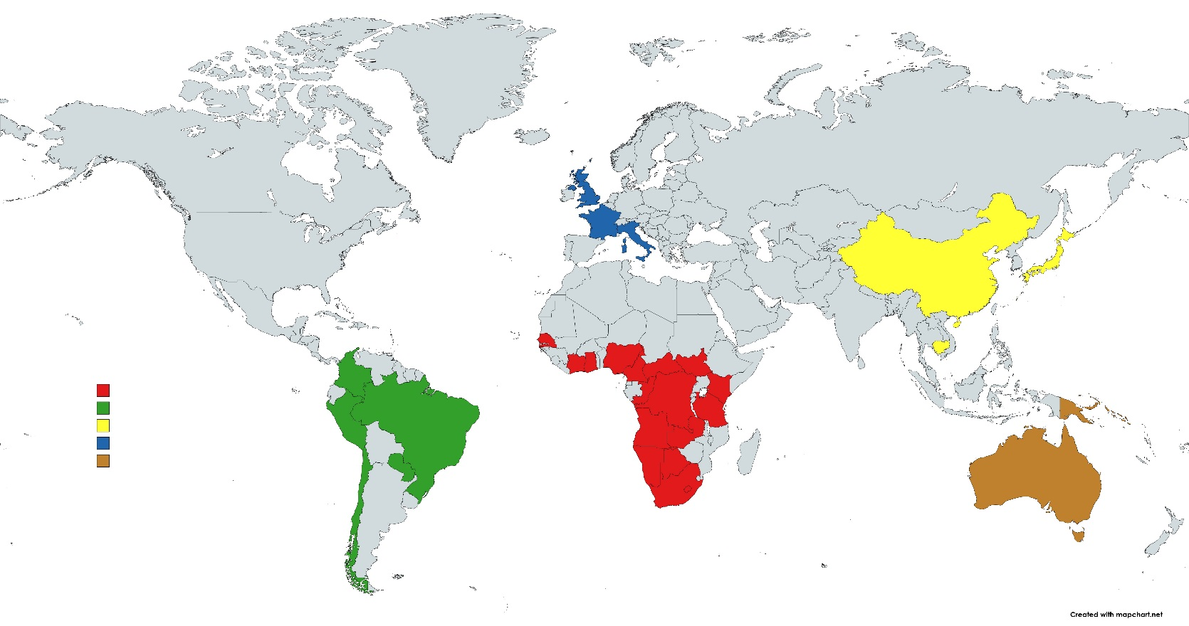
Principal Component Analysis of 645 microsatellite loci
Humans from Oceania & Australia are a fifth genetic cluster.
Data from: Pemberton, DeGiorgio, & Rosenberg. 2013. Population Structure in a Comprehensive Genomic Data Set on Human Microsatellite Variation. G3 (Bethesda) 3(5): 891–907

Slide 46
Principal Component Analysis of 645 microsatellite loci
Humans from Oceania & Australia are a fifth genetic cluster.
Data from: Pemberton, DeGiorgio, & Rosenberg. 2013. Population Structure in a Comprehensive Genomic Data Set on Human Microsatellite Variation. G3 (Bethesda) 3(5): 891–907

Slide 47
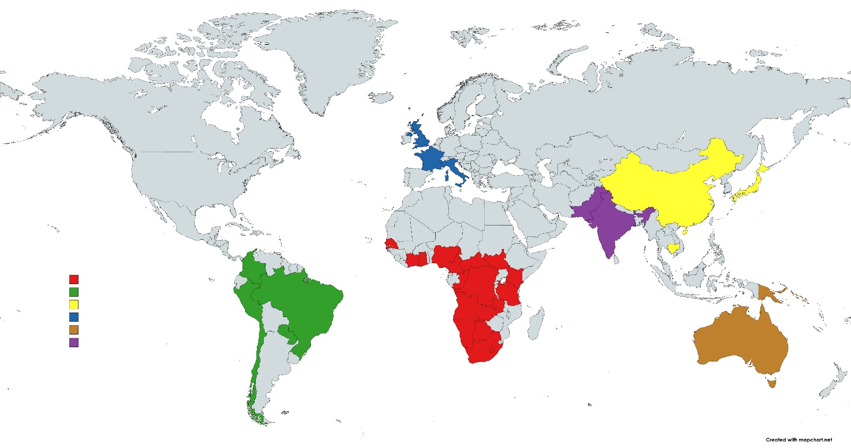
Principal Component Analysis of 645 microsatellite loci
South Asians are genetically intermediate between Europeans and East Asians.
Data from: Pemberton, DeGiorgio, & Rosenberg. 2013. Population Structure in a Comprehensive Genomic Data Set on Human Microsatellite Variation. G3 (Bethesda) 3(5): 891–907

Slide 48
Principal Component Analysis of 645 microsatellite loci
Taiwanese are genetically intermediate between East Asians & Oceanians.
Data from: Pemberton, DeGiorgio, & Rosenberg. 2013. Population Structure in a Comprehensive Genomic Data Set on Human Microsatellite Variation. G3 (Bethesda) 3(5): 891–907

Slide 49
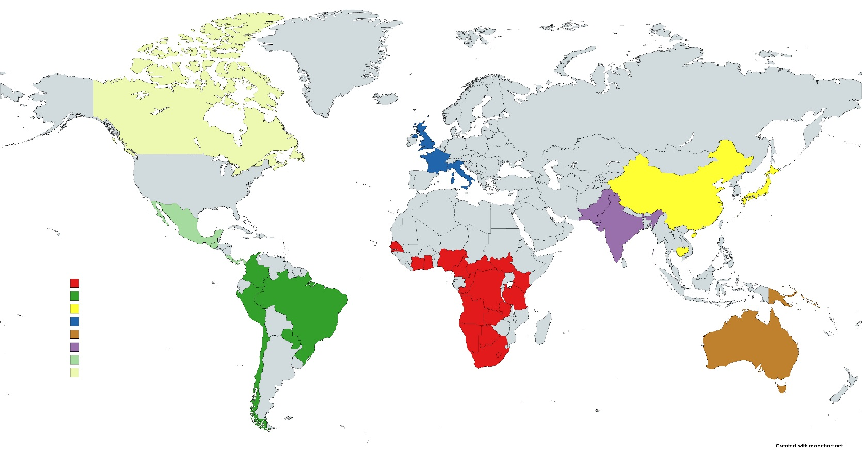
Principal Component Analysis of 645 microsatellite loci
Native North Americans are genetically closer to East Asians & Europeans than are native South & Central Americas.
Data from: Pemberton, DeGiorgio, & Rosenberg. 2013. Population Structure in a Comprehensive Genomic Data Set on Human Microsatellite Variation. G3 (Bethesda) 3(5): 891–907

Slide 50

Principal Component Analysis of 645 microsatellite loci
Northeast Africans are genetically closer to Europeans and South Asians than are southern and central Africans.
Data from: Pemberton, DeGiorgio, & Rosenberg. 2013. Population Structure in a Comprehensive Genomic Data Set on Human Microsatellite Variation. G3 (Bethesda) 3(5): 891–907

Slide 51
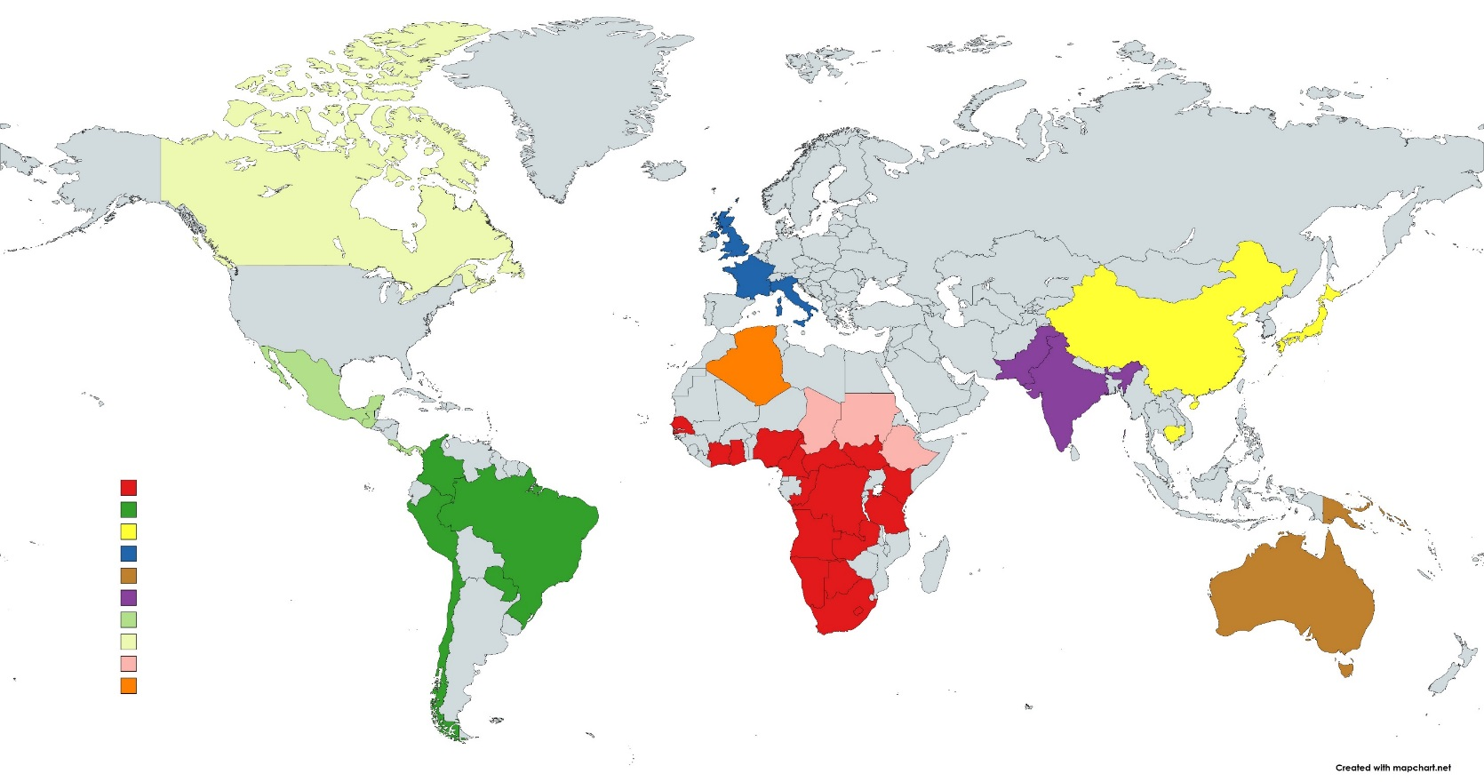
Principal Component Analysis of 645 microsatellite loci
Algerians are genetically intermediate between Europeans and Africans.
Data from: Pemberton, DeGiorgio, & Rosenberg. 2013. Population Structure in a Comprehensive Genomic Data Set on Human Microsatellite Variation. G3 (Bethesda) 3(5): 891–907

Slide 52

Principal Component Analysis of 645 microsatellite loci
Middle Easterners are intermediate between Europeans, South Asians, & Algerians.
Data from: Pemberton, DeGiorgio, & Rosenberg. 2013. Population Structure in a Comprehensive Genomic Data Set on Human Microsatellite Variation. G3 (Bethesda) 3(5): 891–907

Slide 53
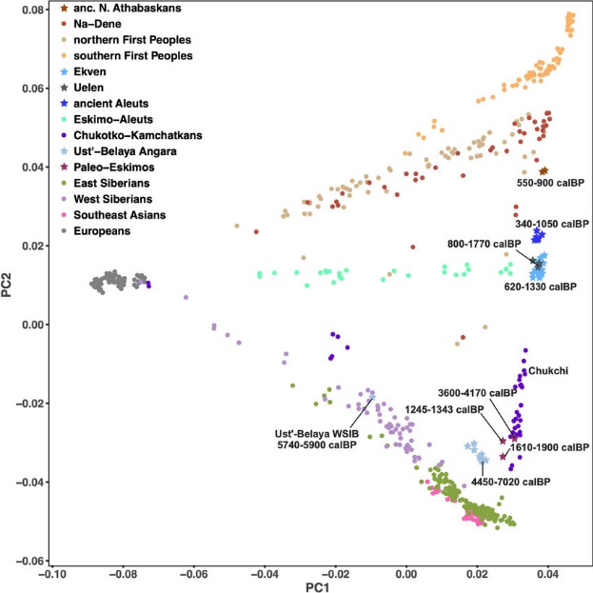
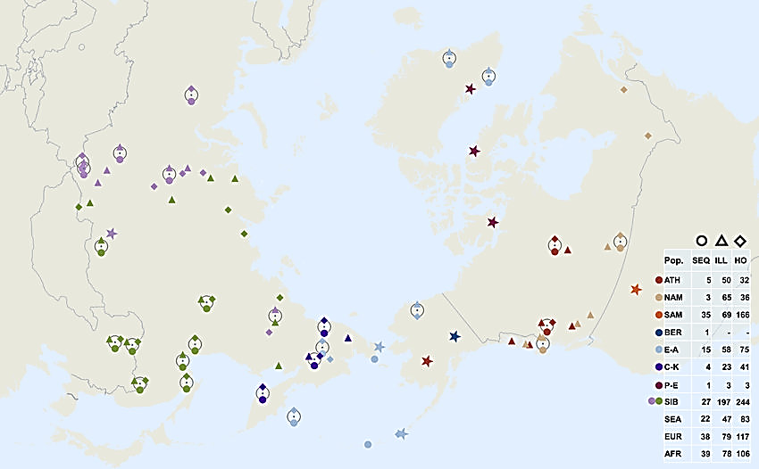
Native humans from northeastern Russia, Alaska, northern Canada, and Greenland are genetically intermediate between more southern Native Americans and East Asians.
North America
Americas
Ancient Northern Canada, Greenland, Alaska, & NE Russia
Europe
Northeast Siberia
Southeast Asia
524,830 loci
Flegontov et al. 2019. Palaeo-Eskimo genetic ancestry and the peopling of Chukotka and North America. Nature. 570. 10.1038/s41586-019-1251-y.

Slide 54
Native humans from northeastern Russia, Alaska, northern Canada, and Greenland are genetically intermediate between more southern Native Americans and East Asians.

Slide 55
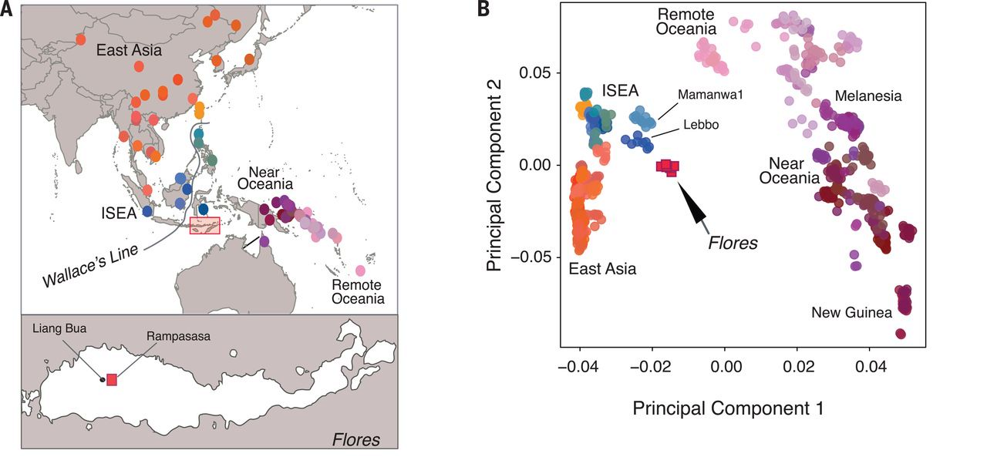
Indonesians & Malaysians are genetically intermediate between East Asians & Oceanians.

Slide 56
Principal Component Analysis
Indonesians & Malaysians are genetically intermediate between East Asians & Oceanians.

Slide 57
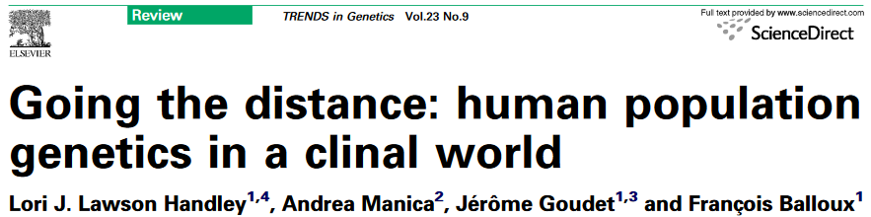
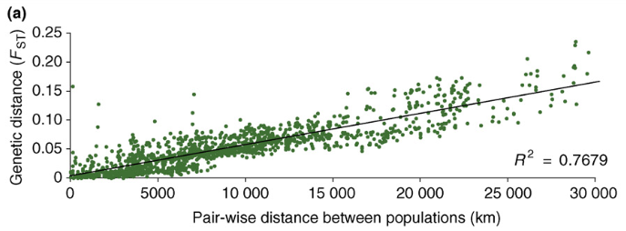
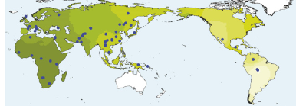
Lecture 04.4

Slide 58
Rather than discrete human populations that can be easily delineated, …
…genetic variation is clinal, and attempts to delineate population (i.e., racial) boundaries are subjective.

Slide 59
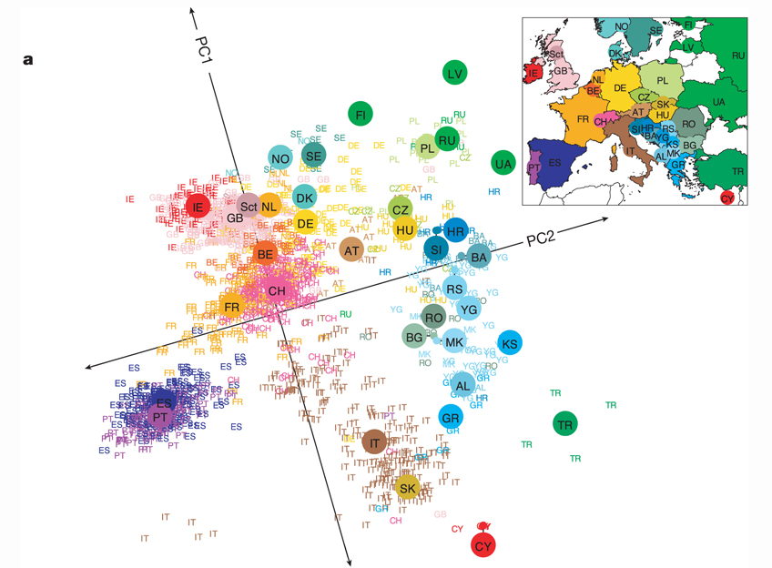
Fine-scale population structure exists within “racial” groups (lecture 05.4)
Population structure within Europe
Note the pattern of isolation-by-distance
  Populations that cluster geographically also cluster genetically
  PC1 separates populations along a north-south gradient.
  PC2 separates populations along an east-west gradient.
Novembre et al. (2008) Nature 456, 98-101

Slide 60
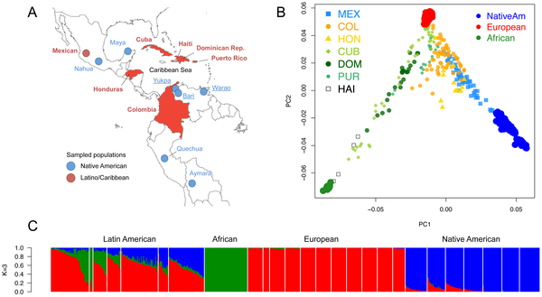
Extensive admixture between “racial” groups (lecture 05.4)
Figure 1. Population structure of Caribbean and neighboring populations of humans.
Moreno-Estrada A, Gravel S, Zakharia F, McCauley JL, et al. (2013) Reconstructing the Population Genetic History of the Caribbean. PLoS Genet 9(11): e1003925.

Slide 61
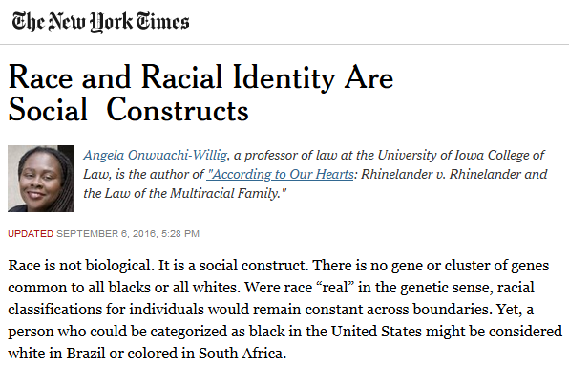

Slide 62

Population
History
Immigration (gene flow)
2N_{e}m
+
$$\frac{1}{2N_{e}}$$
2N_{e}µ
Genetic Variation within Population
Mutation
Genetic Drift
+
-
2N_{e}s
Human evolution
Natural selection
Humans originated in Africa.
Sequential founder events (bottlenecks) resulted in strong genetic drift as humans colonized the globe.
  Drift caused changes in allele frequencies, including those that code for phenotypic characters.
Mutation gave rise to new allelic variants.
Gene flow (migration) between archaic hominins and anatomically modern humans resulted in new allelic variants entering the human population.
Natural selection favored allelic variants (ancestral variants, new mutations, & introgressed alleles) that provided an advantage in novel environments.
Subsequent human migration (ancient & recent) resulted in admixture, hindering population divergence.
Interactions between mutation, genetic drift, gene flow, & natural selection gave rise to strong, but continuous, phenotypic variation throughout the human population.

Slide 63
Thanks for taking my class!

