Slide 1
Coalescent Theory
Population Genomics
University of Miami
Spring 2023

Slide 2
Introduction to Coalescent Theory
Phylogenetics: Trees & genealogies
Population
Genetics: Allele frequencies
Coalescent
Theory
Coalescence theory: A theory that describes the ancestry of a sample of genetic variation in terms of a genealogy.

Slide 3

Introduction to Coalescent theory
Coalescent theory: moving back in time, alleles join at a common ancestor with a predictable probability
Coalescent event: the process of lineages merging at a common ancestor
coalescence
1 generation
ago:
Probability = $\frac{1}{2N}$
Sample of gene copies from a population
Present:

Slide 4
Introduction to Coalescent theory
Coalescent theory: moving back in time, alleles join at a common ancestor with a predictable probability
Coalescent event: the process of lineages merging at a common ancestor
1 generation
ago:
Sample of gene copies from a population
Present:

Slide 5
The Wright-Fisher Model of Genetic Drift
Coalescent theory is similar to the Wright-Fisher Model
  Wright-Fisher models allele frequencies forward in time (into the future)
    Follow entire population
  Coalescent models allele frequencies backward in time (into the past)
    Trace genealogical history of a sample
    Relates directly to real data sampled from populations
    Offers flexibility for analyzing data under diverse models of population history
Wright-Fisher
Coalescence
t
t - 6
t + 1
t - 5
t + 2
t - 4
t + 3
t - 3
t + 4
t - 2
t + 5
t - 1
t + 6
t*

Slide 6
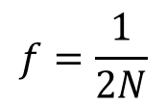
Introduction to coalescent theory: fundamental questions
What is the probability that two random copies will coalesce into a common ancestor?
$$f=\frac{1}{2N}$$
What is the expected time for coalescence to a common ancestor for two random samples?
Past
MRCA
Past
Generations
Present
Generations
What is the expected time for coalescence to the most recent common ancestor (MRCA) of all samples?
[TMRCA = time to most recent common ancestor]
Present

Slide 7

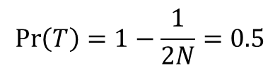
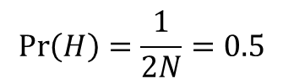
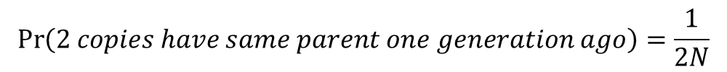
The coalescence time follows a geometric distribution with $E\left(u\right)=2N$
$$\operatorname{Pr}\left(2 copies have same parent one generation ago\right)=\frac{1}{2N}$$
$$\operatorname{Pr}\left(2 copies do not have same parent one generation ago\right)=1−\frac{1}{2N}$$
Coalescence modeled with coin tosses (2N = 2):
Ancestor
$$\operatorname{Pr}\left(H\right)=\frac{1}{2N}=0.5$$
H =
2nd copy coalesces with 1st copy
Present
2nd copy does not coalesce with 1st copy
Ancestor
$$\operatorname{Pr}\left(T\right)=1−\frac{1}{2N}=0.5$$
T =
Present

Slide 8


Coalescence modeled with coin tosses (2N = 2):
50% did not coalesce (tails).
What is the probability of coalescence two generations ago?
t -2
H =
2nd copy coalesces with 1st copy
$$0.5×Pr\left(H\right)=0.5×0.5=0.25$$
Present
t -2
2nd copy does not coalesce with 1st copy
T =
Present
$$0.5×Pr\left(T\right)=0.5×0.5=0.25$$

Slide 9
Coalescence modeled with coin tosses (2N = 2):
50% did not coalesce (tails).
What is the probability of coalescence two generations ago?
t -2
H =
2nd copy coalesces with 1st copy
$$0.5×Pr\left(H\right)=0.5×0.5=0.25$$
Present
t -2
2nd copy does not coalesce with 1st copy
T =
Present
$$0.5×Pr\left(T\right)=0.5×0.5=0.25$$

Slide 10

Coalescence modeled with coin tosses (2N = 2):
25% did not coalesce (tails) yet.
What is the probability of coalescence three generations ago?
t -3
H =
2nd copy coalesces with 1st copy
$$0.25×Pr\left(H\right)=0.25×0.5=0.125$$
Present
t -3
2nd copy does not coalesce with 1st copy
T =
$$0.25×Pr\left(T\right)=0.25×0.5=0.125$$
Present

Slide 11
Coalescence modeled with coin tosses (2N = 2):
25% did not coalesce (tails) yet.
What is the probability of coalescence three generations ago?
t -3
H =
2nd copy coalesces with 1st copy
$$0.25×Pr\left(H\right)=0.25×0.5=0.125$$
Present
t -3
2nd copy does not coalesce with 1st copy
T =
$$0.25×Pr\left(T\right)=0.25×0.5=0.125$$
Present

Slide 12


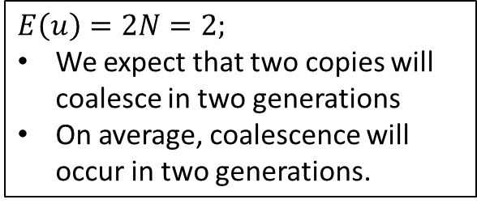
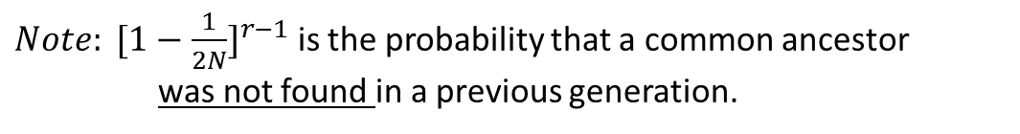
Coalescence modeled with coin tosses (2N = 2):
What is the probability of coalescence n generations ago?
$$E\left(u\right)=2$$
$$Generation t−1: Pr\left(H\right)=0.5$$
$$Generation t−2:0.5 ×Pr\left(H\right)=0.5 ×0.5=0.25$$
$$Generation t−3:0.25×Pr\left(H\right)=0.25×0.5=0.125$$
$$Generation t−4:0.125×Pr\left(H\right)=0.125×0.5=0.0625$$
$Generation t−5:0.0625×Pr\left(H\right)=0.0625×0.5=0.0$3125
$Generation t−6:0.03125×Pr\left(H\right)=0.03125×0.5=0.0$1525
.
.
.
$E\left(u\right)=2N=2;$
We expect that two copies will coalesce in two generations
On average, coalescence will occur in two generations.
$$\operatorname{Pr}\left(2 gene copies find common ancestor in generation r\right)={[1−\frac{1}{2N}]}^{r−1}[\frac{1}{2N}]$$
$Note: {[1−\frac{1}{2N}]}^{r−1}$ is the probability that a common ancestor was not found in a previous generation.

Slide 13
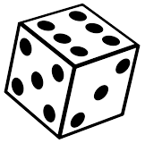
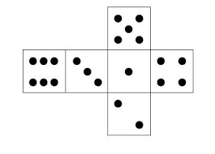
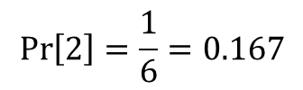
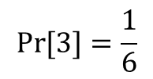
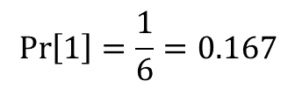
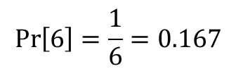
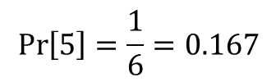
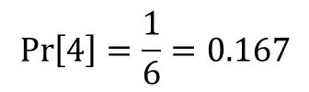
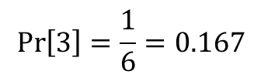
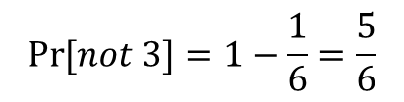
Coalescence of n = 2 samples in a population of $2N=6$ gene copies.
Sampled gene copies
Population:
Unsampled gene copies
$$\operatorname{Pr}\left(2 copies have same parent one generation ago\right)=\frac{1}{2N}$$
$$\operatorname{Pr}\left(2 copies do not have same parent one generation ago\right)=1−\frac{1}{2N}$$
Sample 1:
$$\operatorname{Pr}\left[1\right]=\frac{1}{6}=0.167$$
$$\operatorname{Pr}\left[2\right]=\frac{1}{6}=0.167$$
?
$$\operatorname{Pr}\left[3\right]=\frac{1}{6}=0.167$$
n = 2, 2N =6
Sample 2:
$$\operatorname{Pr}\left[4\right]=\frac{1}{6}=0.167$$
$$\operatorname{Pr}{[3]}=\frac{1}{6}$$
$$\operatorname{Pr}\left[5\right]=\frac{1}{6}=0.167$$
$$\operatorname{Pr}\left[6\right]=\frac{1}{6}=0.167$$
$$\operatorname{Pr}{[not 3]}=1−\frac{1}{6}=\frac{5}{6}$$

Slide 14
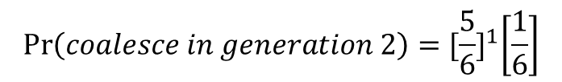

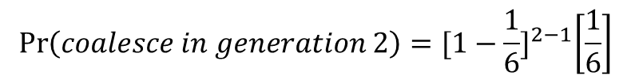
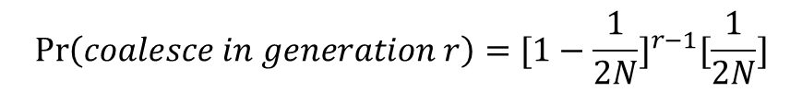
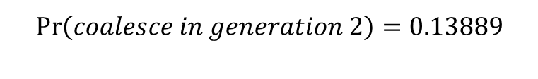
Coalescence of n = 2 samples in a population of $2N=6$ gene copies.
$\operatorname{Pr}{[coalesce one generation ago]}=\frac{1}{6}$ = 0.167
$\operatorname{Pr}{[does not coalesce one generation ago]}=1−\frac{1}{6}=\frac{5}{6}$ = 0.833
$$\operatorname{Pr}\left(coalesce in generation r\right)={[1−\frac{1}{2N}]}^{r−1}[\frac{1}{2N}]$$
$$\operatorname{Pr}\left(coalesce in generation 2\right)={[1−\frac{1}{6}]}^{2−1}\left[\frac{1}{6}\right]$$
$$\operatorname{Pr}\left(coalesce in generation 2\right)={[\frac{5}{6}]}^{1}\left[\frac{1}{6}\right]$$
$$\operatorname{Pr}\left(coalesce in generation 2\right)=0.13889$$

Slide 15
Coalescence of n = 2 samples in a population of $2N=6$ gene copies.
$\operatorname{Pr}{[coalesce one generation ago]}=\frac{1}{6}$ = 0.167
$\operatorname{Pr}{[does not coalesce one generation ago]}=1−\frac{1}{6}=\frac{5}{6}$ = 0.833
$$\operatorname{Pr}\left(coalesce in generation r\right)={[1−\frac{1}{2N}]}^{r−1}[\frac{1}{2N}]$$
$$\operatorname{Pr}\left(coalesce in generation 2\right)={[1−\frac{1}{6}]}^{2−1}\left[\frac{1}{6}\right]$$
$$\operatorname{Pr}\left(coalesce in generation 2\right)={[\frac{5}{6}]}^{1}\left[\frac{1}{6}\right]$$
$$\operatorname{Pr}\left(coalesce in generation 2\right)=0.13889$$

Slide 16
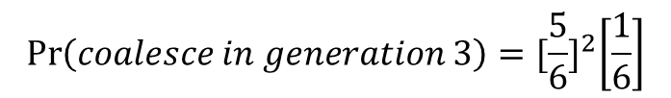
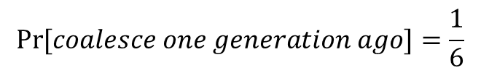
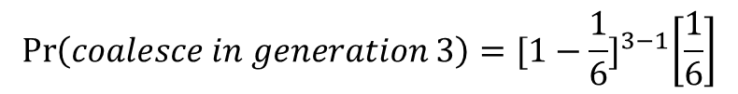
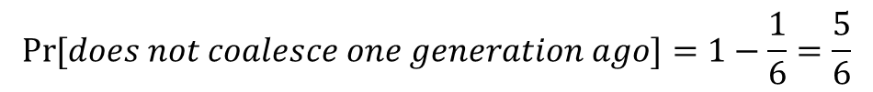
Coalescence of n = 2 samples in a population of $2N=6$ gene copies.
$$\operatorname{Pr}{[coalesce one generation ago]}=\frac{1}{6}$$
$$\operatorname{Pr}{[does not coalesce one generation ago]}=1−\frac{1}{6}=\frac{5}{6}$$
$$\operatorname{Pr}\left(coalesce in generation r\right)={[1−\frac{1}{2N}]}^{r−1}[\frac{1}{2N}]$$
$$\operatorname{Pr}\left(coalesce in generation 3\right)={[1−\frac{1}{6}]}^{3−1}\left[\frac{1}{6}\right]$$
$$\operatorname{Pr}\left(coalesce in generation 3\right)={[\frac{5}{6}]}^{2}\left[\frac{1}{6}\right]$$
$$\operatorname{Pr}\left(coalesce in generation 3\right)=\text{0.694444}×0.166667$$
$$\operatorname{Pr}\left(coalesce in generation 3\right)=\text{0.115741}$$

Slide 17
Coalescence of n = 2 samples in a population of $2N=6$ gene copies.
$$\operatorname{Pr}{[coalesce one generation ago]}=\frac{1}{6}$$
$$\operatorname{Pr}{[does not coalesce one generation ago]}=1−\frac{1}{6}=\frac{5}{6}$$
$$\operatorname{Pr}\left(coalesce in generation r\right)={[1−\frac{1}{2N}]}^{r−1}[\frac{1}{2N}]$$
$$\operatorname{Pr}\left(coalesce in generation 3\right)={[1−\frac{1}{6}]}^{3−1}\left[\frac{1}{6}\right]$$
$$\operatorname{Pr}\left(coalesce in generation 3\right)={[\frac{5}{6}]}^{2}\left[\frac{1}{6}\right]$$
$$\operatorname{Pr}\left(coalesce in generation 3\right)=\text{0.694444}×0.166667$$
$$\operatorname{Pr}\left(coalesce in generation 3\right)=\text{0.115741}$$

Slide 18

Coalescence of n = 2 samples in a population of $2N=6$ gene copies.
The coalescence time follows a geometric distribution with $E\left(u\right)=2N=6$
The time to coalescence is called the waiting time. How long do you have to wait until a 3 is rolled?
$$E\left(u\right)=2N=6$$

Slide 19
N = 1000 replicates
Stochasticity:
# of heads in 1000
coin tosses
follows binomial distribution.
Number of heads
Coalescence:
Waiting time as
# of tosses before heads follows
geometric distribution
E(heads) = 1/p = 1/0.5 = 2

Slide 20
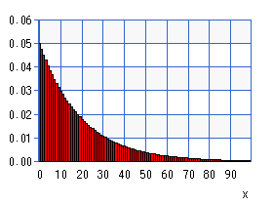
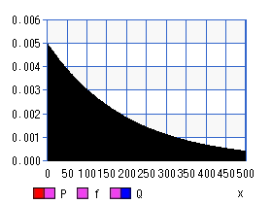
Coalescence: Waiting time follows a geometric distribution
N = 10 The expected waiting time is short
E(u₂) = 20
Proportion
N = 100 The expected waiting time is longer
E(u₂) = 200
Generations
Coalescence has a high variance which is related to N

Slide 21
Summary for this section
The probability of coalescence is inversely correlated with population size (N)
  The probability of coalescence is larger in smaller population sizes
The waiting time for coalescence is positively correlated with population size
  Coalescence requires more time in larger populations
  Less time in smaller populations
There is wide variance in coalescence times, especially for large populations
Coalescence is a stochastic process—the outcome of any one (coalescent) event is not predictable, but the average outcome of many events is predictable.

Slide 22
TMRCA

Slide 23
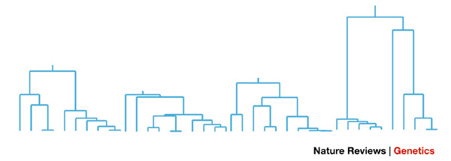
Random genealogical trees generated by coalescent process
Four trees generated using a standard coalescent model
for a sample size of N = 10.
Rosenberg and Nordborg 2002

Slide 24
Time is Measured in Substitutions (Tree Height)
3 substitutions
E(u₂) = 3 substitutions/copy/lineage
E(u₃) = 1.5 substitutions/copy/lineage
1.5 substitutions
1 substitution =

Slide 25
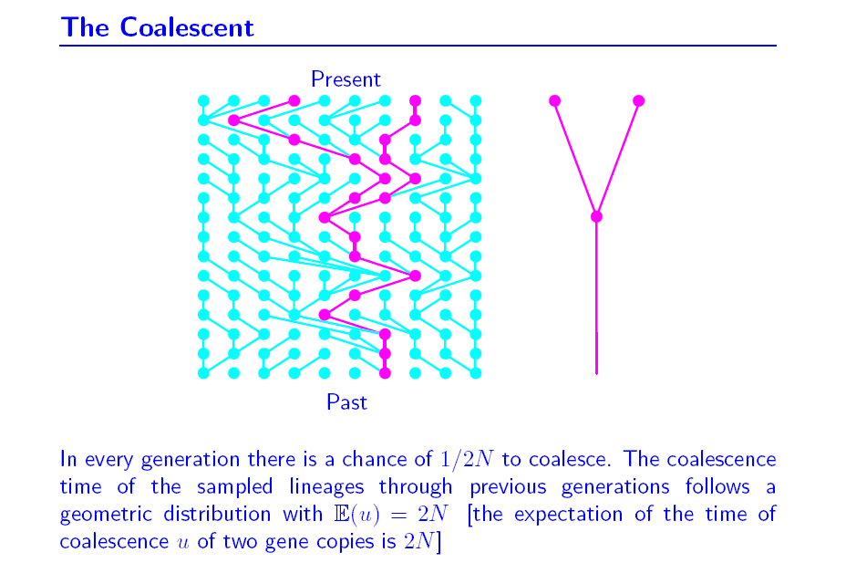
(k = 2 gene copies)
2N generations
N = 10
E(u₂) = 20
Proportion

Slide 26
(n gene copies)
Ex. If k = 4 and N = 100, then [4*(4-1)]/(4*100) = 0.03]
There is a 3% chance that 4 sampled copies from a population of 100 will coalesce to 3 ancestors one generation ago.

Slide 27
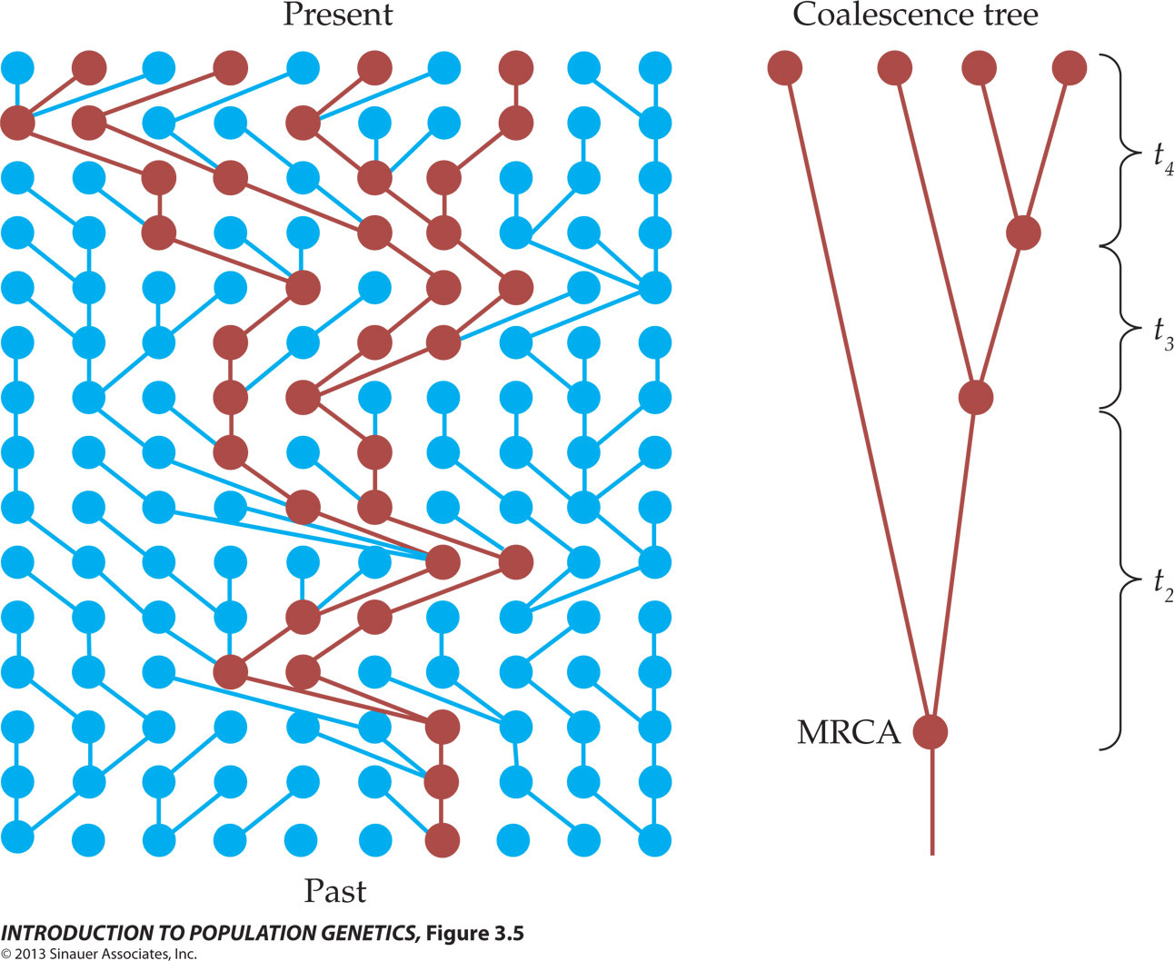

Slide 28
Ex. If k = 4 and N = 100, then 4 copies are expected to coalesce to 3 ancestors in {(4*100)/[4*(4-1)]} generations; or 33.3 generations

Slide 29
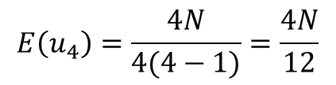
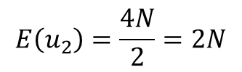

$$E\left(u_{4}\right)=\frac{4N}{4(4−1)}=\frac{4N}{12}$$
$$E\left(u_{3}\right)=\frac{4N}{6}$$
$$E\left(u_{2}\right)=\frac{4N}{2}=2N$$

Slide 30
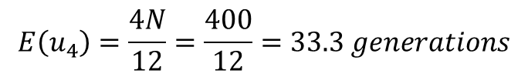
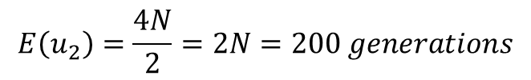
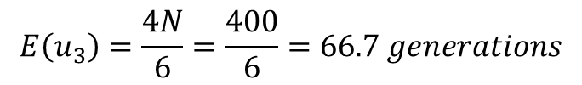
N = 100
$$E\left(u_{4}\right)=\frac{4N}{12}=\frac{400}{12}=33.3 generations$$
$$E\left(u_{3}\right)=\frac{4N}{6}=\frac{400}{6}=66.7 generations$$
$$E\left(u_{2}\right)=\frac{4N}{2}=2N=200 generations$$
The probability of coalescence decreases as you move back further in time (as the number of gene copies decreases).
The waiting time is longer.

Slide 31
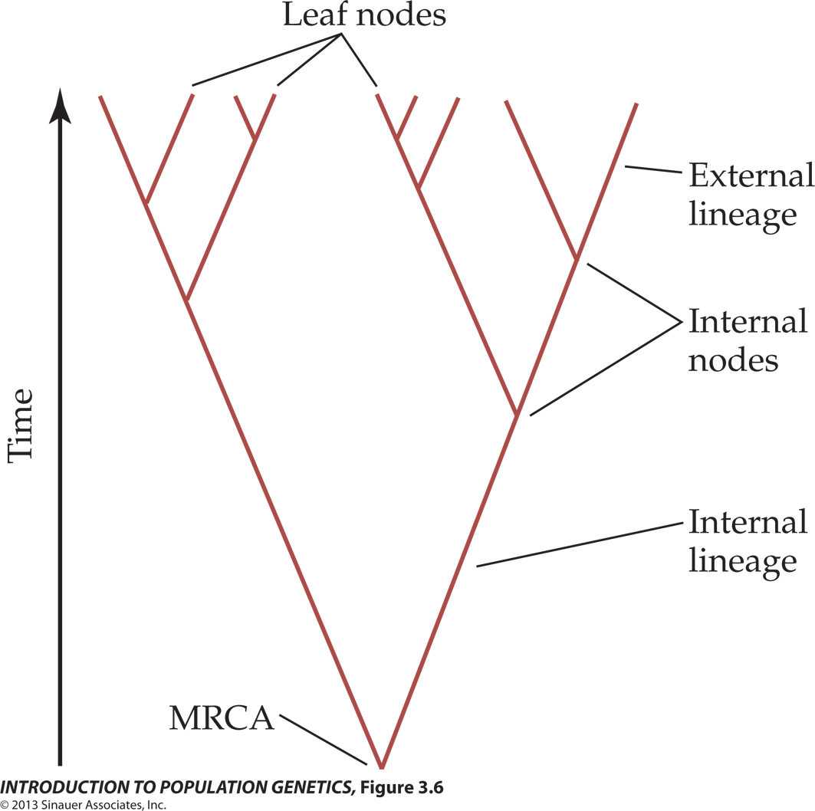
(Present-day samples)
The probability of coalescence decreases as you move back further in time (as the number of gene copies decreases)
  External lineages are shorter than internal lineages
(Common ancestors)
Figure 3.6 An example of a coalescence tree

Slide 32
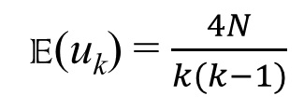
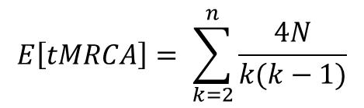
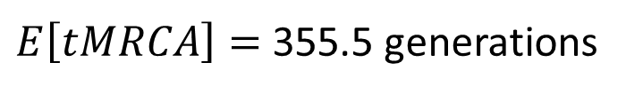
Time to Most Recent Common Ancestor
E(u_{k}) = $\frac{4N}{k(k−1)}$
$$E\left[tMRCA\right]= \sum_{k=2}^{n}{\frac{4N}{k(k−1)}}$$
E(u₁₀) = (4*100)/(10*(10-1)) = 4.4 generations
E(u₉) = (4*100)/(9*(9-1)) = 5.6 generations
E(u₈) = (4*100)/(8*(8-1)) = 7.1 generations
E(u₇) = 9.5 generations
E(u₆) = 13.3 generations
E(u₅) = 20.0 generations
E(u₄) = 33.3 generations
E(u₃) = 66.7 generations
E(u₂) = 200 generations
$E\left[tMRCA\right]=$ 355.5 generations

Slide 33
Coalescence is a noisy process—it is stochastic
Think of coalescence events being randomly draw from the geometric distribution
Results in high variation in the shape of genealogies
10 genealogies generated under the same population size (N = 10,0000)

Slide 34
Summary
If we know N, we can estimate the geometric distribution of coalescent events and the TMRCA in a genealogy.
Application: If we have a genealogy, we can estimate N based on the geometric distribution of coalescent events and the TMRCA.

Slide 35
Neutral Parameter
4Ν_{e}μ = θ

Slide 36
Applying coalescent theory to populations
Given that coalescence occurs with a predictable probability that is a function of N_{e}, if we know the genealogy, we can estimate N_{e} from the frequencies of coalescent times.
Problems:
We cannot determine time directly from a genealogy.
We do not know the precise genealogy.

Slide 37
Applying coalescent theory to populations
Problem: We cannot determine time directly from a genealogy
Solution
Time is scaled to the mutation rate (µ)
  In x generations since coalescence, we expect µx mutations to have occurred on a lineage.
  The number of mutations separating two randomly-selected gene copies is given by 4N_{e}µ.
  We define Ө = 4N_{e}µ
  By scaling to the mutation rate, we can estimate Ө directly from the genealogy.

Slide 38
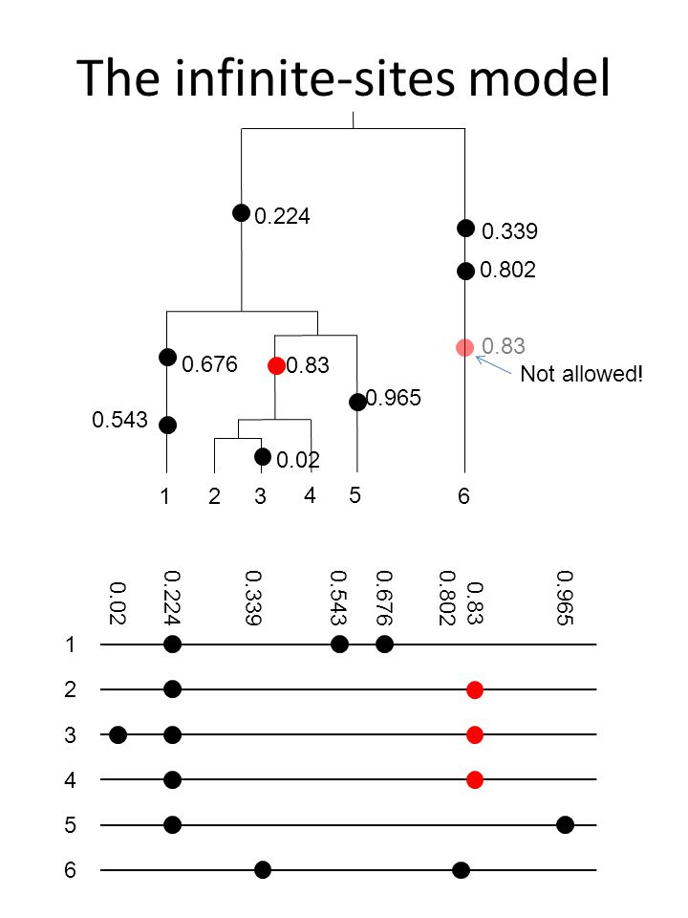
Infinite sites model of mutation
Mutations are rare, so each new mutation creates a new variable site.
No site experiences >1 mutation (i.e., there is no homoplasy).
Applies to DNA sequence data (SNPs)
Shared mutations indicate common ancestry
  Construct genealogies
Note that more complex substitution models have been developed.
  Applying different weights to different mutations.
    Transitions > tranversions, e.g., HKY
    Invariable sites (some nucleotide positions are conserved)
    Etc.
Kimura (1969) The Number of Heterozygous Nucleotide Sites Maintained in a Finite Population Due to Steady Flux of Mutations. Genetics 61:893–903.

Slide 39
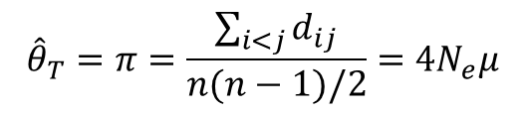
Estimators of Θ
Tajima’s estimator = average number (or proportion) of pairwise differences (π)
$${\hat{θ}}_{T}=π=\frac{\sum_{i<j}{d_{ij}}}{n(n−1)/2}=4N_{e}μ$$
^ (“hat”) indicates that this is an estimator

Slide 40
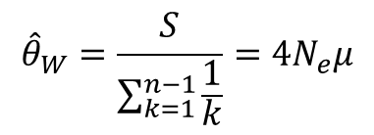

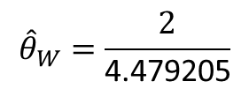
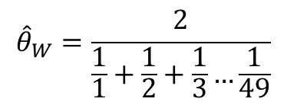
Estimators of Θ
Watterson’s estimator = number (or proportion) of segregating sites (S)
Segregating site—a position in a DNA sequence that differs between two or more individuals
n
28
21
1
…GCTGTGGGCAAGAAGGCAGATTGAGCCCCGTGTACGCTGC… allele A
…GCTGTGGGCAAGGAGGCAGATTGAGCCCCGTGTACGCTGC… allele B
…GCTGTGGGCAAGAAGGCAGATTGAGCCCTGTGTACGCTGC… allele C
There are two segregating sites (S = 2) in this sample of DNA sequences
$${\hat{θ}}_{W}=\frac{S}{\sum_{k=1}^{n−1}{\frac{1}{k}}}=4N_{e}μ$$
$${\hat{θ}}_{W}=\frac{2}{\frac{1}{1}+\frac{1}{2}+\frac{1}{3}…\frac{1}{49}}$$
n is the number of samples, and k is all from 1 to $n−1$
$${\hat{θ}}_{W}=\frac{2}{\text{4.479205}}$$
$${\hat{θ}}_{W}=\text{0.446508}$$

Slide 41
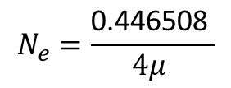



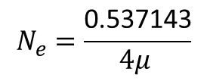




Estimators of Θ
n
28
21
1
…GCTGTGGGCAAGAAGGCAGATTGAGCCCCGTGTACGCTGC… allele A
…GCTGTGGGCAAGGAGGCAGATTGAGCCCCGTGTACGCTGC… allele B
…GCTGTGGGCAAGAAGGCAGATTGAGCCCTGTGTACGCTGC… allele C
Tajima’s estimator
Watterson’s estimator
$${\hat{θ}}_{T}=\text{0.537143}$$
$${\hat{θ}}_{W}=\text{0.446508}$$
*Both are estimates of $4N_{e}μ$*
$4N_{e}μ$ = 0.537143
$4N_{e}μ$ = $\text{0.446508}$
$$N_{e}=\frac{\text{0.537143}}{4μ }$$
$$N_{e}=\frac{\text{0.446508} }{4μ }$$
If µ = 10⁻⁷ substitutions per locus per generation, then
$$N_{e}=1,342,857 individuals$$
$$N_{e}=\text{1}\text{,}\text{116}\text{,}\text{269} individuals$$
These estimators only provide point estimates of Θ. Do the two estimates differ from each other? What is our confidence interval for Θ?
Applying coalescence theory provides a measure of uncertainty in estimates of Θ.

Slide 42
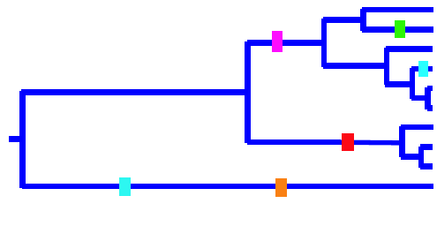
Construct genealogies and infer time from mutations.
Map mutations onto a genealogy.
Mutations occur with an associated probability given by the mutation rate (µ).
Expect µ x l mutations per lineage in the tree.
Mutation is a stochastic force—the sequence of events are random, but they occur at a predictable frequency (the outcome of a single event cannot be predicted, but the average over many replicates can be predicted)

Slide 43
Applying coalescent theory to populations
Given that coalescence occurs with a predictable probability that is a function of N_{e}, if we know the genealogy, we can estimate N_{e} from the frequencies of coalescent times.
Problems:
We cannot determine time directly from a genealogy.
We do not know the precise genealogy.

Slide 44
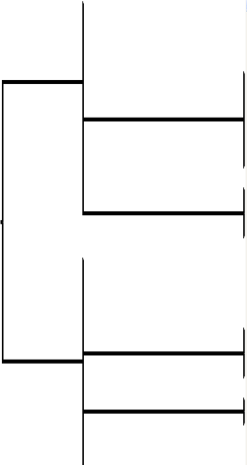
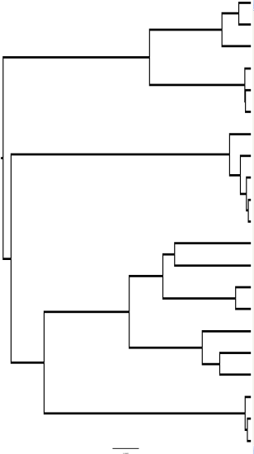
Applying Coalescent Theory to Populations
Many genealogies are consistent with the data:
N
TCGAGGTATTAAC 3
TCTAGGTATTAAC 6
TCGAGGCATTAAC 5
TCTAGGTGTTAAC 3
TCGAGGTATTAGC 3
TCTAGGTATCAAC 2

Slide 45
Applying coalescent theory to populations
Problem: We do not know the precise genealogy
Solution
Estimate Ө for many genealogies that are consistent with the data
Use Markov Chain Monte Carlo to update genealogies and obtain estimates of Ө
Markov Chain Monte Carlo: a class of algorithms for sampling from a probability distribution by recording states from the chain.

Slide 46
MCMC Application

Slide 47
Applying coalescent theory to populations
Markov Chain Monte Carlo
Considers millions or even billions of genealogies consistent with the data
Estimate time to coalescence from each genealogy
  Expect µ x l mutations per lineage, and
  An average of 4N_{e}µ mutations to separate two random copies
Provides a posterior distribution of values of Θ and the probability associated with each value
Peak of the distribution is the “best” estimate of Θ
Variance (95% HPD—highest posterior density) around estimate provides measure of confidence
  Incorporates the influence of stochastic variance in both mutation and drift
Posterior distribution of estimates of Θ
Best estimate
Posterior probability
95% HPD
Ө (4N_{e}µ)

Slide 48
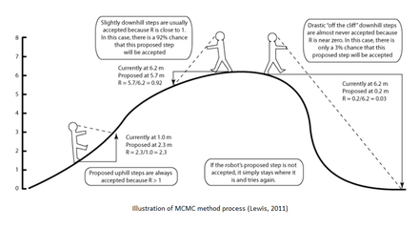

Markov Chain Monte Carlo
likelihood of parameter
estimate
burnin
period
(discard)
sample
period
(keep)
Softwares
LAMARC - Mary Kuhner
Migrate - Peter Beerli
MS - Dick Hudson (simulated data)
IM - Jody Hey
BEAST - Alexei Drummond
Sampling different genealogies using MCMC (e.g., >100,000) & recording parameter estimates each step

Slide 49


Slide 50
Markov Chain Monte Carlo
Typical sampling period might include 100,000 burnin steps & 500,000 samples (end point is user defined by the # steps).
MCMC “improves” max. likelihood (−lnL) at each step (like the robot analogy).
Algorithm can take a long time to run depending on # of parameters and level of nucleotide diversity (i.e., complexity of the genealogy).
Final sample provides posterior probability of the parameter estimate (this technique is Bayesian).

Slide 51
Credit – Paul Lewis & Mark Holder

Slide 52

Global Optimum (s.) vs. Local Optima (pl.)
Global optimum is the parameter estimate with the greatest maximum likelihood (−lnL).
You will find the global optimum if you run the MCMC algorithm long enough.
But likelihood surfaces can be complex.
−lnL
Likelihood Surface

Slide 53
2 Ways to Reach the Global Optimum Faster
Use independent runs of the program (chains) that start the analysis (using random # seed) at different points on the likelihood surface.
Heating – mathematically flattens the likelihood surface so your MCMC is less likely to get stuck at local optima, and moves to the global optimum faster.

Slide 54
Credit – Paul Lewis & Mark Holder

Slide 55


Slide 56


Slide 57
Population Models
Samples vs. Loci

Slide 58




mtDNA genealogies in two species of ducks
American Wigeon
Anas americana
Gadwall
Anas strepera
Which has the larger N_{e}?

Slide 59

Parameters
T = time
t = tree height
u = mutation rate
N = Pop size
m = migration
*this model
assumes no pop
growth

Slide 60

Parameters
T = time
t = tree height
u = mutation rate
N = Pop size
m = migration
*this model does assume pop growth (exponential)
s = splitting parameter (can indicate direction of colonization)
s = 0 or 1 implies founder event
Past
Present

Slide 61

To further simplify calculations, must define a single tree.

Slide 62

3, 4, 5 etc. Population Models
Big problem for genealogy samplers - as # populations increases linearly, # parameters to be estimated increases logarithmically.
Jody Hey – IMa2 Documentation

Slide 63
mtDNA genealogies in two species of ducks
American Wigeon
Gadwall
Θ = 0.0187
95% HPD = 0.012 – 0.029
Θ = 0.0086
95% HPD = 0.0050 – 0.014
Cannot reject null hypothesis of equal effective population sizes (e.g., Θ = 0.012 – 0.014 can generate either genealogy some of the time).

Slide 64
Coalescence methods: estimate Ө from all possible genealogies consistent with the data
Best estimates
Posterior probability
Some overlap – cannot reject null hypothesis of no difference in N_{e}
Ө (N_{e}µ for mtDNA)
Estimated using the coalescent program Lamarc

Slide 65
How can we improve our estimates to better account for stochasticity generated by genetic drift?
Adding individuals to a coalescent analysis will only help parameter estimates slightly, and it will greatly slow down computational time.
Adding additional base pairs from a single locus will only help slightly.
  Adds more information (more sites with mutations) for constructing genealogy & estimating coalescence times.
  The locus is evolving as a single unit (only a single outcome of the stochastic process).
  The presence of recombination will lead to upward bias in ϴ.
However, genetic drift is independent across unlinked loci, so adding multiple loci short enough to be non-recombining is the best way to go.

Slide 66
Multiple unlinked loci provide independent estimates of Θ
*Multiple outcomes of the stochastic process
Four trees generated using a standard coalescent model
for a sample size of ten.

Slide 67
Estimates of Ө from 20 independent autosomal loci
Posterior distribution
No overlap
ϴ (4N_{e}µ)
Wigeons have a significantly larger N_{e} than gadwalls (stochastic drift is insufficient for explaining differences in genetic diversity)

Slide 68
Estimates of Ө from the single mtDNA locus
Posterior probability
Some overlap – cannot reject null hypothesis of no difference in N_{e}
Ө (N_{e}µ for mtDNA)

Slide 69

The value of adding samples to estimate TMRCA
$$E\left[tMRCA\right]$$
Number of gene copies sampled (n)
A sample size of n = 8 provides a 95% chance of sampling the deepest coalescence (MRCA) in a population.

Slide 70
Summary
Coalescence theory can be applied to estimate N_{e} from genealogies sampled from natural population.
When applying coalescence theory, time is scaled to the mutation rate.
  Thus, N_{e} is scaled to the mutation rate (Ө = 4N_{e}µ)
Estimating Ө from many genealogies that are consistent with the genetic data compensates for not knowing the true genealogy.
Analyzing many loci is the best way to improve coalescent estimates of Ө.

Slide 71
Considerations Related to Recombination

Slide 72

Difficult to incorporate recombination in genealogy samplers – only LAMARC
The evolutionary genomics of pathogen recombination
Philip Awadalla
Nature Reviews Genetics 4, 50-60 (January 2003)
doi:10.1038/nrg964

Slide 73

Effect of recombination on the genealogy
recombination event
Sequence on one side of the genealogy has this genealogy
Sequence on other side of the genealogy has this genealogy

Slide 74
In practice it is common to eliminate recombining sites by trimming sequences to largest non-recombining fragment.
(1) Use 4 gamete test to identify sites of possible recombination.
(2) Software like IMgc (Hammer Lab, U. Arizona) to trim sequences and eliminate some individuals.
➔ recombination free data set

Slide 75

Four-gamete Test
Statistical power is low. Works when the rec rate is >> mutation rate. If μ is high, infinite-sites assumption is violated and homoplasy creates patterns that look like recombination.
Wikipedia

