Slide 1
Population Subdivision
Population Genomics
University of Miami
Spring 2023

Slide 2

Population Subdivision for Two Populations
2N_{e}μ
Genetic variation; Allele or genotype frequencies
Mutation
Genetic Drift
Migration
2N_{e}μ
Genetic variation; Allele or genotype frequencies
Mutation
Genetic Drift
Mutation and genetic drift (and selection) act independently in each population.
Gene flow homogenizes allele frequencies, offsets drift by increasing Ne.

Slide 3
Different Estimates of Heterozygosity:
HI = mean Obs. H over all subpops = (∑Hobs) / x
*HI per subpop = Hobs = obs f(AB)
HS = Exp. H over all subpops = (∑(2pq)) / x
*Exp. HS per subpop = 2pq based on H-W eq.
HT = Exp. H of random mating total pop = 2pq of total pop
If HT ≠ HS → population subdivision

Slide 4
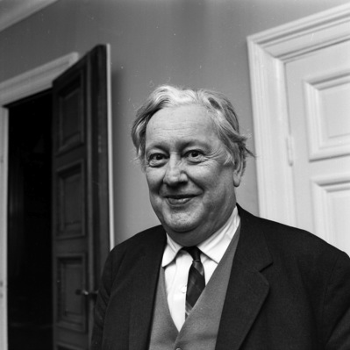
Wahlund Effect
The deficiency of heterozygosity that results from treating multiple populations as a single population.
Even if the subpopulations themselves are in H-W equilibrium.
Caused by geographic barriers + genetic drift.
Sten Wahlund, Uppsala University, Sweden – 1928

Slide 5
Example
 | SUBPOPS
 | A | B | C
f (AA) | 0.64 | 0.20 | 0.30
f (AT) | 0.32 | 0.50 | 0.40
f (TT) | 0.04 | 0.30 | 0.30
f (A) | 0.80 | 0.45 | 0.50
f (T) | 0.20 | 0.55 | 0.50
Total Population
f (A) = (0.80 + 0.45 + 0.50)/3 = 0.58
f (T) = 1 - 0.58 = 0.42
H_{I} = (0.32 + 0.50 + 0.40)/3 = 0.407
H_{S} = (0.32 + 0.495 + 0.50)/3 = 0.438
H_{T} = 2 x (0.58) x (0.42) = 0.487
H_{T} > H_{S} => Pop Structure!
H_{I} = obs (subdivided)
H_{S} = exp (subdivided)
H_{T} = pooled (H-W)
H_{obs} = f (AT) | 0.32 | 0.50 | 0.40
Hexp = 2 x f (A) f (T) | 0.32 | 0.495 | 0.50

Slide 6
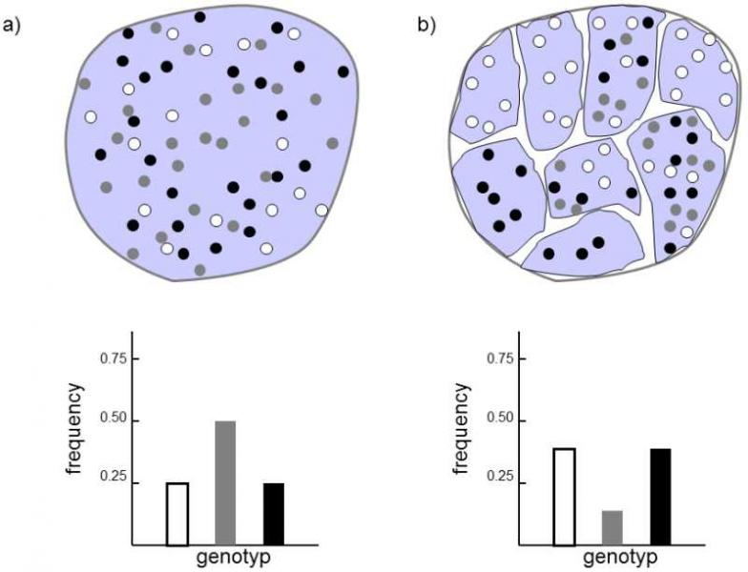
No Population
Subdivision
Population
Subdivision
Heterozygotes disappear from metapopulation
https://www.frozenevolution.com/v21-number-homozygotes-increases-after-large-population-splits-number-smaller-ones

Slide 7
How do we measure population structure?
We use F statistics.
F_{st} = Sewall Wright’s Fixation Index
F_{st} = deviation in allele frequencies among subpopulations relative to what is expected under panmixia (random mating).
F_{st} = H_{t} - H_{s} / H_{t}
F_{st} is bounded by 0 and 1
  0 = populations have identical allelic frequencies.
  1 = populations fixed for different alleles.
Pop1
Pop2

Slide 8
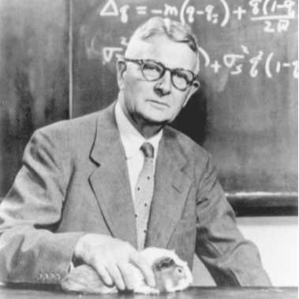
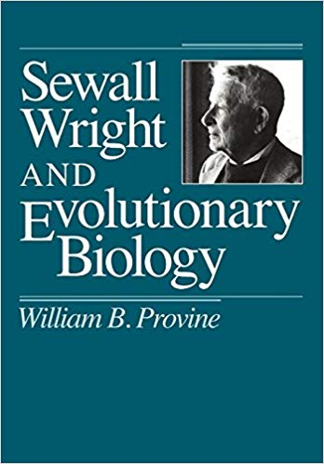
F_{ST} – developed by Sewall Wright

Slide 9
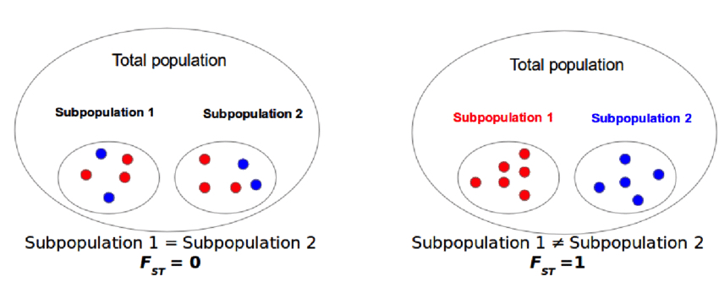
https://www.researchgate.net/figure/Genetic-differentiation-an-example-of-the-behavior-of-fixation-index-FST-If-allele_fig9_306018124

Slide 10
Example F_{ST} Calculation
 | SUBPOPS
 | A | B | C
f (AA) | 0.64 | 0.20 | 0.30
f (AT) | 0.32 | 0.50 | 0.40
f (TT) | 0.04 | 0.30 | 0.30
f (A) | 0.80 | 0.45 | 0.50
f (T) | 0.20 | 0.55 | 0.50
Total Population
f (A) = (0.80 + 0.45 + 0.50)/3 = 0.58
f (T) = 1 - 0.58 = 0.42
H_{I} = (0.32 + 0.50 + 0.40)/3 = 0.407
H_{S} = (0.32 + 0.495 + 0.50)/3 = 0.438
H_{T} = 2 x (0.58) x (0.42) = 0.487
H_{T} > H_{S} => Pop Structure!
H_{obs} = f (AT) | 0.32 | 0.50 | 0.40
Hexp = 2 x f (A) f(T) | 0.32 | 0.495 | 0.50
F_{st} = H_{t} - H_{s} / H_{t} = (0.487 – 0.438)/0.487 = 0.10062
*This is the % reduction in heterozygosity due to genetic differentiation among pops.

Slide 11
Pairwise F_{ST} for Three Subpopulations
Subpop | HS
A | 0.320
B | 0.495
C | 0.500
Mean HS | 0.4383
HT | 0.4870
HT (1 - FST) = HS
0.487 x (1 - FST) = 0.4383
FST = -[(0.4383 / 0.487) -1]
FST = 0.10
*Do this across subpopulations for all pair-wise comparisons:
F_{st} A-B = (((2*((0.8+0.45)/2)*((0.2+0.55)/2))) – ((0.32+0.5)/2)) / ((2*((0.8+0.45)/2)*((0.2+0.55)/2))) =
0.125
F_{st} A-C = (((2*((0.8+0.5)/2)*((0.2+0.5)/2))) – ((0.32+0.4)/2)) / ((2*((0.8+0.5)/2)*((0.2+0.5)/2))) =
0.209
F_{st} B-C = (((2*((0.45+0.5)/2)*((0.55+0.5)/2))) – ((0.5+0.4)/2)) / ((2*((0.45+0.5)/2)*((0.55+0.5)/2))) =
0.0977

Slide 12
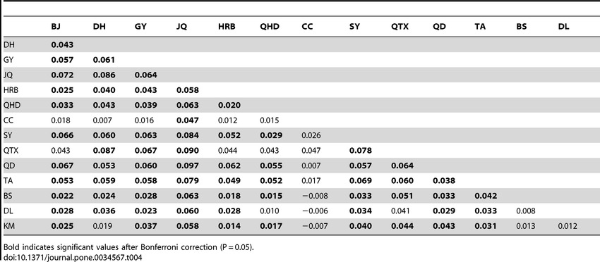
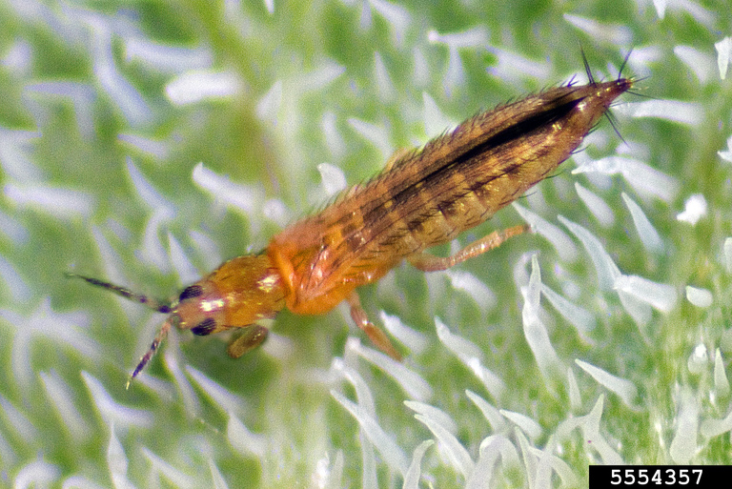
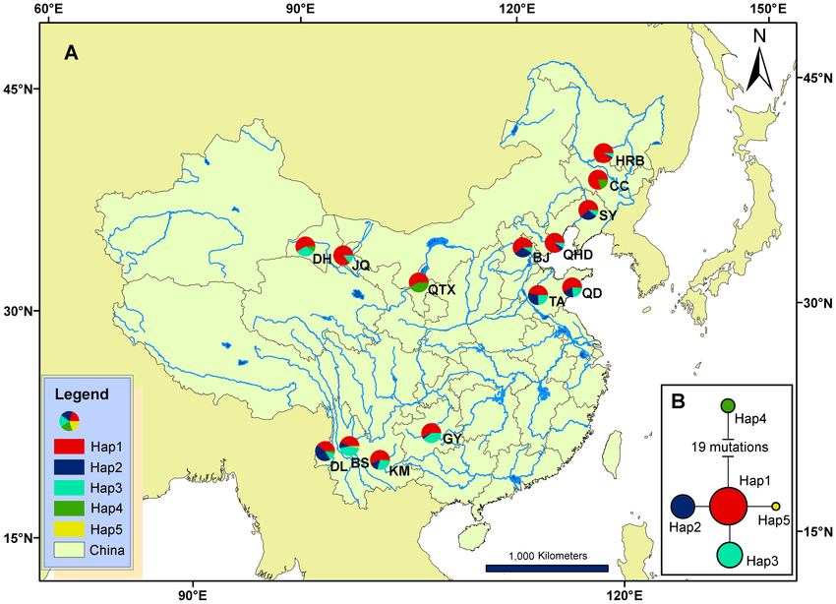
Pairwise F_{ST} for microsatellite loci among 13 localities in China
Invasion Genetics of the Western Flower Thrips in China: Evidence for Genetic Bottleneck, Hybridization and Bridgehead Effect
Xian-Ming Yang,
Jing-Tao Sun,
Xiao-Feng Xue,
Jin-Bo Li,
Xiao-Yue Hong
Published: April 3, 2012
https://doi.org/10.1371/journal.pone.0034567

Slide 13
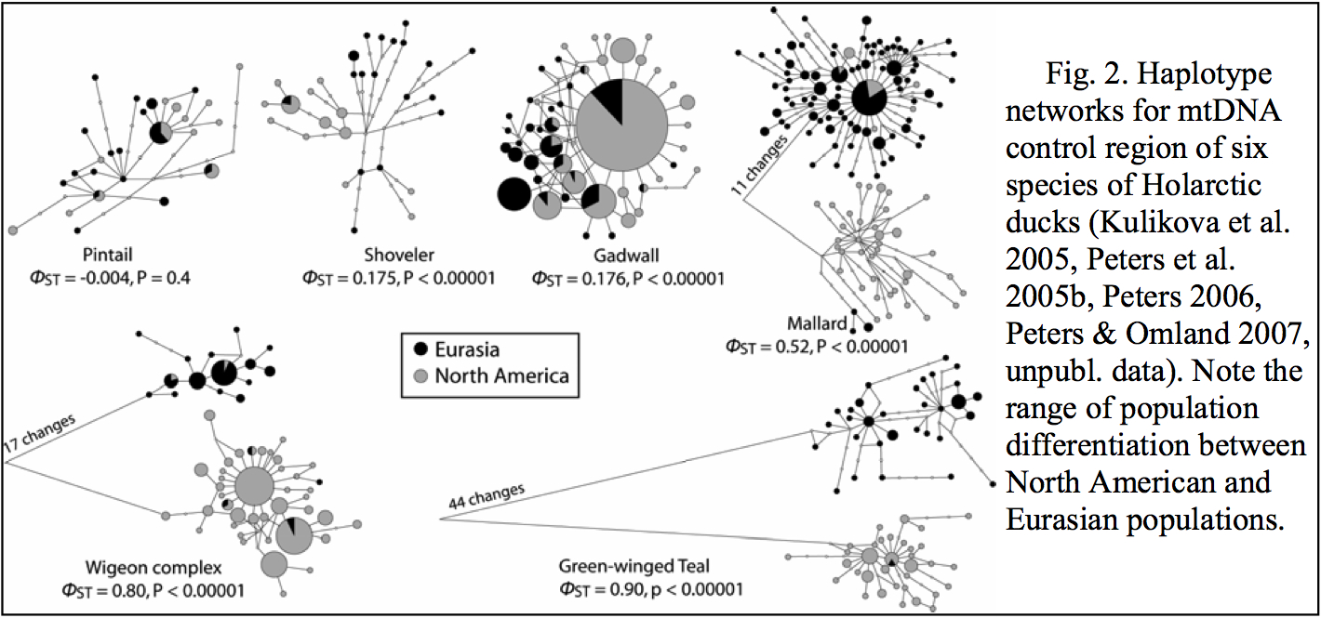

Slide 14


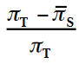
Multiple Loci
Nei (1977, 1987) → F_{st} = H_{t} - H_{s} / H_{t}
---calculate H per locus and avg across all loci
Weir & Cocherham → = Wright’s FST →
ΦST = is the best estimator for lots of DNA sequence data.
*Calculating the proportion of nucleotide diversity among subpopulations, relative to the total.
*However we require a means to statistically test and verify differences among and between estimators.

Slide 15
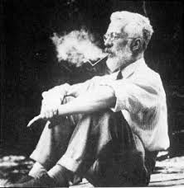
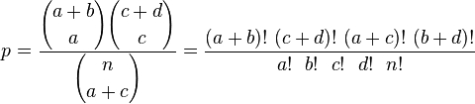
Fisher’s Exact Test
Useful for small samples.
Significance of the deviation from a null hypothesis can be calculated exactly (instead of approximation).
 | Category 1 | Category 2 | Row Total
Group 1 | a | b | a + b
Group 2 | c | d | c + d
Column total | a + c | d + d | n

Slide 16
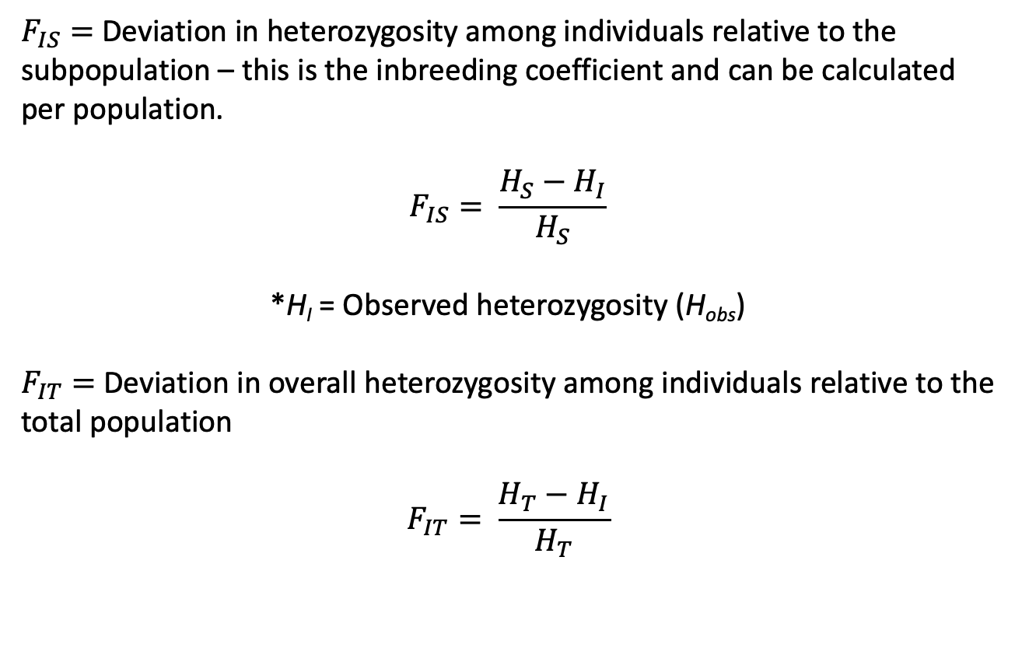
Related F coefficients
$F_{IS}=$Deviation in heterozygosity among individuals relative to the subpopulation – this is the inbreeding coefficient and can be calculated per population.
$$F_{IS}= \frac{H_{S}−H_{I}}{H_{S}}$$
*H_{I} = Observed heterozygosity (H_{obs})
$F_{IT}=$Deviation in overall heterozygosity among individuals relative to the total population
$$F_{IT}= \frac{H_{T}−H_{I}}{H_{T}}$$

Slide 17
Analysis of Molecular Variance (AMOVA)
Tests for hierarchical population subdivision.
*Proportion of genetic diversity is partitioned among groups vs. among subpopulations within groups
Population 1
Population 2
A
B
Among groups
Ф_{ct}
D
E
C
F
Among subpopulations within regions
Ф_{sc}
Among subpopulations within regions
Ф_{sc}
= sample sites

Slide 18
Difference between F_{ST} and Φ_{ST}
F_{ST} is based on allelic frequencies.
Φ_{ST} incorporates a nucleotide substitution model that accounts for different rates for transitions (TIs) and transversions (TVs), % invariant sites, etc.
HKY & Tamura-Nei are common.
Calculated using nucleotide diversity (π), the per site heterozygosity

Slide 19
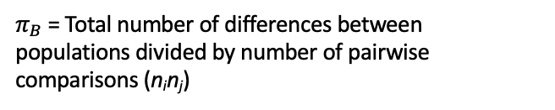









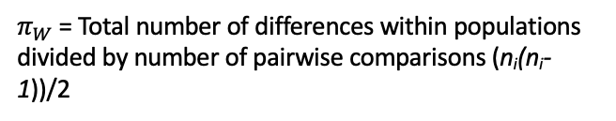

Calculating F_{st} from sequence data: Φ_{ST} (Phi-ST)
$${\text{F}}_{ST}=\frac{π_{B}−π_{W}}{π_{B}}$$
$π_{B}$ = the average number (or proportion) of nucleotide differences between populations (divergence)
$π_{W}$ = the average number (or proportion) of nucleotide differences within subpopulations (nucleotide diversity)
Pop1 Pop2
28 50
22 0
…GCTGTGGGCAAGAAGGCAGATTGAGCCCCGTGTACGCTGC… allele A
…GCTGTGGGCAAGGAGGCAGATTGAGCCCCGTGTACGCTGC… allele B
For two populations,
$π_{B}$ = Total number of differences between populations divided by number of pairwise comparisons (n_{i}n_{j})
$π_{W}$ = Total number of differences within populations divided by number of pairwise comparisons (n_{i}(n_{i}-1))/2
$$π_{B}=(22∗50∗1)/(50∗50)$$
$π_{W1}$ = (28*22*1)/((50*(50-1))/2)
$$π_{B}=(1100)/(2500)$$
$π_{W1}$ = 588/1225
$\overline{π_{W}}$ = (0.48 + 0)/2
$$π_{B}=0.44$$
$π_{W1}$ = 0.48
$\overline{π_{W}}$ = 0.24
$π_{W2}$ = 0.0

Slide 20
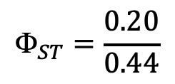
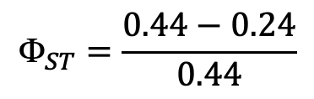



Calculating F_{st} from sequence data: Φ_{ST} (Phi-ST)
$${\text{F}}_{ST}=\frac{π_{B}−π_{W}}{π_{B}}$$
$π_{B}$ = the average number (or proportion) of nucleotide differences between populations (divergence)
$π_{W}$ = the average number (or proportion) of nucleotide differences within subpopulations (nucleotide diversity)
Pop1 Pop2
28 50
22 0
…GCTGTGGGCAAGAAGGCAGATTGAGCCCCGTGTACGCTGC… allele A
…GCTGTGGGCAAGGAGGCAGATTGAGCCCCGTGTACGCTGC… allele B
$$π_{B}=0.44$$
$${\text{F}}_{ST}=\frac{0.44−0.24}{0.44}$$
45.5% of the total variation is explained by differences in allele frequencies between populations.
Strong population structure.
$\overline{π_{W}}$ = 0.24
$${\text{F}}_{ST}=\frac{0.20}{0.44}$$
$${\text{F}}_{ST}=0.455$$

Slide 21
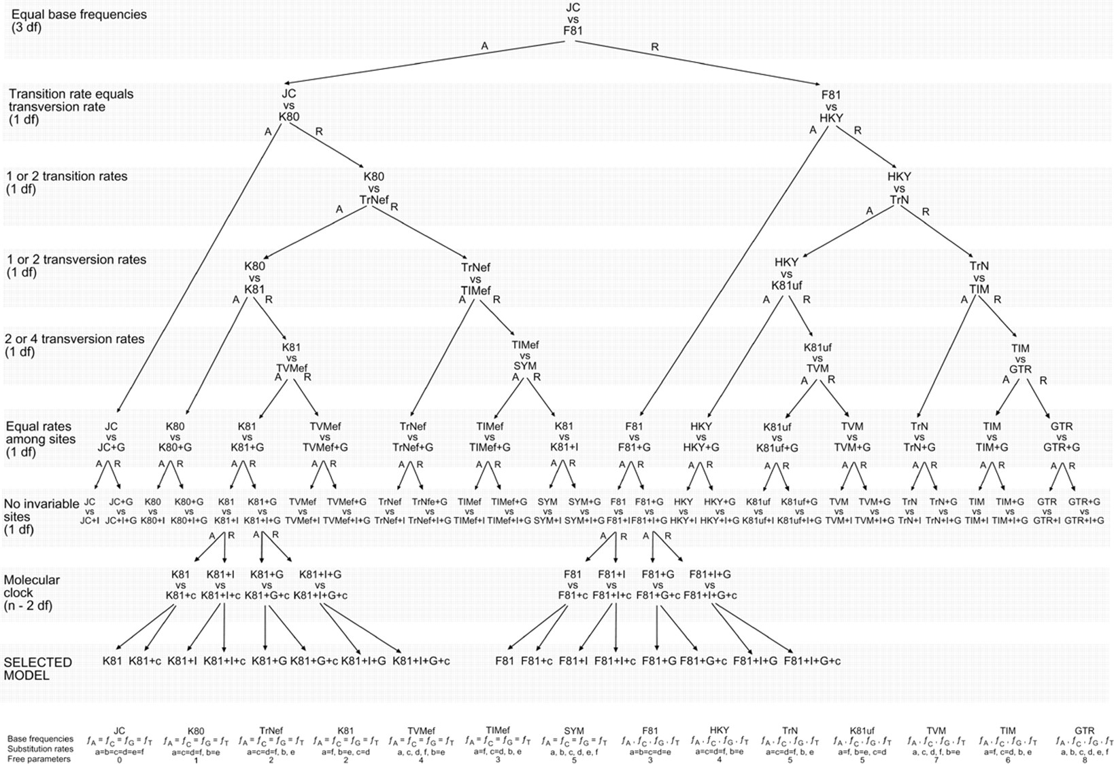
DNA substitution models:

Slide 22
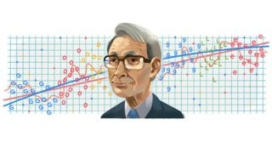
How do we choose among models?
Akaike Information Criterion (AIC)
Measure of relative quality of statistical models for given data.
Tradeoff between goodness-of-fit (likelihood) and complexity of the model (degrees of freedom).
Adding parameters to a model usually improves fit, but also adds complexity. A simpler model may be preferable.
AIC = 2k – 2ln(L), where k = # free parameters
AICc is corrected for sample size.

Slide 23
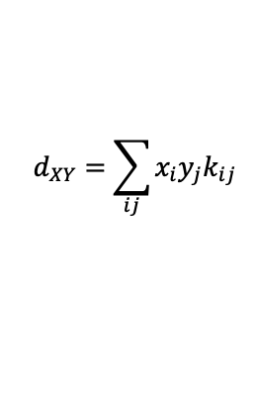
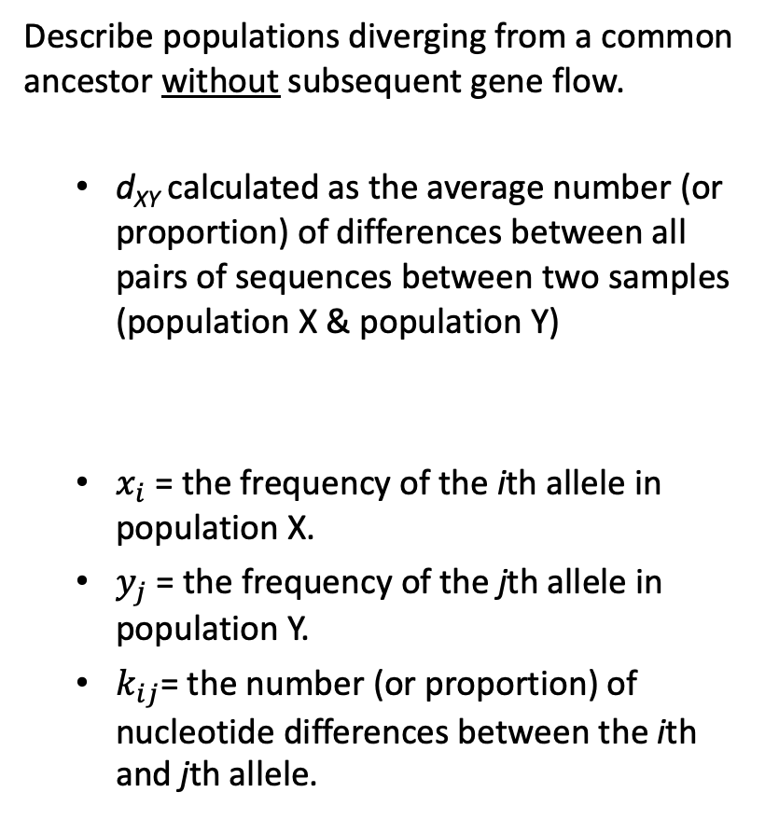
Divergence models (d_{XY})
Describe populations diverging from a common ancestor without subsequent gene flow.
  d_{XY} calculated as the average number (or proportion) of differences between all pairs of sequences between two samples (population X & population Y)
  $x_{i}$ = the frequency of the ith allele in population X.
  $y_{j}$ = the frequency of the jth allele in population Y.
  $k_{ij}$= the number (or proportion) of nucleotide differences between the ith and jth allele.
X
Y
X
Y
m
d_{xy}
d_{xy}
$$d_{XY}=\sum_{ij}{x_{i}y_{j}k_{ij}}$$
Recent common ancestor
Old common ancestor

Slide 24
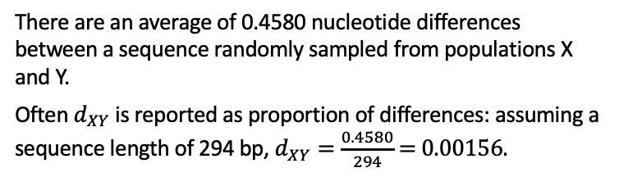
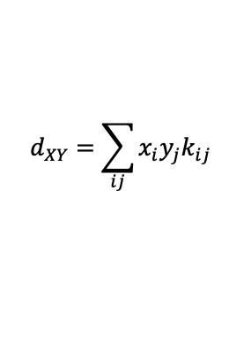

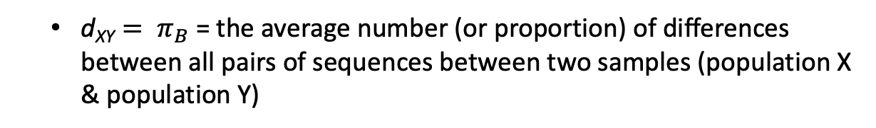
Divergence models (d_{XY})
  ${\text{d}\text{XY}= π}_{B}$ = the average number (or proportion) of differences between all pairs of sequences between two samples (population X & population Y)
$$d_{XY}=\sum_{ij}{x_{i}y_{j}k_{ij}}$$
Pop X Pop Y
0.46 0.98
0.42 0.00
0.02 0.00
0.00 0.02
…GCTGTGGGCAAGAAGGCAGATTGAGCCCCGTGTACGCTGC… allele A
…GCTGTGGGCAAGGAGGCAGATTGAGCCCCGTGTACGCTGC… allele B
…GCTGTGGGCAAGAAGGCAGATTGAGCCCTGTGTACGCTGC… allele C
…GCTGTGGGCAAGAAGGCAGATTGAGCCCCGTGTACGCCGC… allele D
$d_{XY}=x_{A}y_{D}k_{AD}+$ $x_{B}y_{A}k_{BA}+x_{B}y_{D}k_{BD}+x_{C}y_{A}k_{CA}+x_{C}y_{D}k_{CD}$
$d_{XY}=(0.46∗0.02∗1)+$ $(0.42∗0.98∗1)+(0.42∗0.02∗2)+(0.02∗0.98∗1)+(0.02∗0.02∗2)$
$d_{XY}=0.0092+$ 0.4116 $+ \text{0.0168}+\text{0.0196}+\text{0.0008}$
$d_{XY}=\text{0.458}$0
There are an average of 0.4580 nucleotide differences between a sequence randomly sampled from populations X and Y.
Often $d_{XY}$ is reported as proportion of differences: assuming a sequence length of 294 bp, $d_{XY}=\frac{0.4580}{294}$ = 0.00156.

Slide 25
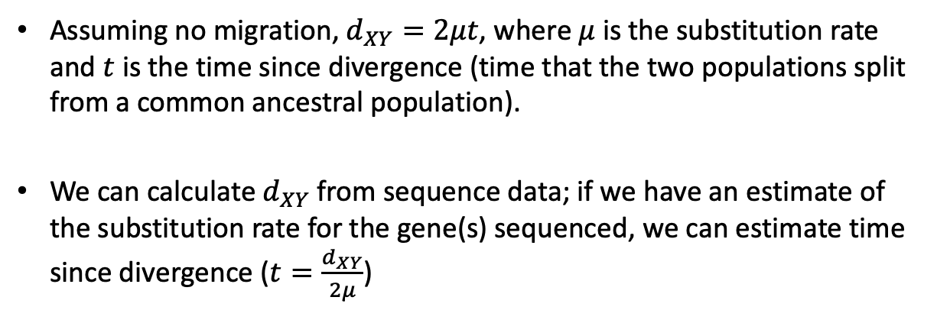
Divergence models (d_{XY})
Assuming no migration, $d_{XY}=2μt$, where $μ$ is the substitution rate and $t$ is the time since divergence (time that the two populations split from a common ancestral population).
We can calculate $d_{XY}$ from sequence data; if we have an estimate of the substitution rate for the gene(s) sequenced, we can estimate time since divergence ($t=\frac{d_{XY}}{2μ}$)
X
Y
X
Y
m
t2
t1
Recent common ancestor
Old common ancestor

Slide 26
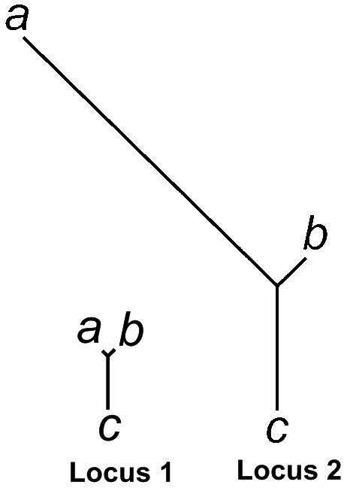
Population Branch Statistic (PBS)
Yi et al.(2010) --- A summary statistic that utilizes pairwise F_{ST} values among three populations to quantify sequence differentiation along each branch of the corresponding three-population tree.
Allow for detection of positions
with unusually high differentiation
across the genome.

Slide 27
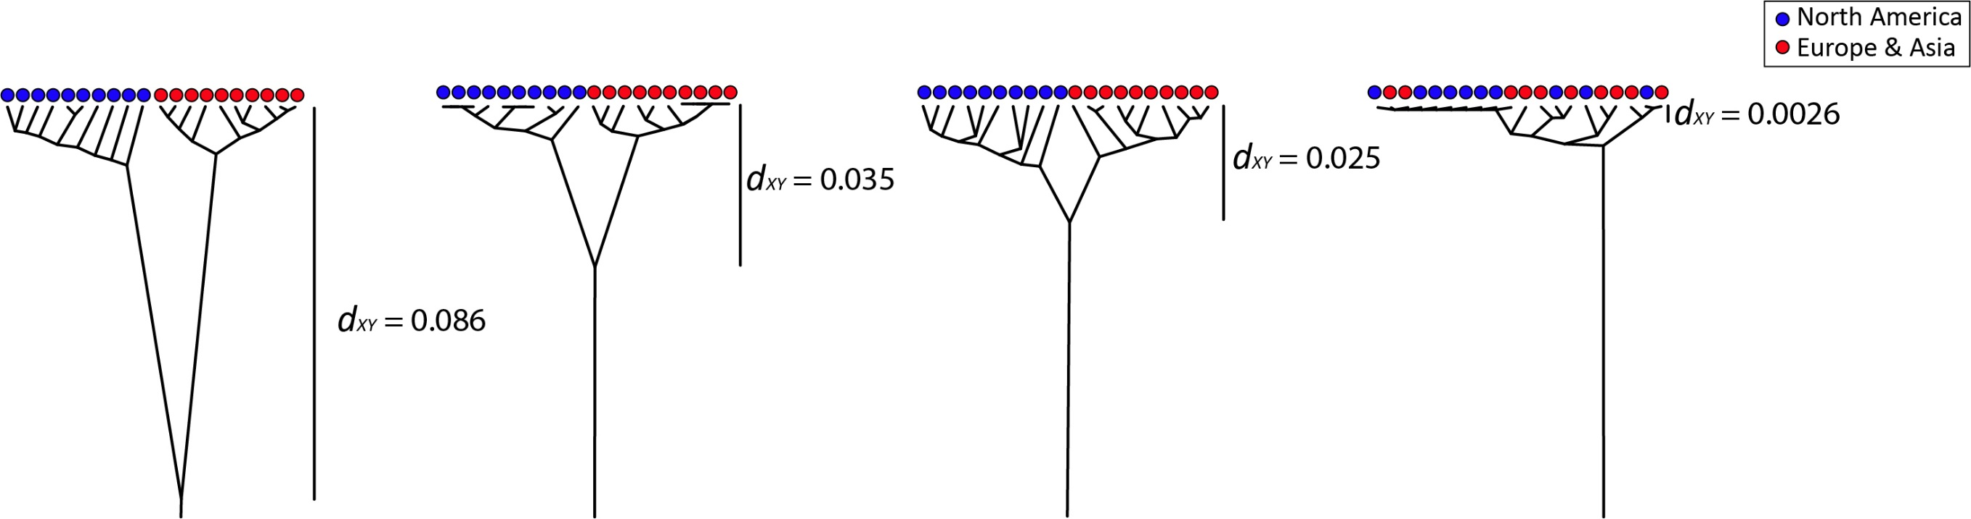
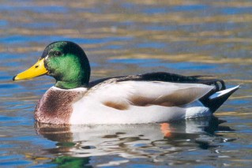

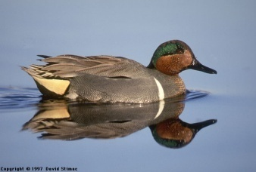
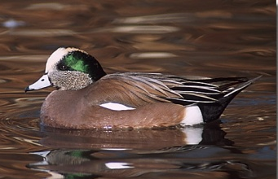
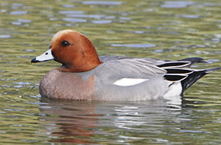









Mitochondrial DNA divergence in four groups of Holarctic ducks
with t calculated from the coalescent
Peters et al. 2014. Molecular Ecology 23:2961-2974.
*$d_{XY}$ was calculated as the proportion of nucleotide differences between populations.
What is t (time since divergence)?
$$d_{XY}=2μt$$
$μ=4.8×{10}^{−8}$ substitutions/site/year
Green-winged Teal
$$0.086=2×(4.8×{10}^{−8})×t$$
$$t=\frac{0.086}{{9.6×10}^{−8}}$$
$$\frac{substitutions per site}{substitutions per site per year}$$
$t=900,000$ years
$t=27$,000 years
$t=360,000$ years
$t=26$0,000 years
Green-winged Teal
American & Eurasian Wigeon
Mallard
Gadwall

Slide 28
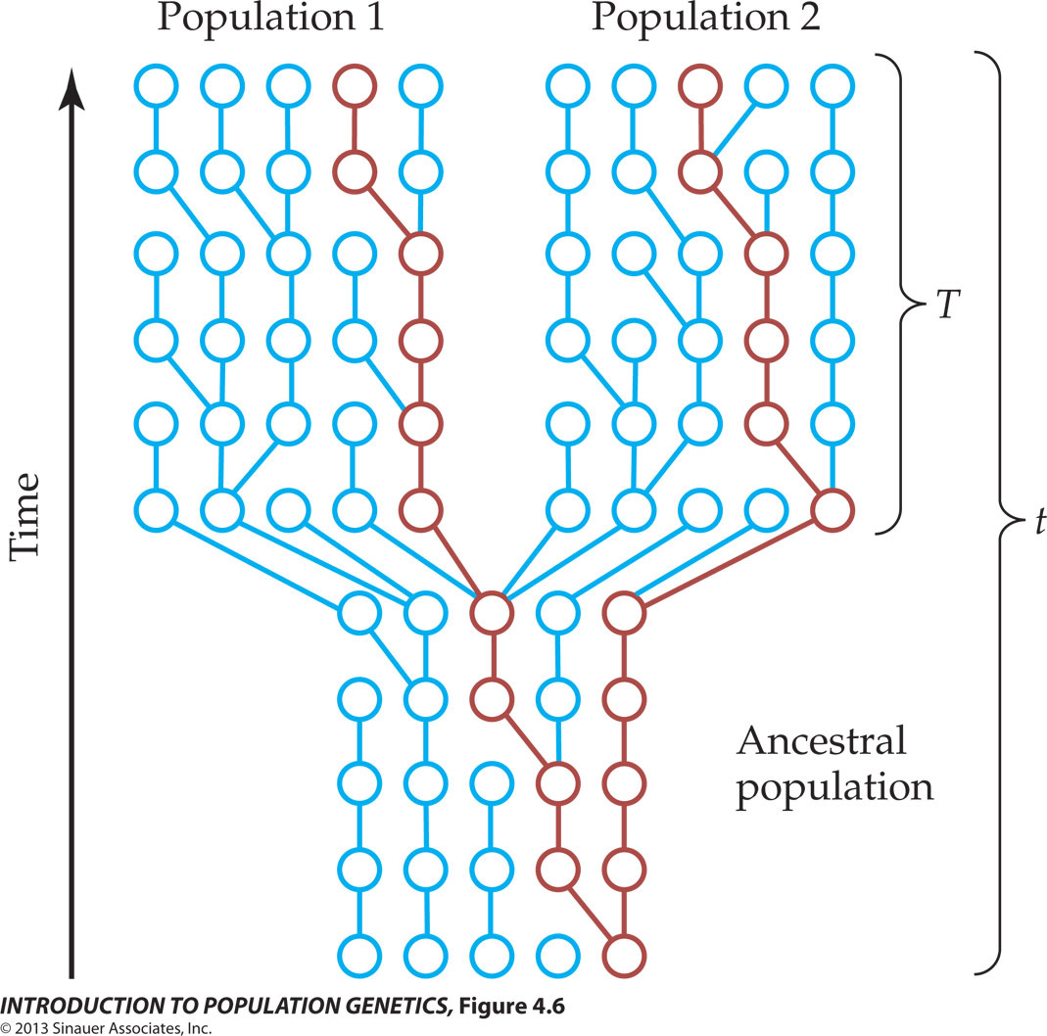



The coalescence process in a model with population subdivision
T = time since divergence
Coalescence is independent in each population
$$f_{1}=\frac{1}{2N_{1}}$$
$$f_{2}=\frac{1}{2N_{2}}$$
tMRCA
*For real populations, use N_{e}
Moving back in time, populations merge into a common ancestor of size N_{A}.
$$f=\frac{1}{2N_{A}}$$
Samples from different populations can coalescence only after populations merge.
*Assumes no migration
Notes:
IntroPopGen-Fig-04-06-0.jpg

Slide 29
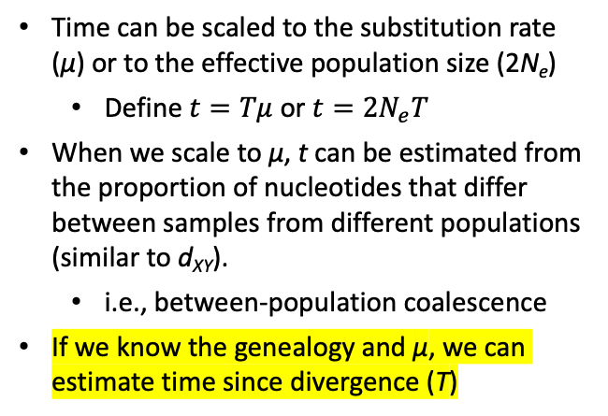
The coalescence process in a model with population subdivision
Applications to real populations
Time can be scaled to the substitution rate (µ) or to the effective population size (2N_{e})
  Define $t=Tμ$ or $t=2N_{e}T$
When we scale to µ, t can be estimated from the proportion of nucleotides that differ between samples from different populations (similar to d_{XY}).
  i.e., between-population coalescence
If we know the genealogy and µ, we can estimate time since divergence (T)
T = time since divergence
tMRCA
*Assumes no migration
Notes:
IntroPopGen-Fig-04-06-0.jpg

Slide 30
Coalescent model with deep population subdivision
Barrier to gene flow
Population 1
Population 2
Present
Time
Time of divergence (T)

Slide 31
Coalescence with recent divergence
Present
Divergence time
Time

