Slide 1
Population Subdivision
Population Genomics
University of Miami
Spring 2023

Slide 2

Population Subdivision for Two Populations
2N_{e}μ
Genetic variation; Allele or genotype frequencies
Mutation
Genetic Drift
Migration
2N_{e}μ
Genetic variation; Allele or genotype frequencies
Mutation
Genetic Drift
Mutation and genetic drift (and selection) act independently in each population.
Gene flow homogenizes allele frequencies, offsets drift by increasing Ne.

Slide 3
How to test for population structure using probabilistic assignment tests

Slide 4
Maximum Likelihood & Bayesian Parameter Estimation
Data = true (not estimated) measure of a population
Parameter estimate = a quantity of interest that defines a group; this is the item of biological interest.
Maximum Likelihood (-lnL) = Method for estimating unknown parameter from data using a statistical model.
Bayesian - specifies some prior probability, which is then updated to a posterior probability with the addition of new, relevant data.
Prior - a prior probability distribution.
Posterior - conditional probability assigned after data are collected (e.g., such as the results of an experiment or set of genealogies).

Slide 5
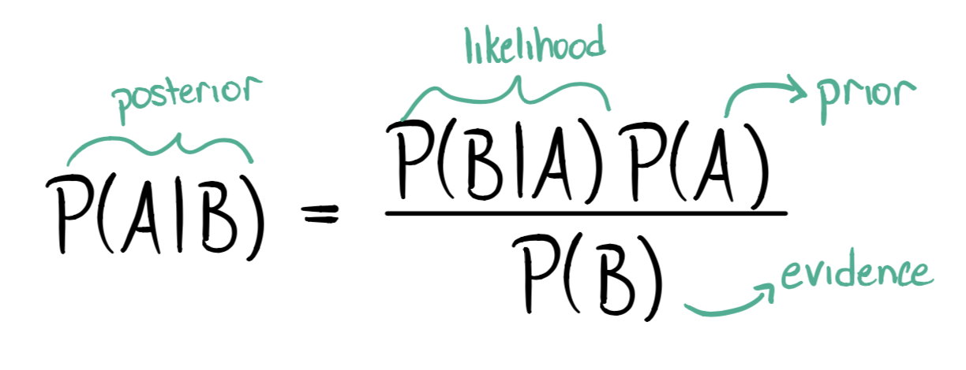
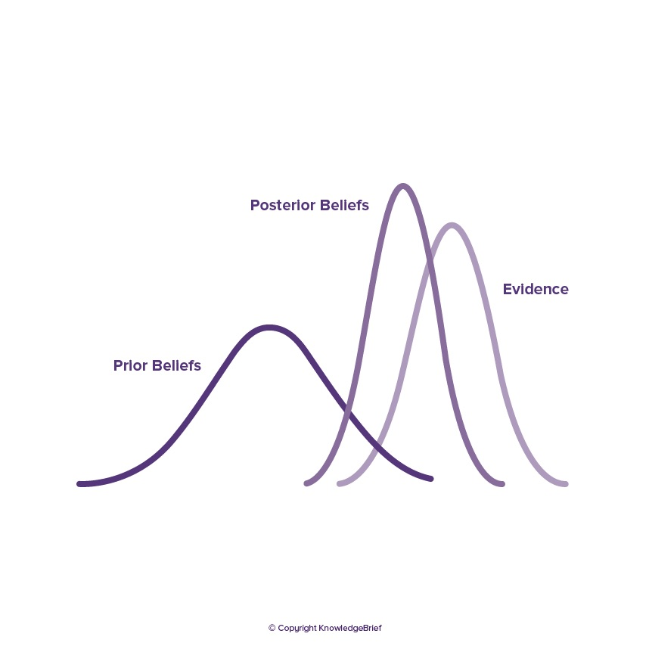

Slide 6
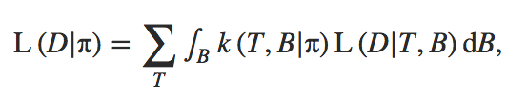
Maximum Likelihood Steps
(1) Specify mathematical relationship between parameter being estimated (e.g., tree length) and data observed (e.g., genealogies built using nucleotide substitution models).
(2) Calculate probability of observing data assuming a particular parameter value.
(3) Repeat step 2 for each possible parameter value.
Best parameter estimate maximizes the probability of observing the data given a model:
where k(T, B|π) is the Kingman coalescent probability density and L(D|T, B) is the likelihood of the data given the genealogy.

Slide 7
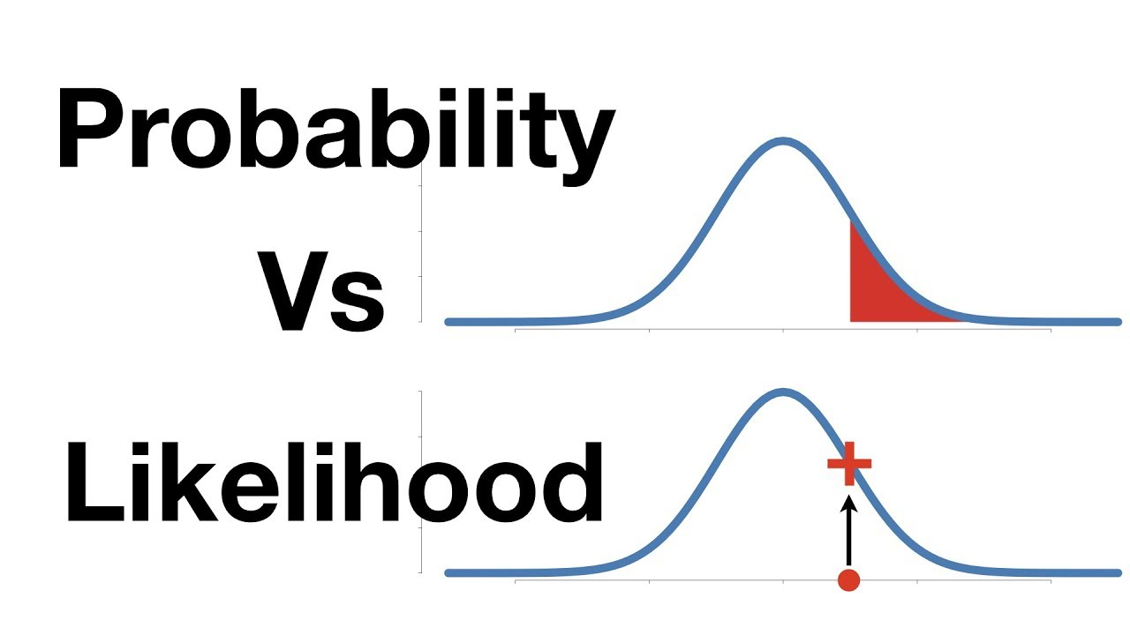
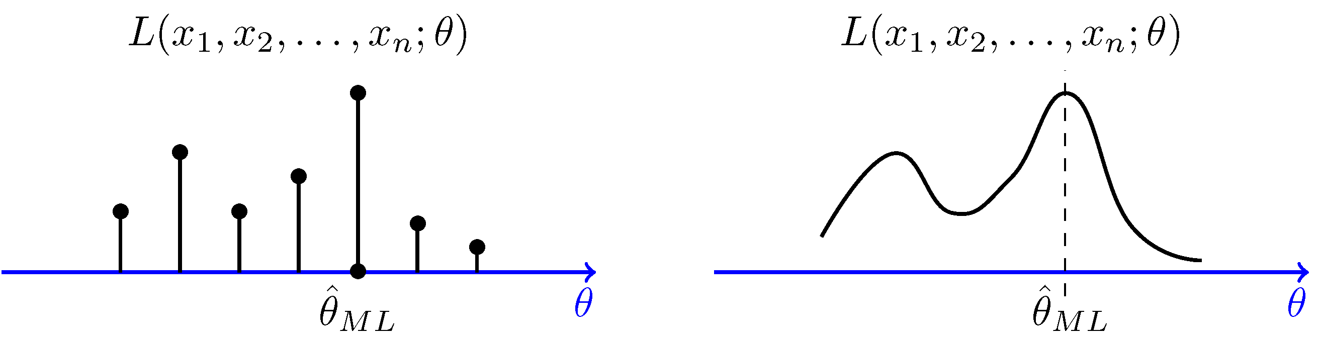
https://www.probabilitycourse.com/chapter8/8_2_3_max_likelihood_estimation.php

Slide 8
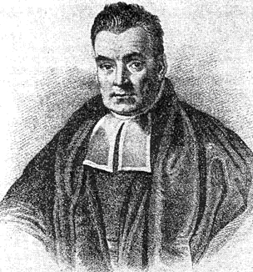

Bayesian Estimation
Named after Rev. Thomas Bayes (1701-1761).
Incorporates Maximum Likelihood but proceeds differently.
Allows direct probabilistic test of a parameter given the data (with confidence intervals).
Posterior distribution is approximated over many samples, in genetics there are often genealogies.
<-- a posterior probability

Slide 9
The difference in sum:
In ML, the best parameter estimate maximizes the probability of observing the data given a model.
L(Data|Model)
Bayesian allows direct probabilistic test of a parameter given the data (with confidence intervals).
f(Model|Data x Prior)
Posterior probability

Slide 10

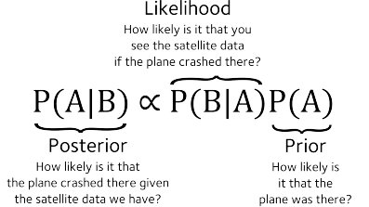
In Bayesian Estimation each prior piece of information is multiplied by the likelihood to obtain what is called a posterior.
This provides the relative importance location in the search space.

Slide 11
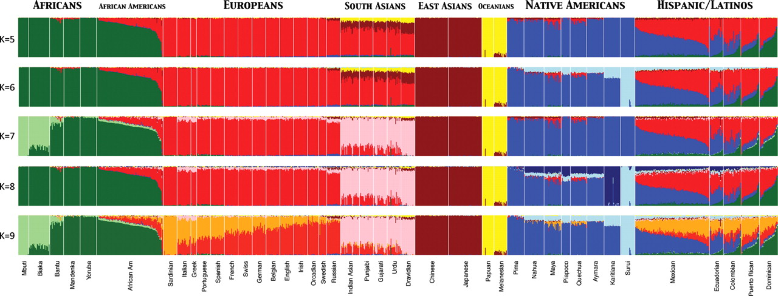
Assignment Tests to Study Structure of Worldwide Human Populations
Used ADMIXTURE clustering algorithm to infer genomic assignments/ individual
K = number of assumed populations
73,901 autosomal SNP markers & 1,112 individuals from 42 global pops
Assignment Tests – Maximize Hardy-Weinberg equilibrium & minimize LD to assign individuals to populations based on genotypes at many loci.
Henn B M et al. Hum. Mol. Genet. 2010;19:R221-R226
© The Author 2010. Published by Oxford University Press. All rights reserved. For Permissions, please email: journals.permissions@oxfordjournals.org

Slide 12
Principal Components Analysis (PCA)
An exploratory technique first developed by Karl Pearson used to reduce a large number of variables in a data set to fewer variables that still contain the information.
  Variables in a data set are often highly correlated.
  PCA identifies correlations among variables in a data set and creates new variables that capture that information.
  The new variables, called principal components (PCs) or eigenvalues, are uncorrelated.
Can be used to:
  Find patterns in high-dimensional data
  Visualize data of high dimensionality
Population genetics applications:
  Detect population structure using genomic data (large number of loci sequenced from the genome)
  Identify admixed individuals

Slide 13
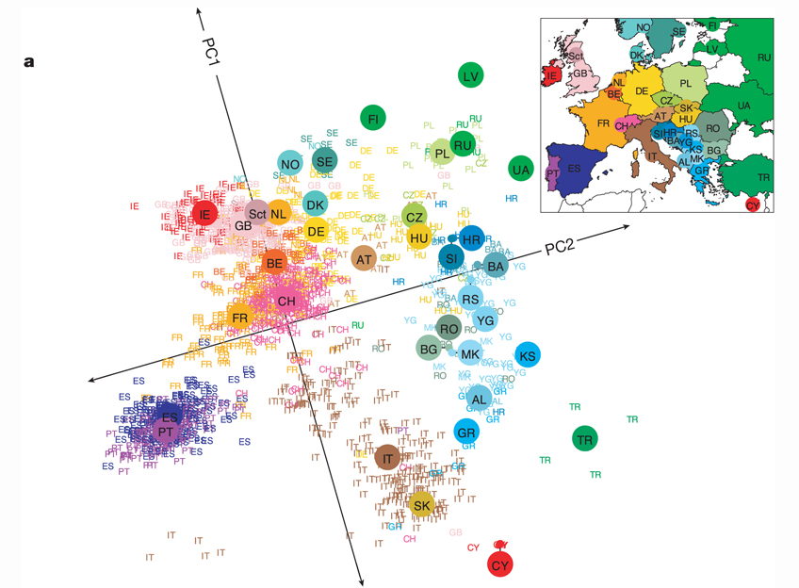
Principal Components Analysis (PCA)
Transforms genotypic data into components that account for correlations in genotypes among multiple loci. Results in clustering of individuals with similar genotypes.
Human Population structure within Europe.
Novembre et al. (2008) Nature 456, 98-101

Slide 14
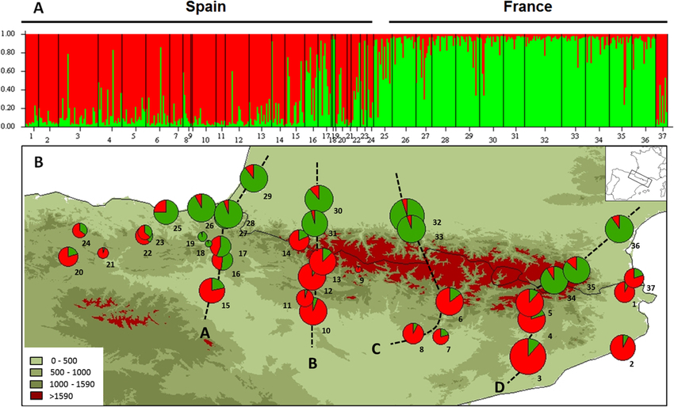
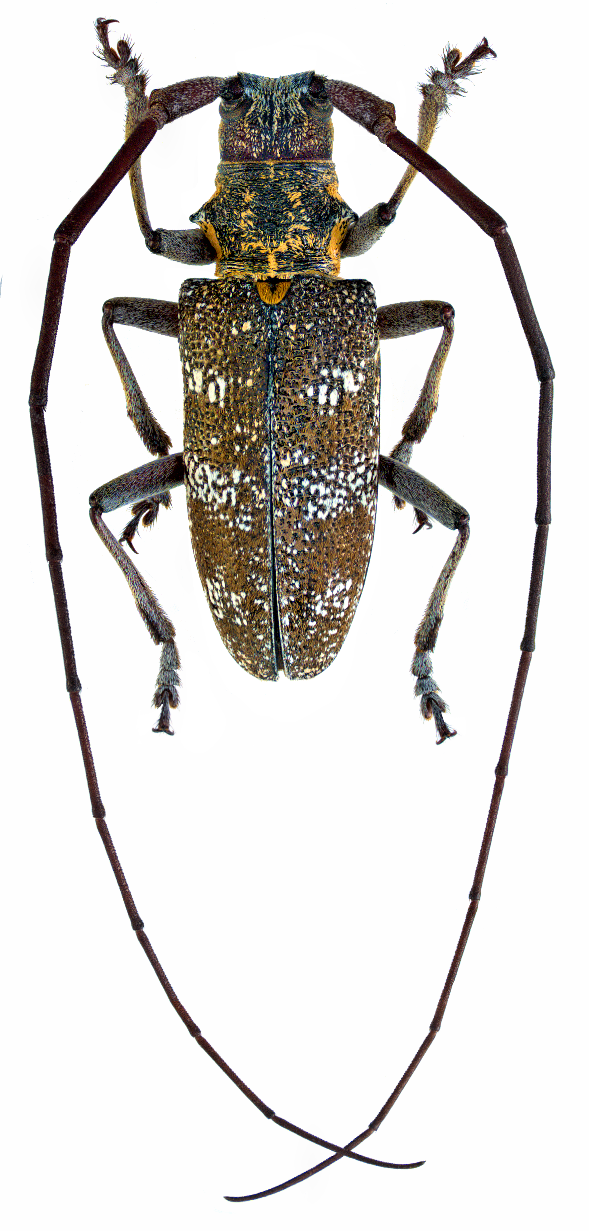
Altitudinal Barrier to the Spread of an Invasive Species: Could the Pyrenean Chain Slow the Natural Spread of the Pinewood Nematode?
July 2015
PLoS ONE DOI: 10.1371/journal.pone.0134126
Population genetic structure of the native vector, Monochamus galloprovincialis, a type of long-horned beetle.

Slide 15
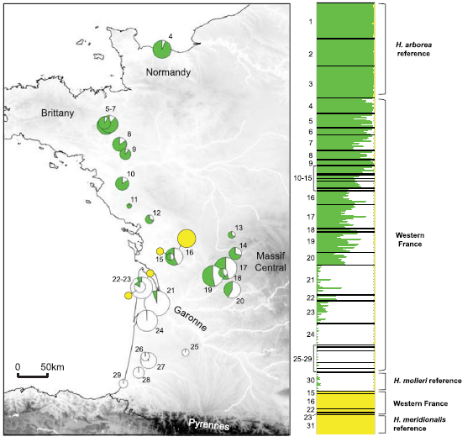
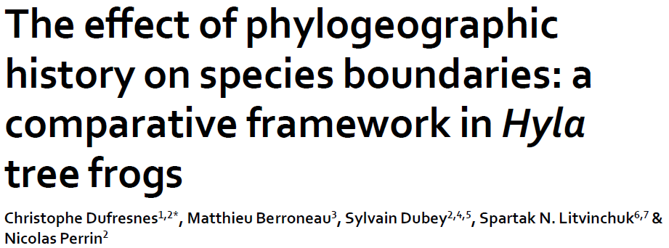
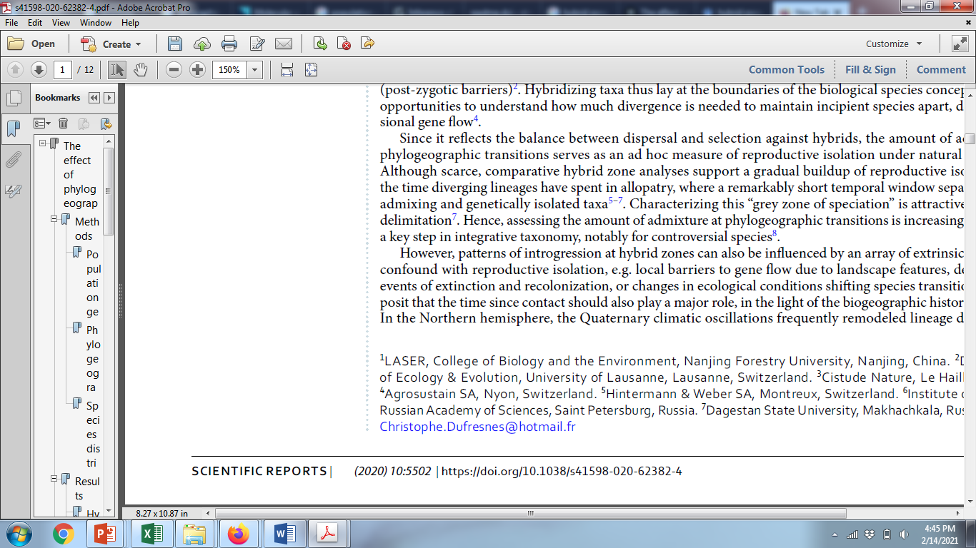


Studying hybrid zones
Hybrid zone
Hyla arborea
Hyla molleri
Assignment based on 26 microsatellite loci

Slide 16
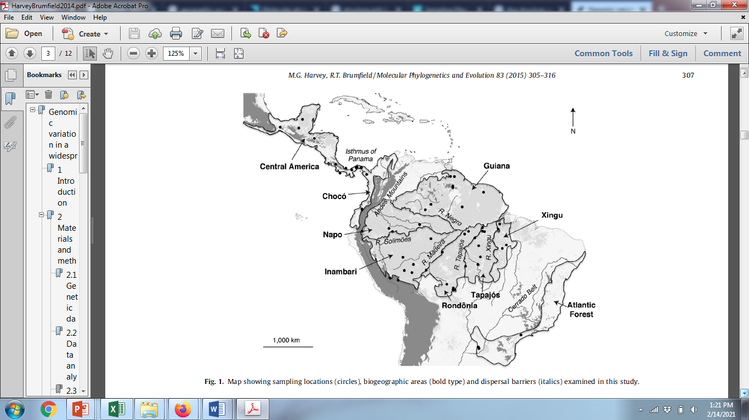
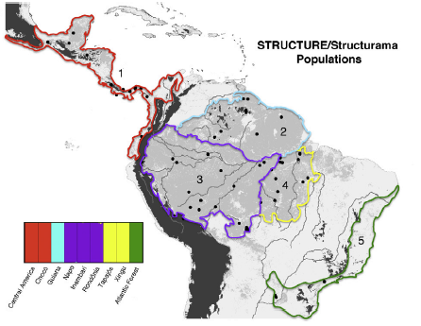

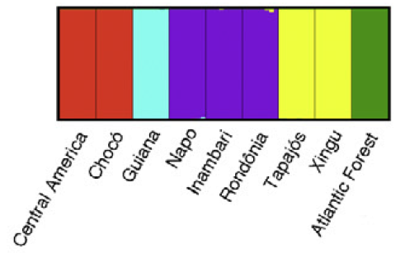
Genomic variation in a widespread Neotropical bird (Xenops minutus) reveals divergence, population expansion, and gene flow
Identifying population boundaries & assigning individuals to populations

Slide 17
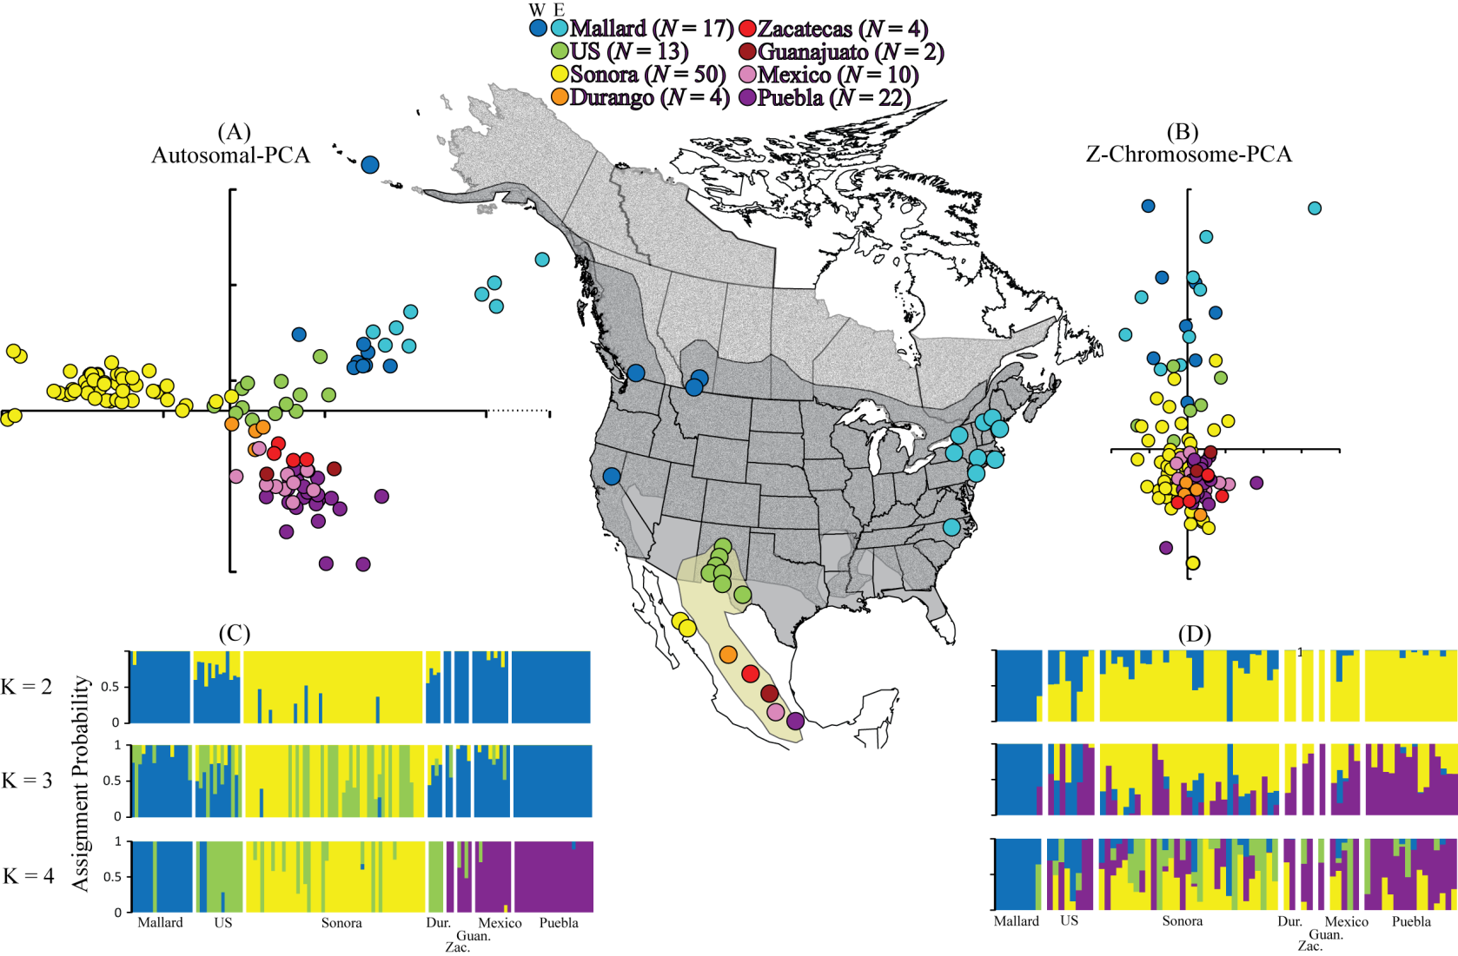
Mexican Duck Data – Lavretsky et al. (2015) Speciation genomics and a role for the Z chromosome in the early stages of divergence between Mexican ducks and mallards. Molecular Ecology 24:5364–5378.

Slide 18
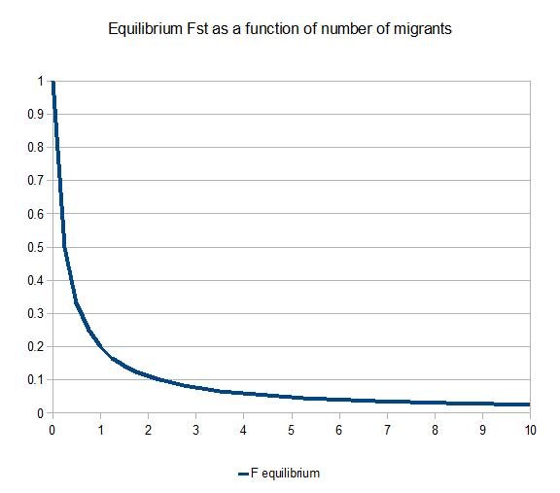
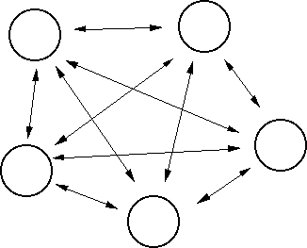
For the Island Model, with equal sample sizes per population:
1 _
1 + 4Nm_{T}
F_{ST} =
F_{ST}
Nm
Island Model
1 migrant per generation prevents fixation

Slide 19
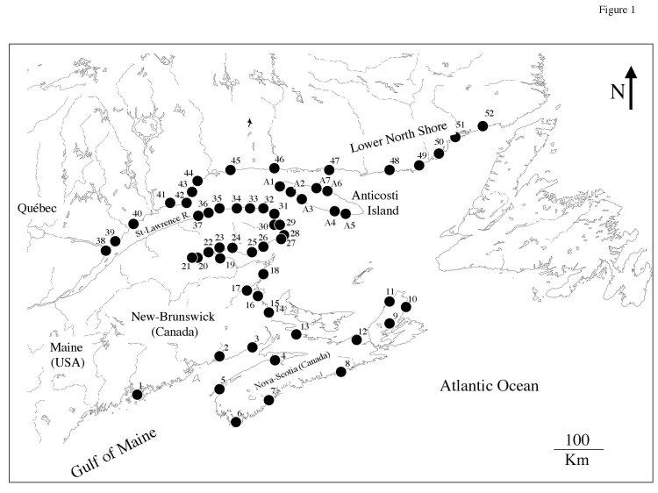
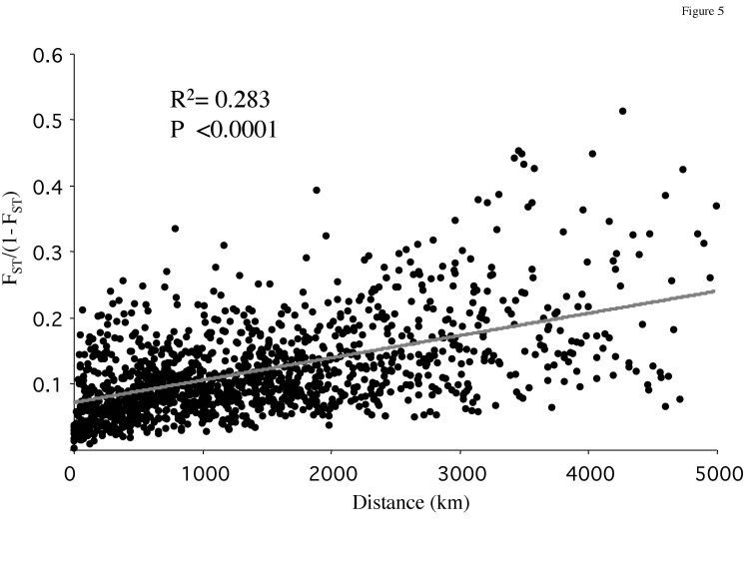
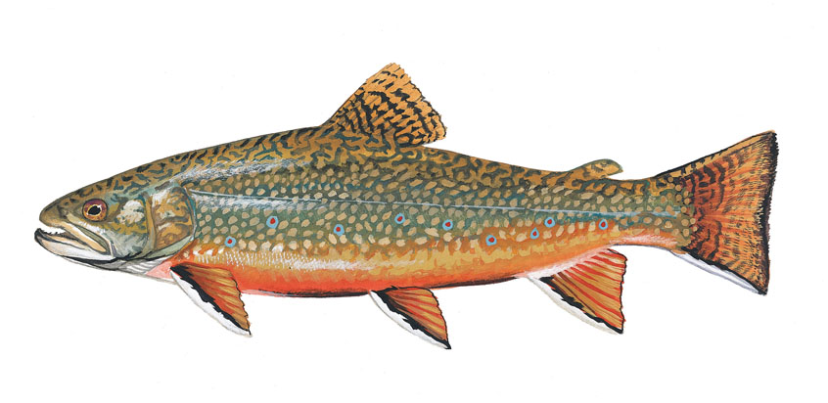
Isolation by Distance - the other IBD
Typically plotted against geographic distance as F_{ST}/(1 - F_{ST}) to obtain a linear relationship.
The rise and fall of isolation by distance in the anadromous brook charr Salvelinus fontinalis Mitchill
http://theses.ulaval.ca/archimede/fichiers/20348/ch04.html

Slide 20
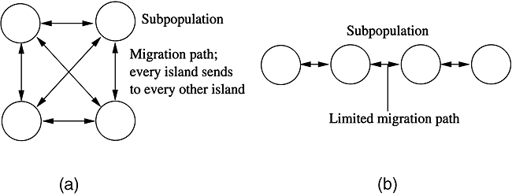
Island Model
Stepping Stone Model

Slide 21
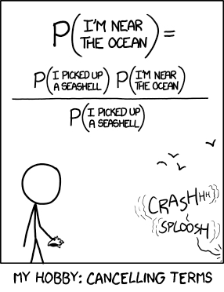
https://xianblog.wordpress.com/2013/07/13/the-original-xkcd-entry-on-bayes-with-its-mistake/

