Slide 1
Neutral Theory & Nearly Neutral Theory of Molecular Evolution
Population Genomics
University of Miami
Spring 2023

Slide 2
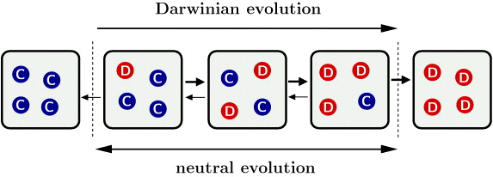
A debate over the importance of selection versus drift
Directional
Not directional

Slide 3
Neo-Darwinism & Neutralism
Natural selection for advantageous mutations that improve fitness is primary source of genetic variation
→ “Survival of the fittest”
At molecular level, most evolutionary changes occur by random genetic drift of alleles which are selectively neutral (or nearly neutral)
“Survival of the luckiest”

Slide 4

Motoo Kimura
“The vast majority of substitutions in DNA and proteins, and polymorphism within species, are caused not by positive Darwinian selection, but by random drift of alleles that are selectively neutral or nearly so.”

Slide 5
The Neutral Theory of Molecular Evolution
High levels of polymorphism (variation) in protein and DNA sequences among individuals and species.
Discovery of the molecular clock, that substitutions occur at a constant rate over time by Jukes & King 1969.
Difficult to reconcile with mutation-selection equilibrium.
Can be explained by mutation & drift alone.
Most mutations affecting fitness are deleterious, hence quickly eliminated by selection.
Therefore, essentially all new mutations that become fixed are neutral, and evolve by genetic drift.
Bold idea, considering the importance of selection.

Slide 6
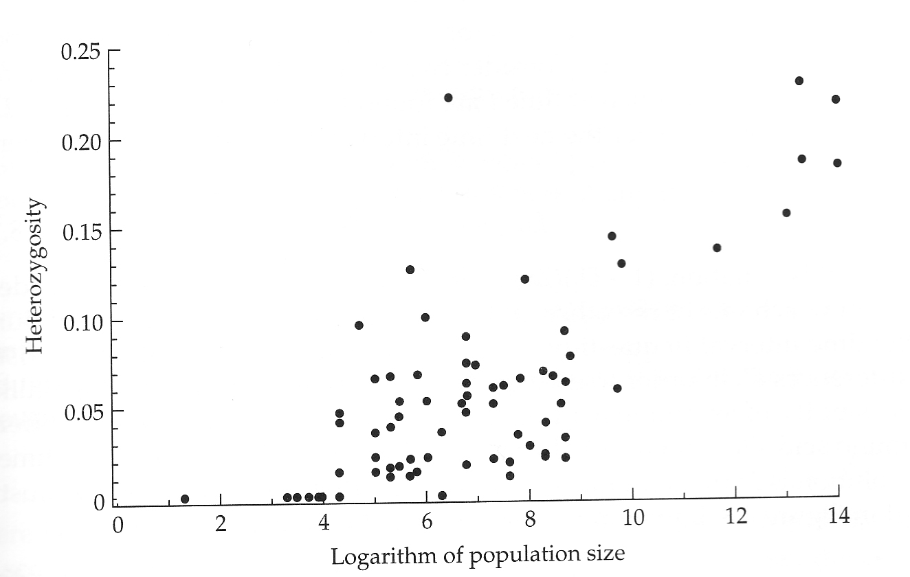
Two Sources of Data: #1
Observed relationship for diversity and Ne.
Hartl & Clark (1997) Principles of Population Genetics

Slide 7
Two Sources of Data: #1
Observed relationship for diversity and Ne.
High levels of heterozygosity unexpected under mutation-selection balance.
Positive correlation between Ne & heterozygosity is expected at drift-mutation equilibrium.
  Kimura reasoned that there were too many substitutions to be tolerable within the selectionist theory of natural selection.
Hartl & Clark (1997) Principles of Population Genetics

Slide 8
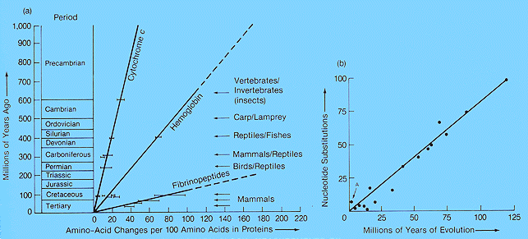
Two Sources of Data: #2
Constant rate of evolution within gene families

Slide 9
Two Sources of Data: #2
Constant rate of evolution within gene families
The slopes of the lines give the average rate of change (molecular clock) in amino acid substitutions
Kimura argued that this relationship reflects the actions of genetic drift and mutation.
Fossil calibrations

Slide 10
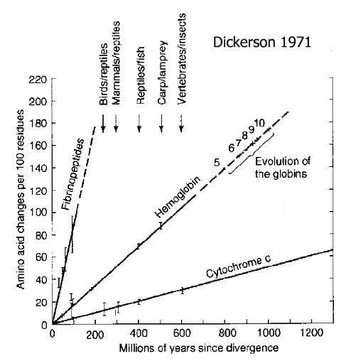
Molecular Clock—substitutions occur at a constant rate over time
Constant rates of amino acid substitutions for three genes = molecular clock
High rate variation among genes = functional constraints
  The neutral theory does not imply no selection, but rather that most mutations that affect fitness are deleterious.
  Lower rates suggest higher functional constraints (i.e., more mutations are deleterious).

Slide 11
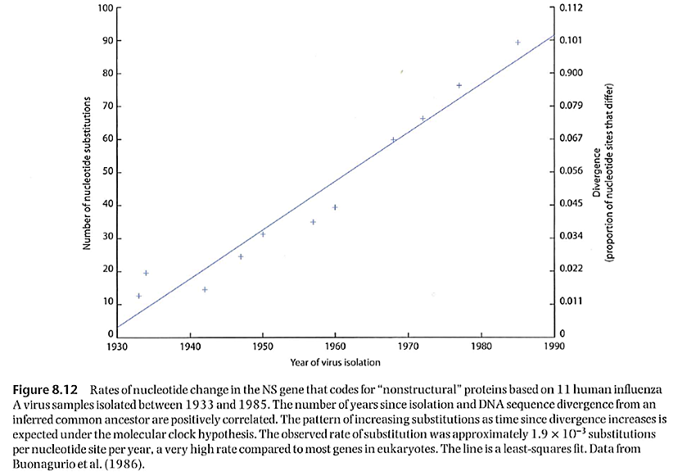
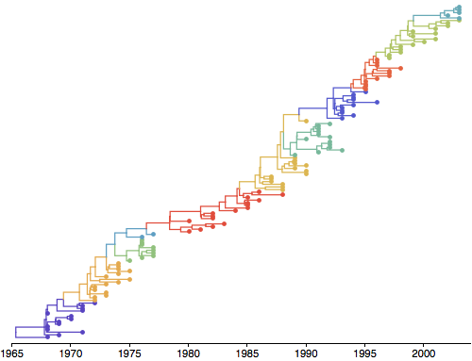
Molecular Clocks are easily visible in viruses.
Phylogeny of influenza A virus from 1968 to 2003 illustrating the molecular clock—over time substitutions accumulate at a constant rate (http://www.trevorbedford.com/writeups/interpretable_phylogenies.html)
http://people.bu.edu/msoren/BI515_2014/LectureCh9A.pdf

Slide 12
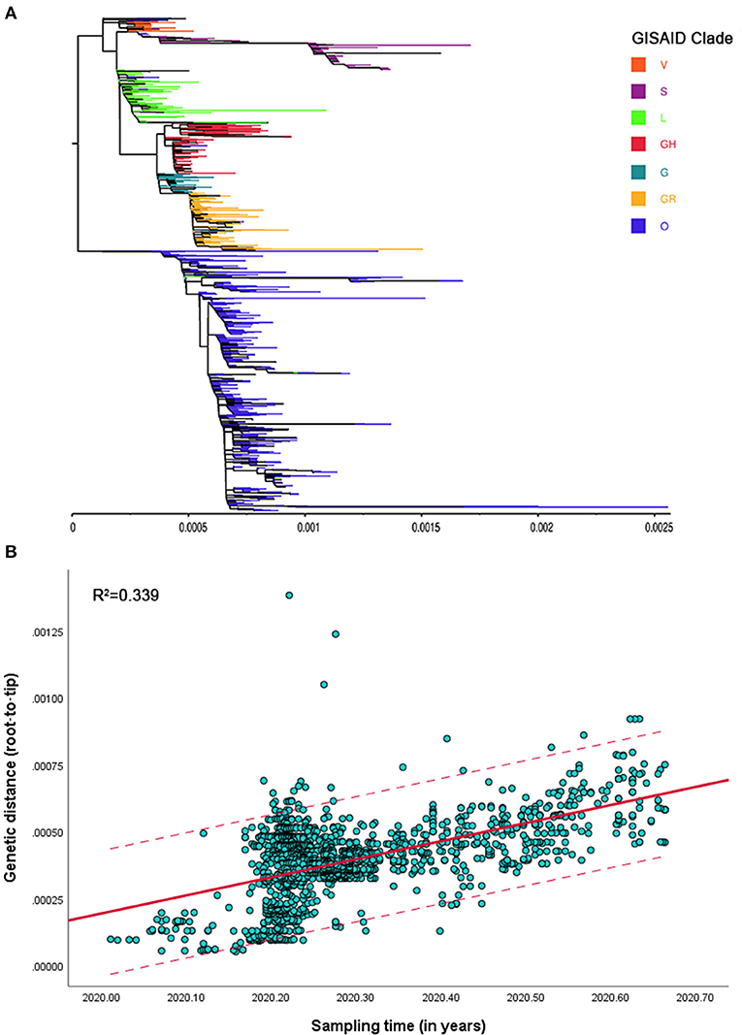
Zhu M, Shen J, Zeng Q, Tan JW, Kleepbua J, Chew I, Law JX, Chew SP, Tangathajinda A, Latthitham N and Li L (2021) Molecular Phylogenesis and Spatiotemporal Spread of SARS-CoV-2 in Southeast Asia. Front. Public Health 9:685315.

Slide 13
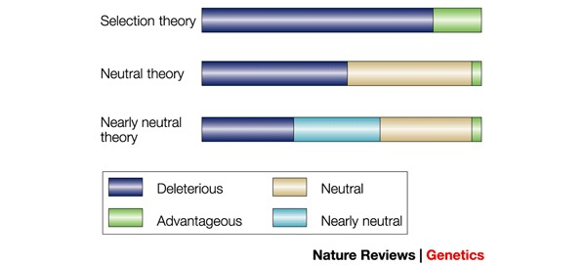
Selectionist vs. Neutralist Theories
Bromham & Penny “The modern molecular clock” Nature Rev Genet 4:216, 2003
Mutation-selection balance
Most mutations are deleterious & removed by negative selection.
Evolutionary change results from advantageous mutations that are driven to fixation by positive selection.
Genetic variation within and between species results from selection.
Mutation-drift equilibrium
Many mutations are deleterious & removed by negative selection, but many are neutral (no selection); advantageous mutations are rare.
Evolutionary change results from neutral mutations that drift to fixation.
Genetic variation within and between species results from genetic drift.

Slide 14
Review: Evolution by Genetic Drift
Diploid population size N
There are 2N alleles
μ is the mutation rate to neutral alleles
Every generation, there are 2Nμ new neutral mutations, each with frequency 1/2N
Chance of drifting to fixation = 1/2N
So 2Nμ /2N = μ neutral mutations will go to fixation every generation.
Rate of neutral evolution = μ

Slide 15
Testing for Neutrality
Given that the divergence (d) between species is given by d = 2µT, where T is the time since divergence and µ is the mutation rate.
Nucleotide diversity (θ_{π}) is given by θ_{π} = 4N_{e}µ.
What is the expected relationship between d & θ_{π} in a sample of multiple loci from a pair of species if loci are evolving under neutrality?

Slide 16
Testing for Neutrality
Genetic divergence (d) & diversity (π) should be correlated among loci
π = nucleotide diversity, equates to per site heterozygosity

Slide 17
HKA Test
d & π should be correlated among loci
This individual has low polymorphism relative to divergence
This is the basis for the Hudson, Kreitman, Aguade (HKA) Test of Neutrality.
  Compare S (segregating sites) within species with number of differences between species.
  Test for significance using a Chi-square test or simulations.

Slide 18
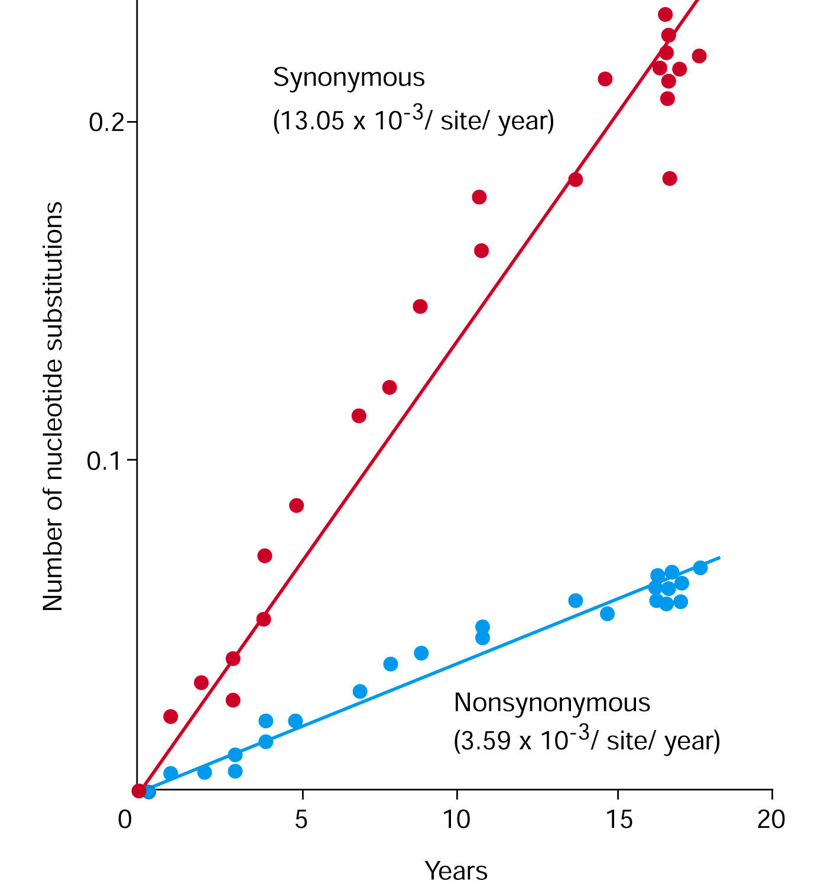
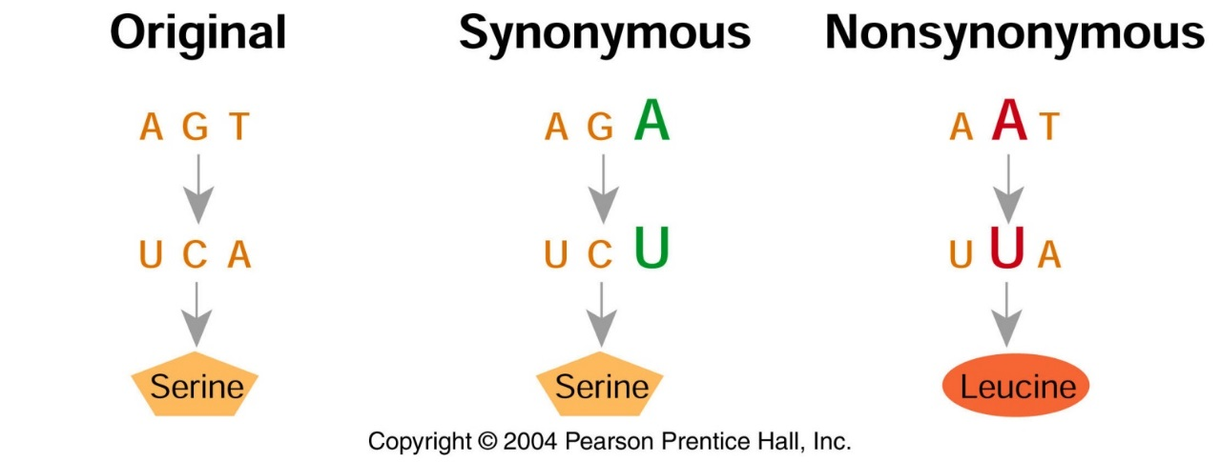
Synonymous substitutions accumulate faster than nonsynonymous substitutions
Influenza virus evolution over 20 years

Slide 19
McDonald-Kreitman Test
d_{S} = # synonymous substitutions per synonymous site in the sequence; abbreviated K_{S}
d_{N} = # non-synonymous (replacement) substitutions per non-synonymous site in the sequence; abbreviated K_{A}

Slide 20
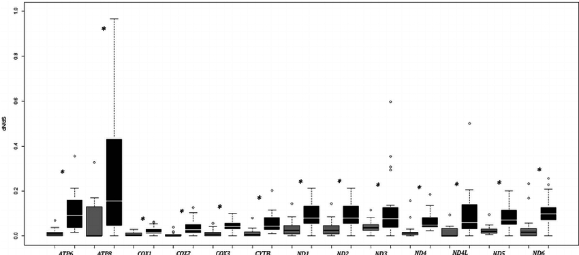
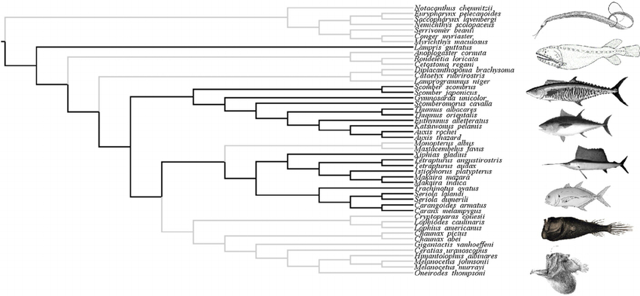
Mt genes experience relaxed purifying selection in sedentary fishes.
Results in higher dN/dS
Fast fish have few mutations and lower dN/dS.
Strohm, J. H., Gwiazdowski, R. A., & Hanner, R. (2015). Fast fish face fewer mitochondrial mutations: Patterns of dN/dS across fish mitogenomes. Gene, 572, 27-34.

Slide 21
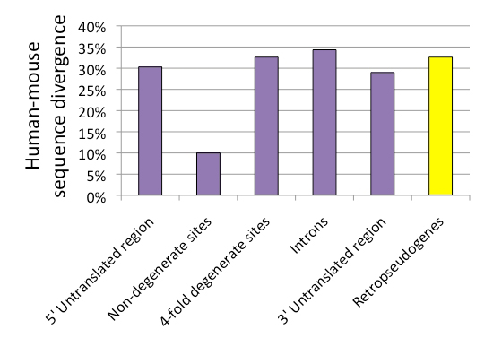
Prediction under neutral theory: changes that do not affect the function of the protein will occur more frequently.
Duret, L. (2008) Neutral theory: The null hypothesis of molecular evolution. Nature Education 1(1)

Slide 22
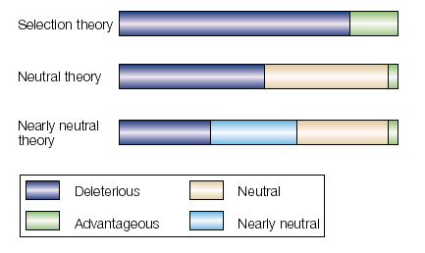
Summary
Selectionist theory: all mutations affect fitness; most mutations are deleterious
Neutral theory: most mutations are either deleterious or neutral; advantageous mutations are rare. More neutral sites would produce a faster overall rate of change.
Better supported by molecular data
Bromham & Penny “The modern molecular clock” Nature Rev Genet 4:216, 2003

Slide 23
Problems with Neutral Theory
The neutral mutation rate, µ should vary among species as a function of generation time; there should be more changes per million years for rodents than for primates.
However, some proteins evolve at constant rate among lineages without regard to generation time: same rate between mice/rats and chimp/human.
µ rates are more often gene specific.

Slide 24
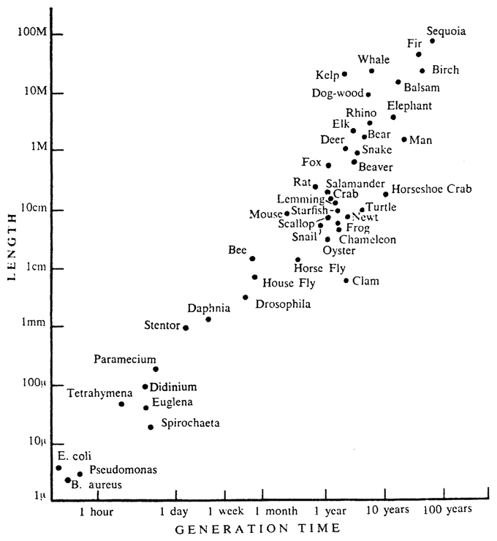
The neutral mutation rate, µ, should vary among species as a function of generation time.
Larger organisms have longer generation times.
  Neutral theory predicts a slower rate of molecular evolution.
  Fewer meiotic events over a given time period = fewer opportunities for new mutations.
Smaller organisms have shorter generation times.
  Neutral theory predicts a faster rate of molecular evolution.
  More meiotic events over a given time period = more opportunities for new mutations.
Problem: Rates of protein evolution are fairly independent of generation time.
https://www.evolbiol.ru/document/637

Slide 25
Generation Time vs. Population Size
Why can rates of non-synonymous substitutions be constant in species with long and short generation times, for some proteins?
The difference between mutation rate frequency of neutral mutations cancel out.
Short generation time | Long generation time
Many mutations per year | Few mutations per year
Few mutations are effectively neutral because Ne is large | Many mutations are effectively neutral because Ne is small

Slide 26

Nearly Neutral Theory
Tomoko Ohta (1973)
Many mutations are “nearly neutral” (i.e., weak selection).
Recall that drift is a more powerful force and can overpower selection when population size (N_{e} ) is small.
If s << 1/(2N_{e}), then mutations are effectively neutral and drift will dominate.
If s >> 1/(2N_{e}), then selection will dominate.

Slide 27
If N_{e} is Large, Selection Determines Fate of Mutations
- No mutation
- Deleterious mutation
No bottleneck
Effective pop size : N_{e} >> 1
Organisms with deleterious mutation has to compete, selection determines fate.
Credit: Way Sung, Indiana University

Slide 28
If N_{e} is Small, Drift Determines Fate of Mutations
- No mutation
- Deleterious mutation
Bottleneck
Effective pop size : N_{e} = 1
Organisms with deleterious mutation does not have to compete, drift not selection determines fate.
Credit: Way Sung, Indiana University

Slide 29
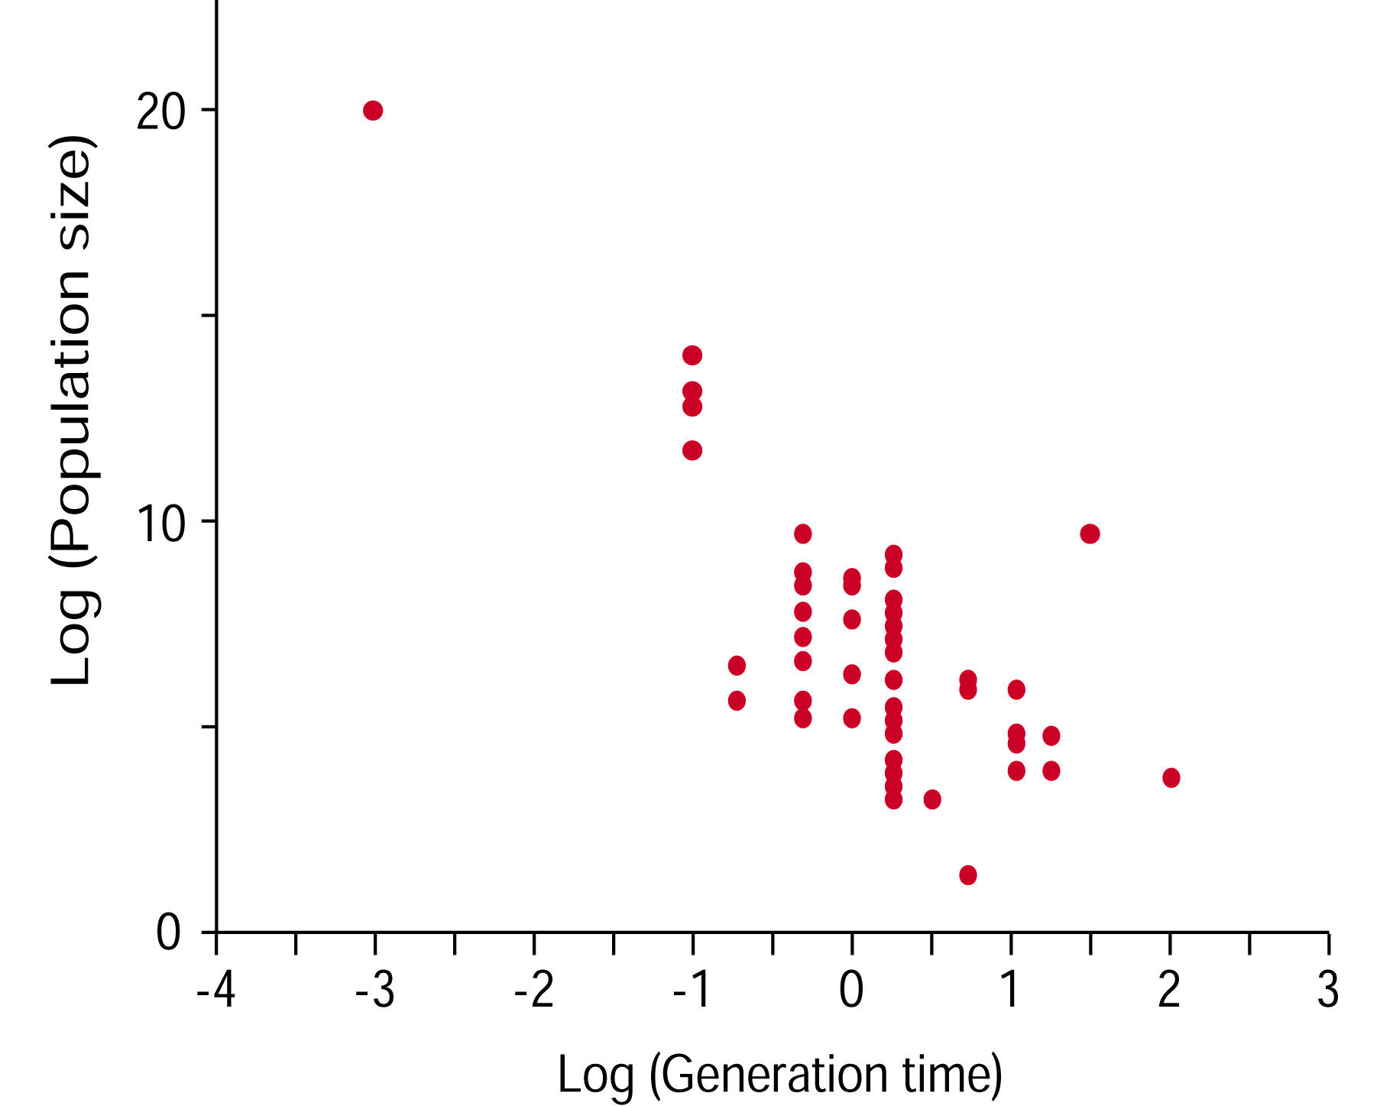
Nearly Neutral Theory
Selection more effective; fewer effectively neutral mutations
Selection less effective, more effectively
neutral mutations
Population size is negatively correlated with generation time. Species with short generation time will have large N_{e}.

Slide 30
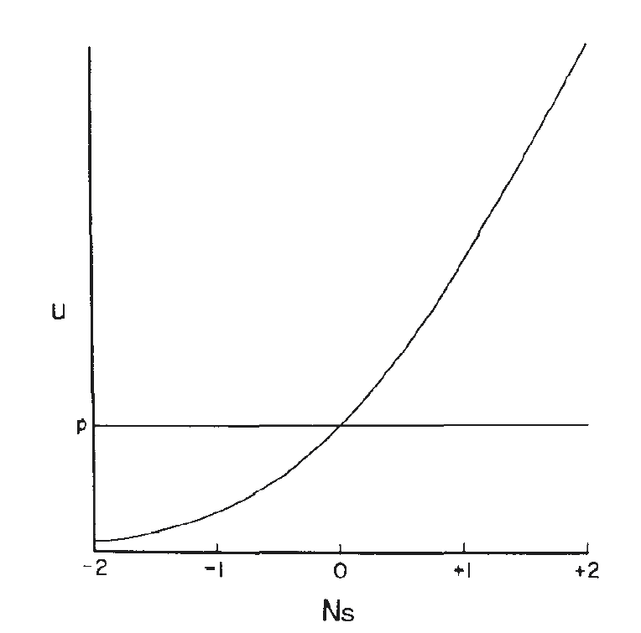
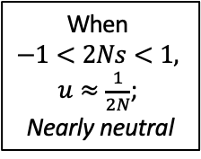
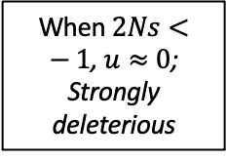
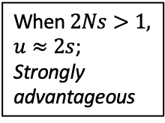

Fixation probability of nearly neutral mutations (u = substitution rate)
Fixation probability ($u$)
When $2Ns<−1$, $u≈0$; Strongly deleterious
When
$−1<2Ns<1,$
$u≈\frac{1}{2N}$;
Nearly neutral
When $2Ns>1,$ $u≈2s$; Strongly advantageous

Slide 31
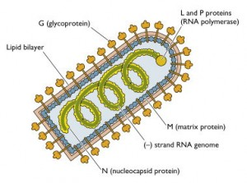
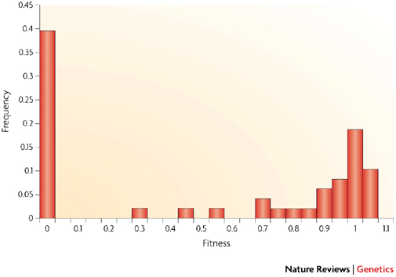
Beneficial mutations are rare.
The distribution of fitness effects of random mutations in vesicular stomatitis virus. Random mutations introduced into virus; fitness measured relative to wild type.
Fitness = 0 indicates lethality --- most new mutations were lethal.
Fitness >0 but <1 = deleterious or slightly deleterious.
Fitness = 1 indicates complete neutrality.
Fitness > 1 indicates was advantageous.
Lethal
Neutral
Beneficial
Eyre-Walker A, Keightley PD. 2007. The distribution of fitness effects of new mutations. Nature Rev. Genet. 8:610-618.

Slide 32
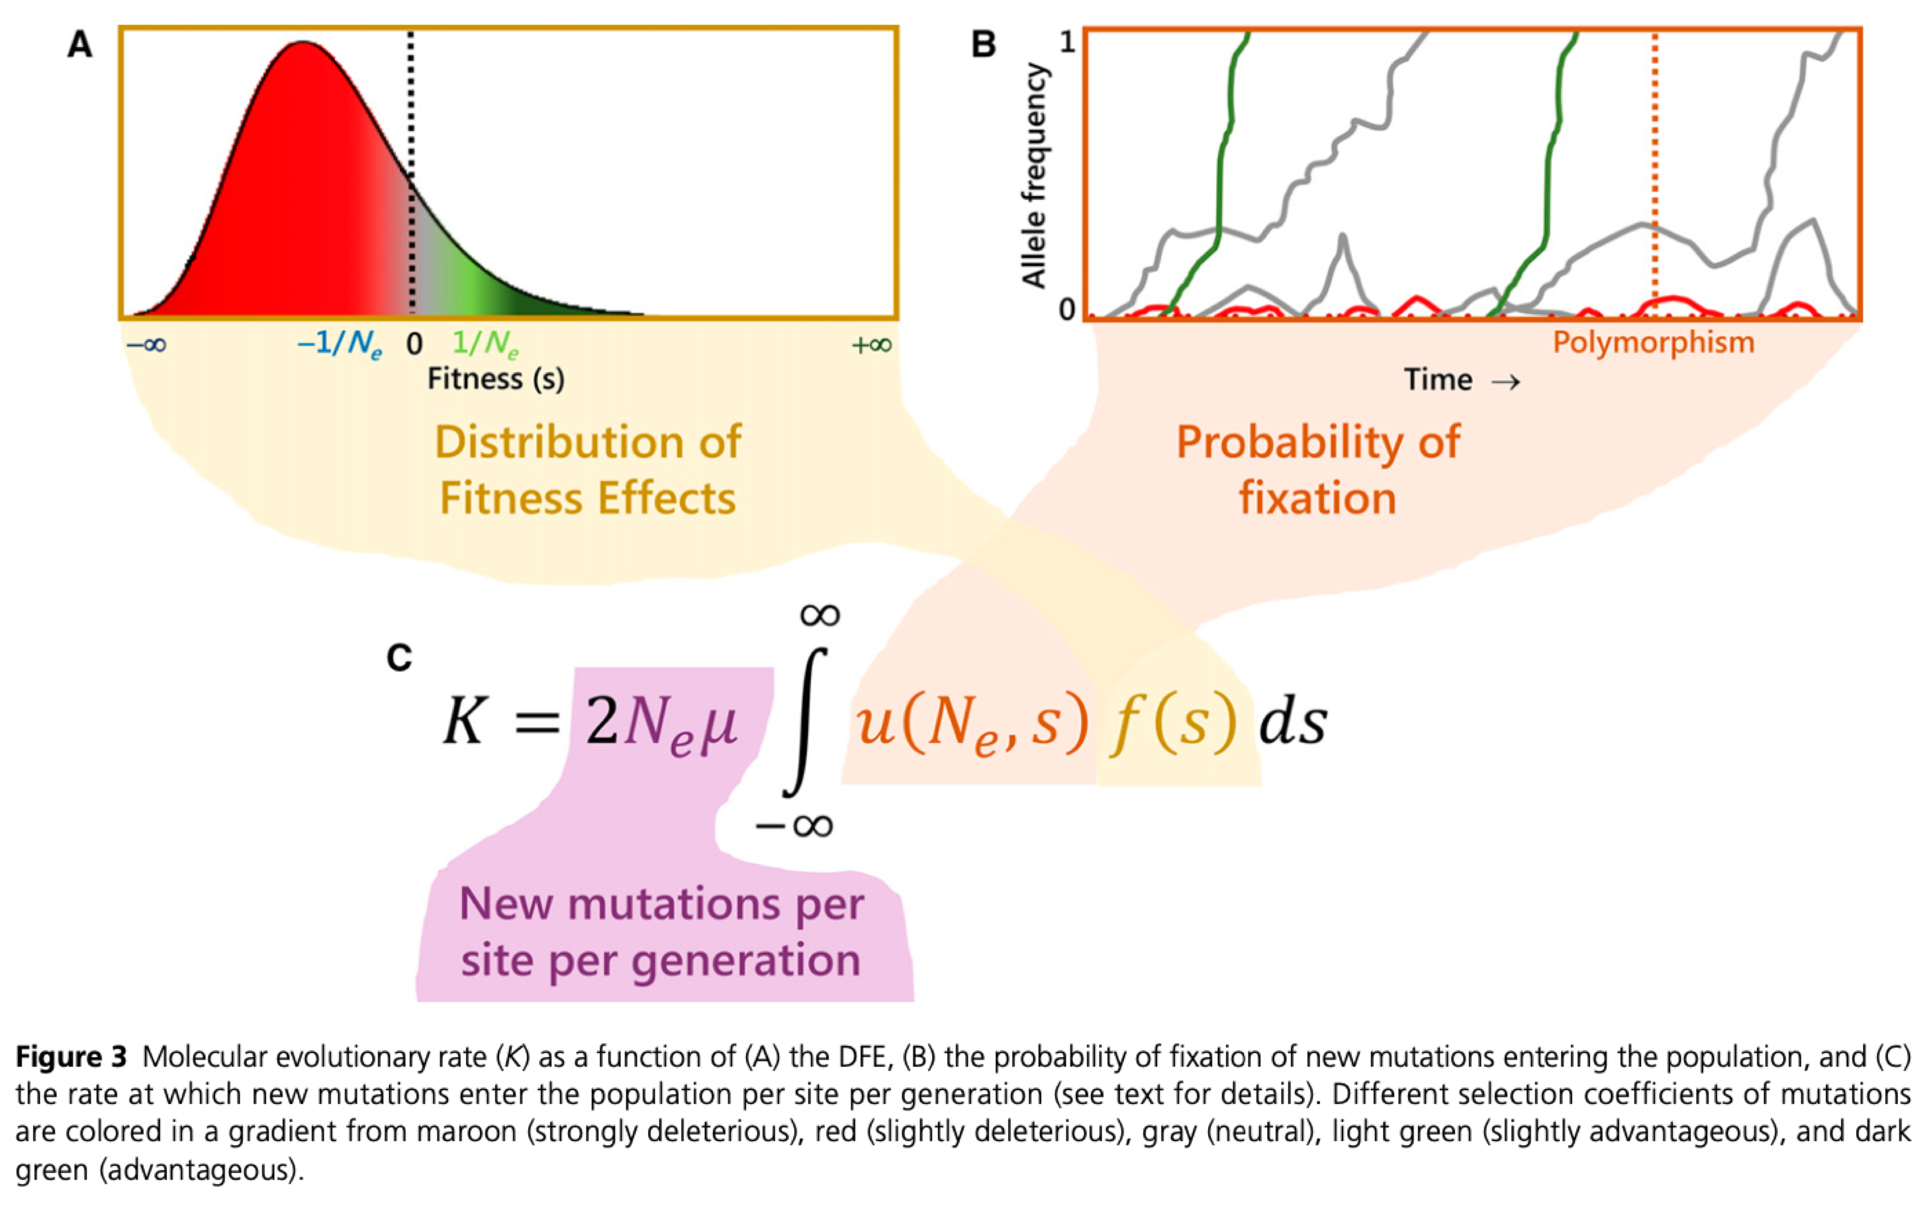
Casillas, S. and Barbadilla, A., 2017. Molecular population genetics. Genetics, 205(3), pp.1003-1035.

Slide 33
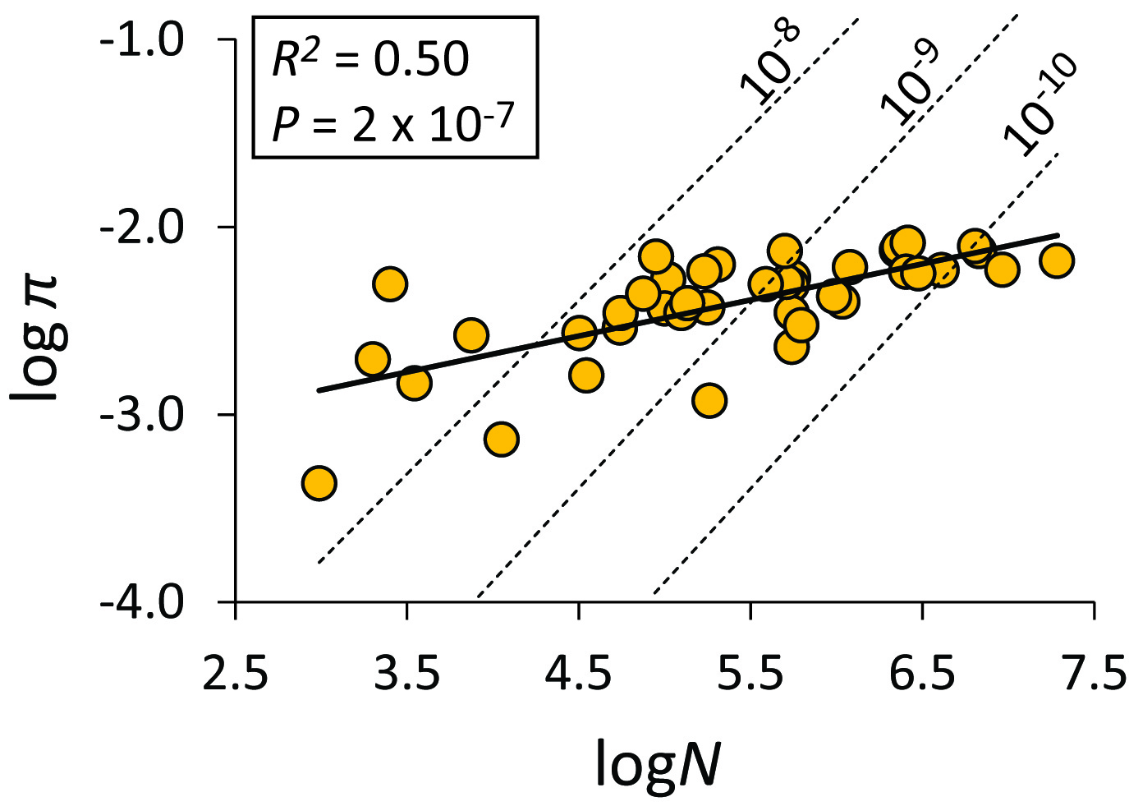
Genetic Diversity vs. Population Size
With accounting for generation time, we should expect to see greater nucleotide diversity in larger populations, and we do.
But we don’t see as much as predicted by the neutral parameter θ = 4N_{e}μ
This is Lewontin’s Paradox.
10-fold increase in N_{e} results in much smaller increase in π.
Relationship between N and π (proportion of variable sites) at 3,200 ddRAD loci from 41 species of ducks (1 individual/species). The dashed lines are the relationships expected from three different mutation rates - Jeff Peters, Wright State University.

Slide 34
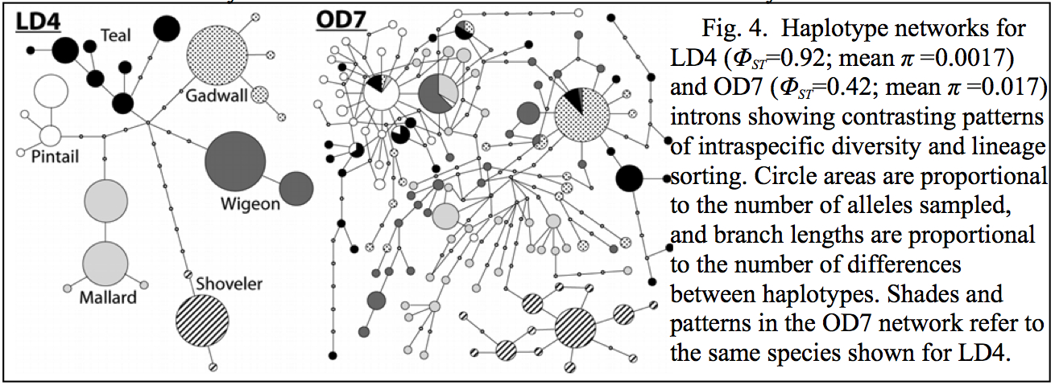
Peters, J. L. et al. (2014) Mito-nuclear discord in six congeneric lineages of Holarctic ducks (genus Anas). Molecular Ecology 23:2961-2974.
Sorted
Directional or Purifying?
Not Sorted
Balancing Selection
or Neutral?

Slide 35
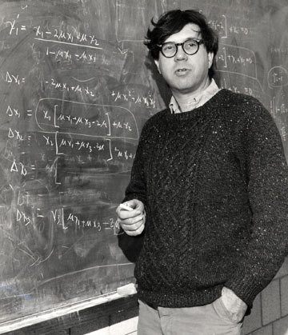
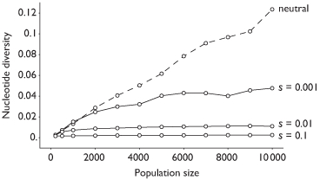
Lewontin’s Paradox
Selection Constrains Variation in Larger Populations
Effects of selection are locus specific, and consistent across species within loci, but variable among loci.
http://www.trevorbedford.com/tree_topology/

Slide 36
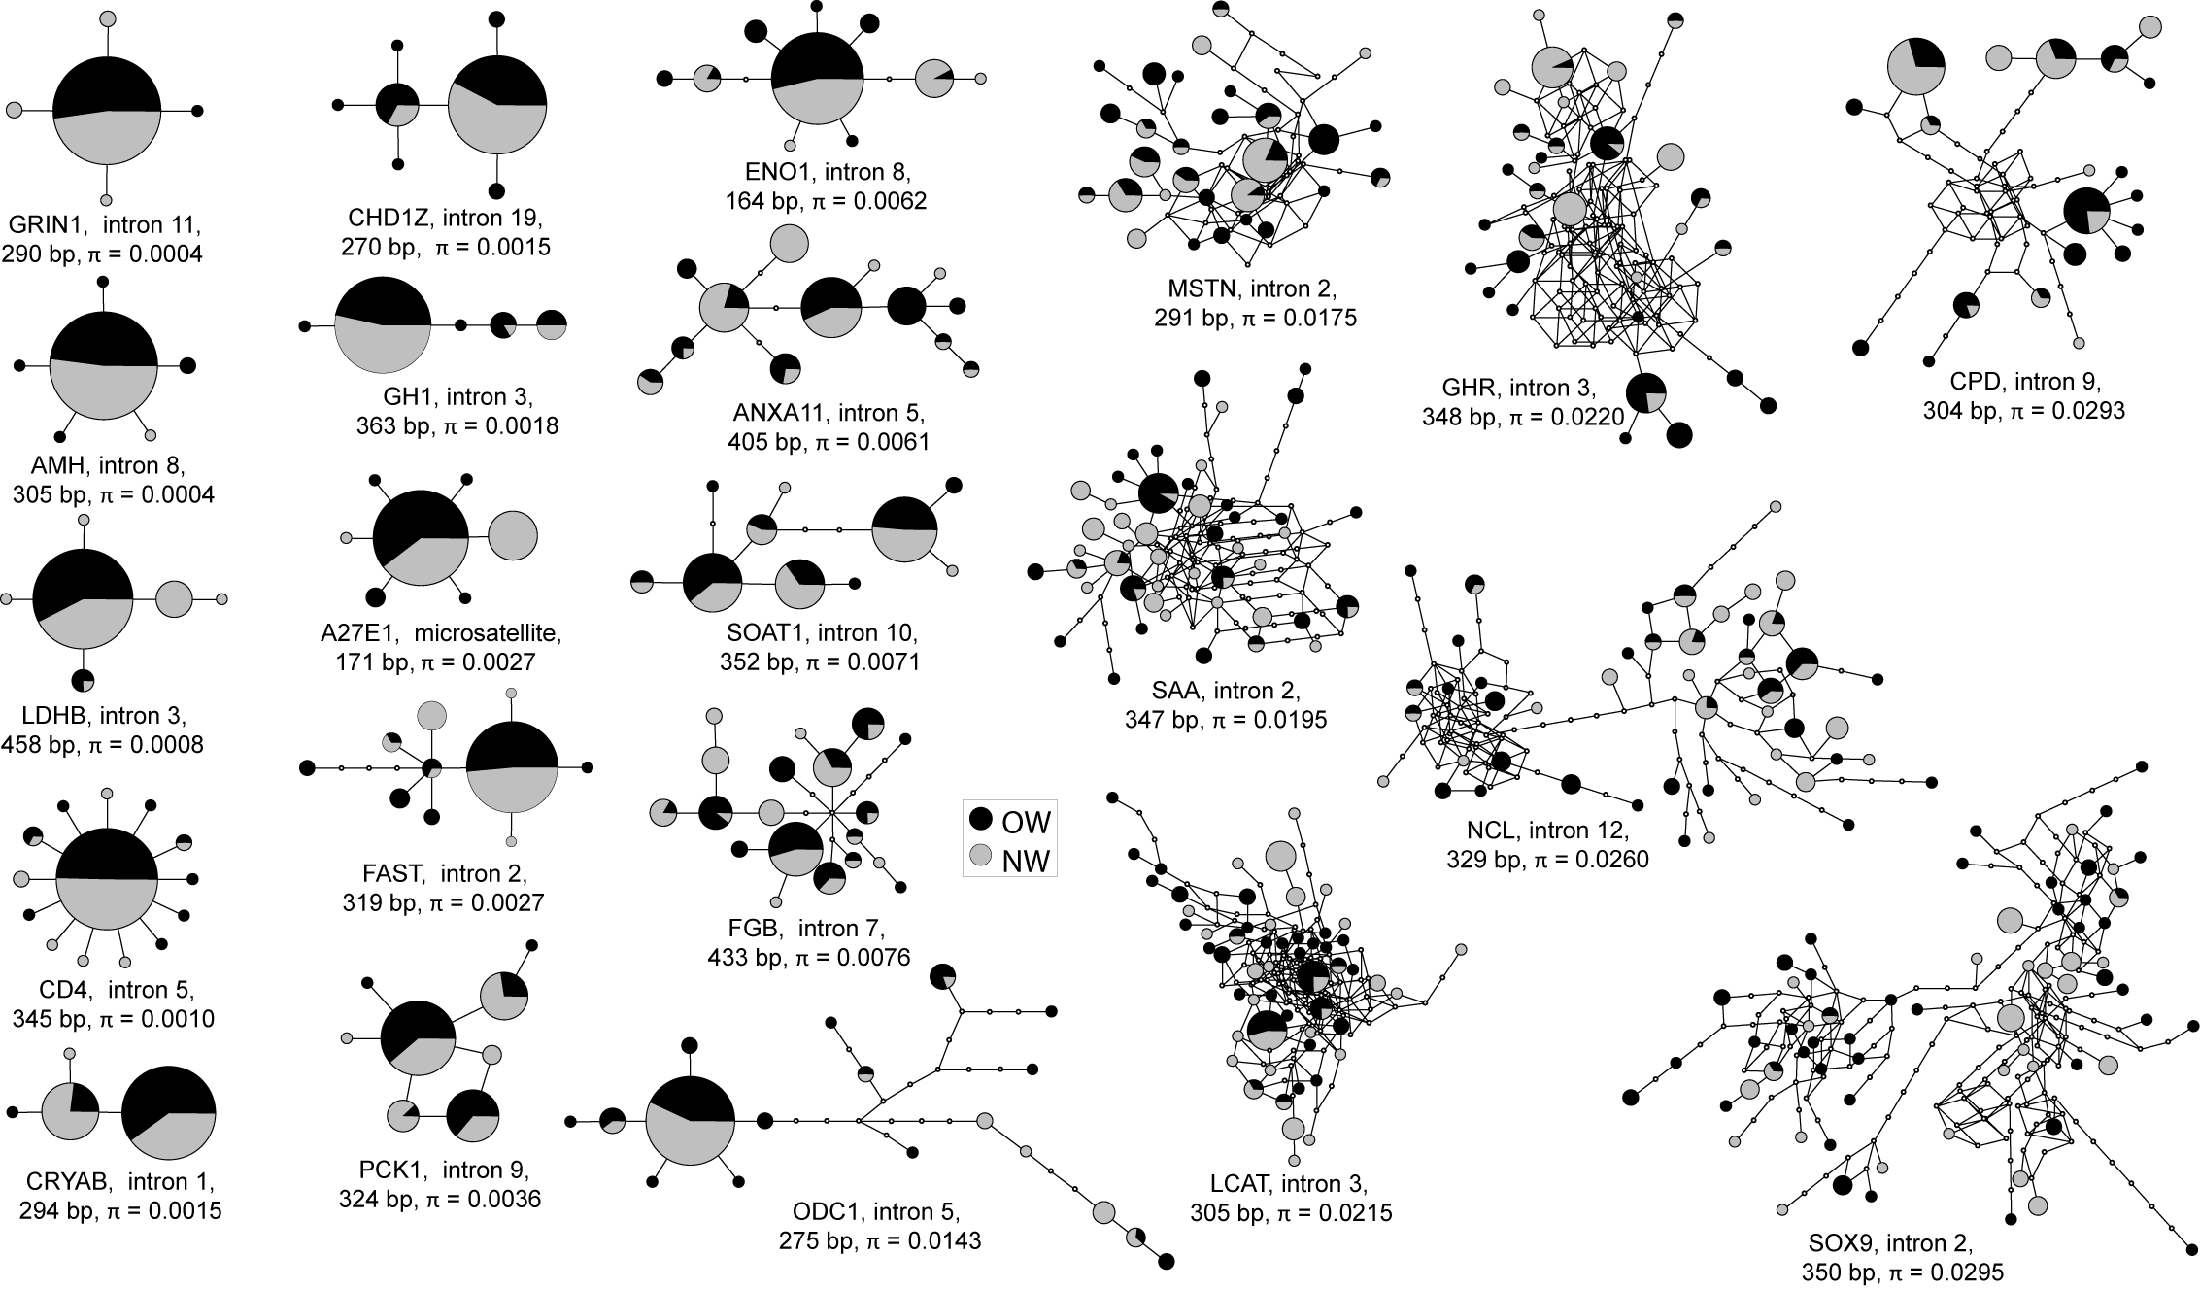
Peters, J. L. et al. (2012) Heterogeneity in genetic diversity among non-coding loci fails to fit neutral coalescent models of population history. PLoS ONE 7:e31972.

Slide 37
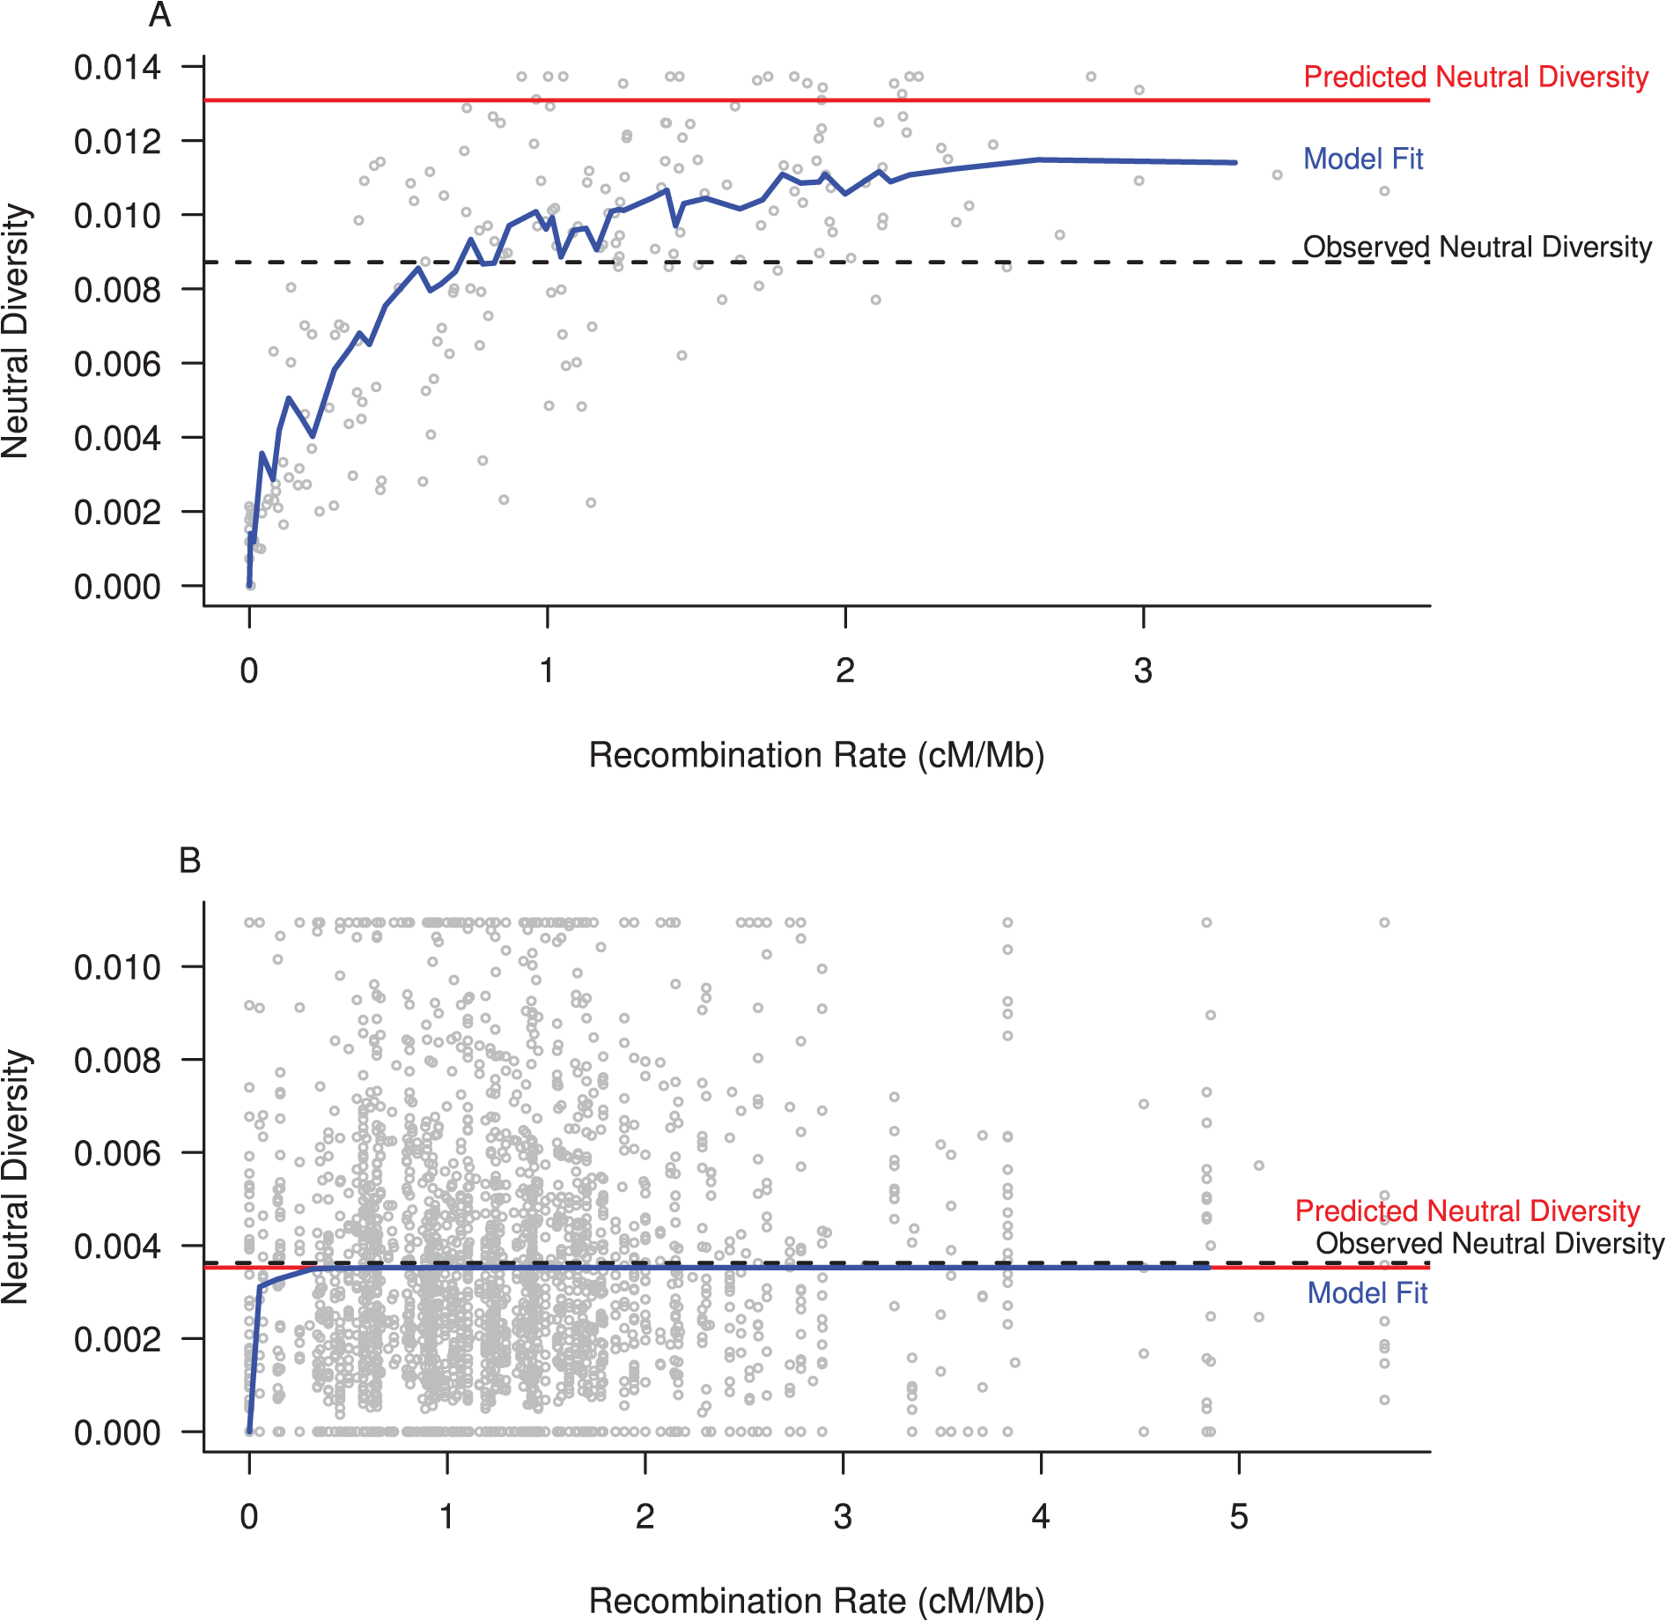

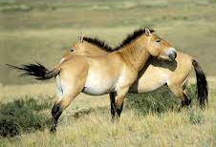
Drosophila melanogaster; Large N_{e}
Answer to Lewontin’s Paradox
Selection removes linked variation (background selection, genetic hitchhiking).
Genetic variation is reduced in regions of DNA with low recombination rates.
  The reduction in variation is much more pronounced in species with a large N.
Genetic variation at regions with high recombination rates is closer to the predicted neutral diversity based on N.
Equus ferus przewalskii ; Small N_{e}
Corbett-Detig RB, Hartl DL, Sackton TB (2015) Natural Selection Constrains Neutral Diversity across A Wide Range of Species. PLoS Biol 13

Slide 38
Summary
Selectionist theory: all mutations affect fitness; most mutations are deleterious
Neutral theory: most mutations are either deleterious or neutral; advantageous mutations are rare. More neutral sites would produce a faster overall rate of change.
Nearly neutral theory: most mutations are deleterious, neutral, or “nearly” neutral; few are advantageous. Fate of mutations will depend on population size.
Bromham & Penny “The modern molecular clock” Nature Rev Genet 4:216, 2003

