Slide 1
Quantitative Genetics
Population Genetics & Genomics
University of Miami
Spring 2023

Slide 2
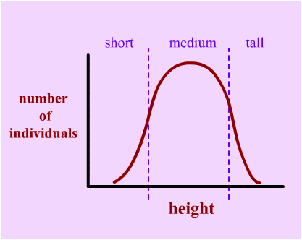
Traits with a continuous distribution of phenotypes are called quantitative traits (e.g., height, weight, growth rate, personality, learning ability, crop yield, fat content, etc.).

Slide 3
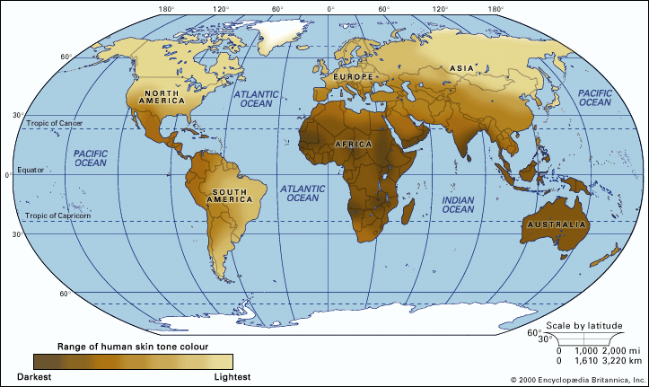
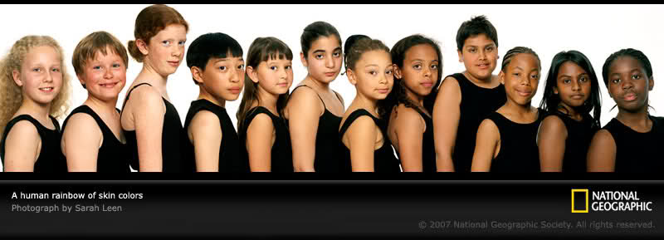

Slide 4
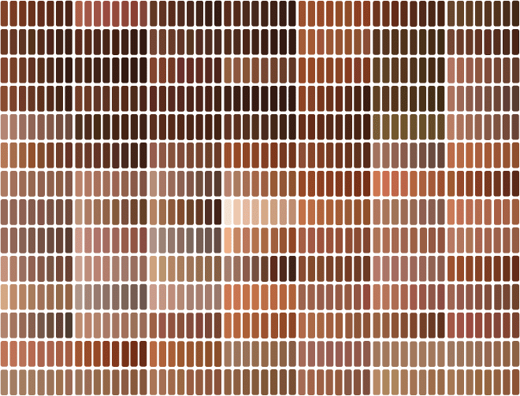
Quantitative trait: A trait that shows a continuous range of phenotypes is usually “polygenic”.
Human skin colors

Slide 5
Quantitative traits arise from effects of:
  Multiple loci, polygenic (effects of many genes)
  Pleiotropy (one single gene has many different effects)
  Epistasis (effects of gene interactions)
  Variable expressivity and penetrance
  Environment (produces a range of phenotypes)

Slide 6
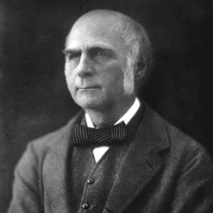
Francis Galton (1822-1911)
Cousin of Charles Darwin
Among the first to recognize that continuous traits are
statistically correlated between parents and offspring, but could not determine how transmission occurs.
Hereditary Genius (1869) - hypothesize that ability was inherited; The History of Twins (1875) - developed first controlled twin studies
Invented term Eugenics
Experimentally invalidated Darwin’s “Pangenesis” hypothesis and firmly rejected Lamarck’s inheritance of acquired characters.
First conceived the “standard deviation”, use of the “regression line”, and correlation coefficient (r).
Almost rediscovered Mendel’s particulate theory of inheritance, but fell short because of his focus on continuous rather than discrete traits.

Slide 7
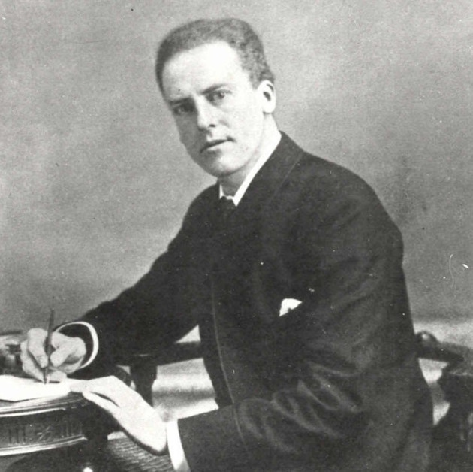
Karl Pearson (1857-1936)
Student of Francis Galton
Influential mathematical statistician - founded first university statistics department at University College in London.
Developed many statistics used in study of quantitative traits:
  Pearson’s correlation coefficient
  Chi-square test
  Principal components analysis (PCA)
  First use of histogram
Founded “Annals of Eugenics”, now “Annals of Human Genetics” - journals
Socialist, rejected induction into the OBE and Knighthood

Slide 8
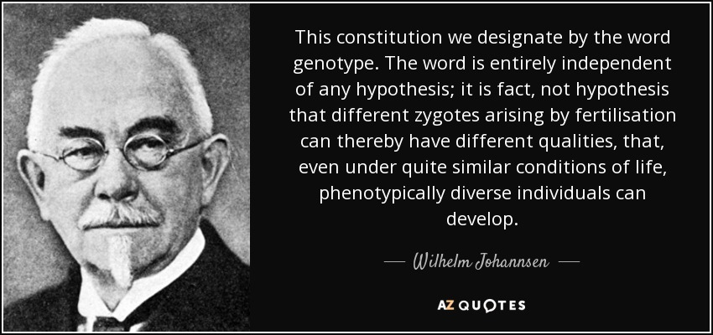
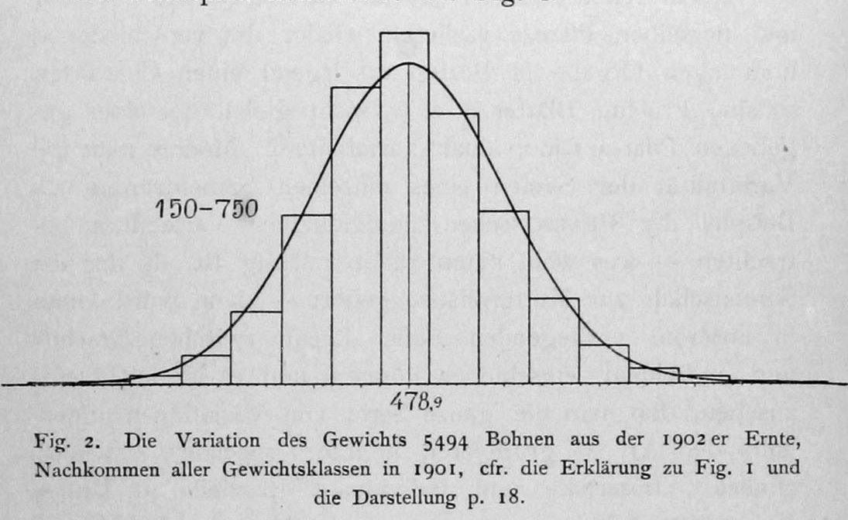
Wilhelm Johannsen (1857-1927)
Danish plant physiologist & geneticist.
First coined the terms genotype and phenotype
Found that seed size followed a normal distribution, and demonstrated that this is partly heritable and partly environmental.

Slide 9
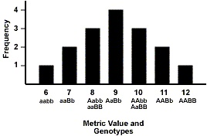
Can Mendelian genetics explain quantitative traits?

Slide 10
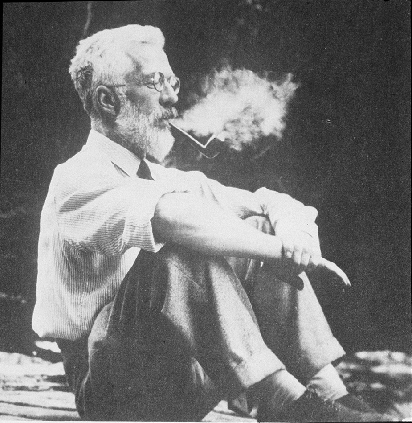
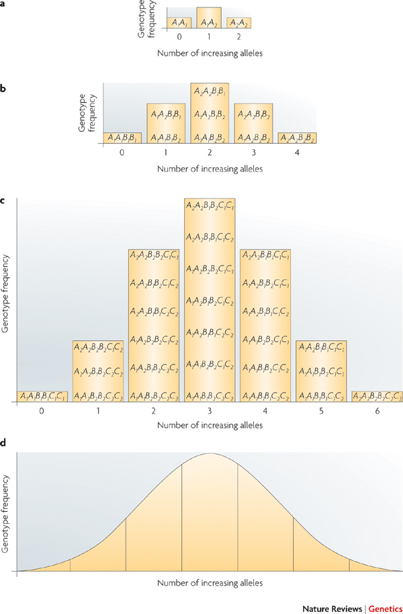
Ronald Fisher (1890-1962)
First to demonstrate mathematically that Mendelian models of allele segregation apply to multiple genetic loci.
Fisher, R. A. (1919) The correlation between relatives on the supposition of Mendelian inheritance. Transactions of the Royal Society of Edinburgh 52:399-433
Plomin, R., Haworth, C. M., & Davis, O. S. (2009). Common disorders are quantitative traits. Nature Reviews Genetics, 10(12), 872-878.

Slide 11
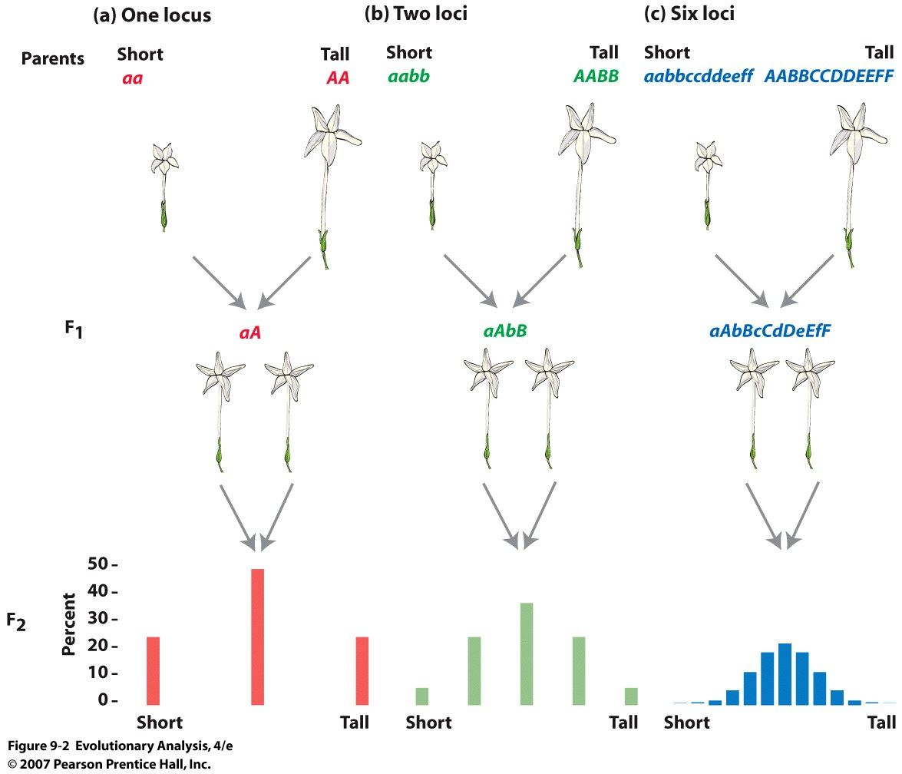
Edward East (1916) addressed this question using the model system, Longflower Tobacco (Nicotiana longiflora).
East, E. M. (1916). Studies on size inheritance in Nicotiana. Genetics, 1, 164.

Slide 12
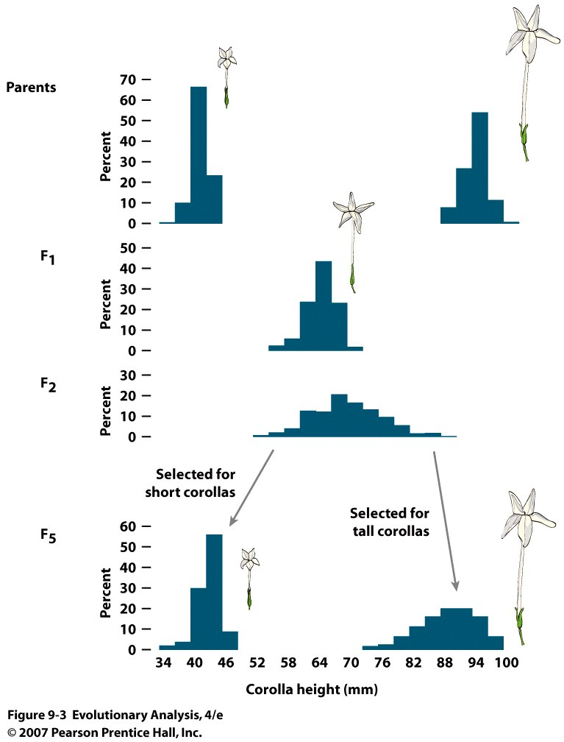
East’s experimental predictions:
F2 progeny should have a range of phenotypes intermediate to the parents.
Parental phenotypes should be recoverable by selection on F2s.
Quantitative traits determined by Mendelian alleles at many loci and environmental variation.

Slide 13
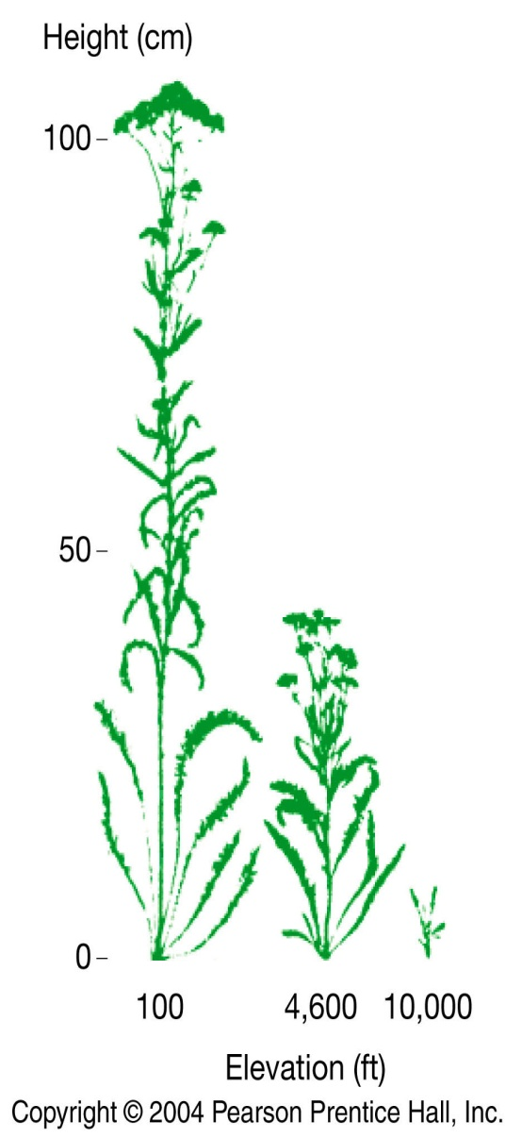
Quantitative traits are influenced by the environment as well as genotype.
Experiments by Clausen, Keck, and Hiesey (1948)
Genetically identical cuttings of the same individual Achillea plant grown at different altitudes.
Clausen, J., Keck, D. D., & Hiesey, W. M. (1948). Experimental studies on the nature of species. III. Environresponses of climatic races of Achillea. Experimental studies on the nature of species. III. Environresponses of climatic races of Achillea. Publ. No. 581.

Slide 14
Some types of questions studied in quantitative genetics:
How do genetics and environment affect a trait?
Which and how many genes produce a set of phenotypes for a trait?
Where in the genome are they located? Autosomal or sex-linked, etc.? What is the recombination distance between linked loci?
Do some genes play a major role (large effect size), whereas other genes modify or play a small role (small effect size)?
Do alleles interact to produce additive or epistatic effects?
How does selection affect the trait; does it affect other traits that may be linked?
If so what types of mating and selection produce desired phenotypes?
How will species respond to changing environment?

Slide 15
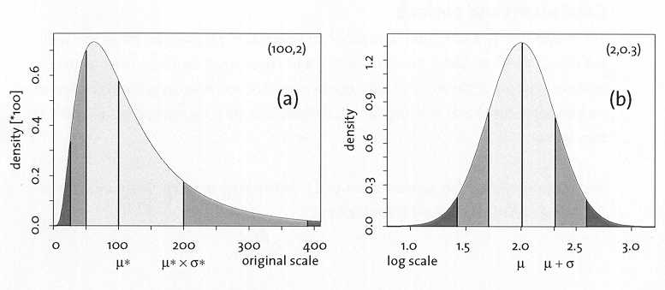
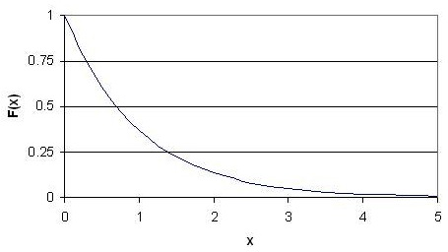
Statistical analyses and distributions:
Sample size/randomization
Type of distribution (e.g., normal distribution)
Mean, variance, and standard deviation
Correlation/regression
Analysis of variance (ANOVA)
Lognormal
Normal
Exponential

Slide 16
Components of Phenotypic Variation
Individuals : P = G + E
(Phenotype = Genetic + Environmental effects)
Population : Variance (P) = Variance (G) + Variance (E)
V_{P} = V_{G} + V_{E}
V_{P} = V_{G} + V_{E} + 2COV_{G,E} + V_{G X E}

Slide 17
Components of Genetic Variation
Additive genetic variance (V_{A}): effects of alleles at two or more loci contribute to phenotype. F1 will will appear intermediate to the parental phenotypes for repeated test crosses.
Dominance variance (V_{D}): effects of alleles are not strictly additive; must consider how alleles interact in the heterozygote. F1 will resemble one of the parental phenotypes.
Interaction variance (V_{I}): accounts for epistatic interactions between two or more loci. F1 phenotype is unpredictable.
    Substitute V_{G} with V_{A} + V_{D} + V_{I} :
    V_{P} = (V_{A} + V_{D} + V_{I}) + V_{E} + 2COV_{G,E} + V_{G x E}

Slide 18
Analysis of Quantitative trait loci (QTLs):
QTLs =specific genomic segments correlated with continuous phenotypic trait variation.
Perform Genome Wide Association Study (GWAS)
Cross inbred lines with different phenotypes (homozygotes for different alleles at most loci) to produce heterozygotes.
Self F₁ or back cross to parental lines to increase phenotypic variation and segregation of traits.
Analyze F₂ with physical markers (microsatellites) that correlate with phenotypic variation.
Create a linkage map.
Calculate components of phenotypic variance (V_{P}) due to genetic effects (V_{G}) and components due to environment effects (V_{E}).
    V_{P} = V_{G} + V_{E} + 2COV_{G,E} + V_{G x E}

Slide 19
GWAS is similar to F_{ST} genomic scan in the end results, but involves test crosses to create a linkage map, and can be used to identify loci of small effect (i.e., low F_{ST}) with sufficient sample size.
Relies on LD (i.e., hitchhiking) to detect gene of interest.
Calculate Lod Score (Logarithm of the Odds):
Lod = log of the ratio odds that two loci (or a locus and a trait) are linked with a recombination factor (q) greater than 0 and less than 0.5.
z = log₁₀ {Prob(data|q)/Prob(data|0.5)}
Lod score of +3.00 (odds of 1000:1) or greater is regarded as acceptable evidence for linkage.
Lod 3 = 1000:1
Lod 2 = 100:1
Lod 1 = 10:1

Slide 20
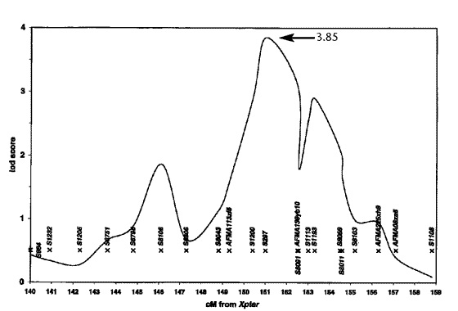
Figure 1. Graph of multipoint lod scores assuming heterogenity
The peak multipoint lod score of 3.85 is located between DXS1200 and DXS297.
Nature Genetics 20, 175 - 179 (1998)
Evidence for a prostate cancer susceptibility locus on the X chromosome.
Jianfeng Xu et al.

Slide 21
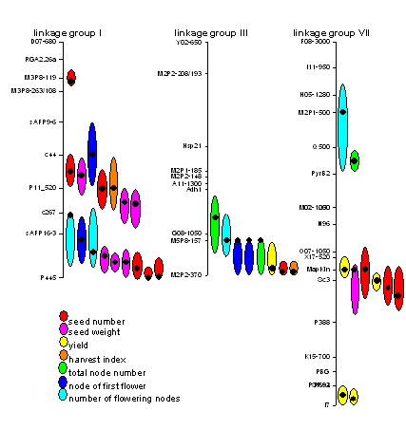
Timmerman-Vaughan et al. 2004 - Linkage mapping of QTLs for seed yield, yield components and developmental traits in pea (Pisum sativum L.)

Slide 22
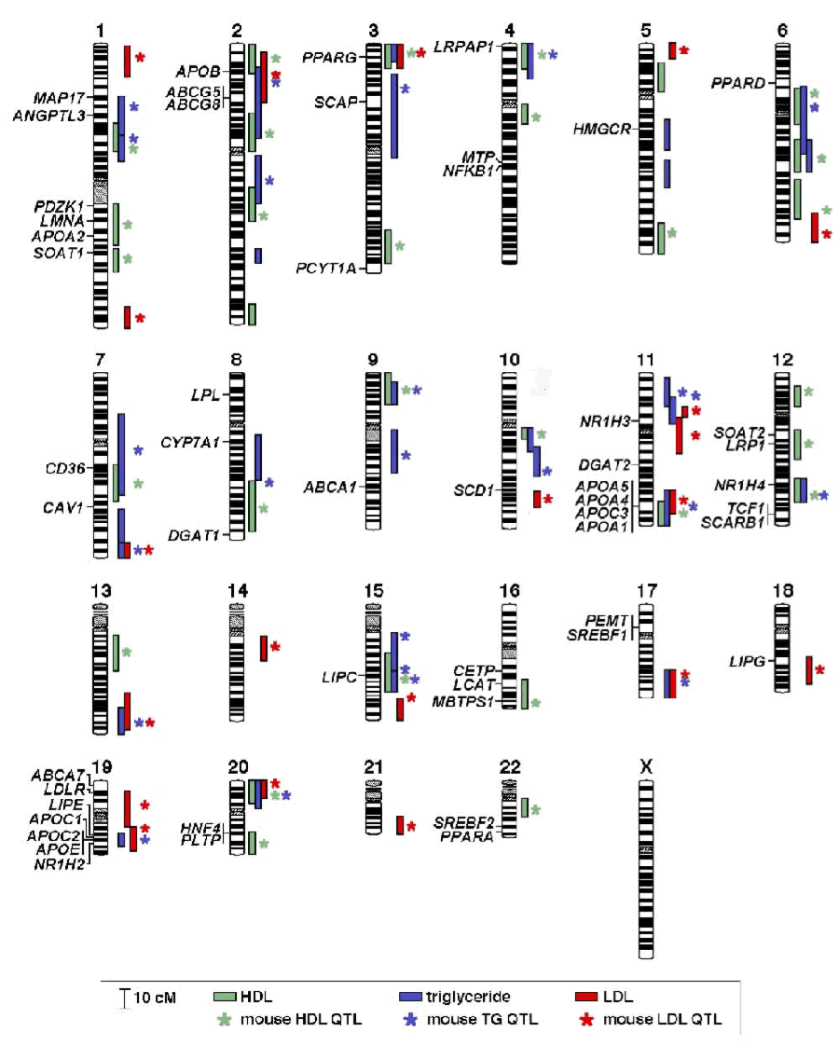
Chromosome map of human QTLs for plasma concentrations of HDL-C, LDL-C and triglyceride levels. 2007. The Jackson Laboratory

Slide 23
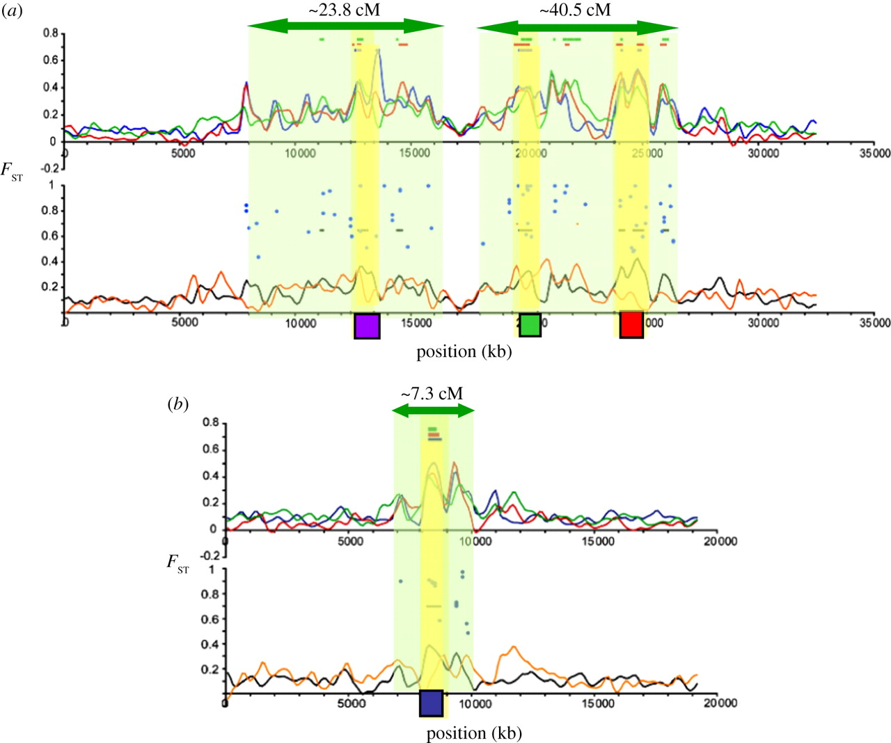

Probable DH regions in threespine stickleback.
Via S Phil. Trans. R. Soc. B 2012;367:451-460
Multiple genes in same region evolve as a cassette
(recombination is suppressed)
©2012 by The Royal Society
Notes:
Probable DH regions in threespine stickleback. (a) Genome scan of divergence on LGIV between freshwater and oceanic threespine stickleback (reproduced from figs. 7 & 8 in [53], except for the addition of the QTLs and proposed DH regions). The candidate gene regions are shown as yellow bars; Class1 SNPs appear as blue dots. The purple square marks the location of the gene Eda. Green and red squares mark QTL affecting body shape [54]. Regions of DH (green shading) are arbitrarily extended to the edge of each cluster of SNP outliers. (b) LGVIII from the same study [53]. Blue square denotes a candidate gene at marker stn90; Class1 SNPs appear as blue dots; from [55].

Slide 24
Heritability
In the broad sense, variation in a trait that is due to variation in genes.
If variation among individuals is due to genes, then offspring should resemble their parents
Two ways to measure:
  parent-offspring regression
  selection experiments

Slide 25
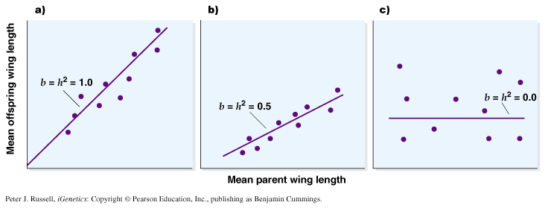
Parent-Offspring Regression
Plot mid-parent value against mid-offspring value. Slope (b) of best-fit regression line = heritability (h²).

Slide 26
Narrow Sense Heritability
V_{P} = variation in phenotype
V_{A} = additive effects of genes
V_{D} = dominance effects
V_{I} = interaction between genes (epistasis)
V_{E} = environment effects
The narrow sense heritability determines the proportion of the total phenotypic variance that can be attributed to additive genetic variation.
Narrow sense heritability is what can be used to predict resemblance between offspring and parents, between you and your parents.

Slide 27
Broad-Sense Heritability
Broad-sense heritability incorporates variance due to additive effects, dominance, and genetic interactions.
Variation due to dominance and interactions is not linearly heritable. Broad-sense heritability is therefore seldom used because it is difficult to predict.
Heritability is a measure of variance and is only meaningful for characteristics of a population (not the individual).

Slide 28
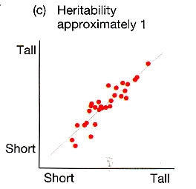
Effects of the Environment
If variation among individuals is due to genes, then offspring should resemble their parents.
However, what if offspring resemble their parents due to their shared environment?

Slide 29
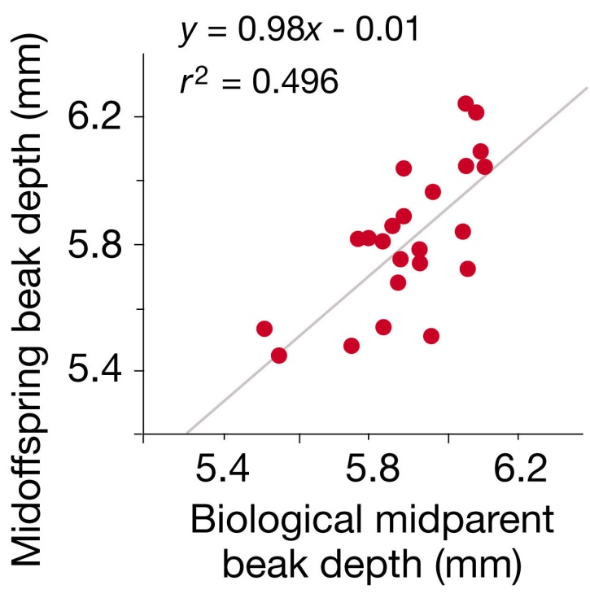
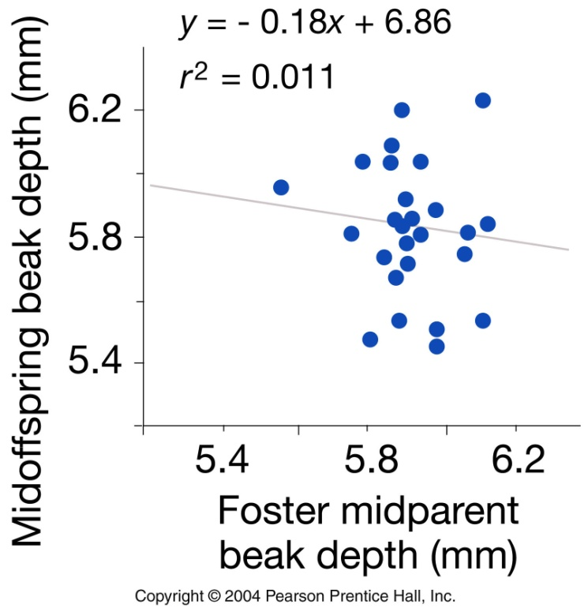
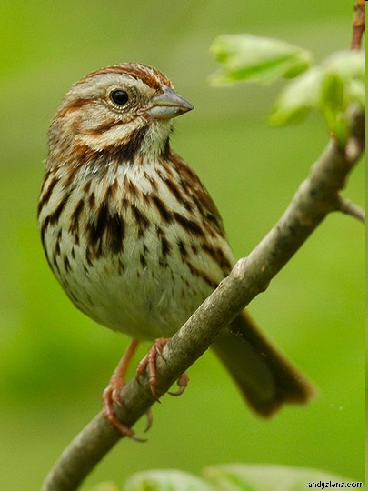
Distinguishing Heritability From Effects Of Parental Environment
Smith, J. N., & Dhondt, A. A. (1980). Experimental confirmation of heritable morphological variation in a natural population of song sparrows. Evolution, 1155-1158.

Slide 30
Selection Experiments
Only particular individuals allowed to breed
Difference between mean phenotype of population and mean of selected group = selection differential, S

Slide 31
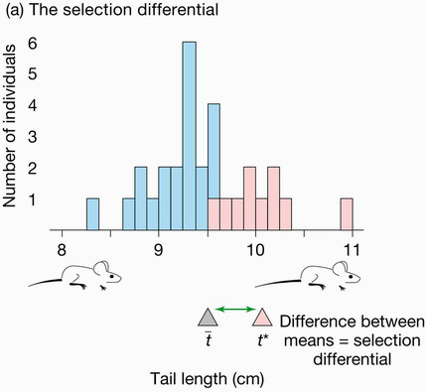

Slide 32
Selection Experiments

Slide 33
Selection Experiments

Slide 34
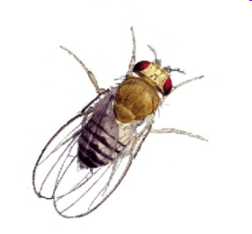
Graphical representation of selection on bristle number in Drosophila

Slide 35
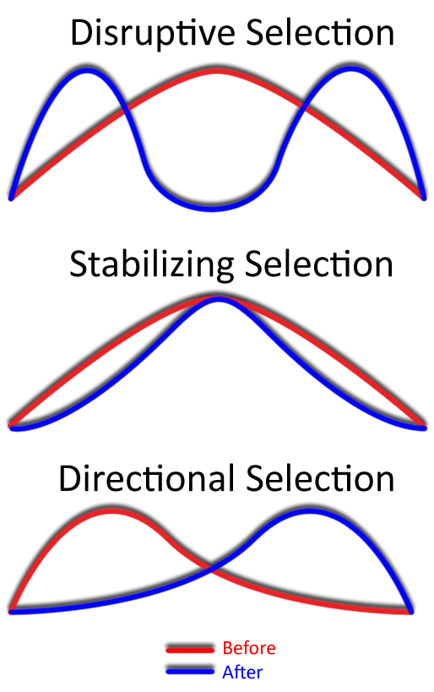
Wikipedia

Slide 36
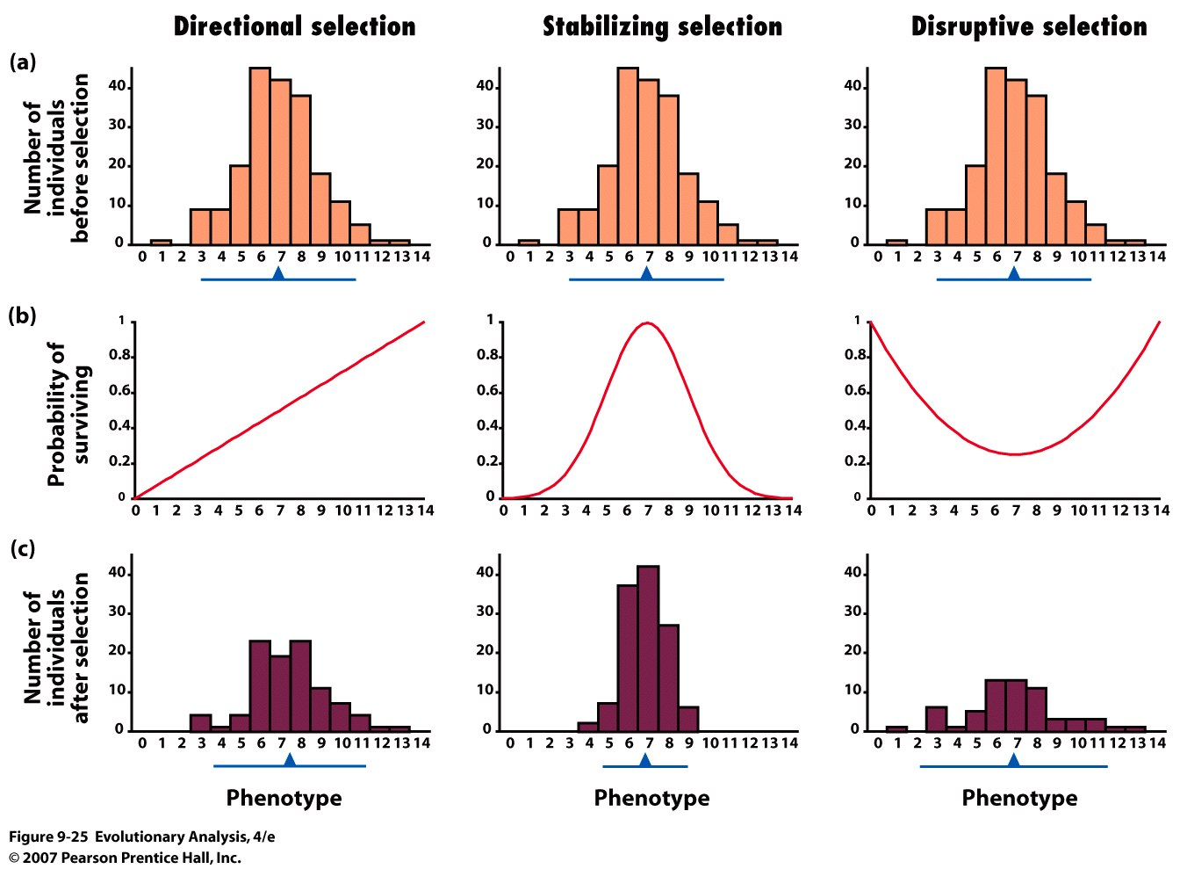
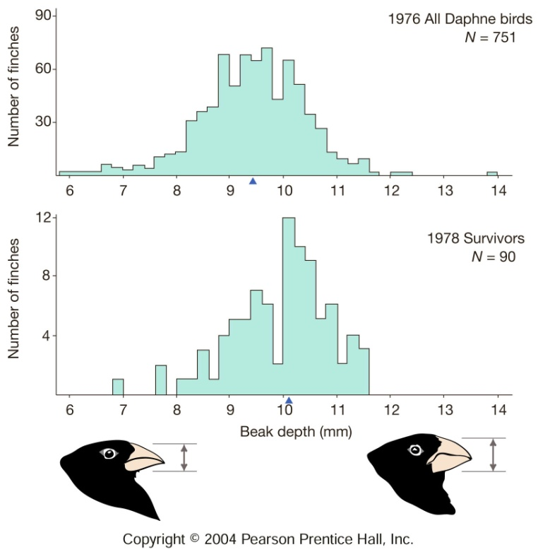
Directional Selection
Linear relationship for fitness.
Leads to change in mean of trait and small reduction in variance.
Darwin’s Finches

Slide 37
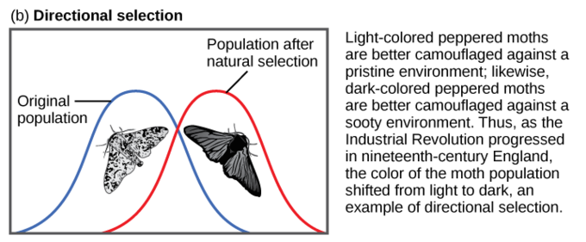
https://www.boundless.com/biology/textbooks/boundless-biology-textbook/the-evolution-of-populations-19/adaptive-evolution-132/stabilizing-directional-and-diversifying-selection-535-11742/

Slide 38
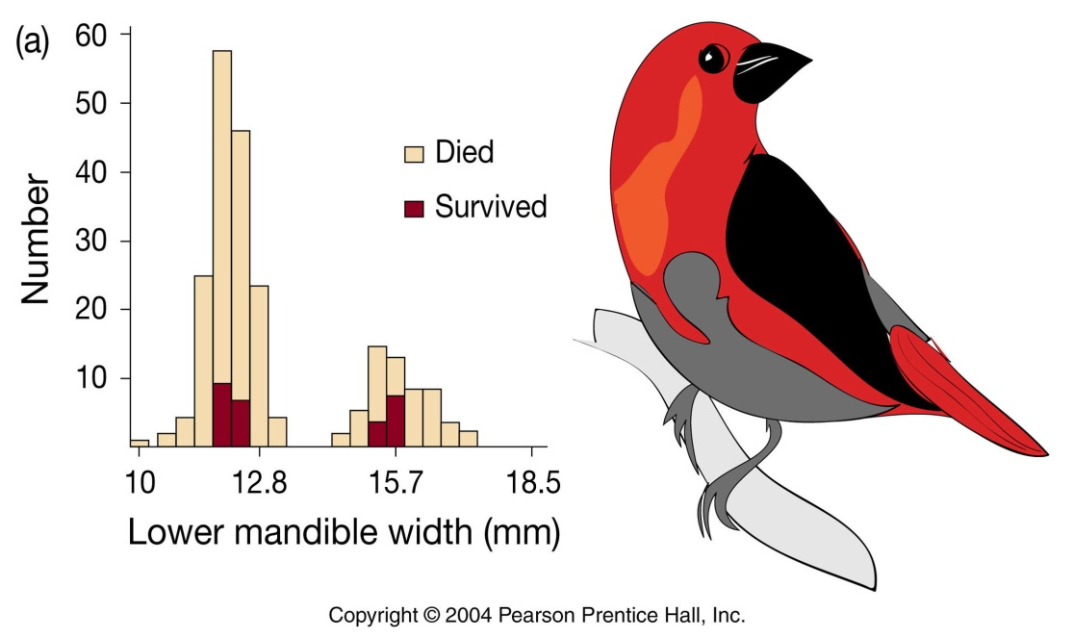
Disruptive Selection
Curvilinear fitness function, lowest in center, highest at extremes.
Broadens distribution, (increases variance), does not change mean.
Pine Grosbeak

Slide 39
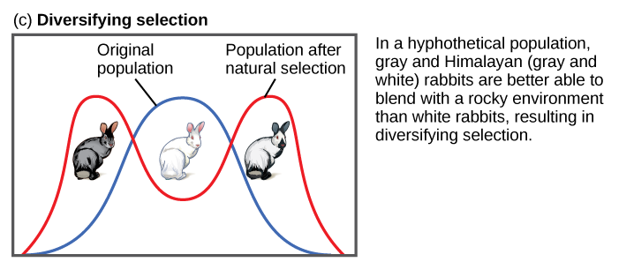
https://www.boundless.com/biology/textbooks/boundless-biology-textbook/the-evolution-of-populations-19/adaptive-evolution-132/stabilizing-directional-and-diversifying-selection-535-11742/

Slide 40
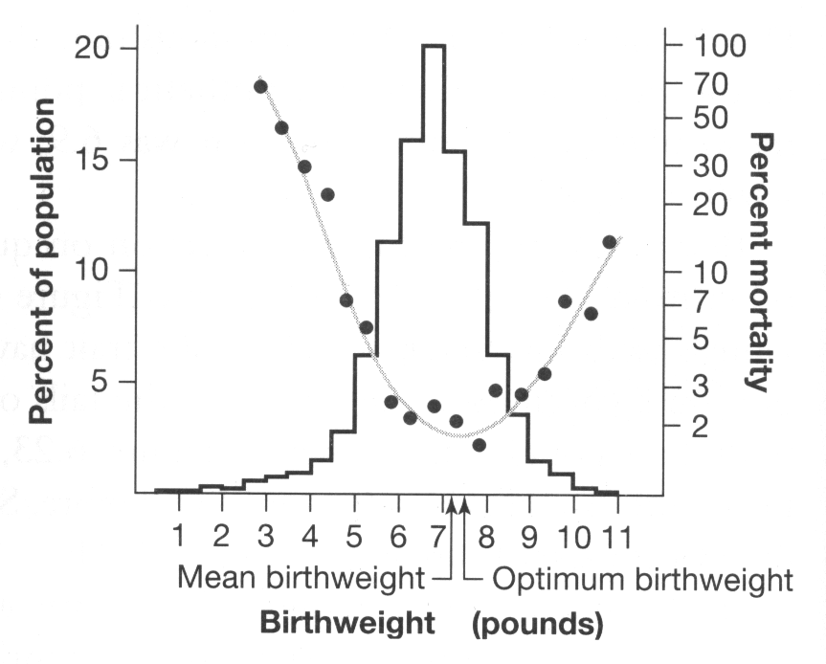
Stabilizing Selection
Curvilinear fitness function, highest in center, lowest at extremes.
Narrows distribution (reduces variance), does not change mean.

Slide 41
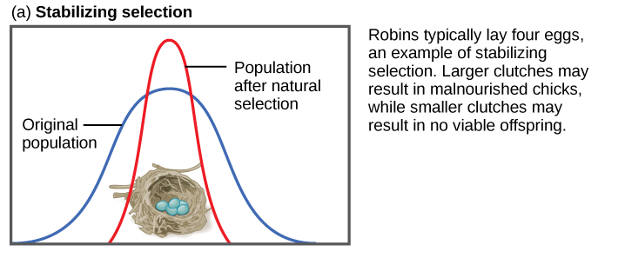
https://www.boundless.com/biology/textbooks/boundless-biology-textbook/the-evolution-of-populations-19/adaptive-evolution-132/stabilizing-directional-and-diversifying-selection-535-11742/

Slide 42
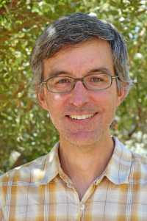
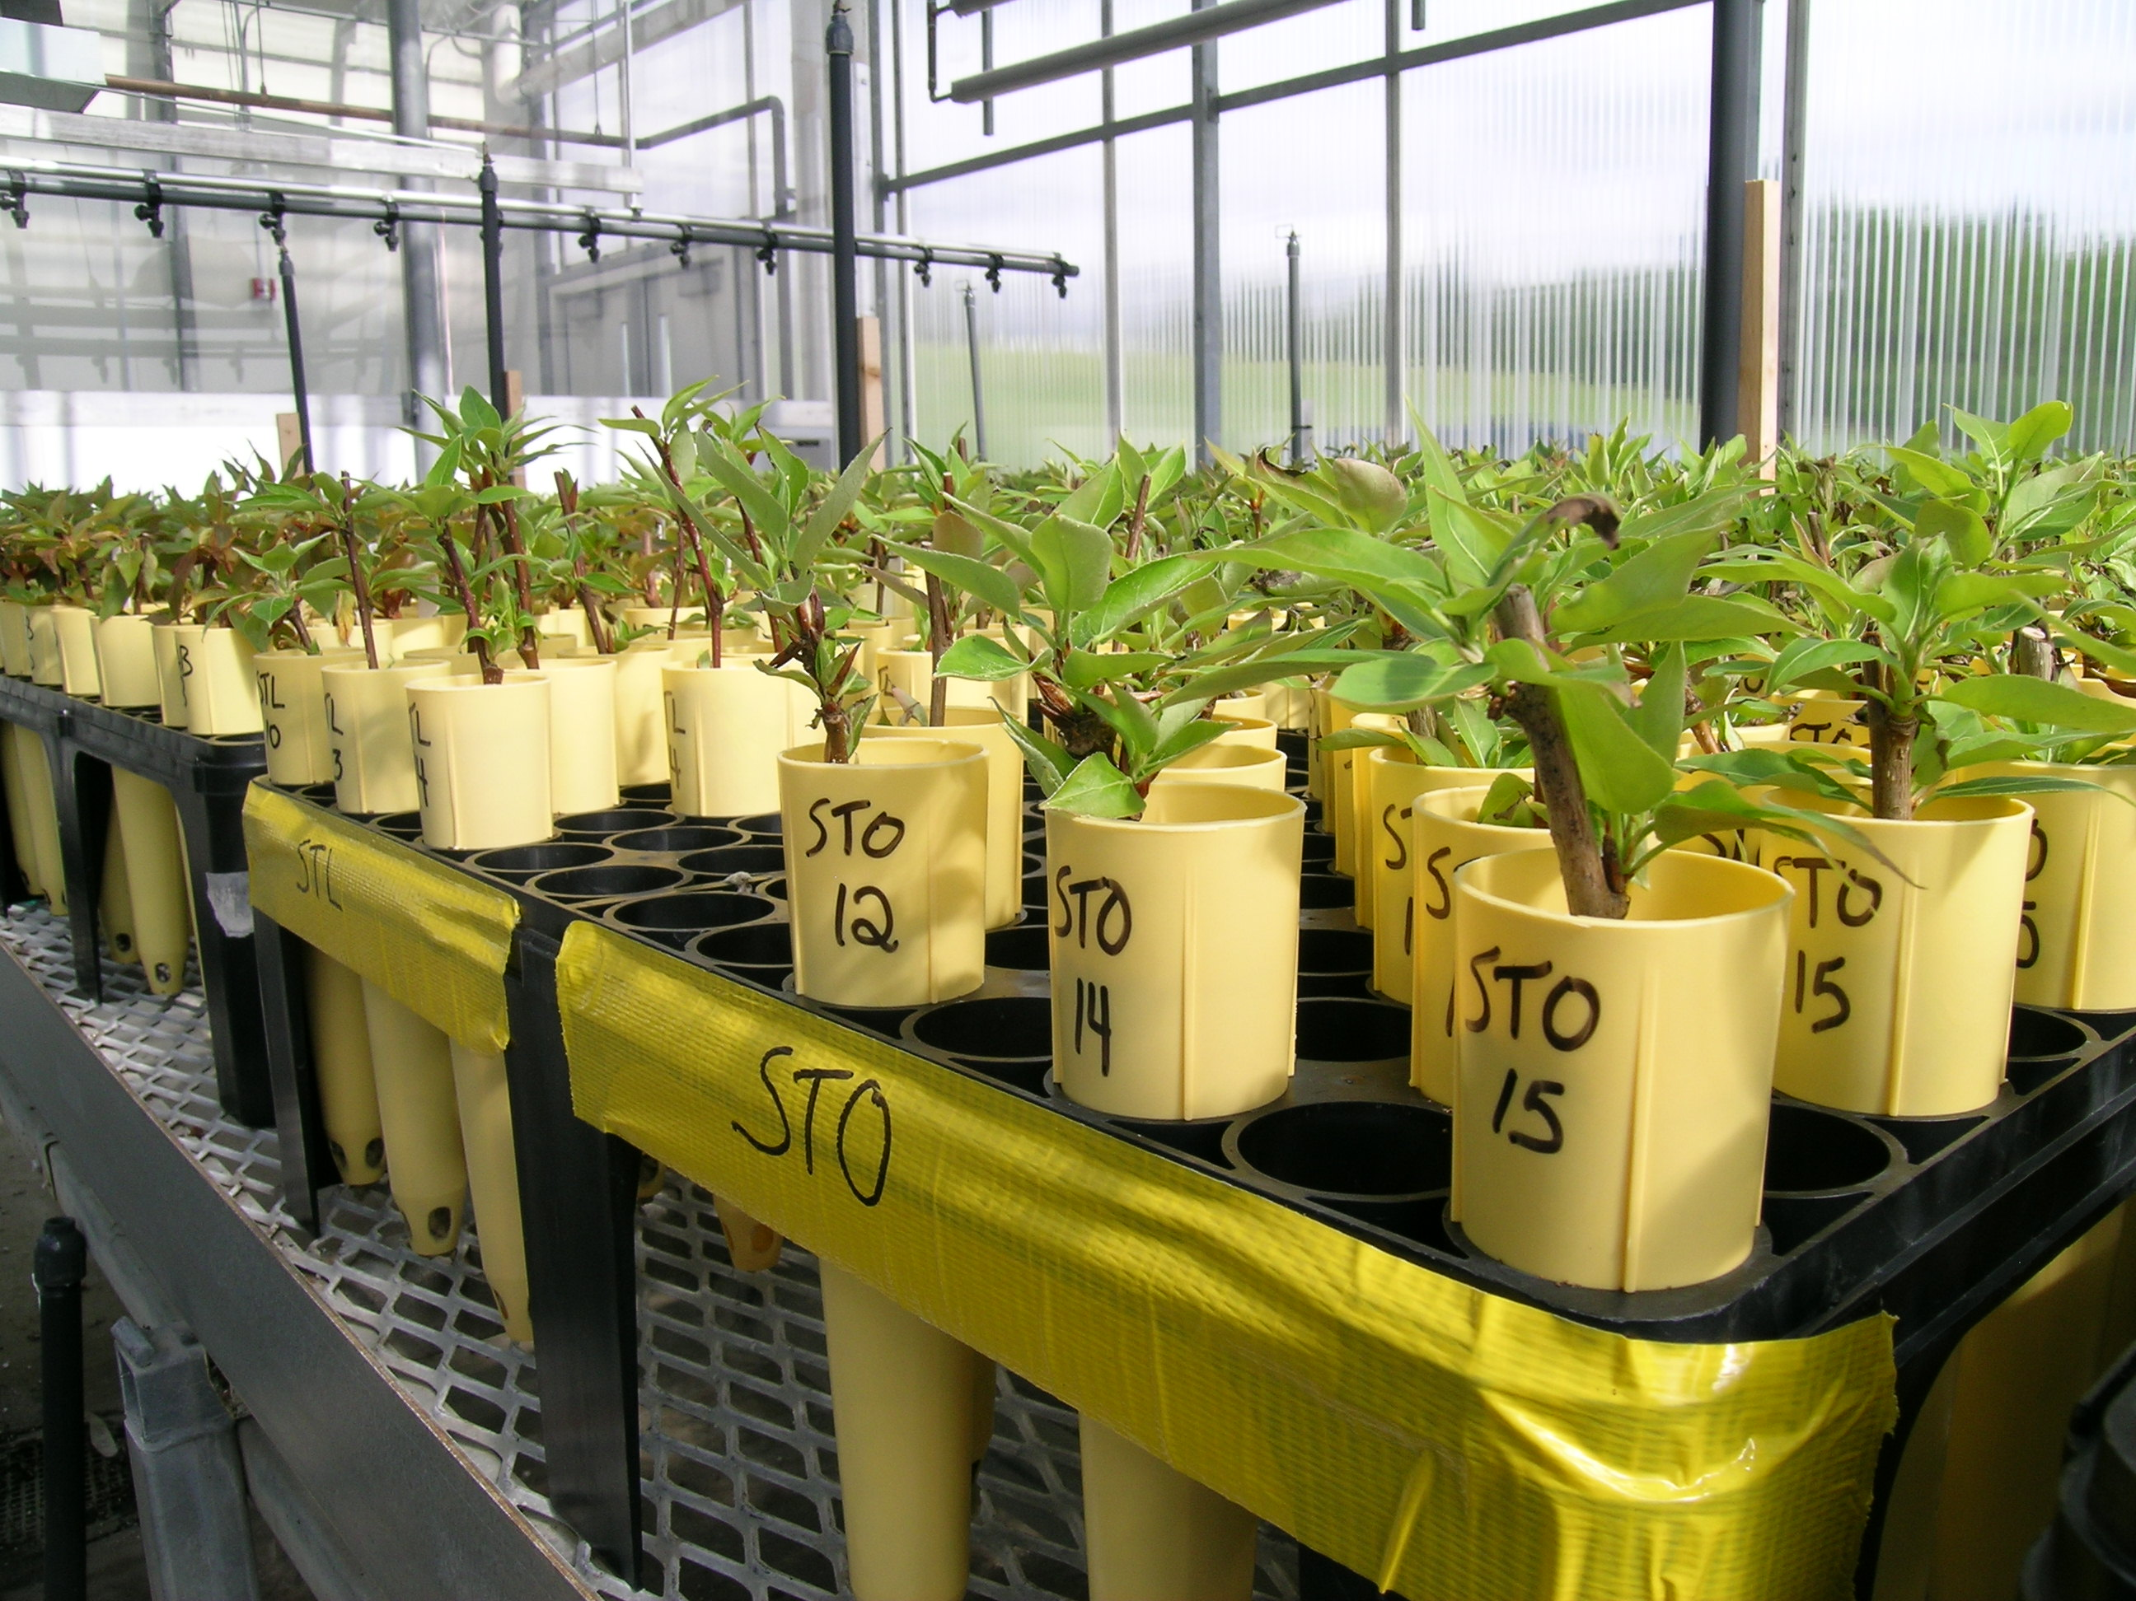
Common Garden Experiments – Matt Olson & Colleagues
with Balsam Poplar (Populus balsamifera)
Texas Tech University (formerly University of Alaska Fairbanks)
Fairbanks, AK 64.8ºN (cooler, longer photoperiods)
Indian Head, SK 50.5ºN (warmer, shorter photoperiods)

Slide 43
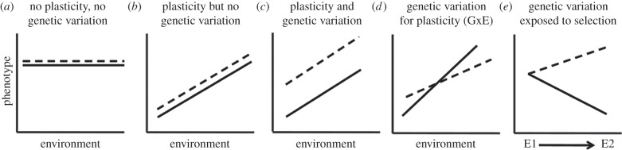
Reaction Norm
Used to describe how different species or populations respond to varying environments. Used to disentangle plasticity, genetic variation, and gene x environment interactions.
https://www.researchgate.net/figure/261255912_fig3_Phenotypic-plasticity-and-reaction-norms-In-panel-a-phenotype-does-not-vary-with-the

Slide 44
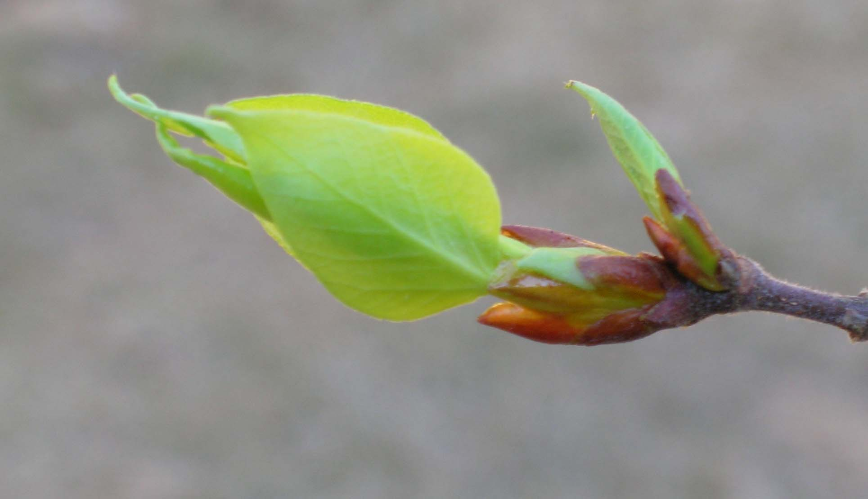
Bud flush in common gardens
in the spring
late
early
Northern Garden
Clonal repeatability = H²
IH Total 0.82
w/in pop 0.25
FBX Total 0.57
w/in pop 0.06
Southern Garden
Northern genotypes take advantage of early season growing opportunities
Latitude of genotype origin
Garden differences show that cGDD is not the only cue for bud flush
cGDD = Cumulative Growing Degree Days
Notes:
Strong correlation with Latitude
GxE
Low latitude origins flush buds later
If spring advances, however, we expect fewer cGDD required at bud flush, but genotypes from the south currently require the most? PARADOX

Slide 45
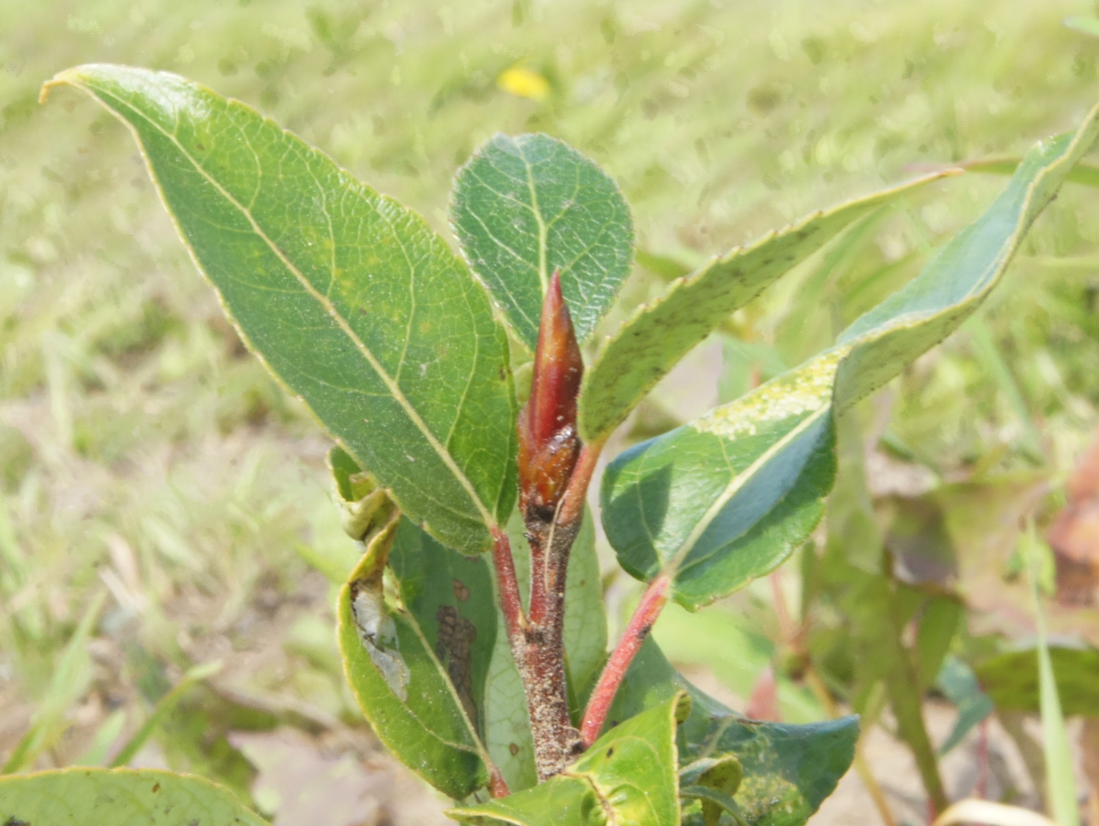
Bud set in common gardens
in the fall
late
early
Clonal repeatability = H²
IH Total 0.86
w/in pop 0.08
FBX Total 0.62
w/in pop 0.04
Northern Garden
Southern Garden
In the southern garden, northern genotypes stop growing in June
Garden differences show that DL is not the only cue for bud set
cGDD = Cumulative Growing Degree Days
Notes:
Note plateau in time of bud set in Indian Head
Most of genetic variation is partitioned among populations
Warming environment -> southern pops can move north and set bud later

Slide 46
tree growing season (bud flush to bud set) in common gardens
Clonal repeatability = H²
IH Total 0.87
w/in pop 0.08
FBX Total 0.47
w/in pop 0.07
Southern genotypes
grow longer than northern genotypes in both gardens
Northern genotypes grow longer in the northern than in the southern garden
Latitude of genotype origin
Notes:
Strong correlation with Latitude
GxE for growing season length
Estimates of broad sense heritability varied with population

Slide 47
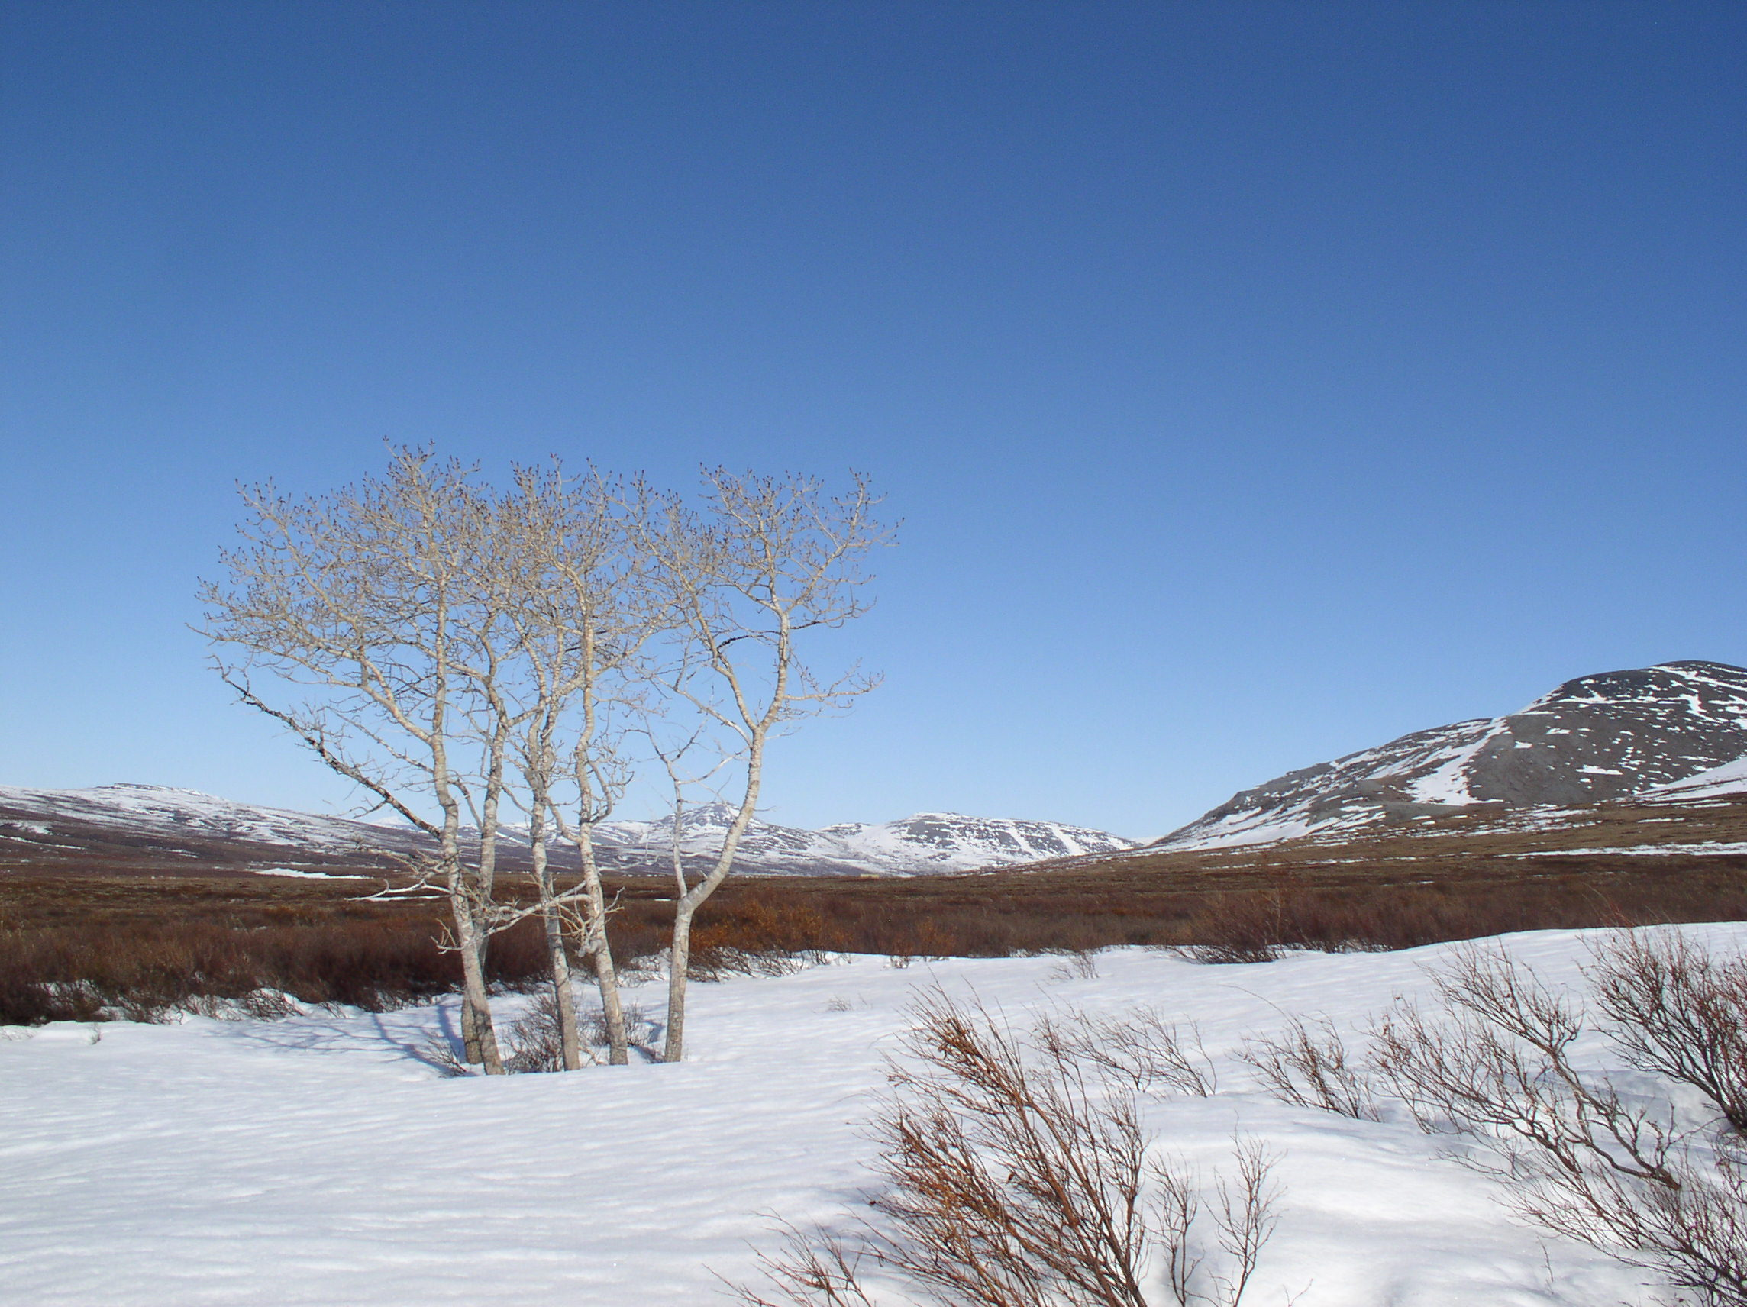
Conclusions
Variation controlled by genetics
Trees will have to migrate to respond to future climate warming

Slide 48
Conclusion - How Is Quantitative Genetic Variation Maintained?
Populations are not in evolutionary equilibrium with respect to directional or stabilizing selection (new favorable mutations always arising), and there are a large # of mutations if Ne is large.
Selection-mutation balance (selection on any particular locus affecting a quantitative trait may be weak because there are many loci or effect size may be small).
Disruptive/Balancing or Frequency Dependent selection actively maintains variation (counters effects of drift).
Direction and magnitude of selection varies over space and/or time (and populations are structured & environments change).

