Slide 1
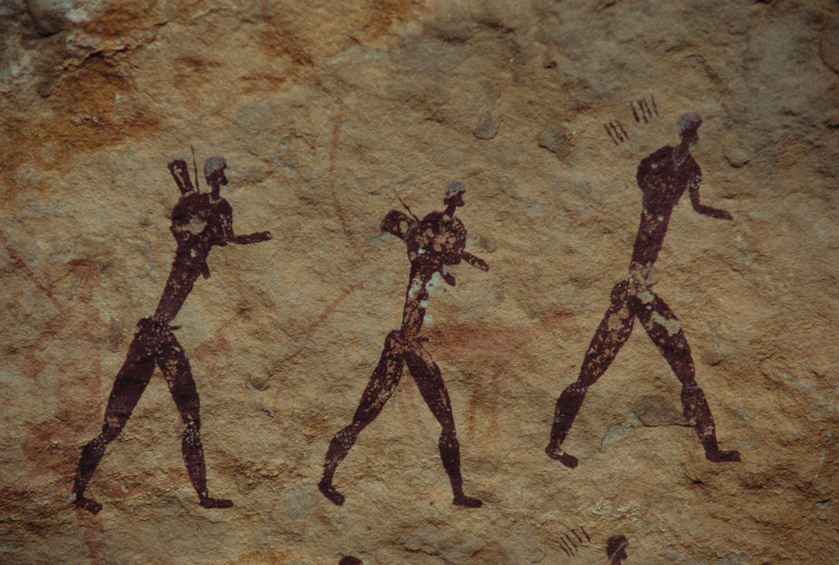
Human Population Genetics
Lecture Material Contributed by Jeff Peters
Wright State University

Slide 2

Fundamental Model of Population Genetics
Population
History
Immigration (gene flow)
2N_{e}m
+
Genetic Variation within Population
$$\frac{1}{2N_{e}}$$
2N_{e}µ
Genetic Drift
Mutation
-
+
2N_{e}s
Natural selection
Applications to Human Evolution

Slide 3
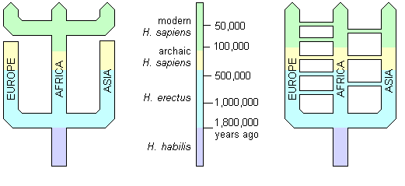
Two Models of Human Evolution
Replacement Hypothesis (Out-of-Africa; OoA): transition from archaic to anatomically modern humans in Africa, followed by migration to the rest of the world.
Multiregional Hypothesis: Anatomically modern humans trace their origin to multiple hominin groups (Homo erectus) living in multiple regions throughout the world, but connected by gene flow.
OoA
Multiregional

Slide 4
Review: Four fundamental aspects of genetic drift
The direction of genetic drift is unpredictable.
The magnitude of genetic drift depends on population size.
Genetic drift reduces genetic variation over the long-term.
Genetic drift causes populations to diverge.

Slide 5
Review: Bottlenecks and founder events
Genetic consequences of a severe reduction in population size
The post-bottleneck population will have less genetic variation than the pre-bottleneck population.
  The survivors will carry a subset of genetic variation.
  Drift will cause a further loss of diversity, especially while the population is small.
Allele frequencies will differ between pre- and post-bottleneck population.

Slide 6
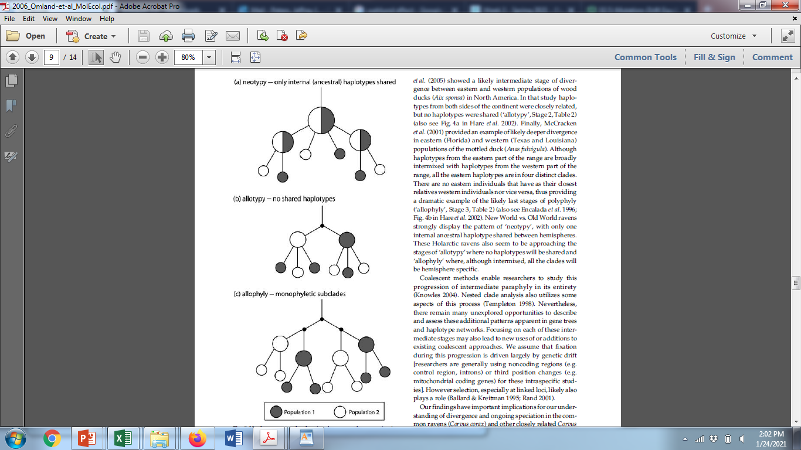
Founder Event
(bottleneck)
Review: Genetic drift & mutation
Genetic drift & mutation act together to cause populations to diverge over time
  New mutations arise
  Genetic drift causes ancestral variation to be lost
Omland, Baker & Peters. 2006. Genetic signatures of intermediate divergence: population history of Old and New World Holarctic ravens (Corvus corax). Molecular Ecology 15:795-808.
Multiregional hypothesis
Replacement hypothesis

Slide 7
mtDNA phylogeny: maternal lineage
Africa
Asia
America
Europe
Full mitochondrial genomes
Restriction fragment length polymorphisms in total mitochondrial DNA
Cann et al. 1987. Nature 325:31-36.

Slide 8
mtDNA phylogeny
Africa
Asia
America
Europe
Time to most recent common ancestor (TMRCA) for African lineages 2.3-times older than rest of the world
Present-day mtDNA variation throughout the world traces back to an African ancestor
Larger effective population size in Africa
Consistent with OoA hypothesis, but not multiregional hypothesis
N_{e} (Asia) = 80,000 females
N_{e} (America) = 50,000 females
N_{e} (Europe) = 40,000 females
TMRCA = 57,000 YBP
TMRCA = 130,000 YBP
N_{e} (Africa) = 90,000 females

Slide 9
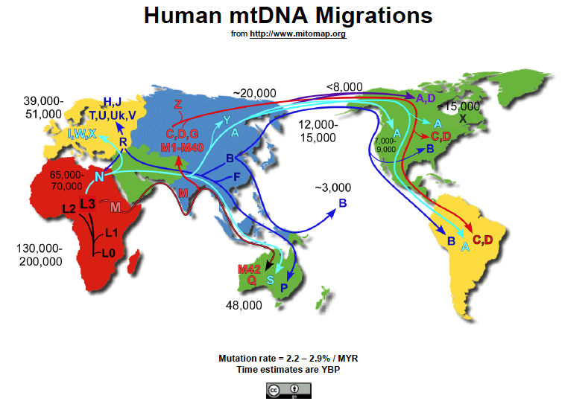

Slide 10
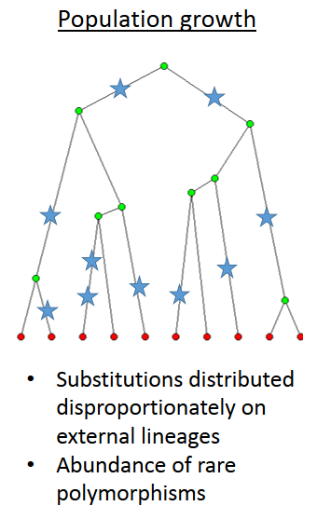
Review: Effects of Variation in Population
N_{e}
Time
Changes in Population Size produce waves of coalescence
Coalescence
events
Time

Slide 11
Bayesian Skyline Plots:
Full mitochondrial genomes (Lab 7)
Fairly stable N_{e}
Rapid expansion ~12,000 YBP
Relatively stable N_{e} in Africa consistent with lack of a bottleneck
Rapid expansions in Asia & America (& Europe) consistent with bottleneck associated with founder event
Consistent with OoA hypothesis, but not multiregional hypothesis
Rapid expansions ~40,000 YBP & 20,000 YBP

Slide 12
Review: Coalescence is a noisy process—it is stochastic
10 genealogies generated under the same population size (N = 10,0000)
However, genetic drift is independent across unlinked loci, so adding multiple loci short enough to be non-recombining is the best way to improve inferences of population history. ✔✔✔
Is there independent evidence supporting the out-of-Africa hypothesis?

Slide 13
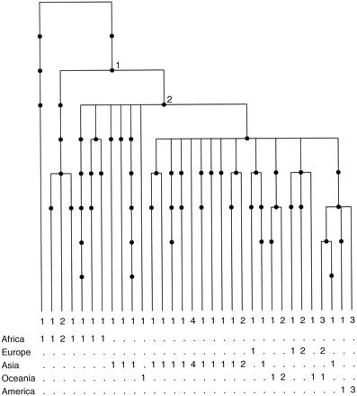
Y-chromosome phylogeny: paternal lineage
Y-chromosome diversity traces back to African ancestor
Thompson et al. 2000.

Slide 14
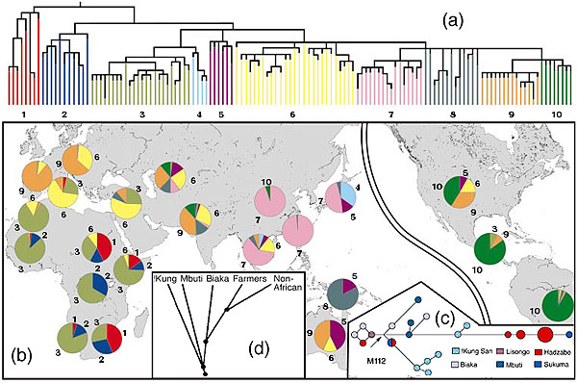
Y-chromosome phylogeny
Y-chromosome diversity traces back to African ancestor

Slide 15
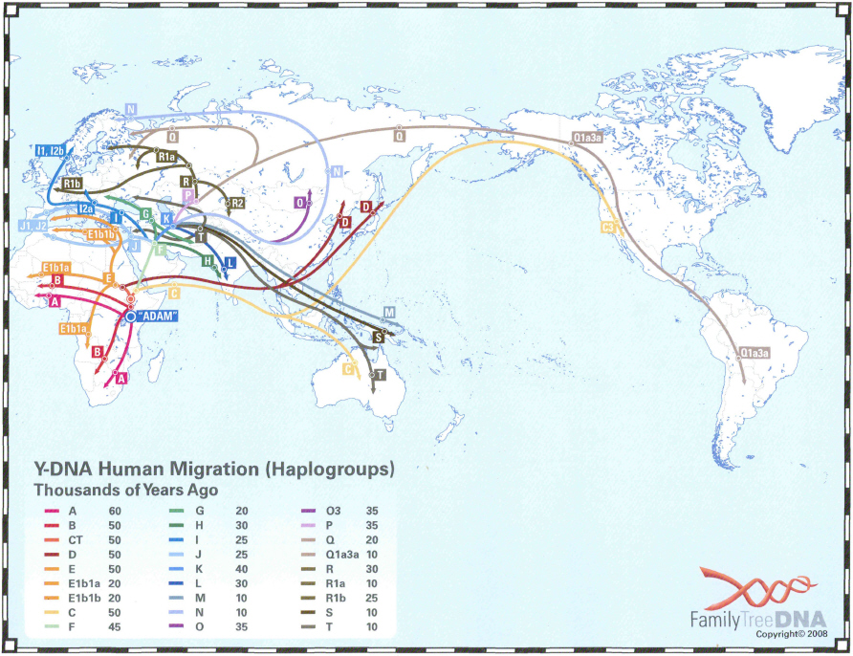
https://phillipsdnaproject.com/faq-sections/114-haplogroup-migration-map
Y-chromosome data is consistent with mtDNA & independently supports out-of-Africa

Slide 16
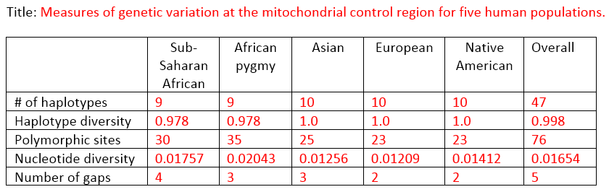
Genetic diversity
Replacement hypothesis (Out-of-Africa; OoA): expect higher genetic variation in Africa.
Multiregional hypothesis: differences in genetic variation not expected.
Higher mitochondrial diversity in African populations.
Consistent with out-of-Africa hypothesis.

Slide 17
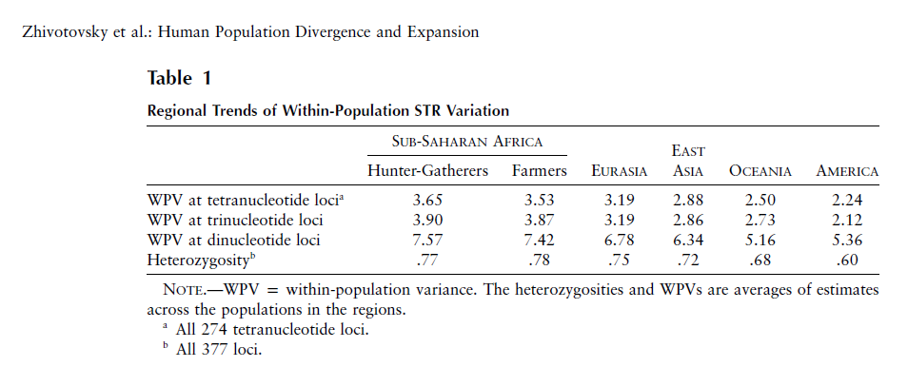
Genetic diversity: 377 microsatellite loci
Replacement hypothesis (Out-of-Africa; OoA): expect higher genetic variation in Africa.
Multiregional hypothesis: differences in genetic variation not expected.
Higher nuclear microsatellite variation in Africa.
Consistent with OoA, but not multiregional hypothesis.

Slide 18
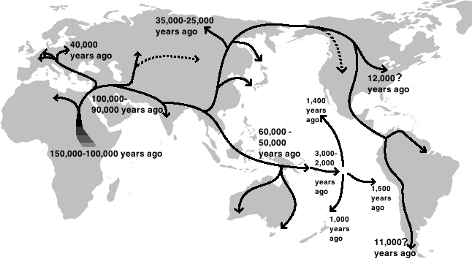
Human global expansion
Out-of-Africa hypothesis strongly supported by multiple lines of population genetics evidence.

Slide 19
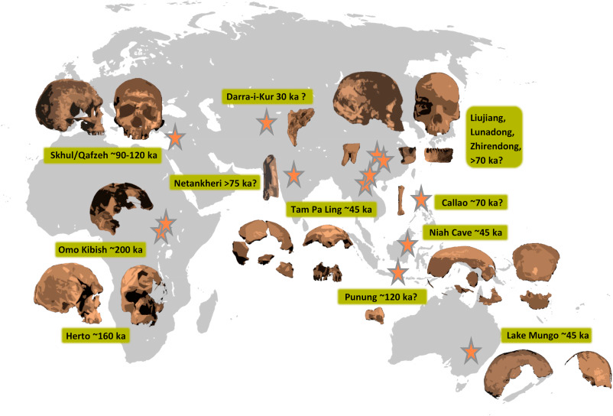
Human global expansion: fossil evidence
“Genetic and fossil evidence has accumulated in support of an African origin for modern humans. Competing models differ primarily by the number of dispersals, their geographic route, and the extent to which expanding modern humans interacted with other hominins.”
Reves-Centeno, H. 2016. Out of Africa and into Asia: Fossil and genetic evidence on modern human origins and dispersals. Quaternary International 416:249-262

Slide 20
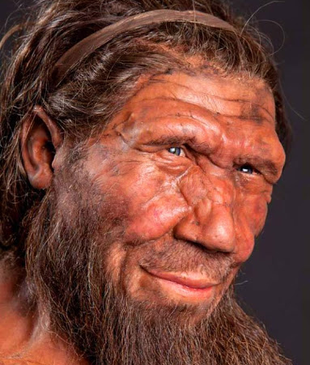
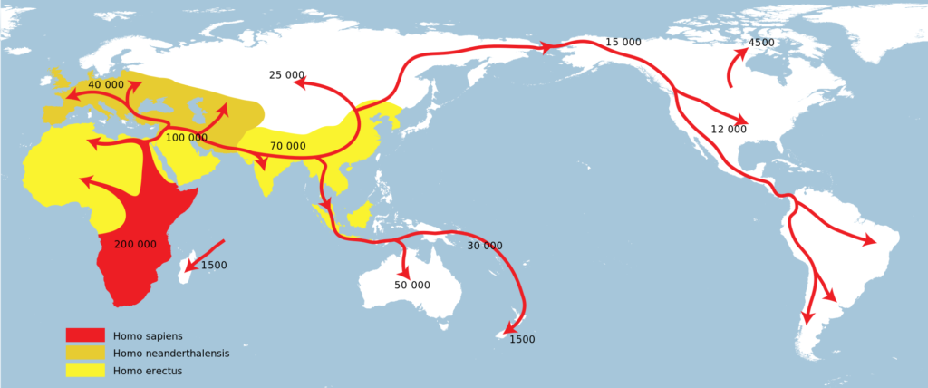
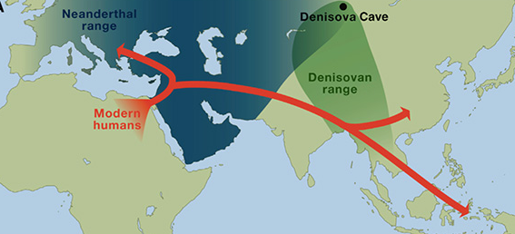
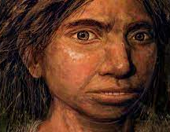
Human migration & archaic hominids
As anatomically modern humans spread across the globe, they came into contact with other forms of archaic humans.
(Extinction ~100,000 YBP)
https://www.zmescience.com/science/news-science/neanderthal-dna-influence-06102017/
https://www.uctv.tv/shows/CARTA-Ancient-DNA-and-Human-Evolution-Neandertal-and-Denisovan-Genomes-and-What-They-Tell-Us-A-Map-of-Neandertal-Genes-in-Present-Day-Humans-The-Phenotypic-Legacy-of-Neandertal-Interbreeding-on-Modern-Humans-30971

Slide 21
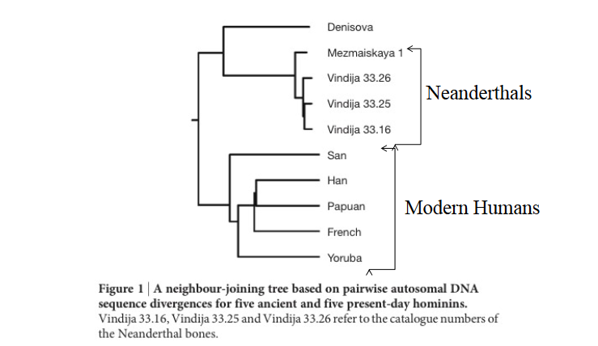
Ancient DNA (extracted from fossils) phylogeny
Reich et al. 2010. Genetic history of an archaic hominin group from Denisova Cave in Siberia. Nature 468:1053-1060.

Slide 22
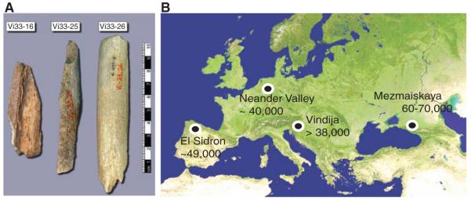
Whole genome sequencing of Neanderthal
Did anatomically modern humans interbreed with archaic hominids?
Green et al. 2010. A Draft Sequence of the Neandertal Genome. Science 325:710-722.

Slide 23
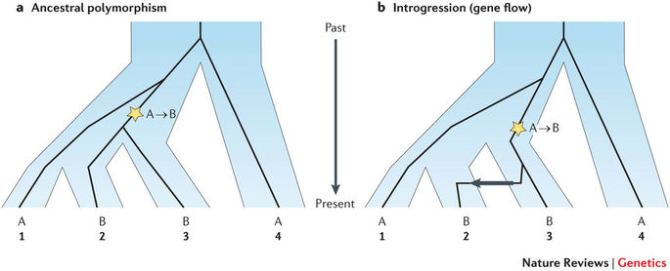
ABBA-BABA test
ABBA & BABA are expected due to incomplete lineage sorting or introgression (gene flow)
Incomplete lineage sorting—Some members of a group share a more recent common ancestor with members of another group than they do with other members of the same group.
Sousa and Hey. 2013. Nature Reviews Genetics

Slide 24
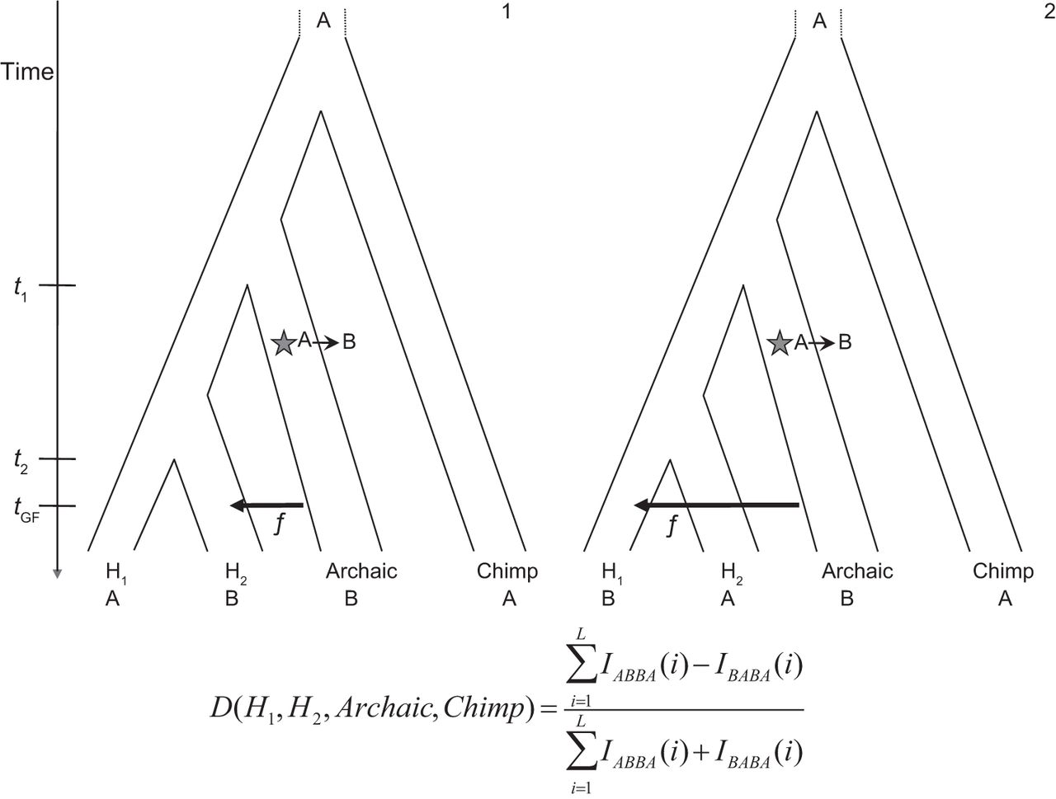
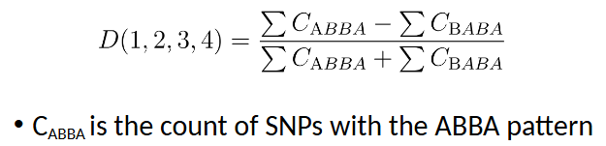
ABBA-BABA test
If ABBA = BABA, then D = 0
  Incomplete lineage sorting
If ABBA > BABA, then D > 0
  Gene flow between taxa 3 & 2
If ABBA < BABA, then D < 0
  Gene flow between taxa 3 & 1

Slide 25
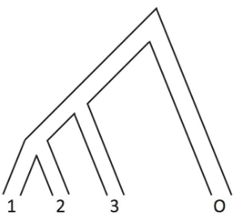
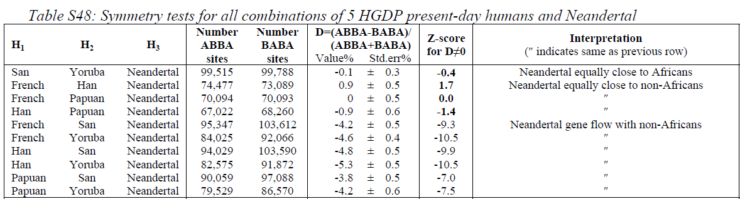
ABBA-BABA results
ABBA = BABA
ABBA < BABA
ABBA < BABA
San (Africa)
Yoruba (Africa)
Neanderthal
Chimp
Yoruba (Africa)
Neanderthal
Chimp
Han (Asia)
Yoruba (Africa)
Neanderthal
Chimp
French (Europe)
Significant gene flow between Neanderthal and humans from Europe, Asia, and Papua, but not Africans

Slide 26
Proportion of human genome derived from Neanderthal ancestry
Africans: 0.0%
East Asians: 2.3-2.6%
Western Eurasians: 1.8-2.4%
*Note that some estimates reach as high as 7% of genome
Prüfer et al. (2017)

Slide 27
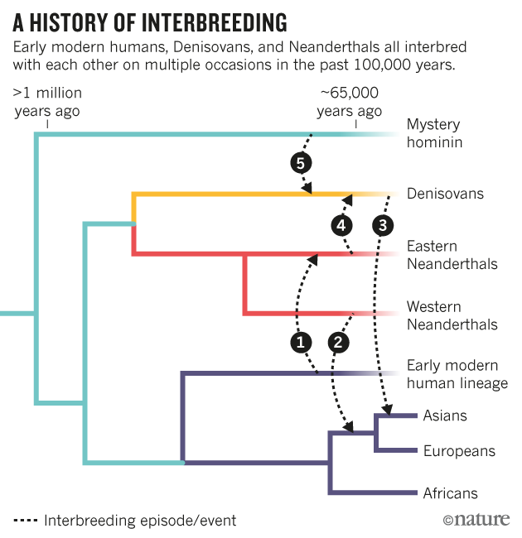

Slide 28
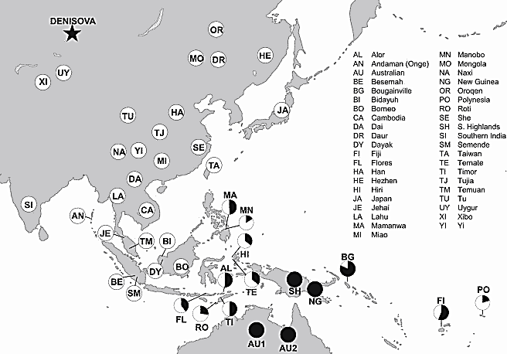
Denisovan admixture
Denisovan admixture proportions
(filled circles indicate 5% Denisovan; others are scaled accordingly)
Reich et al. 2011. Denisova Admixture and the First Modern Human Dispersals into Southeast Asia and Oceania. Am J Hum Genet. 89: 516–528.

Slide 29
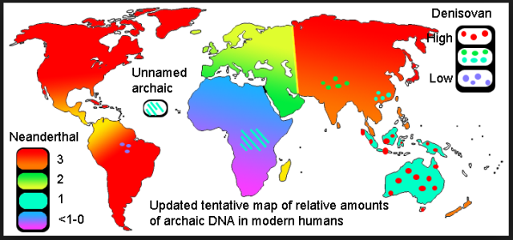
Variable geographic distribution of introgressed DNA
https://evolutionistx.wordpress.com/2016/04/21/updated-tentative-map-of-neanderthal-dna/

Slide 30
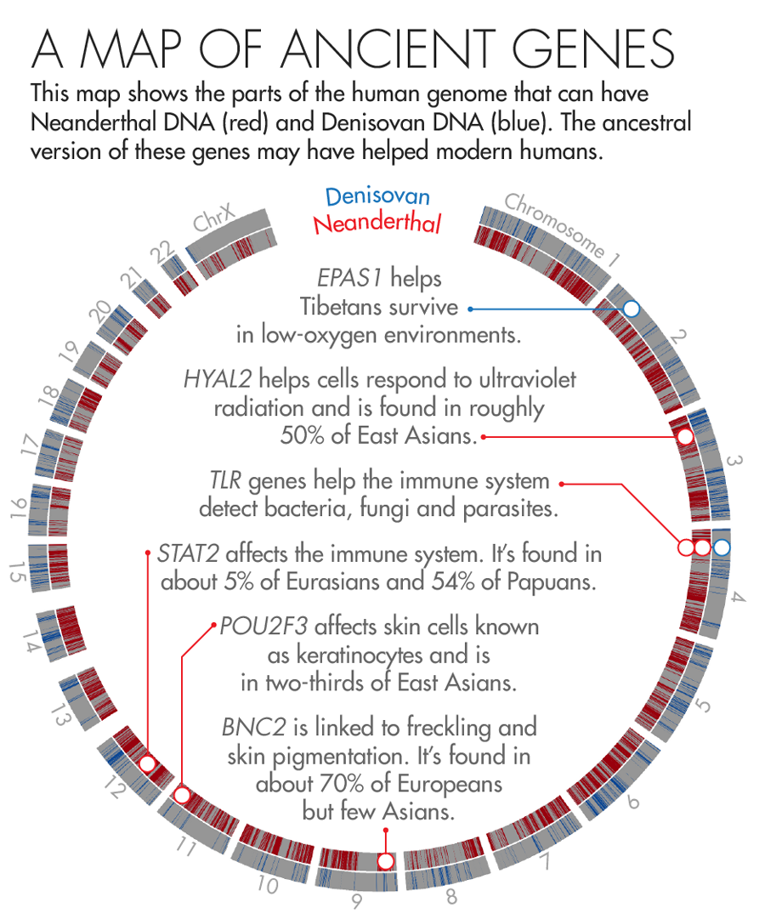
Adaptive introgression from archaic hominids
https://www.quantamagazine.org/how-neanderthal-dna-helps-humanity-20160526/

Slide 31
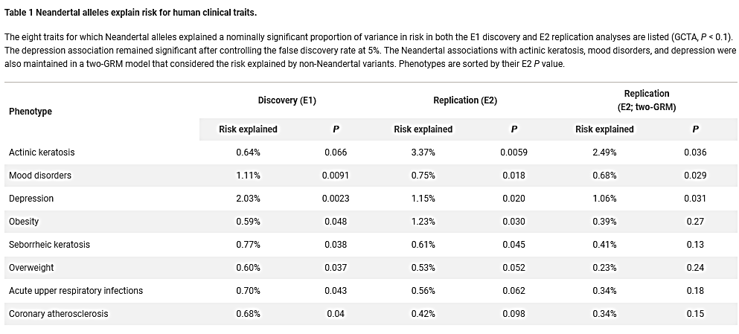
Negative consequences of introgression from archaic hominids
Simonti et al. 2016. The phenotypic legacy of admixture between modern humans and Neandertals. Science 351:737-741

Slide 32
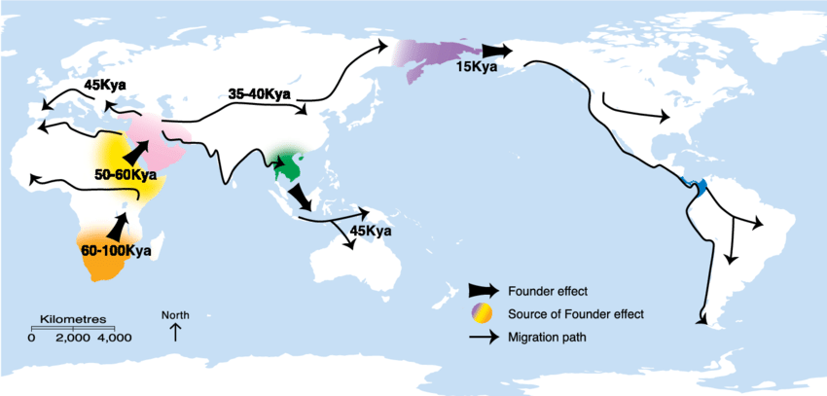
Clinal Genetic Variation in Humans
Feary et al. 2014. Chapter 4, Earth’s cultural heritage. Pp. 81-115 in Protected Area Governance and Management, 8th edition (Worboys et al., Editors). ANU Press.

Slide 33
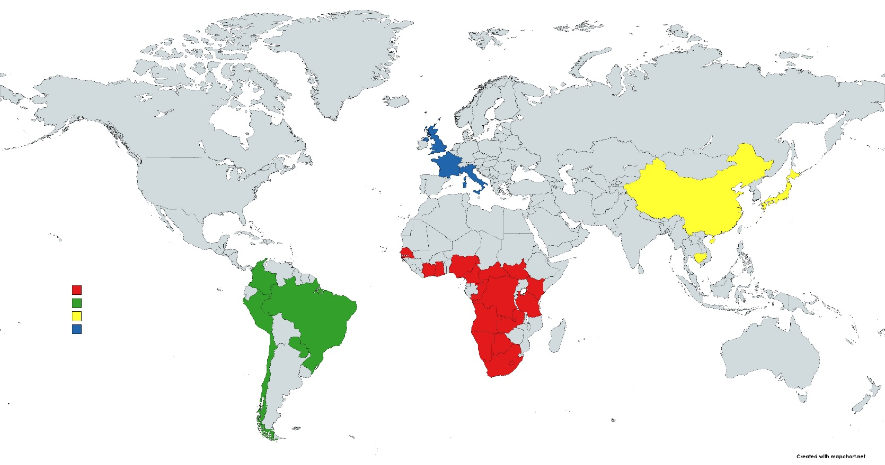
Four groups of humans appear as discrete population units when analyzed this way.
However, this ignores the majority of global diversity.
Principal Component Analysis of 645 microsatellite loci
Pemberton, DeGiorgio, & Rosenberg. 2013. Population Structure in a Comprehensive Genomic Data Set on Human Microsatellite Variation. G3 (Bethesda) 3(5): 891–907

Slide 34
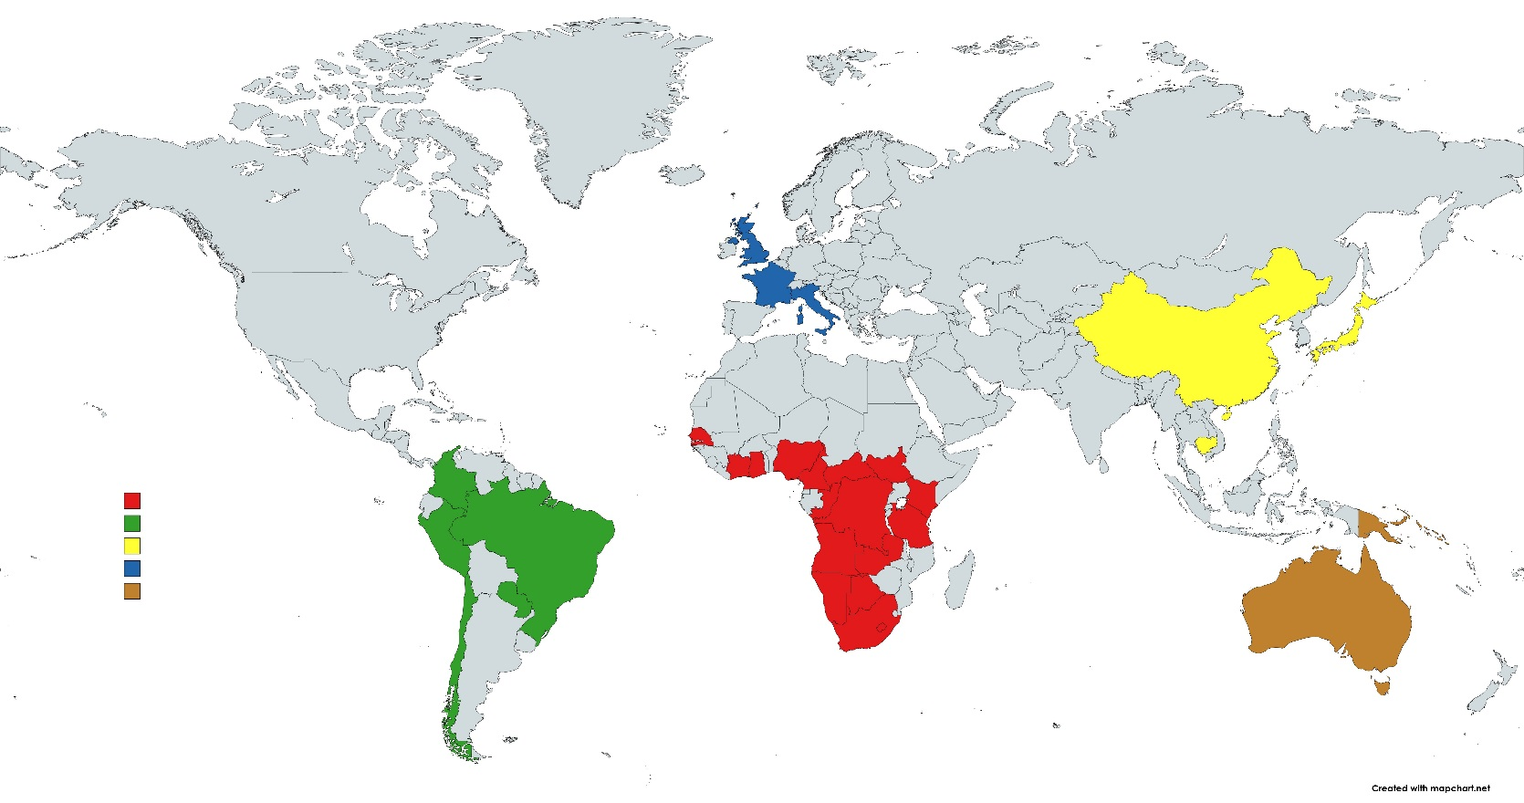
Humans from Oceania & Australia are a fifth genetic cluster.
Principal Component Analysis of 645 microsatellite loci
Pemberton, DeGiorgio, & Rosenberg. 2013. Population Structure in a Comprehensive Genomic Data Set on Human Microsatellite Variation. G3 (Bethesda) 3(5): 891–907

Slide 35
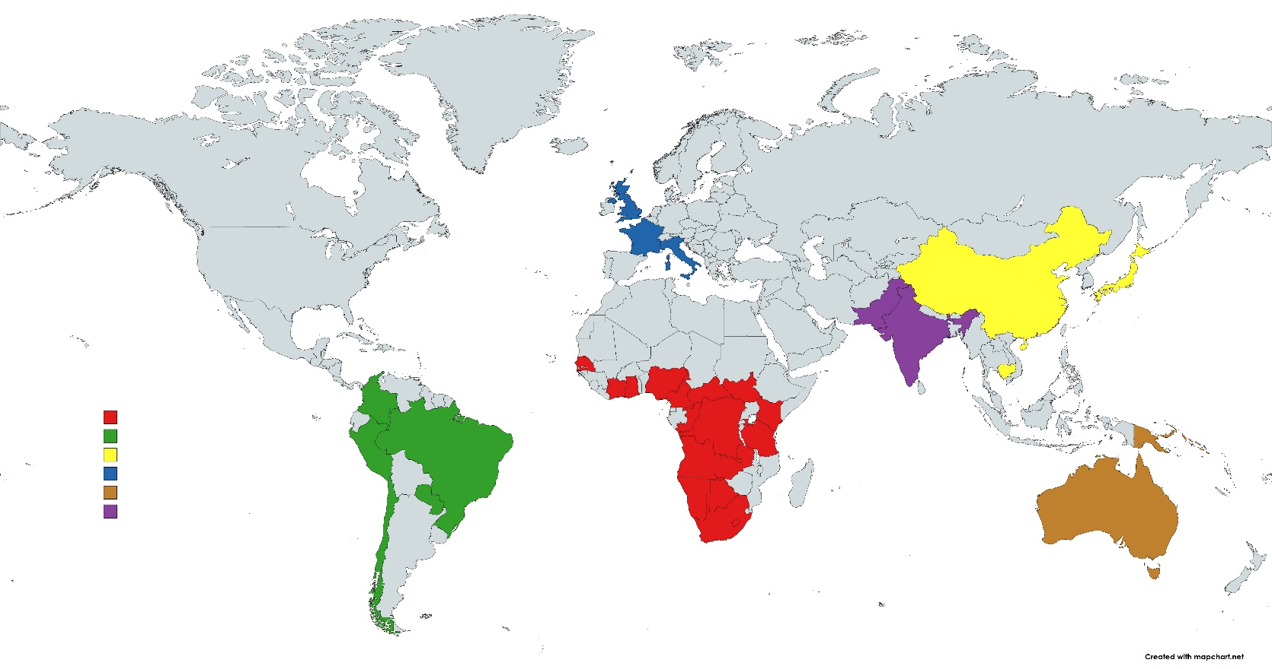
South Asians are genetically intermediate between Europeans and East Asians.
Principal Component Analysis of 645 microsatellite loci
Pemberton, DeGiorgio, & Rosenberg. 2013. Population Structure in a Comprehensive Genomic Data Set on Human Microsatellite Variation. G3 (Bethesda) 3(5): 891–907

Slide 36
Taiwanese are genetically intermediate between East Asians & Oceanians.
Principal Component Analysis of 645 microsatellite loci
Pemberton, DeGiorgio, & Rosenberg. 2013. Population Structure in a Comprehensive Genomic Data Set on Human Microsatellite Variation. G3 (Bethesda) 3(5): 891–907

Slide 37
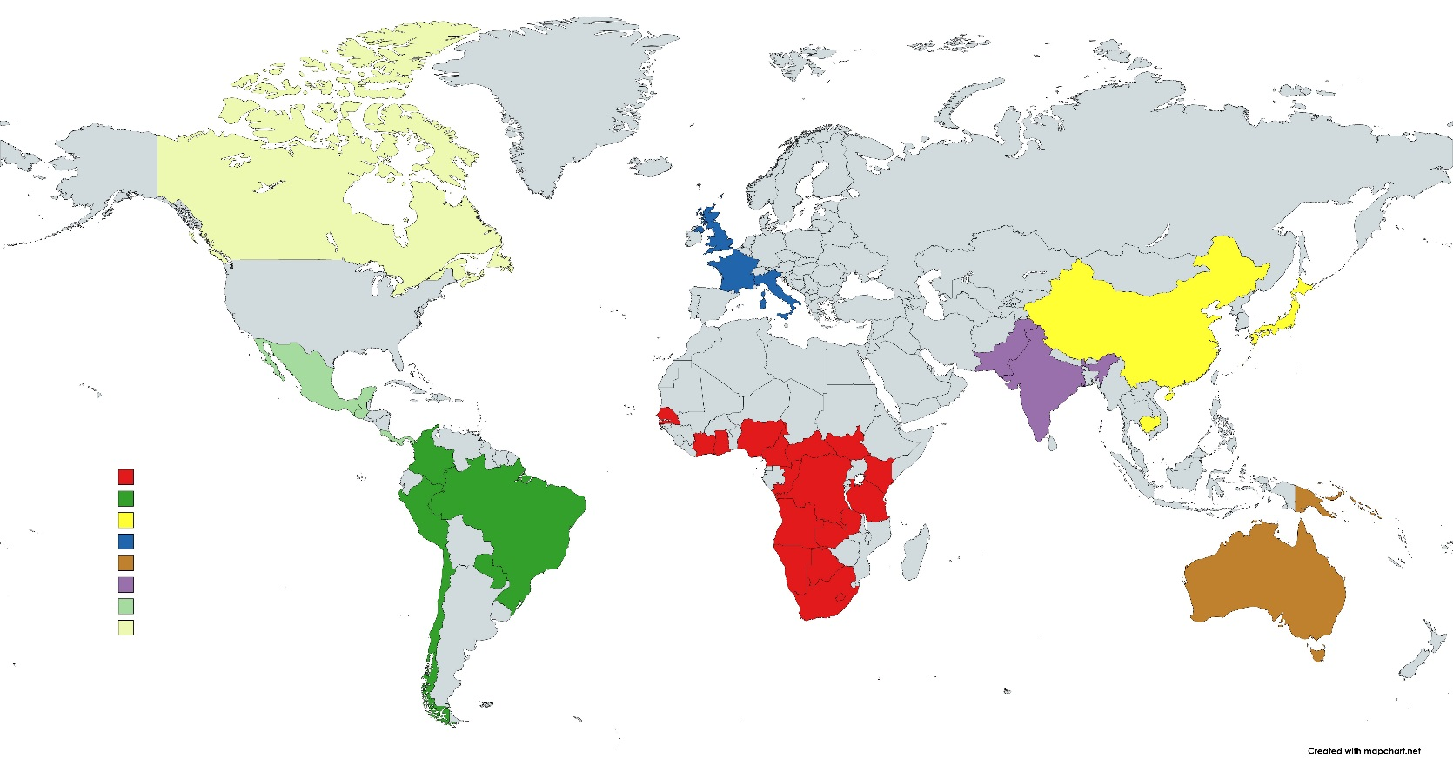
Native North Americans are genetically closer to East Asians & Europeans than are native South & Central Americas.
Principal Component Analysis of 645 microsatellite loci
Pemberton, DeGiorgio, & Rosenberg. 2013. Population Structure in a Comprehensive Genomic Data Set on Human Microsatellite Variation. G3 (Bethesda) 3(5): 891–907

Slide 38

Northeast Africans are genetically closer to Europeans and South Asians than are southern and central Africans.
Principal Component Analysis of 645 microsatellite loci
Pemberton, DeGiorgio, & Rosenberg. 2013. Population Structure in a Comprehensive Genomic Data Set on Human Microsatellite Variation. G3 (Bethesda) 3(5): 891–907

Slide 39
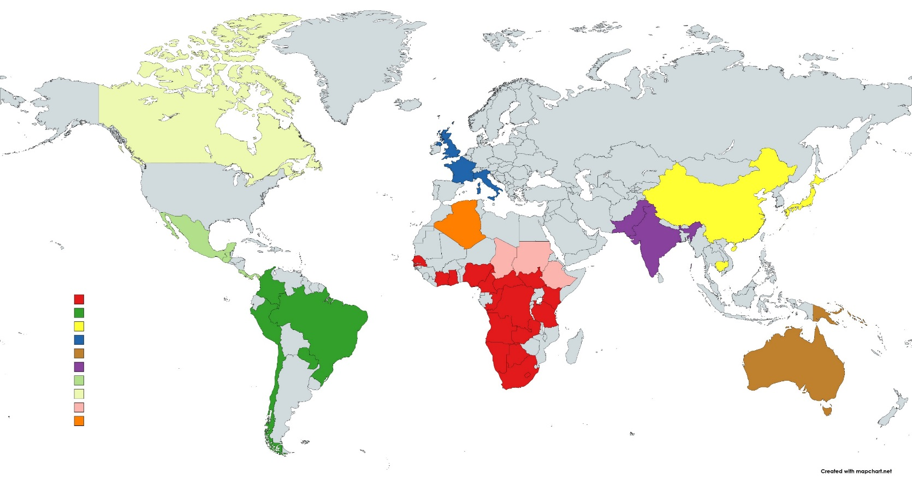
Algerians are genetically intermediate between Europeans and Africans.
Principal Component Analysis of 645 microsatellite loci
Pemberton, DeGiorgio, & Rosenberg. 2013. Population Structure in a Comprehensive Genomic Data Set on Human Microsatellite Variation. G3 (Bethesda) 3(5): 891–907

Slide 40

Middle Easterners are intermediate between Europeans, South Asians, & Algerians.
Principal Component Analysis of 645 microsatellite loci
Pemberton, DeGiorgio, & Rosenberg. 2013. Population Structure in a Comprehensive Genomic Data Set on Human Microsatellite Variation. G3 (Bethesda) 3(5): 891–907

Slide 41
Native humans from northeastern Russia, Alaska, northern Canada, and Greenland are genetically intermediate between more southern Native Americans and East Asians.
Principal Component Analysis of 645 microsatellite loci

Slide 42
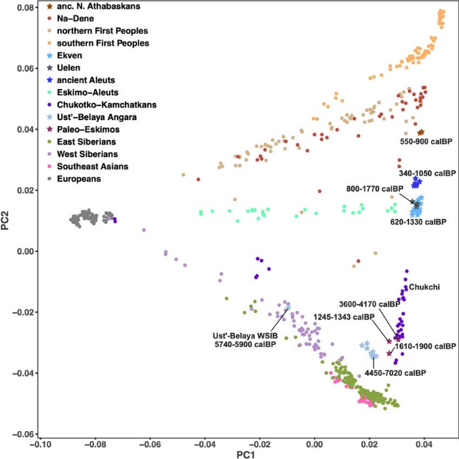
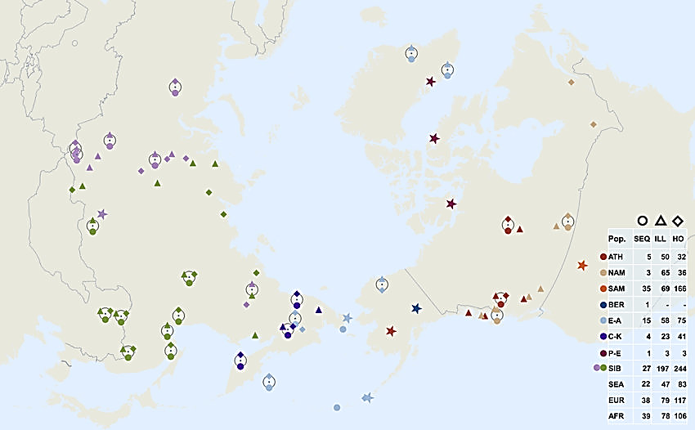
Native humans from northeastern Russia, Alaska, northern Canada, and Greenland are genetically intermediate between more southern Native Americans and East Asians.
North America
Americas
Ancient Northern Canada, Greenland, Alaska, & NE Russia
Europe
Northeast Siberia
Southeast Asia
524,830 loci
Flegontov et al. 2019. Palaeo-Eskimo genetic ancestry and the peopling of Chukotka and North America. Nature. 570. 10.1038/s41586-019-1251-y.

Slide 43
Indonesians & Malaysians are genetically intermediate between East Asians & Oceanians.
Principal Component Analysis of 645 microsatellite loci

Slide 44
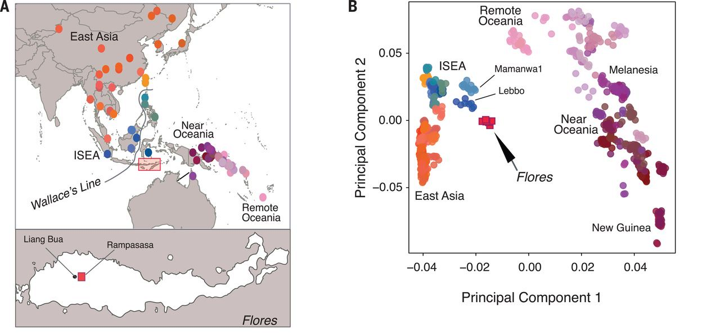
Indonesians & Malaysians are genetically intermediate between East Asians & Oceanians.

Slide 45
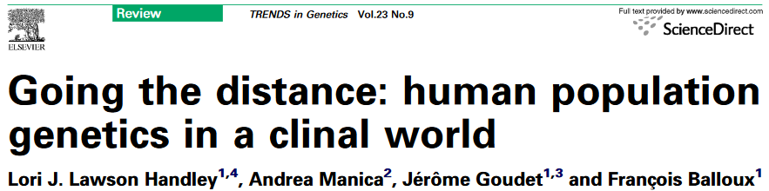
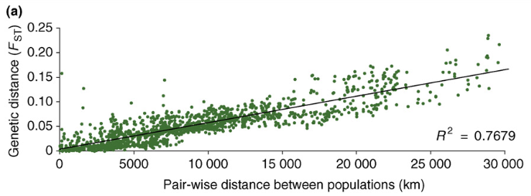
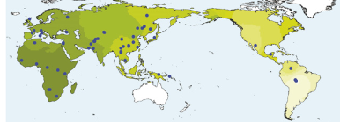

Slide 46
Rather than discrete human populations that can be easily delineated, …
…genetic variation is clinal, and attempts to delineate population (i.e., racial) boundaries are rather subjective.

Slide 47
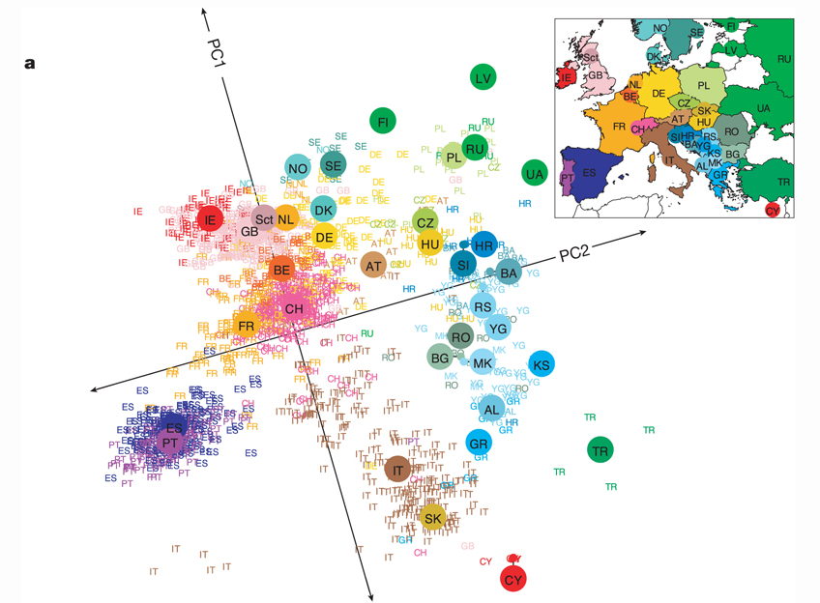
Fine-scale population structure exists within “racial” groups
Population structure within Europe
Note the pattern of isolation-by-distance
  Populations that cluster geographically also cluster genetically
  PC1 separates populations along a north-south gradient.
  PC2 separates populations along an east-west gradient.
Novembre et al. (2008) Nature 456, 98-101

Slide 48
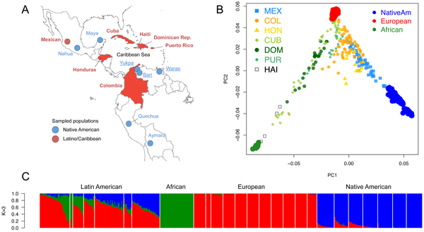
Extensive admixture between “racial” groups
Figure 1. Population structure of Caribbean and neighboring populations of humans.
Moreno-Estrada A, Gravel S, Zakharia F, McCauley JL, et al. (2013) Reconstructing the Population Genetic History of the Caribbean. PLoS Genet 9(11): e1003925.

Slide 49
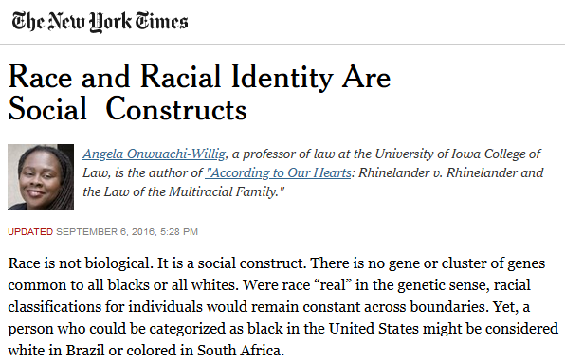

Slide 50
Thanks for listening to my lectures!

